Slide 1
DRIFT
A trading bot whose risk rules you can verify
Off-chain quant research · on-chain risk gate on BNB Chain
Live demo
drift-macroguard.vercel.app/macroguard
Dex's contract on BSC Testnet
0x8b09ebB85Be8Ed55Bb5132d29eABc567c42aa83D
Indonesia Web3 Hackathon 2026 · Dex Bennett
Notes:
DRIFT in one line: the trading bot's risk rules live in a public contract on BNB Chain, so anyone can check them.

Slide 2
The problem
Trading bots ask users to trust risk rules nobody can see.
Settings change silently; off-chain decision logs can be rewritten.
The promise
Anyone can check what DRIFT's bot is allowed to do right now,
and every recorded decision is public on BscScan.
Notes:
Bots ask for trust. DRIFT replaces the promise with a public rule and a public record.

Slide 3
Who needs it, and how it could pay
HYPOTHESIS: not yet validated with users; no market figures claimed
Who needs it
How it could pay
Retail traders who follow or rent bots: proof that the risk stop is real
Bot builders and signal sellers: a record of discipline a screenshot cannot fake
Communities and auditors: check a bot's rules without trusting its operator
A risk gate per bot: its own MacroGuard plus a public panel, as a monthly service
The panel link as a trust badge for strategy sellers
No custody and no performance fee; on-chain cost per decision stays tiny (slide 7)
Notes:
Everything on this slide is a hypothesis: no user interviews or market sizing have been done yet. The point is the shape of the value: proof of discipline, not proof of profit.

Slide 4
How DRIFT works
1 Signal
Python engine: four strategies, point-in-time, no look-ahead
2 Ask the gate
MacroGuard.allowed(signal) on BSC Testnet: regime + 20% halt
3 Trade
Runner places the order on Bybit testnet (vetoed signals go Flat)
4 Record
recordDecision(...) leaves a public receipt; a breach halts the contract
Periwinkle: off-chain engine · white: on-chain contract
The contract never executes orders; it is the public rule and the public record.
Notes:
Four steps: signal off-chain, ask the gate, trade on the exchange, record on-chain.

Slide 5
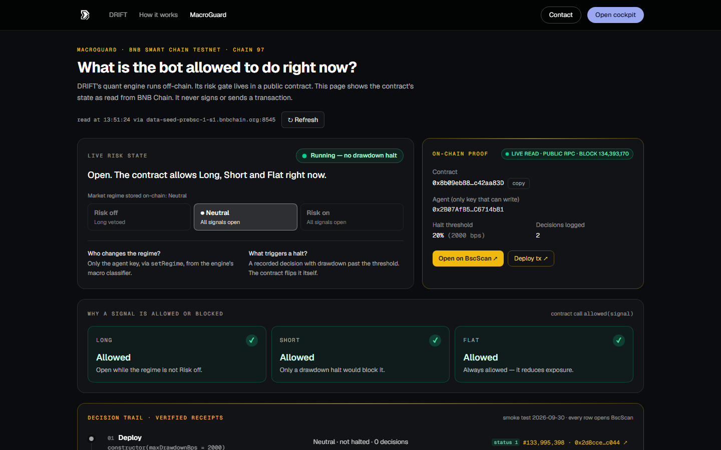
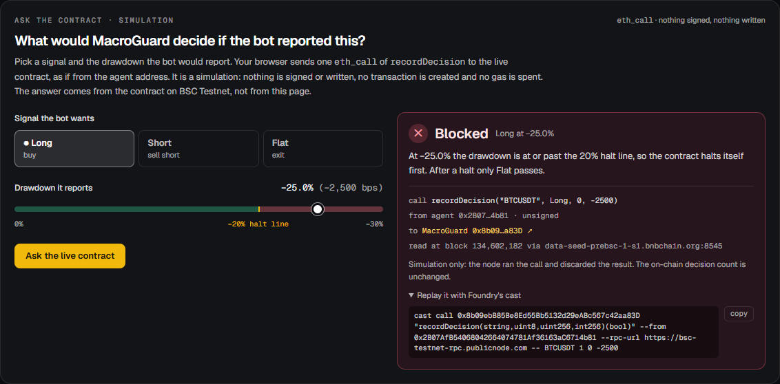
The panel, and asking the contract
Live regime, halt, 20% line and decisions,
read from BSC Testnet at a named block
Long at −25%: Blocked, answered by the live contract
via eth_call from the agent address (simulation)
Notes:
Public, no login, no wallet. Left: the live state read from BNB Chain in the browser. Right: ask the contract a what-if; it answers through eth_call, nothing is signed.

Slide 6
−25% recorded: the contract halted itself
halt line 20%
−1%: kept running
−25%: halted itself
#134,042,196
setRegime(RiskOff)
Long blocked; Short and Flat open
#134,042,256
recordDecision(BNB, Short, −1%)
Decision #1, inside the line
#134,042,283
recordDecision(BNB, Short, −25%)
Halted event: only Flat allowed
#134,042,318
resume()
Agent-only, on the record
#134,042,328
setRegime(Neutral)
Long allowed again; 2 decisions on-chain
Every row is a transaction with receipt status 1 on BscScan · block 134,042,283 is the halt
Notes:
Smoke test on 30 Sep 2026. At step 3 nobody pressed a button: the rule fired inside the contract when the reported drawdown crossed 20%. Honest limit: the drawdown was reported by the agent.

Slide 7
Why BNB Chain
≈ 0.0000034 tBNB
What else it gives us
per recorded decision: 33,189–34,323 gas
at 0.1 gwei (our receipts, BSC Testnet)
EVM: Foundry tests and Sourcify verification on chain 97
Public RPCs a browser can call: the panel needs no backend
Five smoke-test transactions within 132 blocks
Mainnet (chain 56) is a config switch; not deployed there
≈ 0.00008 tBNB a day
for an hourly bot (24 decisions);
deploy: 449,207 gas ≈ 0.000045 tBNB
Testnet gas price, not a mainnet quote. Mainnet is on the roadmap, after an audit.
Notes:
Costs come from our own receipts on BSC Testnet at the observed 0.1 gwei; they are not a mainnet quote. The panel reads the chain from the browser because the public RPCs allow it.

Slide 8
Evidence and current limits
30 / 30
47
15
exact match
contract tests: unit, fuzz, invariant
100% coverage of MacroGuard.sol
offline engine tests;
no look-ahead tested as a property
web tests: contract reads and the
what-if encoder against cast
source verified on Sourcify
6 receipts, all status 1
Limits, said plainly
The contract never executes orders · the runner fails open if the RPC is down · the agent can resume() at once
The drawdown is reported by the agent · no live bot tick and no profit claimed; backtests are research
Notes:
Numbers from real runs on 3 Oct 2026. CI is set up and runs after the next push; not claimed green yet.

Slide 9
What Dex added
Upstream DRIFT project
Dex's work in this fork
Quant engine, cockpit and MacroGuard.sol
7 contract tests
Built for a Mantle hackathon track (June 2026)
Migrated to BNB Chain in bcc-ukdw/seed-bnb
(commit 52671ce, 29 Sep 2026)
Own BSC Testnet deploy + 5-tx smoke test (status 1)
Source verified on Sourcify (exact match)
Public panel: live browser reads, receipts, limits
Ask the contract: eth_call what-if, nothing signed
+23 contract tests, 47 engine tests, 15 web tests, CI
Labelled Binance data fallback · threat model
Landing, visual system, PRD, this deck
Code: github.com/Stylenecy/seed-bnb/tree/dex/drift/drift
Notes:
DRIFT's core (the quant engine, the cockpit and `MacroGuard.sol`) comes from the upstream DRIFT project, built for a Mantle hackathon track ("AI Trading & Strategy", June 2026) and migrated to BNB Chain in `bcc-ukdw/seed-bnb` (commit `52671ce`, 29 Sep 2026). Dex Bennett's contribution in this fork: the MacroGuard transparency panel (`/dashboard/macroguard` and the public `/macroguard`), the read-only `/guard/state` API, contract reads straight from the browser over a public RPC (no engine needed), an "Ask the contract" what-if that simulates `recordDecision` with `eth_call` (nothing signed), a labelled Binance public-data fallback for the engine, honest copy corrections, a self-owned MacroGuard deployment with an on-chain smoke test (30 Sep 2026), source verification on Sourcify, contract fuzz and invariant tests, an offline engine test suite, CI, a threat model, the judge-facing landing page and visual system, the PRD and the pitch deck.

Slide 10
Roadmap
Not built yet; listed in order of trust gained per step
Resume through a multisig or timelock
Fail-closed mode for the runner
Signed regime verdicts (EIP-712) with an input hash
Attested equity, so the drawdown is not self-reported
Record the raw signal plus a veto flag
Agent identity (ERC-8004), then mainnet after an audit
Check it yourself
drift-macroguard.vercel.app/macroguard
github.com/Stylenecy/seed-bnb/tree/dex/drift/drift
BscScan: 0x8b09ebB8…2aa83D
Sourcify: repo.sourcify.dev/97/…
Notes:
Roadmap items are not built yet. The links are live today.

