Slide 1
Sprite Batching and Texture Atlases
Randy Gaul

Slide 2
Overview
Batches
Sending data to GPU
Texture atlases
Premultiplied alpha
Note: Discussion on slides is in 2D, I’m more familiar with OpenGL

Slide 3
Batches (Draw Calls)
Data sent to GPU through driver
API function call
OpenGL
glDrawElements
glDrawArrays
DirectX
DrawPrimitive
DrawIndexed
DrawInstanced

Slide 4
Batches
Data sent to GPU through driver
API function call
OpenGL
glDrawElements
glDrawArrays
DirectX
DrawPrimitive
DrawIndexed
DrawInstanced

Slide 5
Driver
GPU drivers are black boxed
Management of GPU memory
Interfaces with hardware
Manufacturer specific
Result:
Cannot send very many batches per frame
Fewer and bigger batches can utilize GPU power well

Slide 6
Batch Counts are a Big Deal
Often times batch count is a limiting factor
This transcends the art pipeline

Slide 7
Sprite Batching
Idea:
Render all entities with the same texture at once
Requirement:
Data sorting
Result:
Drastically reduced batch counts

Slide 8
Sprite Batching
for each texture
{
context->SetTexture( texture );
context->SendSpriteData( dataArray );
context->Render( "simpleShader" );
}

Slide 9
Sorting Data
Data needs to be sorted according to GPU texture
All transformed vertices need to be on GPU
Use std::sort
Usually implement qsort, it’s pretty fast (will not bottleneck)
Dirty flag
Sort by texture name or pointer
Make sprites POD

Slide 10
Sorting Data
All transformed vertices need to be on GPU
Two simple (and efficient) methods:
Pre-compute transformed vertices on CPU, send big buffer to GPU
Send transform data to GPU, transform vertices on GPU

Slide 11
1: Vertex Buffer Object
Transform quads on CPU with ModelViewProjection
Place all transformed vertices into homogenous array
Send array to GPU in one go
Render

Slide 12
2: Instancing
Place transform info on the GPU
Compute transformation and apply in vertex shader

Slide 13
2: Instancing - OpenGL
My preference:
Use texture buffer object
Reasonable requirement on hardware (not too new)
Generate big texture
Place transformation (instance) info in texture
Access texture in vertex shader to pull instance data

Slide 14
Z Ordering
Usually 2D games implement z ordering
Extremely simple:
Modify your sort function for std::sort
Example:
// For std::sort
static inline bool SpriteCompare( const Sprite& a, const Sprite& b )
{
if(a.m_tx.zOrder == b.m_tx.zOrder)
return a.m_texture->location < b.m_texture->location;
else
return a.m_tx.zOrder < b.m_tx.zOrder;
}

Slide 15
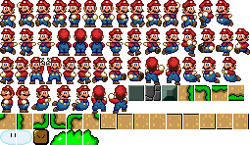
Texture Atlases
Place images drawn at same time onto a single texture
Reference individual images by UV coordinates
http://gamua.com/blog/2010/10/new-options-for-creating-a-texture-atlas/

Slide 16
Texture Atlases
Texture atlas is apart of art pipeline
Art pipeline is as slow as the slowest part
Use command line tool (or something else automated)
GUI is rigid and manual

Slide 17
Making an atlas:
Load a bunch of images from file
Place all images into huge array (image) with bin packing
Save final image on disk
Save atlas on disk

Slide 18
Actual Atlas File
Maps unique name (“blueEnemy.png”) to UV coordinate set
Can use min/max points for UV AABB
Used to know UV sets of the atlas image file

Slide 19
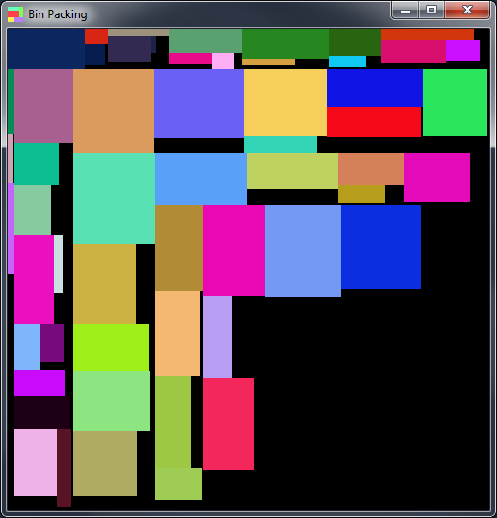
Bin Packing
Bin packing is NP hard
Some sort of heuristic needed
http://joelverhagen.com/blog/2011/03/jim-scotts-packing-algorithm-in-c-and-sfml/

Slide 20
Bin Packing – An Algorithm
Setup a large box (initial image)

Slide 21
Bin Packing – An Algorithm
Place bin in a corner

Slide 22
Bin Packing – An Algorithm
Partition the space along shortest bin extent

Slide 23
Bin Packing – An Algorithm
Place another bin into the best fit partition (same corner)

Slide 24
Bin Packing – An Algorithm
Repeat partition step (partition along shortest AABB extent)

Slide 25
Bin Packing – An Algorithm
Continue until finished

Slide 26
Bin Packing – Partitions
Can use a linked list of partitions
Best fit: search list for smallest partition which bin can fit
struct Partition
{
Partition *next, *prev;
AABB extents;
};

Slide 27
Bin Packing – Partitioning
How to split a partition?
Place AABB image into corner

Slide 28
Bin Packing – Partitioning
Find shortest AABB extent (x axis)

Slide 29
Bin Packing – Partitioning
Create a new partition, insert into partition list
Resize old (large) partition
Old partition
New

Slide 30

Atlas Format
Make it simple
fire.png
red_ball.png
0.000000, 0.000000
1.000000, 0.500000
orange_ball.png
0.000000, 0.500000
1.000000, 1.000000

Slide 31
Atlas Generation Tool
Make a simple command line tool:
Finds all images in folder, places into atlas sized 256 by 256 pixels
Can call from C code:
>> AtlasGenerator "out.atlas" "out.png" 256 256 "inputFolderName"
system( "AtlasGenerator ..." );

Slide 32
Atlas Generation Run-time
Can make atlases for lightmaps (or other stuff) during run-time
Use a tree for best fit query
Preallocate tree nodes (use an array, index references not pointers)

Slide 33
Premultiplied Alpha
Swapping render states is slow (like a batch)!
Use premultiplied alpha:
No render state swap required
Can render additive blending
Can render traditional alpha blending
Idea: upon loading an image, multiple RGB components by A
Zero alpha denotes “additive blending”

Slide 34
Example Code (OpenGL)
https://bitbucket.org/rgaul/sel

Slide 35
Demo of Fire Atlas – Additive Blending

