Slide 1
NotifyMe!
Matthew Manning and Suveni Tangnu

Slide 2
What is it?
A website that monitors a list of websites that you provide.
Sends an email when it discovers that one of the websites have updated.
User Accounts with personalized lists of websites.
Password Optional.
Caveat: Only ETag or Last-Modified Allowed.

Slide 3
How do we do it?
Database Design
Account Creation, Logging In, and Logging Out
Changing Password and Account Recovery
Adding, Editing, and Deleting URLs
Searching for Updates
Updating the Database and Sending Emails

Slide 4
How do we do it?
Database Design
Account Creation, Logging In, and Logging Out
Changing Password and Account Recovery
Adding, Editing, and Deleting URLs
Searching for Updates
Updating the Database and Sending Emails

Slide 5
Database Design
3 Tables: URLs, Users, and User_URL_List
URLs:
URL
Last-modified
Etag
Updated
Users:
Email
Username
Password
User_URL_List:
Email
URL

Slide 6
How do we do it?
Database Design
Account Creation, Logging In, and Logging Out
Changing Password and Account Recovery
Adding, Editing, and Deleting URLs
Searching for Updates
Updating the Database and Sending Emails

Slide 7
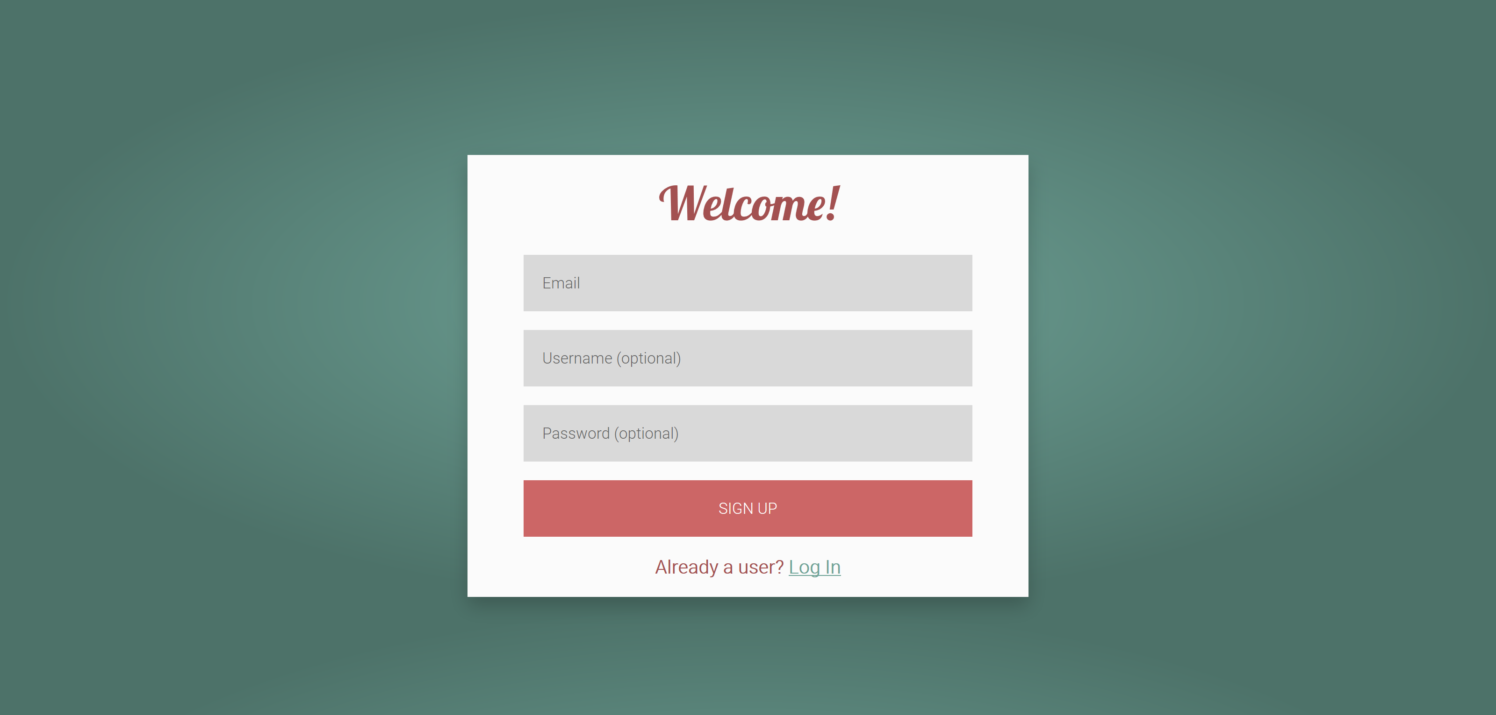
Account Creation

Slide 8
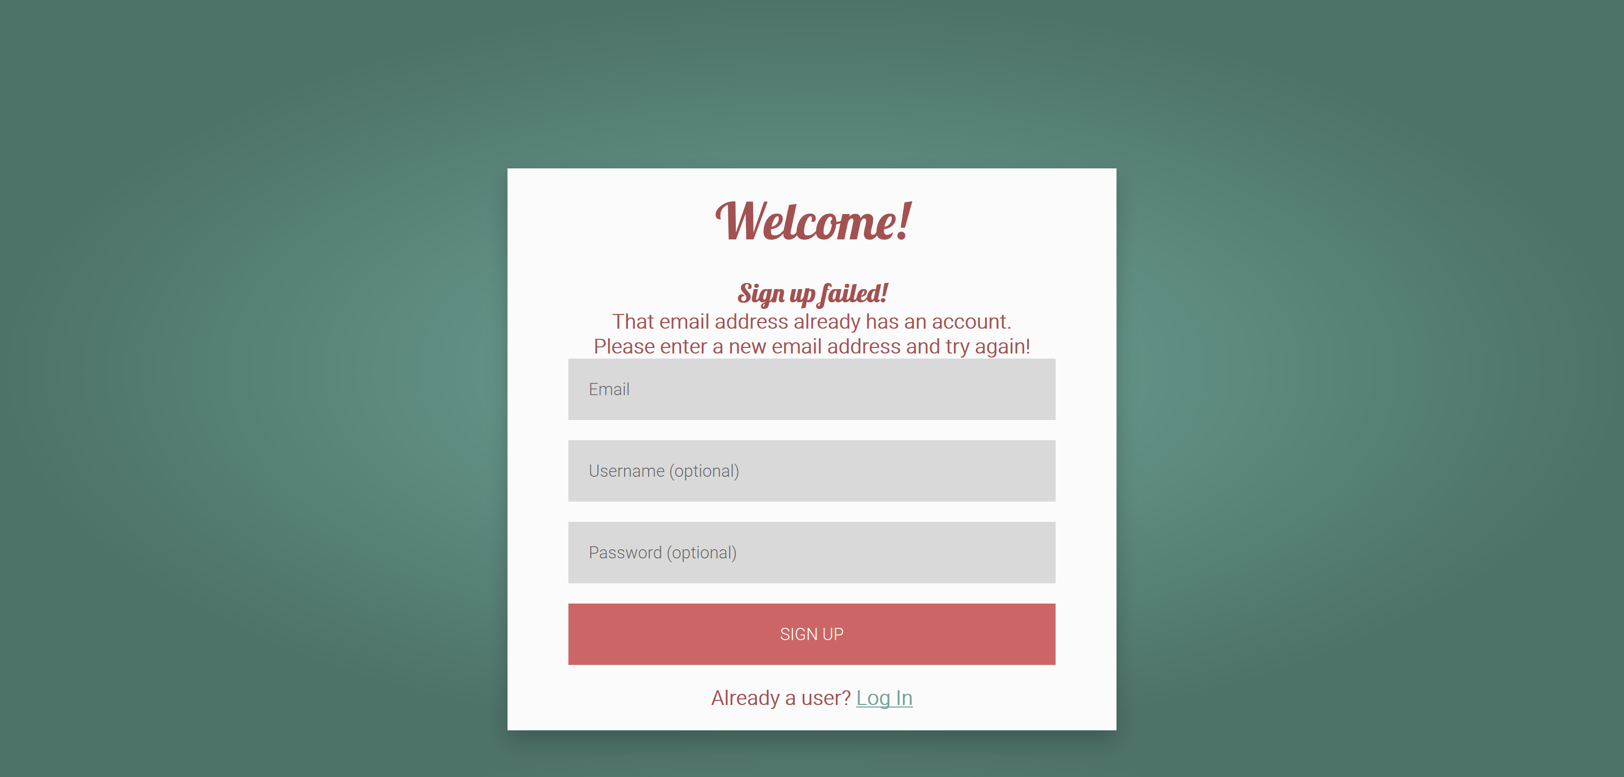
Account Creation

Slide 9
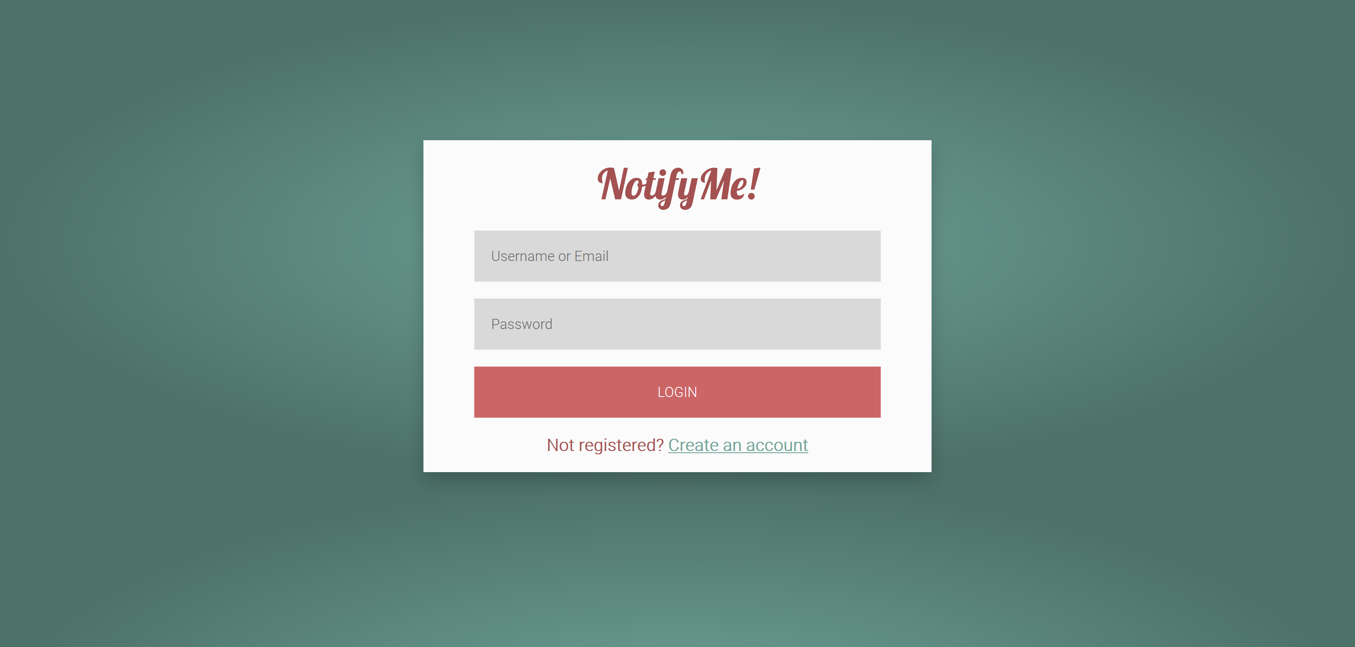
Logging In

Slide 10
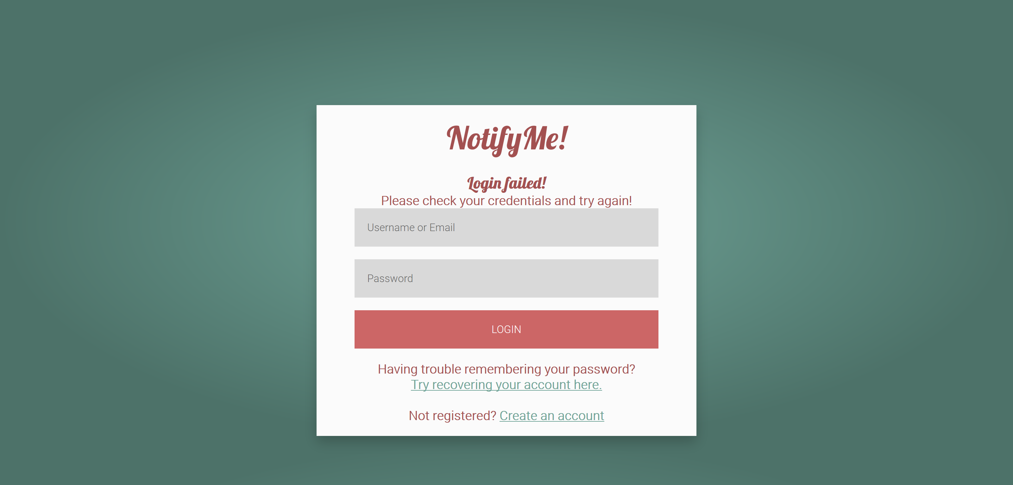
Logging In

Slide 11
How do we do it?
Database Design
Account Creation, Logging In, and Logging Out
Changing Password and Account Recovery
Adding, Editing, and Deleting URLs
Searching for Updates
Updating the Database and Sending Emails

Slide 12
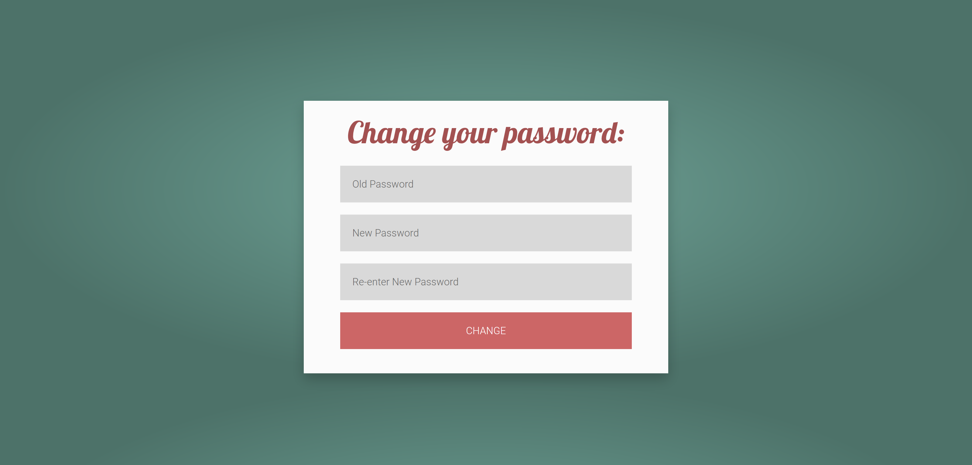
Changing Password

Slide 13
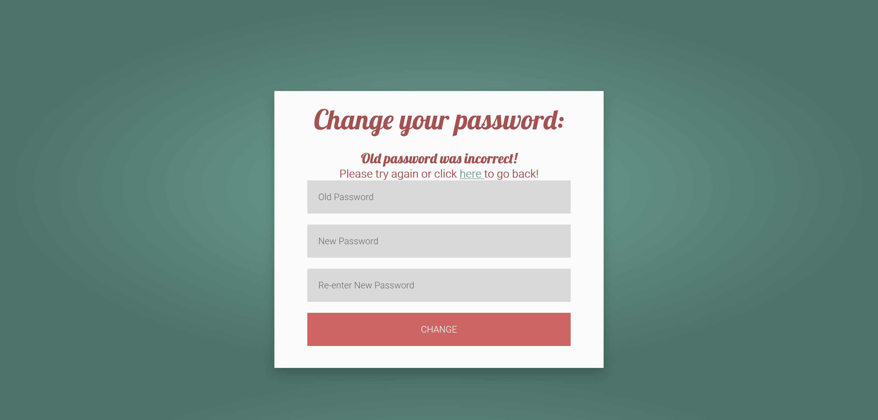
Changing Password

Slide 14
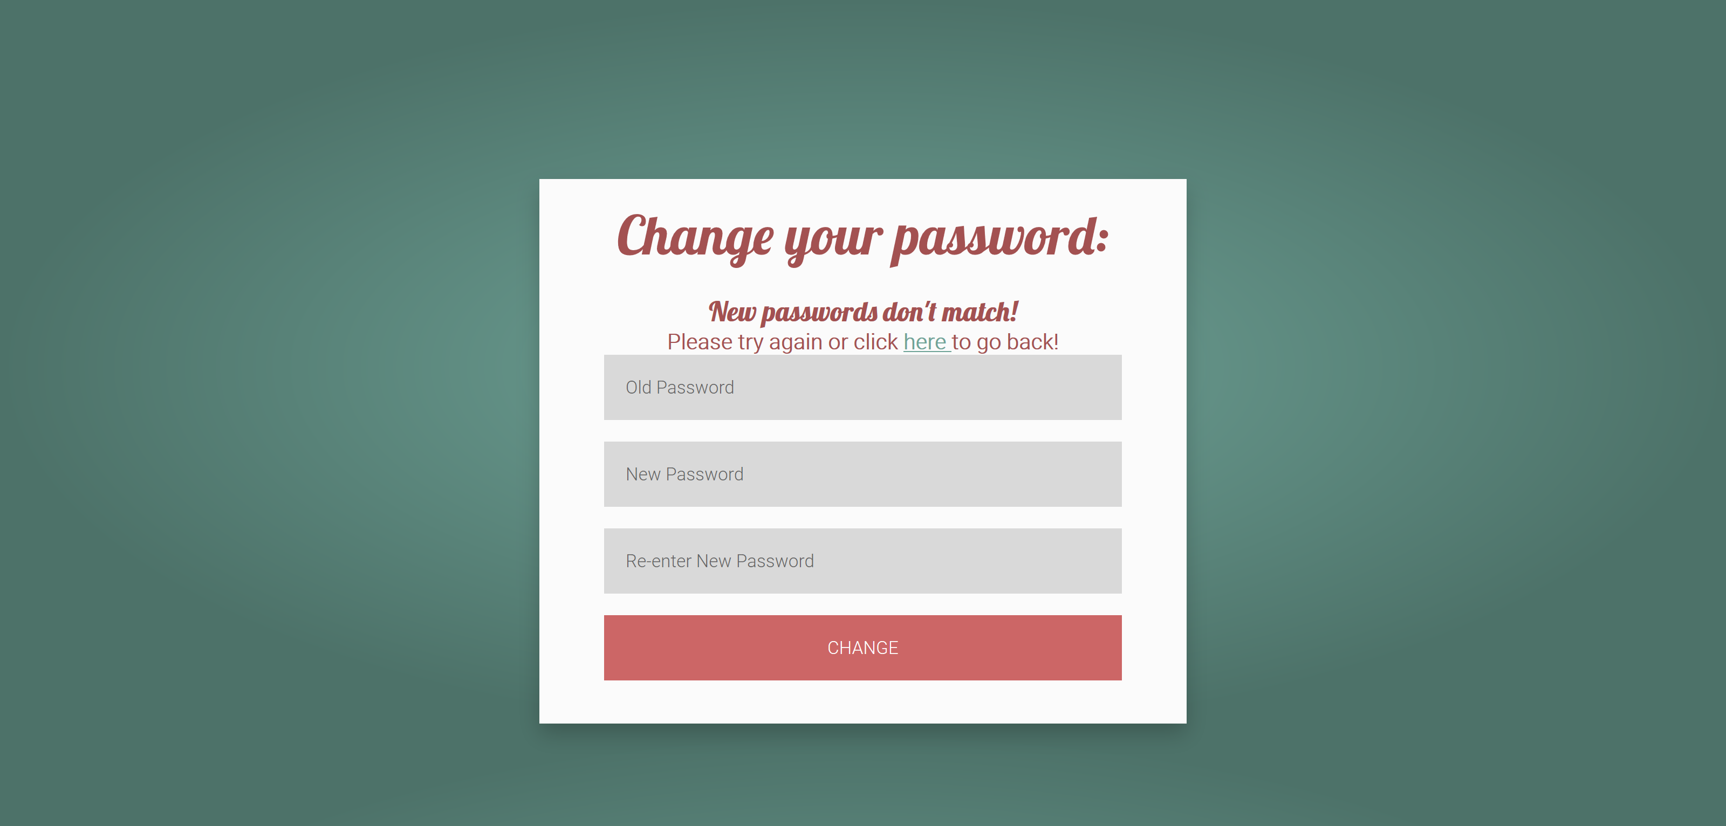
Changing Password

Slide 15
How do we do it?
Database Design
Account Creation, Logging In, and Logging Out
Changing Password and Account Recovery
Adding, Editing, and Deleting URLs
Searching for Updates
Updating the Database and Sending Emails

Slide 16
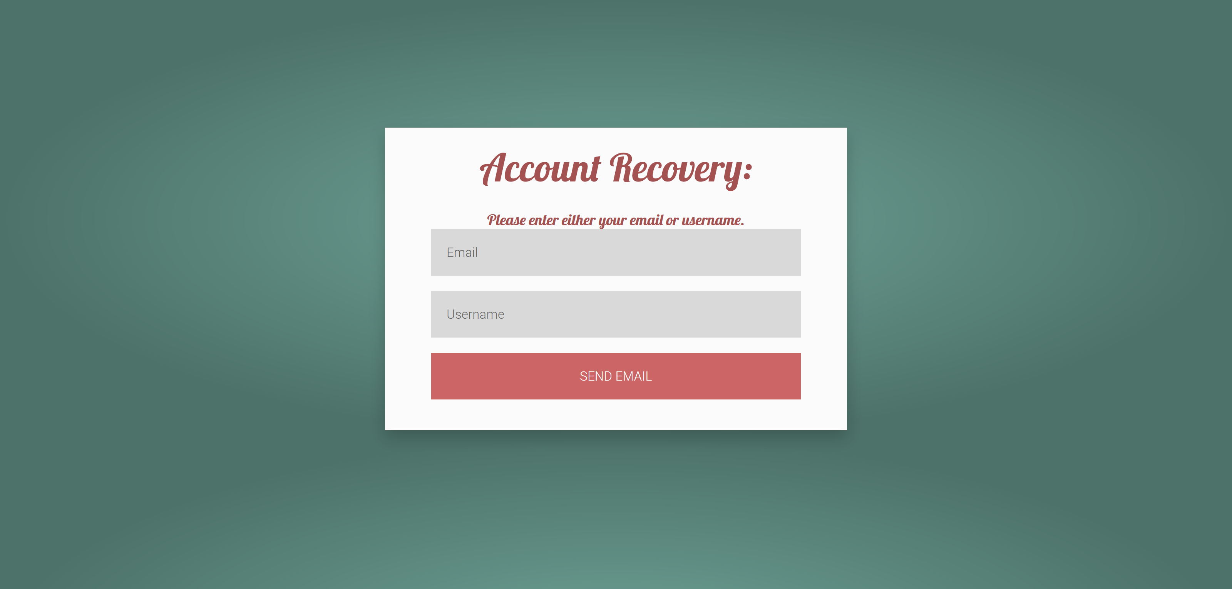
Account Recovery

Slide 17
How do we do it?
Database Design
Account Creation, Logging In, and Logging Out
Changing Password and Account Recovery
Adding, Editing, and Deleting URLs
Searching for Updates
Updating the Database and Sending Emails

Slide 18
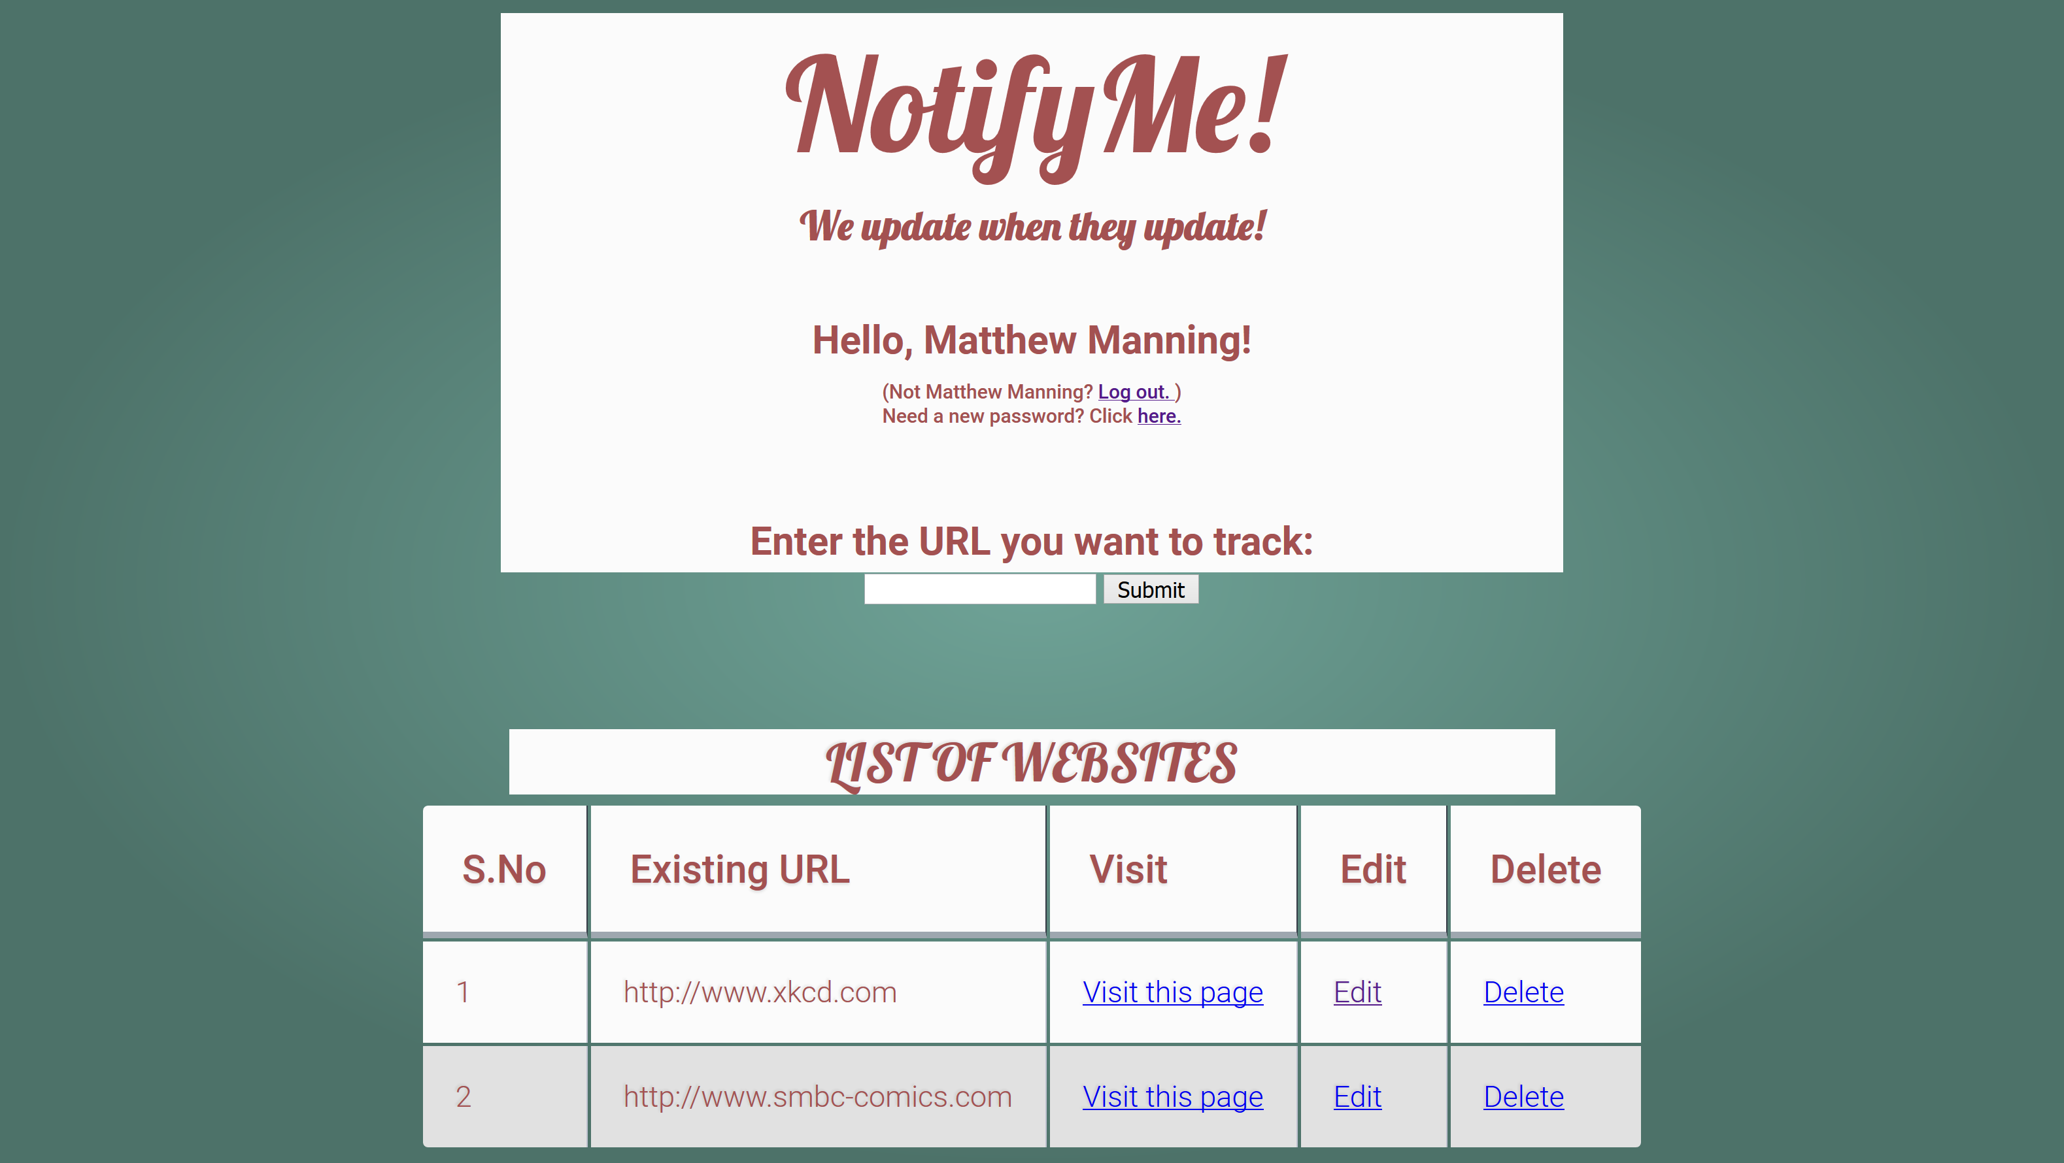
Adding, Editing, and Deleting URLs

Slide 19
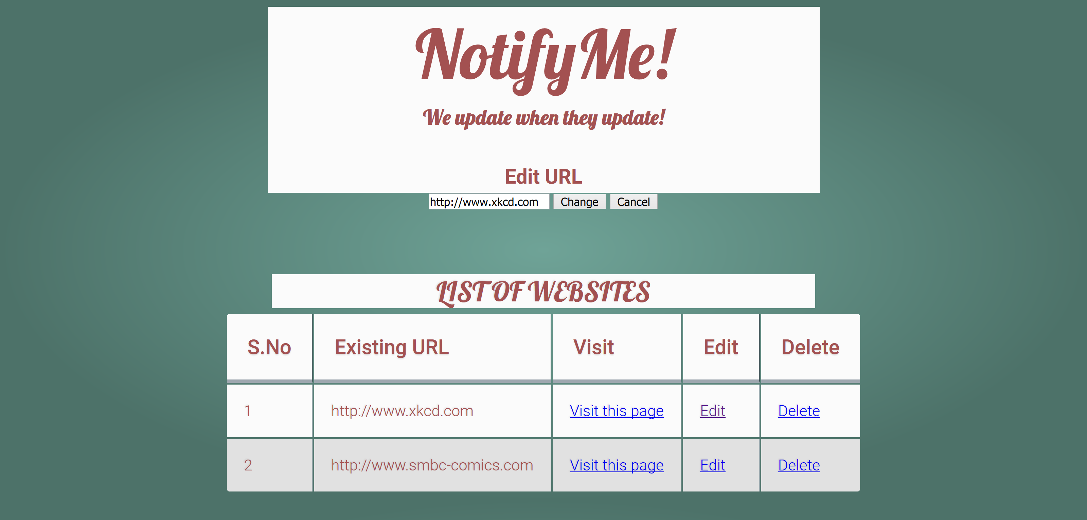
Adding, Editing, and Deleting URLs

Slide 20
How do we do it?
Database Design
Account Creation, Logging In, and Logging Out
Changing Password and Account Recovery
Adding, Editing, and Deleting URLs
Searching for Updates
Updating the Database and Sending Emails

Slide 21
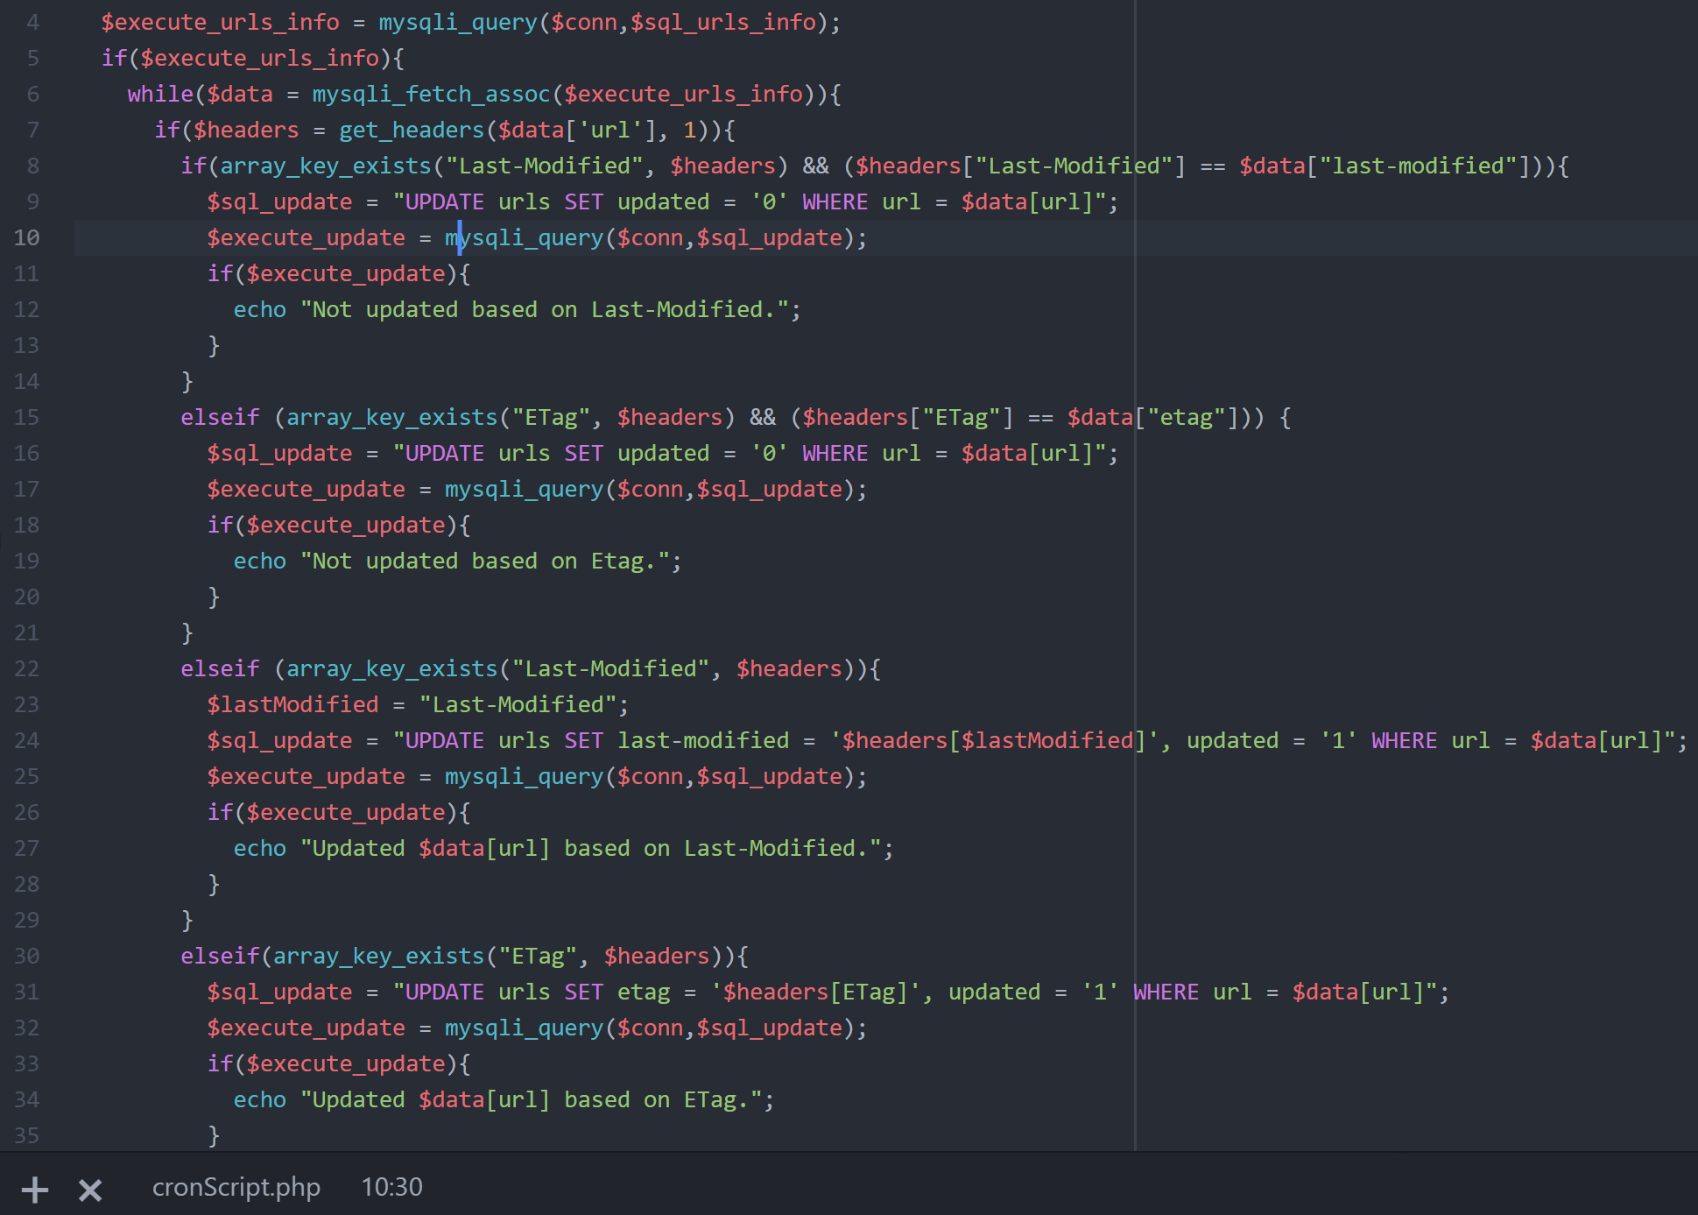
Searching for Updates

Slide 22
How do we do it?
Database Design
Account Creation, Logging In, and Logging Out
Changing Password and Account Recovery
Adding, Editing, and Deleting URLs
Searching for Updates
Updating the Database and Sending Emails

Slide 23
Updating the Database

Slide 24
How do we do it?
Database Design
Account Creation, Logging In, and Logging Out
Changing Password and Account Recovery
Adding, Editing, and Deleting URLs
Searching for Updates
Updating the Database and Sending Emails

Slide 25
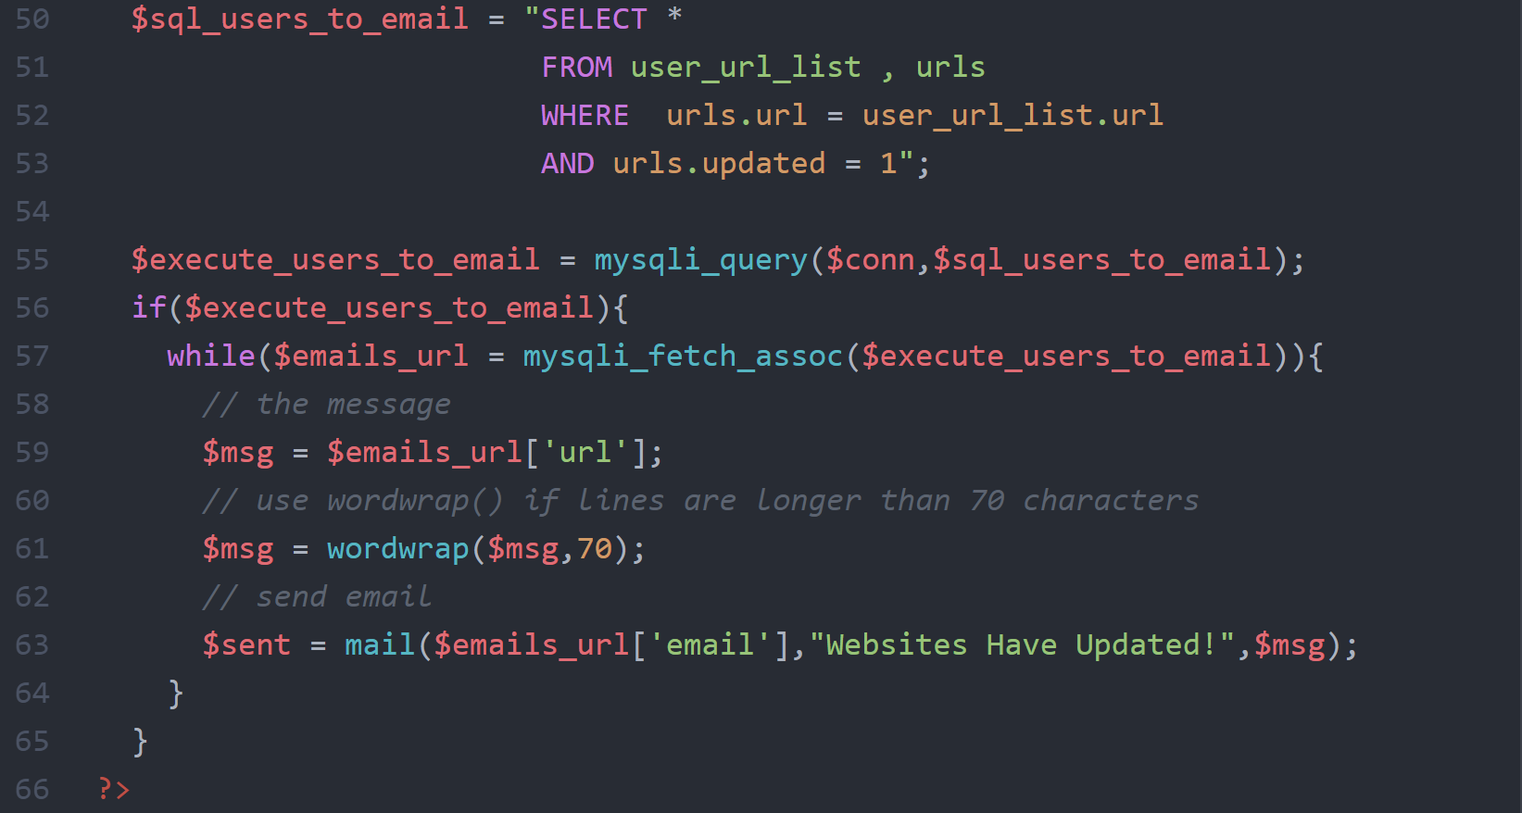
Sending Emails

Slide 26
The Tools We Used
XAMPP (Cross-platform, Apache, MariaDB, PHP, and Perl)
Apache for Server
HTML, MySQL, PHP, and CSS for the Website
PHPMyAdmin for Front-End Database GUI

Slide 27
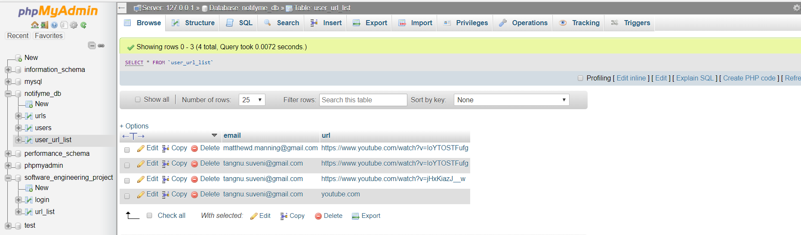
PhpMyAdmin
2 separate Database maintained
Tables in the Database

Slide 28
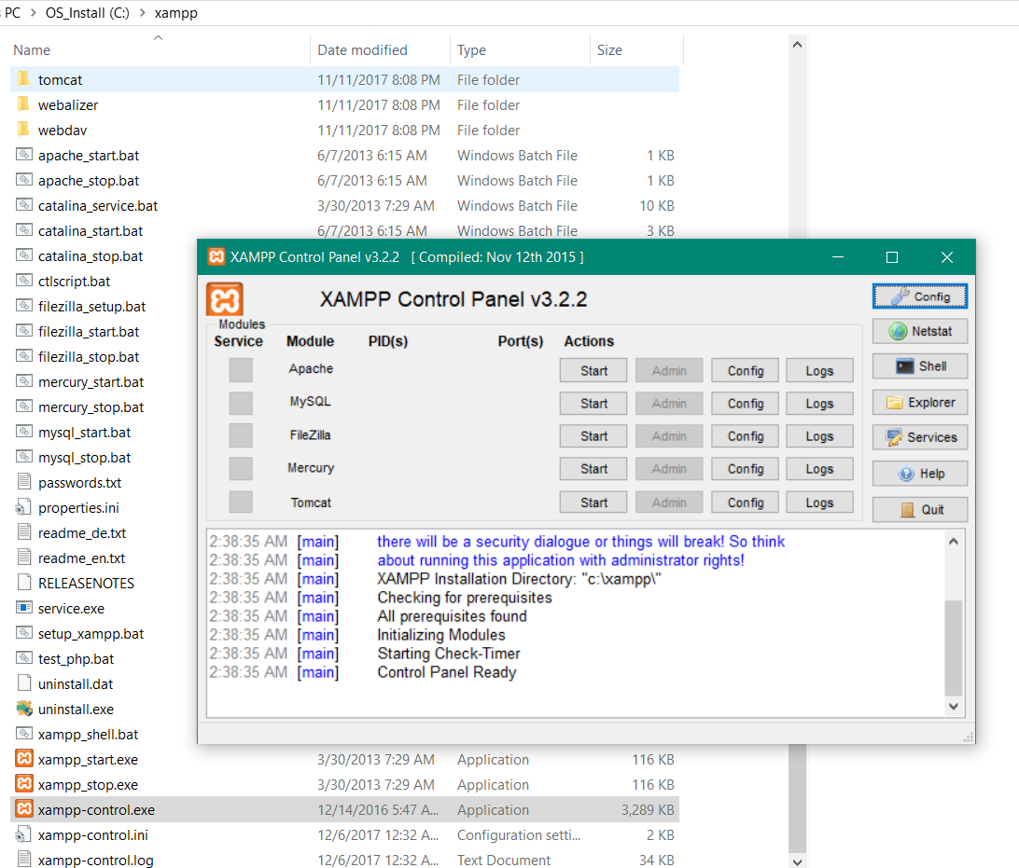
Apache for Server MySQL

Slide 29
DEMO

Slide 30
Future Work
Set frequency with which the user is updated
List sharing
Better security

