Slide 1
NotifyMe!
Matthew Manning and Suveni Tangnu

Slide 2
What is it?
Website that monitors a list of user-provided websites.
User Accounts for personalization.
Password Optional.
Sends an email when it discovers a website has updated.
Caveat: Only ETag or Last-Modified Allowed.

Slide 3
How do we do it?
Database Design
Account Creation, Logging In, and Logging Out
Changing Password and Account Recovery
Adding, Editing, and Deleting URLs
Searching for Updates and Updating the Database
Sending Emails

Slide 4
How do we do it?
Database Design
Account Creation, Logging In, and Logging Out
Changing Password and Account Recovery
Adding, Editing, and Deleting URLs
Searching for Updates and Updating the Database
Sending Emails

Slide 5
Database Design
3 Tables: URLs, Users, and User_URL_List
URLs:
URL
Last-modified
Etag
Updated
Users:
Email
Username
Password
User_URL_List:
Email
URL

Slide 6
How do we do it?
Database Design
Account Creation, Logging In, and Logging Out
Changing Password and Account Recovery
Adding, Editing, and Deleting URLs
Searching for Updates and Updating the Database
Sending Emails

Slide 7
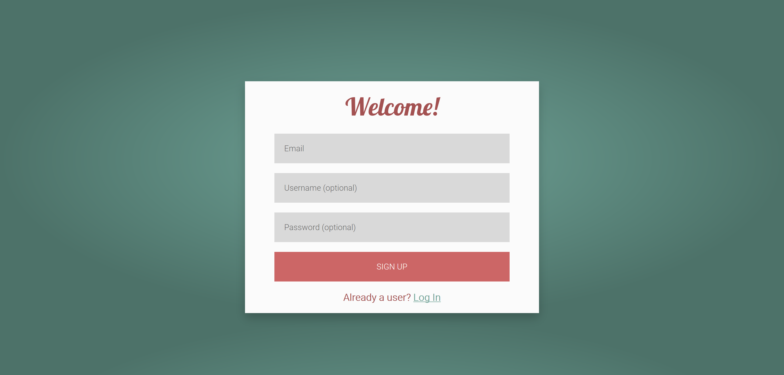
Account Creation

Slide 8
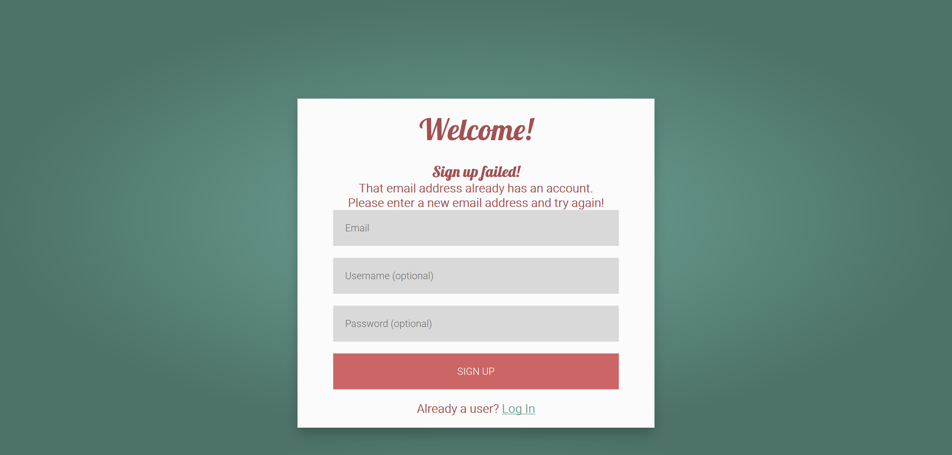
Account Creation

Slide 9
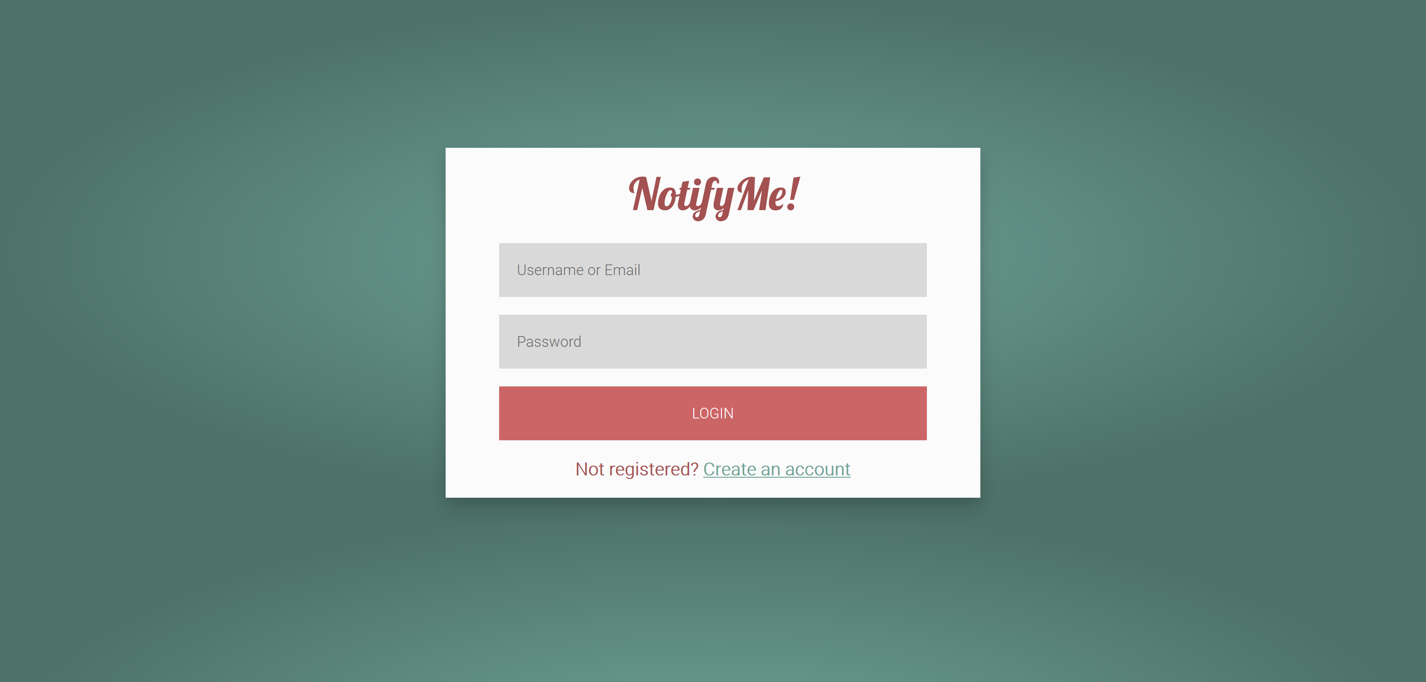
Logging In

Slide 10
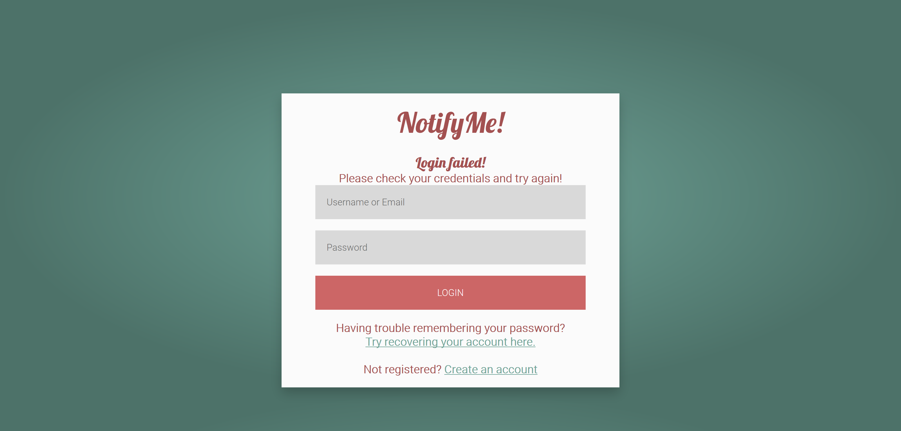
Logging In

Slide 11
How do we do it?
Database Design
Account Creation, Logging In, and Logging Out
Changing Password and Account Recovery
Adding, Editing, and Deleting URLs
Searching for Updates and Updating the Database
Sending Emails

Slide 12
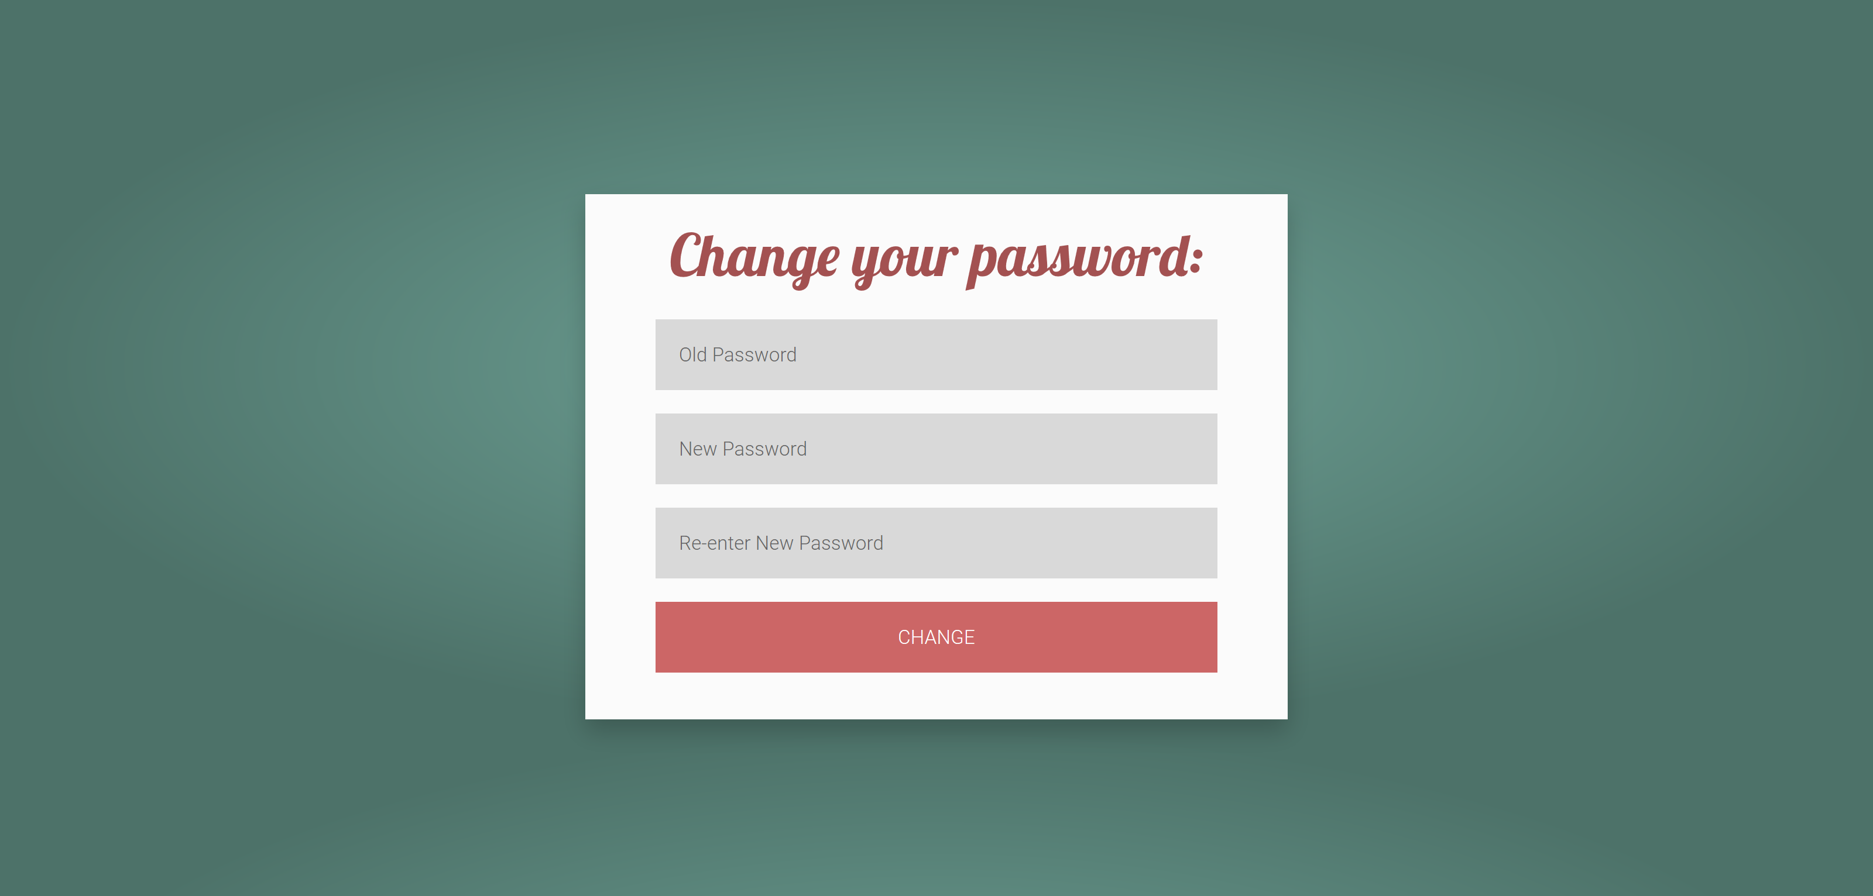
Changing Password

Slide 13
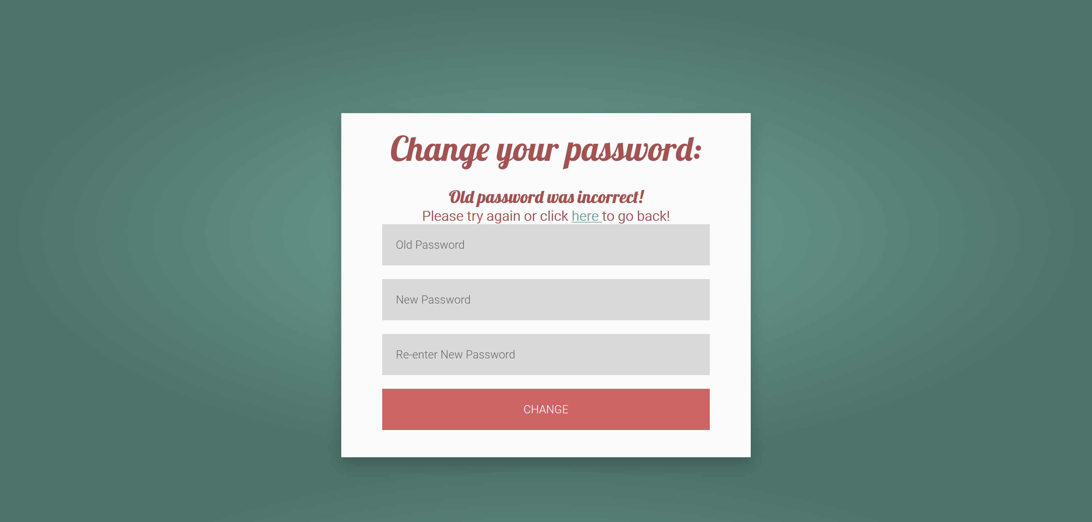
Changing Password

Slide 14
How do we do it?
Database Design
Account Creation, Logging In, and Logging Out
Changing Password and Account Recovery
Adding, Editing, and Deleting URLs
Searching for Updates and Updating the Database
Sending Emails

Slide 15
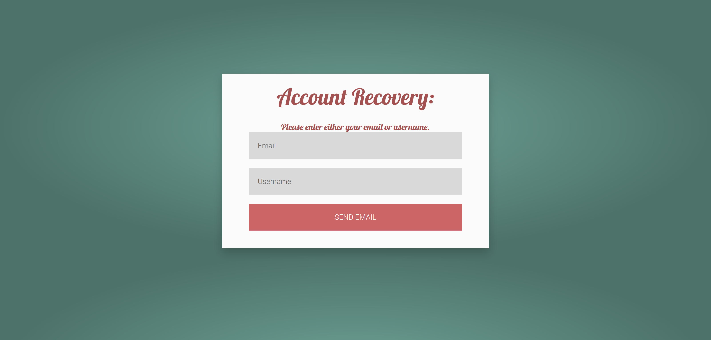
Account Recovery

Slide 16
How do we do it?
Database Design
Account Creation, Logging In, and Logging Out
Changing Password and Account Recovery
Adding, Editing, and Deleting URLs
Searching for Updates and Updating the Database
Sending Emails

Slide 17
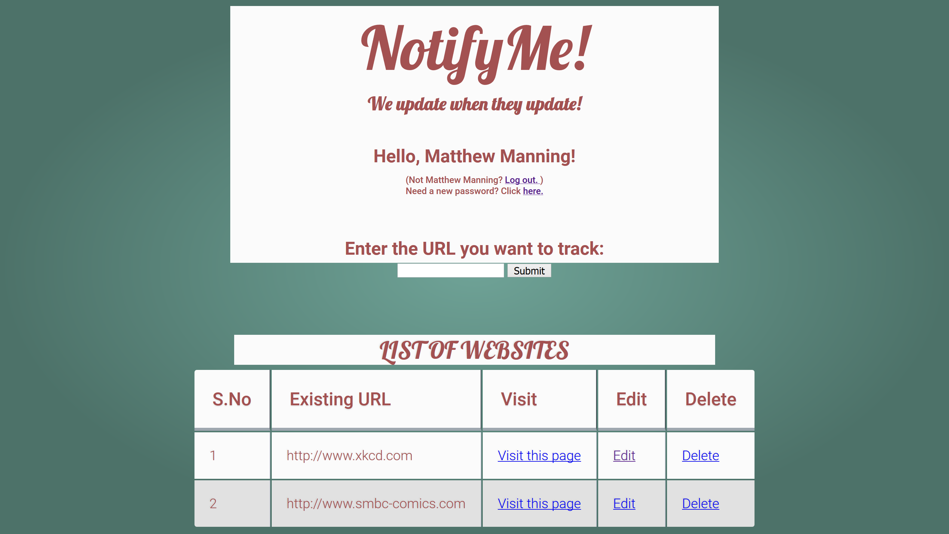
Adding, Editing, and Deleting URLs

Slide 18
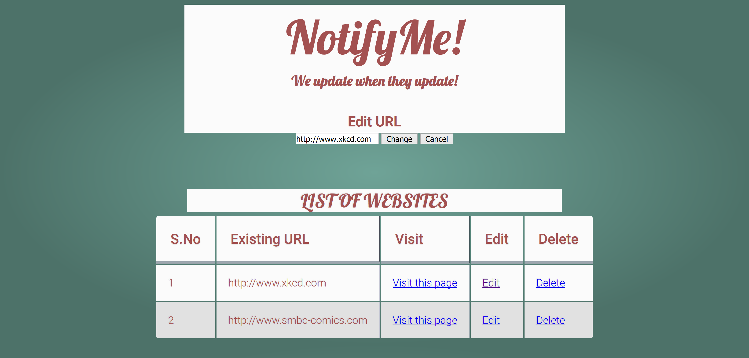
Adding, Editing, and Deleting URLs

Slide 19
How do we do it?
Database Design
Account Creation, Logging In, and Logging Out
Changing Password and Account Recovery
Adding, Editing, and Deleting URLs
Searching for Updates and Updating the Database
Sending Emails

Slide 20
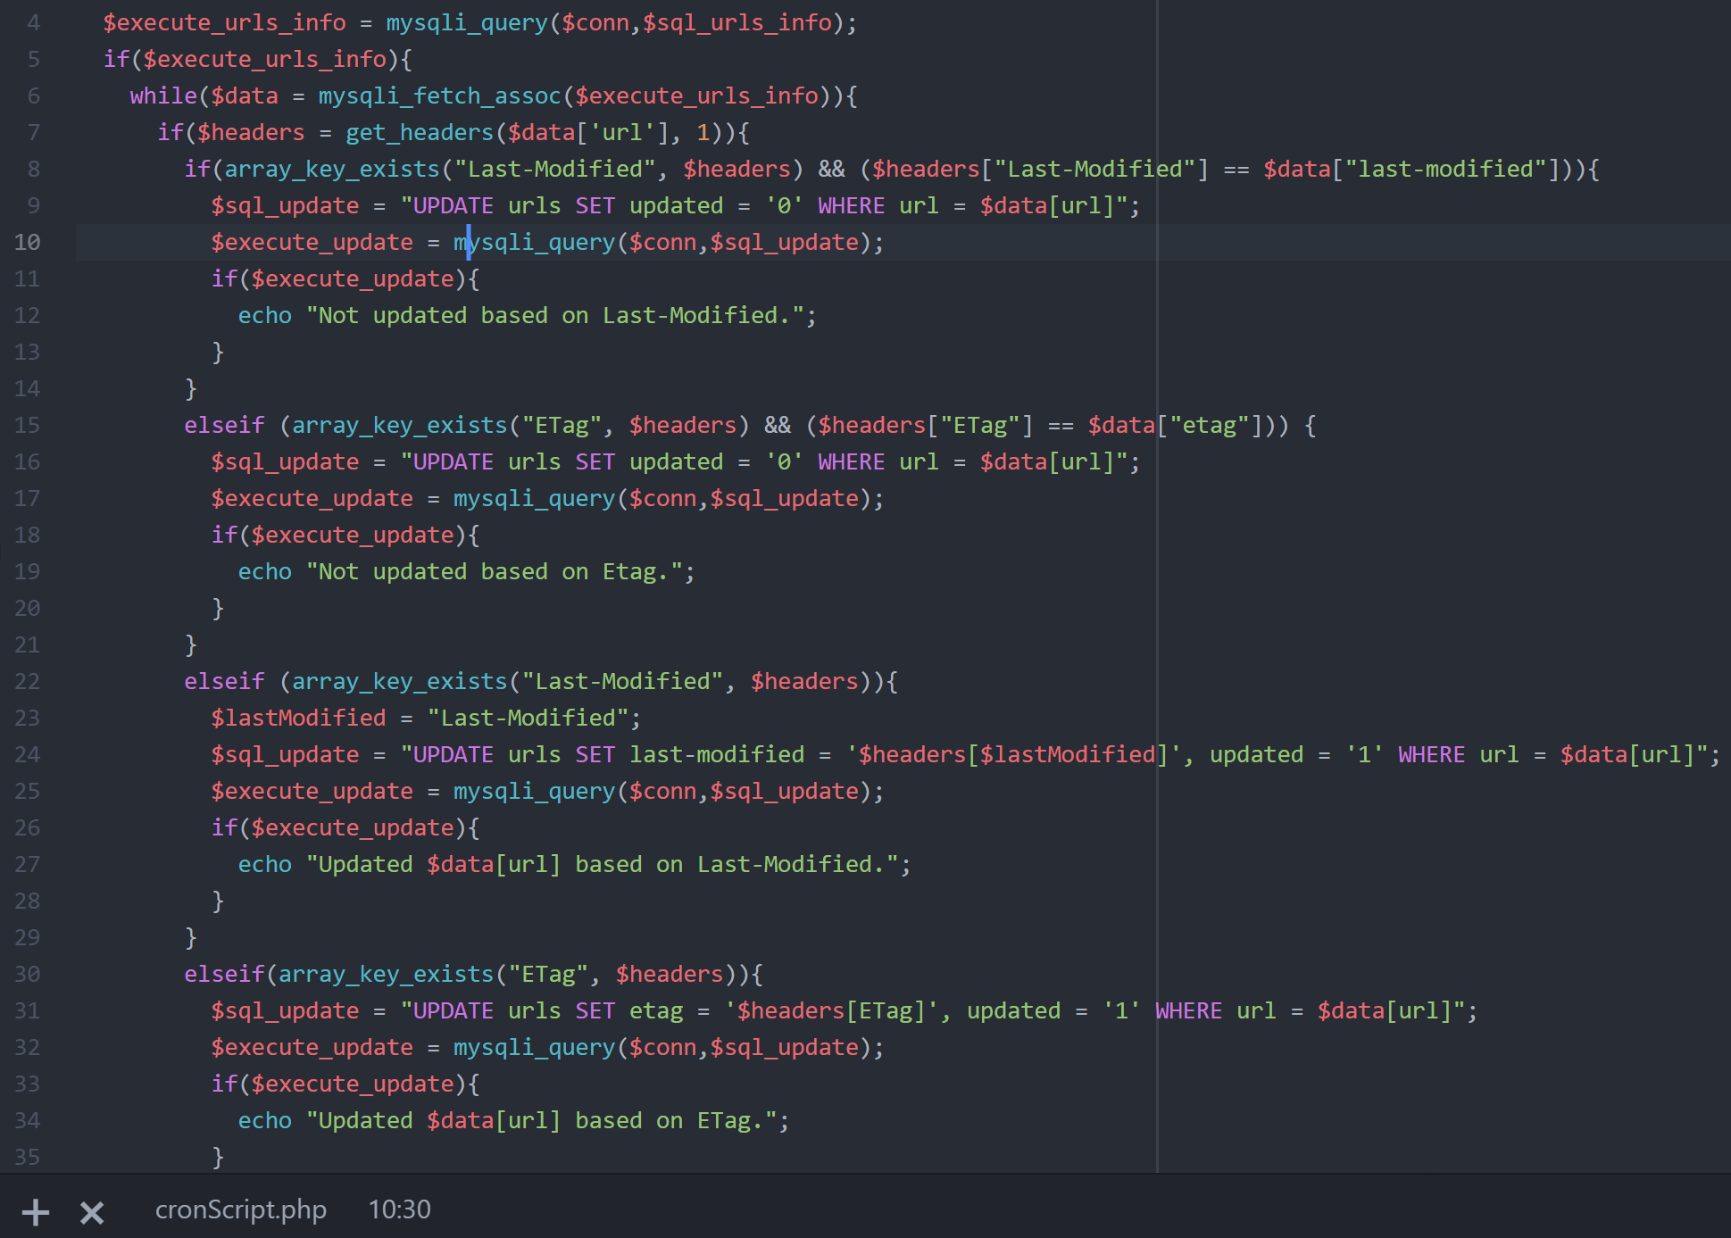
Searching for Updates and Updating the Database

Slide 21
How do we do it?
Database Design
Account Creation, Logging In, and Logging Out
Changing Password and Account Recovery
Adding, Editing, and Deleting URLs
Searching for Updates
Sending Emails

Slide 22
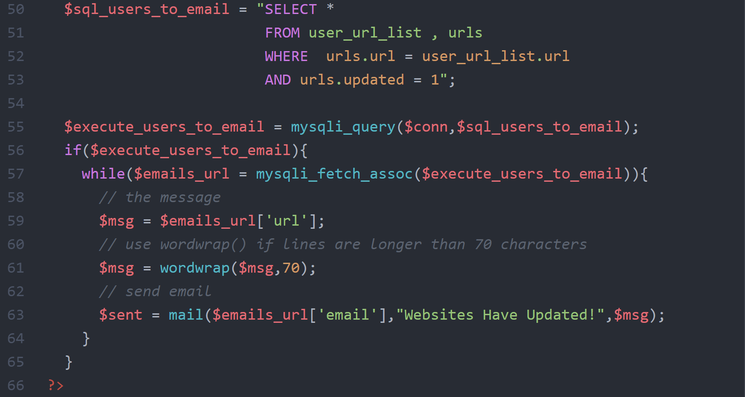
Sending Emails

Slide 23
The Tools We Used
XAMPP (Cross-platform, Apache, MariaDB, PHP, and Perl)
Apache for Server
HTML, MySQL, PHP, and CSS for the Website
PHPMyAdmin for Front-End Database GUI
Windows Task Scheduler
CRON

Slide 24
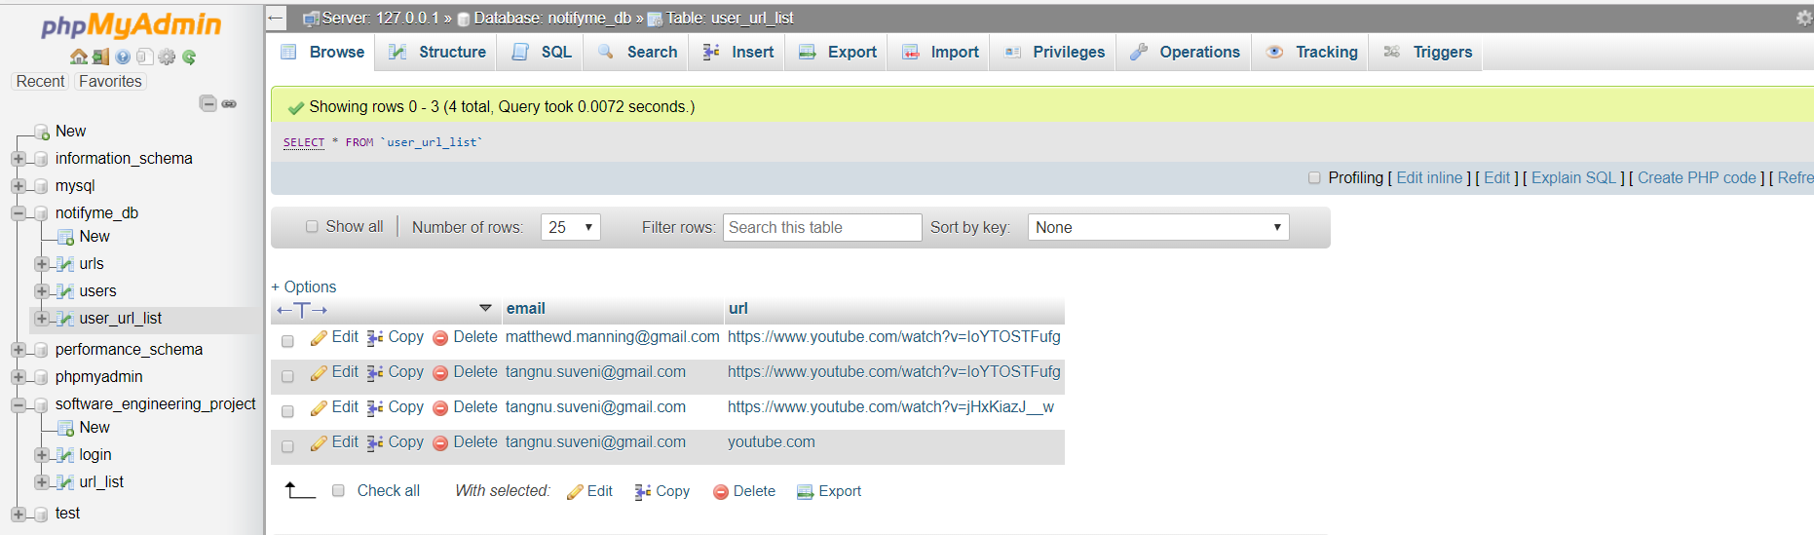
PhpMyAdmin
2 separate Database maintained
Tables in the Database

Slide 25
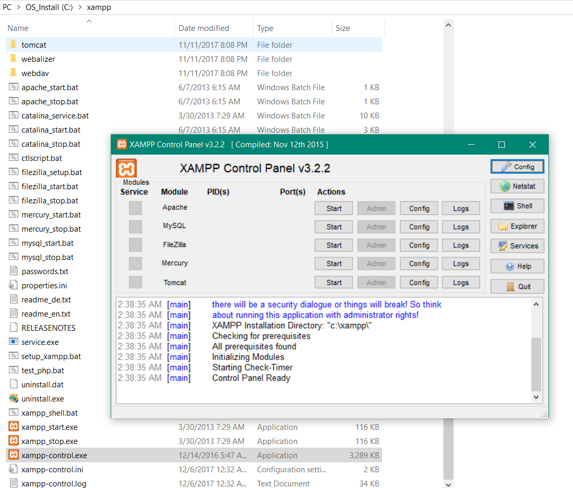
Apache for Server MySQL

Slide 26
DEMO

Slide 27
Future Work
Set frequency with which the user is updated
Allow the input of multiple websites simultaneously
List sharing
Better security

