Slide 1
NotifyMe!
Matthew Manning and Suveni Tangnu

Slide 2
What is it?
A website that monitors a list of websites that you provide.
Sends an email when it discovers that one of the websites have updated.
User Accounts with personalized lists of websites.
Password Optional.
Caveat: Only ETag or Last-Modified Allowed.

Slide 3
How do we do it?
Database Design
Account Creation, Logging In, and Logging Out
Changing Password and Account Recovery
Adding, Editing, and Deleting URLs
Searching for Updates
Updating the Database and Sending Emails

Slide 4
How do we do it?
To let the user create an account.
To let user enter , delete or/and edit a URL .
Create a relational view of the database , with proper key – table relation to store user details and the URL details.
Scan through the saved Websites.
For the identified websites, update the database.
Send the email to the user , without spamming them.

Slide 5
How do we do it?
Php - Front End handling
MySql – To store the user details
phpMyadmin- Connect Php and Mysql.
To let the user create an account.
To let user enter , delete or/and edit a URL .
Create a relational view of the database , with proper key – table relation to store user details and the URL details.
Scan through the saved Websites.
For the identified websites, update the database.
Send the email to the user , without spamming them.

Slide 6
How do we do it?
Php - Front End handling
MySql – To store the user details
phpMyadmin- Connect Php and Mysql.
To let the user create an account.
To let user enter , delete and edit a URL .
Create a relational view of the database , with proper key – table relation to store user details and the URL details.
Scan through the saved Websites.
For the identified websites, update the database.
Send the email to the user , without spamming them.

Slide 7
How do we do it?
To let the user create an account.
To let user enter , delete or/and edit a URL .
Create a relational view of the database , with proper key – table relation to store user details and the URL details.
Scan through the saved Websites.
For the identified websites, update the database.
Send the email to the user , without spamming them.
MySql – To store the user details
phpMyadmin- Use Mysql.

Slide 8
How do we do it?
To let the user create an account.
To let user enter , delete or/and edit a URL .
Create a relational view of the database , with proper key – table relation to store user details and the URL details.
Scan through the saved Websites.
For the identified websites, update the database.
Send the email to the user , without spamming them.
Php - Front End handling.

Slide 9
How do we do it?
To let the user create an account.
To let user enter , delete or/and edit a URL .
Create a relational view of the database , with proper key – table relation to store user details and the URL details.
Scan through the saved Websites.
For the identified websites, update the database.
Send the email to the user , without spamming them.
Php - Front End handling
MySql – To store the user details
phpMyadmin- Connect Php and Mysql.

Slide 10
How do we do it?
Php - Front End handling
MySql – To store the user details
phpMyadmin- Connect Php and Mysql.
Windows Task Scheduler,Crons – Read the php to send email on the basis of identified URL
To let the user create an account.
To let user enter , delete or/and edit a URL .
Create a relational view of the database , with proper key – table relation to store user details and the URL details.
Scan through the saved Websites.
For the identified websites, update the database.
Send the email to the user , without spamming them.

Slide 11
The Tools We Used
XAMPP (Cross-platform, Apache, MariaDB, PHP, and Perl)
Apache for Server
HTML, MySQL, PHP, and CSS for the Website
PHPMyAdmin for Front-End Database GUI

Slide 12
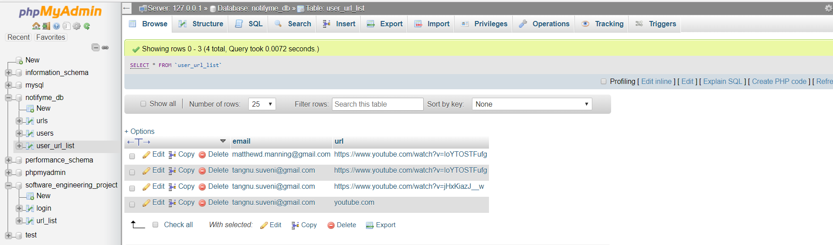
Layout of phpMyAdmin
2 separate Database maintained
Tables in the Database

Slide 13
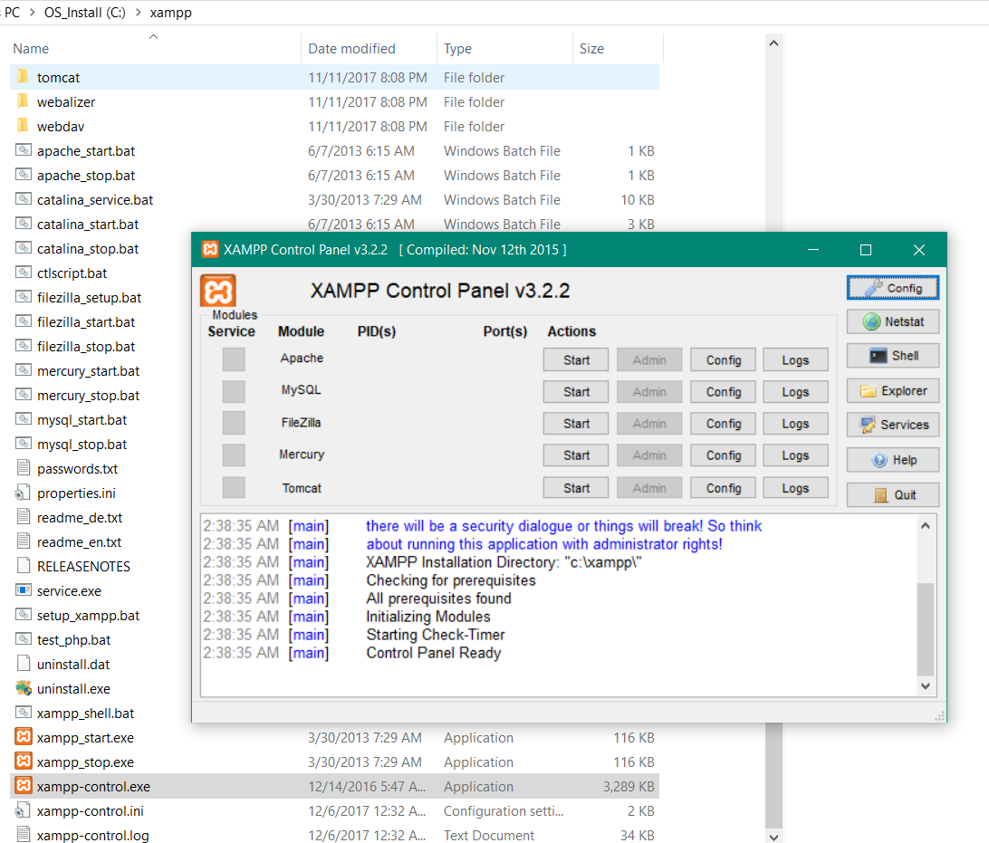
Apache for Server MySQL

Slide 14
DEMO

Slide 15
Future Work

