Slide 1
DATA SCIENCE MODULE PROJECT · TEAM 2
S&P 500 Stock Data Pipeline & Performance Analysis
End-to-end ELT engineering, automated data quality testing, and market return analytics across 600k+ stock records
Team: Kenny · Angeline · Suhana · Neo · Michael
Coverage: 622,710 records · 503 Tickers · 2021–2026

Slide 2


EXECUTIVE SUMMARY
Central business question: With Data Cleaning techniques, can accurate and precise analysis be performed on free and readily available public data to arrive at useful insights for everyday investors?
Robust ELT Architecture
Core Business Insights
Extracted 622k+ rows of static S&P 500 daily price and fundamental data.
Stock-level insight
AAPL Return Growth: No incremental annual return growth since the 2023–2024 period.
NVDA Sharpe Ratio: Exceptional risk-adjusted Sharpe ratio > 1 over 3- and 5-year horizons.
Loaded from Supabase PostgreSQL to Google BigQuery via Meltano ELT.
Transformed into high-performance star schema models using dbt.
Sector Risk-Reward: Tech led in daily return (+0.21%) but exhibited greatest volatility (3.60%).
Price-profits: Tech earned its rally (+30% price +32% profits) vs. Financials grew profits without moving price (+1%, +23%)
Price momentum
Price vs. Moving Average to show if stock is on uptrend, (short-term or deeper) pullback, or downtrend.

Slide 3


INFRASTRUCTURE STRATEGY
Technical Approach: Tool Selection Rationale
Google BigQuery
Supabase & Meltano
dbt Modeling
Python & SQLAlchemy
Serverless scale for 600k+ rows and 38 fields using GCP credits.
PostgreSQL staging with automated CLI ELT to cloud warehouse.
Transforms raw tables into star schema with automated test suites.
Direct connection to BigQuery for vectorized Pandas analysis.

Slide 4

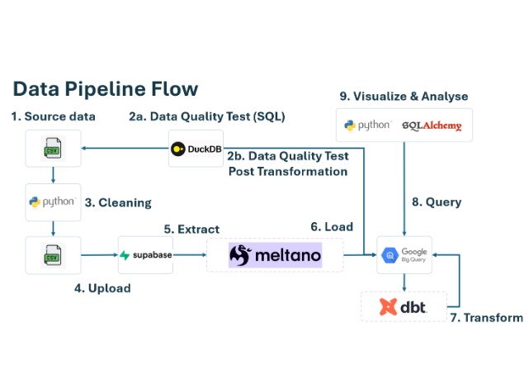
END-TO-END WORKFLOW
Data Pipeline Architecture & Execution Stages
1. Source & Extraction
503 S&P 500 tickers, Yahoo Finance prices, SEC EDGAR XBRL.
2. Staging & Meltano ELT
Loaded to Supabase, piped via tap-postgres to target-bigquery.
3. Transform & Quality Test
dbt star schema transformation and automated integrity tests.
4. Analysis Layer
SQLAlchemy querying directly into Pandas for financial EDA.

Slide 5
DATA ENGINEERING RIGOR
Data Quality Testing & Anomaly Remediation
Initial V1 SQL Findings
Cleaned V2 Regression Results
Waters (WAT): ~1,000× share-count error causing $43T market cap.
Corrected shares × EPS cross-checks against net income.
Zero duplicate records, zero orphan facts, and zero return mismatches.
McDonald's (MCD) share collapse and Halliburton (HAL) EPS distortions.
622,710
503
0
100%
Stock-Day Records
Validated Tickers
Duplicate Key Records
Daily Return Reconciliation

Slide 6
Data quality testing framework
A layered control set covering source integrity, business rules, analytical consistency, and warehouse validation.
SOURCE & RECORD CONTROLS
ANALYTICAL & WAREHOUSE
Source integrity
File hash, row count, column count, date range
Financial reasonableness
Implausible P/E, EPS, shares, market cap
Schema validity
Dates, numeric prices, integer-like fields
Outliers
Extreme values and scale errors
Completeness
NULLs and blank key fields
Temporal consistency
Example: WAT shares ~59m → ~59bn (≈1,000×)
Uniqueness
One ticker + date record
Snapshot consistency
Example: compare every company on 2026-10-06
Price validity
OHLC relationships; prices > 0
Coverage / population
491 at start + 12 later entrants = 503 latest
Volume validity
Non-negative volume
Referential integrity
Every fact ticker must exist in dim_ticker (0 missing)
Cross-field reconciliation
Market cap vs price × shares
Post-ELT validation
Source preservation + derived-field checks
MODULE 2 ASSIGNMENT • PART 4 DATA QUALITY
S&P 500 Panel
2
Notes:
Source integrity asks: are we testing the expected file/population? We recorded the hash, row count, 38 columns and date range.
Temporal consistency example: WAT shares moved from roughly 59 million to roughly 59 billion — about a 1,000× jump. That is why we compare values through time, not only within one row.
Snapshot consistency example: when ranking companies, compare them on one common date such as 2026-10-06, rather than mixing different dates or each company’s historical maximum.
Coverage/population: the dataset had 491 tickers at the first date and 12 later entrants, giving 503 at the latest date. A later entrant is not automatically missing/bad data.
Referential integrity in simple terms: every ticker appearing in the daily-price fact table must have a matching ticker master record in dim_ticker. We found zero missing matches.

Slide 7
Test evidence matrix
Every conclusion is traceable to a SQL script and a corresponding CSV result file in the project repository.
#
Test
Why
SQL
Result evidence
Outcome
01
Baseline / source integrity
Establish control totals
01_baseline.sql
01_baseline.csv
PASS
02
Completeness
Quantify missing fields
02_completeness.sql
02_completeness.csv
REVIEW
03
Uniqueness
Prevent duplicate stock-day rows
03_duplicates.sql
03_duplicates_summary.csv
PASS
04
Price & volume validity
Validate OHLCV business rules
04_price_business_rules.sql
04_price_business_rules.csv
PASS
05
Cross-field integrity
Detect financial scaling inconsistencies
05_financial_integrity.sql
05_financial_integrity.csv
REVIEW
06
Reasonableness / outliers
Flag implausible financial values
06_financial_reasonableness.sql
06_financial_reasonableness.csv
REVIEW
07
Temporal consistency
Detect step-change scale errors
07_temporal_consistency.sql
07_temporal_consistency.csv
REVIEW
08
Snapshot / coverage
Control date and constituent population
08_snapshot_coverage.sql
08_snapshot_coverage.csv
REVIEW
09
Referential integrity
Validate fact-to-dimension keys
09_bigquery_referential_integrity.sql
bigquery/09_...csv
PASS
10
Post-ELT validation
Reconcile source and derived fields
10_post_elt_validation.sql
bigquery/10_...csv
PASS
Submission pack: SQL scripts ZIP + CSV results ZIP. Each matrix row maps directly to its evidence file in the ZIP.
MODULE 2 ASSIGNMENT • PART 4 DATA QUALITY
S&P 500 Panel
3
Notes:
This is the audit trail. For every test, the ZIP contains the SQL used and the corresponding CSV output.
PASS means an objective rule had no violations. REVIEW means the test found something requiring interpretation; it does not automatically mean every flagged row is wrong.
The important REVIEW areas are then explained on the following exception slides rather than crowding this matrix.
No need to show the full SQL on-screen during the presentation; the file names let the marker trace the evidence directly.

Slide 8
Exceptions worth presenting
The controls exposed material scaling anomalies that simple reconciliation could miss.
WAT • Waters
MCD • McDonald’s
HAL • Halliburton
BE • Bloom Energy
~1,000× share-count scale anomaly
Share count collapsed to hundreds
Extreme EPS scaling anomaly
Quarterly EPS temporal anomaly
~59m shares appeared as ~59bn, creating an implausible >$10T market cap.
Hundreds of millions of shares temporarily appeared as hundreds before reverting.
TTM EPS jumped from ordinary values to an extreme ~100,001.63 level.
Diluted EPS exhibited ≥1,000× period-to-period movement requiring review.
93 temporal anomaly events across 12 tickers — counts below sum to 93
KEY CONTROL INSIGHT
Two wrong fields can still reconcile.
Share-count jump events
25
Diluted EPS jump events
2
A market-cap check alone can pass if market cap and shares outstanding carry the same upstream scale error. Independent temporal and reasonableness tests are therefore essential.
TTM EPS jump events
2
Revenue/share jump events
20
Assets/share jump events
26
Liabilities/share jump events
18
93 EVENTS
Detailed exception rows: 05_share_count_exceptions.csv • 06_financial_outlier_exceptions.csv • 07_temporal_exceptions.csv
MODULE 2 ASSIGNMENT • PART 4 DATA QUALITY
S&P 500 Panel
4
Notes:
These are the clearest anomalies worth discussing. I would not list every detailed row on the slide.
WAT: approximately 59 million shares appeared as approximately 59 billion, creating an implausible market capitalisation above $10 trillion.
MCD: share count temporarily appeared in the hundreds rather than hundreds of millions, then reverted.
HAL and BE: extreme period-to-period EPS movements triggered the temporal controls.
The six event counts on the right add to 93. They are anomaly EVENTS across 12 tickers, not 93 unique companies and not necessarily 93 independent source errors.
The detailed rows are retained in 05_share_count_exceptions.csv, 06_financial_outlier_exceptions.csv and 07_temporal_exceptions.csv.
Key lesson: a market-cap reconciliation can still pass when both market cap and shares carry the same scale error. That is why independent temporal/reasonableness tests were necessary.

Slide 9
S&P 500 membership changed during the five-year dataset
491 of the 503 latest tickers were already present on the first date; 12 entered later. This is a population change, not automatically a data error.
491
503
11
0
securities on first observation date
securities on latest observation date
sectors
exits before latest date
+12 entrants
How to read 491 + 12 = 503
Practical rule
• 491 tickers are present from the first observation date through the latest date.
• 12 tickers entered the dataset later, giving 503 on the latest date.
• For rankings or comparisons, use one common date (or a fixed cohort) so the comparison is fair.
Same-date snapshot or fixed cohort = fair comparison
A later entrant should not be treated as “missing historical data” simply because it was not in the starting S&P 500 population.
MODULE 2 ASSIGNMENT • PART 4 DATA QUALITY
S&P 500 Panel
5
Notes:
491 + 12 = 503 means: 491 tickers were already present from the first observation date; another 12 entered later; therefore 503 are present on the latest date.
This is not the same as a data-quality failure. The composition of the S&P 500 changes over time.
The risk is analytical: if we compare one company on one date with another company on a different date, or treat later entrants as missing data, the conclusion can be misleading.
The control rule is simple: use one common snapshot date for cross-sectional rankings, or deliberately define a fixed cohort.

Slide 10
Post-ELT validation: warehouse transformation passed
PASS
How we checked it: row/ticker counts, ticker-date keys, fact-to-dimension joins, plus independent recalculation of SMA and adjusted-close daily returns.
Raw source
Fact table
Dimension
public_proj2_sp500
ELT
fact_dailyprice
JOIN
dim_ticker
622,689 rows
503 tickers
622,689 rows
503 tickers
503 rows
503 unique tickers
0
source keys lost
0
unexpected fact keys
0
orphan fact rows
0
duplicate ticker-date rows
0
SMA mismatches
622,186 / 622,186
daily returns reconciled
Conclusion • Transformation integrity passed: no keys were lost or added, joins were complete, and derived fields reconciled. PASS here does not mean every upstream source anomaly was cleaned; those exceptions remain separately documented for remediation.
MODULE 2 ASSIGNMENT • PART 4 DATA QUALITY
S&P 500 Panel
6
Notes:
This slide validates the ELT rather than claiming the raw source became error-free.
We compared public_proj2_sp500 with fact_dailyprice: both had 622,689 rows, 503 tickers, the same date range, zero source keys lost and zero unexpected fact keys.
Referential integrity also passed: zero orphan fact rows and 503 unique dimension tickers.
We independently recalculated SMA 20/50/100/200 and found zero mismatches.
For daily_return, all 622,186 calculable rows matched adjusted-close returns. 622,186 equals 622,689 total rows minus the first observation for each of 503 tickers.
Important: PASS means the transformation preserved the population and calculations correctly. It does not mean the WAT/MCD/HAL/BE source anomalies were automatically cleaned. Those remain exception evidence for ELT/remediation ownership.

Slide 11

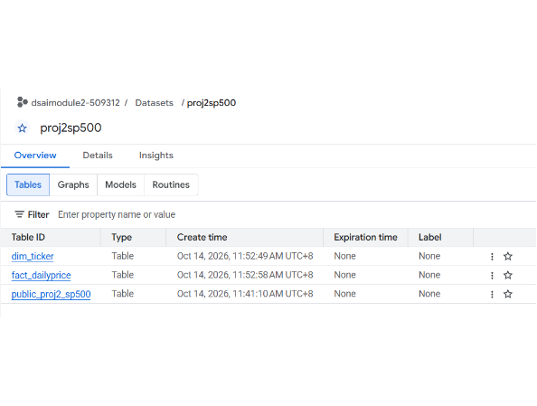
DATA MODELING
Star Schema Transformation via dbt in BigQuery
dim_ticker (Dimension Table)
Stores ticker, company name, GICS sector, and sub-industry mappings.
fact_dailyprice (Fact Table)
Stores daily OHLCV prices, market cap, and valuation multiples.
Derived Technical Indicators
Precomputes SMA 20, 50, 100, 200, and adjusted daily return fields.

Slide 12
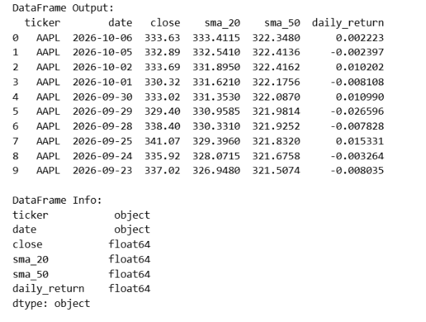
ANALYTICS INTEGRATION
Querying BigQuery with Python & SQLAlchemy
Secure Credentials
Uses python-dotenv and GCP credentials for programmatic authentication.
Optimized Star Joins
Joins fact_dailyprice with dim_ticker on ticker symbol efficiently.
Fast Pandas Ingestion
Streams schema-typed data into memory for statistical calculations.

Slide 13
A scheduled pipeline that stops itself when data is wrong
Tue–Sat at 6:30 am SGT, after each US trading day – no manual steps
1
Download
2
Parquet
3
GX gate 0
4
BigQuery
Team 2 notebook
Wikipedia + Yahoo + SEC
41 columns, retries
One file per year
31 MB vs 183 MB CSV
Rows, tickers, duplicates,
impossible prices, freshness
My own project
Partitioned by month,
clustered by ticker
Fails → retry once after 5 min → still failing: nothing is loaded, yesterday’s table stays
622,757
503
14 Oct
22 min
rows loaded
S&P 500 stocks
last complete day
end to end
First run, 15 Oct 2026 · Dagster job own_v2_extract_and_load · download notebook by Team 2
Notes:
My part is making the pipeline run by itself, and stop itself when the data is wrong. I built on our Team 2 download notebook: it already produces all 41 columns in one run. I added retries for Yahoo rate limits, and it now saves Parquet, one file per year: 31 MB instead of 183 MB. Dagster runs it every morning at 6:30 Singapore time, after the US close. Download, then GX gate 0 checks the files, and only if that passes it loads into BigQuery, partitioned by month and clustered by ticker. First run this morning: 622,757 rows, 503 stocks, up to 14 October, in 22 minutes. It writes only to my own project, so it never touches the team tables.

Slide 14
Five quality gates – gate 3 caught a partial trading day
Gate 0
Gate 1
Gate 2
Gate 3
Gate 4
Download files
Raw table
Schema
14 dimensions
Marts + views
Before load
Meltano load
4 + 41 columns
Team 2 rules
Before analysis
8 Oct was downloaded while the US market was still trading
20
impossible prices flagged by gate 3 – open outside the day’s high–low
Closes that differ from my own (final) download
228 → 0
Waters market caps above $10 tn, v1 → v2
Action: analysis ends 7 Oct; evidence committed to the repo
Next: incremental loads · Docker + Google Cloud · project ID in .env
Notes:
On the team's tables I run four more gates: the raw load, the schema contract, our team's 14 quality dimensions, and a final check before analysis. They have already paid off. The gates confirmed Waters' market cap was fixed between v1 and v2: 228 rows above 10 trillion dollars went to zero. And on v2, gate 3 stopped the pipeline: 20 rows on 8 October had an opening price outside the day's high-low range, which is impossible. I compared with my own download: on 7 October all 503 closes match exactly; on 8 October 500 of 503 differ. So 8 October was downloaded while the US market was still trading. Only 20 rows looked wrong, but nearly all 503 were wrong. So our analysis ends on 7 October. Next steps: incremental loads, and Docker plus Google Cloud so it runs without my laptop.

Slide 15

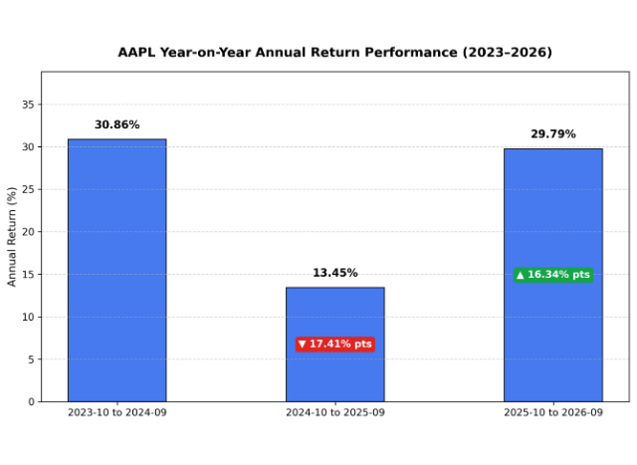
ANALYSIS 1 · AAPL TRAILING RETURNS
Is there growth in Apple Inc. annual return in last three 12 months trailing period?
Key Finding: No incremental growth on annual return since 2 years ago (since 202310–202409 period).
2 years ago: 2023-10 to 2024-09
+30.86%
Strong baseline performance year.
1 year ago: 2024-10 to 2025-09
+13.45%
17.41% points sharp deceleration.
latest: 2025-10 to 2026-09
+29.79%
Rebound remains below 2024 peak level.

Slide 16
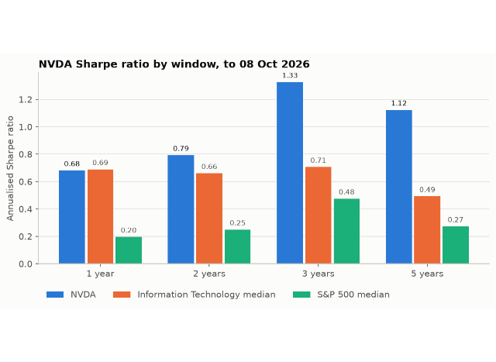
ANALYSIS 3 · RISK-ADJUSTED LEADERSHIP
Nvidia (NVDA): Multi-Window Sharpe Ratio Report
Key Finding: NVDA maintained exceptional Sharpe > 1 over 3 and 5 year horizons.
3-Year Window (AI Wave)
Sharpe: 1.33
95th percentile in S&P 500 (417.5% return).
5-Year Window
Sharpe: 1.12
98th percentile in S&P 500 (1038.4% return).
Above-Market Compensation
Sharpe > 1 proves excess returns comprehensively surpassed elevated volatility.

Slide 17
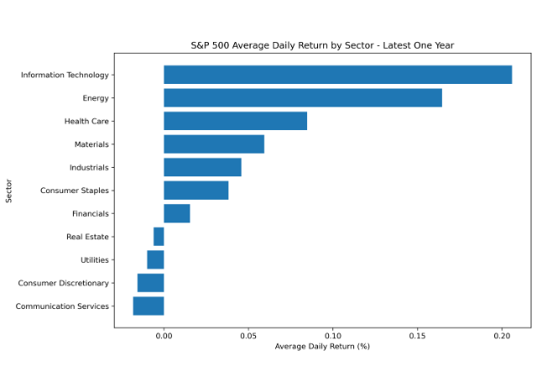
ANALYSIS 2 · SECTOR COMPARISON
S&P 500 Average Daily Return by Sector (Latest 1-Year)
Key Finding: Tech (+0.21%) and Energy (+0.16%) led all sectors in daily returns.
Top Performers
Info Tech: +0.2060%
Energy: +0.1645%
Positive Breadth
7 of 11 sectors posted positive average daily gains.
Lagging Sectors
Communication Services: -0.0182%
Consumer Discretionary: -0.0151%

Slide 18
ANALYSIS 2 · RISK VS. RETURN TRADE-OFF
Daily Return Volatility Across S&P 500 Sectors
Key Finding: Tech had highest returns but also the greatest daily variability (3.60%).
Highest Volatility
Info Tech: 3.6026% daily standard deviation.
Lowest Volatility
Utilities: 1.5530% daily standard deviation.
Risk-Return Principle
Superior tech performance required tolerating over 2.3× the daily price swings of utilities.

Slide 19
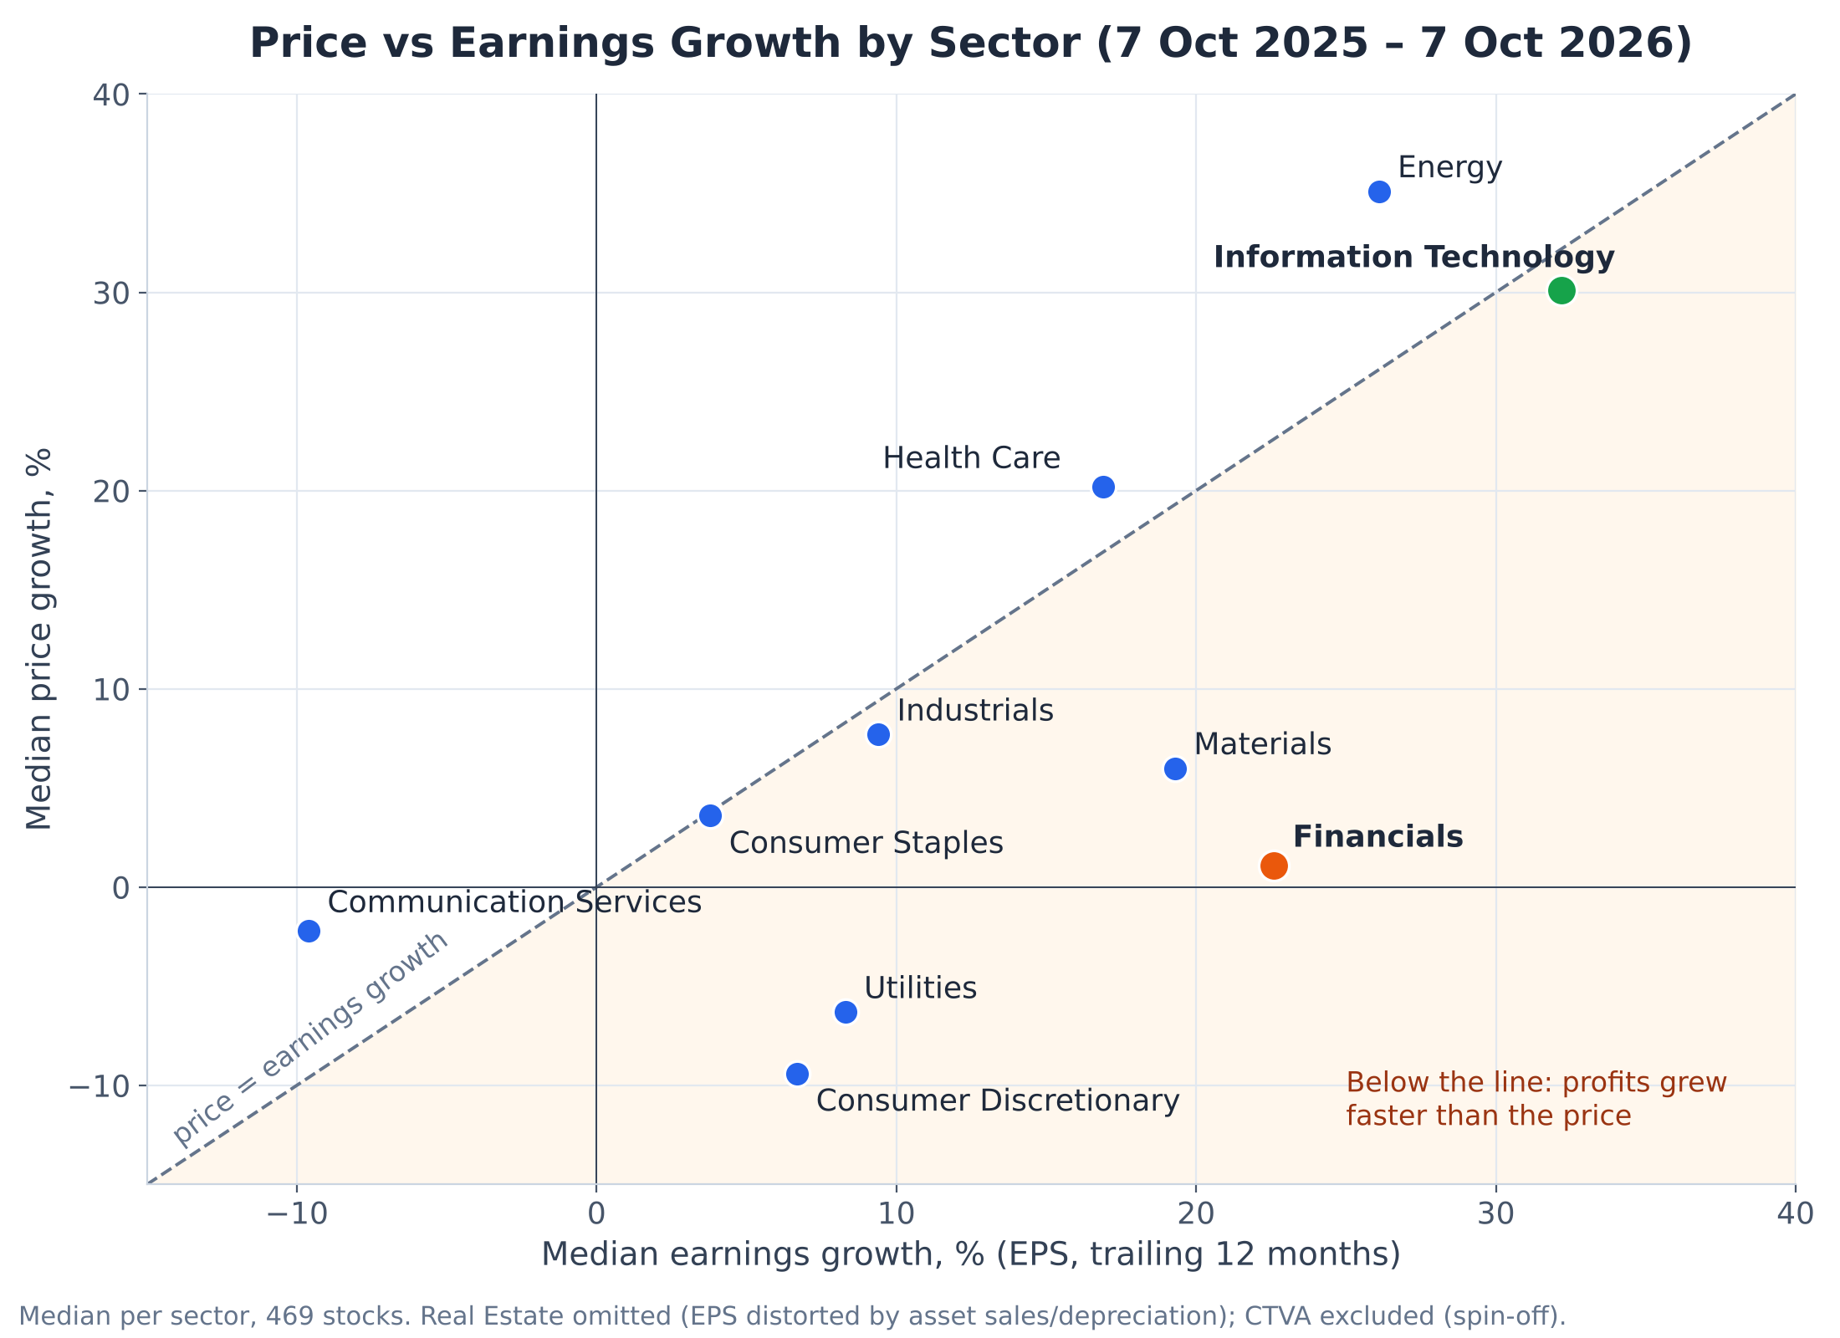
ANALYSIS 4 · SECTOR VALUATION
Did Prices Follow Profits? Price vs Earnings Growth by Sector
Key Finding: IT earned its rally; Financials grew profits 23% while prices stood still.
Information Technology
Price +30% · Profits +32%
Earned rally, but priciest sector (P/E 37.4).
Financials
Price +1% · Profits +23%
Lowest P/E of all sectors (14.3).
Method & Data Quality
Sector medians, 7 Oct 2025 – 7 Oct 2026 (8 Oct excluded). Real Estate omitted: distorted EPS.

Slide 20
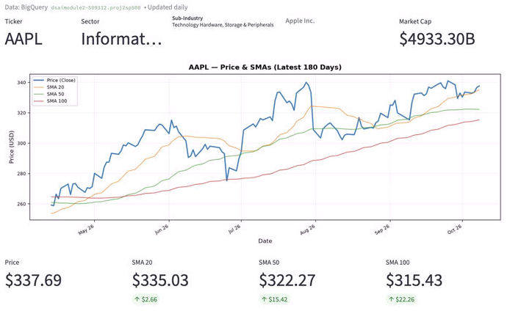
ANALYSIS 5 · PRICE MOMENTUM
Example 1: Stock on the up (AAPL)
Strong uptrend
Price > MA20 >MA50 >MA 100
In past week, price came down slightly to intersect MA20, but still comfortably above MA50 and MA100
Above-Market Compensation
Stock in healthy, powerful bull market

Slide 21
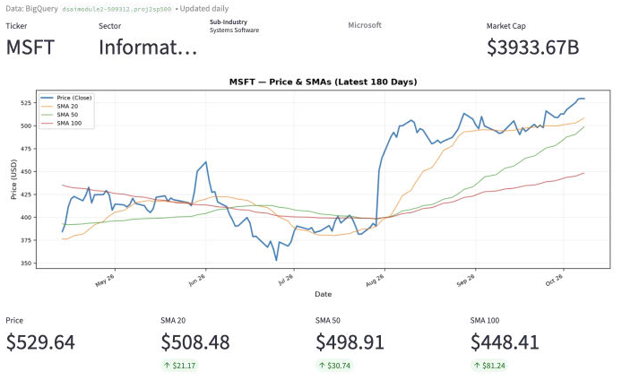
ANALYSIS 5 · PRICE
Example 2: Short-term pullback (MSFT)
..
Short-term pullback
MA20 > Price in Sep
.
Brief cooling off period before buyers stepped back in in early Oct

Slide 22
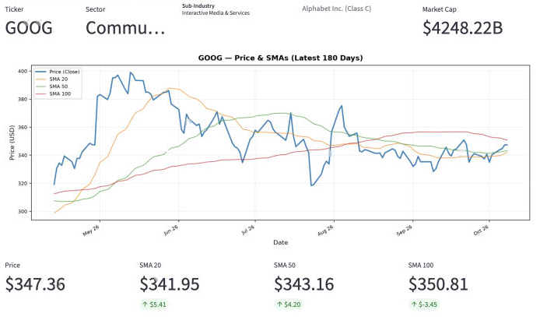
ANALYSIS 5 · PRICE
Example 3: Deeper pullback (GOOG)
..
June pullback
Price below MA20, MA50 after Q2 earnings which rattled the market on capex
Sep pullback working through long term resistance
MA100 crosses price
Some uptick in early Oct
Is the stock ready to resume broader uptrend?

Slide 23
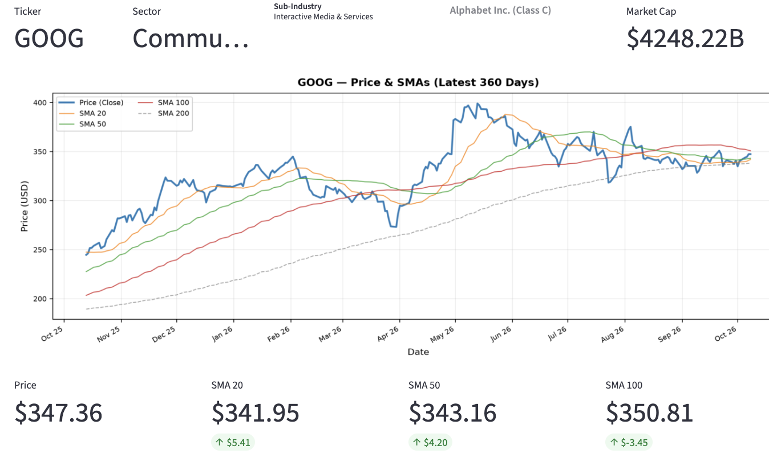
ANALYSIS 5 · PRICE
Example 3: Deeper pullback (GOOG) – zoom to past 360 days
..
GOOG still on long-term upward trend
Pullback since
May (Price slipped below MA20)
Jun (MA50)
Aug (MA100)

Slide 24
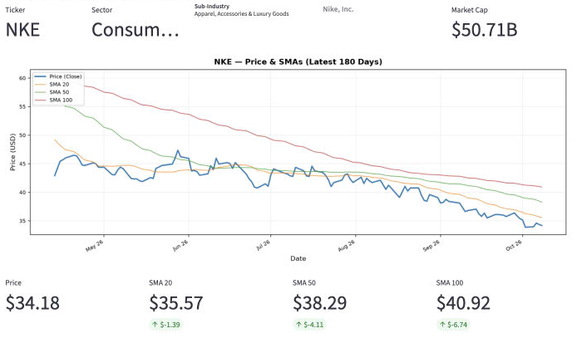
ANALYSIS 5 · PRICE
Example 4: Stock on structural downward trend
..
Price below all major MA
Price < MA20 < MA50 < MA100
.
Signals structural headwinds or fundamental business challenges

Slide 25
PROJECT SUMMARY
Summary of Engineering & Business Findings
1. Pipeline Reliability
2. Risk-Return Dynamic
3. Alpha Leadership
Multi-layer validation resolved upstream financial anomalies and ensured clean cloud data tables.
Sector returns must be assessed with volatility; tech delivered top returns with 2.3× risk.
NVDA demonstrated sustained risk-adjusted alpha (Sharpe > 1.3), outpacing peers across cycles.
Data Science Module · S&P 500 Project · Team 2
Thank You & Questions

