Slide 1
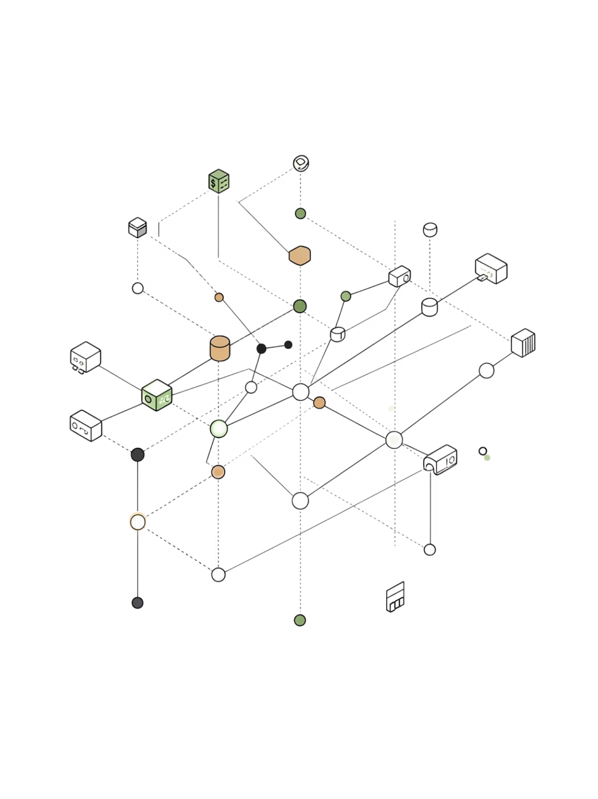
Parallel Evolutionary Portfolio Optimization
Architecture, Implementation & Results
A rigorous investigation of Island Model Genetic Algorithms applied to mean-variance portfolio optimization over 10+ years of NIFTY 50 equity data, leveraging two-level OpenMP parallelism to quantify scaling limits and topology trade-offs.
C++17 · OPENMP · GENETIC ALGORITHMS · PORTFOLIO THEORY

Slide 2

Introduction & Motivation
Portfolio optimization at scale is computationally demanding. Maximizing the Sharpe ratio under mean-variance constraints is a non-convex, NP-hard problem — gradient-based methods fail on rugged fitness landscapes with local optima. Genetic algorithms offer a natural fit, but their iterative, population-based nature demands significant compute for realistic datasets.
Computational Cost
Embarrassingly Parallel
Dataset Scale
Evaluating Sharpe ratios across large populations and generations requires millions of covariance matrix operations — a burden that grows quadratically with asset count.
GA fitness evaluation is inherently parallel: each individual's fitness is independent. This maps naturally to OpenMP task and data parallelism.
NIFTY 50 equities, 2,597 aligned trading days (Nov 2010 – Apr 2021), ~10.4 years. 20-stock portfolios with daily rebalancing weights.

Slide 3
Algorithm Architecture: Island Model GA
The Island Model Genetic Algorithm (IMGA) partitions the population into 4 independent subpopulations (islands), each evolving over 200 generations. Periodic migration exchanges elite individuals between islands, maintaining diversity while accelerating convergence toward high-Sharpe portfolios.
Island Configuration
Migration Topologies Compared
4 islands, each with 80 individuals
200 generations per island
Fitness: daily Sharpe ratio via covariance-based mean-variance
Selection: tournament selection with elitism
Crossover & mutation operators on weight vectors
Ring Topology
Star Topology
Each island exchanges migrants only with immediate neighbors. Low coordination overhead, preserves local search pressure, better cache locality.
All islands connect to a central hub. Global sorting introduces coordination cost but increases selection pressure and work distribution.

Slide 4
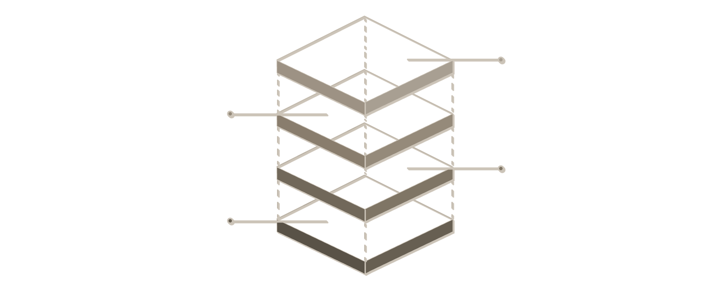
Parallelization Strategy
Two orthogonal levels of parallelism are exploited simultaneously. Task parallelism distributes islands across threads via #pragma omp parallel for, while data parallelism parallelizes fitness evaluation within each island's population. Dynamic thread partitioning balances inter-island and intra-island work.
Hybrid Execution
Combine #pragma omp parallel for and intra-island threads
Data Parallelism
80 individuals per island evaluated in parallel
Island Workers
Each island assigned to separate threads
Task Parallelism
4 islands run concurrently via OpenMP
The diagram illustrates the nested parallel structure: outer-level task parallelism distributes islands, while inner-level data parallelism accelerates fitness computation within each island.
Serial Bottlenecks
Thread Allocation
Migration synchronization between islands
Global best reduction (convergence tracking)
I/O and logging operations
Thread pool initialization overhead
omp_set_dynamic(0) for deterministic counts
Seed strategy: island_index + thread_count
5 trials per configuration for statistical rigor
Reproducible across runs and platforms

Slide 5
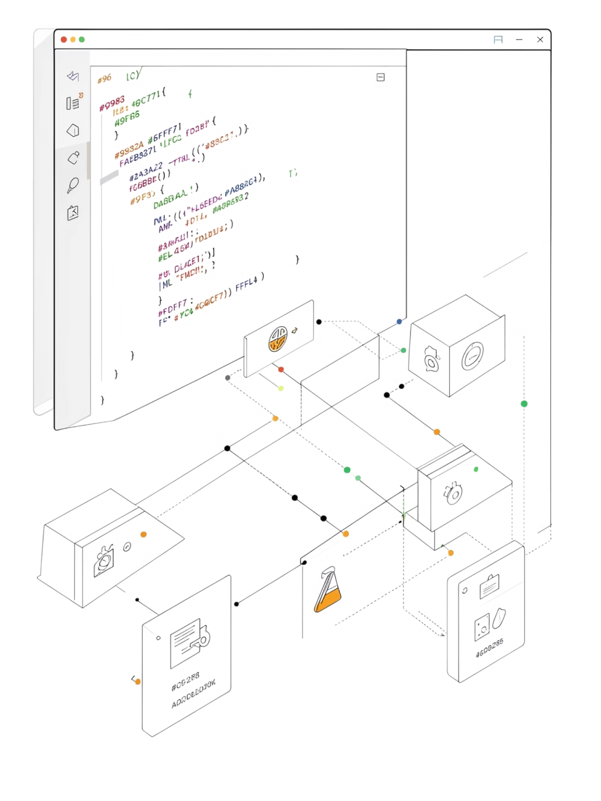



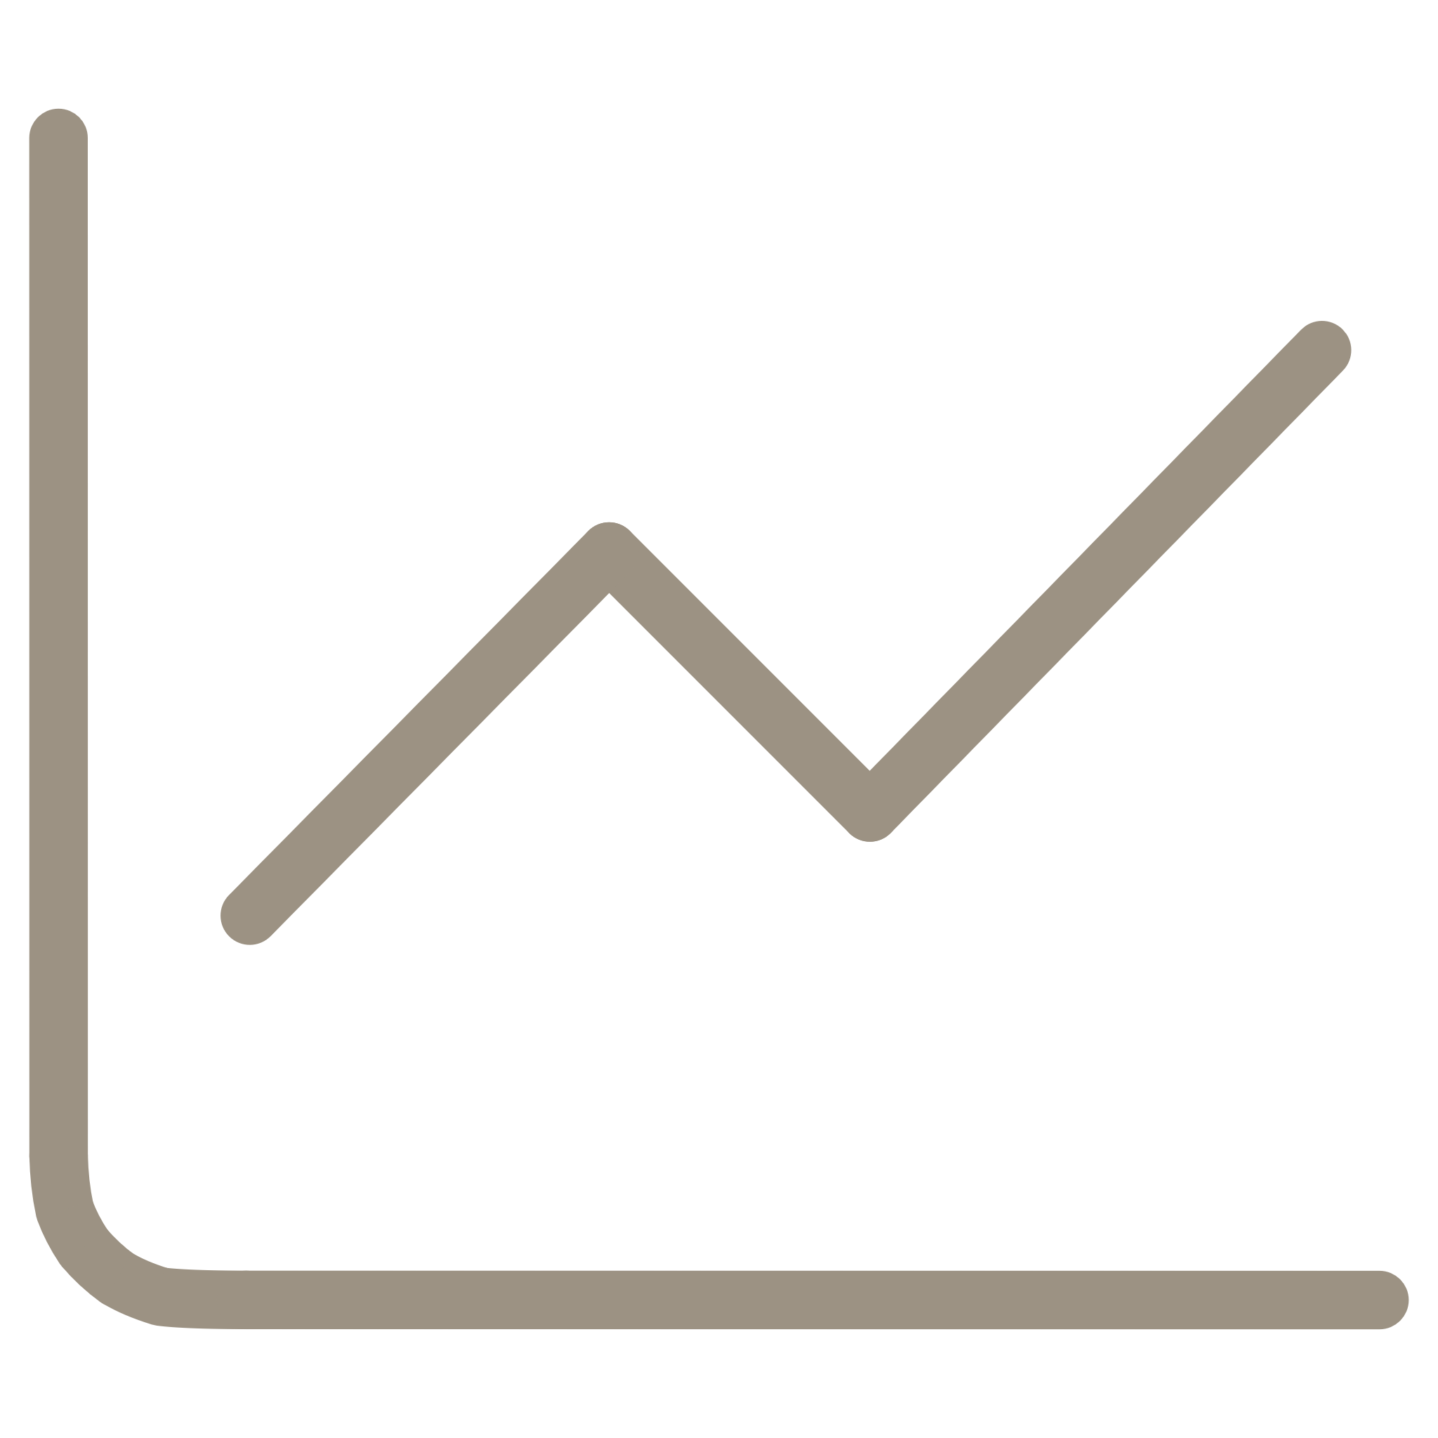
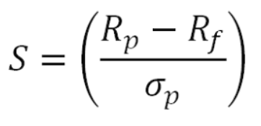
Implementation Details
Language & Build
C++17 with OpenMP 4.5+ for nested parallelism. CMake-based build system ensures portability. Strict compiler flags (-O3 -march=native) maximize instruction-level parallelism.
Dataset Profile
20 stocks selected from NIFTY 50 archive. 2,597 aligned trading days from 2010-11-05 to 2021-04-30 (~10.4 years). Daily returns used for Sharpe computation with full covariance matrix.
Population & Trials
80 individuals per island × 4 islands = 320 total. 5 independent trials per configuration. Deterministic seeding via island_index + thread_count guarantees repeatability.
Fitness Function
Daily Sharpe ratio with full covariance-based portfolio variance. No simplifying heuristics — realistic risk modeling with daily rebalancing weights.

Slide 6

Experimental Results: Performance Metrics
Mean ± standard deviation across 5 trials per configuration. Speedup and efficiency computed relative to single-thread baseline for each topology. Best Sharpe values are daily; annualized ≈ 1.064.
Topology
Threads
Best Sharpe (daily)
Runtime (s)
Speedup
Efficiency
Ring
1
0.06724 ± 0.00001
1.750 ± 0.219
1.00×
1.000
Ring
2
0.06725 ± 0.00001
2.168 ± 0.675
0.81×
0.404
Ring
4
0.06724 ± 0.00002
1.436 ± 0.088
1.22×
0.305
Ring
8
0.06724 ± 0.00001
1.248 ± 0.272
1.40×
0.175
Star
1
0.06725 ± 0.00001
1.844 ± 0.249
1.00×
1.000
Star
2
0.06727 ± 0.00001
1.795 ± 0.279
1.03×
0.513
Star
4
0.06727 ± 0.00001
1.488 ± 0.176
1.24×
0.310
Star
8
0.06726 ± 0.00001
1.562 ± 0.674
1.18×
0.148
Key observation: Both topologies converge to Sharpe ≈ 0.0672 (daily). Best speedup: 1.40× at 8 threads (Ring) and 1.24× at 4 threads (Star). Efficiency floor of 17–18% at 8 threads reflects serial bottlenecks in migration and I/O.

Slide 7
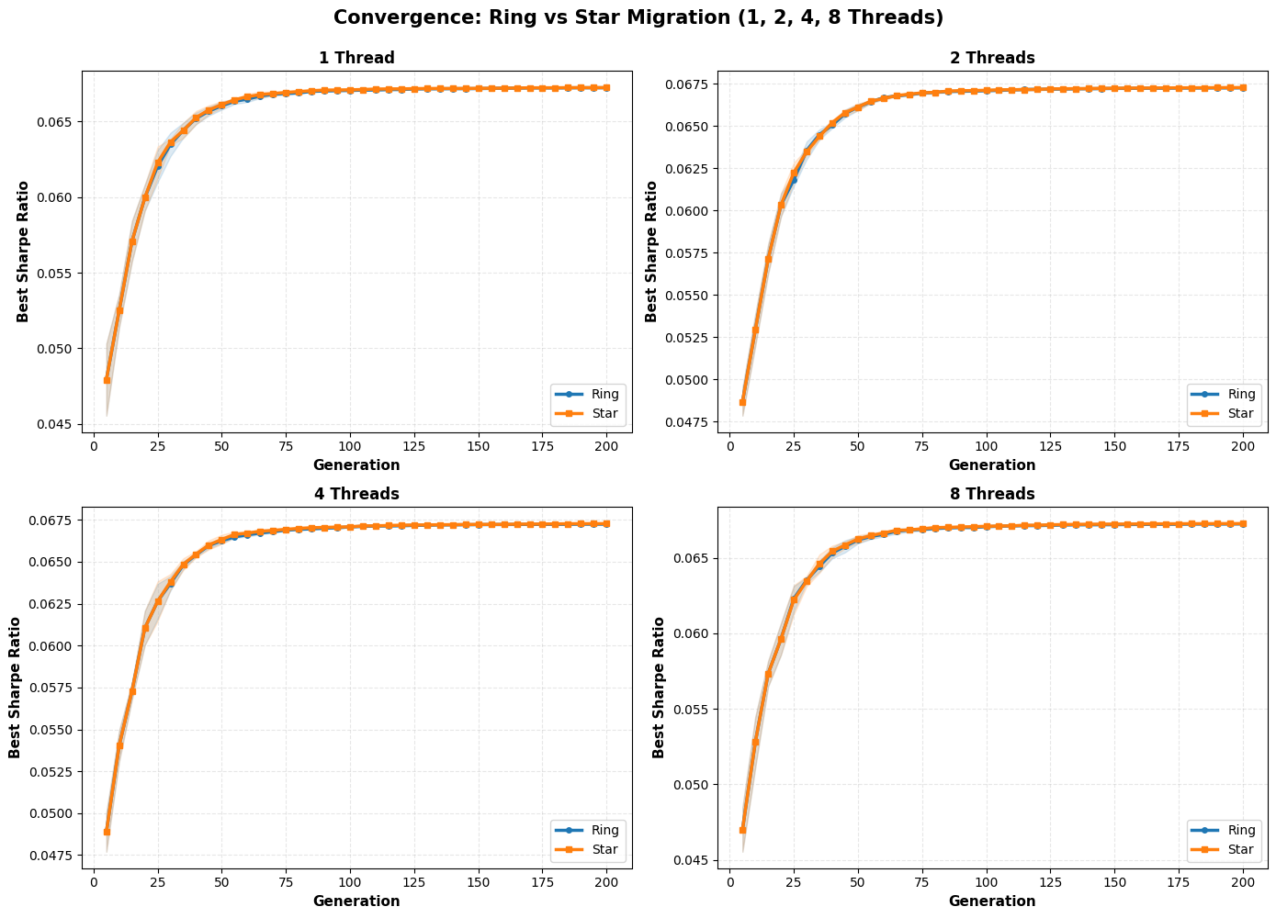
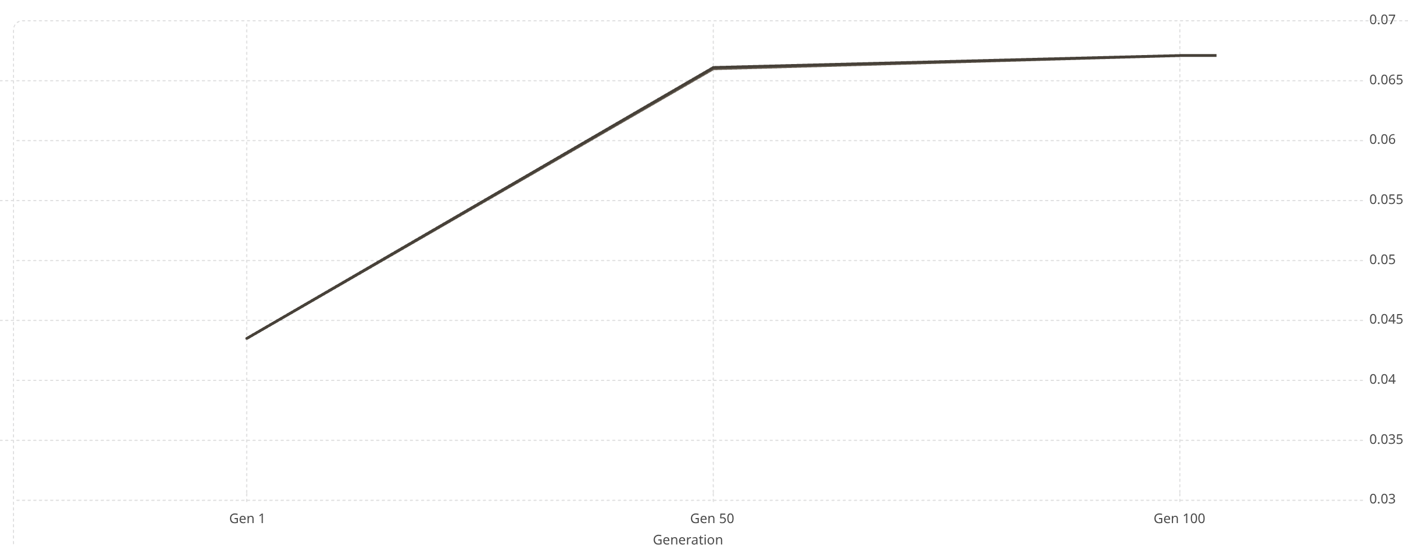
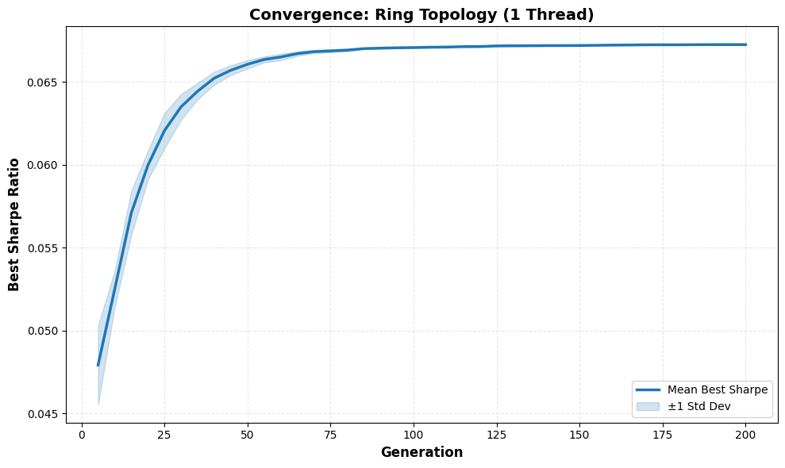
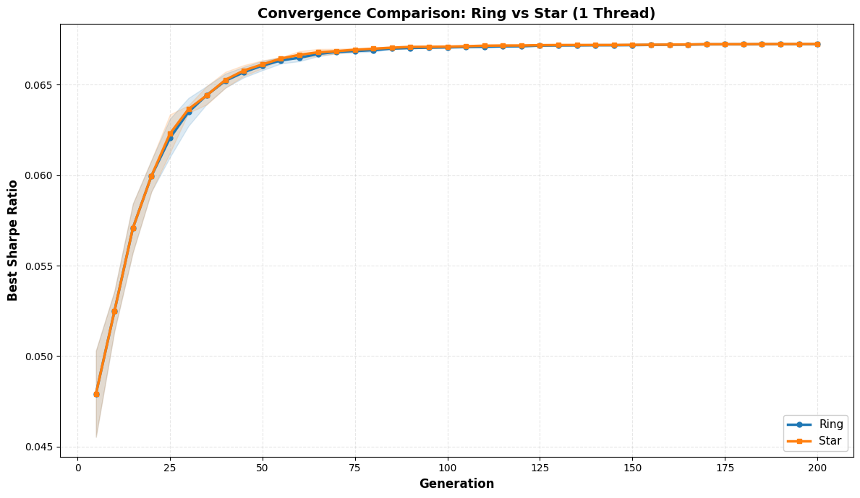
Convergence Analysis: Generation-wise Best Sharpe
Convergence curves track the best Sharpe ratio found across all islands at each generation. Both Ring and Star topologies exhibit smooth, reproducible convergence with negligible variance by generation 200 — confirming algorithmic stability across random seeds.
Star Topology
Ring Topology
0.0435
0.0661
0.0672
Gen 1 Mean Sharpe
Gen 50 Mean Sharpe
Gen 200 Final Sharpe
High initial variance (std ≈ 0.0018) reflects random population initialization.
Converging — std drops to ≈ 0.0003. Migration effects become visible.
Plateau reached — std ≈ 0.00001. Ring and Star curves nearly identical.

Slide 8

Performance Analysis: Why Speedup Plateaus at ~1.4×
Amdahl's Law governs the ceiling. With ~20–30% serial fraction (migration, sorting, I/O), even 8 threads cannot exceed ~1.4× speedup. The 2-thread Ring anomaly (slowdown) reveals stochastic GA variation at low thread counts.
Serial Bottleneck Breakdown
2-Thread Ring Anomaly
Migration & synchronization: ~10–15% of wall time
Global best reduction: convergence tracking serial
I/O & logging: file writes not parallelized
Thread overhead: context switching at low population-to-thread ratios
Memory bandwidth: contention evaluating ~320 individuals in parallel
Ring at 2 threads showed slowdown (speedup 0.81×, runtime 2.168s ± 0.675s). High variance stems from stochastic GA behavior — different seeds explore the fitness landscape differently, and some trials converge slower at low thread counts.
Mitigated by averaging 5 trials. Demonstrates why statistical rigor is essential in evolutionary computation experiments.
Ring vs. Star Trade-offs
Ring: 6.7% faster at 1 thread (lower coordination cost)
Star: 3% faster at 2 threads (better work distribution)
Both reach identical final Sharpe → topology does not affect solution quality

Slide 9
Key Takeaways
1
Two-Level OpenMP Parallelism Works
2
Topology Affects Speed, Not Quality
Task parallelism (islands) + data parallelism (fitness eval) effectively utilized multi-core hardware, but Amdahl's Law limits gains to ~1.4× at 8 threads given ~20–30% serial fraction.
Ring and Star converge to identical Sharpe ≈ 0.0672. Migration strategy influences convergence speed slightly but not final portfolio quality — both discover the same efficient frontier point.
3
Statistical Rigor Is Non-Negotiable
4
Robust Backtest Validation
5-trial averaging exposed the 2-thread Ring slowdown (high std). Deterministic seeding via island_index + thread_count ensures reproducibility across platforms and runs.
10+ year historical backtest with daily rebalancing weights on 2,597 trading days. Covariance-based fitness provides realistic risk modeling — discovered portfolio achieves ~67bps daily Sharpe (~1.06× annualized).

Slide 10
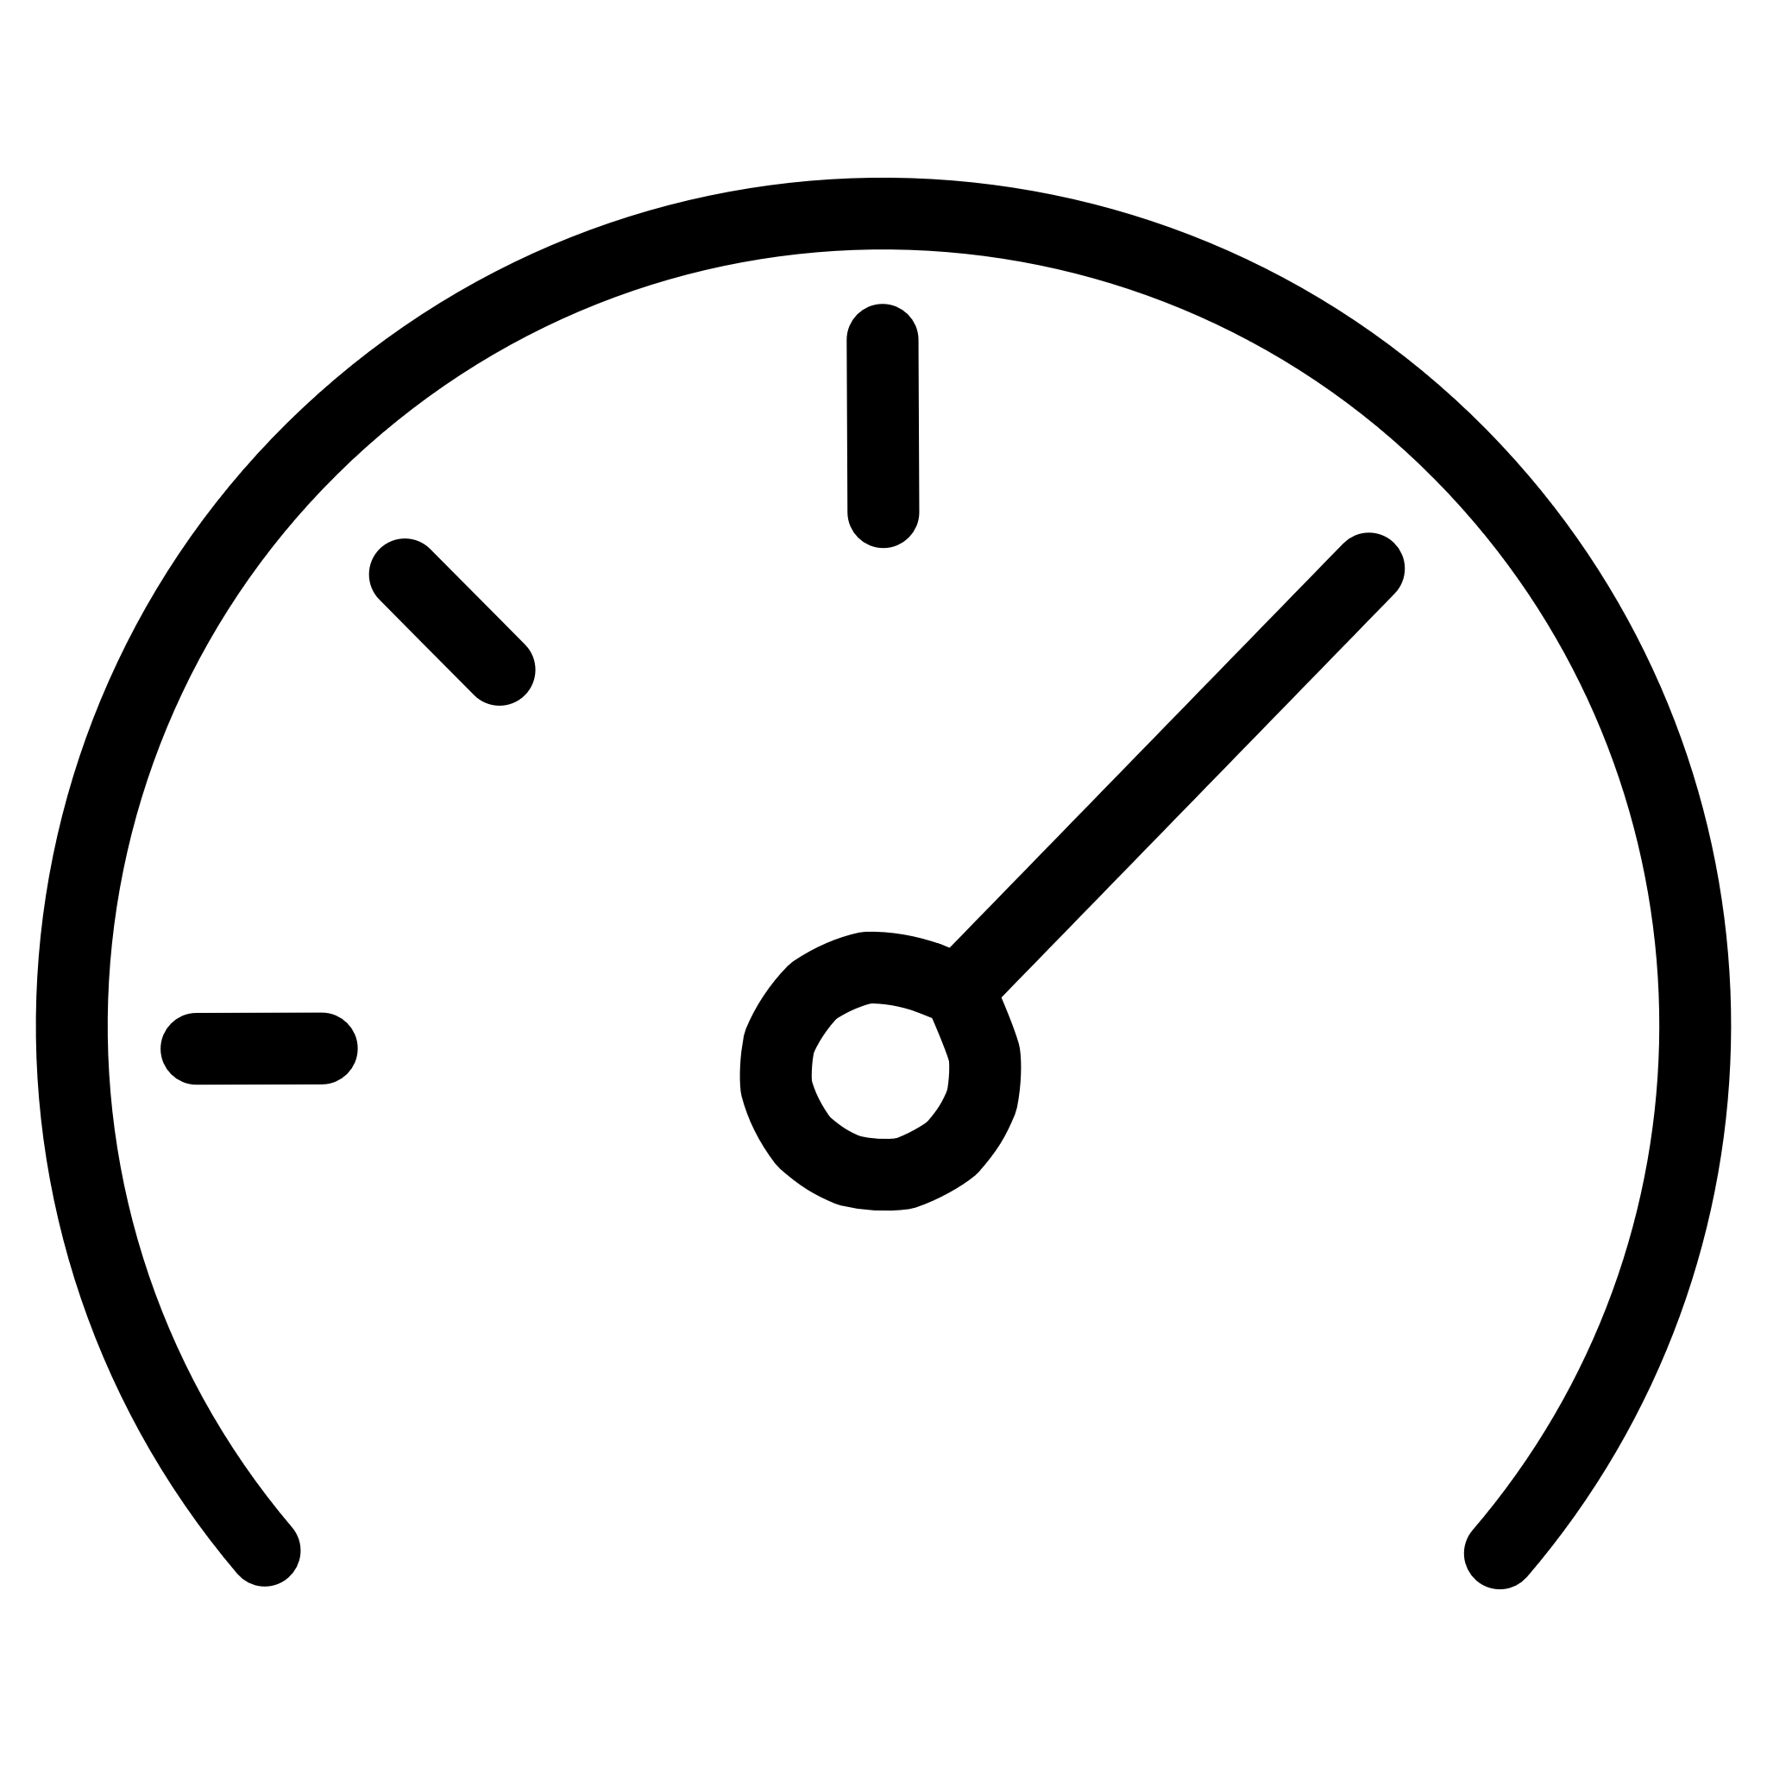




Technical Highlights & HPC Best Practices
This work demonstrates that rigorous HPC methodology — reproducible experiments, parallel metrics, and realistic workloads — yields trustworthy insights for evolutionary portfolio optimization.
Parallel Metrics
Covariance Fitness
Speedup and efficiency computed per HPC best practices. Efficiency floor of 17–18% at 8 threads quantifies the serial bottleneck precisely.
Full covariance-based mean-variance fitness — not diagonal approximations or simpler heuristics. Captures realistic cross-asset risk correlations.
Historical Backtest
Deterministic Reproducibility
10.4 years of NIFTY 50 data (2,597 trading days). Daily rebalancing weights tested against real market conditions including multiple volatility regimes.
omp_set_dynamic(0) ensures fixed thread counts. Seed strategy island_index + thread_count guarantees identical runs across platforms.
Efficient portfolio discovered: ~67bps daily Sharpe ratio (≈1.06× annualized) on a 20-stock NIFTY 50 portfolio — robust across 10+ years of market headwinds and validated through 5-trial statistical averaging.

