Slide 1
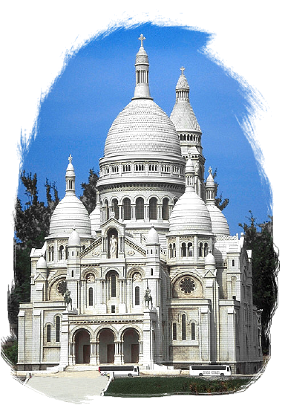
习题
上次考试各题型所占分数：
单选题：10分
填空题：10分
简答题：12分
关系代数运算：12分
SQL：30分
E-R图与转换：16分
模式分解：10分

Slide 2
Single Choice
The database system provides an abstract view of the data, this is achieved through several level of abstraction, among these levels, the (________) describes part of the logical structure of the database.
  Physical level
  Logical level
  View level
  Application level
C

Slide 3

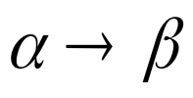
Single Choice
Witch one of the following is not true for schema normalization? (_________)
  In relational model, any legal relation schema must satisfies 1NF
  For any relation schema, there is always a lossless-join, dependency preserving decomposition into 3NFs
  Relations with only 3 attributes are automatically in BCNF
  If , then is a trivial functional dependency
C

Slide 4
Fill In the Following Blanks
Database system provides Data Definition Language(DDL) to specify database schema, and (__DML_____) to express database queries and updates.
Collection of operations that form a single logical unit of work in database system are called (_Transaction____).

Slide 5
Answer The Following Questions
Briefly describe the difference between database schema and database instance.
Briefly describe the difference between tables and views.

Slide 6
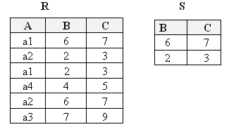
Relational Algebra
A
R4 = Π_{A} ( R ) — ( R ÷ S )
a₃
a₄

Slide 7

Compose SQL
Consider the database of a clinic described below (the primary keys are underlined):
  Patient (PatCode, Name, Age, Sex, Street, City, Occupation)
  Operation (OperCode, PatCode, DoctCode, OperDate,OperTime, Detail)
  Doctor (DoctCode, Name, Specialty, Age)
  Diagnosed_By (PatCode, DoctCode, DiagDate, DiagTime, Prescription)

Slide 8
Compose SQL
Define the relation schema Operation in SQL (indicates Primary Key and Foreign Key)
List all patients diagnosed or operated by doctor “smith”
Find all doctors who have diagnosed all patients who’s age are below 12.

Slide 9
1.
Define the relation schema Operation in SQL
Create Table Operation(
OperCode Char(30),
PatCode Char(15),
DocCode Char(15),
DiagDate Date,
DiagTime Time,
Detail VarChar(255),
Primary Key(OperCode),
Foreign Key(PatCode) References Patient,
Foreign Key(DocCode) References Doctor)

Slide 10
2.
List all patients diagnosed or operated by doctor “smith”
Using Union
(Select Patient.Name
From Doctor, Operation, Patient
Where Doctor.DocCode = Operation.DocCode
AND Operation.PatCode=Patient.PatCode
AND Doctor.Name=‘Smith’)
Union
(Select Patient.Name
From Doctor, Diagnosed_by, Patient
Where Doctor.DocCode = Diagnosed_by.DocCode
AND Diagnosed_by.PatCode=Patient.PatCode
AND Doctor.Name=‘Smith’)

Slide 11
2.
List all patients diagnosed or operated by doctor “smith”
Using Subquery
Select Patient.Name
From Patient
Where Exists(
Select *
From Doctor, Operation
Where Doctor.DocCode=Operation.DocCode
AND Doctor.Name=‘Smith’
AND Operation.PatCode=Patient.PatCode) OR
Exists(
Select *
From Doctor, Diagnosed_by
Where Doctor.DocCode=Diagnosed_by.DocCode
AND Doctor.Name=‘Smith’
AND Diagnosed_by.PatCode=Patient.PatCode)

Slide 12
3.
Find all doctors who have diagnosed all patients who’s age are below 12.
Using Subquery
Select Doctor.Name
From Doctor D
Where Not Exists(
Select *
From Patient P
Where Age < 12 AND
Not Exists(
Select *
From Diagnosed_by
Where Diagnosed_by.DocCode=D.DocCode
AND Diagnosed_by.PatCode=P.PatCode))

Slide 13
3.
Find all doctors who have diagnosed all patients who’s age are below 12.
Using Set Operations
Select Doctor.Name
From Doctor D
Where Not Exists(
(Select Patient.PatCode
From Patient
Where Patient.Age < 12)
EXCEPT
(Select Diagnosed_by.PatCode
From Diagnosed_by
Where Diagnosed_by.DocCode=D.DocCode)
)

Slide 14
E-R Model
The Chinese Film Institute collects statistics about movies and moviegoers in china. These statistics is stored in a database.
This database has the following entity sets
  -Movies, with attributes movie_id, movie_name, production_year, country.
  -Movie Theaters, with attributes theater_id, thearter_name, city.
  -Screen, with attributes screen_id, screen_name. It is a weak entity set, its identifying entity set is Movie Theaters, its discriminator is screen_id. (movie theater contains one or more screens, where the movies are shown.)

Slide 15
E-R Model
In addition there are the following relationship sets:
  -In, The identifying relationship set between Screen and Movie Theaters.
  -Shows, The movies are showed on different screens, and we need to store data about the movie shows that have occurred: which movie that was shown, on which screen, at what time, and how many visitors there were.

Slide 16
E-R Model
Design an Entity-Relationship diagram with the given entity sets and relationship sets.
Translate the E-R diagram into relation schemas.

Slide 17
movie_name
production_year
screen_id
screen_name
movie_id
country
Show
Screen
Movie
1.
Date
visitor_number
In
city
Theater
theater_id
theater_name
Chapter7 Relational Database Design

Slide 18
2.
Movie(Movie_id, Movie_name, production_year,country)
Theater(theater_id, theater_name, city)
Screen(theater_id, screen_id, screen_name)
Show(movie_id, theater_id, screen_id, date, visitor_number)

Slide 19
Schema Normalization
Given is the following set of functional dependencies F for a relation schema R:
R={A, B, C, D, E, G} F={E→D, C→B, CE→G, B→A}
Attribute set (C, E) is the only candidate key of R.
Decide whether relation schema R is in BCNF. If it is not, describe why
Decompose relations R, if necessary, into a collection of relations that are in BCNF. Make sure to indicate which dependency you apply to each decomposition.

Slide 20
R={A, B, C, D, E, G} F={E→D, C→B, CE→G, B→A}
1.
R is Not in BCNF
∵E→D is not a trivial functional dependency,
and E is not a super key
2.
R
E→D: (E,D), (A,B,C,E,G)
C→B: (C,B), (A,C,E,G)
C→B,B→A ∴C→A: (C,A), (C,E,G)
Final Result: (E,D),(C,B),(C,A),(C,E,G)

