Slide 1
Chapter 15: Transactions

Slide 2
Chapter 15: Transactions
Transaction Concept
Transaction State
Concurrent Executions
Serializability
Recoverability
Implementation of Isolation
Transaction Definition in SQL
Testing for Serializability.

Slide 3
Transaction Concept
A transaction is a unit of program execution that accesses and possibly updates various data items.
E.g. transaction to transfer $50 from account A to account B:
  1. read(A)
  2. A := A – 50
  3. write(A)
  4. read(B)
  5. B := B + 50
  6. write(B)
Two main issues to deal with:
  Failures of various kinds, such as hardware failures and system crashes
  Concurrent execution of multiple transactions
Notes:
事务是访问并可能更新各种数据项的程序执行单元。
例如，将50美元从账户A转移到账户B的交易：
1.读（a）
2.a：=a–50
3.写（a）
4.阅读（b）
5.b：=b+50
6.写（b）
要处理的两个主要问题：
各种故障，如硬件故障和系统崩溃
同时执行多个事务

Slide 4
Example of Fund Transfer
Transaction to transfer $50 from account A to account B:
  1. read(A)
  2. A := A – 50
  3. write(A)
  4. read(B)
  5. B := B + 50
  6. write(B)
Atomicity requirement
  if the transaction fails after step 3 and before step 6, money will be “lost” leading to an inconsistent database state
    Failure could be due to software or hardware
  the system should ensure that updates of a partially executed transaction are not reflected in the database
Durability requirement — once the user has been notified that the transaction has completed (i.e., the transfer of the $50 has taken place), the updates to the database by the transaction must persist even if there are software or hardware failures.
Notes:
将50美元从账户A转移到账户B的交易：
1.读（a）
2.a：=a–50
3.写（a）
4.阅读（b）
5.b：=b+50
6.写（b）
原子性要求
如果事务在第3步之后和第6步之前失败，金钱将“丢失”，导致数据库状态不一致。
故障可能是由软件或硬件引起的。
系统应确保部分执行事务的更新不会反映在数据库中。
耐久性要求-一旦用户收到交易完成的通知（即发生50美元的转移），即使存在软件或硬件故障，交易对数据库的更新也必须持续。

Slide 5
Example of Fund Transfer (Cont.)
Consistency requirement in above example:
  the sum of A and B is unchanged by the execution of the transaction
In general, consistency requirements include
    Explicitly specified integrity constraints such as primary keys and foreign keys
    Implicit integrity constraints
      e.g. sum of balances of all accounts, minus sum of loan amounts must equal value of cash-in-hand
  A transaction must see a consistent database.
  During transaction execution the database may be temporarily inconsistent.
  When the transaction completes successfully the database must be consistent
    Erroneous transaction logic can lead to inconsistency
Notes:
上述示例中的一致性要求：
A和B的总和在交易执行时不变。
一般来说，一致性要求包括
显式指定的完整性约束，如主键和外键
隐式完整性约束
例如，所有账户的余额之和减去贷款金额之和必须等于手头现金的价值。
事务必须看到一致的数据库。
在事务执行期间，数据库可能暂时不一致。
当事务成功完成时，数据库必须一致
错误的事务逻辑可能导致不一致

Slide 6
Example of Fund Transfer (Cont.)
Isolation requirement — if between steps 3 and 6, another transaction T2 is allowed to access the partially updated database, it will see an inconsistent database (the sum A + B will be less than it should be).
T1 T2
  1. read(A)
  2. A := A – 50
  3. write(A)
  read(A), read(B), print(A+B)
  4. read(B)
  5. B := B + 50
  6. write(B
Isolation can be ensured trivially by running transactions serially
  that is, one after the other.
However, executing multiple transactions concurrently has significant benefits, as we will see later.
Notes:
隔离要求-如果在步骤3和6之间，允许另一个事务t2访问部分更新的数据库，它将看到不一致的数据库（A+B的和将小于它应该的值）。T1 t2
1.读（a）
2.a：=a–50
3.写（a）读（a），读（b），打印（a+b）
4.阅读（b）
5.b：=b+50
6.写（b
可以通过连续运行事务来确保隔离性。
也就是说，一个接一个。
但是，正如我们稍后将看到的，同时执行多个事务具有显著的好处。

Slide 7
ACID Properties
A transaction is a unit of program execution that accesses and possibly updates various data items.To preserve the integrity of data the database system must ensure:
Atomicity. Either all operations of the transaction are properly reflected in the database or none are.
Consistency. Execution of a transaction in isolation preserves the consistency of the database.
Isolation. Although multiple transactions may execute concurrently, each transaction must be unaware of other concurrently executing transactions. Intermediate transaction results must be hidden from other concurrently executed transactions.
  That is, for every pair of transactions T_{i} and T_{j}, it appears to T_{i} that either T_{j}, finished execution before T_{i} started, or T_{j} started execution after T_{i} finished.
Durability. After a transaction completes successfully, the changes it has made to the database persist, even if there are system failures.
Notes:
事务是访问并可能更新各种数据项的程序执行单元。为了保持数据的完整性，数据库系统必须确保：
原子性。要么事务的所有操作都正确地反映在数据库中，要么没有。
一致性。单独执行事务可以保持数据库的一致性。
隔离。尽管多个事务可能同时执行，但每个事务必须不知道其他同时执行的事务。中间交易结果必须对其他同时执行的交易进行隐藏。
也就是说，对于每对事务ti和tj，在ti看来，要么tj在ti开始之前完成了执行，要么tj在ti完成之后开始执行。
耐久性。事务成功完成后，它对数据库所做的更改将持续存在，即使存在系统故障。

Slide 8
Transaction State
Active – the initial state; the transaction stays in this state while it is executing
Partially committed – after the final statement has been executed.
Failed -- after the discovery that normal execution can no longer proceed.
Aborted – after the transaction has been rolled back and the database restored to its state prior to the start of the transaction. Two options after it has been aborted:
  restart the transaction
    can be done only if no internal logical error
  kill the transaction
Committed – after successful completion.
Notes:
active–初始状态；事务在执行时保持此状态
部分承诺-在执行最终报表之后。
失败——在发现无法继续正常执行之后。
中止–在事务回滚并将数据库还原到事务开始之前的状态之后。中止后有两个选项：
重新启动事务
只有在没有内部逻辑错误时才能执行
终止交易
承诺-成功完成后。

Slide 9

Transaction State (Cont.)

Slide 10

Implementation of Atomicity and Durability
The recovery-management component of a database system implements the support for atomicity and durability.
E.g. the shadow-database scheme:
  all updates are made on a shadow copy of the database
    db_pointer is made to point to the updated shadow copy after
      the transaction reaches partial commit and
      all updated pages have been flushed to disk.
Notes:
数据库系统的恢复管理组件实现了对原子性和持久性的支持。
例如，影子数据库方案：
所有更新都是在数据库的卷影副本上进行的
数据库指针指向更新后的卷影副本
事务达到部分提交，并且
所有更新的页面都已刷新到磁盘。

Slide 11
Implementation of Atomicity and Durability (Cont.)
db_pointer always points to the current consistent copy of the database.
  In case transaction fails, old consistent copy pointed to by db_pointer can be used, and the shadow copy can be deleted.
The shadow-database scheme:
  Assumes that only one transaction is active at a time.
  Assumes disks do not fail
  Useful for text editors, but
    extremely inefficient for large databases (why?)
      Variant called shadow paging reduces copying of data, but is still not practical for large databases
  Does not handle concurrent transactions
Will study better schemes in Chapter 17.
Notes:
db_指针始终指向数据库的当前一致副本。
如果事务失败，可以使用db_指针指向的旧一致副本，并可以删除卷影副本。
影子数据库方案：
假设一次只有一个事务处于活动状态。
假设磁盘没有故障
对文本编辑器有用，但
大型数据库效率极低（为什么？）
称为影子分页的变体减少了数据的复制，但对于大型数据库仍然不实用
不处理并发事务
将在第17章研究更好的方案。

Slide 12
Concurrent Executions
Multiple transactions are allowed to run concurrently in the system. Advantages are:
  increased processor and disk utilization, leading to better transaction throughput
    E.g. one transaction can be using the CPU while another is reading from or writing to the disk
  reduced average response time for transactions: short transactions need not wait behind long ones.
Concurrency control schemes – mechanisms to achieve isolation
  that is, to control the interaction among the concurrent transactions in order to prevent them from destroying the consistency of the database
    Will study in Chapter 16, after studying notion of correctness of concurrent executions.
Notes:
允许多个事务在系统中并发运行。优点是：
提高处理器和磁盘利用率，从而提高事务吞吐量
例如，一个事务可以使用CPU，而另一个事务正在从磁盘读取或写入磁盘
减少事务的平均响应时间：短事务不需要在长事务之后等待。
并发控制方案——实现隔离的机制
也就是说，控制并发事务之间的交互，以防止它们破坏数据库的一致性。
在研究了并发执行的正确性概念之后，将在第16章进行研究。

Slide 13
Schedules
Schedule – a sequences of instructions that specify the chronological order in which instructions of concurrent transactions are executed
  a schedule for a set of transactions must consist of all instructions of those transactions
  must preserve the order in which the instructions appear in each individual transaction.
A transaction that successfully completes its execution will have a commit instructions as the last statement
A transaction that fails to successfully complete its execution will have an abort instruction as the last statement
Notes:
调度—一系列指令，指定执行并发事务指令的时间顺序。
一组事务的时间表必须包含这些事务的所有指令
必须保留指令在每个单独事务中出现的顺序。
成功完成其执行的事务将有一个COMMIT指令作为最后一条语句。
未能成功完成其执行的事务将有一个abort指令作为最后一条语句。

Slide 14

Schedule 1
Let T₁ transfer $50 from A to B, and T₂ transfer 10% of the balance from A to B.
A serial schedule in which T₁ is followed by T₂ :

Slide 15

Schedule 2
A serial schedule where T2 is followed by T1

Slide 16

Schedule 3
Let T₁ and T₂ be the transactions defined previously. The following schedule is not a serial schedule, but it is equivalent to Schedule 1.
In Schedules 1, 2 and 3, the sum A + B is preserved.

Slide 17

Schedule 4
The following concurrent schedule does not preserve the value of (A + B ).

Slide 18
Serializability
Basic Assumption – Each transaction preserves database consistency.
Thus serial execution of a set of transactions preserves database consistency.
A (possibly concurrent) schedule is serializable if it is equivalent to a serial schedule. Different forms of schedule equivalence give rise to the notions of:
  1. conflict serializability
  2. view serializability*
Simplified view of transactions
  We ignore operations other than read and write instructions
  We assume that transactions may perform arbitrary computations on data in local buffers in between reads and writes.
  Our simplified schedules consist of only read and write instructions.
Notes:
基本假设——每个事务都保持数据库的一致性。
因此，一组事务的串行执行保持了数据库的一致性。
如果一个（可能是并发的）调度等价于一个串行调度，那么它是可序列化的。不同形式的时间表等效产生了以下概念：
1.冲突可序列化
2.视图可序列化*
简化的交易视图
我们忽略了读写指令以外的操作
我们假设事务可以在读写之间对本地缓冲区中的数据执行任意计算。
我们简化的时间表只包含读写指令。

Slide 19
Conflicting Instructions
Instructions l_{i} and l_{j} of transactions T_{i} and T_{j} respectively, conflict if and only if there exists some item Q accessed by both l_{i} and l_{j}, and at least one of these instructions wrote Q.
1. l_{i} = read(Q), l_{j} = read(Q). l_{i} and l_{j} don’t conflict.
2. l_{i} = read(Q), l_{j} = write(Q). They conflict.
3. l_{i} = write(Q), l_{j} = read(Q). They conflict
4. l_{i} = write(Q), l_{j} = write(Q). They conflict
Intuitively, a conflict between l_{i} and l_{j} forces a (logical) temporal order between them.
  If l_{i} and l_{j} are consecutive in a schedule and they do not conflict, their results would remain the same even if they had been interchanged in the schedule.

Slide 20
Conflict Serializability
If a schedule S can be transformed into a schedule S´ by a series of swaps of non-conflicting instructions, we say that S and S´ are conflict equivalent.
We say that a schedule S is conflict serializable if it is conflict equivalent to a serial schedule

Slide 21


Conflict Serializability (Cont.)
Schedule 3 can be transformed into Schedule 6, a serial schedule where T₂ follows T₁, by series of swaps of non-conflicting instructions.
  Therefore Schedule 3 is conflict serializable.
Schedule 3
Schedule 6

Slide 22

Conflict Serializability (Cont.)
Example of a schedule that is not conflict serializable:
We are unable to swap instructions in the above schedule to obtain either the serial schedule < T₃, T₄ >, or the serial schedule < T₄, T₃ >.

Slide 23
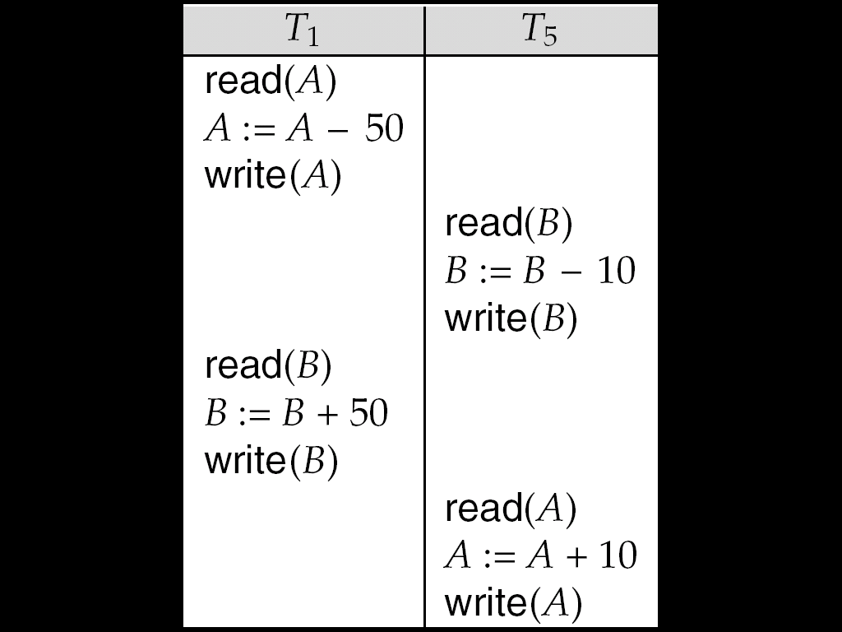
Other Notions of Serializability
The schedule below produces same outcome as the serial schedule < T₁, T₅ >, yet is not conflict equivalent or view equivalent to it.
Determining such equivalence requires analysis of operations other than read and write.

Slide 24

Testing for Serializability
Consider some schedule of a set of transactions T₁, T₂, ..., T_{n}
Precedence graph — a direct graph where the vertices are the transactions (names).
We draw an arc from T_{i} to T_{j} if the two transaction conflict, and T_{i} accessed the data item on which the conflict arose earlier.
We may label the arc by the item that was accessed.
Example 1
x
y

Slide 25
Example Schedule (Schedule A) + Precedence Graph
T₁ T₂ T₃ T₄ T₅
read(X)
read(Y)
read(Z)
read(V)
read(W)
read(W)
read(Y)
write(Y)
write(Z)
read(U)
read(Y)
write(Y)
read(Z)
write(Z)
read(U)
write(U)
T₁
T₂
T₄
T₃
T₅

Slide 26

Test for Conflict Serializability
A schedule is conflict serializable if and only if its precedence graph is acyclic.
Cycle-detection algorithms exist which take order n² time, where n is the number of vertices in the graph.
  (Better algorithms take order n + e where e is the number of edges.)
If precedence graph is acyclic, the serializability order can be obtained by a topological sorting of the graph.
  This is a linear order consistent with the partial order of the graph.
  For example, a serializability order for Schedule A would be
  T₅ → T₁ → T₃ → T₂ → T₄
    Are there others?

Slide 27
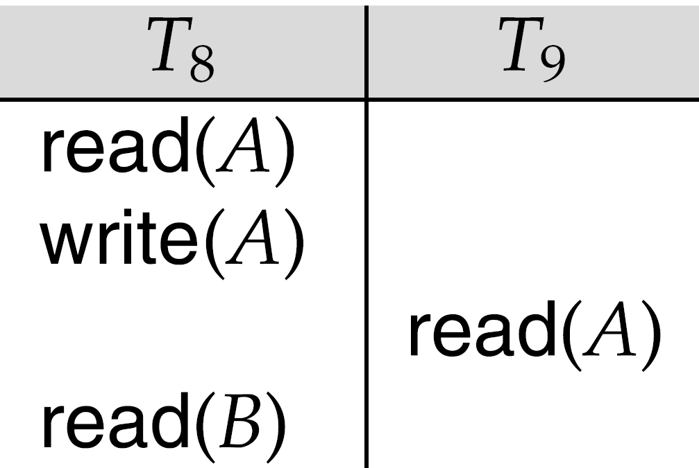
Recoverable Schedules
Need to address the effect of transaction failures on concurrently
running transactions.
Recoverable schedule — if a transaction T_{j} reads a data item previously written by a transaction T_{i} , then the commit operation of T_{i} appears before the commit operation of T_{j}.
The following schedule (Schedule 11) is not recoverable if T₉ commits immediately after the read
If T₈ should abort, T₉ would have read (and possibly shown to the user) an inconsistent database state. Hence, database must ensure that schedules are recoverable.

Slide 28

Cascading Rollbacks
Cascading rollback – a single transaction failure leads to a series of transaction rollbacks. Consider the following schedule where none of the transactions has yet committed (so the schedule is recoverable)
If T₁₀ fails, T₁₁ and T₁₂ must also be rolled back.
Can lead to the undoing of a significant amount of work

Slide 29
Cascadeless Schedules
Cascadeless schedules — cascading rollbacks cannot occur; for each pair of transactions T_{i} and T_{j} such that T_{j} reads a data item previously written by T_{i}, the commit operation of T_{i} appears before the read operation of T_{j}.
Every cascadeless schedule is also recoverable
It is desirable to restrict the schedules to those that are cascadeless

Slide 30
Concurrency Control
A database must provide a mechanism that will ensure that all possible schedules are
  either conflict or view serializable, and
  are recoverable and preferably cascadeless
A policy in which only one transaction can execute at a time generates serial schedules, but provides a poor degree of concurrency
Testing a schedule for serializability after it has executed is a little too late!
Goal – to develop concurrency control protocols that will assure serializability.

Slide 31
Concurrency Control vs. Serializability Tests
Concurrency-control protocols allow concurrent schedules, but ensure that the schedules are conflict/view serializable, and are recoverable and cascadeless .
Concurrency control protocols generally do not examine the precedence graph as it is being created
  Instead a protocol imposes a discipline that avoids nonseralizable schedules.
  We study such protocols in Chapter 16.
Different concurrency control protocols provide different tradeoffs between the amount of concurrency they allow and the amount of overhead that they incur.
Tests for serializability help us understand why a concurrency control protocol is correct.

Slide 32
Weak Levels of Consistency
Some applications are willing to live with weak levels of consistency, allowing schedules that are not serializable
  E.g. a read-only transaction that wants to get an approximate total balance of all accounts
  E.g. database statistics computed for query optimization can be approximate (why?)
  Such transactions need not be serializable with respect to other transactions
Tradeoff accuracy for performance

Slide 33
Levels of Consistency in SQL-92
Serializable — default
Repeatable read — only committed records to be read, repeated reads of same record must return same value. However, a transaction may not be serializable – it may find some records inserted by a transaction but not find others.
Read committed — only committed records can be read, but successive reads of record may return different (but committed) values.
Read uncommitted — even uncommitted records may be read.
Warning: some database systems do not ensure serializable schedules by default
  E.g. Oracle and PostgreSQL by default support a level of consistency called snapshot isolation (not part of the SQL standard)

Slide 34
Transaction Definition in SQL
Data manipulation language must include a construct for specifying the set of actions that comprise a transaction.
In SQL, a transaction begins implicitly.
A transaction in SQL ends by:
  Commit work commits current transaction and begins a new one.
  Rollback work causes current transaction to abort.
In almost all database systems, by default, every SQL statement also commits implicitly if it executes successfully
  Implicit commit can be turned off by a database directive
    E.g. in JDBC, connection.setAutoCommit(false);

Slide 35
End of Chapter

