Slide 1
Software Engineering
Northeastern University
Software College
Wei Zhang
zhangwei@swc.neu.edu.cn

Slide 2
期末复习-UML总结自学部分
UML
-SELF STUDY

Slide 3
UML Is Not a Methodology
UML is a notation, not a methodology
  It can be used in conjunction with any methodology
UML has become a world standard
  Every professional today needs to know UML
Notes:
UML是一种符号，而不是一种方法论。
它可以与任何方法结合使用
UML已成为世界标准
今天的每个专业人员都需要了解UML

Slide 4
UML Is Not a Methodology (contd)
UML is a language
The small subset of UML presented in Chapters 7, 11, 13, and 14 is adequate for the purposes of this book
The larger subset of UML presented in this chapter is adequate for the development and maintenance of most software products
Notes:
UML是一种语言
第7章、第11章、第13章和第14章中介绍的UML的小子集对于本书来说是足够的。
本章中给出的UML的较大子集足以开发和维护大多数软件产品。

Slide 5
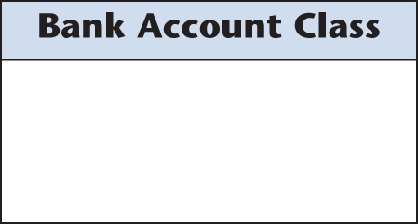
17.2 Class Diagrams
A class diagram depicts classes and their interrelationships
Here is the simplest possible class diagram
Notes:
类图描述了类及其相互关系。
这是最简单的类图

Slide 6
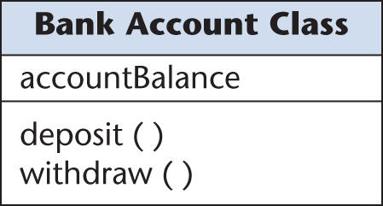
Class Diagrams (contd)
Class diagram showing more details of Bank Account Class
Add as many details as appropriate for the current iteration
Figure 17.2
Notes:
显示银行帐户类详细信息的类图
为当前迭代添加尽可能多的详细信息

Slide 7
Class Diagrams: Notation (contd)
objects
Example:
  bank account : Bank Account Class
bank account is an object, an instance of a class Bank Account Class
  The underlining denotes an object
  The colon denotes “an instance of”
  The boldface and initial upper case letters in Bank Account Class denote that this is a class
Notes:
物体
示例：
银行账户：银行账户类别
银行帐户是一个对象，一个类银行帐户类的实例
下划线表示对象
冒号表示“的实例”
银行账户类中的粗体和大写字母表示这是一个类。

Slide 8
Class Diagrams: Notation (contd)
UML allows a shorter notation when there is no ambiguity
  bank account
Notes:
特指一个对象
UML允许在没有歧义的情况下使用较短的表示法。
银行账户

Slide 9
Class Diagrams: Notation (contd)
The UML notation for modeling the concept of an arbitrary bank account is
  : Bank Account Class
The colon means “an instance of,” so
  : Bank Account Class
means
  “an instance of class Bank Account Class”
This notation has been used in the interaction diagrams of Chapter 12
Notes:
泛指一个对象

Slide 10
Class Diagrams: Visibility Prefixes (contd)
UML visibility prefixes (used for information hiding)
  Prefix + indicates that an attribute or operation is public
    Visible everywhere
  Prefix – denotes that the attribute or operation is private
    Visible only in the class in which it is defined
  Prefix # denotes that the attribute or operation is protected
    Visible either within the class in which it is defined or within subclasses of that class

Slide 11
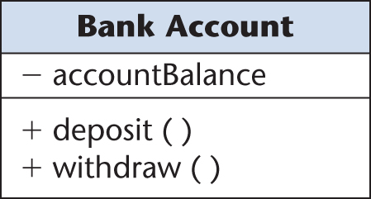
Class Diagrams: Visibility Prefixes (contd)
Example:
  Class diagram with visibility prefixes added
  Attribute accountBalance is visible only within the Bank Account Class
  Operations deposit and withdraw are accessible from anywhere within the software product
Figure 17.3

Slide 12
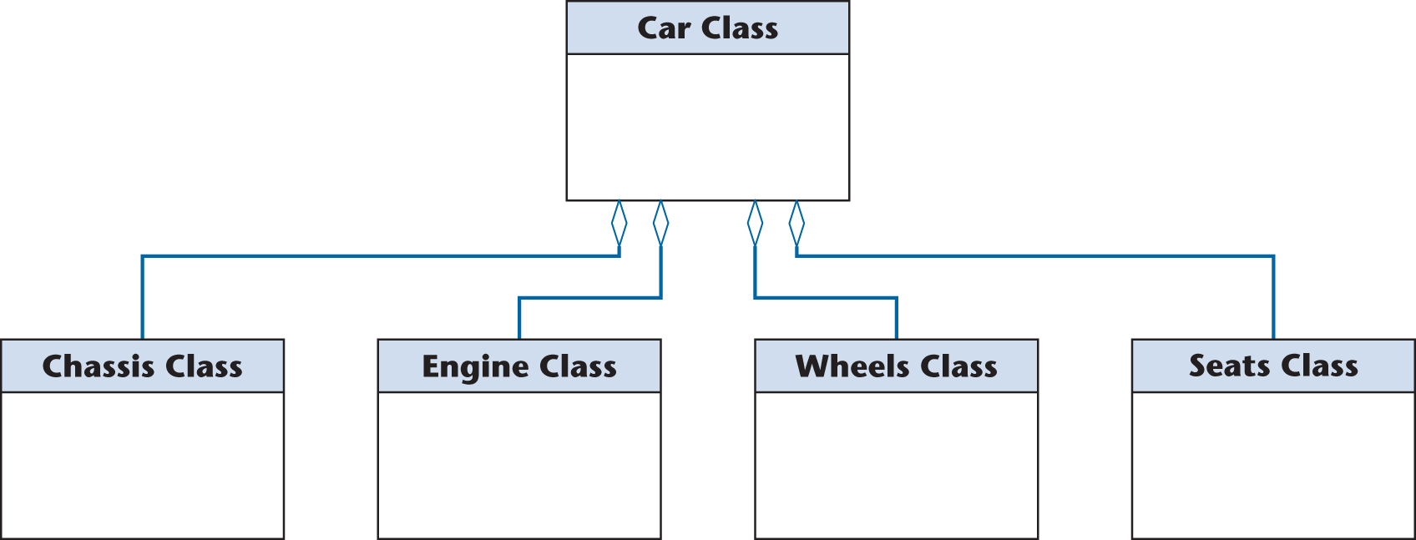
17.2.1 Aggregation
Example: “A car consists of a chassis, an engine, wheels, and seats”
Figure 17.4
Notes:
聚合
Chassis 车架

Slide 13
Aggregation (contd)
The open diamonds denote aggregation
  Aggregation is the UML term for the part–whole relationship
The diamond is placed at the “whole” (car) end, not the “part” (chassis, engine, wheels, or seats) end of the line connecting a part to the whole
Notes:
开菱形表示聚集
聚合是部分-整体关系的UML术语。
菱形放在“整体”（汽车）端，而不是连接一个部分与整体的线路的“部分”（底盘、发动机、车轮或座椅）端。

Slide 14
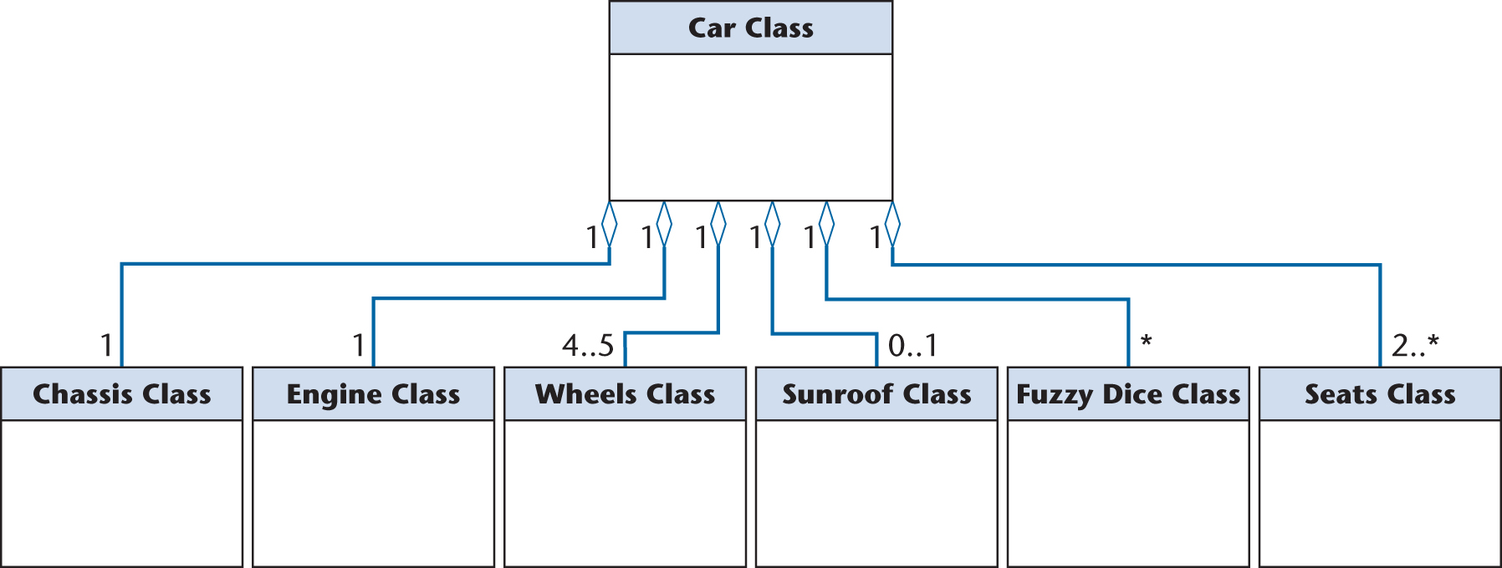
17.2.2 Multiplicity
Example: “A car consists of one chassis, one engine, 4 or 5 wheels, an optional sun roof, zero or more fuzzy dice hanging from the rear-view mirror, and 2 or more seats”
Figure 17.5
Notes:
Chassis底盘；

Slide 15
17.2.4 Generalization
Inheritance is a required feature of object orientation
Inheritance is a special case of generalization
  The UML notation for generalization is an open triangle
  Sometimes the open triangle is labeled with a discriminator

Slide 16
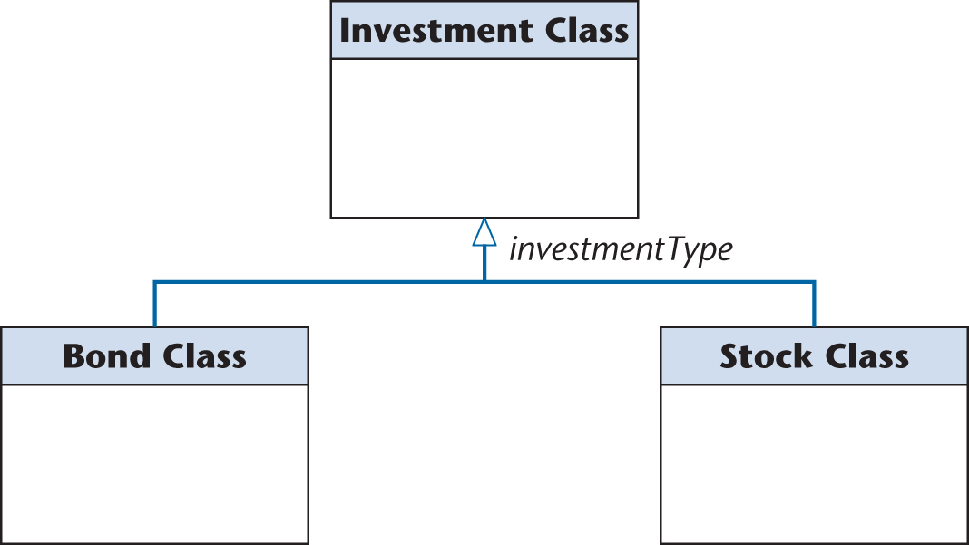
Generalization (contd)
Every instance of Investment Class or its subclasses has an attribute investmentType
Figure 17.8
Notes:
Bond 债券

Slide 17
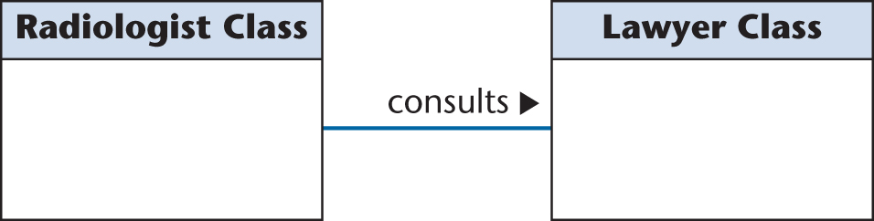
17.2.5 Association
Example of association:
A radiologist consults a lawyer
  The optional navigation triangle shows the direction of the association
Figure 17.9

Slide 18
Association (contd)
The association between the two classes may be modeled as a class
  Example: Suppose the radiologist consults the lawyer on a number of occasions, each one for a different length of time
    A class diagram is needed such as that depicted in the next slide

Slide 19
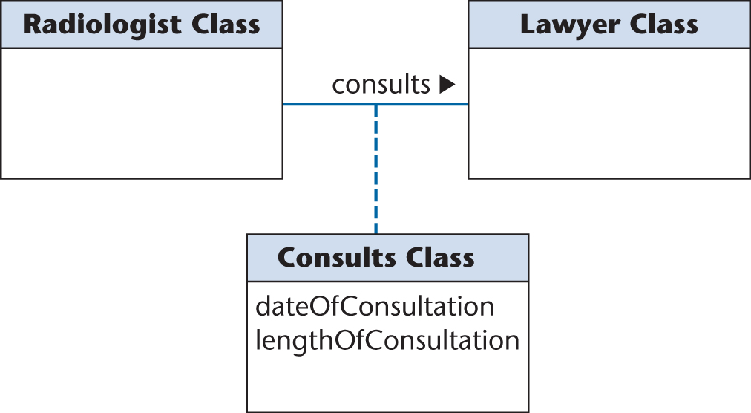
Association (contd)
Now consults has become a class, Consults Class, which is called an association class
  Because it is both an association and a class
Figure 17.10

Slide 20
17.4 Use-Case Diagrams
A use case is a model of the interaction between
  External users of a software product (actors) and
  The software product itself
    More precisely, an actor is a user playing a specific role
A use-case diagram is a set of use cases

Slide 21

Use-Case Diagrams (contd)
Generalization of actors is supported
  The open triangle points toward the more general case
Figure 17.11

Slide 22
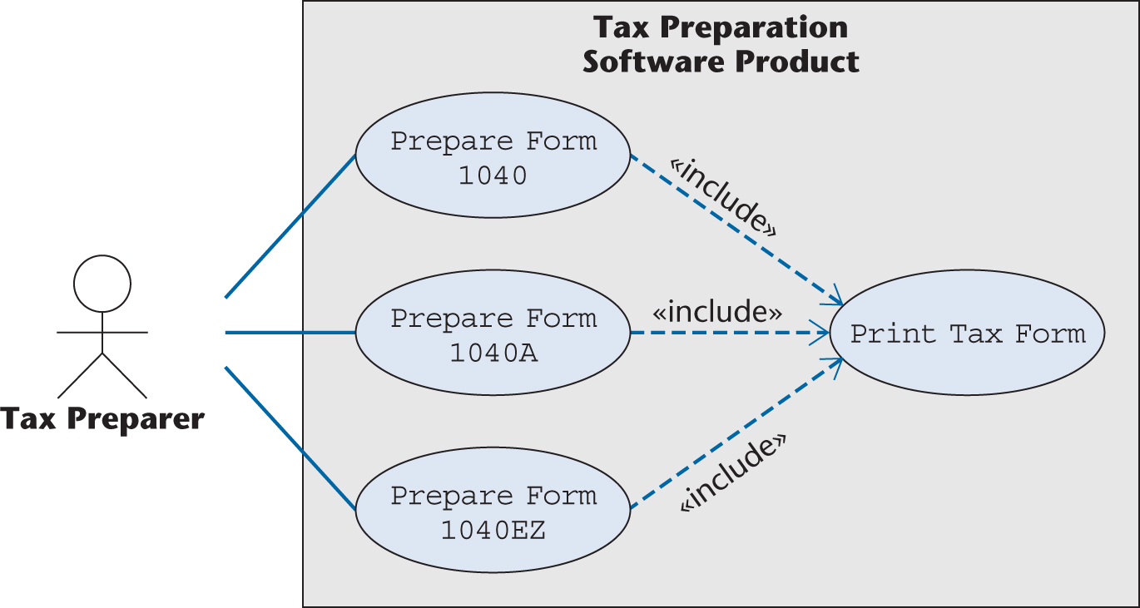
Stereotypes (contd)
Example:
  All three primary U.S. tax forms need to be printed
  The other three use cases incorporate Print Tax Form
Figure 17.12
Notes:
构造型

Slide 23
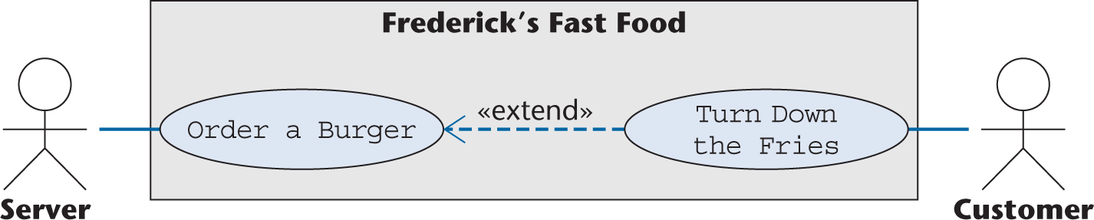
Stereotypes (contd)
In the «extend» relationship, one use case is a variation of the standard use case
  Example: A separate use case to model the situation of a diner ordering a burger but turning down the fries.
  The open-headed arrow goes in the other direction
Figure 17.13
Notes:
点了汉堡套餐而不要薯条

Slide 24
17.6 Interaction Diagrams
Interaction diagrams show how objects interact with one another
UML supports two types of interaction diagrams
  Sequence diagrams
  Collaboration diagrams
Notes:
分析，设计。用例实现中

Slide 25
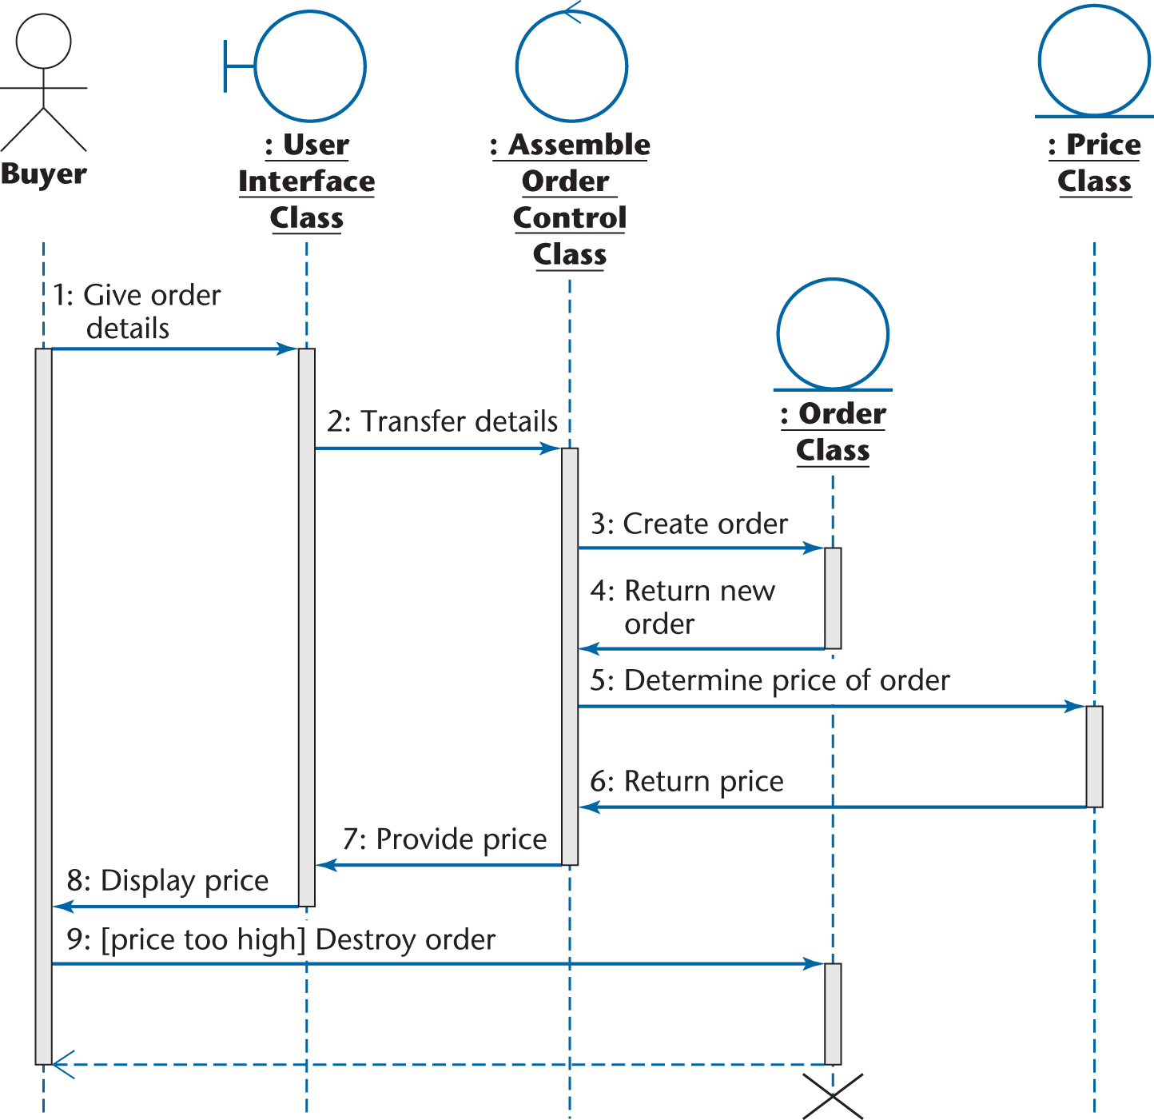
Sequence Diagrams
Example:
Figure 17.14

Slide 26
Sequence Diagrams (contd)
The lifelines in the sequence diagram
  An active object is denoted by a thin rectangle (activation box) in place of the dashed line
Creation of the : Order Class object is denoted by the lifeline starting at the point of dynamic creation
Destruction of that object after it receives message
    9: Destroy order
is denoted by the heavy X

Slide 27
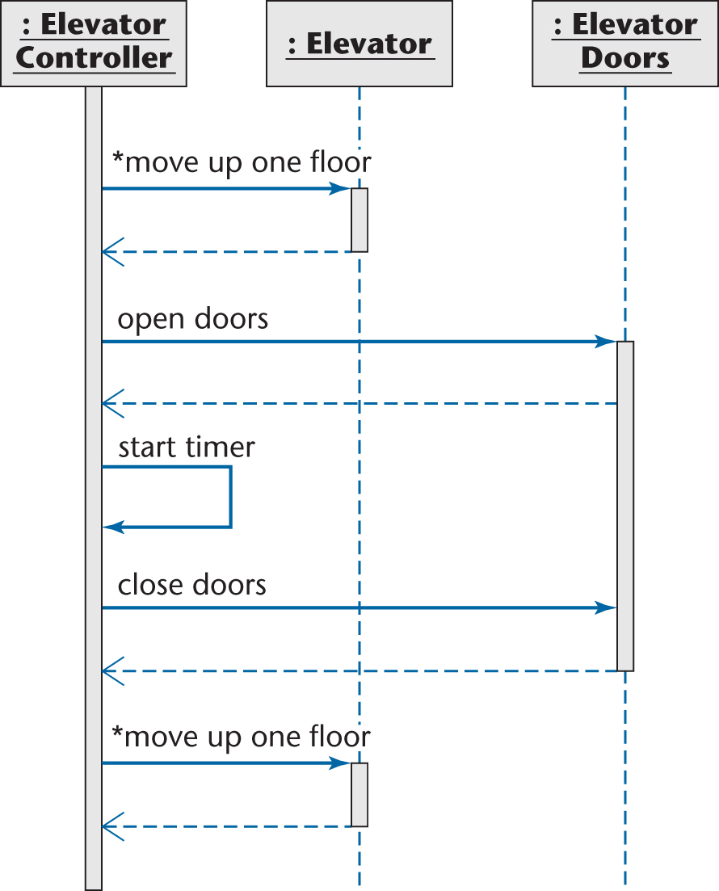
Sequence Diagrams (contd)
Sequence diagram for elevator
Figure 17.15

Slide 28
Collaboration Diagrams
Collaboration diagrams are equivalent to sequence diagrams
  All the features of sequence diagrams are equally applicable to collaboration diagrams
Use a sequence diagram when the transfer of information is the focus of attention
Use a collaboration diagram when concentrating on the classes

