Slide 1
Software Engineering
Northeastern University
Software College
Wei Zhang
zhangwei@swc.neu.edu.cn

Slide 2
Design

Slide 3
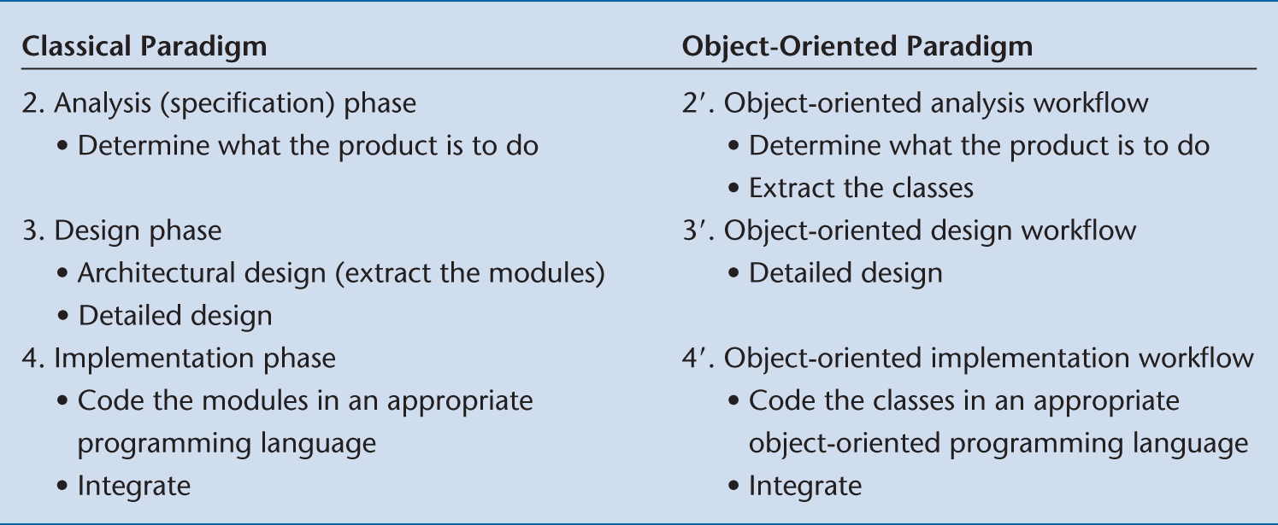
Chapter Overview
Classical Design
Object Oriented Design

Slide 4
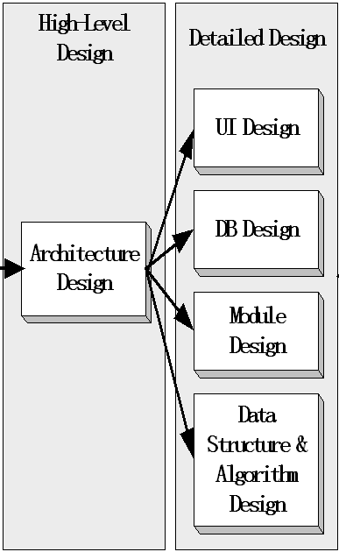


Classic Design
Architecture Design
Detailed Design
  Module Design
  Database Design
  Data Structure & Algorithm Design
  User Interface Design

Slide 5
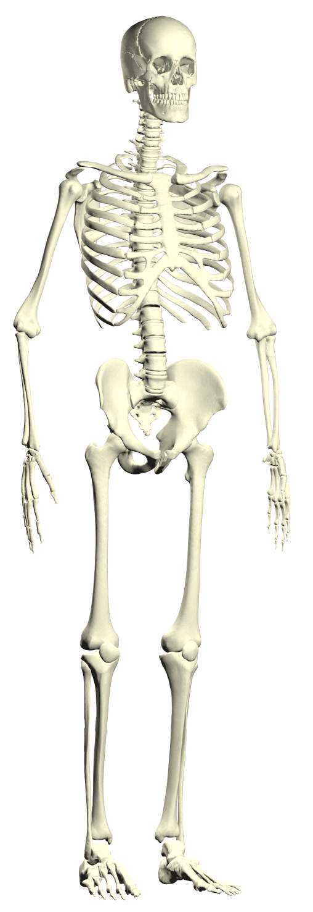
Architecture Design
Architecture ----skeleton, the overall structure of the software system
Software Architecture (软件架构) includes
  A set of components
  features of the component
    E.g. service, performance, resource usage, faulting dealing
  3. Relationships between components

Slide 6
Model/View/Controller Architecture
Model/View/Controller Architecture (模型/视图/控制器结构)
  Separates the system into 3 components
    Model（模型）是应用程序中用于处理应用程序数据逻辑的部分。通常模型对象负责在数据库中存取数据。
    View（视图）是应用程序中处理数据显示的部分。
    通常视图是依据模型数据创建的。
    Controller（控制器）是应用程序中处理用户交互的部分。
    通常控制器负责从视图读取数据，控制用户输入，并向模型发送数据。

Slide 7
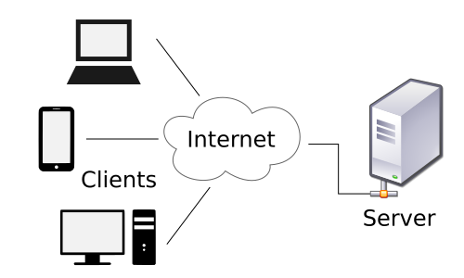
Client/Server Architecture
Client/Server Architecture (客户机/服务器结构)
  The sub-system as the server to provide services for other client sub-systems
  The client sub-system is to interact with users

Slide 8
Hierarchical Architecture
Hierarchical Architecture (分层体系结构)
  Organizes the software into a hierarchical of classes & components
  Classes & components in the same hierarchical implement a specific goal
Example
  Three-tie Architecture
    Expression: UI
    Business logic: manage tasks & rules of the process
    Storage: persistent storage

Slide 9
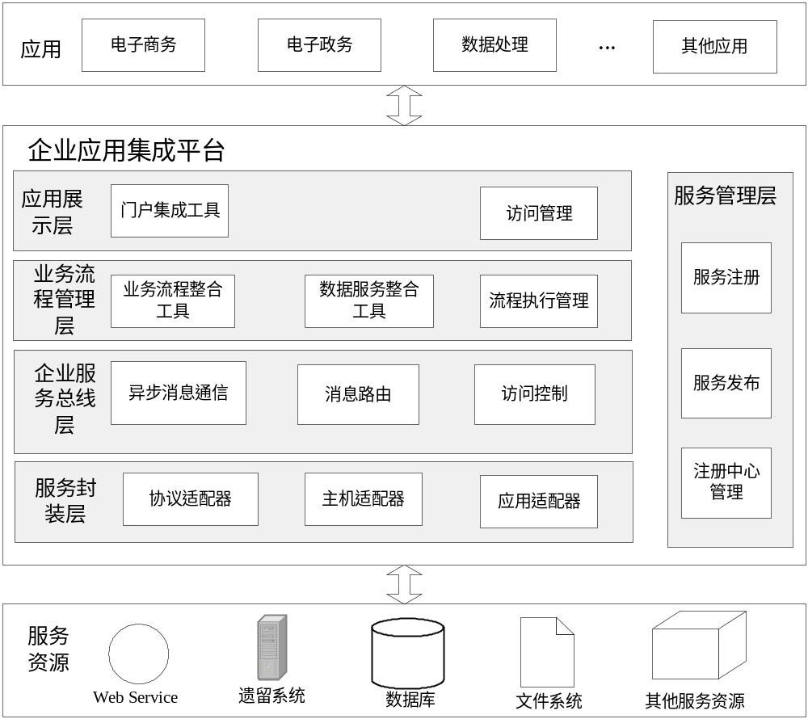

Slide 10
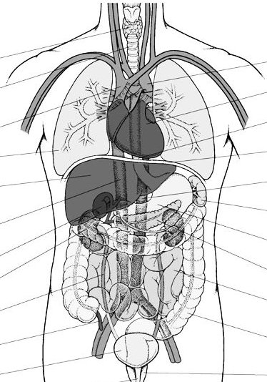
Module design
The module design phase can also be referred to as low-level design.
The system is split into smaller units or modules and
Programmer: each of them is explained so that the programmer can start coding directly.
The low-level design contains :
  detailed functional logic of the module
  all interface details with complete API references
  all dependency issues
  error message listings
  complete input and outputs for a module.

Slide 11

Database Design
Database ---- brain
  Store data
  Process data
DataBase

Slide 12
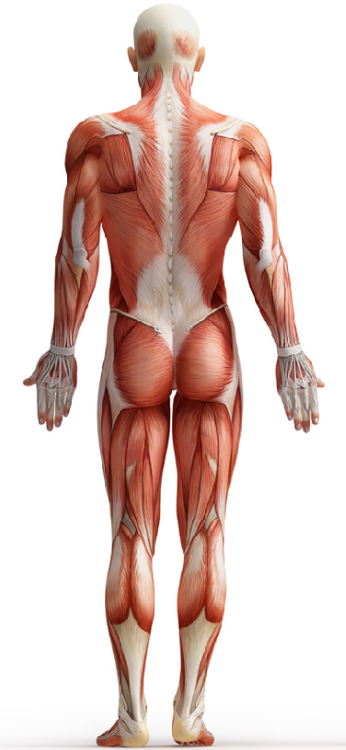
Data Structure & Algorithm Design
Data Structure & Algorithm
---- nerves & muscles
Link all the components together to have them work as a whole system.

Slide 13
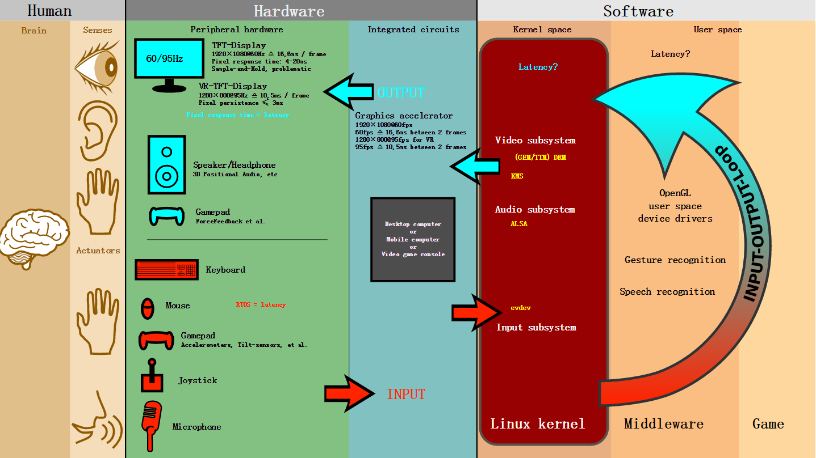
User Interface Design
User interface design (UI) or user interface engineering is the design of user interfaces for machines and software, such as computers, home appliances, mobile devices, and other electronic devices, with the focus on maximizing usability and the user experience.

Slide 14
Object Orient Design
OOD consists of 3 key steps:
Construct interaction diagrams （OOA）
The designer creates a sequence diagram or a collaboration diagram for each of the use case scenarios defined during the analysis phase.

Slide 15
Object-Oriented Design
2. Complete class diagram
Based on the preliminary class diagram, the designer completes a detailed class diagram with all kinds of classes, and their attributes and methods.
  Entity class
  Boundary class
  Control class

Slide 16
Object-Oriented Design
3. Perform the detailed design
For Each method：
  The designer then specifies the algorithms to be implemented for each method, along with the internal variables and data structures required by each method.

Slide 17
Case-Study 1: Elevator Problem
1 Construct interaction diagram
  For each scenario
Next slide: one scenario

Slide 18
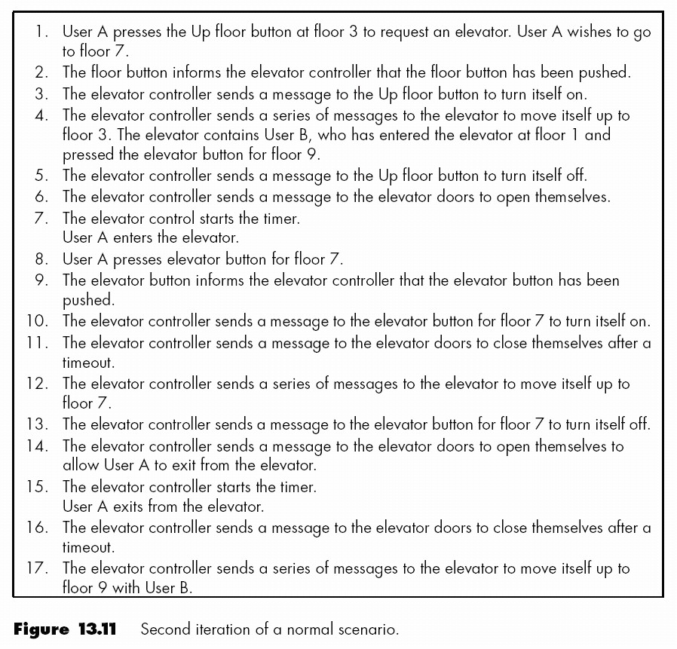

Slide 19
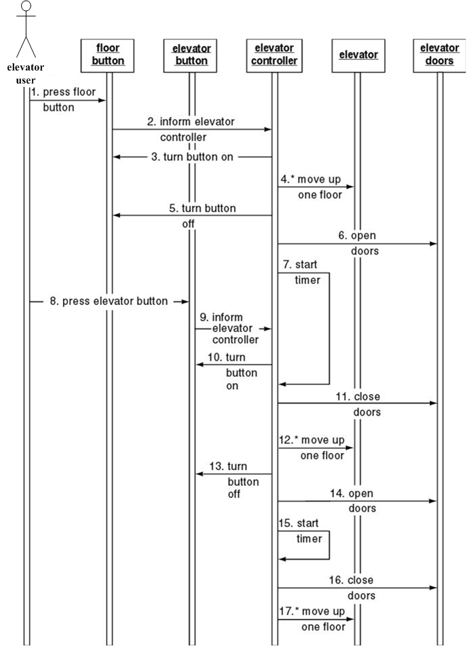

Slide 20
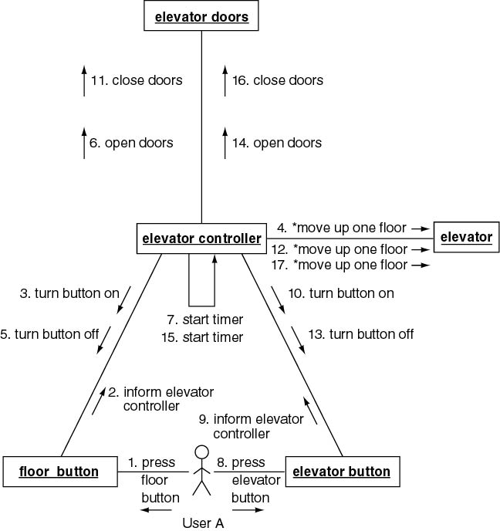

Slide 21
Case-Study 1: Elevator Problem
2 Complete the class diagram
  Assign a method to a class

Slide 22
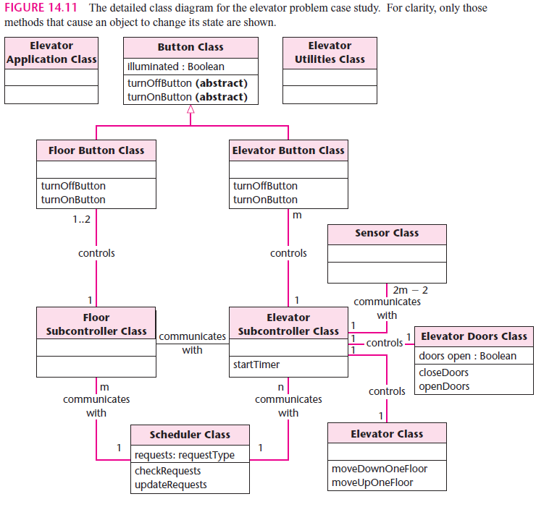

Slide 23
Self Exercise: Case Study
Please draw the detailed class diagram for your Grade Management System
  Including full attributes and methods for each class
  10 minutes

Slide 24
Case-Study 1: Elevator Problem
3 Perform the Detailed Design
  Perform detailed design with PDL (program description language)

Slide 25
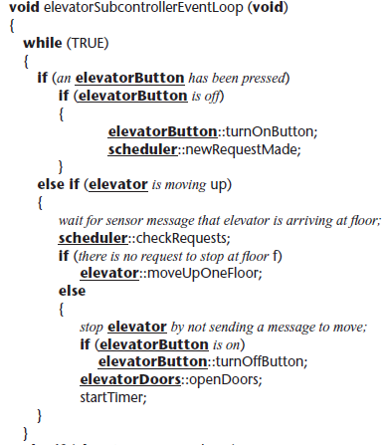

Slide 26
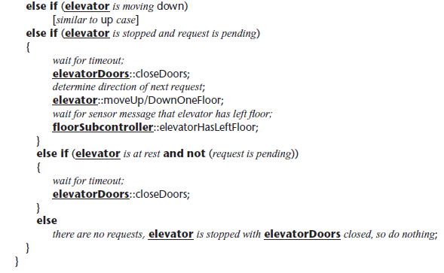

Slide 27
Case-Study 2：MSG Foundation
1 Interaction Diagram
2 Complete the Class Diagram
3 Perform the Detailed Design

Slide 28
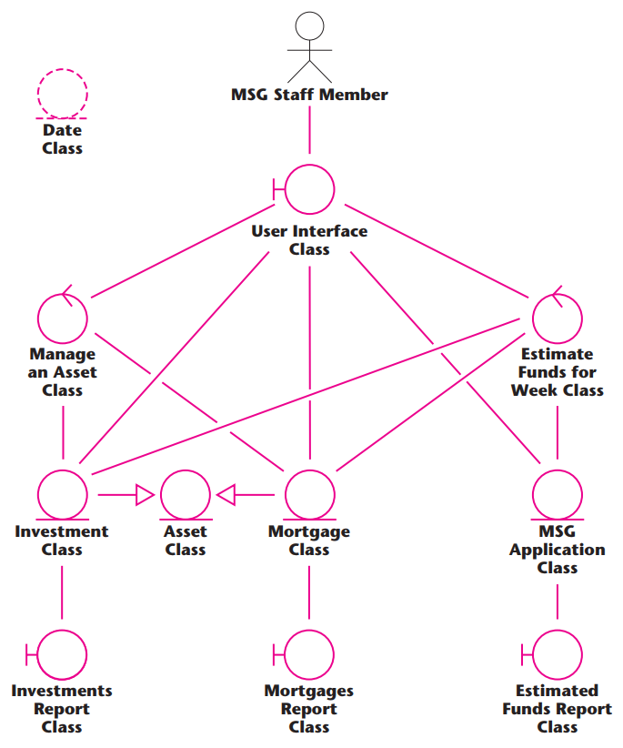

Slide 29
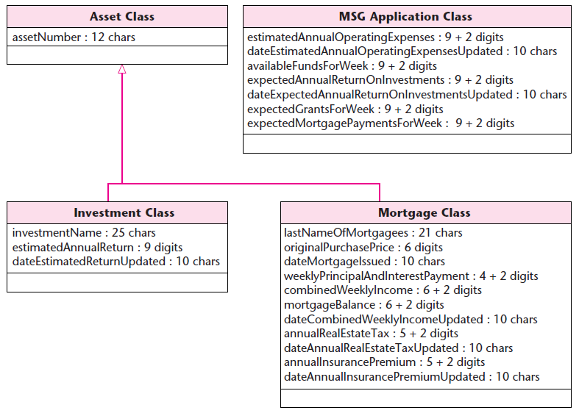

Slide 30
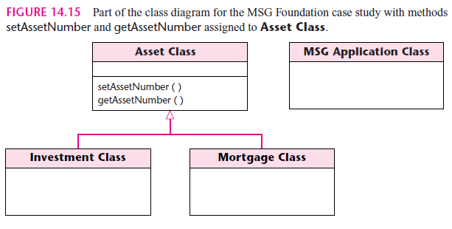
Entity Classes

Slide 31
Please provide the detailed design (in a PDL for JAVA) of a method computeEstimateFunds of class EstimateFundsForWeek of the MSG Foundation Case Study
Exercise on Class

Slide 32
The end of this Section

