Slide 1
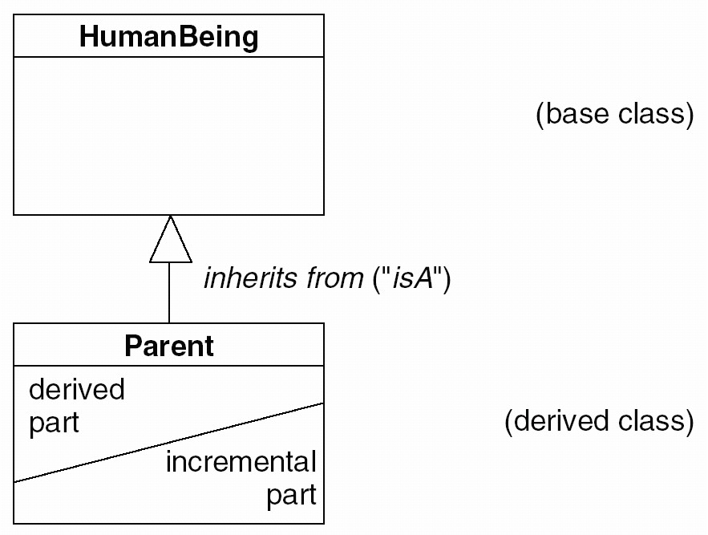
Inheritance (contd)
UML notation
  Inheritance is represented by a large open triangle
Zhang Shuang, zhangs@swc.neu.edu.cn

Slide 2
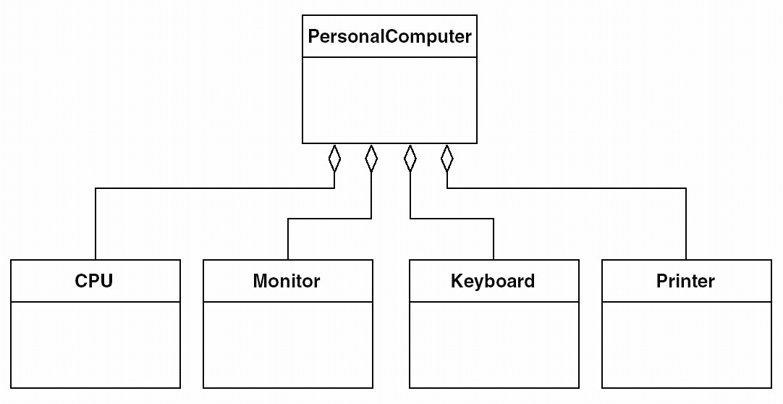
Aggregation
UML Notation
Software College, Zhang Shuang, Zhangs914@163.com

Slide 3
Aggregation
UML Notation
Software College, Zhang Shuang, Zhangs914@163.com

Slide 4
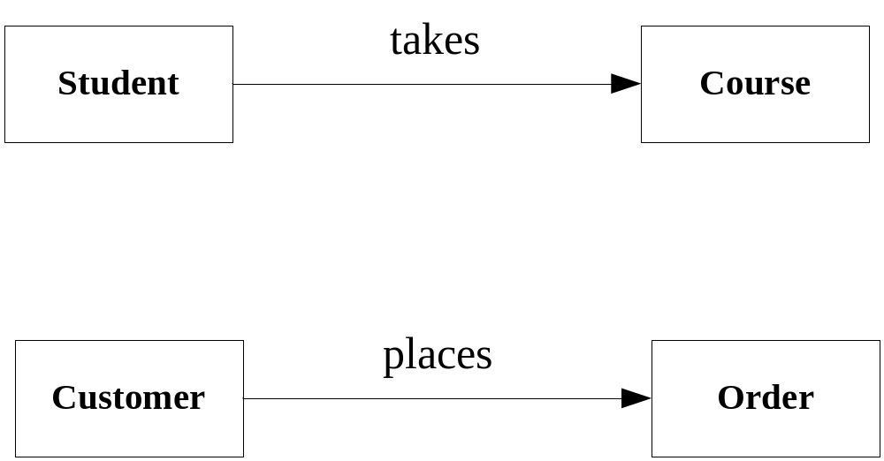
Association
UML Notation
Zhang Shuang, zhangs@swc.neu.edu.cn

Slide 5
Association
UML Notation
Zhang Shuang, zhangs@swc.neu.edu.cn

Slide 6
Association
UML Notation
Zhang Shuang, zhangs@swc.neu.edu.cn

Slide 7
5.1.1 Use-Case Modeling
Case 1: Elevator Problem
Press an
Elevator Button
Elevator
User
Press a
Floor Button
Zhang Shuang, zhangs@swc.neu.edu.cn

Slide 8
Case 2: Bank Customer Service System
Open Account
Deposit Funds
Withdraw Funds
Customer
Close Account
Zhang Shuang, zhangs@swc.neu.edu.cn

Slide 9
5.1.1 Use-Case Modeling
Case 3: On-line Shop
Browse Products
Customer
Place Order
Zhang Shuang, zhangs@swc.neu.edu.cn

Slide 10
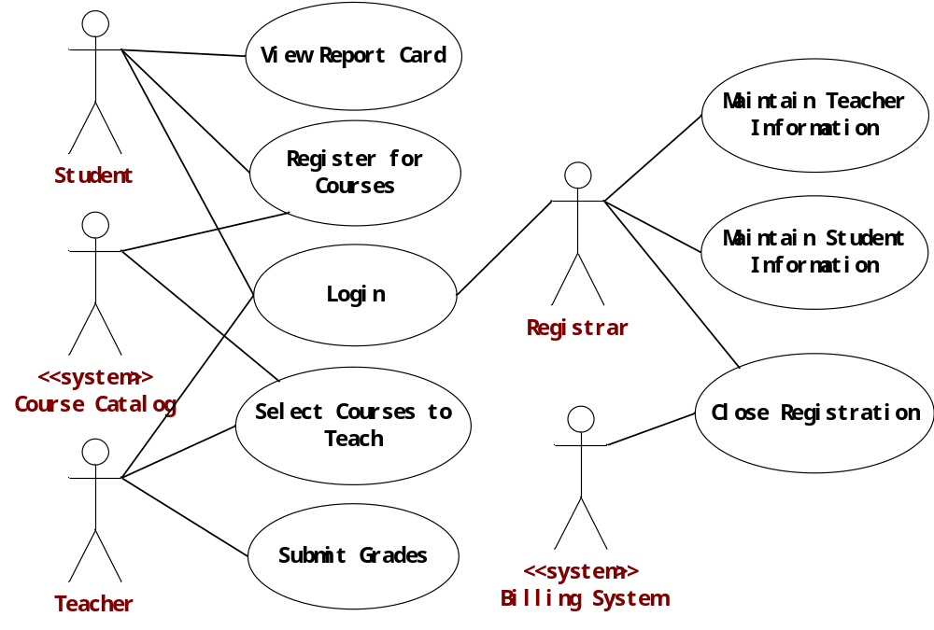
How would you read this diagram?

Slide 11

The Relationship between Actors
---- Generalization
Take course
Sub-actor inherits super-actor’s actions
Sub-actor can also have his own actions
Undergraduate
Take exam
Make
graduation design
Senior

Slide 12
The Relationship between Actors
---- Agency
Deposit Fund
Dotted line directs from agency requestor to agent
Clerk
Withdraw Fund
Transfer Fund
Customer

Slide 13
The Relationship between Use Cases
---- Generalization
Deposit Fund
BankActor
Clerk
Withdraw Fund
Transfer fund
between banks
Transfer Fund
Transfer fund
within a bank
Customer

Slide 14
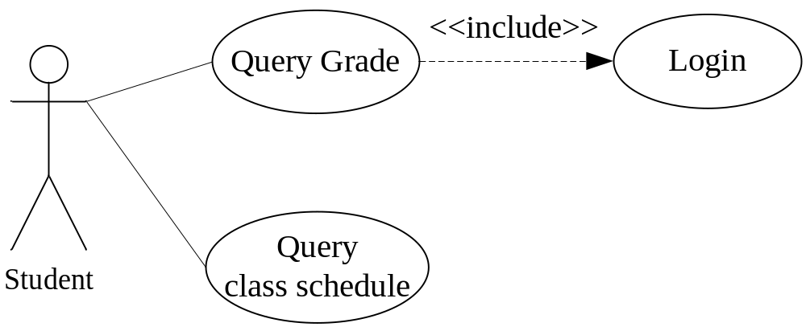
The relationship between use cases
---- Inclusion

Slide 15
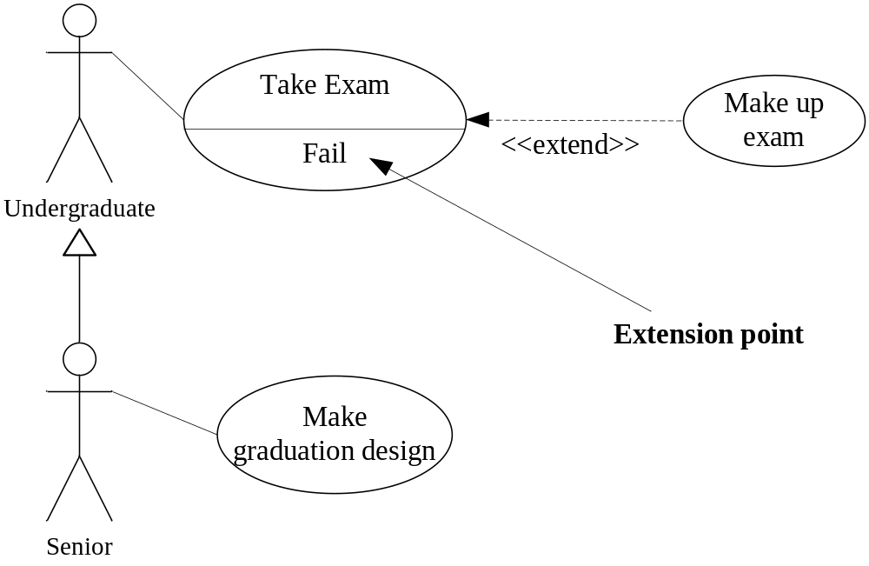
The Relationship between use cases
---- Extension
Extension use case must no surely happen. If the result of base use case satisfies a certain condition ---- extension point, extension use case happen and base use case is extended.

Slide 16
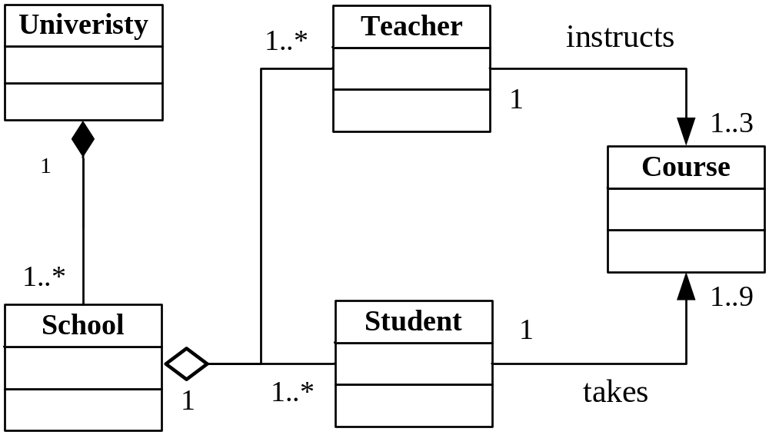
University System

Slide 17
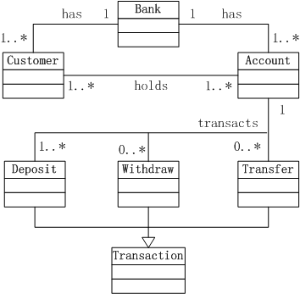
bank

Slide 18
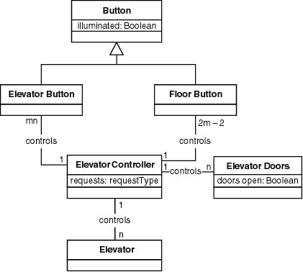
Third Iteration of Class Diagram
电梯

Slide 19
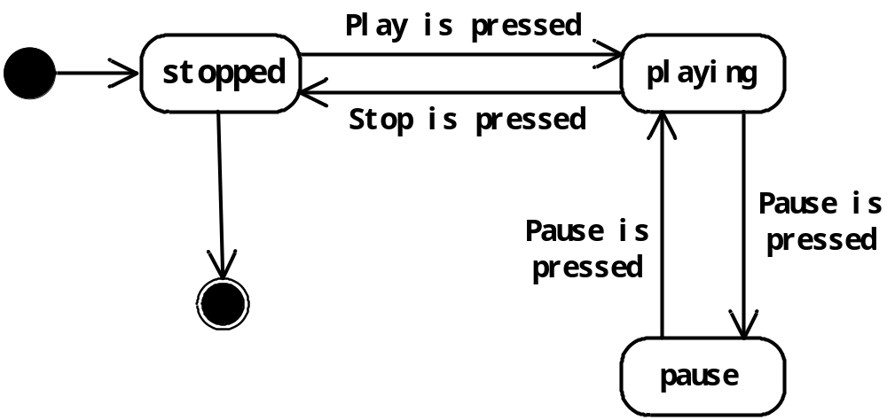
3. Dynamic Modeling
State Diagram for CD player
paused
Zhang Shuang, zhangs@swc.neu.edu.cn

Slide 20
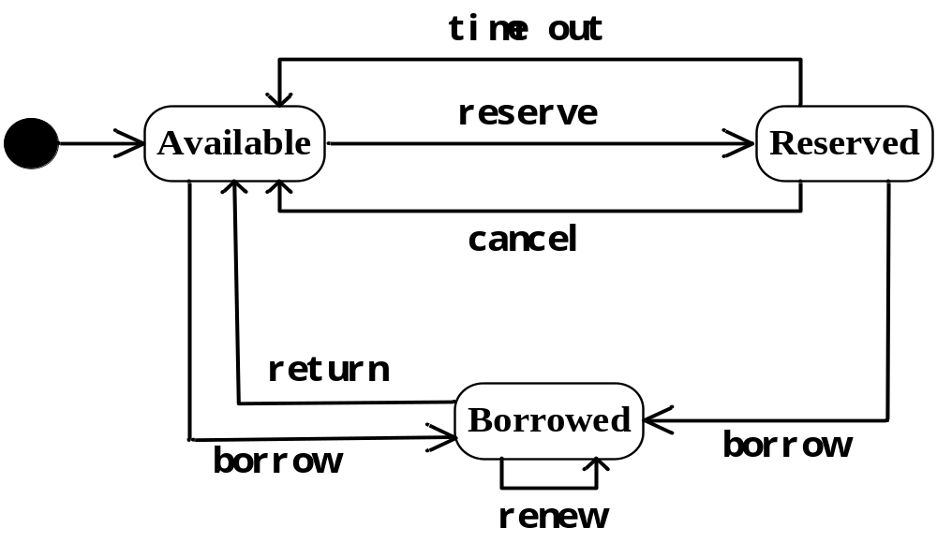
3. Dynamic Modeling
State Diagram for Book in Library Mgmt. Sys.

Slide 21
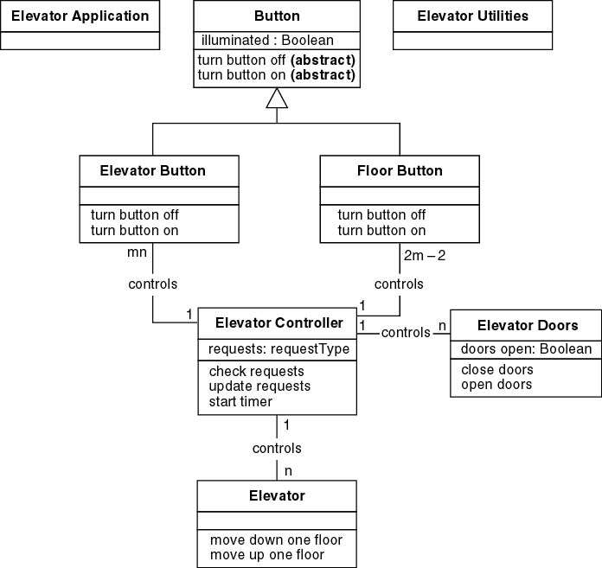
Elevator Problem: OOD (contd)
Detailed class diagram

