Slide 1

Principles of
Operating System
Preface

Slide 2
About me
Wei Zhang 张伟， Associate Professor
副教授
From : Software College, NEU
Office : 信息楼B 442
Phone : 139 9822 8657
Email : zhangwei@swc.neu.edu.cn
Research interests :
Encryption algorithm, Multimedia coding,
Data Compression, Joint compression and encryption information Coding, Chaos Theory.

Slide 3

Description
Operating system is an essential part of computer system.
This course examines the important problems in operating system design and implementation.
Particular emphasis will be given to three major OS subsystems:
  Process management
  Memory management
  I/O systems.
Notes:
关于学习操作系统的争议
世界上只需要很少的操作系统设计/实现者
Win9x、NT、CE、2000的天下垄断不易改变
赞成学习操作系统的理由
需要总体上掌握系统设计
操作系统包括了所有软件设计/实现问题：资源共享/管理，安全和身份验证，灵活性，健壮性，友好界面设计
设计操作系统，或者修改现有的系统：存在人们意识不到的大量“操作系统”、嵌入式系统（Embedded OS）
加深对使用的OS的理解，有利于深入编程：用户为了开发应用程序必须与操作系统打交道
编程时借鉴操作系统的设计思想和算法：操作系统中所用的许多概念和技巧可以推广应用到其他领域
选择购买操作系统
特点
强实践性（从实践中总结出原理）
涉及面广
错综复杂：横纵交叉

Slide 4
Domains referred to
Computer organization/hardware
Programming language as C or Java
Software design
Basic data structures
Algorithms
Networks
Made by Najun

Slide 5
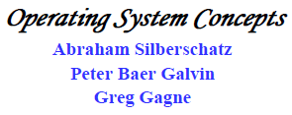
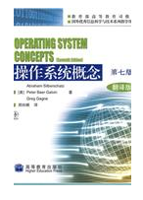
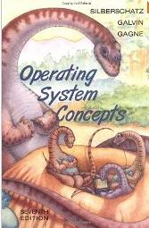
Textbook
Made by Najun

Slide 6
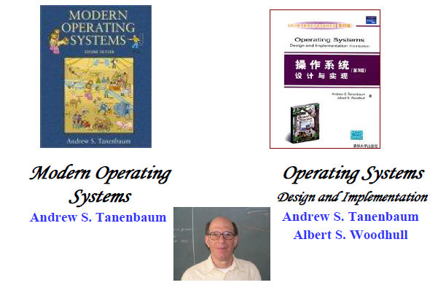
Reference Material
Made by Najun
Notes:
分布式系统，计算机网络 ，操作系统

Slide 7
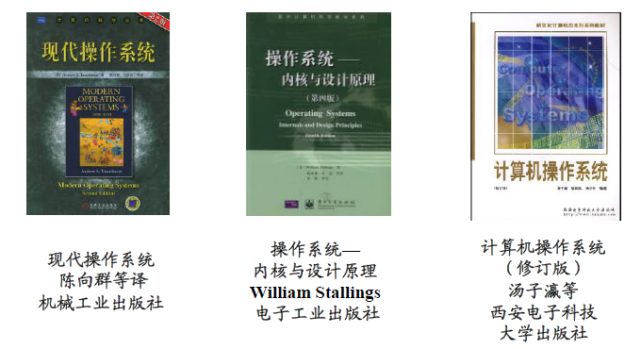
Reference Material (cont.)
Made by Najun

Slide 8
Grading
Experiments:
Test:
Homework: 50%
Attendance:
Final exam: 50%
The only thing you need to do is to be always honest!!!
Made by Najun

Slide 9
Principles of
Operating System
End of preface

