Slide 1

Principles of
Operating System
Process Ⅱ
——process communication, thread

Slide 2

Roadmap
Process Concept
Process Scheduling
Operations on Processes
Cooperating Processes
Interprocess Communication
Threads
Made by Najun
Notes:
进程间通信（Interprocess communication，IPC）提供一种机制，以允许进程不必通过共同地址空间共享来通信和同步其动作。

Slide 3
Interprocess Communication (IPC)
Mechanism for processes to communicate and to synchronize their actions.
Message Passing System (MPS)– processes communicate with each other without resorting to shared variables.
MPS facility provides two operations:
  send(message) – message size
    fixed or variable
  receive(message)
Made by Najun
Notes:
IPC最好由消息传递系统提供。消息系统的功能是允许进程相互通信而不需要利用共享数据。在这种方案中，服务是通过普通用户进程提供的，即服务在微内核之外进行。用户进程间的通信是通过消息传递完成的。
IPC工具至少提供两个操作：发送消息和接收消息。
进程发送的消息可以是定长的或变长的。

Slide 4
Interprocess Communication (IPC)
If P and Q wish to communicate, they need to:
  establish a communication link between them
  exchange messages via send/receive
Implementation of communication link
  physical (e.g., shared memory, hardware bus)
  logical (e.g., logical properties)
Made by Najun
Notes:
如果进程P和Q需要通信，那么它们必须相互发送消息和接收消息；它们之间必须要有通信线路。
线路实现有物理实现和逻辑实现，这里只关心逻辑实现。
逻辑实现线路和发送/接收操作的方法：
直接或间接通信
对称或非对称通信
自动或显式缓冲
复制发送或引用发送
固定大小或可变大小消息

Slide 5
Implementation Questions
How are links established?
Can a link be associated with more than two processes?
How many links can there be between every pair of communicating processes?
What is the capacity of a link?
Is the size of a message that the link can accommodate fixed or variable?
Is a link uni-directional or bi-directional?
Made by Najun

Slide 6
Direct Communication
Processes must name each other explicitly:
  send (P, message) – send a message to process P
  receive(Q, message) – receive a message from process Q
  receive(id, message)
Properties of communication link
  Links are established automatically.
  A link is associated with exactly one pair of communicating processes.
  Between each pair there exists exactly one link.
  The link may be uni-directional, but is usually bi-directional.
Made by Najun
Notes:
直接通信，需要通信的进程必须明确地命名通信的接收者或发送者。采用这种方案，原语send和receive定义如下;
Send (p, message)发送消息到进程P；
Receive (Q, message)接收来自进程Q的消息。
该通信线路的属性：
需要通信的一对进程之间自动建立线路
一个线路只与两个进程相关
每对进程之间只有一个线路
该方式是对称寻址，即发送进程和接收进程必须命名对方，以便通信。该方案的一个变形采用非对称寻址。只要发送者命名接收者，而接收者不需要命名发送者，原语定义为：
Send (P, message)发送消息到进程Ｐ
Receive (id, message)接收来自任何进程的消息，变量id设置成与其通信的进程名称

Slide 7
Direct Communication
Need to know the names of processes
Limited modularity
  As changing the identifier of a process, all references to the old identifier must be found, so they can be modified to the new identifier.
Made by Najun
Notes:
直接访问的缺点是限制了进程定义的模块化，改变进程的名字可能必须检查所有其他进程定义。所有就名称的引用都必须被找到，一遍修改成为新名字。

Slide 8
Indirect Communication
Messages are directed and received from mailboxes (also referred to as ports).
  Each mailbox has a unique id.
  Processes can communicate only if they share a mailbox.
Properties of communication link
  Link established only if processes share a common mailbox
  A link may be associated with many processes.
  Each pair of processes may share several communication links.
  Link may be unidirectional or bi-directional.
Made by Najun
Notes:
间接通信：消息通过油箱或端口来发送和接收。每个邮箱都有一个唯一的标识符，一个进程能通过不同的邮箱与其它进程进行通信。原语定义为：
Send (A, message)发送一个消息到邮箱A
Receive (A, message)接收来自邮箱A的消息
通信线路属性为：
只要一对进程中的两个成员共享一个邮箱即可建立通信线路
一个线路可以与两个或更多的进程相关联
两个通信进程之间可能有多个不同的线路，每个线路对应一个邮箱

Slide 9
Indirect Communication (cont.)
Operations
  create a new mailbox
  send and receive messages through mailbox
  destroy a mailbox
Primitives are defined as:
  send(A, message) – send a message to mailbox A
  receive(A, message) – receive a message from mailbox A
Made by Najun
Notes:
进程和操作系统都可以拥有邮箱。
操作系统必须提供机制，以允许进程进行如下操作：
创建一个新邮箱
通过邮箱发送和接收消息
删除一个邮箱

Slide 10
Indirect Communication (cont.)
Mailbox sharing
  P₁, P₂, and P₃ share mailbox A.
  P₁, sends; P₂ and P₃ receive.
  Who gets the message?
Solutions
  Allow a link to be associated with at most two processes.
  Allow only one process at a time to execute a receive operation.
  Allow the system to select arbitrarily the receiver. Sender is notified who the receiver was.
Made by Najun
Notes:
现假设进程P1、P2和P3都共享邮箱A。进程P1发送一个消息到A，而进程P2和P3都对A执行receive。哪个进程能收到P1所发的消息呢？
允许一个线路做多只能与两个进程相关联
允许一次最多一个进程执行receive操作
允许系统随意选择一个进程以接收消息。系统可以告诉发送者谁是接收者。

Slide 11
IPC models
Processes can communicate through
  shared memory: processes share some data structure or memory block;
  pipe: connect a reading process and a writing process, as the shared file for communication between the two processes;
  message passing: message is the unit of data transmission, which is much more useful for information transfer.
Made by Najun
Notes:
目前，高级通信机制可归结为三大类：
共享存储器系统：相互通信的进程共享某些数据结构或共享存储区。进程之间能通过它们进行通信。例如，生产者-消费者问题中的buffer；
管道通信系统：管道指用于连接一个读进程和一个写进程，以实现它们之间通信的共享文件,pipe 文件。
消息传递系统：进程之间的数据交换以消息为单位，可分为直接通信和间接通信。
IPC最好由消息传递系统提供。

Slide 12
Synchronization
Message passing may be either blocking or non-blocking.
  Blocking is considered synchronous
  Non-blocking is considered asynchronous
send and receive primitives may be either blocking or non-blocking.
Made by Najun
Notes:
进程间的通信可以通过调用原语send和receive来进行。有不同的设计选项，消息传递可以是阻塞或非阻塞，也称为同步或异步。
阻塞send：发送进程阻塞，直到消息被接收进程或邮箱所接收
非阻塞send：发送进程发送消息并再继续操作
阻塞receive：接收者阻塞，直到有消息可用
非阻塞receive：接收者收到一个有效消息或无效消息
使用阻塞的send和receive，即可解决生产者消费者问题。

Slide 13
Buffering
Queue of messages attached to the link; implemented in one of three ways.
  1. Zero capacity – 0 messages
  Sender must wait for receiver.
  Bounded capacity – finite length of n messages
  Sender must wait if link full.
  Unbounded capacity – infinite length
  Sender never waits.
Made by Najun
Notes:
不管直接或间接通信，通信进程所交换的消息都驻留在临时队列中。
队列实现有三种方法：
零容量：队列的最大长度为0，因此，线路中不能有任何消息处于等待。此时，发送者必须阻塞，直到接收者接收到消息。
有限容量：队列的长度为有限的n，因此，最多只能有n个消息驻留其中。此时，如果消息队列未满，消息要放在队列中，发送者可继续执行而不必等待。但线路满时，发送者必须等待知道队列中的空间可用为止。
无限容量：队列长度无限，不管多少消息都可在其中等待。发送者从不阻塞。

Slide 14
Roadmap
Process Concept
Process Scheduling
Operations on Processes
Cooperating Processes
Interprocess Communication
Threads
Made by Najun
Notes:
OS中一直都是以进程作为能拥有资源和独立运行的基本单位的。直道20世纪80年代中期，人们又提出了比进程更小的能独立运行的基本单位——线程，试图用它来提高系统内程序并发执行的程度，从而可进一步提高系统的吞吐量。

Slide 15
Thread
Process：design for Multiprogramming
Thread: Reduce the cost of Multiprogramming
Review:
  What is process?
  Operations of process
    Creation
    Switch
    Terminate
Made by Najun
Notes:
从调度、并发性、拥有资源、系统开销，说明进程和线程的区别
线程是CPU使用的基本单元，它由线程id，程序计数器，寄存器和栈组成。与同属一个进程的其他进程共享代码段、数据段和其他系统资源。
因为进程是一个资源的拥有者，因而在创建、撤销和切换中，系统为之付出了较大的时空开销。正因为如此，系统中设置的进程不能过多，进程切换的频率也不宜过高。

Slide 16

Origin of threads
Group related resources together in the form of process to manage resources more easily.
Resource grouping
process
Executing
A process has a thread of execution, which is the entity scheduled for execution on the CPU.
Single-threaded process
Made by Najun
Notes:
进程模型基于以下两个独立的概念：资源分组处理与执行。有时，这两个概念分开是有益的，这就是线程的由来。
观察进程的一种方式是，用某种方法把相关的资源集中在一起。进程有存放正文和数据以及其他资源的地址空间，把这些资源都放到进程中更易于管理。
另一个角度是，进程拥有一个执行的线程，拥有与调度相关的所有信息，是在CPU上被调度执行的实体。

Slide 17
Requirements for parallel programs
We need parallel programs, such as:
  Parallel execution on a multiprocessor
  Web server to handle multiple simultaneous web requests
What we will need to:
  Create several processes that can execute in parallel
  Cause each to map to the same address space
    because they’re part of the same computation
  Give each its starting address and initial parameters
  The OS will then schedule these processes in parallel
Made by Najun
Notes:
同为并行，多进程与多线程的区别，多进程的缺点

Slide 18
Problems of using processes
A full process includes numerous things:
  an address space (defining all the code and data pages)
  OS resources and accounting information
  a “thread of control”: defines where the process is currently executing, which is the PC and registers
Creating a new process is costly
  all of the structures (e.g., page tables) that must be allocated
Communicating between processes is costly
  most communication goes through the OS
Made by Najun

Slide 19
What we need?
What’s similar in these processes?
  They all share the same code and data (address space)
  They all share the same privileges
  They share almost everything in the process
What don’t they share?
  Each has its own PC, registers, and stack pointer
Idea: why don’t we separate the idea of process (address space, accounting, etc.) from that of the minimal “thread of control” (PC, SP, registers)?
Made by Najun

Slide 20
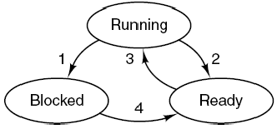
Thread
Thread is an independent and schedulable executing unit, including
  Program counter: as a thread can also be suspended and resumed.
  Registers: as when threads are suspended, their registers must be saved.
  State: as threads can be in running, ready, blocked (waiting) state.
  Stack: to save local information, such as local variables.
Made by Najun
Notes:
线程是CPU使用的基本单元，它由线程id，程序计数器，寄存器和栈组成。与同属一个进程的其他进程共享代码段、数据段和其他系统资源。

Slide 21
Single and Multithreaded Processes
Made by Najun
Notes:
在OS中引入线程，是为了减少程序在并发执行时所付出的时空开销，使OS具有更好的并发性。
进程特性：
进程是一个可拥有资源的独立单元
进程同时又是一个可独立调度和分派的基本单元
为了程序能并发执行，系统还必须进行以下的一系列操作：创建进程、撤销进程和进程切换
线程，有时称轻量级进程LWP，是CPU使用的基本单元；它由线程ID、程序计数器、寄存器集合和堆栈组成。它与属于同一进程的其它线程共享其代码段、数据段和其他操作系统资源。
一个传统进程只有单个控制线程。如果进程有多个控制线程，那么它能同时做多个任务。
线程给进程模型增加了一项内容，即在同一个进程环境中，允许彼此之间有较大独立性的多个线程执行，即多线程。
左侧图中是一个传统的进程，一个进程具有自己的地址空间和单个控制线程。
右侧图中是一个带有多个控制线程的进程，线程共享相同的地址空间，即共享进程的程序、数据和文件，但是每个线程都有自己的执行状态，相互独立执行。
类似多道程序设计中在多个进程之间的切换，多个线程的工作方式类似，CPU在线程之间快速切换。

Slide 22
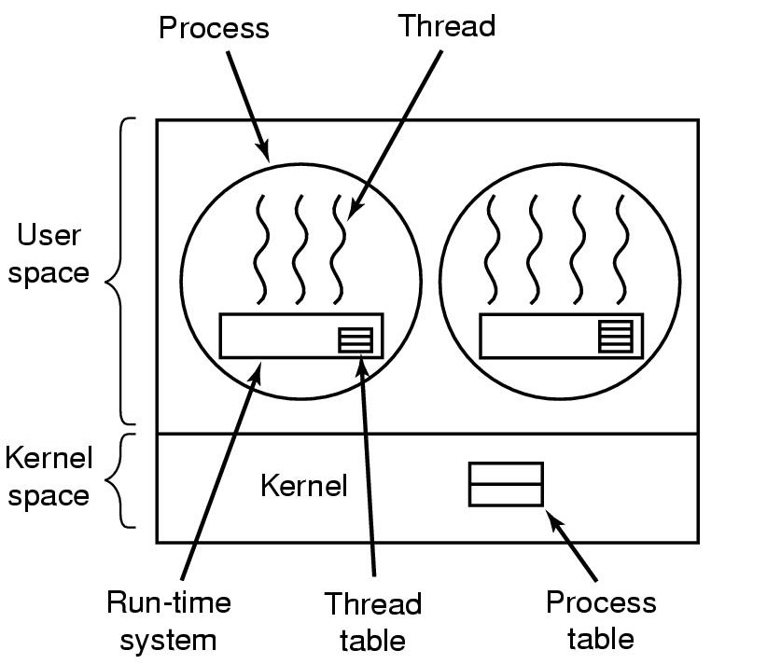
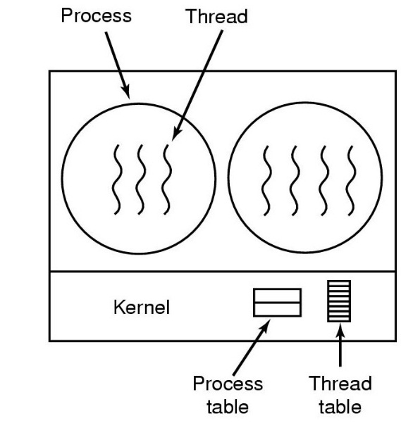
Details in a multithreaded process
  Unit of resource ownership remains the process
    all threads within a process share the same resources
    processes compete for resources from the kernel
    threads must cooperate in using their resources
  Unit of scheduling and dispatching becomes the thread
    each thread needs its own volatile context, ex. PC, stack and stack pointers, registers and status
Made by Najun
Notes:
在OS中引入线程，是为了减少程序在并发执行时所付出的时空开销，使OS具有更好的并发性。
进程特性：
进程是一个可拥有资源的独立单元
进程同时又是一个可独立调度和分派的基本单元
为了程序能并发执行，系统还必须进行以下的一系列操作：创建进程、撤销进程和进程切换
线程，有时称轻量级进程LWP，是CPU使用的基本单元；它由线程ID、程序计数器、寄存器集合和堆栈组成。它与属于同一进程的其它线程共享其代码段、数据段和其他操作系统资源。
一个传统进程只有单个控制线程。如果进程有多个控制线程，那么它能同时做多个任务。

Slide 23
Threads vs. Processes
A thread has no data segment or heap
A thread cannot live on its own, it must live within a process
There can be more than one thread in a process, the first thread calls main & has the process’s stack
Inexpensive creation
Inexpensive context switching
If a thread dies, its stack is reclaimed
A process has code/data/heap & other segments
There must be at least one thread in a process
Threads within a process share code/data/heap, share I/O, but each has its own stack & registers
Expensive creation
Expensive context switching
If a process dies, its resources are reclaimed & all threads die
Made by Najun

Slide 24
Benefits
Responsiveness
Resource Sharing
Economy
Utilization of MP(Multi Processor) Architectures
Made by Najun
Notes:
多线程编程的优点：
响应度高：多个线程分别处理相应事件，如多线程网页浏览器在用一个线程装入图像时，能通过另一个线程与用户交互。
资源共享：线程默认共享它们所属进程的内存和资源。
经济：进程创建所需的内存和资源的分配比较昂贵。由于线程能共享它们所属进程的资源，所以线程创建和上下文切换会更为经济。
多处理器体系结构的利用：能充分使用多处理器体系结构，以便每个线程能并行运行在不同的处理器上。

Slide 25
User Threads and Kernel Threads
There are two main ways to implement a thread: in kernel and in user space.
  User threads
    Provided by a thread library at the user level.
    All thread operations are completed in user space, which are unknown in kernel space.
    POSIX Pthreads、Mach C-threads、Solaris threads
  Kernel threads
    Provided by the OS directly.
    All thread operations are performed by OS.
    Windows 95/98/NT/2000、Solaris、Tru64 UNIX、BeOS、Linux
Made by Najun
Notes:
用户线程在内核之上支持，并在用户层通过线程库来实现。线程库提供对线程创建、调度和管理的支持而无需内核支持。优点：能快速创建和管理。
内核线程由操作系统直接支持：内核在其空间内执行线程创建、调度和管理。内核线程的创建和管理通常要慢于用户线程的创建和管理。

Slide 26
Implementation of user threads
Provides operations like thread_create, thread_exit, thread_wait, thread_yield and etc.
Traces threads and records attributes of threads.
Managed by run-time system, as the process table managed by kernel.
Made by Najun
Notes:
线程在用户空间中，内核对线程一无所知，即内核仍然按单线程进程管理。
线程在一个运行时系统的顶部运行，该运行时系统是一个管理线程的过程的集合，包括：thread_create, thread_exit, thread_wait, thread_yield等。
在用户空间管理线程时，每个进程有一个专用的线程表，用来跟踪该进程中的线程，记录每个线程的属性，并由运行时系统管理。
在切换线程时，只要堆栈指针和程序计数器一被切换，新线程就自动投入运行。
优点：可以在不支持线程的操作系统上实现。允许用户自己定制调度算法，且具有良好的伸缩性。

Slide 27
Implementation of user threads
Superiority
  Switch of Threads without Kernel supported
  Specified scheduling algorithm
  No relationship with OS platform
Shortcoming
  Blocking of system call
Made by Najun

Slide 28

Implementation of kernel threads
Traces states of processes and records attributes of processes.
Subset of process table
Made by Najun
Notes:
内核线程不需要运行时系统，每个进程也没有线程表，而是在内核中记录系统中所有线程的线程表。当某个线程希望创建一个新线程或撤销一个已有线程时，它进行一个系统调用，通过对线程表的更新完成线程的创建和撤销工作。
内核的线程表保存了每个线程的相关信息，是内核维护的单个进程信息的子集。此外，内核还维护了传统的进程表，跟踪进程状态。

Slide 29
Implementation of kernel threads
Superiority
  In multi-processor system, Kernel supports to schedule multi-threads in one process for concurrent performing
  Blocking
  Small scale of data structure and stack, faster switching.
Shortcoming
  Kernel thread for the thread in user space
Made by Najun
Notes:
内核级线程缺点：对于用户的线程切换而言，其模式切换的开销较大，再同一个进程中，从一个线程切换到另一个线程时，需要从用户模式转换到内核模式下运行，这是因为用户进程的线程在用户模式下运行，而线程的调度和管理是在内核模式下实现的。

Slide 30
Multithreading Models
Many-to-One
One-to-One
Many-to-Many
Made by Najun
Notes:
三种常用的多线程模型：
多对一
一对一
多对多

Slide 31

Many-to-One
Many user-level threads mapped to single kernel thread.
Made by Najun
Notes:
多对一模型将许多用户级线程映射到一个内核线程。线程管理在用户空间进行，因而效率比较高，但是如果一个线程执行了阻塞系统调用，那么整个进程就会阻塞。因为任一时刻只有一个线程能访问内核，多个线程不能并行运行在多处理器上。
在不支持内核级线程的操作系统上所实现的用户级线程库也使用了多对一模型。

Slide 32

One-to-One
Each user-level thread maps to kernel thread.
Examples
  Windows 95/98/NT/2000
  OS/2
Made by Najun
Notes:
每个用户线程映射到一个内核线程。该模型在一个线程执行阻塞系统调用时，能允许另一个线程继续执行，所以它提供了比多对一模型更好的并发功能；它也允许多个线程能并行地运行在多处理器系统上。
缺点是：创建一个用户线程就需要创建一个相应的内核线程。由于创建内核线程的开销会影响应用程序的性能，所以这种模型的绝大多数实现限制了系统所支持的线程数量。

Slide 33

Many-to-Many Model
Allows many user level threads to be mapped to many kernel threads.
Allows the operating system to create a sufficient number of kernel threads.
Solaris 2
Made by Najun
Notes:
多对多模型多路复用了许多用户级线程到同样数量或更小数量的内核线程上。
多对多模型中，开发人员可以创建任意多的必要用户线程，并且相应内核线程能在多处理器系统上并行执行。一个线程执行阻塞系统调用时，内核能调度另一个线程来执行。

Slide 34
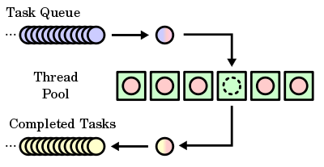
Thread pool
In computer programming, the thread pool is where a number of threads are created to perform a number of tasks, which are usually organized in a queue.
Made by Najun
Notes:
线程池的主要思想是在进程开始时创建一定数量的线程，并放入到池中等待工作。当服务器接收到请求时，唤醒池中的一个线程（如果有可用的线程），并将要处理的请求传递给它。一旦线程完成了其服务，它会返回到池中再等待更多的工作。如果池中没有可用的线程，那么服务器会一直等待到有空线程为止。其优点在于：
1，通常用现有线程处理请求要比等待创建新的线程要快。
2，线程池限制了在任何时候可存在线程的数量，对不能支持大量并发线程的系统尤为重要。
In computer programming, the thread pool pattern is where a number of threads are created to perform a number of tasks, which are usually organized in a queue. Typically, there are many more tasks than threads. As soon as a thread completes its task, it will request the next task from the queue until all tasks have been completed. The thread can then terminate, or sleep until there are new tasks available.

Slide 35
Java Threads
Java threads may be created by:
  Extending Thread class
  Implementing the Runnable interface
Java threads are managed by the JVM.
Made by Najun
Notes:
在java程序中，有两种创建线程的技术。一种方法是创建一个新的类，从Thread派生，并重载run()函数。另一种方法是定义一个实现runable接口的类。
多线程jvm实现。Xp使用一对一模式，solaris早期多对一，9后，多对多。

Slide 36
Keystone
Process communication
Basic concept of threads
Made by Najun

Slide 37
Principles of
Operating System
End of Process Ⅱ

