Slide 1

Principles of
Operating System
CPU Schedule Ⅱ
Notes:
CPU调度准则，4种调度算法 FCFS,SJF,priority scheduling， RR

Slide 2

Roadmap
Basic Concepts
Scheduling Criteria
Scheduling Algorithms
Multiple-Processor Scheduling
Real-Time Scheduling
Algorithm Evaluation
Made by Najun

Slide 3
Multilevel Queue
A multilevel queue scheduling algorithm partitions the ready queue into several separate queues.
The processes are permanently assigned to one queue, generally based on some property of the process, such as memory size, process priority, or process type.
Each queue has its own scheduling algorithm.
Made by Najun

Slide 4
Multilevel Queue
Ready queue is partitioned into separate queues, for example:
  foreground (interactive)
  background (batch)
Each queue has its own scheduling algorithm, for example:
  foreground – RR
  background – FCFS
Made by Najun
Notes:
多级队列调度将就绪队列分成多个独立队列。根据进程的某些属性，如内存大小、进程优先权或进程类型，进程会被永久地分配到一个队列。每个队列有自己的调度算法。

Slide 5

Multilevel Queue Scheduling
Made by Najun
Notes:
1 队列间使用抢占式的优先级调度（或者时间片）
2 队列间的调度算法可以任意指定

Slide 6
Multilevel Queue (cont.)
Scheduling must be done between the queues.
  Fixed priority scheduling; (i.e., serve all from foreground then from background). Possibility of starvation. Preemptive
  Time slice – each queue gets a certain amount of CPU time which it can schedule among its processes; i.e.:
    80% to foreground in RR
    20% to background in FCFS
Made by Najun
Notes:
队列之间必须有调度，通常采用固定优先权可抢占调度来实现。
每个队列与更低优先权队列相比有绝对的优先权。若低优先级进程运行时，进入一个高优先级进程，则抢占。
另一种可能是在队列之间划分时间片。每个队列都有一定的CPU时间，这可用于调度队列内的不同进程。

Slide 7
Multilevel Feedback Queue
Multilevel feedback queue scheduling allows a process to move between queues.
The idea is to separate processes with different CPU-burst characteristics.
  If a process uses too much CPU time, it will be moved to a lower-priority queue. Why？
  A process that waits too long in a lower-priority queue may be moved to a higher-priority queue. Why？
Made by Najun
Notes:
多级队列调度算法中进程并不在队列之间移动，优点是低调度开销，缺点是不够灵活。
多级反馈队列调度允许进程在队列之间移动。其主要思想是根据不同CPU区间特点以区分进程。如果进程使用过多CPU时间，那么它会被移到更低优先权队列。这种方案会将I/O约束和交互式进程留在较高优先权队列。类似地，在较低优先权队列中等待过长的进程会被转移到较高优先权队列。这种形式的老化能阻止饥饿的发生。

Slide 8

Example of Multilevel Feedback Queue
Three queues:
  Q₀ – time quantum 8 milliseconds
  Q₁ – time quantum 16 milliseconds
  Q₂ – FCFS
Scheduling
  A new job enters queue Q₀ which is served FCFS. When it gains CPU, job receives 8 milliseconds. If it does not finish in 8 milliseconds, job is moved to queue Q₁.
  At Q₁ job is again served FCFS and receives 16 additional milliseconds. If it still does not complete, it is preempted and moved to queue Q₂.
Made by Najun
Notes:
进入就绪队列的进程被放在队列0内。队列0的每个进程都有8ms的时间片。如果一个进程必能在这一时间内完成，那么它就被移到队列1的尾部。如果队列0为空，队列1头部进程会得到一个16ms的时间片。如果它不能完成，那么它将被抢占，并被放到队列2中。只有当队列0和1为空时，队列2内的进程才可根据FCFS来运行。

Slide 9
Multilevel Feedback Queue (cont.)
Multilevel-feedback-queue scheduler defined by the following parameters:
  number of queues
  scheduling algorithms for each queue
  method used to determine when to upgrade a process
  method used to determine when to demote a process
  method used to determine which queue a process will enter when that process needs service
Made by Najun
Notes:
多级反馈队列调度程序可由下列参数来定义：
队列数量
每个队列的调度算法
用以确定进程何时升级到较高优先权队列的方法
用以确定进程何是降级到较低优先权队列的方法
用以确定进程在需要服务时应进入哪个队列的方法
多级反馈队列是最通用的方案，但是它也是最复杂的。

Slide 10
Roadmap
Basic Concepts
Scheduling Criteria
Scheduling Algorithms
Multiple-Processor Scheduling
Real-Time Scheduling
Algorithm Evaluation
Made by Najun

Slide 11
Multiple-Processor Scheduling
CPU scheduling more complex when multiple CPUs are available.
Homogeneous processors within a multiprocessor.
Load sharing
Asymmetric multiprocessing – only one processor accesses the system data structures.
Processor Affinity
Made by Najun
Notes:
1 如果有多个CPU，那么调度问题就相应地更为复杂。本节主要讨论处理器功能相同（或同构）的系统，任何可用处理器可用于运行队列内的任何进程。而且还假定通用内存访问UMA。
2 即使对同构多处理器，也有一些调度限制。
3 如果有多个相同处理器可用，那么可进行负载分配。有可能为每个处理器提供独立的队列。而在此情况下，一个具有空队列的处理器会空闲，而另一个处理器会很忙。为了阻止这种情况，可使用一个共同就绪队列。所有进程都进入这一队列，并被调度到任何可用空闲处理器上。
4 对于这种情况，有两种调度方法可用：
一种方法是每个处理器是自我调度的。每个处理器必须被仔细编程，必须确保两个处理器不能选择同一个进程，且进程不会从队列中丢失。
另一个方法可以避免这个问题，即选择一个处理器来为其他处理器进行调度，因此创建了主-从结构。

Slide 12
Roadmap
Basic Concepts
Scheduling Criteria
Scheduling Algorithms
Multiple-Processor Scheduling
Real-Time Scheduling
Algorithm Evaluation
Made by Najun

Slide 13
Real-Time Scheduling
Hard real-time systems – required to complete a critical task within a guaranteed amount of time.
Soft real-time computing – requires that critical processes receive priority over less fortunate ones.
Made by Najun
Notes:
实时计算可分成两种类型：
硬实时系统：需要在保证的时间内完成关键任务。
软实时系统：计算的限制较少。它要求关键进程要比其他较弱进程拥有更高的优先权。

Slide 14
Roadmap
Basic Concepts
Scheduling Criteria
Scheduling Algorithms
Multiple-Processor Scheduling
Real-Time Scheduling
Algorithm Evaluation
Made by Najun

Slide 15
Algorithm Evaluation
To select a scheduling algorithm, we must first define the criteria to be used and the relative importance of these criteria.
Some general evaluation methods are:
  Deterministic modeling
  Queuing models
  Simulations
  Implementation
Made by Najun
Notes:
最大化CPU使用率
最大化吞吐量

Slide 16
Deterministic Modeling
Analytic evaluation: one major class of evaluation methods
  It uses the given algorithm and the system workload to produce a formula or number that evaluates the performance of the algorithm for that workload.
Deterministic modeling: one type of analytic evaluation.
  Takes a particular predefined workload and defines the performance of each algorithm for that workload.
Made by Najun
Notes:
分析评估法：一种主要类型的评估方法称为分析评估法，该方法使用给定算法和系统负荷，产生一个公式或数字，以评估针对该负荷算法的性能。
确定模型：一种类型的分析评估是确定性建模法。该方法采用特定预先确定的负荷，定义在给定负荷下每个算法的性能。

Slide 17
Example of Deterministic Modeling
Process Burst time
P₁ 10
P₂ 29
P₃ 3
P₄ 7
P₅ 12
Average waiting time:
  FCFS: (0+10+39+42+49)/5=28ms
  Non-preemptive SJF: (10+32+0+3+20)/5=13ms
  RR(10): (0+32+20+23+40)/5=23ms
Conclusion: SJF results in less than one-half the average waiting time of FCFS, while RR gives an intermediate value.
Made by Najun
Notes:
FCFS,Non preemptive SJF, rr10, 在此情况下，SJF调度策略所产生的平均等待时间不到FCFS调度中的一半；RR算法给出了一个中间值。

Slide 18
Features of Deterministic Modeling
Advantages
  Deterministic modeling is simple and fast.
  It gives exact numbers, allowing the algorithms to be compared.
Disadvantages
  It requires exact numbers for input, and its answers apply to only those cases.
Usage: describing scheduling algorithms and providing examples.
Limitation: too specific and requires too much exact knowledge.
Made by Najun
Notes:
确定性建模不但简单而且也快。他给出了确切数字，以允许算法被比较。然而，它要求输入为精确数字，而且其答案只适用于这些情况。
确定性建模主要用途在于描述调度算法和提供例子。然而，其通常过分特殊且要求过多精确知识，故用处有限。

Slide 19
Queuing Models
Two kinds of distributions should be known.
Queuing-network analysis
  The computer system is described as a network of servers.
  Each server has a queue of waiting process.
  The CPU is a server with its ready queue, as is the I/O system with its device queues.
  Knowing arrival rates and service rates, we can compute utilization, average queue length, average wait time, and so on.
Made by Najun
Notes:
许多系统上运行的进程每天都在变化，因此没有确定性的进程负载集合用于确定性模型。
CPU和IO分布，进程到达系统的时间分布。
在许多系统上运行的进程每天都在变化，因此，没有静态的进程集合和时间用于确定性建模。然而，CPU和I/O区间的分布是可以确定的。这些分布可以被测量，近似或简单估计，其结果是一个数学公式以描述特定CPU区间的分布概率。
计算机系统可描述为服务器网络。每个服务器都有一个等待队列。CPU是具有就绪队列的服务器，而I/O系统具有设备队列。知道了到达率和服务率，就可以计算使用率、平均队列长度、平均等待时间等。这种研究领域称为排队网络分析。

Slide 20
Example of Queuing models
Let n be the average queue length, let w be the average waiting time in the queue, and let λ be the average arrival rate for new processes in the queue.
Expect
  During the time w that process wait, w×λ new processes will arrive in the queue.
  If the system is in a steady state, the number of processes leaving the queue must be equal to the number of processes that arrive.
n= w×λ -- Little’s formula
Made by Najun
Notes:
设n为平均队列长度（不包括正在服务的进程），设w为队列的平均等待时间，设λ为新进程到达队列的平均到达率（如每秒三个进程）。那么，希望在进程等待的w时间内，由w×λ 新进程到达队列。如果系统处于稳定状态，那么离开队列的进程的数量必定等于到达进程的数量。因此，由n=w×λ。
N个进程，w时间内处理完毕，则处理速度为n/w，若系统稳定，则处理速度等于到达速度，级到达速度为lamda=n/w。

Slide 21
Features of queuing models
Advantages
  Useful in comparing scheduling algorithms.
Disadvantages
  The classes of algorithms and distributions that can be handled are fairly limited.
  The mathematics of complicated algorithms or distributions can be difficult to work with.
  Generally need a number of independent assumptions, that may not be accurate.
Made by Najun
Notes:
排队分析可用于比较调度算法，但它也有限制。为了能计算一个答案，排队模型通常只是显式系统的近似。因此，计算结果的精确性值得怀疑。

Slide 22

Simulation
To get a more accurate evaluation of scheduling algorithms, we can use simulation.
Useful but expensive.
program a model of the computer system
Made by Najun
Notes:
最为普通的产生模拟数据的方法是使用随机数生成器，它被编程以根据概率分布生成进程。CPU区间时间、到达时间、离开时间等。分布可以数学地（统一的、指数的、泊松）或经验地加以定义。
分布驱动模拟可能不够精确：频率分布只表示每个时间发生了多少次；它并不能表示事件的发生顺序。可以采用跟踪磁带来纠正这个问题。
为了获得对调度算法更为精确的评估，可使用模拟。
模拟涉及对计算机系统模型进行程序设计。通过软件数据结构表示系统主要组成成分。
随着模拟程序的执行，用以表示算法性能的统计数字可以被收集并打印出来。

Slide 23
Implementation
Even a simulation is of limited accuracy, the only completely accurate way to evaluate a scheduling algorithm is implementation:
  To code the algorithm,
  To put it in the OS,
  To see how it works.
Major difficulty is the cost of this approach:
  A perfect scheduling algorithm is not easy to found.
  In practice, we don’t really need the perfect scheduling algorithm.
Made by Najun

Slide 24
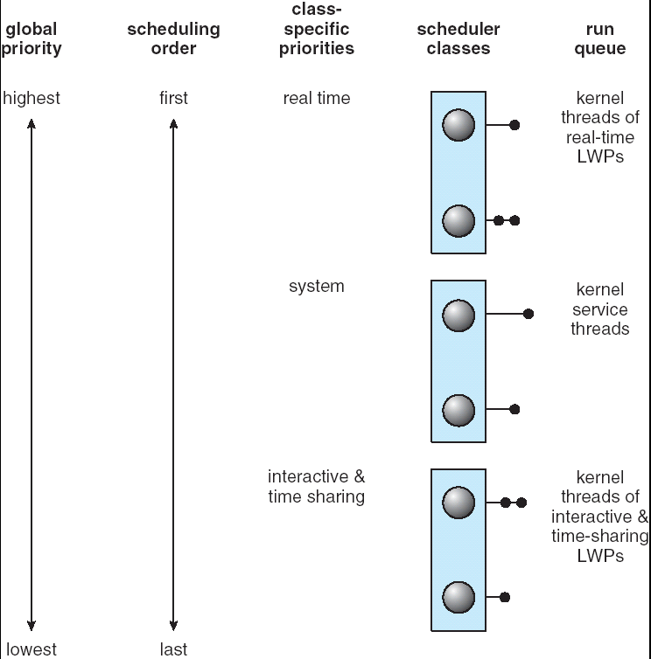
Solaris Scheduling: Priority-Based
Made by Najun

Slide 25
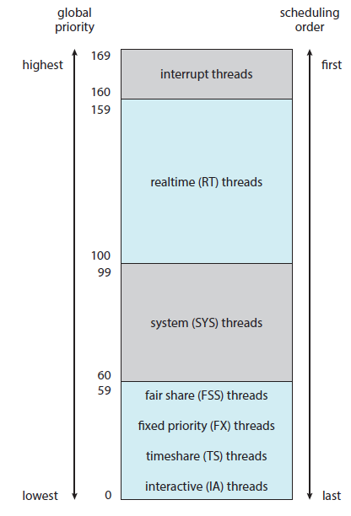
Solaris Scheduling: Priority-Based
Time Sharing
Interactive
Real Time
System
Fair Share
Fixed Priority
Made by Najun

Slide 26
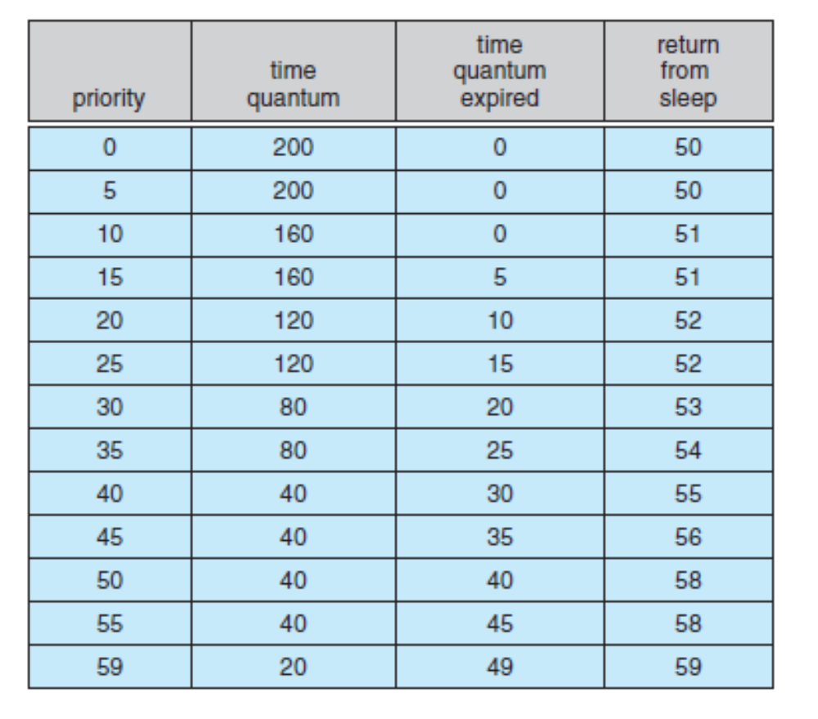
Solaris Scheduling: Priority-Based
Made by Najun

Slide 27
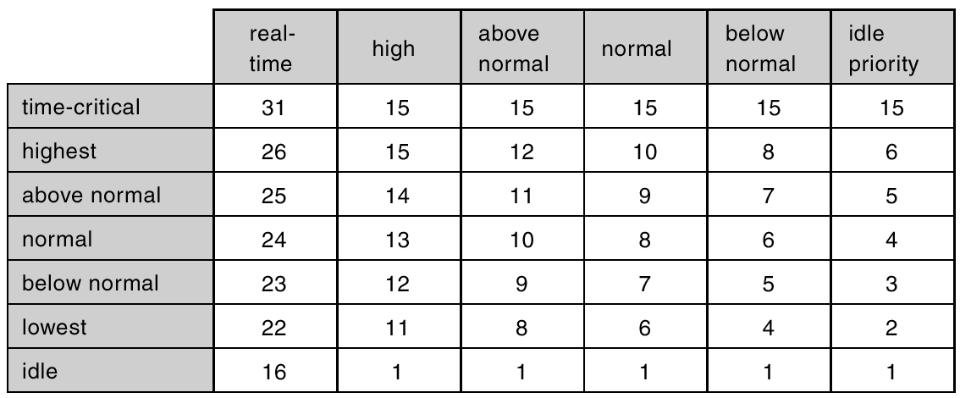
Windows 2000/XP Priorities
Made by Najun
Notes:
Windows使用基于优先级的抢占算法来调度线程
Windows的内核调度程序会选择一个线程一直运行，直到，抢占，终止，时间片已到，阻塞系统调用等情况，才会停止。
调度程序使用32级优先级方案。
Windows 内核和win32 api中的数值有一个对应关系，win32API定义了一个进程可能属于的优先级类型：
1 Real time priority class
2 high priority class
…
每一个优先级内部还定义了6个相对优先级

Slide 28
Linux
A variaion of the traditional UNIX scheduling algorithm.
Unlike other systems, Linux assigns higher-priority tasks longer time quanta and lower-priority tasks shorter time quanta.
Made by Najun
Notes:
活动的，到期的

Slide 29
Keystone
How to evaluate different algorithms
Made by Najun

Slide 30
Homework
Suppose that the following processes arrive for execution at the times indicated. Each process will run the listed amount of time. In answering the questions, use nonpreempive scheduling and base all decisions on the information you have at the time the decision must be made.
process arrival time burst time
P₁ 0.0 8
P₂ 0.4 4
P₃ 1.0 1
a. What is the average turnaround time for these processes with the FCFS scheduling algorithm
b. What is the average turnaround time for these processes with the SJF scheduling algorithm
c. Compute what the average turnaround time will be if the CPU is left idle for the first 1 unit and them SJF scheduling is used.
Made by Najun

Slide 31
Homework
What advantage is there in having different time-quantum sizes on different levels of a multilevel queueing system
Explain the differences in the degree to which the following scheduling algorithms discriminate in favor of short processes:
  FCFS
  RR
  Multilevel feedback queues
Made by Najun

Slide 32
Homework
Consider the following set of processes, with the length of the CPU-burst time given in milliseconds:
process burst time priority arrive
P₁ 10 3 0
P₂ 1 1 1
P₃ 2 3 2
P₄ 1 4 3
P₅ 5 2 4
The processes are assumed to have arrived in the order P₁, P₂, P₃, P₄, P₅, all at time 0.
a. Draw four Gantt charts illustrating the execution of these processes using FCFS, preemptive SJF, a preemptive priority (smaller priority implies higher priority), and RR (quantum=2) scheduling
b. What is the turnaround time of each process for each of the scheduling algorithms in part a
c. What is the waiting time of each process for each of the scheduling algorithms in part a
d. Which of the schedules in part a results in the minimal average waiting time (over all processes)

Slide 33
Principles of
Operating System
End of CPU Schedule Ⅱ

