Slide 1

Principles of
Operating System
Memory Management
Notes:
通常需要将多个进程同时放入内存中，因此需要考虑如何为输入队列中需要调入内存的进程分配内存空间。
程序进入内存的过程 编译 compile，链接 linker，载入，load
并发进程可能的内存分配方案。

Slide 2
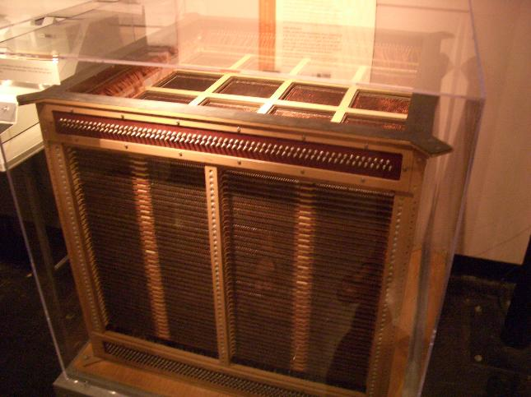
64kb of RAM
Made by Najun
Notes:
在计算机诞生初期并不存在内存条的概念，最早的内存是以磁芯的形式排列在线路上，每个磁芯与晶体管组成的一个双稳态电路作为一比特（BIT）的存储器，每一比特都要有玉米粒大小，可以想象一间的机房只能装下不超过百k字节左右的容量。后来才出线现了焊接在主板上集成内存芯片，以内存芯片的形式为计算机的运算提供直接支持。那时的内存芯片容量都特别小，最常见的莫过于256K×1bit、1M×4bit，虽然如此，但这相对于那时的运算任务来说却已经绰绰有余了。

Slide 3
The Early Computer Memory
Since the ENIAC -- the first computer to be used commercially, went into service in 1945, there have been only three major memory formats.
  In 1945, the ENIAC computer used thousands of vacuum tubes and had a memory of mercury and nickel wire delay lines.
  Between 1945 and 1954, delay lines, William tubes and magnetic drums was used as memory devices.
  In 1952 at MIT, Jay Forrester invented the Core Memory. A core was a small ring of ferrite, a ferromagnetic ceramic material that could be magnetized in either of two directions. This unique feature of core enabled it to hold a bit of information, either a 1 or 0, depending on the direction of the magnetic charge. Core memory was used in about 95% of all computers by 1976.
Made by Najun
Notes:
1945年，
1 ENIAC计算机使用的成千上万的真空管和有汞，镍丝延迟线存储器。
2 从1945年到1954年，延迟线，威廉管和磁鼓被用作存储装置。
3 1952 年，MIT的 JAY 发明了核心内存，一个核心是一个小的铁素体环，一种强磁性的陶瓷材料能够在两个方向下被磁化。这种核心的特殊性质能够使它保存一个比特的信息，是0还是1决定于磁核变化的方向。在1976年以前，95%的计算机都使用这种核心内存。

Slide 4
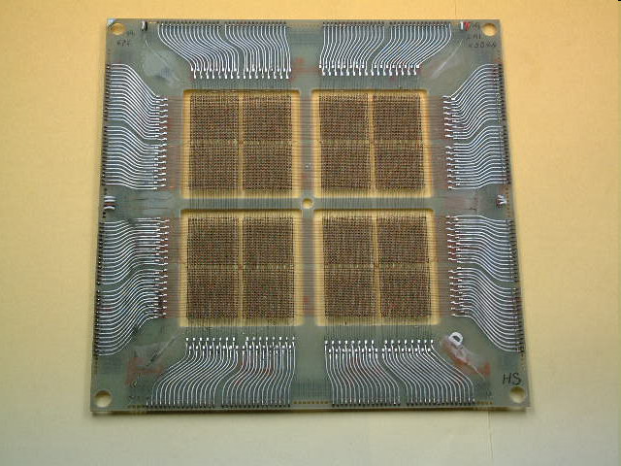
2048x8 bit Core Memory
Made by Najun

Slide 5
In 1974, transistor (semiconductor) memory had become economical and the move to this type of memory began .
Transistors led to integrated chips, which led to today's very highly integrated technology.
Today a typical memory contains 128 or 256 million bytes (8 bits) of information.
Made by Najun

Slide 6
The Birth Of The Semiconductors
In 1968 a small company called Intel was started and it's charter was to design, manufacture and market semiconductor memory components incorporating large scale integrated (LSI) technology.
The company saw an untapped market in the replacement of computer core memories by producing low-cost, standardized circuits in high volume.
The company's first successful product was the 3101 Schottky bipolar memory, a 64-bit high-speed static random access memory (RAM), introduced in 1969.
Made by Najun
Notes:
该公司的第一个成功的产品是3101肖特基双极内存，64位高速静态随机存取存储器（RAM），于1969年推出。

Slide 7
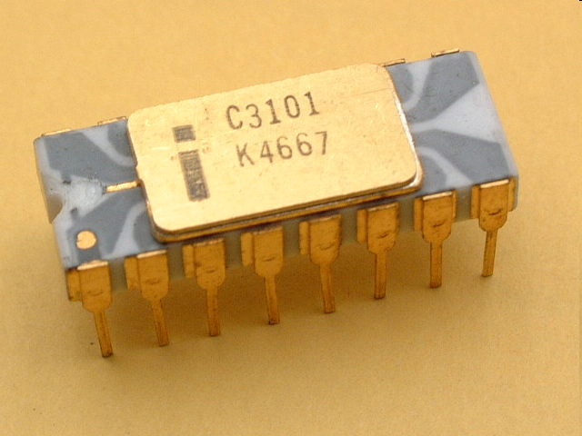
Early 3101 chip
Made by Najun

Slide 8
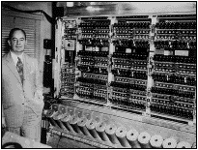
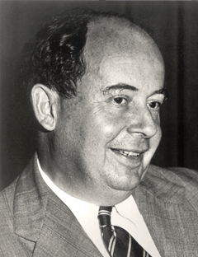
Von Neumann theory
John von Neumann, German mathematician, who was the first to design a computer with a working memory which is still widely adopted in modern computers.
The main point in Von Neumann theory is:
A digital computer should adopt binary counting and execute according the sequence pre-writen in a program.
Made by Najun
Notes:
从20世纪初，物理学和电子学科学家们就在争论制造可以进行数值计算的机器应该采用什么样的结构。人们被十进制这个人类习惯的计数方法所困扰。所以，那时以研制模拟计算机的呼声更为响亮和有力。
20世纪30年代中期，德国科学家冯·诺依曼大胆的提出，抛弃十进制，采用二进制作为数字计算机的数制基础。同时，他还提出预先编制计算程序，然后由计算机来按照人们事前制定的计算顺序来执行数值计算工作。
冯·诺依曼理论的要点是：数字计算机的数制采用二进制；计算机应该按照程序顺序执行。
人们把冯·诺依曼的这个理论称为冯·诺依曼体系结构。从ENIAC到当前最先进的计算机都采用的是冯·诺依曼体系结构。所以冯·诺依曼是当之无愧的数字计算机之父。

Slide 9
Storage in Von Neumann computers
Storage refers to computer components and recording media that retain digital data used for computing for some interval of time.
  Main memory: only large storage media that the CPU can access directly.
  Secondary storage: extension of main memory that provides large nonvolatile storage capacity, such as magnetic disk.

Slide 10

Storage structure
Storage systems are often organized in hierarchy according to their speed, cost and volatility.
Faster &
More expensive
volatile
nonvolatile

Slide 11

Performance of Various Levels of Storage
Movement between levels of storage hierarchy can be explicit or implicit

Slide 12


Roadmap
Background
Contiguous Allocation
Paging
Segmentation
Segmentation with Paging
Made by Najun

Slide 13
Background
Memory consists of a large array of bytes, each with its own address.
  The CPU fetches instructions from memory according to the value of the program counter.
  These instructions may cause additional loading from and storing to specific memory addresses
  Instruction Cycle
Program must be brought into memory and placed within a process for it to be run.
Input queue: collection of processes on the disk that are waiting to be brought into memory to run the program.
Made by Najun
Notes:
内存由很大一组字或字节所组成，每个字或字节都有它们自己的地址。CPU根据程序计数器PC的值从内存中提取指令。这些指令可能会引起进一步的对特定内存地址的读取和写入。
通常，程序以二进制可执行文件形式存储在磁盘上。为了执行，程序应被调入内存并放在进程内。
根据所使用内存管理方案，进程在执行时可以在磁盘和内存之间移动。在磁盘上等待调入内存以便执行的进程形成了输入队列。
通常的步骤是从输入队列中选择一个进程并装入内存。在进程执行时，会访问内存中的指令和数据。最后，进程终止，其地址空间将被释放。

Slide 14
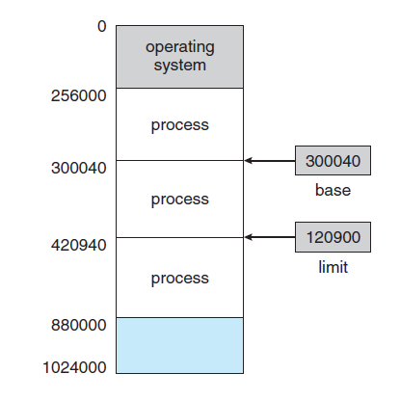
Background
4. We first need to make sure that each process has a separate memory space.
  Base register
  Limit register
Made by Najun

Slide 15
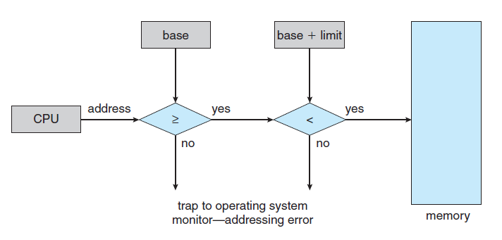
Background
Made by Najun

Slide 16

Multistep Processing of a User Program
User programs go through several steps before being run.
  Address may be represented in different ways during these steps.
Source program
Symbolic
address
Relocatable
address
Absolute
address
Compiler
&linker
Loader
Made by Najun
Notes:
许多系统允许用户进程放在物理内存的任意位置。因此，虽然计算机的地址空间从00000开始，但用户进程的开始地址不必也是00000。在绝大多数情况下，用户程序在执行前，需要经过好几个步骤，其中有的是可选的。
在这些步骤中，地址可能有不同的表示形式。
源程序中的地址通常是符号表示。
编译器通常将这些符号地址捆绑在可重定位的地址。
链接程序或加载程序再将这些可重定位的地址捆绑成绝对地址。
每次捆绑都是从一个地址空间到另一个地址空间的映射。
在多道程序环境中，要想将一个用户源代码变成一个可以在内存中执行的程序，通常分为三个步骤：编译、链接、载入。
（1）编译：由编译程序将用户的源代码编译成若干个目标模块。
（2）链接：由链接程序将编译后形成的一组目标模块以及它们所需要的库函数链接在一起，形成一个完整的载入模块。
（3）载入：由载入程序将载入模块载入内存。

Slide 17
Example of Addresses Conversion
Source program
Logic address space
Physical address space
0
Load A data1
data1 3456
Load A 200
3456
BA=1000
Load A 200
3456
100
1100
Address mapping
Compile & link
200
1200
Made by Najun
Notes:
请求用一个存储单元的内容填充一个通用寄存器通常称为LOAD指令 (这是一个机器指令)
1 将data1的内容读入寄存器中
2 编译后，逻辑地址200
3 载入后，实际地址200+1000

Slide 18
Binding of Instructions and Data to Memory
Address binding of instructions and data to memory addresses can happen at three different stages.
  Compile time: If you know at compile time where the process will reside in memory, then absolute code can be generated. If the starting location changes, recompiling may be required.
  Load time: Must generate relocatable code if memory location is not known at compile time.
  Execution time: Binding delayed until run time if the process can be moved during its execution from one memory segment to another. Need hardware support for address maps (e.g., base and limit registers).
Made by Najun
Notes:
通常，将指令与数据捆绑到内存地址可以在以下步骤地任何一步中执行：
编译时：如果在编译时就知道进程将在内存中的驻留地址，那么就可以生成绝对代码。
加载时：如果在编译时并不知道进程将驻留在何处，那么编译器就必须生成可重定位的代码。对这种情况，最后捆绑会延迟到加载时才进行。如果开始地址发生变化，只需重新加载用户代码以引入改变值。
执行时：如果进程在执行时可以从一个内存段移到另一个内存，那么捆绑必须延迟到执行时才进行。

Slide 19
Logical vs. Physical Address Space
  Logical address : generated by the CPU; also referred to as virtual address.
  Physical address : address seen by the memory unit.
Logical and physical addresses:
  are the same in compile-time and load-time address-binding schemes;
  differ in execution-time address-binding scheme.
  The concept of a logical address space that is bound to a separate physical address space is central to proper memory management.
Made by Najun
Notes:
CPU所生成的地址通常称为逻辑地址，而内存单元所看到的地址通常称为物理地址。
编译时和加载时的地址捆绑生成相同的逻辑地址和物理地址。但是，执行时的地址捆绑方案导致不同的逻辑地址和物理地址。

Slide 20
Memory-Management Unit (MMU)
MMU: is a hardware device that maps virtual to physical address.
In MMU scheme, the value in the relocation register is added to every address generated by a user process at the time it is sent to memory.
  The user program deals with logical addresses;
  It never sees the real physical addresses;
  The memory mapping hardware converts logical addresses into physical addresses.
Made by Najun
Notes:
运行时从虚拟地址到物理地址的映射是由称为内存管理单元（MMU）的硬件设备来完成的。
在MMU方案中，用户进程所生成的地址在送交内存之前，都将加上重定位寄存器的值。用户程序决不会看到真正的物理地址。用户程序处理逻辑地址。内存映射硬件将逻辑地址转变为物理地址。

Slide 21

Example of Dynamic Relocation
Made by Najun

Slide 22
Dynamic Loading
The size of a process is limited to the size of physical memory. To obtain better memory space utilization, dynamic loading is used.
With dynamic loading
  Routine is not loaded until it is called
  All routines are kept on disk in a relocatable load format.
The advantage is: an unused routine is never loaded.
  Useful when large amounts of code are needed to handle infrequently occurring cases.
No special support from the operating system is required implemented through program design.
Made by Najun
Notes:
进程的大小受内存大小的限制。为了获得更好的内存空间使用率，可以使用动态加载。
在动态加载中：一个字程序只有在调用时才被加载。所有子程序都以可重定位的形式保存在磁盘上。
动态加载的优点是不用的子程序决不会被装入内存。如果大多数代码需要用来处理异常情况，如错误处理，那么这种方法特别有用。对这种情况，虽然总体上程序比较大，但是所有使用的部分（即加载的部分）可能很小。
动态加载不需要操作系统提供特别的支持。利用这种方法来设计程序主要是用户的责任。

Slide 23
Dynamic Linking
Linking postponed until execution time.
Stub: is a small piece of code, used to locate the appropriate memory-resident library routine.
  Stub replaces itself with the address of the routine, and executes the routine.
Operating system needed to check if routine is in processes’ memory address.
Dynamic linking is particularly useful for libraries.
Made by Najun
Notes:
动态链接是将链接延迟到运行时。
存根是一小段代码，用来指出如何定位适当的内存驻留库程序，或如果该程序不在内存时应如何装入库。
当存根执行时，它首先检查所需子程序是否已在内存中。如果不在，就将子程序装入内存。不管如何，存根会用子程序地址来替换自己，并开始执行子程序。
动态链接也可用于库更新（如改进版）。

Slide 24
Overlays
Object: to enable a process to be larger than the amount of memory allocated to it.
Idea: keep in memory only those instructions and data that are needed at any given time.
Implemented by user, no special support needed from operating system, programming design of overlay structure is complex.
Made by Najun
Notes:
为了能让进程比它所分配到的内存空间大，可以使用覆盖（overlay）。
覆盖的基本思想是在任何时候只在内存中保留所需的指令和数据。当需要其它指令时，它们会装入到刚刚不再需要的指令所占用的内存空间内。

Slide 25
Overlays for a Two-Pass Assembler
Assume that the sizes of these components are as follows:
Pass 1 70KB
Pass 2 80KB
Symbol table 20KB
Common routines 30KB
If only 150KB is available, what should we do?
Solution
Made by Najun

Slide 26

Symbol
table
Common
routine
Pass 1
Overlay driver
Pass 2
Made by Najun

Slide 27

Swapping
A process can be swapped temporarily out of memory to a backing store, and then brought back into memory for continued execution.
Made by Najun
Notes:
进程需要在内存中以便执行。不过，进程可以暂时从内存中交换出来到备份存储上，当需要再执行时再调回到内存中。
扩展的ready队列，包括内存和backing stroe中的等待程序。
CPU调度算法采用轮转法。

Slide 28
Swapping (cont.)
A variant of this swapping policy is used for priority-based scheduling algorithms.
  Roll out, roll in: if a higher-priority process arrives and wants service, the memory manager can swap out (roll out) the lower-priority process to load and execute the higher priority process (roll in).
Major part of swap time is transfer time; total transfer time is directly proportional to the amount of memory swapped.
Modified versions of swapping are found on many systems, i.e., UNIX, Linux, and Windows.
Made by Najun

Slide 29
Roadmap
Background
Contiguous Allocation
Paging
Segmentation
Segmentation with Paging
Made by Najun

Slide 30
Memory management schemes
Memory management
techniques
Contiguous
allocation
Non-contiguous
allocation
Single
partition
allocation
Multiple
partition
allocation
Paging
Segmentation
Fixed
partition
Variable
partition
Notes:
内存定义；程序载入到内存；地址绑定；逻辑地址，物理地址；动态加载；动态链接；swapping

Slide 31
Contiguous Allocation
Main memory is usually divided into two partitions:
  Resident operating system, usually held in low memory with interrupt vector.
  User processes then held in high memory.
In contiguous memory allocation, each process is contained in a single contiguous section of memory.
Made by Najun
Notes:
内存通常分为两个区域：一个用于驻留操作系统，另一个用于用户进程。
操作系统可以放在低内存也可以放在高内存，由于中断向量通常位于低内存，因此程序员通常将操作系统也放在低内存。
通常需要将多个进程同时放入内存中，因此需要考虑如何为输入队列中需要调入内存的进程分配内存空间。

Slide 32
Memory Protection
How to protect the OS from user processes, and protect user processes from one another:
  Use relocation-register, which contains value of smallest physical address.
  Use limit register, which contains range of logical addresses.
  Each logical address must be less than the limit register.
  The MMU maps the logical address dynamically by adding the value in the relocation register.
Made by Najun
Notes:
通过采用重定位寄存器和界限寄存器，可以实现对内存的保护。重定位寄存器含有最小的物理地址值；界限寄存器含有逻辑地址的值。
有了重定位寄存器和界限寄存器，每个逻辑地址必须小于界限寄存器；MMU动态地将逻辑地址加上重定位寄存器的值后映射成物理地址。映射后的物理地址在送交给内存单元。

Slide 33

Hardware Support for Relocation and Limit Registers
Made by Najun
Notes:
当CPU调度器选择一个进程来执行时，作为上下文切换工作的一部分，调度程序会用正确的值来初始化重定位寄存器和界限地址寄存器。
当CPU所产生的每一个地址都需要与寄存器相比较，保证操作系统进程和其他用户进程不受当前进程的影响。

Slide 34
Contiguous Allocation (Cont.)
Variable-partition allocation
  Hole: block of available memory; holes of various size are scattered throughout memory.
  When a process arrives, it is allocated memory from a hole large enough to accommodate it.
  Operating system maintains information about:
  a) allocated partitions b) free partitions (hole)
OS
OS
OS
OS
process 5
process 5
process 5
process 5
process 9
process 9
process 8
process 10
process 2
process 2
process 2
process 2
Made by Najun
Notes:
最为简单的内存分配方法之一就是将内存分为多个固定大小的分区。每个分区只能容纳一个进程。IBM OS/360
操作系统有一个表用于记录哪些内存可用和哪些内存已用。一开始，所有内存都可用于用户进程，因此能够作为一个大块可用内存，称为孔。通常，一组不同大小的孔分散在内存中。
当有新进程需要内存时，为该进程查找足够大的孔。如果找到，可以为该进程分配所需的内存，未分配的可以下次再用。如果孔太大，那么就分为两块：一块分配给新进程；另一块还回到孔集合。当进程终止时，它将释放其内存，该内存将还给孔集合。如果新孔与其它孔相邻，那么将这些孔合并成大孔。这时，系统可以检查是否有进程在等内存空间，新合并的内存空间是否满足等待进程。

Slide 35
Dynamic Storage-Allocation Problem
How to satisfy a request of size n from a list of free holes.
  First-fit: Allocate the first hole that is big enough.
  Best-fit: Allocate the smallest hole that is big enough; must search entire list, unless ordered by size. Produces the smallest leftover hole.
  Worst-fit: Allocate the largest hole; must also search entire list. Produces the largest leftover hole.
First-fit and best-fit better than worst-fit in terms of speed and storage utilization.
Made by Najun
Notes:
从一组大小不同的可用孔中选择一个空闲孔的最为常用方法有：
首次适应：分配第一个足够大的孔。
最佳适应：分配最小的足够孔。
最差适应：分配最大的孔。
模拟结果显示首次适应核最好适应在执行时间和利用空间方面都好于最差适应。首次适应和最好适应在利用空间方面难分伯仲，但是首次适应要快些。

Slide 36
Fragmentation
External Fragmentation: total memory space exists to satisfy a request, but it is not contiguous.
Internal Fragmentation: allocated memory may be slightly larger than requested memory; this size difference is memory internal to a partition, but not being used.
Made by Najun
Notes:
这些算法都有外部碎片。随着进程装入和移出内存，自由内存空间被分为小片段。当所有总的内存之和可以满足请求，但并不连续时，就出现了外部碎片问题。
通常将内存以固定大小的块为单元来分配。采用这种方案，进程所分配的内存可能比所需要的要大。这两个数字之差称为内部碎片，这部分内存在分区内，而又不能用。

Slide 37
Fragmentation (cont.)
Reduce external fragmentation by compaction
  Shuffle memory contents to place all free memory together in one large block.
  Compaction is possible only if relocation is dynamic, and is done at execution time. Why？
Made by Najun
Notes:
一种解决外部碎片问题的方法是紧缩。紧缩的目的是移动内存内容，以便所有空闲空间合并成一整块。紧缩是有一定条件的，要求重定位是动态的。
另一种可能解决外部碎片问题的方法是允许物理地址空间为非连续，这样只要有物理内存就可为进程分配。

Slide 38
Roadmap
Background
Contiguous Allocation
Paging
Segmentation
Segmentation with Paging
Made by Najun

Slide 39
Memory management schemes
Memory management
techniques
Contiguous
allocation
Non-contiguous
allocation
Single
partition
allocation
Multiple
partition
allocation
Paging
Segmentation
Fixed
partition
Variable
partition

Slide 40
Paging
Paging permits the physical address space of a process to be non-contiguous.
  Divide physical memory into fixed-sized blocks called frames (size is power of 2, between 512 bytes and 8192 bytes).
  Divide logical memory into blocks of same size called pages.
  Page Table
Made by Najun
Notes:
分页内存管理方案允许进程的物理地址空间可以是非连续的。用户的视角：逻辑内存是连续的；系统视角：物理内存是非连续的
传统而言，分页支持一直由硬件来处理的。然而，最近的设计是通过将硬件和操作系统相配合来实现分页。
物理内存分为固定大小的块，称为帧。
逻辑内存也分为同样大小的块，称为页。
备份存储也可分为固定大小的块，其大小与内存的帧一样。
页大小（与帧大小一样）是由硬件来决定的。页的大小通常为2的幂，根据计算机结构的不同，其大小从512B到16MB字节不等。

Slide 41
Address Translation Scheme
Address generated by CPU is divided into:
  Page number (p) : used as an index into a page table which contains base address of each page in physical memory
  Page offset (d) : combined with base address to define the physical memory address that is sent to the memory unit
  For given logical address space 2^{m} and page size 2^{n}
page number
page offset
p
d
m - n
n
Made by Najun
Notes:
由CPU所生成的每个地址分为两个部分：页码p和页偏移d。页码作为页表中的索引。页表包含每页所在物理内存的基地址。这些基地址于页偏移的组合就形成了物理地址，就可送交物理单元。

Slide 42

Address Translation Architecture
Made by Najun
Notes:
分页的硬件支持

Slide 43

Paging Model of Logical and Physical Memory
Made by Najun
Notes:
逻辑内存和物理内存的分页模型

Slide 44

Paging Example (cont.)
Page size: 4 bytes
Physical memory: 32bytes
Logical address 0 is page 0,
offset 0.
logical
address
physical address
0
5*4+0=20
3
5*4+3=23
4
6*4+0=24
Made by Najun
Notes:
使用4B的页对32B的内存进行分页的例子。
10,k :1010

Slide 45
Fragmentation Problem
Paging itself is a form of dynamic relocation.
  Every logical address is bound by the paging hardware to some physical address.
  Using paging is similar to using a table of base (or relocation) registers, one for each frame of memory.
Using paging scheme, there is no external fragmentation, but may be some internal fragmentation.
Page size is 2048 B, process size 72776B, What’s the number of internal fragmentation
Made by Najun
Notes:
采用分页技术不会产生外部碎片：每个帧都可以分配给需要它的进程。不过，分页有内部碎片。
注意分配是以帧为单位进行的。如果进程所要求的内存并不是页的整数倍，那么最后一个帧就可能用不完。
需要35个页，和1086B, 共需要36个帧，2048-1086=962 B 内部碎片。

Slide 46
Page Size
Pages typically are between 4KB and 8KB, and some system support even lager page sizes.
Each page-table entry is usually 4 bytes long, but that size can vary as well.
  A 32-bit entry can point to one of 2³² physical page frames.
  If a frame is 4KB, then a system with 4-byte entries can address 2⁴⁴ bytes of physical memory.
Made by Najun
Notes:
随着时间的推移，页的大小也随着进程、数据和内存的不断增大而增大。现在，页大小通常为4KB或8KB，有的系统可能支持更大的页。
Solaris支持8K 或者4M的页。
每个页表的条目通常为4B，不过这是可变的。

Slide 47

Free Frames
Before allocation
After allocation
Made by Najun
Notes:
当系统需要执行一个进程时，它将检查该进程所需要的页数。因此，如果进程需要n页，那么内存中至少应有n个帧。如果有，那么就可分配给新进程。进程的第一页装入一个已分配的帧，帧号放入进程的页表中。下一页分配给另一帧，其帧号也放入进程的页表中。

Slide 48
Feature of Paging
An important aspect of paging is the clear separation between the user’s view of memory and the actual physical memory.
  The difference between the user’s view of memory and the actual physical memory is reconciled by the address-translation hardware.
  Frame Table
Made by Najun

Slide 49
Implementation of Page Table
Registers
Page table is kept in main memory.
  Page-table base register (PTBR) points to the page table.
  Page-table length register (PTLR) indicates size of the page table.
  In this scheme every data/instruction access requires two memory accesses.
    One for the page table and one for the data/instruction.
Made by Najun
Notes:
1 页表的硬件实现有多种方法。最为简单的一种方法是将页表作为一组专用寄存器来实现。CPU分派程序在装入其他寄存器时，也需要装入这些寄存器。只有操作系统才能修改内存映射图。16(65536) 8k 8
2 页表非常大的时候，采用快速寄存器来实现页表就不可行了。因而需要将页表放在内存中，并将页表基寄存器（PTBR）指向页表。改变页表只需改变这一寄存器即可，这也大大降低了切换时间。然而，需要两次访问内存，造成无法忍受的延迟。
3 转换表缓冲器,TLB 解决方法是采用小但专用且快速的硬件缓冲，这种缓冲称为翻译后备缓冲器（TLB）。TLB只包括页表中的一小部分条目。当CPU产生逻辑地址后，其页号提交给TLB。如果找到页号，那么也就得到了帧号，并可用来访问内存。整个任务与不采用内存映射相比，其时间长度缩短了10%。
一个进程很少会使用其所有的地址空间。事实上，许多进程只使用一小部分可用的地址空间。页表长度寄存器PTLR用来表示页表的大小，该寄存器的值可用于检查每个逻辑地址以验证其是否位于进程的有效范围内。如果检查无法通过，会被操作系统捕捉到。

Slide 50
Implementation of Page Table
3. TLB
  The two memory access problem can be solved by the use of a special fast-lookup hardware cache called associative memory or translation look-aside buffers (TLBs)
    Fast but expensive
    64-1024.
    For one process, TLB only includes part of the page table
Made by Najun

Slide 51
TLB - (Associative Memory)
TLB - parallel search
Address translation (PageNo., FrameNo.)
  If PageNo. is in associative register, get FrameNo. out.
  Otherwise get FrameNo. from page table in memory
Page #
Frame #
Made by Najun
Notes:
不按地址而按给定内容的特征进行存取的存储器。联想存储器的特点是：①除有存储功能外，还具有信息处理功能。它能根据送来内容的特征查找存储单元。②对各个存储单元并行进行查找，因而能显著提高查找速度。这些特点与人脑的“联想”功能有所相似，因而被称为联想存储器。

Slide 52

Paging Hardware With TLB
Made by Najun

Slide 53
Effective Memory-Access Time
The percentage of times that a particular page number is found in the TLB is called the hit ratio.
  80% hit ratio means that we find the desired page number in the TLB 80 percent of the time.
If it takes 20ns to search the TLB, and 100ns to access memory, then the effective memory-access time is:
0.8*120+0.2*220=140ns
Made by Najun
Notes:
TLB 命中，TLB 失效
页号在TLB中被查找到的概率为命中率

Slide 54
Effective Memory-Access Time (cont.)
Associative Lookup = ε time unit
Assume memory cycle time is 1 ms
Hit ratio = α
Effective Access Time (EAT)
EAT = (1 + ε) α + (2 + ε)(1 – α) = 2 + ε – α
Made by Najun

Slide 55
Memory Protection
Memory protection implemented by associating protection bit with each frame.
Valid-invalid bit attached to each entry in the page table:
  “valid” indicates that the associated page is in the process’ logical address space, and is thus a legal page.
  “invalid” indicates that the page is not in the process’ logical address space.
Made by Najun
Notes:
在分页环境下，内存保护是通过与每个帧相关联的保护位来实现的。通常这些位保存在页表中，任何一位都能定义一个页是可读、可写或只可读。
有效无效位与页表中的每一条目相关联：
当该位有效时，该值表示相关的页在进程的逻辑地址空间内，因此是合法的页。
该位无效时，该值表示相关的页不在进程的逻辑地址空间内

Slide 56

Valid (v) or Invalid (i) Bit In A Page Table
Made by Najun
Notes:
对于14位地址空间，0-16383，有一个程序有效地址空间是0-10468，页大小为2KB，
10468/2048 = 5.11
如果在地址范围内的所有页都建立一个条目，非常浪费
大多数系统，使用 页表长度寄存器 page table length register, PTLR

Slide 57
Page Table Structure
Hierarchical Paging
Hashed Page Tables
Inverted Page Tables
Made by Najun

Slide 58
Hierarchical Page Tables
Most modern computer systems support a large logical address space, in which the page table becomes excessively large.
  32 bit logical address space, 4KB page
  Each entry in page table is 4B.
  The size of page table is 4MB
Issue: we would not want to allocate the page table contiguously in main memory.
Solution: Break up the logical address space into multiple page tables.
A simple technique is a two-level page table.
Made by Najun
Notes:
绝大多数现代计算机系统支持大逻辑地址空间。在这种情况下，页表本身可以非常大。显然，人们并不愿意在内存中连续第分配这个页表。这个问题的一个简单解决是将页表划分成更小部分。
完成上述划分有许多方法，一种方法是使用两层分页算法，就是将页表再分页。

Slide 59

Two-Level Page-Table Scheme
Made by Najun
Notes:
将进程逻辑上分成等大的块，叫进程的页
将页表逻辑上分成等大的块，交页表的页

Slide 60
Two-Level Paging Example
A logical address (on 32-bit machine with 4K page size) is divided into:
  a page number consisting of 20 bits.（m-n）
  a page offset consisting of 12 bits.（n）
Since the page table is paged, the page number is further divided into:
  a 10-bit page number.
  a 10-bit page offset.
Thus, a logical address is as follows:
where p₁ is an index into the outer page table, and p₂ is the displacement within the page of outer page table.
page number
page offset
p₁
p₂
d
10
10
12
Made by Najun
Notes:
P1 是用来访问外部页表的索引
P2 是外部页表的页偏移

Slide 61

Address-Translation Scheme
Address-translation scheme for a two-level 32-bit paging architecture
Made by Najun
Notes:
Page of page table page为固定大小的块，将page table分为很多固定跟大小的块，则每一个块为一个page，page of page talbe 可翻译为原始大页表中的一个固定大小的块，被outer page table 索引

Slide 62


Three-level Paging Scheme
Made by Najun

Slide 63
Hashed Page Tables
Common in address spaces > 32 bits.
The virtual page number is hashed into a page table. This page table contains a chain of elements hashing to the same location.
Virtual page numbers are compared in this chain searching for a match.
  If a match is found, the corresponding physical frame is extracted.
Made by Najun
Notes:
处理超过32bit地址空间的常用方法是使用哈希页表，并以虚拟页码作为哈希值。
哈希页表的每一条目都包括一个链接组的元素，这些元素哈希成同一位置。
每个元素有三个域：虚拟页码、所映射的帧号和指向链表中下一个元素的指针。

Slide 64

Hashed Page Table
Made by Najun
Notes:
该算法工作过程：虚拟地址中的虚拟页码转换到哈希表中。用虚拟页码与链表中的每一个元素的第一个域相比较。如果匹配，那么相应的帧号就用来形成物理地址。如果不匹配，那么就对联表中的下一个域进行比较页码。

Slide 65
Inverted Page Table
One entry for each real page of memory.
Each entry consists of the virtual address of the page stored in that real memory location, with information about the process that owns that page.
Only one page table is in the system, and it has only one entry for each page of physical memory.
Made by Najun
Notes:
反向页表对于每个真正的内存页或帧才有一个条目。每个条目包含保存在真正内存位置的页的虚拟地址，以及拥有该页的进程的信息。因此，每个物理内存的页只有一条相应的条目。

Slide 66

Inverted Page Table Architecture
Made by Najun

Slide 67
Feature of Inverted Page Table
Although this scheme decreases the amount of memory needed to store each page table, it increases the amount of time needed to search the table when a page reference occurs.
Can use hash table to limit the search to one —— or at most a few —— page-table entries.
Made by Najun

Slide 68
Shared Pages
Shared code
  One copy of read-only (reentrant) code shared among processes (i.e., text editors, compilers, window systems).
  Shared code must appear in same location in the logical address space of all processes.
Private code and data
  Each process keeps a separate copy of the code and data.
  The pages for the private code and data can appear anywhere in the logical address space.
Made by Najun
Notes:
分页的另一个特点是可以共享共同代码。这一点对分时环境特别重要。
一个支持40个用户的体统，每个用户需要文本编辑器150KB,HE 50KB 的数据空间，则40个用户需要8000KB。

Slide 69
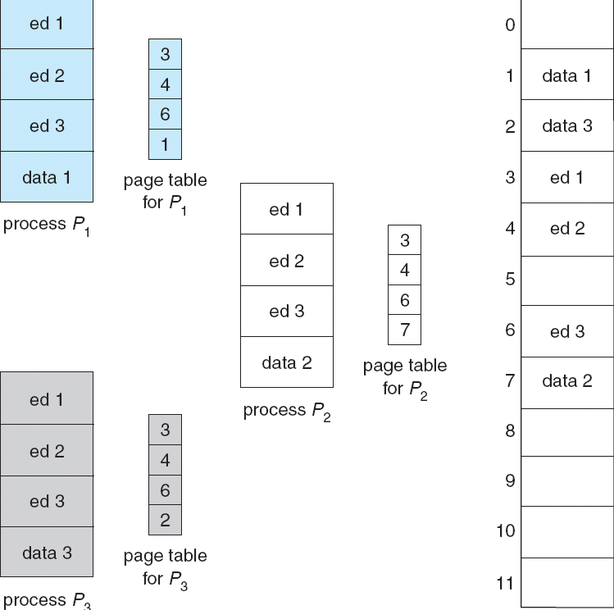
Shared Pages Example
Made by Najun
Notes:
可重入代码 reentrant code: 是不能自我修改的代码，不会再执行期间发生改变。

Slide 70
Roadmap
Background
Contiguous Allocation
Paging
Segmentation
Segmentation with Paging
Made by Najun

Slide 71
Memory management schemes
Memory management
techniques
Contiguous
allocation
Non-contiguous
allocation
Single
partition
allocation
Multiple
partition
allocation
Paging
Segmentation
Fixed
partition
Variable
partition

Slide 72
Segmentation
Memory-management scheme that supports user view of memory.
A program is a collection of segments.
A segment is a logical unit such as:
  main program, procedure, function, method, object, local variables, global variables, common block, stack, symbol table, arrays
Made by Najun
Notes:
分页内存管理中：用户观点的内存和实际内存分离。用户观点的内存需要映射到实际内存。然而，用户并不会希望把内存看作一个线性字节数组，有的包含指令而其他的包含数据。
用户通常会愿意将内存看做为一组不同长度的段的集合，这些段之间并没有一定的顺序。
分段是支持用户观点的内存管理方案。

Slide 73

User’s View of a Program
Made by Najun

Slide 74
Logical View of Segmentation
1
1
4
2
3
4
2
3
user space
physical memory space
Made by Najun

Slide 75
Segmentation Architecture
Logical address consists of a two tuple:
<segment-number, offset>
Segment table: maps two-dimensional logic addresses to one-dimensional physical addresses.
Each table entry has:
  Base: contains the starting physical address where the segments reside in memory.
  Limit: specifies the length of the segment.
Made by Najun
Notes:
逻辑地址空间是由一组段组成。每个段都有名称和长度。地址指定了段名称和段内偏移。
为了实现简单起见，段是编号的，是通过段号而不是段名来引用的。因此，逻辑地址由两个元素组成：<段号，偏移>。
物理内存是一维序列的字节。因此，必须定义一个实现方式，以便将二维的用户定义地址映射为一维物理地址。这个地址是通过段表实现的。
段表的每个条目都有段基地址和段界限。段基地址包含该段在内存中的开始物理地址，而段界限制定该段的长度。

Slide 76
Segmentation Architecture (cont.)
Segment-table base register (STBR) points to the segment table’s location in memory.
Segment-table length register (STLR) indicates number of segments used by a program;
  segment number s is legal if s < STLR.
Made by Najun

Slide 77

Segmentation Hardware
Made by Najun
Notes:
一个逻辑地址由两部分组成：段号s和段内的偏移d。段号用做段表的索引。逻辑地址的偏移d应位于0和段界限之间。如果不是这样，则会陷入到操作系统中。如果偏移d合法，那么就与级地址相加而得到所需字节在物理内存的地址。因此段表是一组基址和界限寄存器对。

Slide 78

Example of Segmentation
Made by Najun
Notes:
有5个段，按0到4来编号。各段按图所示存储。每个段都在段表中有一个条目，它包括段在物理内存中的开始地址和该段的长度（界限）。例如，段2为长400B，开始位于4300。因此，对段2字节53的引用影射成位置4300+53=4253。段0字节1222的引用会陷入操作系统，这是由于该段仅为1000B长。

Slide 79

Segmentation Architecture (cont.)
Advantages of segmentation:
  the association of protection with the segments.
  the sharing of code or data.
Made by Najun
Notes:
分段的一个显著优点是可以将段与对其的保护相关联。因为段内所有内容可能会按同样方式使用。因此有的段是指令，而有的段是数据。内存映射硬件会检查与段条目相关联的保护位以防止对内存的非法访问。
分段的另一个优点是关于代码或数据的共享。每个进程都有一个段表，当该进程被允许使用CPU时，分派程序会定义一个硬件段表。当两个进程的某些条目指向同一个物理位置时，就可以共享段。

Slide 80
Roadmap
Background
Contiguous Allocation
Paging
Segmentation
Segmentation with Paging
Made by Najun

Slide 81
Segmentation with Paging
Paging the segments can solve problems of external fragmentation and lengthy search times.
Solution differs from pure segmentation in that the segment-table entry contains not the base address of the segment, but rather the base address of a page table for this segment.
Made by Najun

Slide 82

Address Translation Scheme
Made by Najun
Notes:
MULTICS

Slide 83

Segmentation with Paging – Intel 386
The Intel 386 uses segmentation with paging for memory management with a two-level paging scheme.
Made by Najun
Notes:
1 Pentium结构允许一个段的大小最大可达4G，每个进程最多的段的数量为16K个。
2 逻辑地址分为两个部分：1 私有部分，最多有8K个段，信息保存在本地描述符表，LDT，每个条目8B，包括基地址和段界限
2 共享部分，最多有8K个段，信息保存在全局描述符表，GDT中，每个条目8B，包括基地址和段界限
3 逻辑地址是一对（selector, offset）来表示，selector 16位，offset32位
selector：13位 段号；1位表示在LDT还是GDT中；2位保护位
offset：共32bit
生成32位线性地址，包括10bit 页目录，10比特页表，12比特偏移量，最终找到物理地址。

Slide 84
Keystone
Definition of logical and physical address
Different kinds of algorithms address mapping
  Continuous memory allocation
  Paging
  Segmentation
  Segmentation with paging
Made by Najun

Slide 85
Homework
Given memory partitions of 100K, 500K, 200K, 300K, and 600K (in order), how would each of the First-fit, Best-fit, and Worst-fit algorithms place processes of 212K, 417K, 112K, and 426K (in order)? Which algorithm makes the most efficient use of memory?
Consider a logical address space of eight pages of 1024 words each, mapped onto a physical memory of 32 frames.
  a. How many bits are there in the logical address?
  b. How many bits are there in the physical address?
Made by Najun

Slide 86
Homework
Consider the following segment table:
Segment Base Length
0 219 600
1 2300 14
2 90 100
3 1327 580
4 1952 96
What are the physical addresses for the following logical addresses?
  a.0,430
  b.1,10
  c.2,500
  d.3,400
  e.4,112
Made by Najun

Slide 87
Principles of
Operating System
End of Memory Management

