Slide 1

Principles of
Operating System
Virtual Memory
Notes:
上一章所介绍的各种内存管理策略，都有一个目的：同时将多个进程存放在内存中，以便允许多道程序设计。不过，这些策略都需要在进程执行之前将整个进程放在内存中。
1 有的作业很大
2 大量作业要求运行
局部性原理：1968年 Denning.指出程序在执行时呈现出局部性规律，即在一个较短的时间内，程序的执行仅局限于某个部分。相应的，它所访问的存储空间也局限于某个部分。局部为使用的页的集合。
基于局部性原理，应用程序在运行前，没有必要全部装入内存，只将当前需要的页面调入即可。
。。。
这样可以使一个大的程序在较小的内存中运行。
虚拟内存：是指具有请求调页功能和页置换功能，能从逻辑上对内存容量进行扩充的一种存储系统。

Slide 2


Roadmap
Background
Demand Paging
Process Creation
Page Replacement
Allocation of Frames
Thrashing
Other Considerations
Made by Najun

Slide 3
Background
Virtual memory: separation of user logical memory from physical memory.
  Only part of the program needs to be in memory for execution.
  Logical address space can therefore be much larger than physical address space.
  Allows address spaces to be shared by several processes.
  Allows for more efficient process creation.
Virtual memory can be implemented via:
  Demand paging
  Demand segmentation
Made by Najun
Notes:
虚拟内存技术允许进程的执行不必完全在内存中。这种方案的一个很大的优点就是程序可以比物理内存大。而且，虚拟内存将内存抽象成一个巨大的、统一的存储数组，进而将用户看到的逻辑内存与物理内存分开。
能够执行只有部分在内存中的程序会有很多好处：
程序不再受现有的物理内存空间限制。
因为每个用户程序使用了更少的物理内存，所以更多的程序可以同时执行。
由于装入或交换每个用户程序到内存中所需的I/O会更少，用户程序会运行的更快。
因此，运行一部分在内存中的程序不但有利系统也有利于用户。
虚拟内存将用户逻辑内存与物理内存分开。这在现有物理内存有限的情况下，为程序员提供了巨大的虚拟内存。
虚拟内存通常采用请求页面调度来实现。它也可以在分段系统上实现。
请求分段调度也可用来实现虚拟内存。由于段是不定长的，段置换算法要比页置换算法复杂得多。

Slide 4
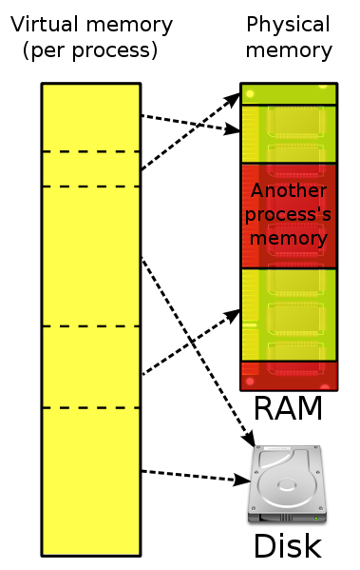
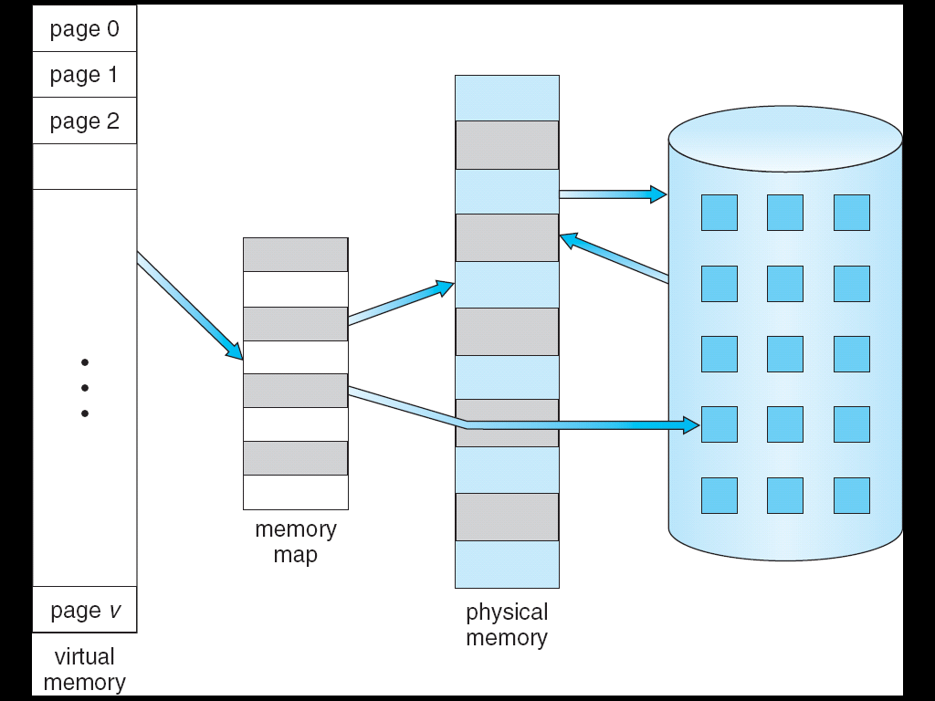
Virtual Memory That is Larger Than Physical Memory
Made by Najun

Slide 5
Roadmap
Background
Demand Paging
Process Creation
Page Replacement
Allocation of Frames
Thrashing
Other Considerations
Made by Najun

Slide 6
Demand Paging
Bring a page into memory only when it is needed.
  Less I/O needed
  Less memory needed
  Faster response
  More users
Page is needed ⇒ reference to it
  invalid reference ⇒ abort
  not-in-memory ⇒ bring to memory
Made by Najun
Notes:
请求页面调度系统类似于分页系统加上交换。当需要执行进程时，不是将整个进程换入内存，而是需要页时才调入。
当换入进程时，调页程序推测在该进程再次换出之前会用到哪些页。调页程序不是换入整个进程，而是把那些必需的页调入内存。这样，调页程序就避免了读入那些不使用的页，也减少了交换时间和所需的物理内存空间。

Slide 7
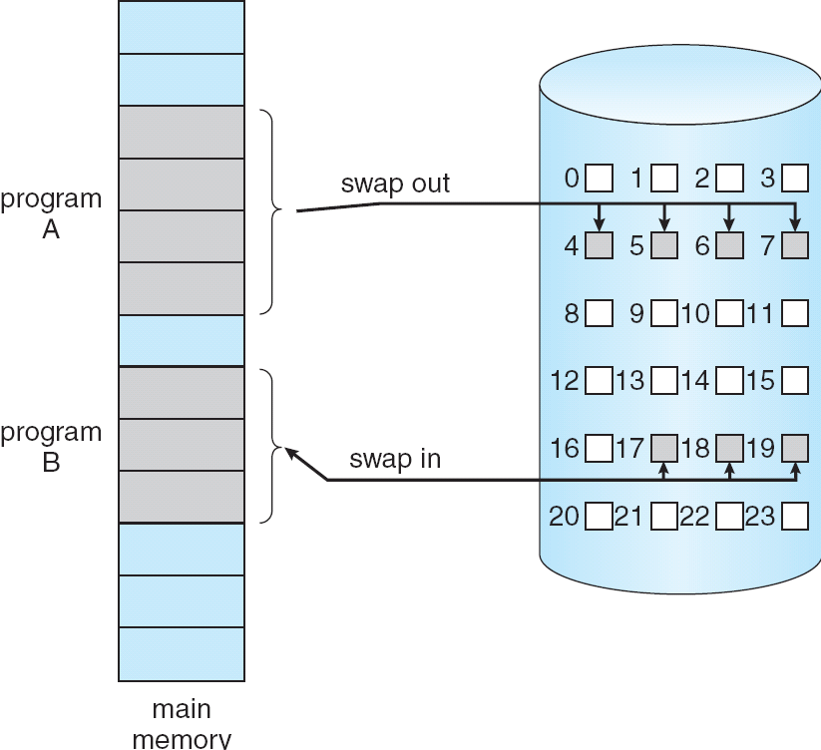
Transfer of a Paged Memory to Contiguous Disk Space
  Swapping and Demand paging
  Context Switch
Made by Najun
Notes:
交换程序和调页程序
按需调页系统类似于 使用交换的分页系统

Slide 8
Valid-Invalid Bit
With each page table entry a valid–invalid bit is associated
  (1 ⇒ in-memory, 0 ⇒ not-in-memory)
  Initially valid–invalid bit is set to 0 on all entries.
Example of a page
table snapshot.
Frame #
valid-invalid bit
1
1
1
1
0

0
0
page table
Made by Najun
Notes:
对这种方案，需要一定形式的硬件来区分哪些页在内存里，哪些页在磁盘上。有效-无效位可以用于这一目的。
现有当该位置为“有效”时，该值表示相关的页既合法且也在内存中。
当该位设置为“无效”时，该值表示相关得页为无效（也就是，不在进程的逻辑地址空间中）或者有效但在磁盘上。

Slide 9
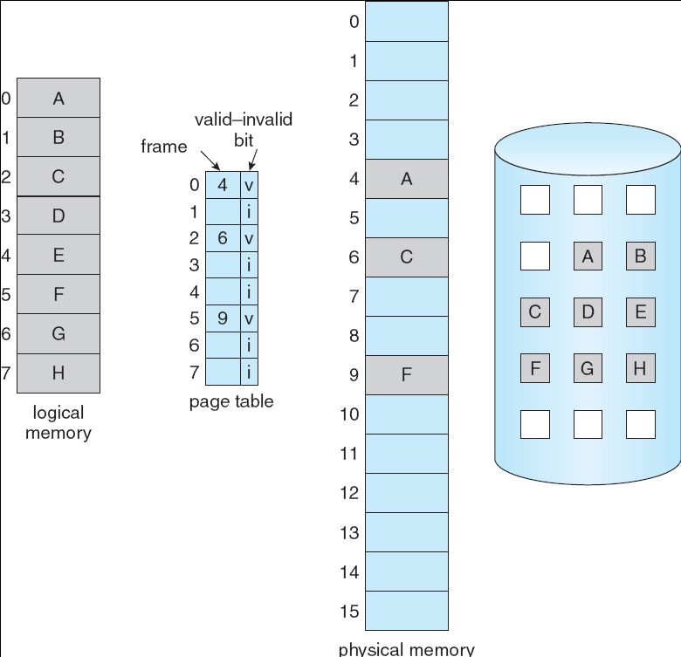
Lazy Swap
Pager
Made by Najun
Notes:
开始时，进程驻留在第二级存储器上，当需要执行进程时，使用惰性交换，即只有在需要页的时候，才将它调入内存。
Pager 调页程序，只对页进行交换操作。

Slide 10
Page Fault
If there is a reference to a page, first reference will trap to OS ⇒ page fault
  OS looks at Page table to decide:
    Invalid reference ⇒ abort.
    Just not in memory.
  Get empty frame？？.
  Swap page into frame.
  Reset tables, validation bit = 1.
  Restart instruction: Least Recently Used
Made by Najun
Notes:
如果进程从不试图访问标记为无效的页，那么并没有什么影响。但是当进程试图访问那些尚未调入到内存的页时，对标记为无效的访问会产生页错误陷阱（page-fault trap）。
分页硬件，在通过页表转换地址时，会发现已设置了无效位，会陷入操作系统。处理这种页错误的程序比较简单

Slide 11

Steps in Handling a Page Fault
Made by Najun
Notes:
检查进程的页表，以确定该引用是合法还是非法的地址访问。
如果引用非法，那么终止进程。如果引用有效但是尚未调入页面，那么现在应调入。
找到一个空闲帧。
调度一个磁盘操作，以便将所需要的页调入刚分配的帧。
当磁盘读操作完成后，修改进程的内部表和页表，以表示该页已在内存中。
重新开始因非法地址陷阱而中断的指令。进程现在能访问所需的页，就好像它似乎总在内存中。

Slide 12
What happens if there is no free frame?
Page replacement: find some page in memory, but not really in use, swap it out.
  Algorithm
  Performance: want an algorithm which will result in minimum number of page faults.
Same page may be brought into memory several times.
Hardware support:
  Page Table
  Second storage: Swap space
Made by Najun
Notes:
纯粹请求页面调度：只有在需要时才将页调入内存。
从理论上说，有的程序的单个指令可能访问多个页的内存（一页用于指令，许多页用于数据），从而一个指令可能产生多个页错误。这种情况会产生令人无法接受的系统性能。幸运的是，对运行程序的分析说明了这种情况是极为少见的。程序具有引用的局部性，这使得请求页面调度性能较为合理。

Slide 13
Performance of Demand Paging
Page Fault Rate 0 ≤ p ≤ 1.0
  if p = 0 no page faults
  if p = 1, every reference is a fault
Effective Access Time (EAT)
EAT = (1 – p) x memory access
+ p (page fault interrupt
+ swap page out
+ swap page in
+ restart the process)
Made by Najun
Notes:
设p为页错误的概率为[0，1]。希望p接近于0，即页错误很少。那么有效访问时间为：有效访问时间=(1-p)*ma+p*页错误时间。
无论如何，都有如下三个主要的页错误处理时间：处理页错误中断，读入页，重新启动进程。

Slide 14

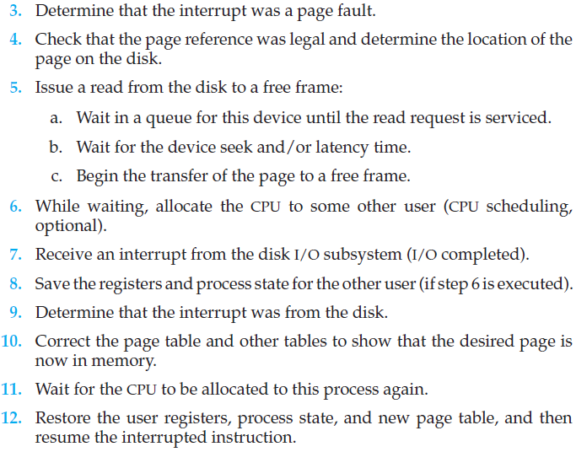
Page fault processing
Made by Najun
Notes:
三个主要的页错误处理时间：处理页错误中断，读入页，重新启动进程

Slide 15
Demand Paging Example
Memory access time = 200 ns
Average page-fault service time = 8 ms
EAT = (1 – p) x 200 + p (8 ms)
= (1 – p) x 200 + p x 8,000,000
= 200 + p x 7,999,800
If one access out of 1,000 causes a page fault, then
EAT = 8.2 microseconds.
Made by Najun
Notes:
因为千分之一的页面错误率，采用按需调页，有效访问时间慢40倍。
若性能降低不超过10%，则页错误率为多少？ P<0.0000025

Slide 16
Roadmap
Background
Demand Paging
Process Creation
Page Replacement
Allocation of Frames
Thrashing
Other Considerations
Made by Najun

Slide 17
Process Creation
Virtual memory allows other benefits during process creation:
  - Copy-on-Write
  - Memory-Mapped Files
Made by Najun
Notes:
虚拟内存带来的用于提高进程创建和运行性能的技术：写时拷贝和内存映射文件

Slide 18
Copy-on-Write
Copy-on-Write (COW) allows both parent and child processes to initially share the same pages in memory.
  If either process modifies a shared page, only then is the page copied.
COW allows more efficient process creation as only modified pages are copied.
Free pages are allocated from a pool of zeroed-out pages.
Made by Najun
Notes:
页面共享 fork
写时拷贝允许父进程与子进程开始时共享同一页面。这些页面标记为写时复制，即如果任何一个进程需要对页进行写操作，那么就创建一个共享页的拷贝。只有被进程所修改的页才会复制；所有非修改页可为父进程和子进程所共享。
当确定一个页要采用写时复制时，从哪里分配空闲页是很重要的。许多操作系统为这类请求提供了空闲缓冲池。这些空闲页在进程栈或堆必须扩展时可用于分配，或用于管理写时复制页。
操作系统通常采用按需填零的技术以分配这些页。
Vfork

Slide 19
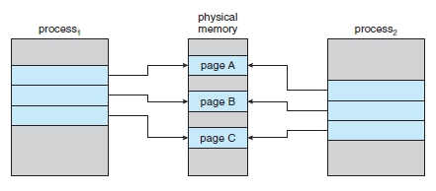
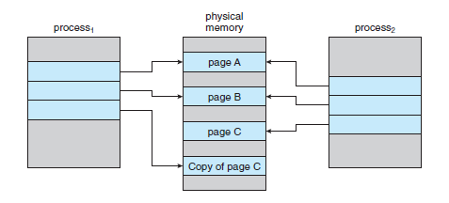
Copy-on-Write
Made by Najun

Slide 20
Memory-Mapped Files
Memory-mapped file I/O allows file I/O to be treated as routine memory access by mapping a disk block to a page in memory.
A file is initially read using demand paging. A page-sized portion of the file is read from the file system into a physical page. Subsequent reads/writes to/from the file are treated as ordinary memory accesses.
Also allows several processes to map the same file allowing the pages in memory to be shared.
Made by Najun
Notes:
传统上，对文件的访问需要系统调用open(), read(), write(). 文件每次访问时都需要一个系统调用和磁盘访问。
可使用所讨论的虚拟内存技术来将文件I/O作为普通内存访问。这种方法称为文件的内存映射，它允许一部分虚拟内存与文件逻辑相关联。文件的内存映射可将一磁盘块映射成内存的一页（或多页）。

Slide 21

Memory Mapped Files
Made by Najun
Notes:
多个进程可以允许将同一文件映射到各自的虚拟内存中，以允许数据共享。
其中任一进程修改虚拟内存中的数据，都会为其他映射相同文件部分的进程所见。
根据虚拟内存的相关知识，可以清楚地看到内存映射部分的共享是如何实现的：
每个共享进程的虚拟内存表都指向物理内存的同一页，该页有磁盘块的复制。

Slide 22
Roadmap
Background
Demand Paging
Process Creation
Page Replacement
Allocation of Frames
Thrashing
Other Considerations
Made by Najun
Notes:
页表结构
Hierarchical Paging
Hashed Page Tables
Inverted Page Tables
分段，段号，偏移量
使用分页的分段
上一章所介绍的各种内存管理策略，都有一个目的：同时将多个进程存放在内存中，以便允许多道程序设计。不过，这些策略都需要在进程执行之前将整个进程放在内存中。
1 有的作业很大
2 大量作业要求运行
局部性原理：1968年 Denning.指出程序在执行时呈现出局部性规律，即在一个较短的时间内，程序的执行仅局限于某个部分。相应的，它所访问的存储空间也局限于某个部分。局部为使用的页的集合。
基于局部性原理，应用程序在运行前，没有必要全部装入内存，只将当前需要的页面调入即可。
。。。
这样可以使一个大的程序在较小的内存中运行。
虚拟内存：是指具有请求调页功能和页置换功能，能从逻辑上对内存容量进行扩充的一种存储系统。
按需调页-》有效位 后备存储 内存-》页错误。基本过程

Slide 23
Page Replacement
Prevent over-allocation of memory by modifying page-fault service routine to include page replacement.
Page replacement completes separation between logical memory and physical memory - large virtual memory can be provided on a smaller physical memory.
Page replacement
Made by Najun
Notes:
正常情况下，通过页置换技术，可以增加多道程序的度，这种所有进程的页的和大于实际内存帧的现象叫过度分配
如果增加了多道程序的程度，那么会过度分配帧。
过度分配会有问题。当一个进程执行时，会出现页错误。硬件陷入到操作系统。接着操作系统会检查其内部表以确定该页错误是合法还是非法的内存访问。进而操作系统会确定所需页在磁盘上的位置，但是却发现空闲帧列表上没有空闲帧：所有帧都在使用。

Slide 24

Need For Page Replacement
Made by Najun
Notes:
1 介绍问题 -》 2 传统解决方案 -》 3 页置换技术
若取E7为victim frame

Slide 25
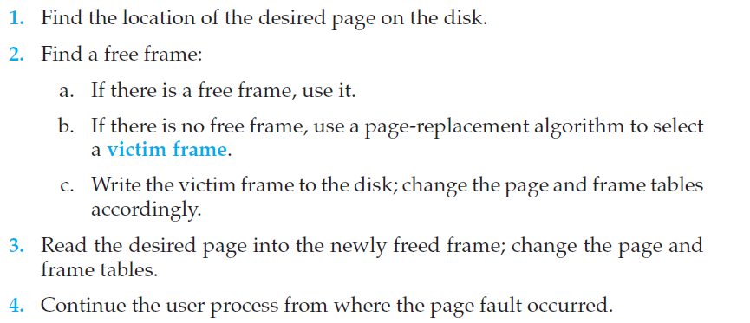
Basic Page Replacement
Made by Najun
Notes:
基本页置换方法：
查找所需页在磁盘上的位置。
查找一空闲帧：
如果有空闲帧，那么就使用它；
如果没有空闲帧，那么就使用页置换算法以选择一个牺牲帧。
将牺牲帧的内容写到磁盘上；改变页表和帧表。
将所需页读入（新）空闲帧；改变页表和帧表。
重启用户进程。

Slide 26

Page Replacement
Use modify (dirty) bit to reduce overhead of page transfers: only modified pages are written to disk.
Made by Najun
Notes:
可通过修改位（或脏位）来降低额外开销。每页或帧可以有一个修改位通过硬件与之相关联。

Slide 27
Page Replacement Algorithms
Want lowest page-fault rate.
Evaluate algorithm by running it on a particular string of memory references (reference string) and computing the number of page faults on that string.
  Reference string
  Algorithms
  Number of frame
Made by Najun
Notes:
如何选择一个置换算法？通常采用最小页错误率的算法。
可以这样来评估一个算法：针对特定内存引用串运行某个置换算法，并计算出页错误的数量。内存的引用序列称为引用串。
1 引用串 2 置换算法 3 帧数量

Slide 28

reference string
How to select a reference string (real recorded data or simulated data)
How to reduce the number of data
  Just consider the page number only, rather than the entire address.
  If we have a reference to a page p, then any immediately following references to page p will never cause a page fault.
Made by Najun

Slide 29

Graph of Page Faults Versus The Number of Frames
Made by Najun
Notes:
针对某一特定的引用串和页置换算法，为了确定页错误的数量，还需要可用的帧的数量。
显然，随着可用帧数量的增加，页错误的数量会相应的减少。

Slide 30

First-In-First-Out (FIFO) Algorithm
A FIFO replacement algorithm associates with each page the time when that page was brought into memory.
Reference string:
7, 0, 1, 2, 0, 3, 0, 4, 2, 3, 0, 3, 2, 1, 2, 0, 1, 7, 0, 1
Made by Najun
Notes:
最简单的页置换算法是FIFO 算法，FIFO页置换算法为每个页记录着该页调入内存的时间。当必须置换一页的时候，将选择最旧的页。
运行背景：1 全部在后备存储 -》 帧数为3 -》 算法 -》 序列

Slide 31
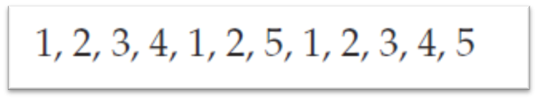
First-In-First-Out (FIFO) Algorithm
The FIFO page-replacement algorithm is easy to understand and program. However, its performance is not always good.
  On the one hand, the page replaced may be an initialization module that was used a long time ago and is no longer needed.
  On the other hand, it could contain a heavily used variable that was initialized early and is in constant use.
To illustrate the problems that are possible with a FIFO page-replacement algorithm, consider the following reference string
Made by Najun
Notes:
1 2 3 4 1 2 5 1 2 3 4 5 帧数为2 会产生12次页错误

Slide 32

Belady’s Anomaly
For some page-replacement algorithms, the page-fault rate may increase as the number of allocated frames increases.
Reference string: 1, 2, 3, 4, 1, 2, 5, 1, 2, 3, 4, 5
Made by Najun

Slide 33

Optimal Algorithm-OPT
Replace page that will not be used for longest period of time.
3 frames example 7, 0, 1, 2, 0, 3, 0, 4, 2, 3, 0, 3, 2, 1, 2, 0, 1, 7, 0, 1
  How do you know this?
  Used for measuring how well your algorithm performs.
Made by Najun
Notes:
Belady异常的发现结果之一是对最优也置换算法的探索。最优页置换算法是所有算法中页错误率最低的，且绝对没有belady异常。
找到未来最长时间不使用的帧。
最优置换算法难以实现，因为需要引用串的未来知识。最优置换算法主要用来比较研究。

Slide 34

Least Recently Used (LRU) Algorithm
LRU chooses that page that has not been used for the longest period of time.
Reference string: 7, 0, 1, 2, 0, 3, 0, 4, 2, 3, 0, 3, 2, 1, 2, 0, 1, 7, 0, 1
Made by Najun
Notes:
置换出最久没有使用的帧。将过去的作为将来的近似。LRU置换记录每个页的上次的使用时间。

Slide 35
LRU Algorithm (Cont.)
Counter implementation
  Every page entry has a counter; every time page is referenced through this entry, copy the clock into the counter.
  When a page needs to be replaced, look at the counters to determine which one to be replaced.
Stack implementation: keep a stack of page numbers in a double link form:
  Page referenced:
    move it to the top
    requires 6 pointers to be changed
  No search for replacement
Made by Najun
Notes:
最优置换和LRU置换都没有belady 异常。LRU置换记录每个页的上次的使用时间。置换出最久没有使用的帧。
具有头指针和尾指针的双向链表

Slide 36

Made by Najun
Notes:
栈顶：是刚被使用过的页；
栈底：LRU页，最久未被使用的页。

Slide 37
LRU Approximation Algorithms (1/2)
Reference bit
Uses a reference bit set (8bit) by hardware when the page is touched. Then when a fault occurs, pick a page that hasn't been referenced.
  With each page associate a bit, initially = 0
  When page is referenced bit set to 1.
  Replace the one which is smallest.
  e.g. 00000000 - did not use in 8 times
  11111110 - used in latest 7 times
Made by Najun
Notes:
很少有计算机系统能提供足够的硬件来支持真正的LRU页置换。然而，许多系统都提供引用位的支持，页表中的每一项都关联着一个引用位。

Slide 38
LRU Approximation Algorithms (2/2)
Second-Chance (clock) Page-Replacement Algorithm
  Need reference bit.
  Clock replacement.
  If page to be replaced (in clock order) has reference bit = 1. then:
    set reference bit 0.
    leave page in memory.
    replace next page, subject to same rules.
Made by Najun
Notes:
基本算法是FIFO。当选择一个页时，检查引用位
Scenario：常用帧的情况，会使得它一直驻留内存

Slide 39

Made by Najun

Slide 40
Counting Algorithms
Keep a counter of the number of references that have been made to each page.
  LFU Algorithm (least frequently used page-replacement algorithm): replaces page with smallest count.
  MFU Algorithm (most frequently used page-replacement algorithm): based on the argument that the page with the smallest count was probably just brought in and has yet to be used.
Both are not common.
Made by Najun
Notes:
LFU最不经常使用页置换。
MFU最常使用页置换算法。

Slide 41
Roadmap
Background
Demand Paging
Process Creation
Page Replacement
Allocation of Frames
Thrashing
Other Considerations
Made by Najun

Slide 42
Allocation of Frames
How much frames does each process required?
  Too Much;
  Too little.
Each process needs minimum number of pages.
Two major allocation schemes.
  fixed allocation
  priority allocation
Made by Najun
Notes:
帧分配：假设系统共有128帧，操作系统占35帧，单用户系统用95帧。
分配至少最少数量的帧的原因是性能。显然，随着分配给每个进程的帧的数量的减少，页错误会增加，从而减慢运行。
若指令完成之前出现页错误，则该指令必须重新执行。必须有足够的帧来容纳所有单个指令所引用的页。
1 考虑一个机器，内存访问指令只能访问一个内存地址。则至少需要一个帧放指令，一个帧用于内存引用
2 若允许一级间接引用，则至少需要三个帧。若只有两个帧，会如何？

Slide 43

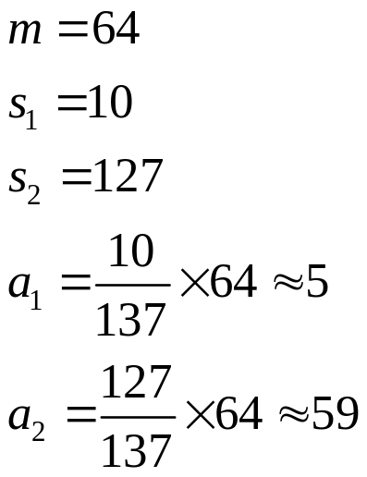
Fixed Allocation
Equal allocation: e.g., if 100 frames and 5 processes, give each 20 pages.
Proportional allocation: Allocate according to the size of process.
Made by Najun
Notes:
Proportional allocation：按比例分配。Si pi虚拟内存的大小

Slide 44
Priority Allocation
Use a proportional allocation scheme using priorities rather than size.
If process P_{i} generates a page fault,
  select for replacement one of its frames.
  select for replacement a frame from a process with lower priority number.
Made by Najun

Slide 45
Global vs. Local Allocation
Global replacement – process selects a replacement frame from the set of all frames; one process can take a frame from another.
  For example, consider an allocation scheme wherein we allow high-priority processes to select frames from low-priority processes for replacement. A process can select a replacement from among its own frames or the frames of any lower-priority process.
Local replacement – each process selects from only its own set of allocated frames.
Made by Najun

Slide 46
Roadmap
Background
Demand Paging
Process Creation
Page Replacement
Allocation of Frames
Thrashing
Other Considerations
Made by Najun

Slide 47
Thrashing
If a process does not have “enough” pages, the page-fault rate is very high. This leads to:
  low CPU utilization.
  operating system thinks that it needs to increase the degree of multiprogramming.
  another process added to the system.
Thrashing: a process is busy swapping pages in and out.
Made by Najun
Notes:
如果一个进程没有获得其活动所需要的最小帧数 -》 全局置换
CPU使用率被操作系统监控 -》 增加多道程序的度，进一步促进颠簸

Slide 48

Thrashing (cont.)
Made by Najun
Notes:
发生颠簸，CPU利用率为0

Slide 49
Demand Paging and Thrashing
What is the most significant basis of Demand Paging?
Locality model
  Process migrates from one locality to another
  Localities may overlap
Why does thrashing occur?
Σ size of locality > total memory size
Made by Najun
Notes:
为了防止颠簸，必须提供进程所需的足够多的帧。如果知道进程需要多少帧呢？可使用局部模型，它说明当进程执行时从一个局部移向另一个局部。局部是一个经常使用页的集合。一个程序通常由多个不同局部组成，它们可以重叠。

Slide 50

Locality In A Memory-Reference Pattern
Made by Najun
Notes:
新局部的产生

Slide 51
Working-Set Model
Δ is working-set window, a fixed number of page references. Working-set is the set of pages in most Δ recent page references.
WSS_{i} (working set of Process P_{i}) =
total number of pages referenced in the most recent Δ (varies in time)
  if Δ too small will not encompass entire locality.
  if Δ too large will encompass several localities.
  if Δ = ∞ ⇒ will encompass entire program.
D = Σ WSS_{i} ≡ total demand frames
if D > m ⇒ Thrashing
Policy if D > m, then suspend one of the processes.
Made by Najun
Notes:
工作集合就是局部的近似

Slide 52
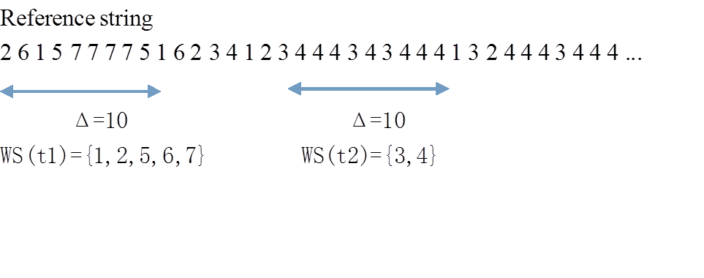
Made by Najun

Slide 53
Roadmap
Background
Demand Paging
Process Creation
Page Replacement
Allocation of Frames
Thrashing
Other Considerations
Made by Najun

Slide 54
Other Considerations
Prepaging
Page size selection
  table size For a virtual memory of 4 MB(2²²), for example, there would be 4,096 pages of 1,024 bytes but only 512 pages of 8,192 bytes.
  Fragmentation This loss is only 256 bytes for a page of 512 bytes but is 4,096 bytes for a page of 8,192 bytes
  I/O overhead transfer rate of 2 MBps, takes only 0.2ms to transfer 512B. Latency and seek time 28 ms. Of the total I/O time 28.2ms. 1024B needs 28.4 ms.
  Locality A smaller page size allows each page to match program
locality more accurately.
Made by Najun
Notes:
Prepaging：什么是页错误-》纯粹按需调页的显著特点是进程开始的时候会产生大量的页错误。这种情况是由于试图将最初的局部调入内存的结果。--》其他情况也可能出现，重新启动调出的进程--》预调页试图阻止这种情况，在开始的时候，全部调入所需的页-》对于采用工作集合的系统，保存每个进程的工作集合内的页列表。

Slide 55
Other Considerations (Cont.)
TLB Reach - The amount of memory accessible from the TLB.
TLB Reach = (TLB Size) X (Page Size)
Ideally, the working set of each process is stored in the TLB. Otherwise there is a high degree of page faults.
Made by Najun
Notes:
TLB范围是指通过TLB访问的内存量

Slide 56
Increasing the Size of the TLB
Increase the Page Size. This may lead to an increase in fragmentation as not all applications require a large page size.
Provide Multiple Page Sizes. This allows applications that require larger page sizes the opportunity to use them without an increase in fragmentation.
Made by Najun
Notes:
1 若页大小从8k增加到32k，则，TLB范围将扩展4倍
2 Solaris提供8K和4M两种页大小。若TLB有64个条目，则TLB范围从512K-256M

Slide 57
Other Considerations (Cont.)
Program structure
  A Java Program
  int A[][] = new int[128][128];
  Each row is stored in one page
  Program 1 for (j = 0; j < A.length; j++)
  for (i = 0; i < A.length; i++)
  A[i,j] = 0;
  128x 128page faults
  Program 2 for (i = 0; i < A.length; i++)
  for (j = 0; j < A.length; j++)
  A[i,j] = 0;
  128page faults
Made by Najun
Notes:
1 若帧数少于128，则会出现128*128个页错误

Slide 58
Other Considerations (Cont.)
I/O Interlock – Pages must sometimes be locked into memory.
Consider I/O. Pages that are used for copying a file from a device must be locked from being selected for eviction by a page replacement algorithm.
Made by Najun
Notes:
Scenario 1 一个进程发出一个IO请求，并被加入到IO设备的等待队列上，而同时CPU被交给了其他进程，这些进程产生页错误，采用全局置换，其中之一只换了等待进程用于IO的缓存页，缓存页被换出。当IO请求移动到设备队列头部时，针对指定指针进行IO.但是此时，该帧已属于另一个进程。
每一个帧都有一个锁住位。如果一帧被锁住，则不能被置换。
页锁的另一个用途：
Scenario 2

Slide 59

Reason Why Frames Used For I/O Must Be In Memory
Made by Najun
Notes:
Scenario 1 一个进程发出一个IO请求，并被加入到IO设备的等待队列上，而同时CPU被交给了其他进程，这些进程产生页错误，采用全局置换，其中之一只换了等待进程用于IO的缓存页，缓存页被换出。当IO请求移动到设备队列头部时，针对指定指针进行IO.但是此时，该帧已属于另一个进程。

Slide 60
Keystone
Demand Paging
Page Replacement
Made by Najun

Slide 61
Homework
Consider the following page reference string:
1,2,3,4,2,1,5,6,2,1,2,3,7,6,3,2,1,2,3,6.
How many page faults would occur for the following replacement algorithms, assuming
one, two, three, four, five, six, or seven frames? Remember all frames are initially empty,
So your first unique pages will all cost one fault each.
  _x000f_ LRU replacement
  _x000f_ FIFO replacement
  _x000f_ Optimal replacement
Made by Najun

Slide 62
Principles of
Operating System
End of Virtual Memory

