Slide 1

Principles of
Operating System
File System Implementation

Slide 2


Roadmap
File System Structure and Implementation
Directory Implementation
Allocation Methods
Free-Space Management
Recovery
Made by Najun

Slide 3
File-System Structure
Characteristics of disks
  Can be rewritten in place
  Can access directly any given block of information
  Block, one or more sectors, 512B
  To provide an efficient and convenient access to the disk, Operating system imposes one or more file systems to allow the data to be stored, located, and retrieved easily
Made by Najun
Notes:
磁盘提供大量的外存空间来维持文件系统。磁盘的两个特点是：可以原地重写和可以直接访问磁盘上的任意一块信息。
为了提供对磁盘的高效且便捷的访问，操作系统通过文件系统来轻松地存储、定位、提取数据。
内存和硬盘之间的IO转移是以块为单位的，每一块为一个或多个扇区。

Slide 4
File-System Structure (cont.)
Design problems
  Defining how the file system should look to the user, including:
    defining a file and its attributes;
    operations allowed on a file;
    directory structure for organizing files.
  Creating algorithms and data structures to map the logical file system onto the physical secondary-storage devices.
Made by Najun
Notes:
文件系统有两个不同的设计问题：
如何定义文件系统对用户的接口。这个任务涉及到定义文件及其属性、文件所允许的操作、组织文件的目录结构。
创建数据结构和算法来将逻辑文件系统映射到物理外存设备上。

Slide 5
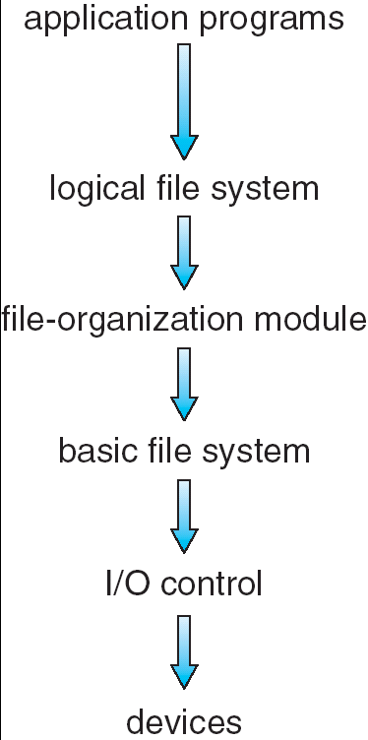
Layered File System
The file system itself is generally composed of different levels.
Manages metadata information, and manages the directory structure to provide the file-organization module, FCB
Knows about files, their logical blocks, and physical blocks. Can translate logical block addresses to physical block addresses
Generic commands to the appropriate device driver to read and write physical blocks on the disk (drive, cylinder, track,sector)
Consists of device drivers and interrupt handlers to transfer information between the main memory and the disk system
Made by Najun
Notes:
文件系统本身通常由许多不同的层组成。设计中的每层利用低层的功能来创建新的功能。
I/O控制为最低层，由设备驱动程序和中断处理程序组成，实现内存与磁盘之间的信息转移。
基本文件系统只需要向合适的设备驱动程序发送一般命令就可对磁盘上的物理块进行读写。
文件组织模块知道文件及其逻辑块和物理块，可以将逻辑块地址转换成基本文件系统所用的物理块地址。
逻辑文件系统管理元数据。元数据包括文件系统的所有结构数据，而不包括实际数据（或文件内容）。根据给定符号文件名来管理目录结构。
UNIX UFS
windows, FAT FAT32 NTFS

Slide 6
Implementation
Generally, On-disk, the file system may contain information about:
  How to boot an operating system stored there
  The total number of blocks
  The number and location of free blocks
  The directory structure
  Individual files.
A file control block (FCB) contains information about the file.
Made by Najun
Notes:
在磁盘上，文件系统可能包括如下信息：如何启动所存储的操作系统、总的块数、空闲块的数目和位置、目录结构以及各个具体文件等。

Slide 7
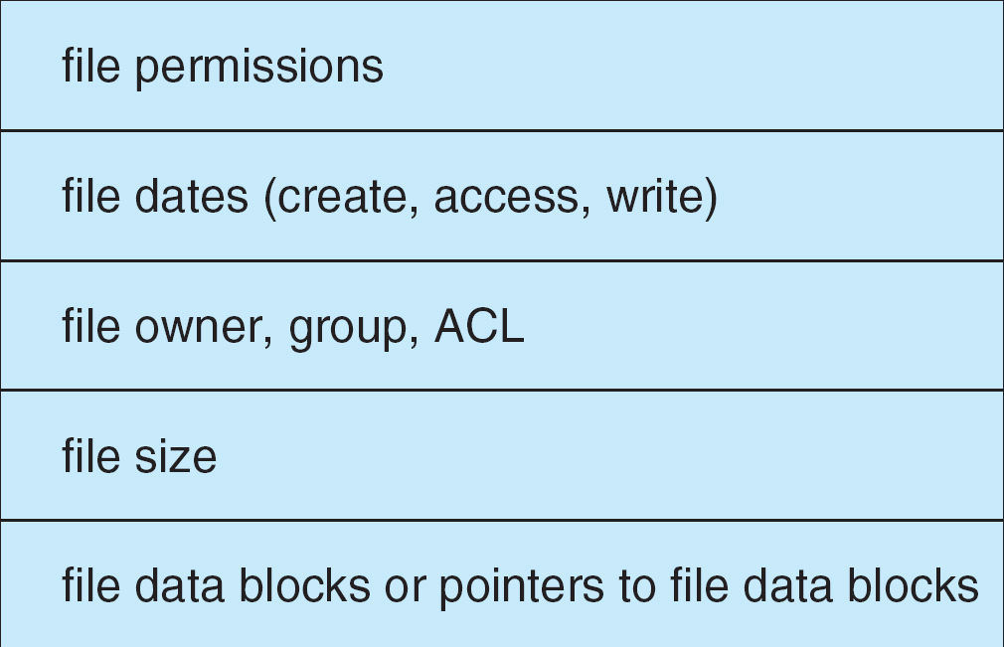
A Typical File Control Block
Made by Najun
Notes:
文件权限
文件的日期
文件所有者、组、访问控制列表
文件大小
文件数据块或者数据块的指针

Slide 8
The On-disk Structures
The on-disk structures include:
  A boot control block can contain information needed by the system to boot an operating from that partition.
  A partition(volume) control block contains details of blocks.
    A directory structure is used to organize the files.
      UFS, inode
      NTFS, master file table
    An FCB contains many of file’s details.
Made by Najun
Notes:
1 引导控制块：为卷的第一块 UFS称之为引导块，NTFS称之为分区引导扇区
2 卷控制块：包括卷的详细信息，分区块数、块大小、空闲块的数量和指针，空闲FCB数量和指针。 UFS称之为超级块， NTFS称之为主控文件表
3 目录结构：UFS目录中包含文件名和相关的索引节点inode，NTFS目录存储在主控文件表中。
4 每个文件的FCB：包含文件的详细信息，UFS为索引节点inode，NTFS采用关系数据库结构，每个文件一行。

Slide 9
Create A New File
To create a new file, an application program calls the logical file system.
The logical file system
  Allocates a new FCB
  Reads the appropriate directory into memory
  Updates it with the new file name and FCB
  Writes it back to the disk.
Made by Najun
Notes:
逻辑文件系统：管理文件系统的元数据，即结构数据。管理目录结构，管理FCB

Slide 10
Open File
The open call passes a file name to the file system.
When a file is opened, the directory structure is searched for the given file name.
  Once the file is found, the FCB is copied into a system – wide open-file table
  An entry is made in the per-process open-file table with a pointer and other fields
  How about to open an opened file ?
The open() call returns a pointer to the entry in the per-process file-system table.
  All file operations are then performed via this pointer
Made by Najun
Notes:
打开文件，调用open()将文件名传递给文件系统。

Slide 11
Close File
When a process closes the file
  The per-process table entry is removed
  The system-wide entry’s open count is decremented.
When all users that have opened the file close it
  The updated file information is copied back to the disk-based directory structure
  The system-wide open-file table entry is removed.
Made by Najun

Slide 12

In-Memory File System Structures
open file
read file
Made by Najun

Slide 13
Virtual File Systems
Implementation details
  How does an operating system allow multiple types of file systems to be integrated into a directory structure
  How can users seamlessly move between file-system types as they navigate the file-system space
A simple solution
  Write directory and file routines for each type of file system
Made by Najun
Notes:
操作系统如何才能把多个文件系统整合成一个目录结构？用户如何在访问文件系统空间时，可以无缝地在文件系统类型之间移动？
实现多个文件系统的一个明显但不十分满意的方法是为每个类型编写目录和文件程序。

Slide 14
Virtual File Systems (cont.)
Virtual File Systems (VFS) provide an object-oriented way of implementing file systems.
  VFS allows the same system call interface (the API) to be used for different types of file systems.
  The API is to the VFS interface, rather than any specific type of file system.
Made by Najun
Notes:
绝大多数操作系统都是用面向对象技术来简化、组织和模块化实现过程。使用这些方法允许不同文件系统类型可通过同样结构来实现。用户可以访问位于本地磁盘的多个文件系统类型，甚至位于网络上的文件系统。

Slide 15

Schematic View of Virtual File System
Based on the open, read, write, and close calls, and file descriptors
Made by Najun
Notes:
文件系统接口，包括open, read, write和close调用及文件描述符。
虚拟文件系统层有两个目的：
通过定义一个清晰的VFS接口，以将文件系统通用操作和具体实现分开。
基于称为vnode的文件表示结构唯一标示一个文件，例如UNIX中索引节点inode在文件系统中唯一的标示一个文件。

Slide 16
Roadmap
File System Structure
Directory Implementation
Allocation Methods
Free-Space Management
Recovery
Made by Najun

Slide 17
Directory Implementation
Linear list of file names with pointer to the data blocks.
  simple to program
  time-consuming to execute
Hash Table – linear list with hash data structure.
  decreases directory search time
  collisions – situations where two file names hash to the same location
  fixed size
Made by Najun
Notes:
目录分配和目录管理算法的选择对文件系统的效率、性能和可靠性有很大影响。因此，需要理解这些算法的优缺点。
线性表：最为简单的目录实现方法，编程简单但运行费时。其真正缺点是查找文件需要线性搜索。
当创建一个文件时；当删除一个文件时；查找一个文件时
哈希表：用线性表存储目录条目，哈希表根据文件名得到一个值，并返回指向线性表中元素的指针。因此，大大降低了目录搜索时间。需要预备措施来避免冲突。哈希表的最大困难是其通常固定的大小和哈希函数对大小的依赖性。 若文件增加，则需要扩大哈希表和新的哈希函数。

Slide 18
Roadmap
File System Structure
Directory Implementation
Allocation Methods
Free-Space Management
Recovery
Made by Najun
Notes:
2014.5.4

Slide 19
Allocation Methods
An allocation method refers to how disk blocks are allocated for files:
  Contiguous allocation
  Linked allocation
  Indexed allocation
Made by Najun
Notes:
如何为多个文件分配磁盘空间，以便有效地使用磁盘空间和快速地访问文件。常用的磁盘空间分配方法有三个：连续、链接和索引。

Slide 20
Contiguous Allocation
Each file occupies a set of contiguous blocks on the disk.
  Simple: only starting location (block #) and length (number of blocks) are required.
  Random, sequential access.
  Hard to estimate(determine) the size of a file
  Wasteful of space (dynamic storage-allocation problem).
  Files cannot grow.
Made by Najun
Notes:
每一个文件对应第一块的磁盘地址和连续块的数量。
可以实现顺序访问和直接访问。
同连续内存分配相似，有孔和碎片问题。合并。
确定文件的大小比较困难。
若采用最优适合分配策略，前后都已经使用。无法原地扩大文件
1 终止程序，+错误信息。用户必须分配更多的空间，再次运行
2 用户需要过多的估计所需磁盘空间 - 》 空间浪费，内部碎片问题
3 寻找一个更大的孔，将内容copy过去。

Slide 21

Contiguous Allocation of Disk Space
Made by Najun

Slide 22
Extent-Based Systems
Many new file systems (i.e. Veritas File System) use a modified contiguous allocation scheme.
Extent-based file systems allocate disk blocks in extents.
An extent is a contiguous block of disks. Extents are allocated for file allocation. A file consists of one or more extents.
Made by Najun
Notes:
该方案开始分配一块连续空间，当空间不够时，另一块被称为扩展（extent）的连续空间会添加到原来的分配中。这样文件的条目包括开始地址、块数、下一个扩展的指针。

Slide 23
Linked Allocation
Each file is a linked list of disk blocks:
  Blocks may be scattered anywhere on the disk.
Simple: need only starting address
Free-space management system
  No waste of space
No random access and reliability problem
block =
pointer
Made by Najun
Notes:
链接分配解决了连续分配的所有问题。对于每一个文件的目录项，包括第一块的地址和最后一块的地址。
需要空闲空间列表记录空闲块。
问题：1 智能顺序访问。要访问第i块，必须从头开始。不支持有效的直接访问。
2 对于每一块来说，指针也需要一定的空间。 簇 cluster
3 可靠性问题。指针链断裂

Slide 24

Linked Allocation
Made by Najun
Notes:
英文版图有误，看中文版 p364

Slide 25

File-Allocation Table (FAT)
A File Allocation Table is a variation of this.
  Take the pointer word from each disk block and put it in FAT in memory.
  This method doesn't use space in data blocks.
  A FAT file system is used
  by MS-DOS.
Made by Najun
Notes:
每个卷的FAT表存储在该卷的开始位置。每个块都在FAT表中有一项，并通过块号索引。
在目录表中，一个文件对应一项，存储着首块号码，根据块号的索引，FAT条目包含文件下一块的号码，并一直链接到文件的结束，最后一块有文件的结束符。未使用的块在FAT中标为0.
FAT和FAT32的区别，
1． FAT32文件系统的优点：与FAT相比，FAT仅能处理容量小于2GB的驱动器，而FAT32可以创建任意容量的单一驱动器。FAT32存储文件更有效，可使硬盘容纳的内容更多
FAT16与FAT32的区别主要在于簇的大小不同，但还有几处其他的不同。FAT32可以精细的分配每一单元，还可以在根目录增加更多的条目。
FAT32的优越性：FAT32比FAT16可以更有效地分配磁盘的空间。FAT32卷的根文件夹是一个普通的簇链，所以可将其定位在卷的任何地方，因此FAT32可以支持根多的条目数量，FAT16只能有512个。由于FAT32比FAT16使用了更小的簇，所以可以创建高大32GB的卷

Slide 26
Indexed Allocation
Brings all pointers together into the index block.
Logical view.
index table
Made by Najun
Notes:
如果不适用FAT，则链接分配不能直接直接访问，这是因为指针与块一起分布于整个磁盘。
索引分配吧所有的指针放在一起，叫索引块。通过索引快解决了直接访问的问题。
每个文件都有一个索引块，索引块是一个磁盘块地址的数组。索引块的第i条指向文件的第i块。
目录条目包含索引块的地址。

Slide 27

Example of Indexed Allocation
Made by Najun
Notes:
如果不适用FAT，则链接分配不能直接直接访问，这是因为指针与块一起分布于整个磁盘。
索引分配吧所有的指针放在一起，叫索引块。通过索引快解决了直接访问的问题。
每个文件都有一个索引块，索引块是一个磁盘块地址的数组。索引块的第i条指向文件的第i块。
目录条目包含索引块的地址。

Slide 28
Indexed Allocation (Cont.)
Need index table
Random, sequential access
Without external fragmentation, but have overhead of index block.
Method suffers from wasted space since, for small files, most of the index block is wasted.
  Mapping from logical to physical in a file of maximum size of 256K words and block size of 512 words. We need only 1 block for index table.
Made by Najun
Notes:
索引分配会因为索引块的存在而浪费空间。256*1024/512=512 1个block

Slide 29

Combined Scheme: UNIX (4K bytes per block)
Made by Najun
Notes:
UFS中索引块的前15个指针存放在inode中，12个为直接块，1个一级间接块，1个为二级间接快，1个为三级间接块。

Slide 30
Roadmap
File System Structure
Directory Implementation
Allocation Methods
Free-Space Management
Recovery
Made by Najun

Slide 31
Free-Space Management
Bit vector (n blocks)
0
1
2
n-1
…
1 ⇒ block[i] free
0 ⇒ block[i] occupied
bit[i] =

e.g.,
The free blocks are 2, 3, 4, 5, 8, 9, 10, 11, 12, 13,
The free-space bit map is
    0 0 1 1 1 1 0 0 1 1 1 1 1 1 0 0
Block number calculation:
(number of bits per word)*(number of 0-value words)+offset of first 1 bit
Made by Najun
Notes:
为了记录空闲磁盘空间，系统需要维护一个空闲空间链表。空闲空间链表记录了所有空闲磁盘空间，即未分配给文件或目录的空间。当创建文件时，搜索空闲空间链表以得到所需要的空间，并分配给新文件。这些空间会从空闲空间链表中删除。

Slide 32
Free-Space Management (Cont.)
Bit map requires extra space.
  Example:
    block size = 2¹² bytes
    disk size = 2³⁰ bytes (1 gigabyte)
    n = 2³⁰/2¹² = 2¹⁸ bits (or 32K bytes)
Easy to get contiguous files
  Simple to implement
  Efficient to find the first free block
Made by Najun

Slide 33

Free-Space Management (Cont.)
Linked list (free list)
  Cannot get contiguous space easily
  No waste of space
Grouping
  first free block stores
  n free block
Counting
  for contiguous allocation,
  record first block and the number of following free block
Made by Najun
Notes:
Linked list (free list): free blocks are chained together, each holding a pointer to the next one free.
组：将n个空闲块的地址存在第一个空闲块中，这些块中的前n-1个确实为空，最后一个块包含另外n个空闲块的地址。
计数：记录第一个空闲块的地址和后续空闲块的个数。

Slide 34
Roadmap
File System Structure
Directory Implementation
Allocation Methods
Free-Space Management
Recovery
Made by Najun

Slide 35
Recovery
Consistency checking: compares data in directory structure with data blocks on disk, and tries to fix inconsistencies.
Use system programs to back up data from disk to another storage device (floppy disk, magnetic tape).
Recover lost file or disk by restoring data from backup.
Made by Najun
Notes:
一致性检查程序将目录结构数据与磁盘数据块相比较，并试图纠正所发生的不一致。分配算法和空闲空间管理算法决定了检查程序能发现什么类型的问题，及其如何成功地纠正问题。
由于磁盘有时会出错，所以必须注意确保数据不会永久丢失。为此，可以利用系统程序将磁盘数据备份到另一存储设备如软盘、磁带或光盘。
恢复单个文件或整个磁盘时，只需要从备份中加以恢复就可以了。

Slide 36
Principles of
Operating System
End of File System Implementation

