Slide 1
Principles of
Operating System
MASS-STORAGE STRUCTURE
Notes:
磁盘为现代计算机系统提供了大容量的外存。盘面直径为1.8-5.25寸，每个磁盘的两面都涂着磁质材料。并通过磁记录保存信息。
简称固盘，固态硬盘（Solid State Drive）用固态电子存储芯片阵列而制成的硬盘

Slide 2

Structure
Disk drives are addressed as a large one-dimensional array of logical blocks
  One logical block is the
  smallest unit of transfer.
  The size of a logical block
  is usually 512B.
Notes:
现代磁盘驱动器可以看作是一个一维逻辑的块的数组。

Slide 3

Logical blocks mapping onto disk
Sector 0 is the first sector of the first track on the outermost cylinder.
Mapping in order
  through that track,
  then the rest of the tracks in that cylinder,
  and then through the rest of the cylinders from outermost to innermost.
Notes:
扇区0是最外面柱面的第一个磁道第一个扇区。然后映射磁道内的其他扇区，然后是柱面内的其他磁道，然后是其他柱面（从外往内）
机械臂杆，磁臂arm，platter磁盘面

Slide 4
Scheduling
The operating system is responsible for using hardware efficiently — for the disk drives, this means having a fast access time and disk bandwidth.
Access time has two major components
  Seek time is the time for the disk are to move the heads to the cylinder containing the desired sector.
  Rotational latency is the additional time waiting for the disk to rotate the desired sector to the disk head.
Notes:
操作系统的任务之一就是有效的使用硬件，对于磁盘驱动器来说，这意味着较快的访问速度和较宽的磁盘带宽。
磁盘带宽：所传递总的字节数除以从服务请求开始到最后传递结束的总时间。
寻道时间
旋转延迟

Slide 5
Scheduling algorithms
Several algorithms exist to schedule the servicing of disk I/O requests.
We illustrate them with a request queue (0-199).
98, 183, 37, 122, 14, 124, 65, 67
Head pointer 53

Slide 6

FCFS
Illustration shows total head movement of 640 cylinders.

Slide 7

SSTF (Shortest-seek-time first)
Selects the request with the minimum seek time from the current head position.
  SSTF scheduling is a form of SJF scheduling; may cause starvation of some requests.
  Illustration shows
  total head movement
  of 236 cylinders.
Notes:
最短寻道时间优先算法 shortest seek time first
在处理离磁头当前位置比较远的请求之前，先处理靠近磁头位置的请求。
会产生饥饿，例如14和186，处理14的时候，不断到达14周围的作业。则186会产生饥饿。

Slide 8

SCAN
Sometimes called the elevator algorithm
  The disk arm starts at one end of the disk, and moves toward the other end,
  servicing requests until it gets to the other end of the disk, where the head movement is reversed and servicing
  continues.
  Illustration shows total
  head movement of 208
  cylinders.
Notes:
不但要知道磁头的当前位置，而且还需要知道磁头移动的方向。

Slide 9

C-SCAN
The head moves from one end of the disk to the other. servicing requests as it goes.
  When it reaches the other end, however, it immediately returns to the beginning of the disk, without servicing any requests on the return trip.
  Treats the cylinders
  as a circular list that
  wraps around from
  the last cylinder to
  the first one.

Slide 10

C-LOOK
Version of C-SCAN
  Arm only goes as far as the last request in each direction,
  then reverses direction immediately, without first going all the way to the end of the disk.

Slide 11
Selecting a Disk-Scheduling Algorithm
Performance depends on the number and types of requests.
Requests for disk service can be influenced by the file-allocation method.
SSTF is common and has a natural appeal
SCAN and C-SCAN perform better for systems that place a heavy load on the disk.
Either SSTF or C-LOOK is a reasonable choice for the default algorithm.
Notes:
连续分配文件会产生较少的磁头移动，而链接分配会产生较多的磁头移动。
SSTF会产生饥饿问题。SCAN CSCAN CLOOK不会产生饥饿问题。
SSTF比较普通且很有吸引力。
SCAN and C-SCAN对于磁盘负载比较大的情况下，表现会更好，且不会产生饥饿问题。

Slide 12
Disk Management
Low-level formatting, or physical formatting
  Dividing a disk into sectors that the disk controller can read and write.
To use a disk to hold files, the operating system still needs to record its own data structures on the disk.
  Partition the disk into one or more groups of cylinders.
  Logical formatting or “making a file system”.
Methods such as sector sparing used to handle bad blocks.
Notes:
一个新的磁盘是一个空白版，只是含有磁性材料的盘子。在磁盘能够存储数据之前，需要划分扇区以便磁盘控制器能够读或者写，这个过程叫低级格式化
为了使用磁盘存储文件，操作系统还要将自己的数据格式记录在磁盘上，分为两步：
1 将磁盘的一个或多个柱面组成分区；
2 创建文件系统，将文件系统数据结构初始化到磁盘上，包括空闲和已分配空间，以及目录结构等。
扇区备用，sector sparing：磁盘控制器维护着一个磁盘坏块的链表，并不断更新。在磁盘低级格式化的时候，留出一部分扇区作为备用，控制器用这些备用块代替坏块。

Slide 13
Swap-Space Management
Swap-space : Virtual memory uses disk space as an extension of main memory.
Swap-space can be carved out of the normal file system,or, more commonly, it can be in a separate disk partition.
Notes:
交换空间主要为了swapping交换和按需调页功能。交换空间管理是操作系统的另一层底层任务。
交换空间可以有两种实现方法：1 在普通的文件系统上创建，实现简单，效率低。2 创立在没有文件系统和目录结构的生磁盘分区上，效率高。

Slide 14
RAID
RAID: Redundant Arrays of Independent Disks.
  Multiple disk drives provides reliability via redundancy.
RAID schemes improve performance and improve the reliability of the storage system by storing redundant data.
  Mirroring or shadowing keeps duplicate of each disk.
  Block striping provides high data-transfer rates.
RAID is arranged into six different levels.
Notes:
RAID磁盘冗余阵列。一个系统拥有大量的磁盘，就能够有机会改善读写速度，改善数据的可靠性。
镜像：最为简单引入冗余的方法是复制每个磁盘。这种技术称为镜像。每个逻辑磁盘由两个物理磁盘组成，每次写都要在两个磁盘上进行。如果一个磁盘循坏，那么可以从另一个磁盘中恢复。
位级分散：在多个磁盘上分散每个字节的位。如果有8个磁盘，则每个字节的第i位存储到磁盘i上。这8个磁盘可以作为单个磁盘使用，拥有8倍的传输速率。
块级分散：对于一个文件的块，可以分散在不同的磁盘上。提升传输数据的速度。

Slide 15
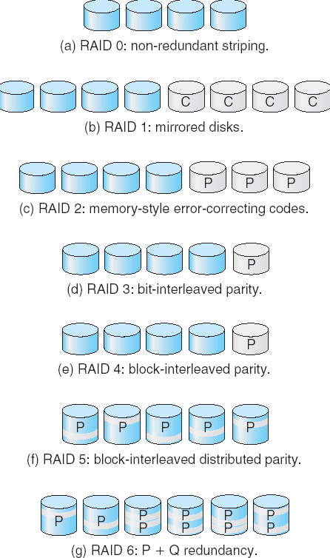
RAID Levels
Notes:
RAID0- 按块级别分散的磁盘阵列，没有冗余，速度加快。
RAID1- 提供磁盘镜像，无按块分散。只有冗余，没有速度加快。
RAID2- 内存方式的差错纠正代码结构。内存中的奇偶位错误检测。内存中的每个字节都有一个相关的奇偶位，记录字节中1的个数是偶数(0)还是奇数(1)。如果字节中的位有损坏那么和保存的奇偶位就不再匹配。则出现错误。差错纠正方案存储两个或多个额外的位，使得当单个位出错的时候用来重新构造数据。海明码。
RAID3- 位交织奇偶结构。磁盘控制器能够检测出一个扇区是否正确读取，这样单个奇偶位就可以用来差错检测和差错纠正。如果使用位级分散，且知道哪个扇区发生故障，则可以通过其他磁盘扇区对应的奇偶值得出损坏位是1还是0.
RAID4- 块交织奇偶结构。另外使用一个磁盘保存其他N个磁盘相应块的奇偶块。
RAID5- 块交织分布奇偶结构。与RAID4不同，将数据和奇偶校验分布在所有N+1块磁盘上，而不是讲数据存在N块磁盘上，将就奇偶校验存在单个磁盘上。
RAID6- 与RAID5类似，但是不是保存奇偶校验码，而是使用了差错纠正码。每四个位，使用了两个位的冗余数据。能够容忍两个磁盘出错。

Slide 16
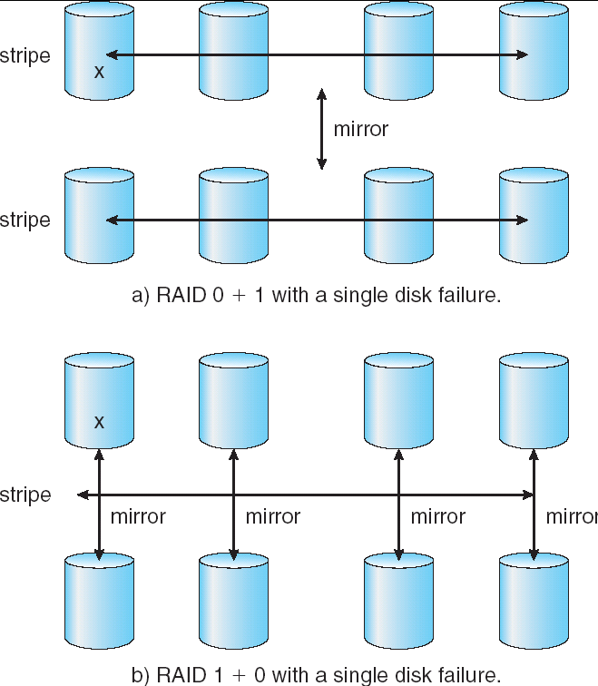
RAID Levels
Notes:
RAID0 块级分散，加快访问速度。
RAID1 镜像，增加可靠性。
RAID0+1 先块级分散，再镜像。
RAID1+0 先镜像，再块级分散

