Slide 1
L1KProcs: an R package for L1000 data processing and analysis
Chenglin Liu , Kun Wei and Jing Su
Center for Bioinformatics and Systems Biology
Wake Forest School of Medicine

Slide 2
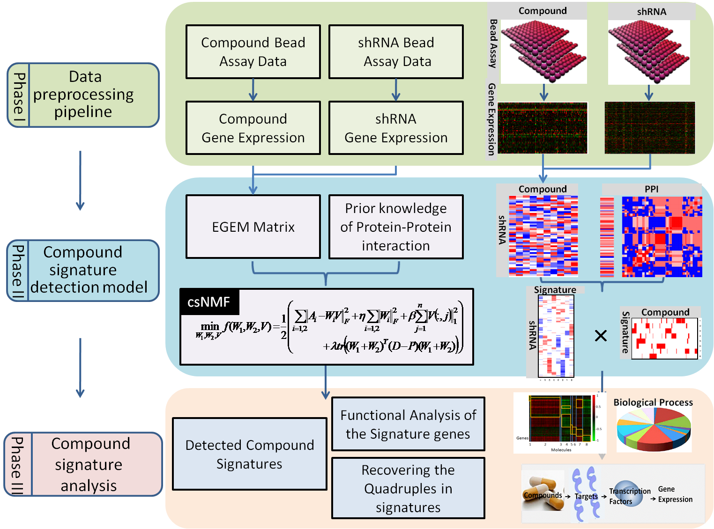
Overview

Slide 3
L1KProcs
L1KProcs is an R package and interface for LINCS L1000 data preprocessing and compound signature detection in both text-mode and graphic-mode way.
Additionally, it is a library for existing L1000 processed expression data and their connections (EGEM library).

Slide 4
L1KProcs
Operating system:
Windows XP, Windows 7, Linux, Mac OS X
Open source
R language based (R>=3.0)
Parallel computing
Require doParallel package
Access
download, web

Slide 5
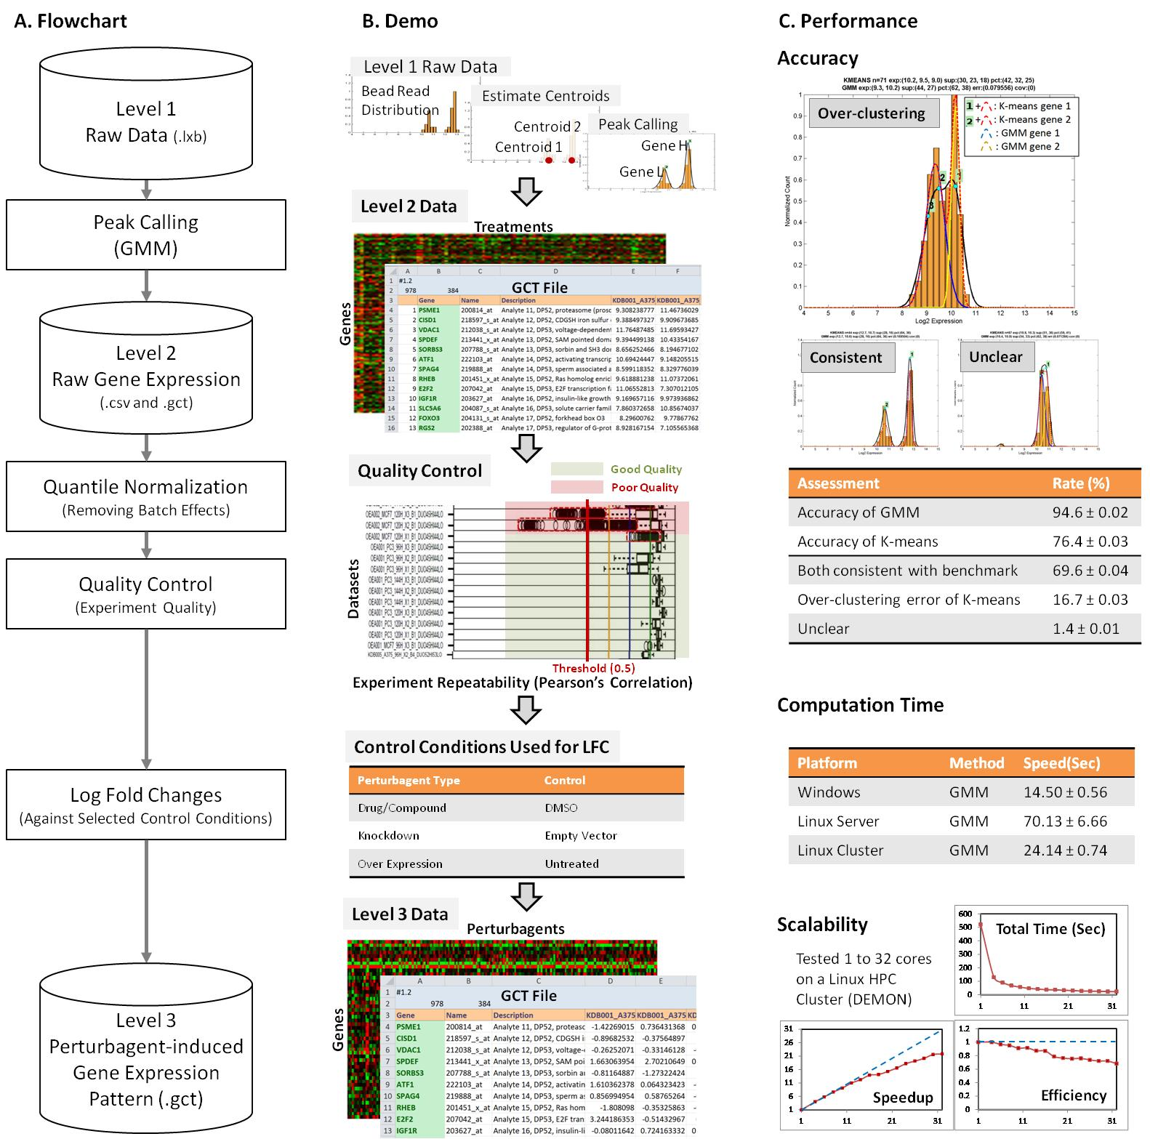
Function I: preprocessing

Slide 6
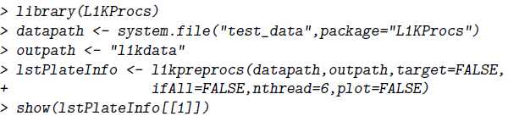
How to Use
Required Input: the location of raw L1000 data
Optional Input:
target: quantile normalization
ifAll: if convert the landmark gene expression to whole genome data
nthread: number of parallel computing
plot: data quality visualization
Output:
The processed data saved in outpath.
The information of the data including the qualities and the control wells in class list lstPlateInfo.

Slide 7
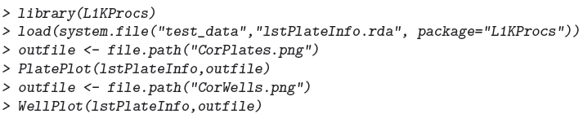
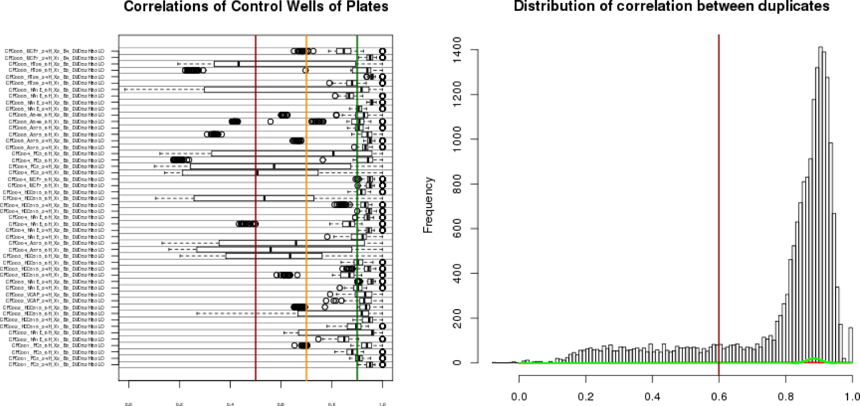
data quality visualization

Slide 8
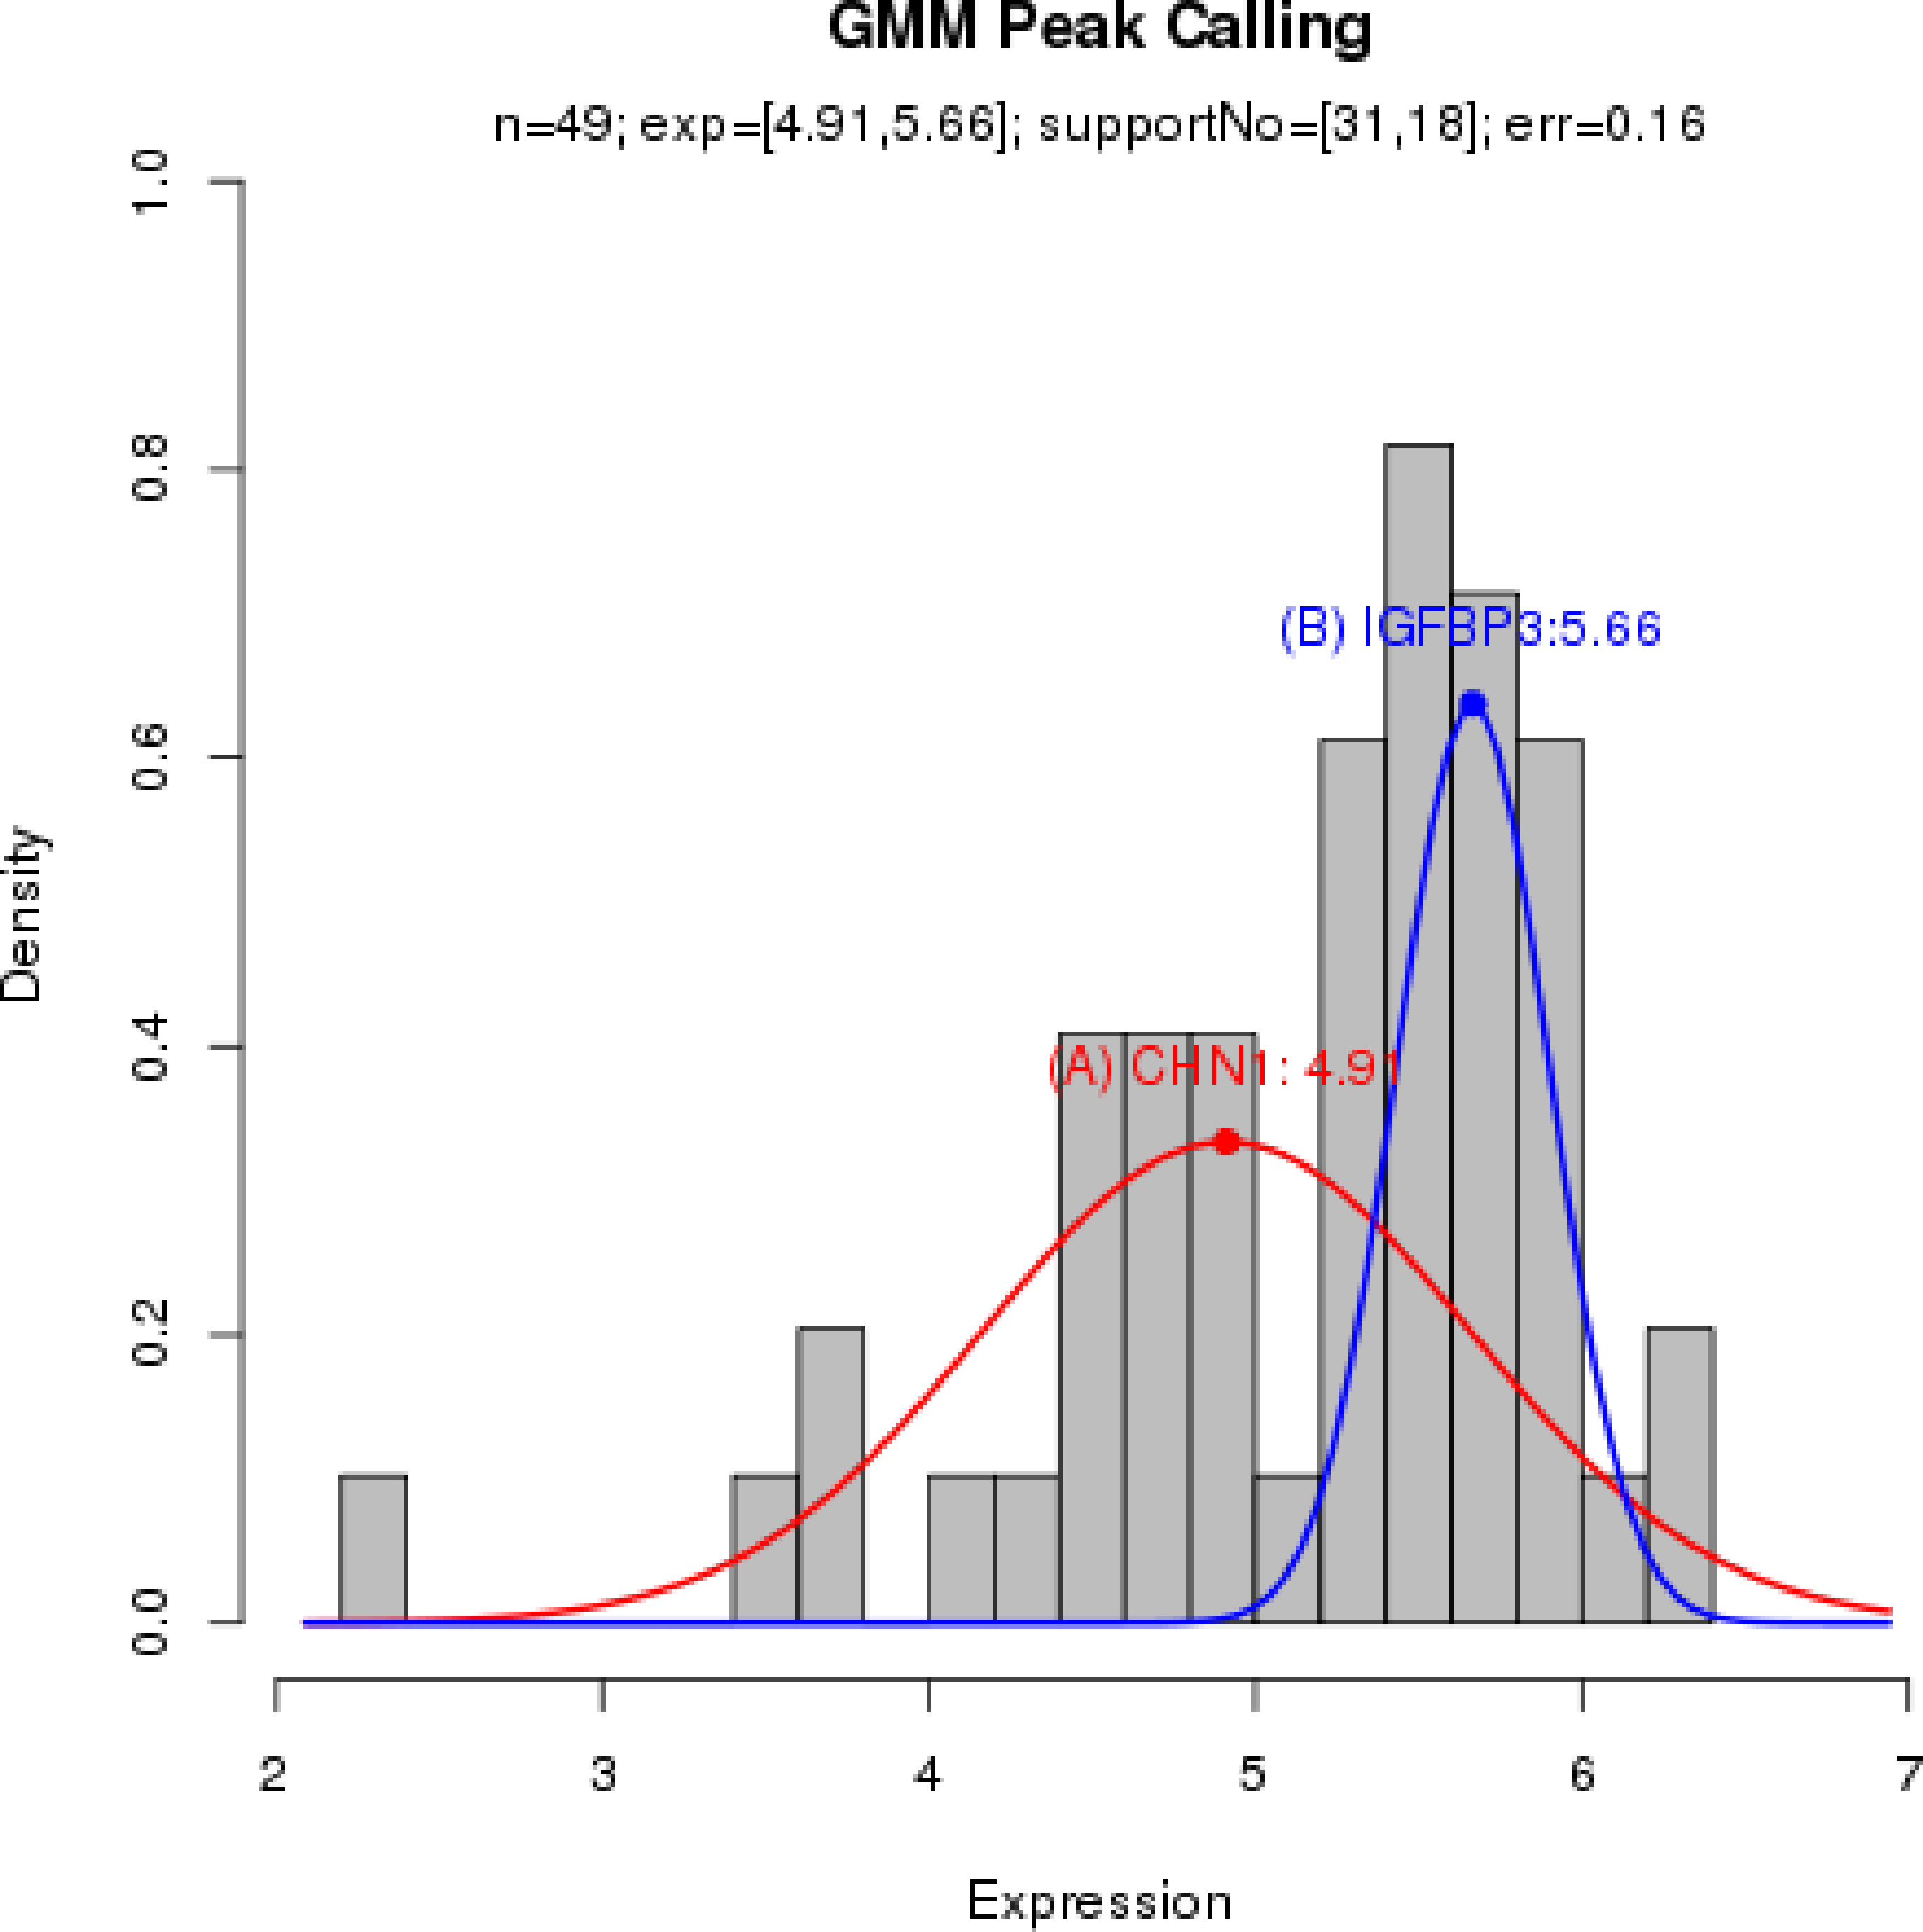
Single well peak calling and visualization

Slide 9

Function II: EGEM matrix
Required Input
cpdata: LFC after compound treatments
Optional Input
LINCS:
if TRUE, specify the name of the existing EGEM library lib.name
otherwise, provide the LFC after knockdown treatments
nthread: number of parallel computing
Output
The EGEM matrix and annotations

Slide 10
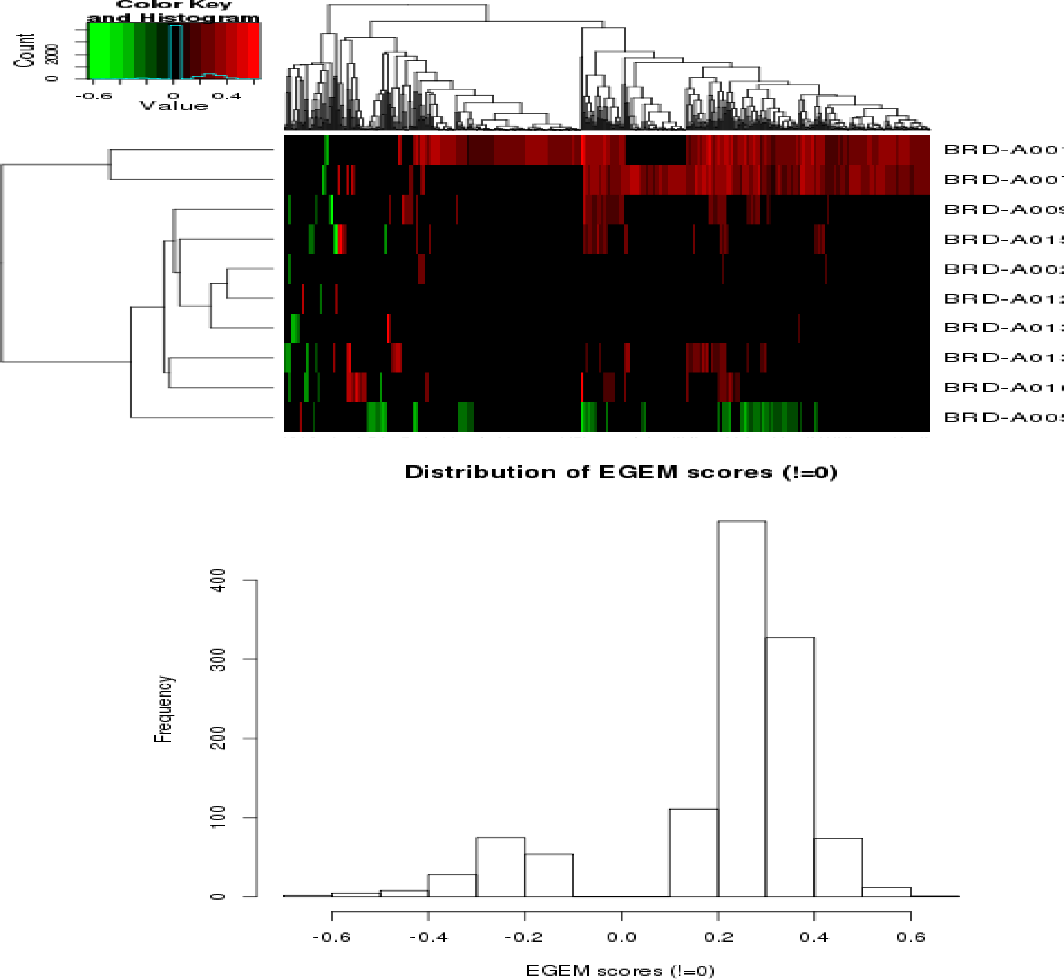
Function II: EGEM matrix

Slide 11
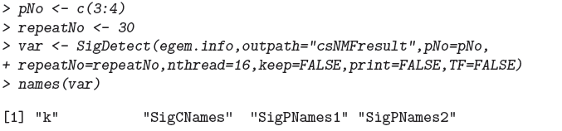
Function III: Compound Signature Discovery
Required Input
The output of Function II egem.info.
The range of signature number pNo.
Optional Input
nthread: number of parallel computing
Output:
Signature number k
Compounds and signature genes.

Slide 12
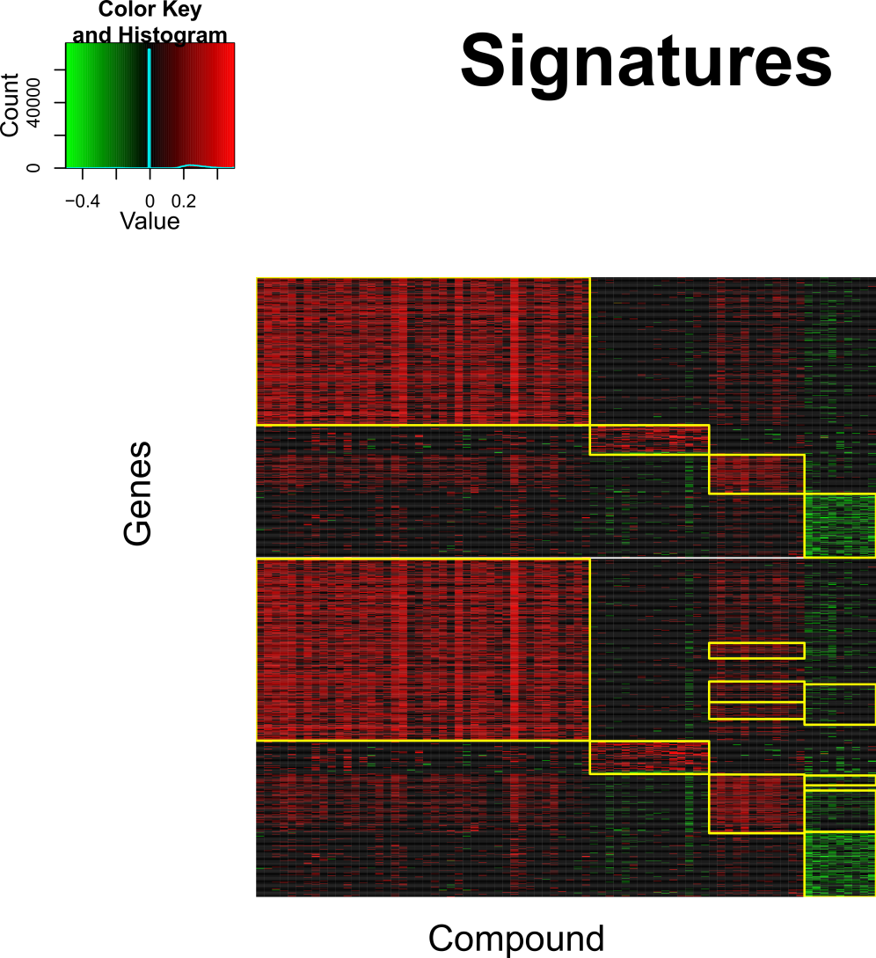
Function III: Compound Signature Discovery

Slide 13
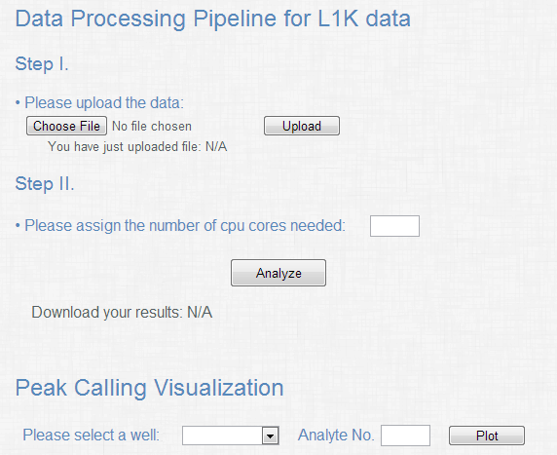
L1KProcs Interface

Slide 14

L1000 preprocessing
Choose one
raw L1000 data
Upload and
start computing

Slide 15
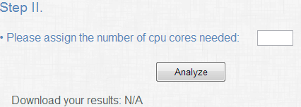
Compound Signature Discovery
nthread
start computing

Slide 16

Single well peak calling visualization

