Slide 1
L1KProcs: an R package for L1000 data processing and analysis
Chenglin Liu , Kun Wei and Jing Su
Center for Bioinformatics and Systems Biology
Wake Forest School of Medicine

Slide 2
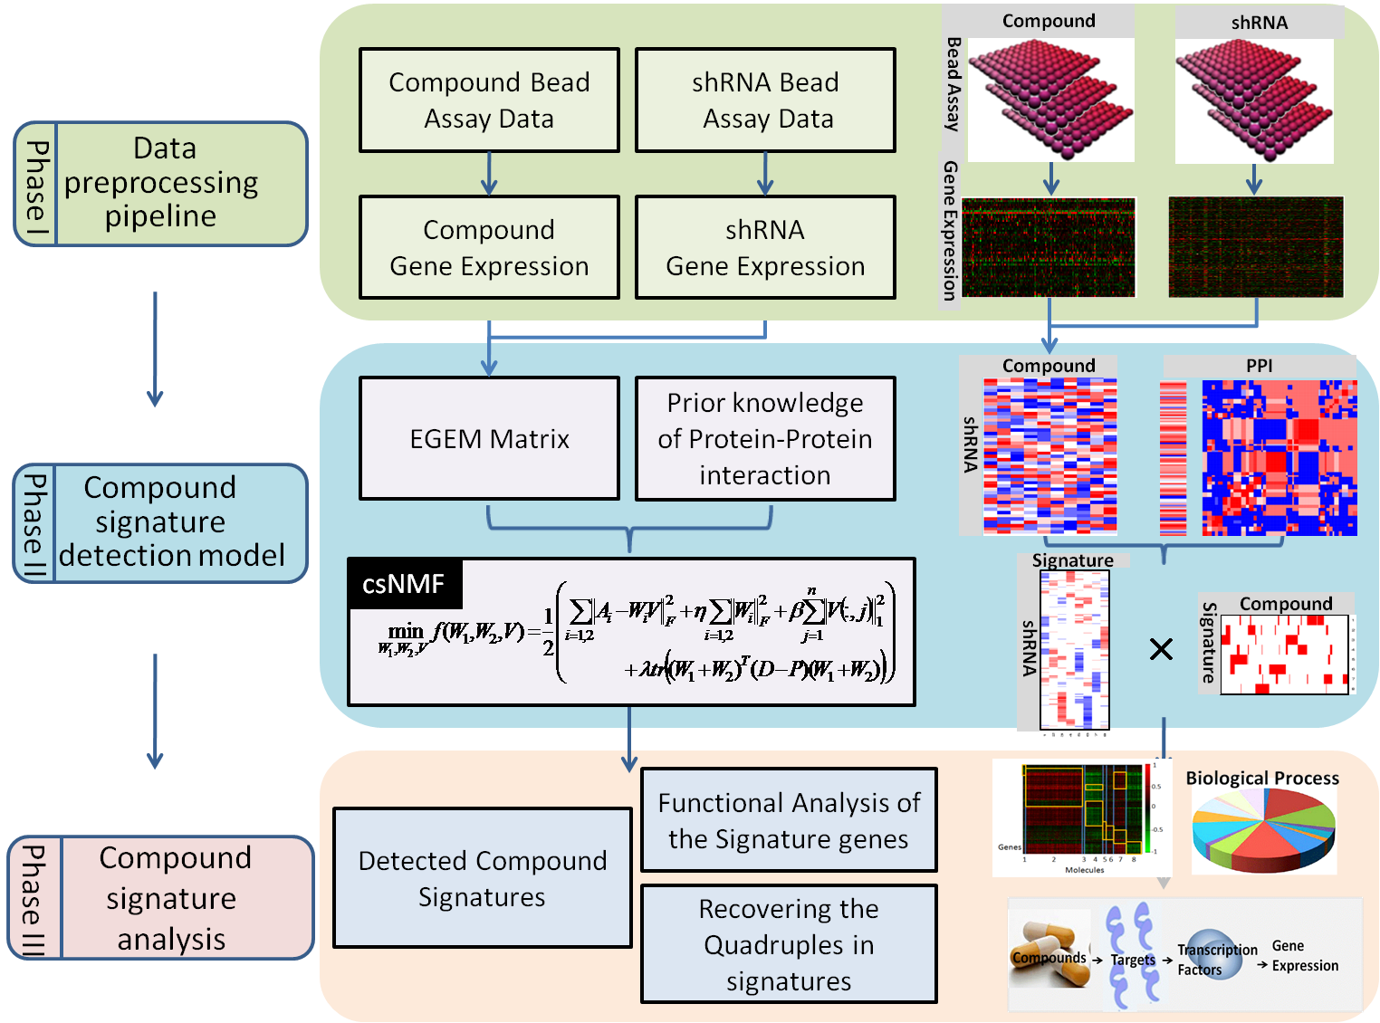
Overview

Slide 3
L1KProcs
L1KProcs is an R package and interface for LINCS L1000 data preprocessing and compound signature detection in both text-mode and graphic-mode way.
Additionally, it is a library for existing L1000 processed expression data and their connections (EGEM library).

Slide 4
L1KProcs
Operating system:
Windows XP, Windows 7, Linux, Mac OS X
Open source
R language based (R>=3.0)
Parallel computing
Require doParallel package
Access
download, web

Slide 5
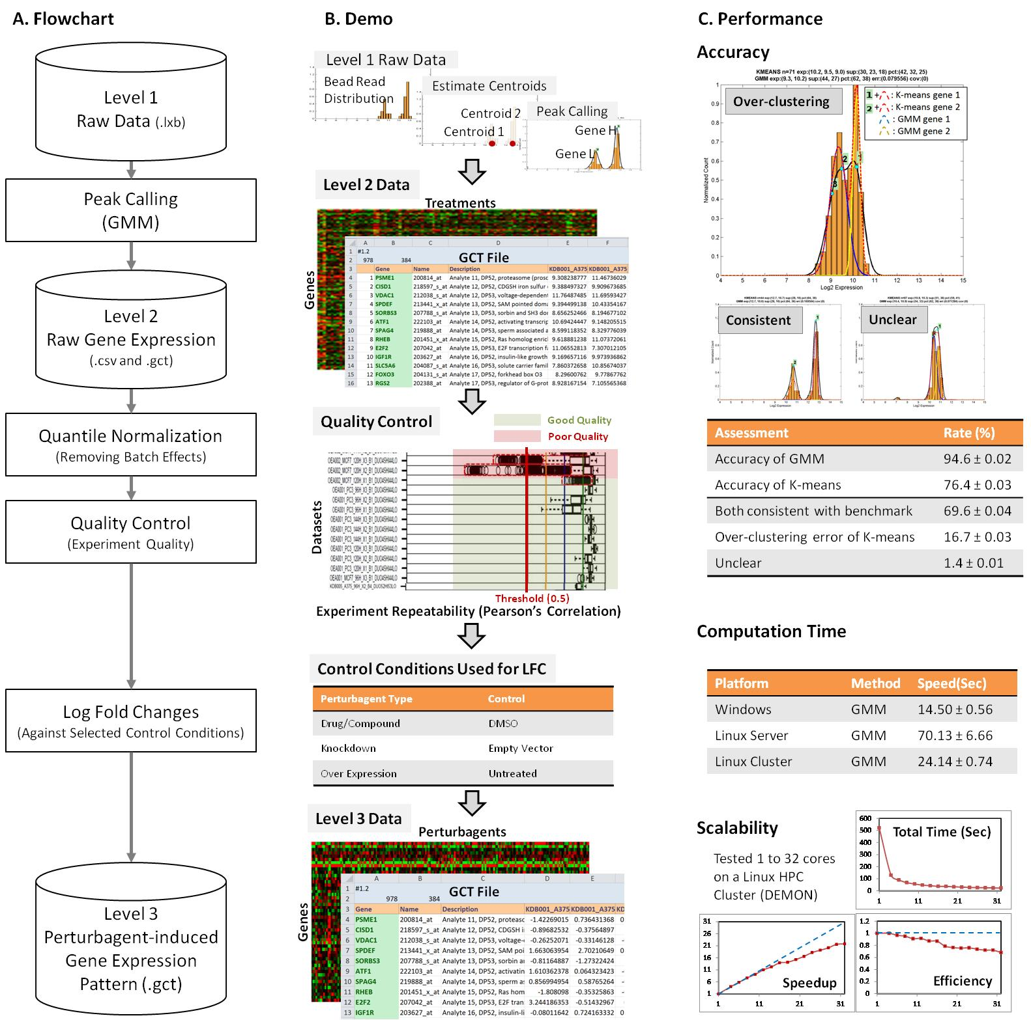
Function I: preprocessing

Slide 6
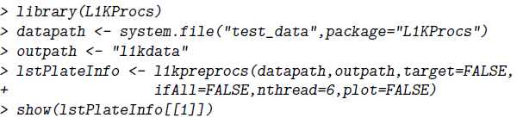
How to Use
Required Input: the location of raw L1000 data
Optional Input:
target: quantile normalization
ifAll: if convert the landmark gene expression to whole genome data
nthread: number of parallel computing
plot: data quality visualization
Output:
The processed data saved in outpath.
The information of the data including the qualities and the control wells in class list lstPlateInfo.

Slide 7
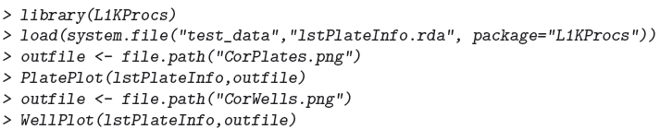
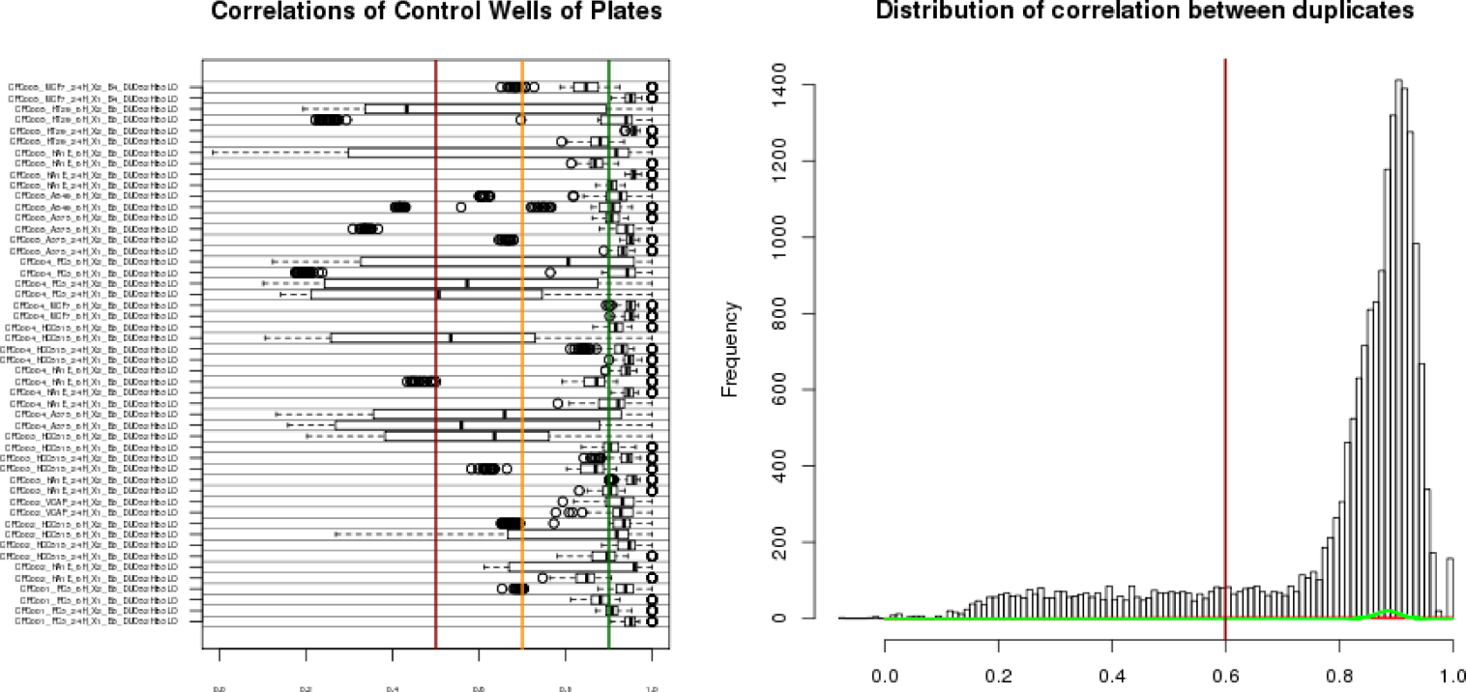
data quality visualization

Slide 8
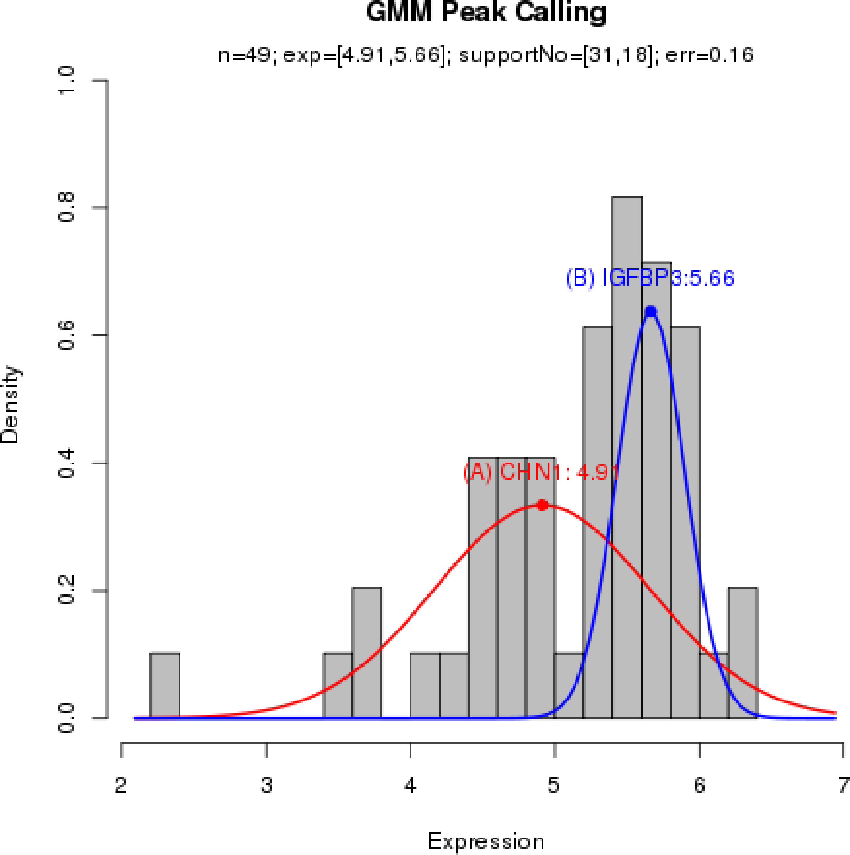
Single well peak calling and visualization

Slide 9

Function II: EGEM matrix
Required Input
cpdata: LFC after compound treatments
Optional Input
LINCS:
if TRUE, specify the name of the existing EGEM library lib.name
otherwise, provide the LFC after knockdown treatments
nthread: number of parallel computing
Output
The EGEM matrix and annotations

Slide 10
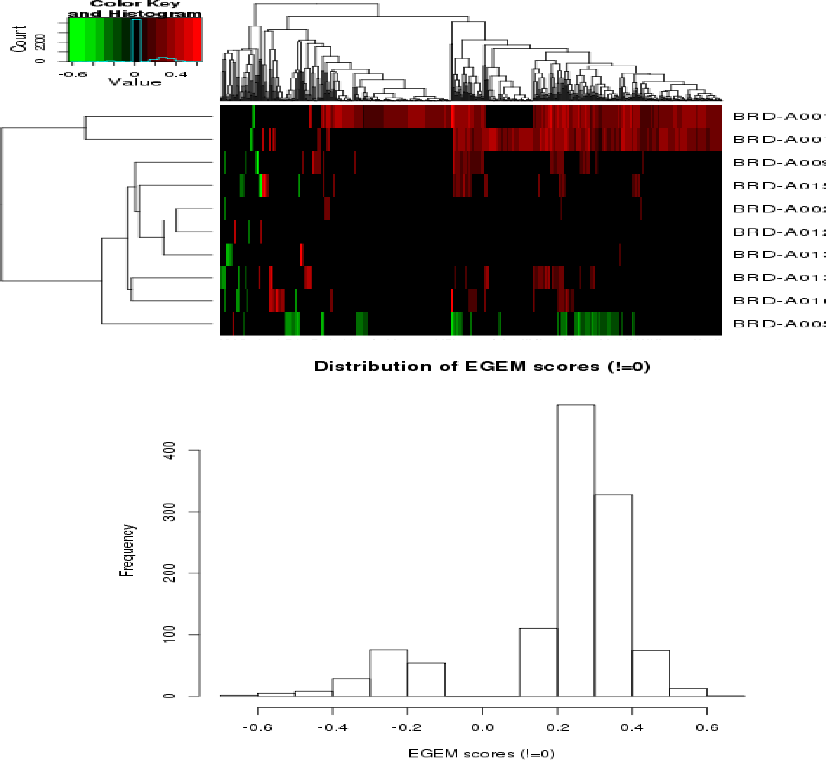
Function II: EGEM matrix

Slide 11
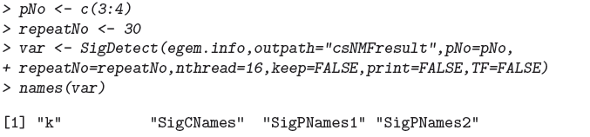
Function III: Compound Signature Discovery
Required Input
The output of Function II egem.info.
The range of signature number pNo.
Optional Input
nthread: number of parallel computing
Output:
Signature number k
Compounds and signature genes.

Slide 12
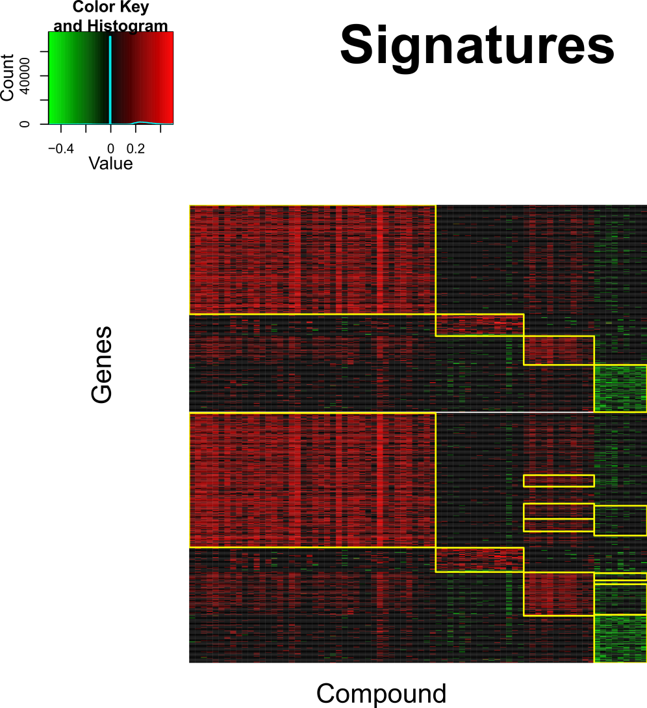
Function III: Compound Signature Discovery

