Slide 1
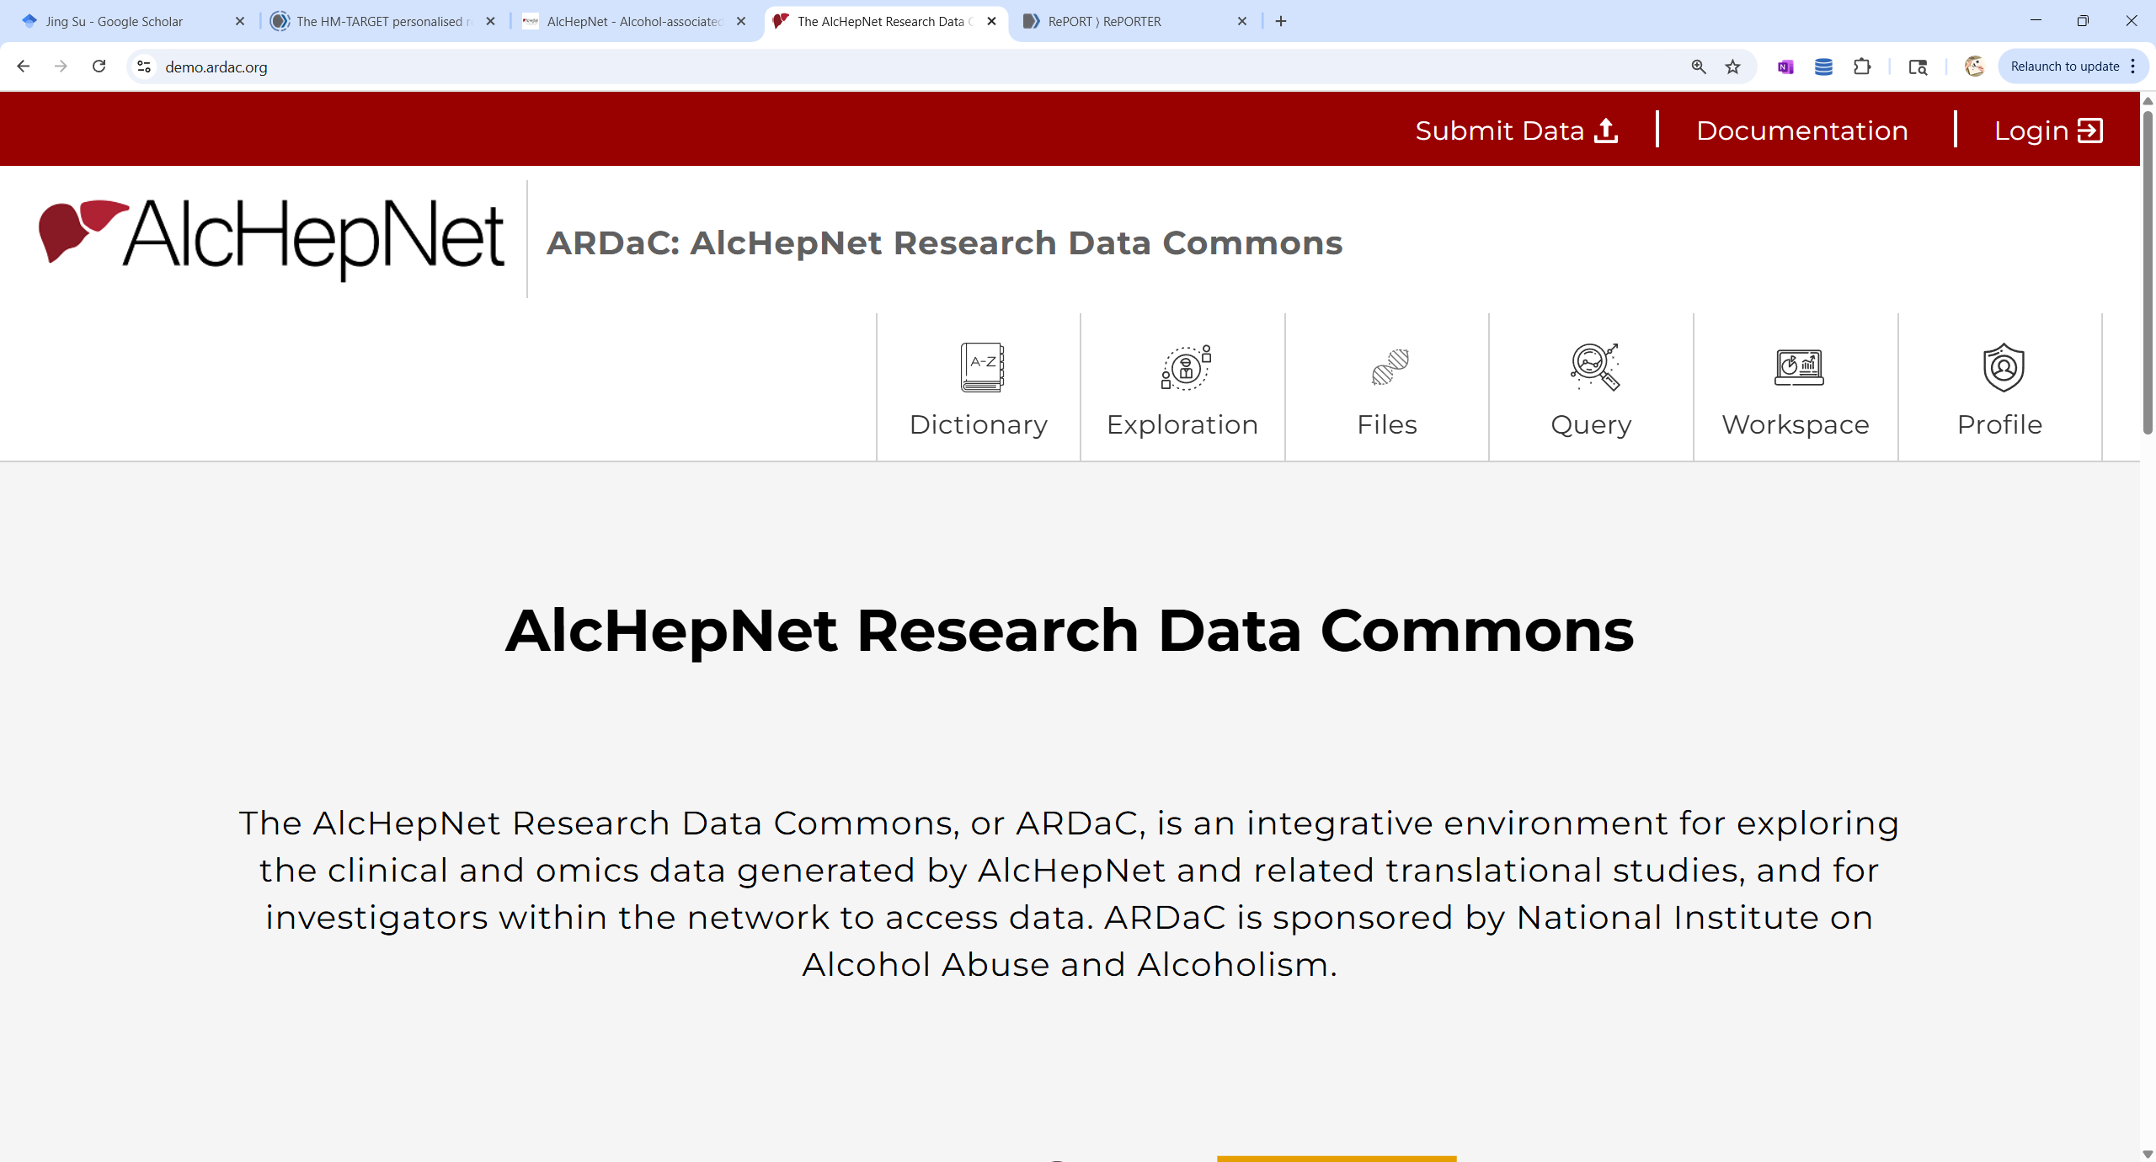

Welcome Onboard!
ARDaC Training
Hao Wang, Mengting Xiong, Jing Su, Carla Kettler, Wanzhu Tu
AlcHepNet – ITAALD Indiana University Data Coordinating Center
September 8, 2025

Slide 2
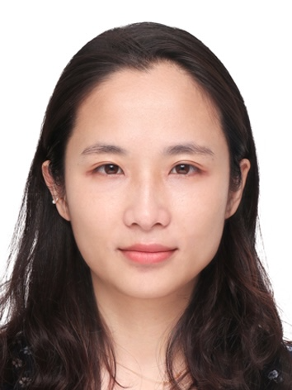

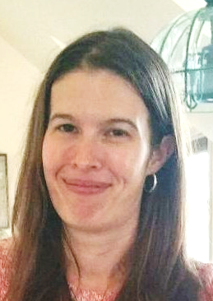
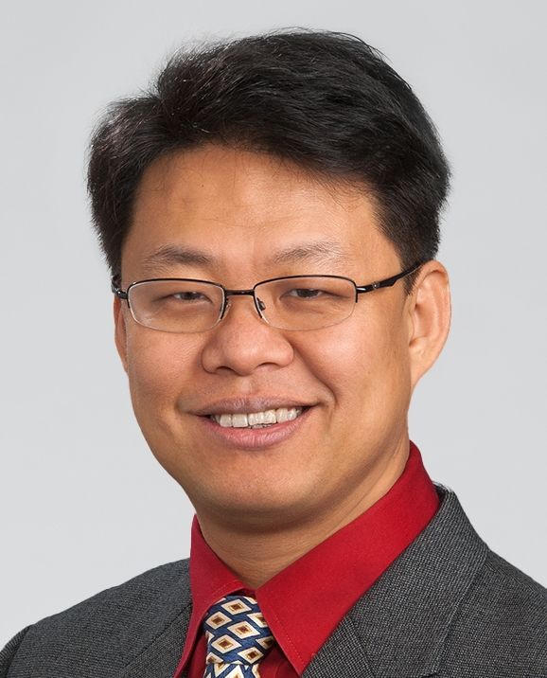

Instructors
Hao Wang
Analytic Visualization
Mengting Xiong​
ARDaC Project Manager
Carla Kettler
Director, Data Core
Jing Su, PhD
Director, Data Commons
Wanzhu Tu, PhD
IUDCC PI

Slide 3
Agenda
Welcome — 2 min
Introduction to instructors — 3 min
ARDaC overview — 5 min
ARDaC walkthrough — 35 min
Q&A and survey — 15 min

Slide 4
ARDaC (Alcohol Research Data Commons)
Developed and maintained by the Data Commons Core of Indiana University DCC.
A modern central data hub, collaboration nexus, and innovation engine for AlcHepNet (AHN).
Studies:
AHN observational study (OBS);
AHN randomized clinical trial (RCT);
Future: ITAALD RCT and external studies.
Data domains:
Clinical data: baseline characteristics, study designs, outcomes, adverse events;
Biospecimens: types, availabilities, distributions to translational labs;
Laboratory assays: collected during studies or generated by translational labs.
Functionalities: ML/AI-ready
Query, exploration, and visualization;
Data access and management;
Data analysis and cloud computing.
F.A.I.R design: the ARDaC Common Data Model is compatible with the NIH’s Genomics Data Commons model and the Global Alliance for Genomics and Health (GA4GH) standards.

Slide 5
ARDaC’s intended use
Currently: initial data exploration for hypothesis generation.
What AHN has collected and whether specific hypotheses or analyses can be pursued;
Support the preparation of data access requests and manuscript proposals;
Based on data exploration, investigators can submit research proposals to the AHN Publication & Ancillary Study Subcommittee to request datasets.
Data analysis functionalities not yet open.
System access:
Phase 1: invited users for system testing;
Phase 2: all AHN investigators;
Phase 3: Approved external users.

Slide 6
The Current State of ARDaC
Development of ARDaC started during the last cycle of AHN.
Recent data expansion and updates:
Detailed information on the biospecimens collected by AHN, including those distributed to translational labs in the previous cycle and those transferred from UMass to the IU biorepository.
Updated lab results from translational labs.
Updated outcome and adverse event data.
A cloud-based system (AWS): ARDaC web portal and interface can be accessed from anywhere.
Industrial-level customer support through IU’s ticketing system.
ARDaC is in development; new data and functions will be added over time.

Slide 7
Please explore
Send us your feedback and help us improve the system
We will have a survey at the end of the training session today

Slide 8
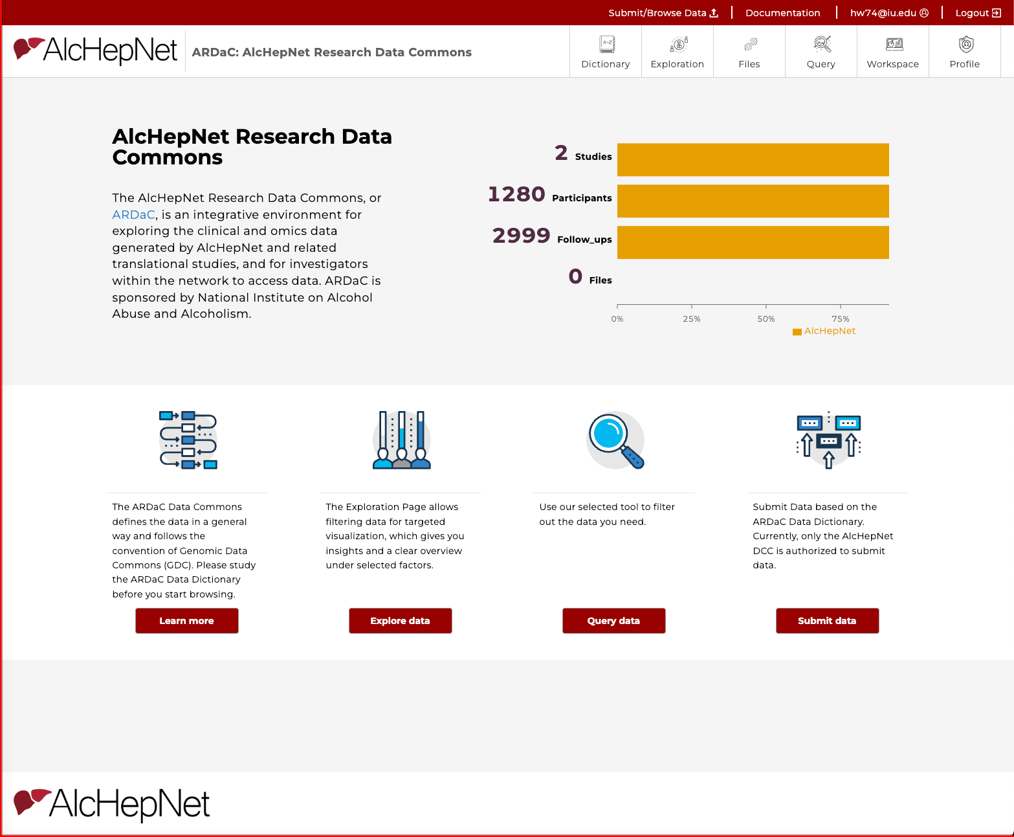
Welcome to ARDaC: The Alcohol-associated Hepatitis Network Research Data Commons
Training link: https://training.ardac.org/
Official entry:
https://portal.ardac.org/
Data Source: AHN

Slide 9
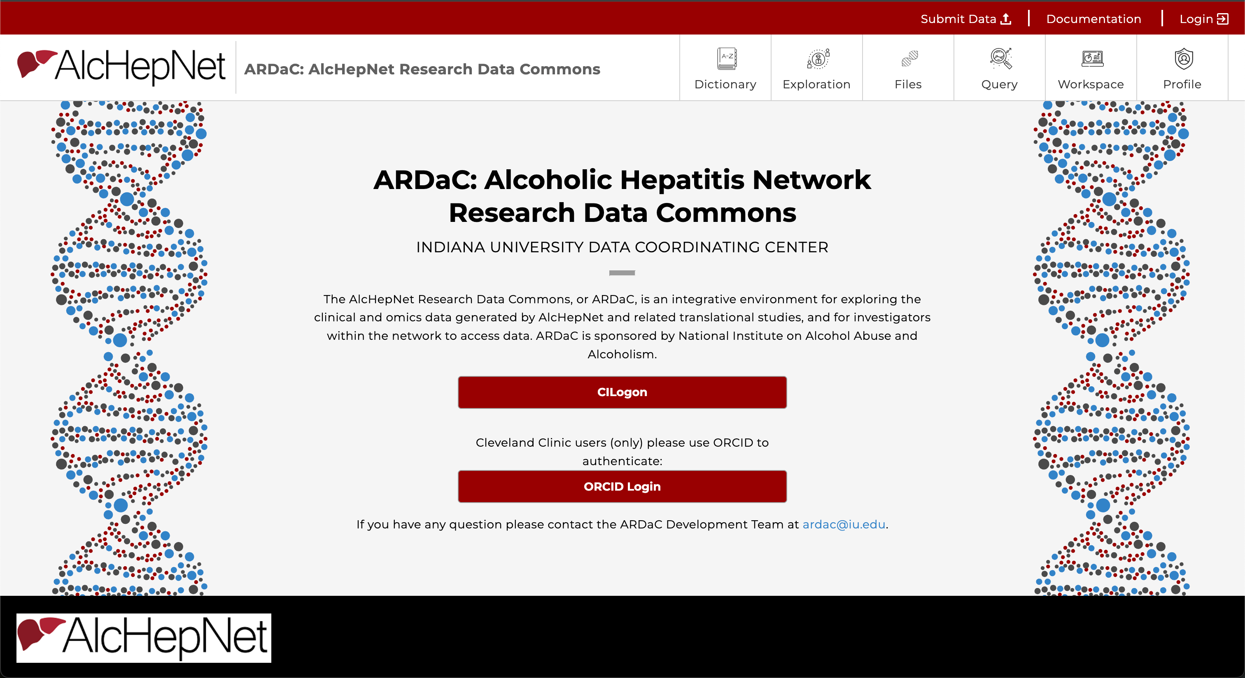
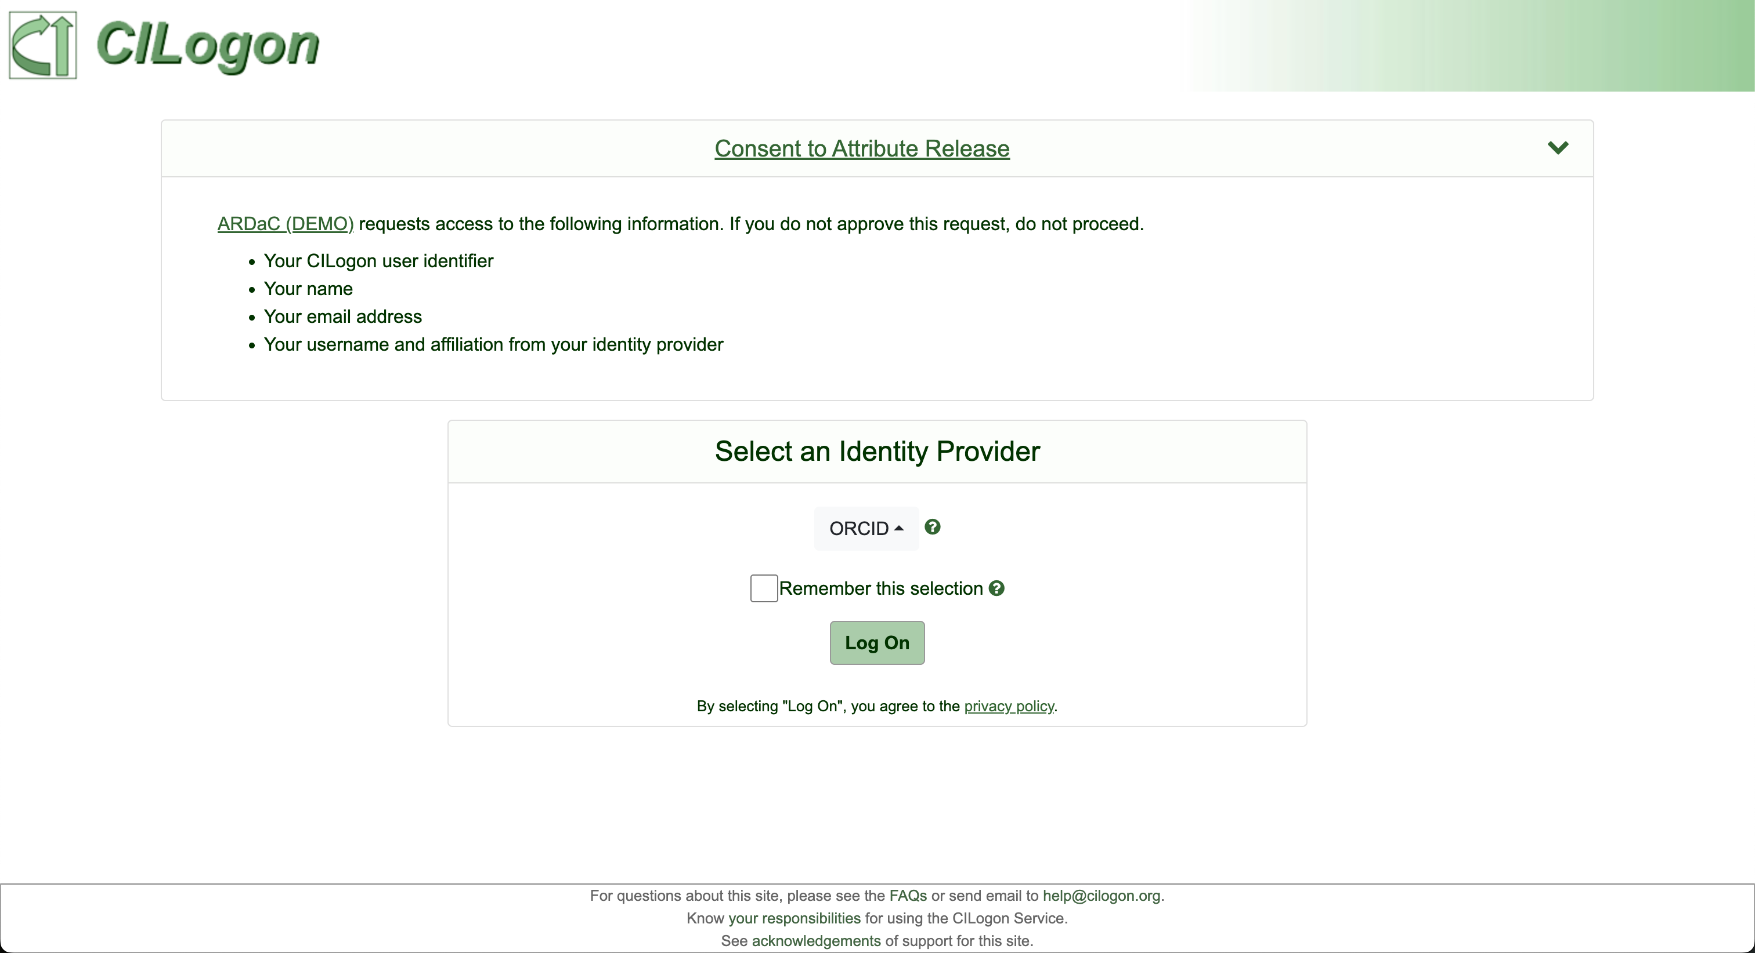
Step 1: Login / Sign In
Sign in with CILogon / ORCID account or institutional credentials (see login guide in Cheat sheet page)
After login, you land on the main dashboard

Slide 10
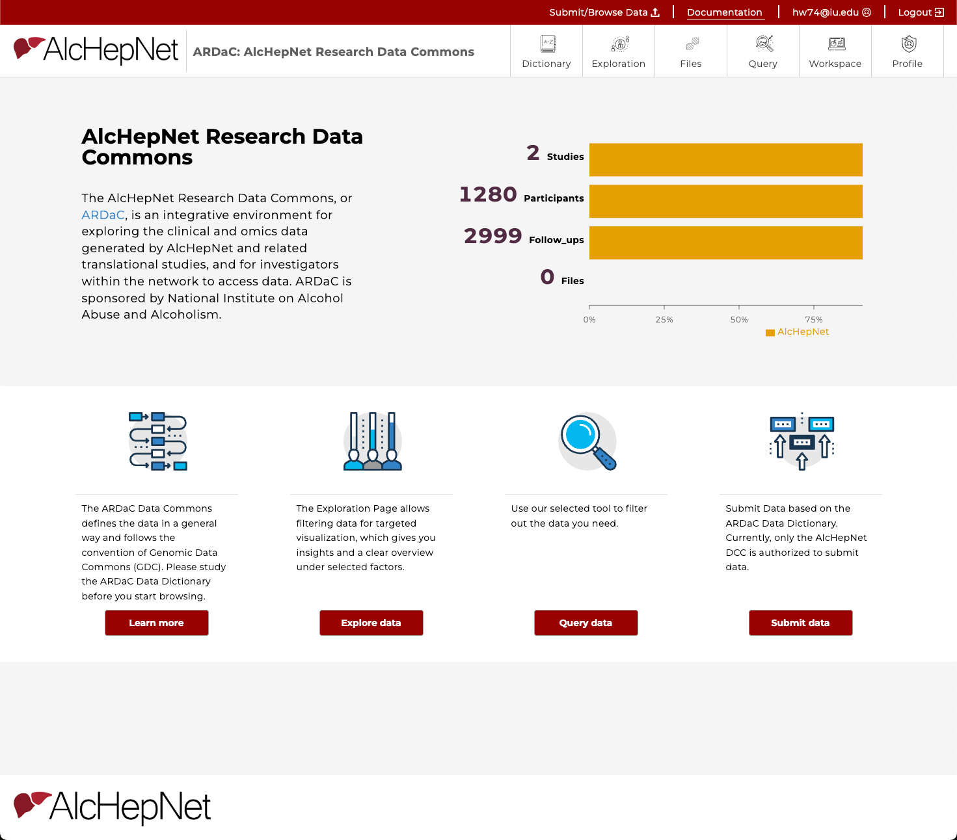
Step 2: Dashboard Overview
Top Navigation Tabs:
Dictionary
Exploration
Query
Workspace
Profile
Top Right:
Login status
User profile
Documentation
Data submission
Central Dashboard:
Summary Text
Stats on Studies / Participants / Follow-ups / Files
Bottom buttons
Quick actions

Slide 11
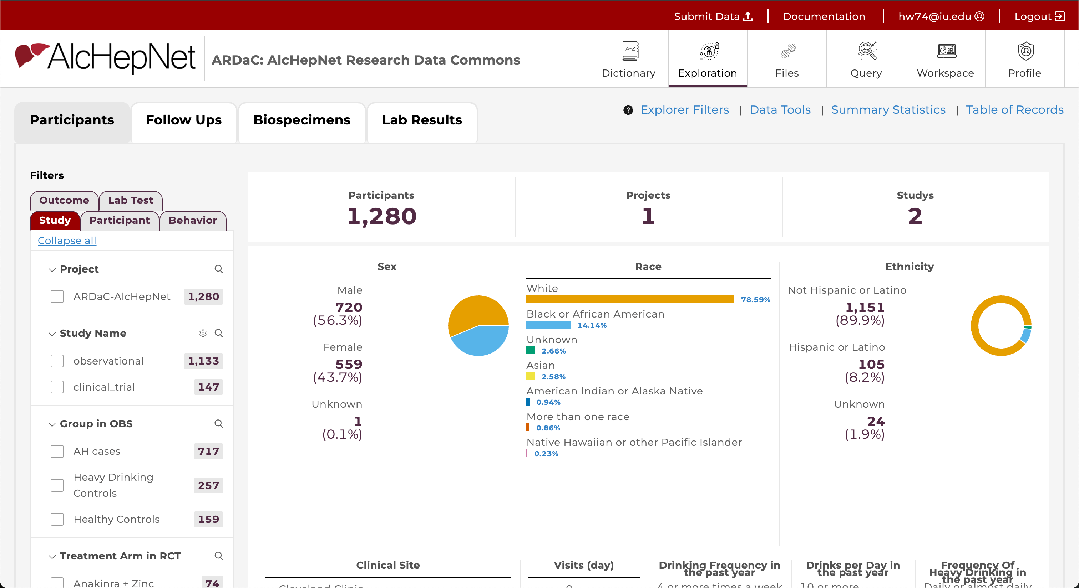
Step 3: Data Exploration
Function: Interactive data filtering and visualization
1. Four main tabs: - Four main nodes
2. Filter panel: - Organized into several tabs
3. Chart panel: - First row: counts summary - Chart Types: Boxplot, Bar, Line, etc. Survival curve - Hover: more info
How to Use: Select filters → apply → view charts
1
2
3

Slide 12
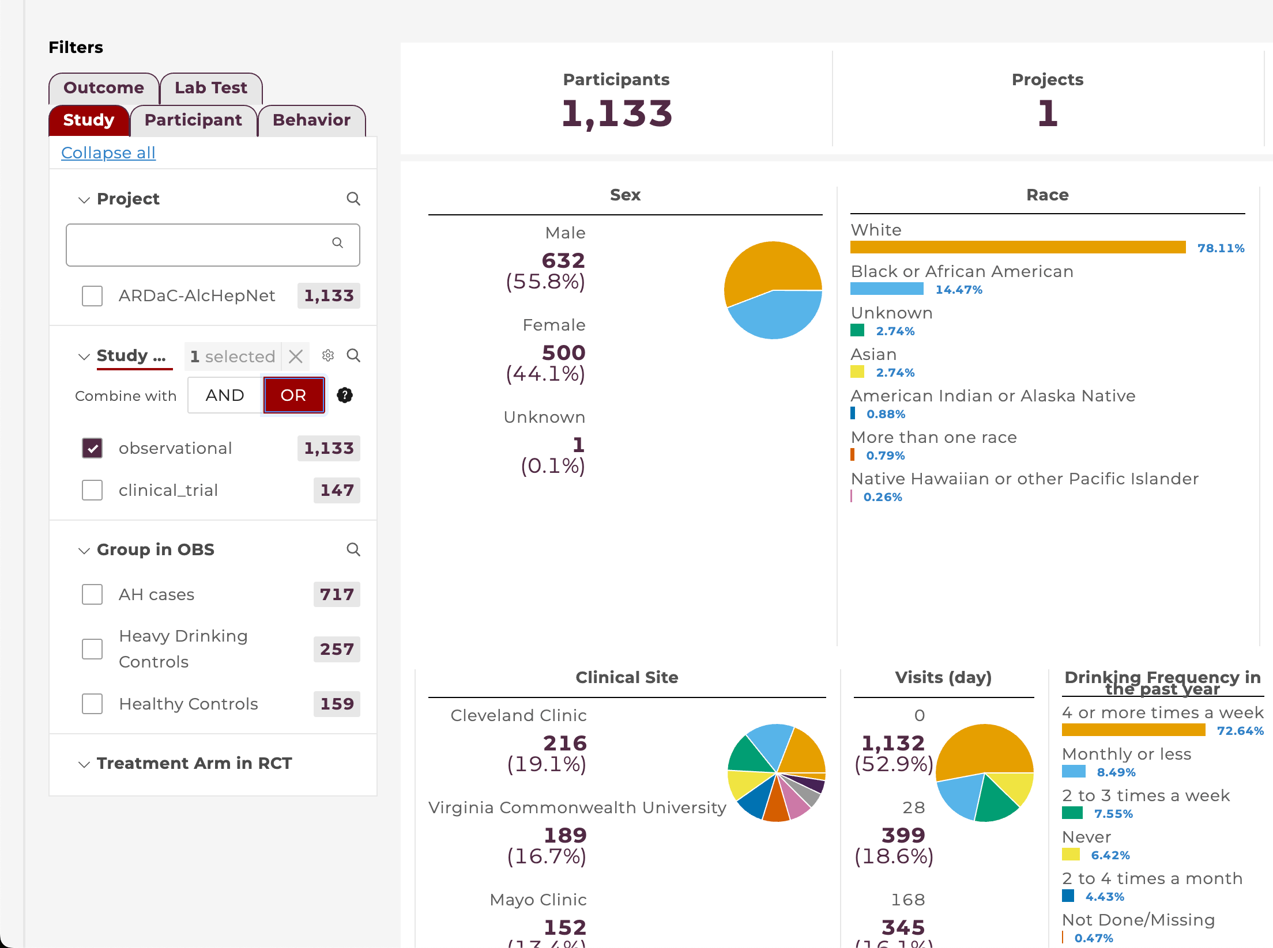
Step 3: Data Exploration
2
Advanced:
2. Filter panel: - Search icon: search in filter options - Gear (Setting) icon: combine with AND/OR
3. Chart panel: - Will change accordingly
3

Slide 13
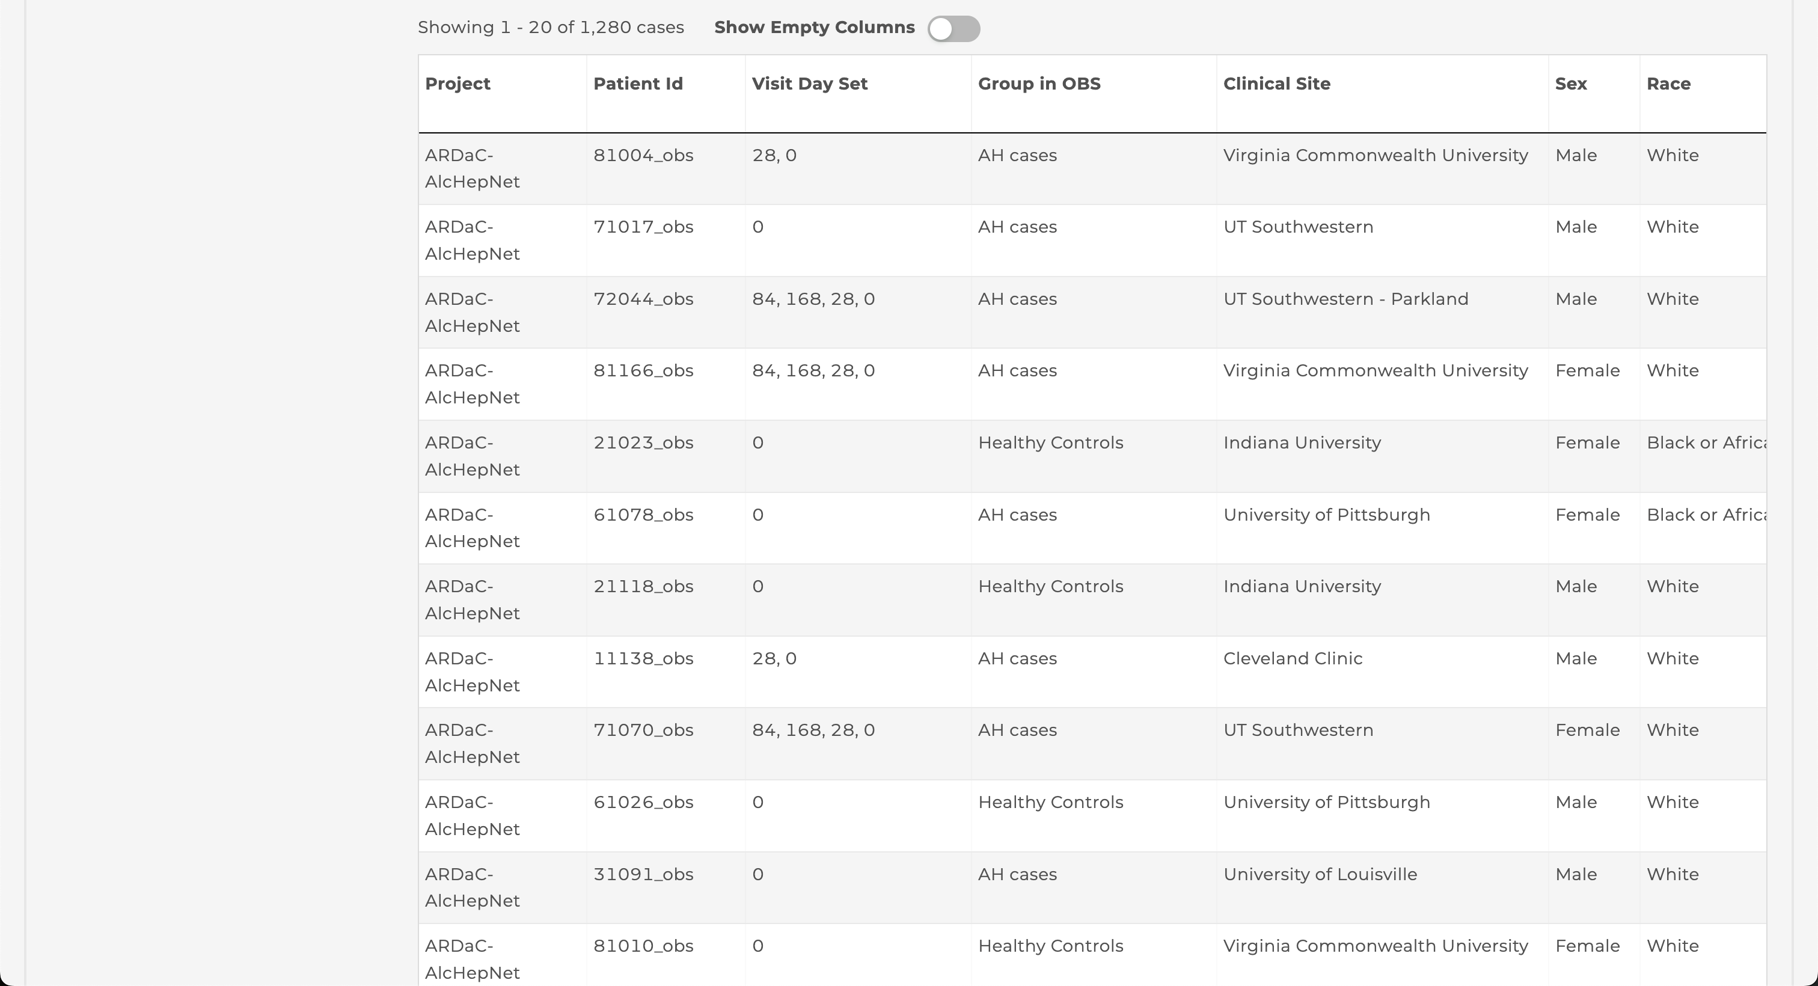
Step 3: Data Exploration
4. Table panel: - At the bottom of the page - Properties that used
4

Slide 14
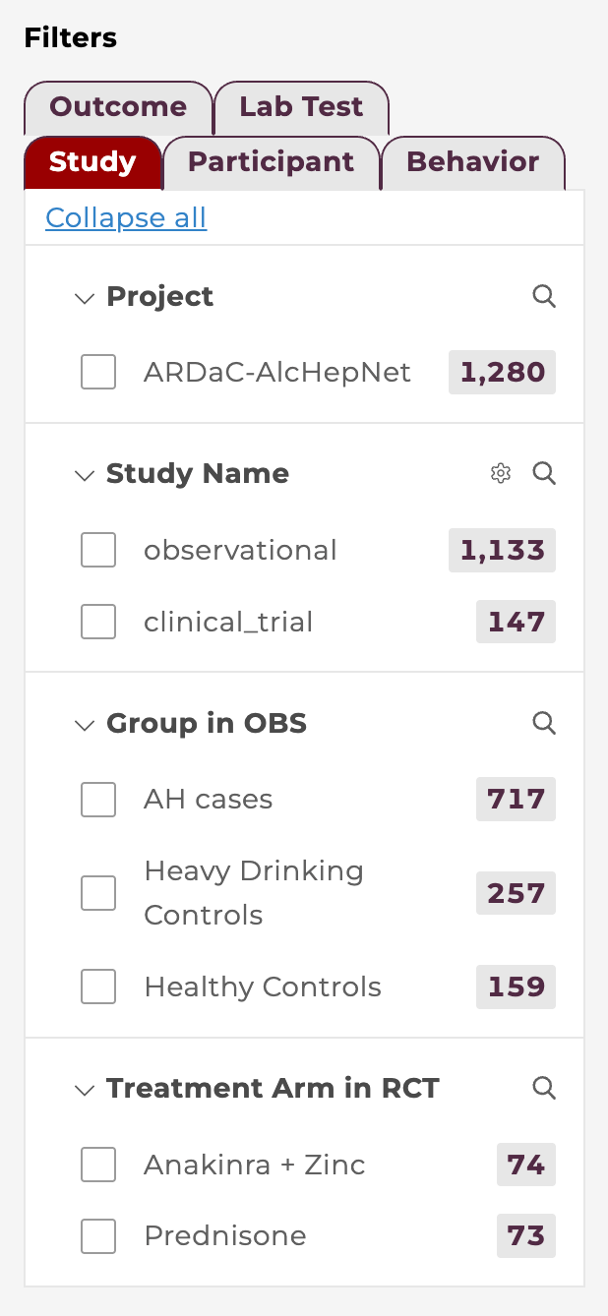
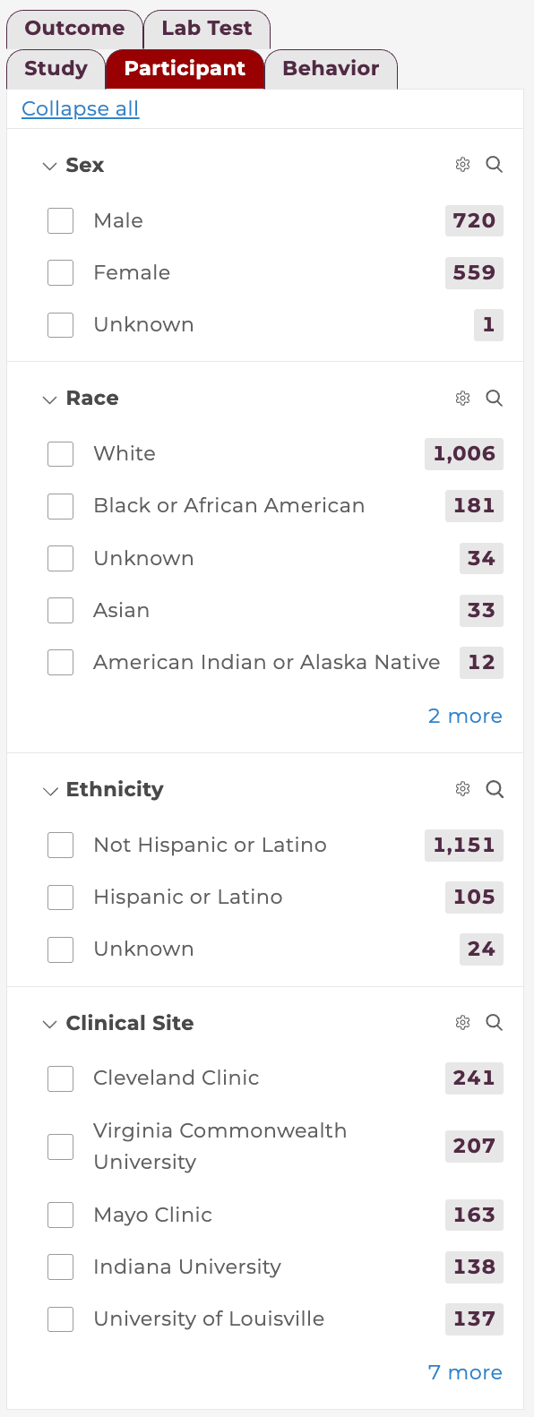
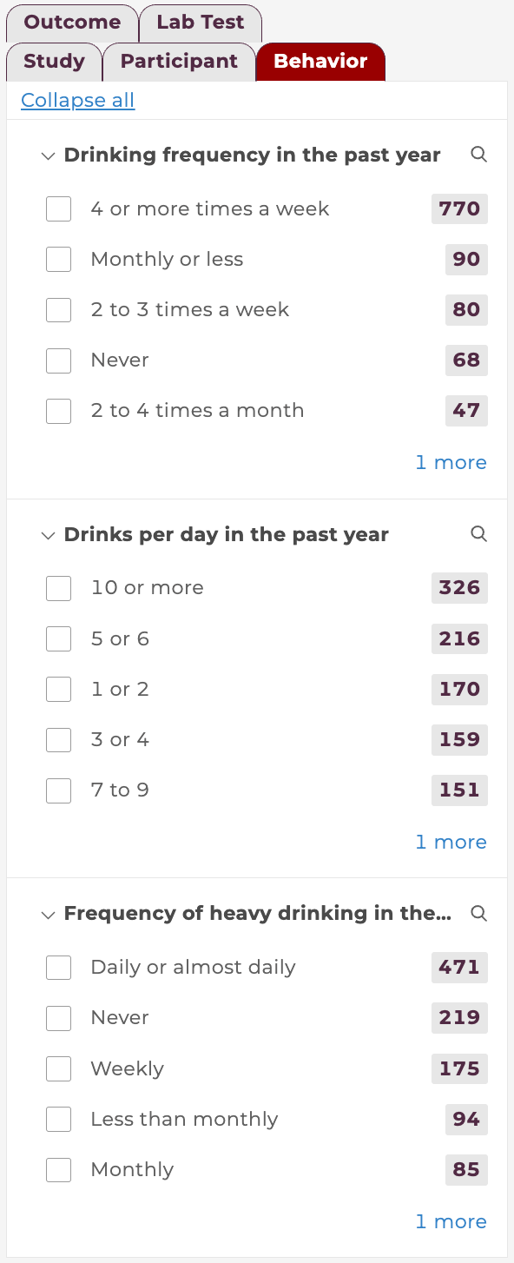
Step 3: Data Exploration
Participants tab
Applying Filters: - Filter by Study attributes (project, study name, group in obs, treatment arm in rct) - Filter by Participant attributes (demographics, clinical sites) - Filter by Behavior - Filter by Outcome and Lab test
Filters instantly update the numbers and charts on the right

Slide 15
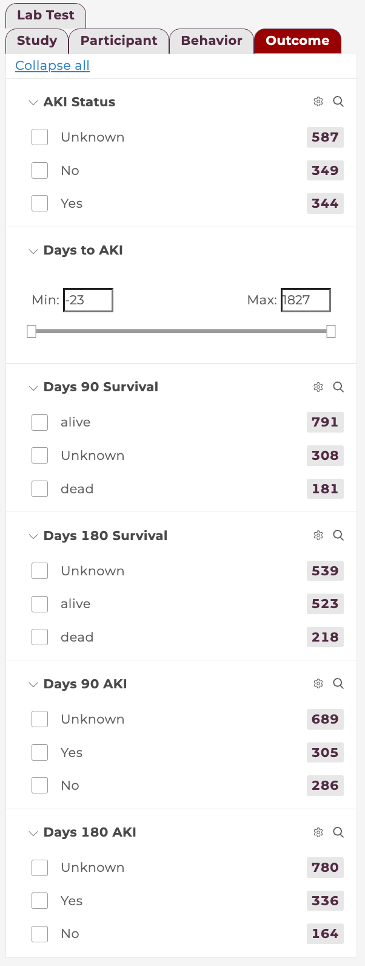
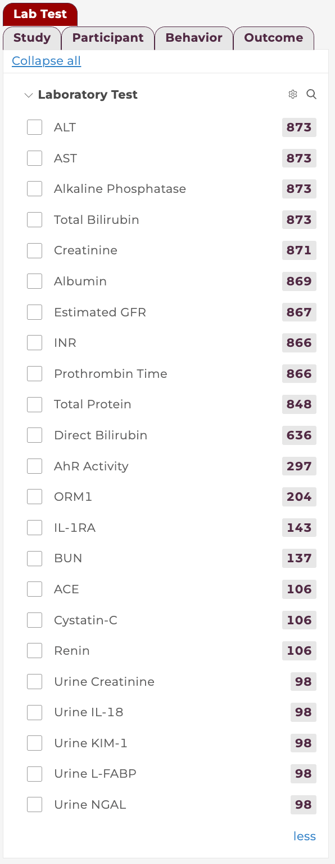
Step 3: Data Exploration
Participants tab
Applying Filters: - Filter by Study attributes (project, study name, group in obs, treatment arm in rct) - Filter by Participant attributes (demographics, clinical sites) - Filter by Behavior - Filter by Outcome and Lab test
Filters instantly update the numbers and charts on the right

Slide 16
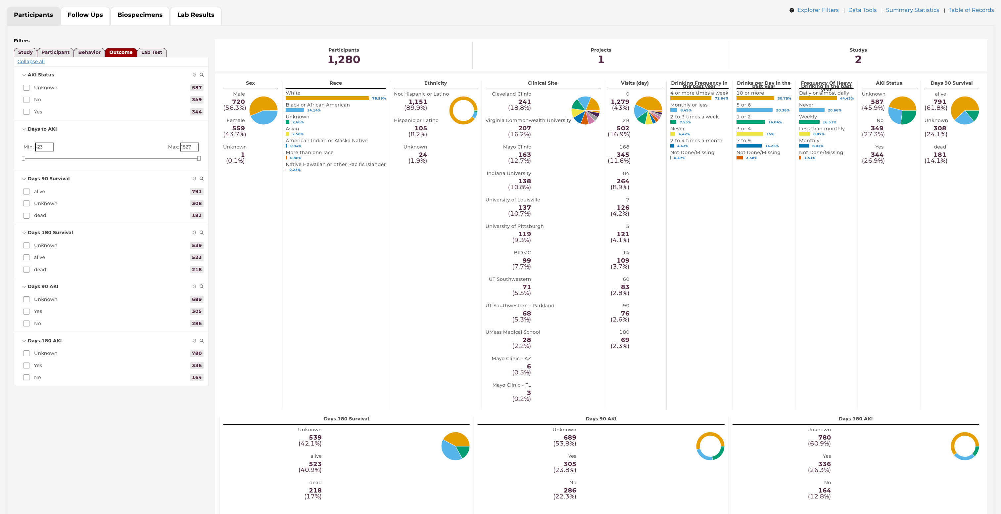
Step 3: Data Exploration
Participants tab
Charts and Charts and Visualizations

Slide 17
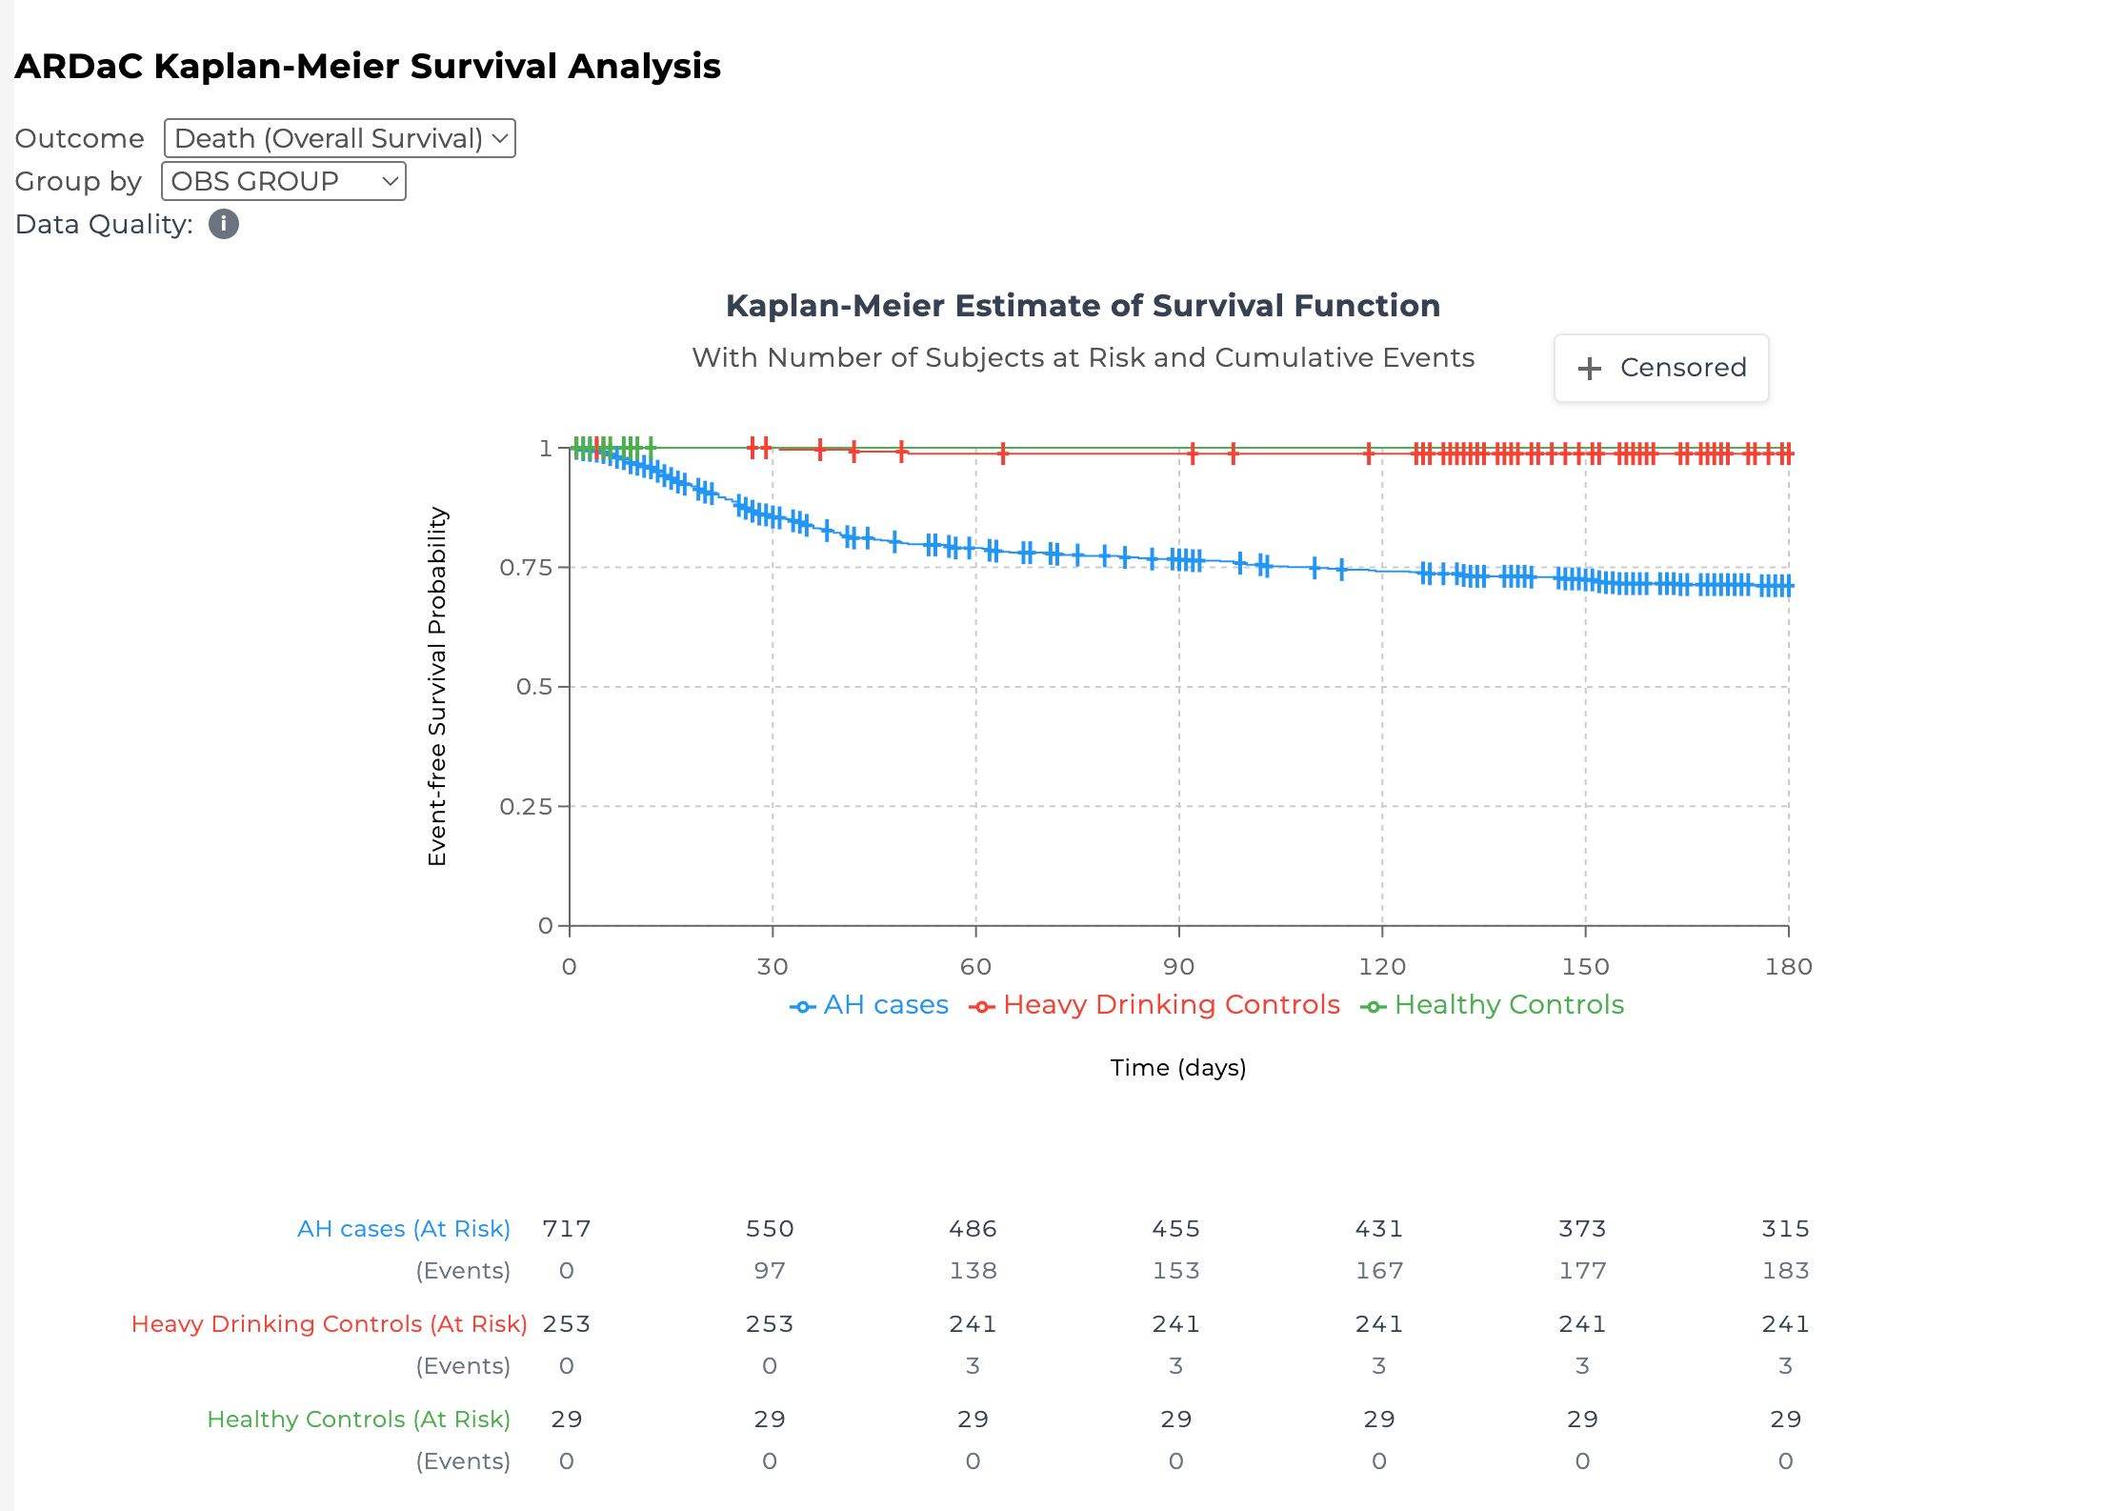
Step 3: Data Exploration
Participants tab
Survival Curve Analysis: - Outcome: - Death (Overall Survival) - AKI - Group by: - No Grouping - OBS Group - Treatment Arm - Sex - Main chart - At Risk and Events table
For RCT patients, when we calculating the survival and aki, we will use treatment date as the start date/index date (variable name “rct_trtstdat”)
For OBS patients, when we calculating the survival and aki, we will use enrollment date as the start date/index date

Slide 18
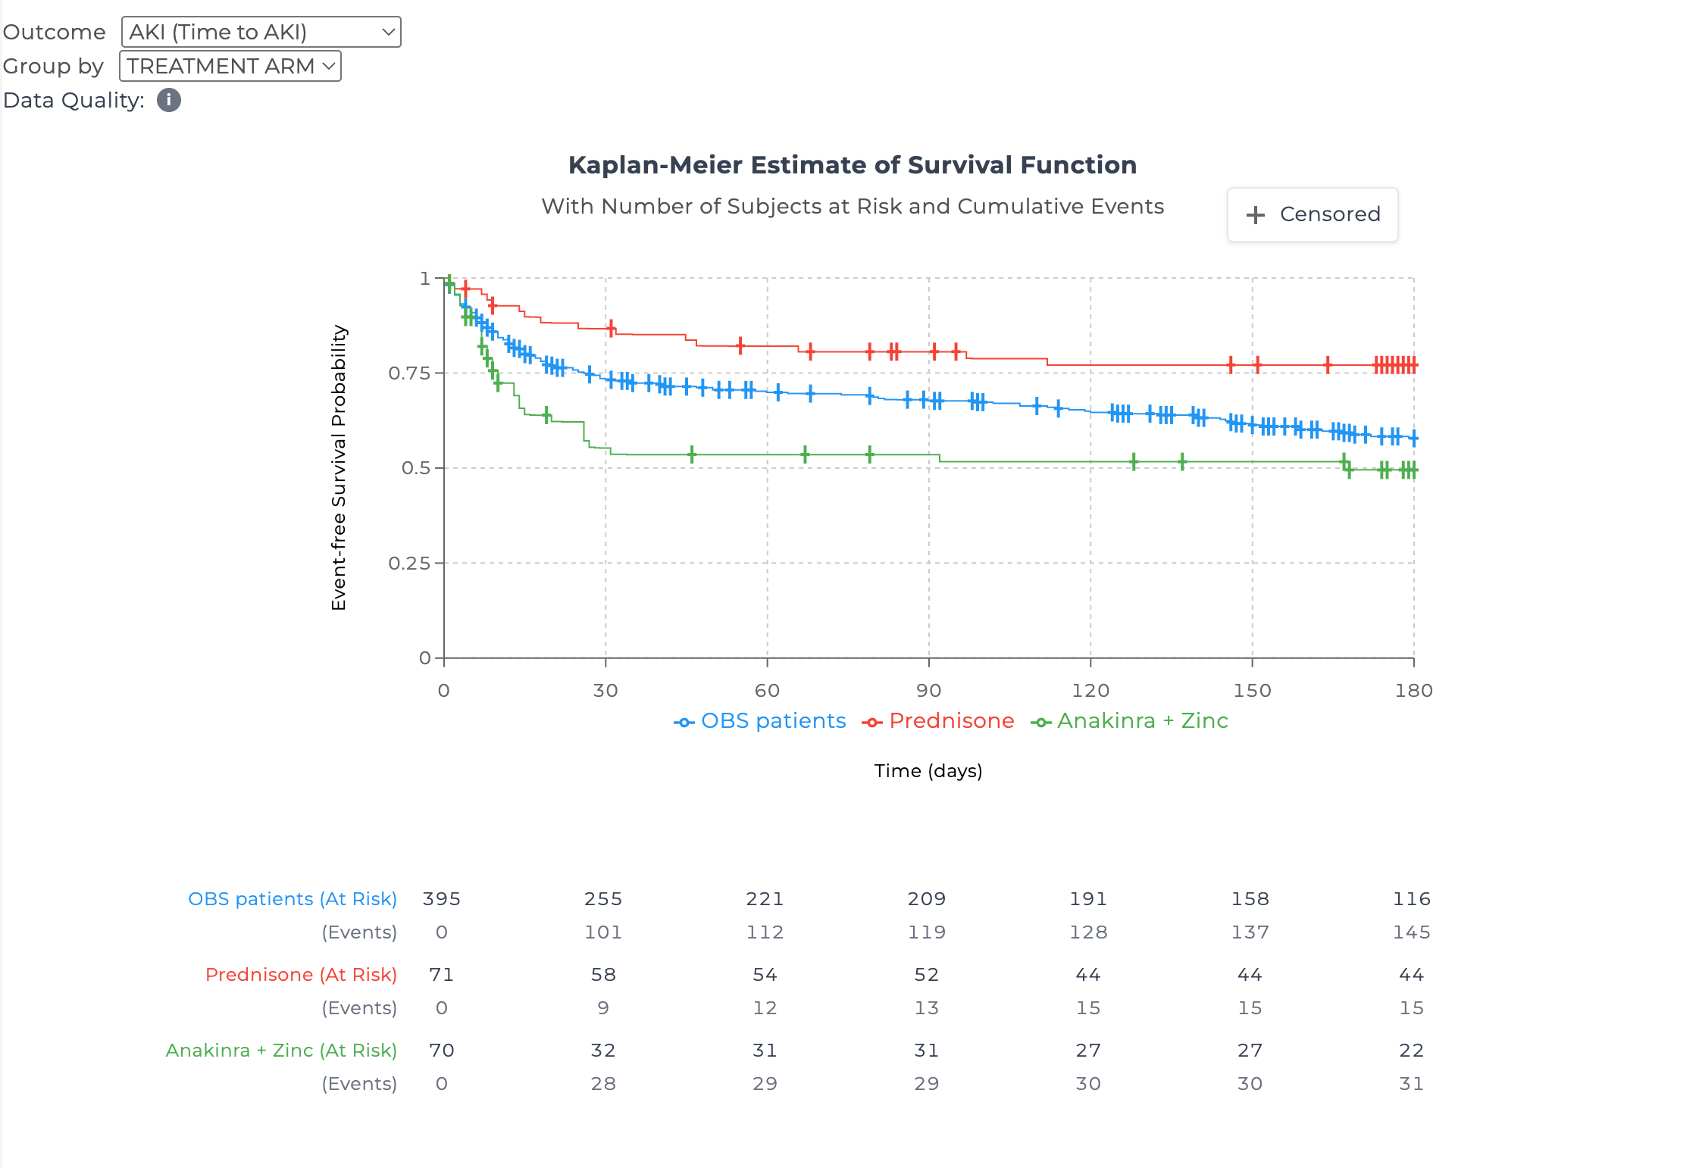
Step 3: Data Exploration
Participants tab
Survival Curve Analysis: - Outcome: - Death (Overall Survival) - AKI - Group by: - No Grouping - OBS Group - Treatment Arm - Sex - Main chart - At Risk and Events table

Slide 19
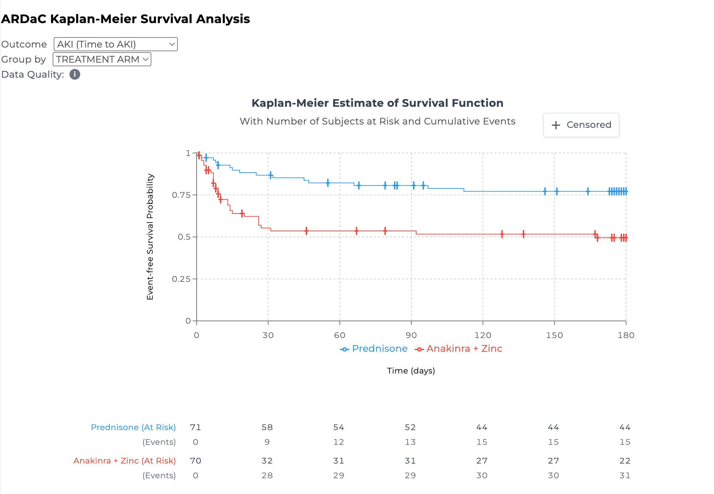
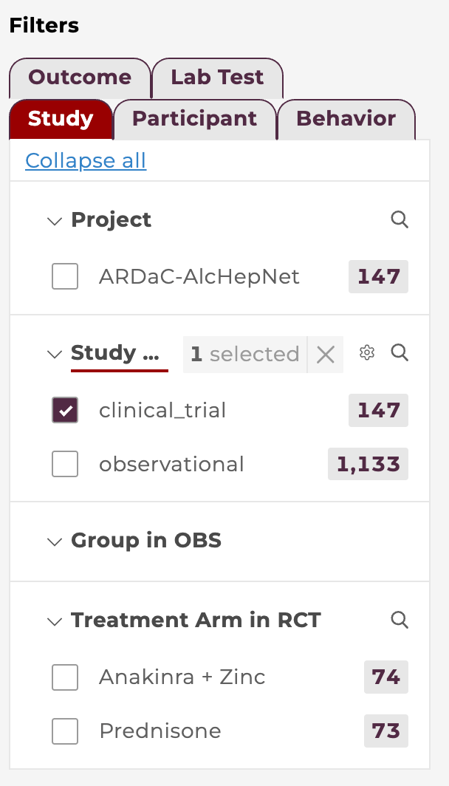
Step 3: Data Exploration
Participants tab
Survival Curve Analysis: - Outcome: - Death (Overall Survival) - AKI - Group by: - No Grouping - OBS Group - Treatment Arm - Sex - Main chart - At rick and events table
- with Filter: RCT OBS options will be excluded

Slide 20
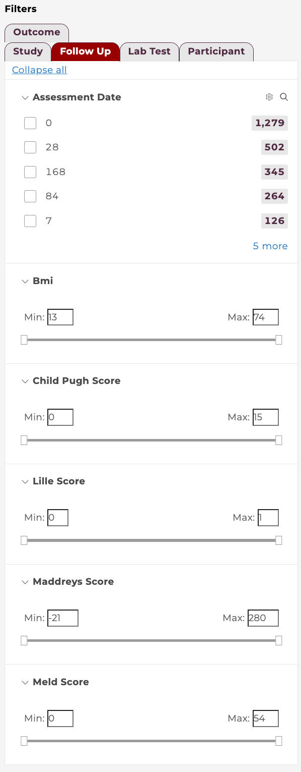
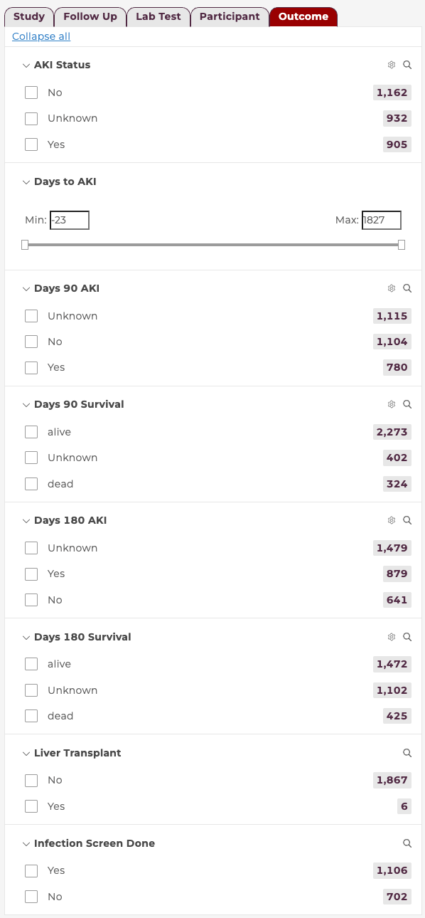
Step 3: Data Exploration
Follow Ups tab
Applying Filters: Filter by study attributes Filter by participant attributes (demographics, clinical sites) Filter by Follow up Filter by outcome and lab test ...
Filters instantly update the numbers and charts on the right

Slide 21
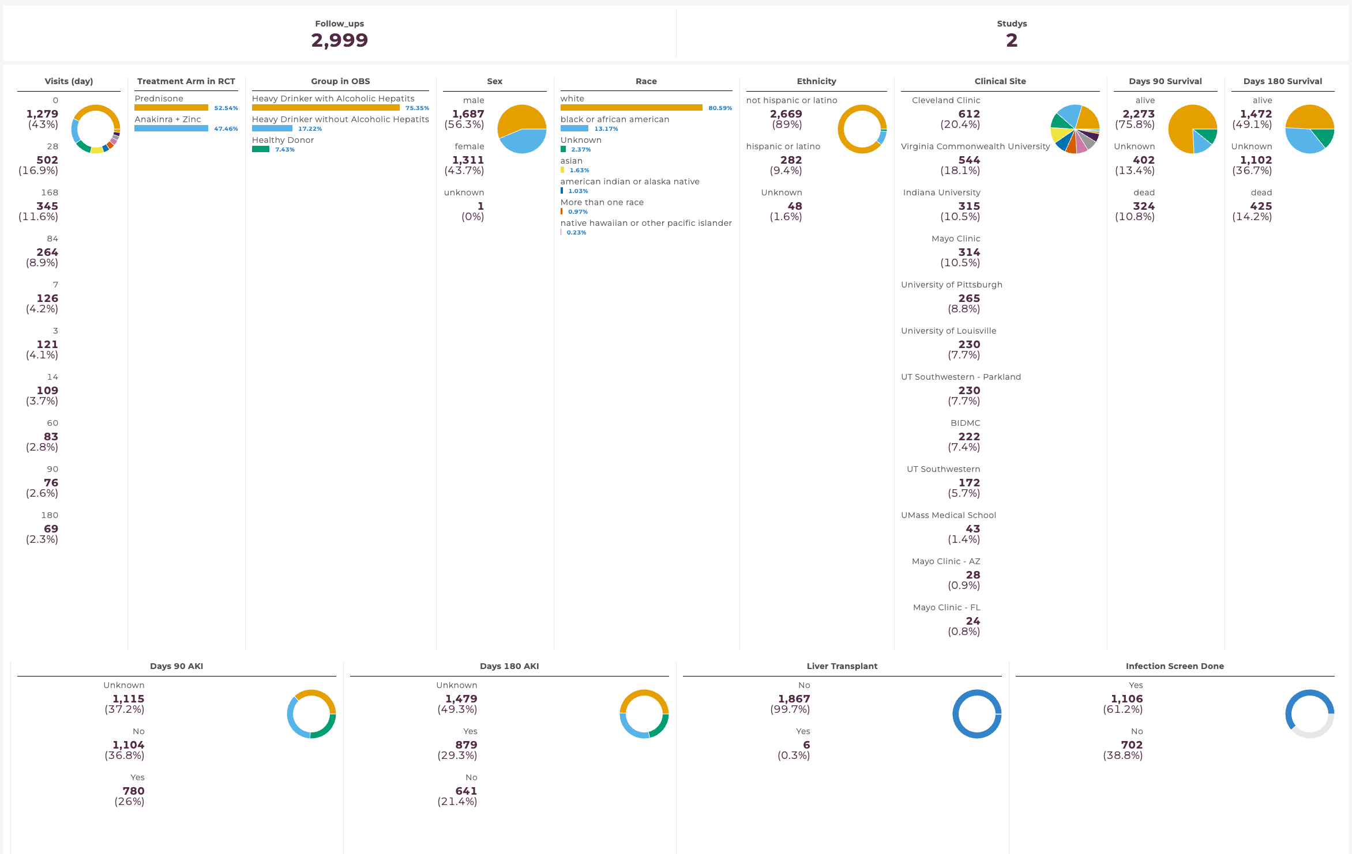
Step 3: Data Exploration
Follow Ups tab
Charts and Visualizations

Slide 22
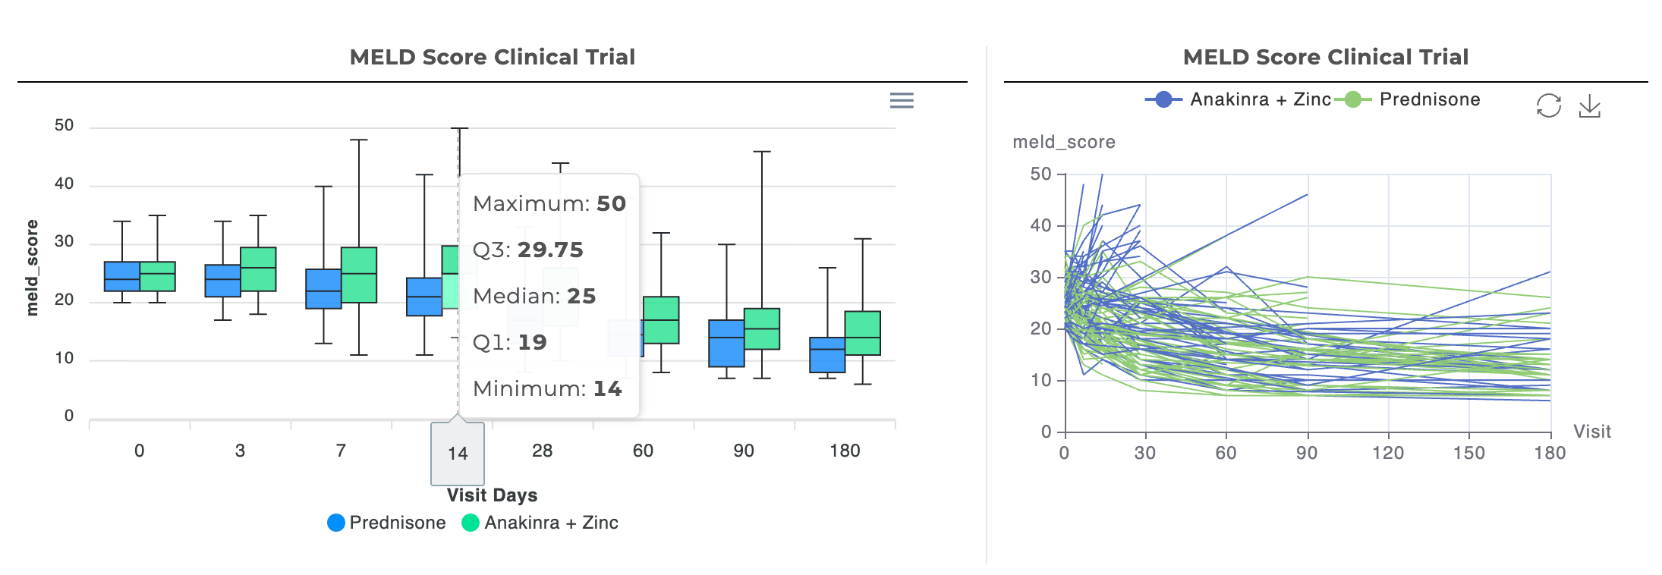
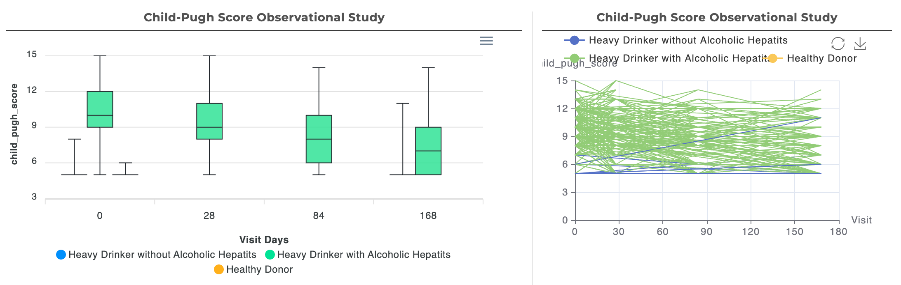
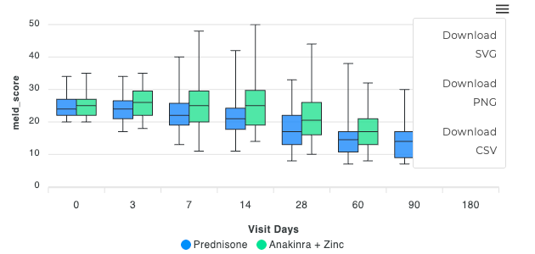
Step 3: Data Exploration
Follow Ups tab
Customized Analysis (OBS and RCT): - MELD Score (mouse hover) - Child-Pugh - Maddrey's Discriminant Function Score - Lille Score

Slide 23
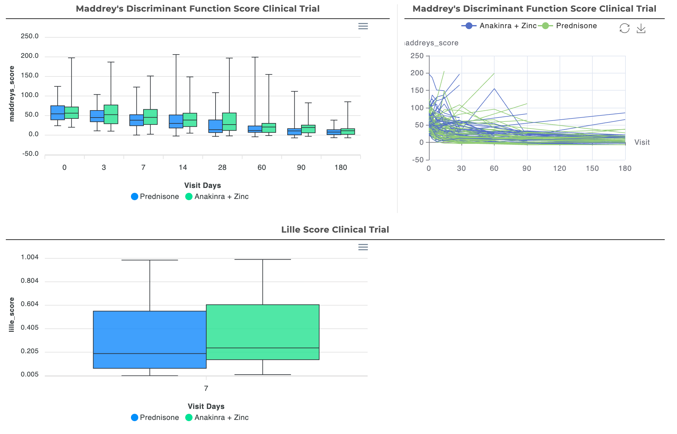
Step 3: Data Exploration
Follow Ups tab
Customized Analysis (OBS and RCT): - MELD Score - Child-Pugh - Maddrey's Discriminant Function Score - Lille Score
Figures are downloadable

Slide 24
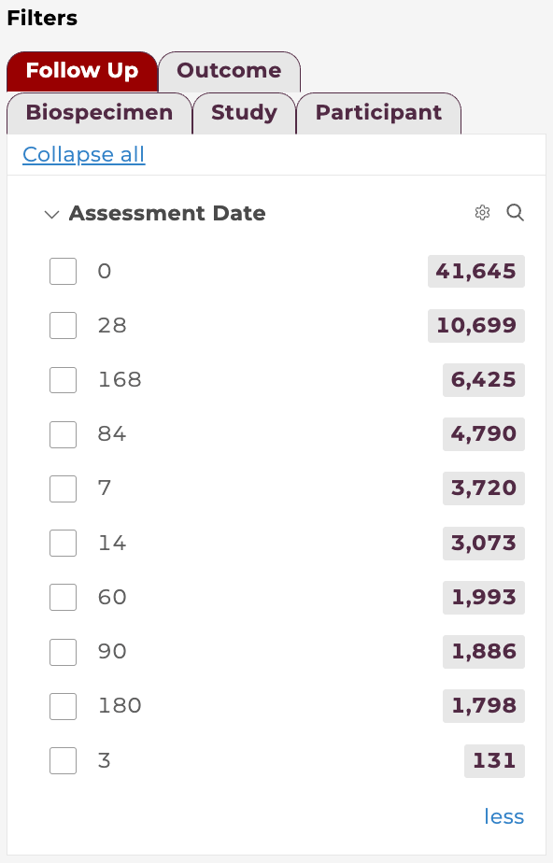
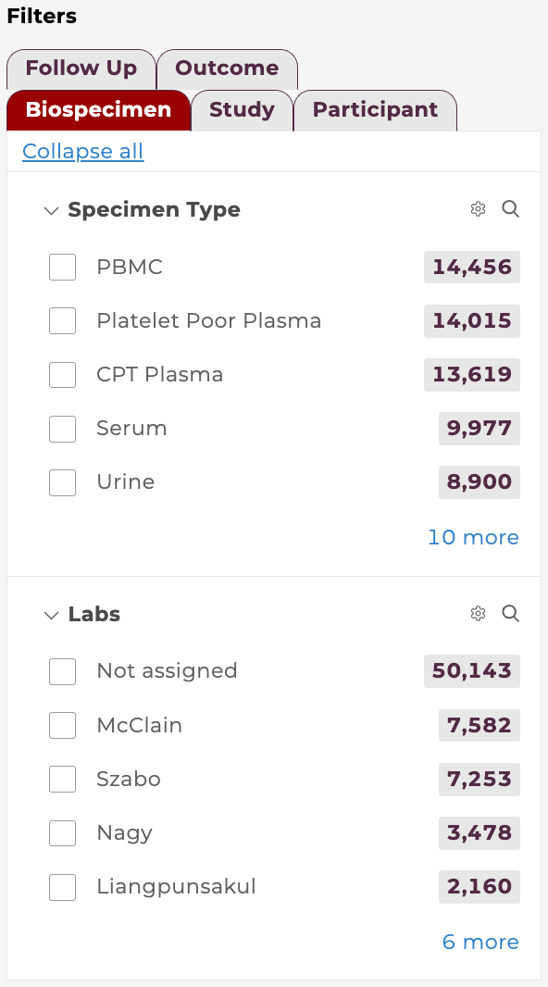
Step 3: Data Exploration
Biospecimens tab
Applying Filters: Filter by Study attributes Filter by Participant attributes (demographics, clinical sites) Filter by Biospecimen Filter by Follow up Filter by Outcome
Filters instantly update the numbers and charts on the right

Slide 25
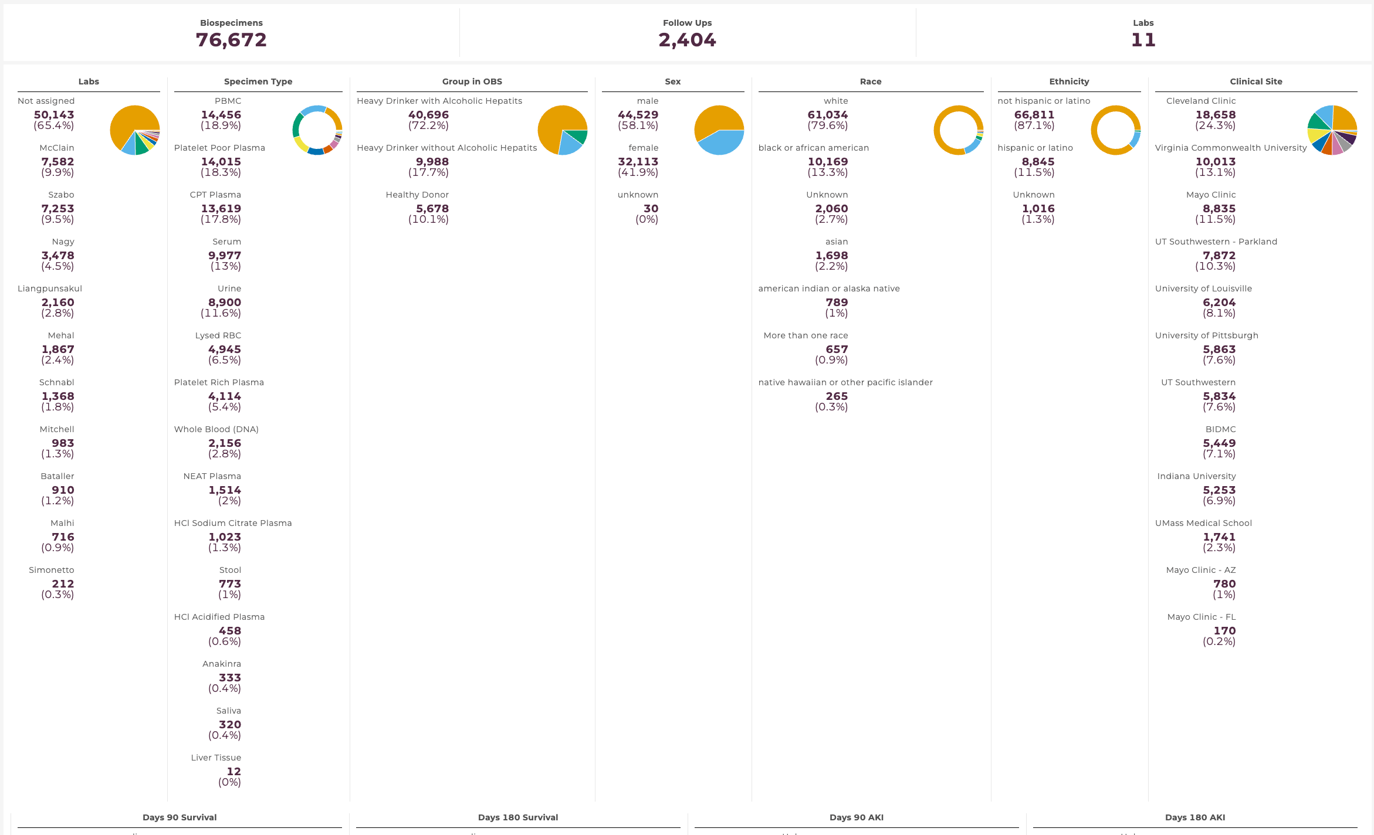
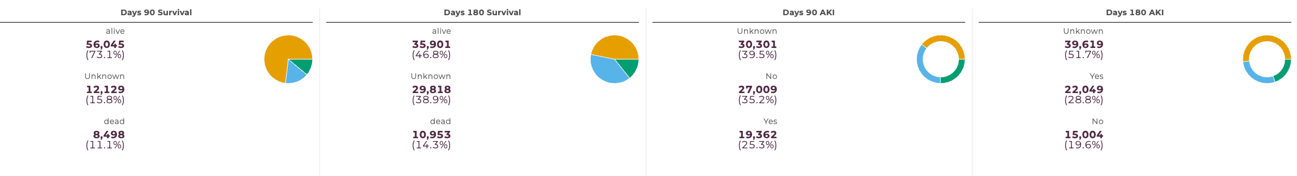
Step 3: Data Exploration
Biospecimens tab
Charts and Visualizations

Slide 26
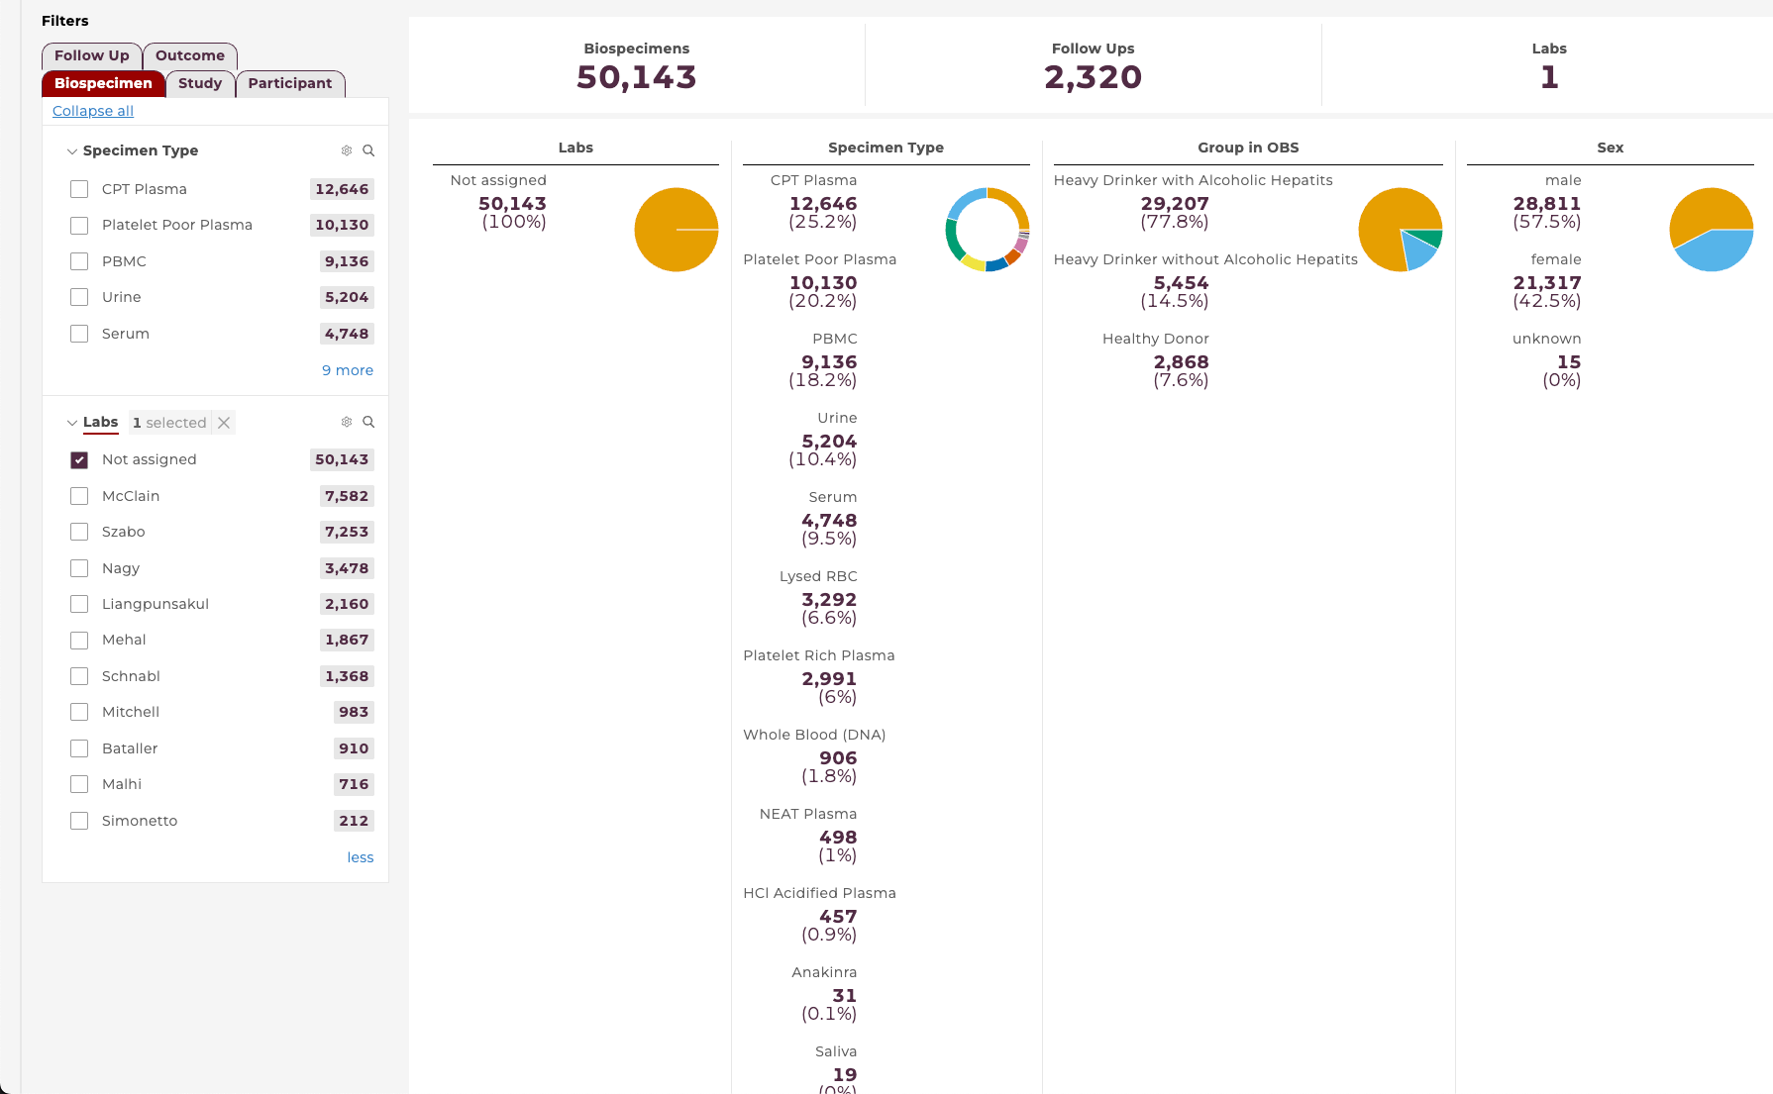
Step 3: Data Exploration
Biospecimens tab
e.g. Click Not assigned in Labs section under Biospecimen filter tab will see the info about the labs that not assigned/shipped
Notes:
Top row shows totals—Biospecimens, Follow Ups, Labs.
Columns summarize by Lab, Specimen Type, OBS Group, Sex/Race/Ethnicity, Clinical Site.
Bottom tiles show outcomes (e.g., 90/180-day survival, AKI).
Hover any chart for exact counts/percentages.

Slide 27
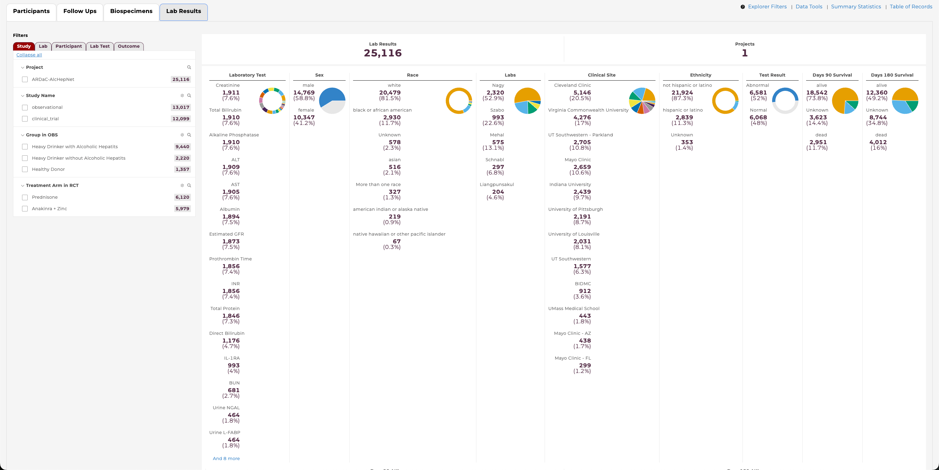
Step 3: Data Exploration
Lab Results tab
Applying Filters: Filter by Study attributes Filter by Lab Filter by Participant attributes (demographics, clinical sites) Filter by Lab Test Filter by Outcome
Filters instantly update the numbers and charts on the right

Slide 28
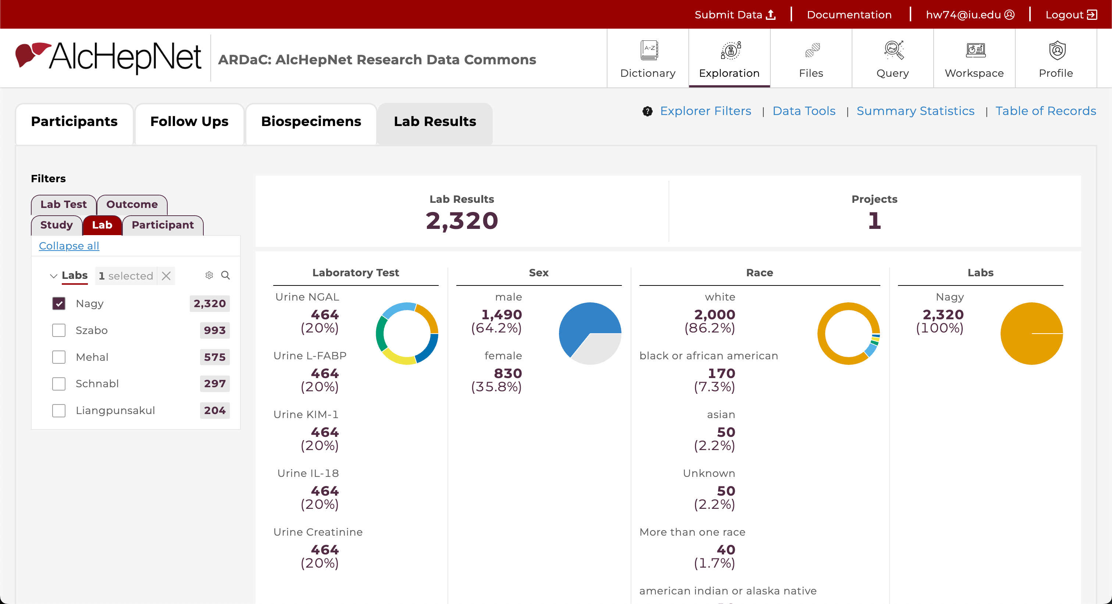
Step 3: Data Exploration
Lab Results tab
e.g.
Filter: - Lab - Nagy

Slide 29
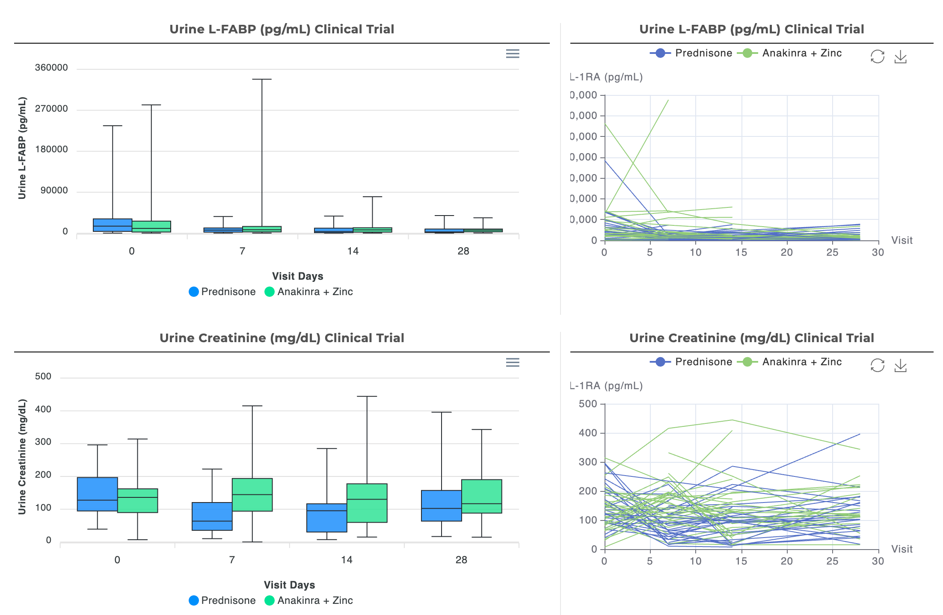
Step 3: Data Exploration
Lab Results tab
Customized Analysis : - Urine L-FABP - Urine Creatinine - Urine IL-18 - Urine KIM-1 - Urine NGAL

Slide 30
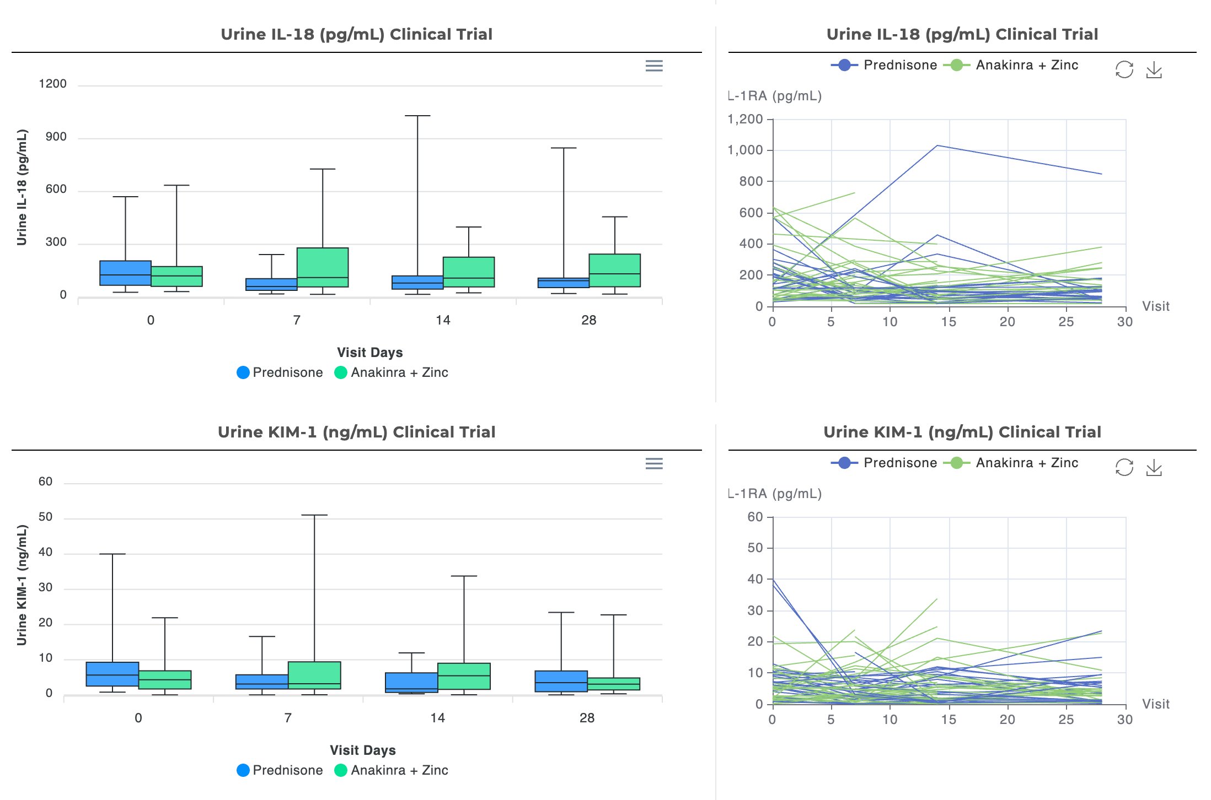
Step 3: Data Exploration
Lab Results tab
Customized Analysis: - Urine L-FABP - Urine Creatinine - Urine IL-18 - Urine KIM-1 - Urine NGAL

Slide 31
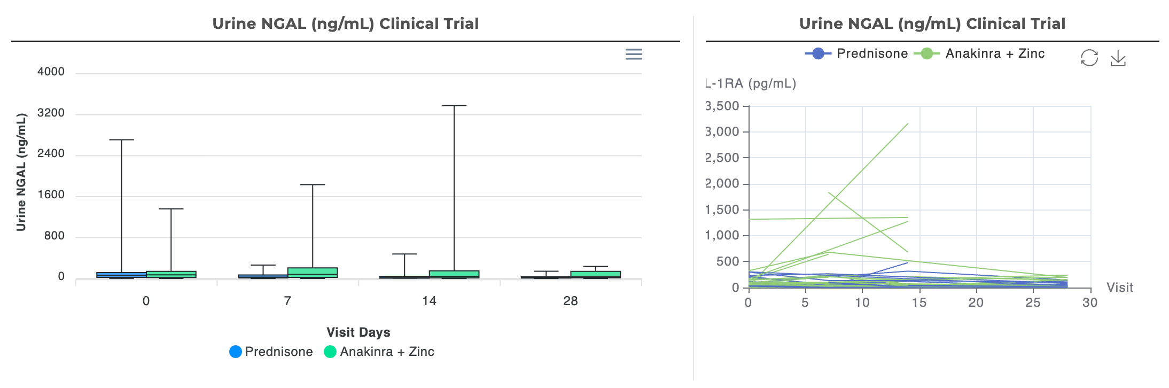
Step 3: Data Exploration
Lab Results tab
Customized Analysis: - Urine L-FABP - Urine Creatinine - Urine IL-18 - Urine KIM-1 - Urine NGAL

Slide 32
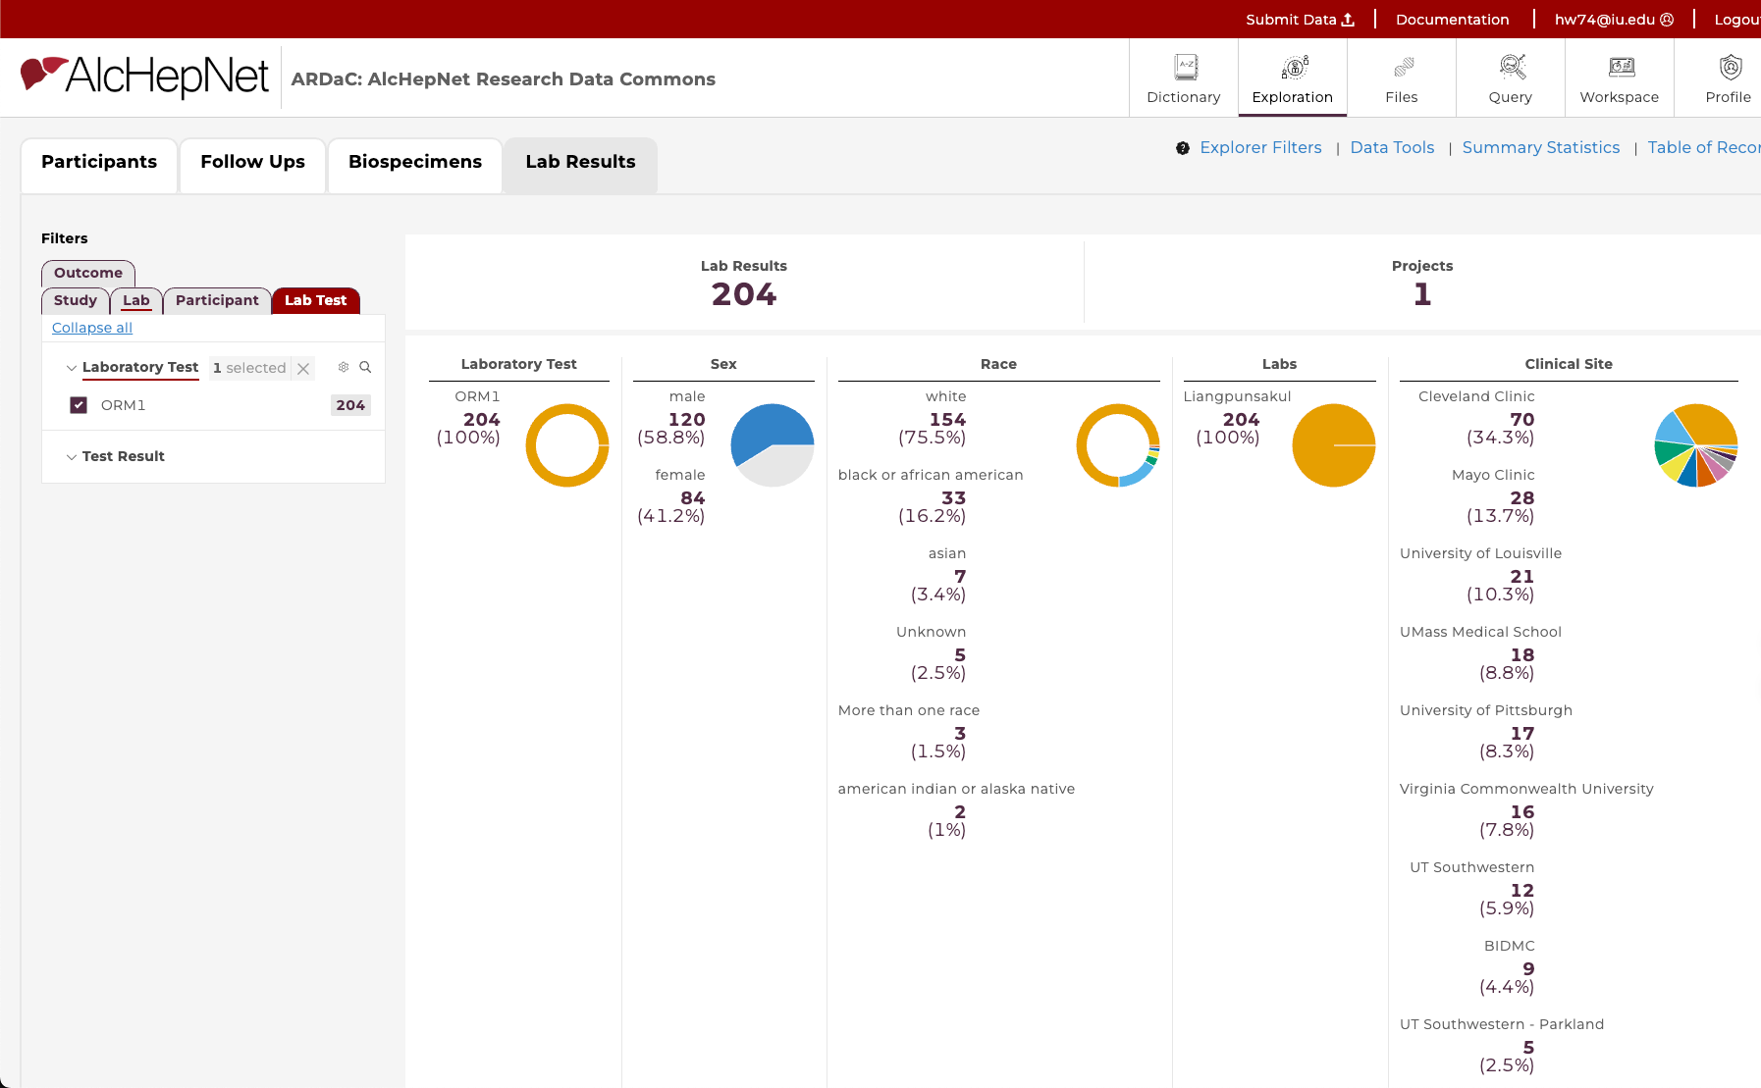
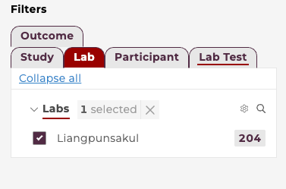
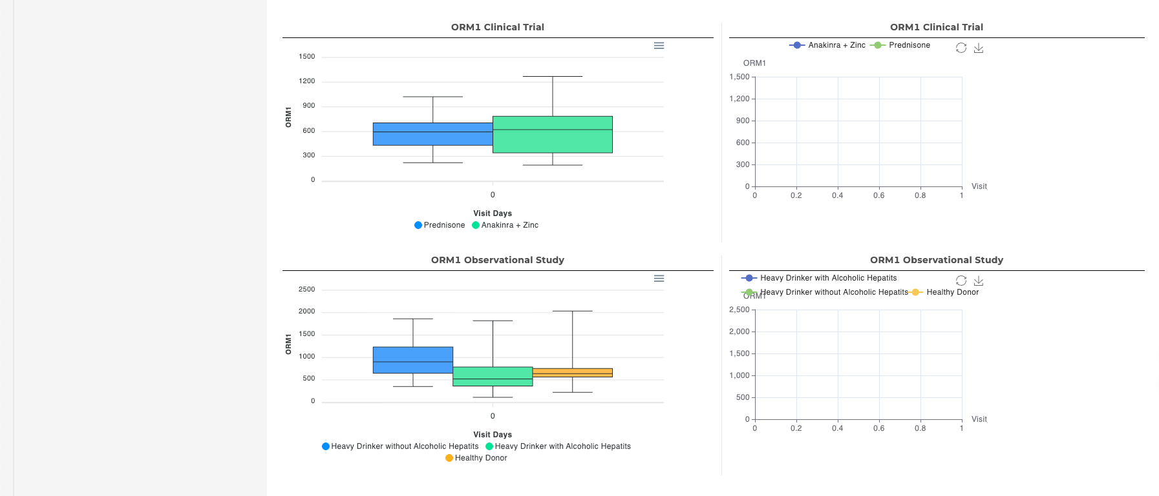
Step 3: Data Exploration
Lab Results tab
e.g.
Filter: - Lab - Liangpunsakul - Lab Test - ORM1

Slide 33
Restricted Functions
—— For advanced users: 1. Informaticians 2. Data Scientists …
Need Data Request

Slide 34
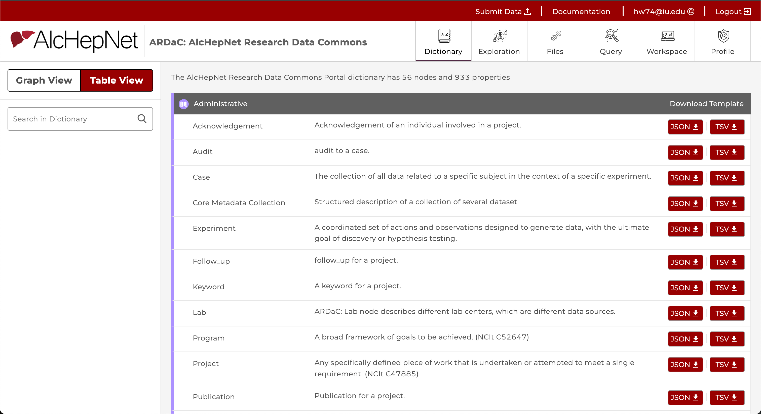
Step 3: Data Dictionary
Function: View the Data Model (nodes, attributes, relationships)
Switch Graph View / Table View
Right: - All the nodes listed with node name, description, and categorized - Can be downloaded in JSON or TSV
Left: Search in Dictionary
Use Case: Pre-submission data structure validation

Slide 35
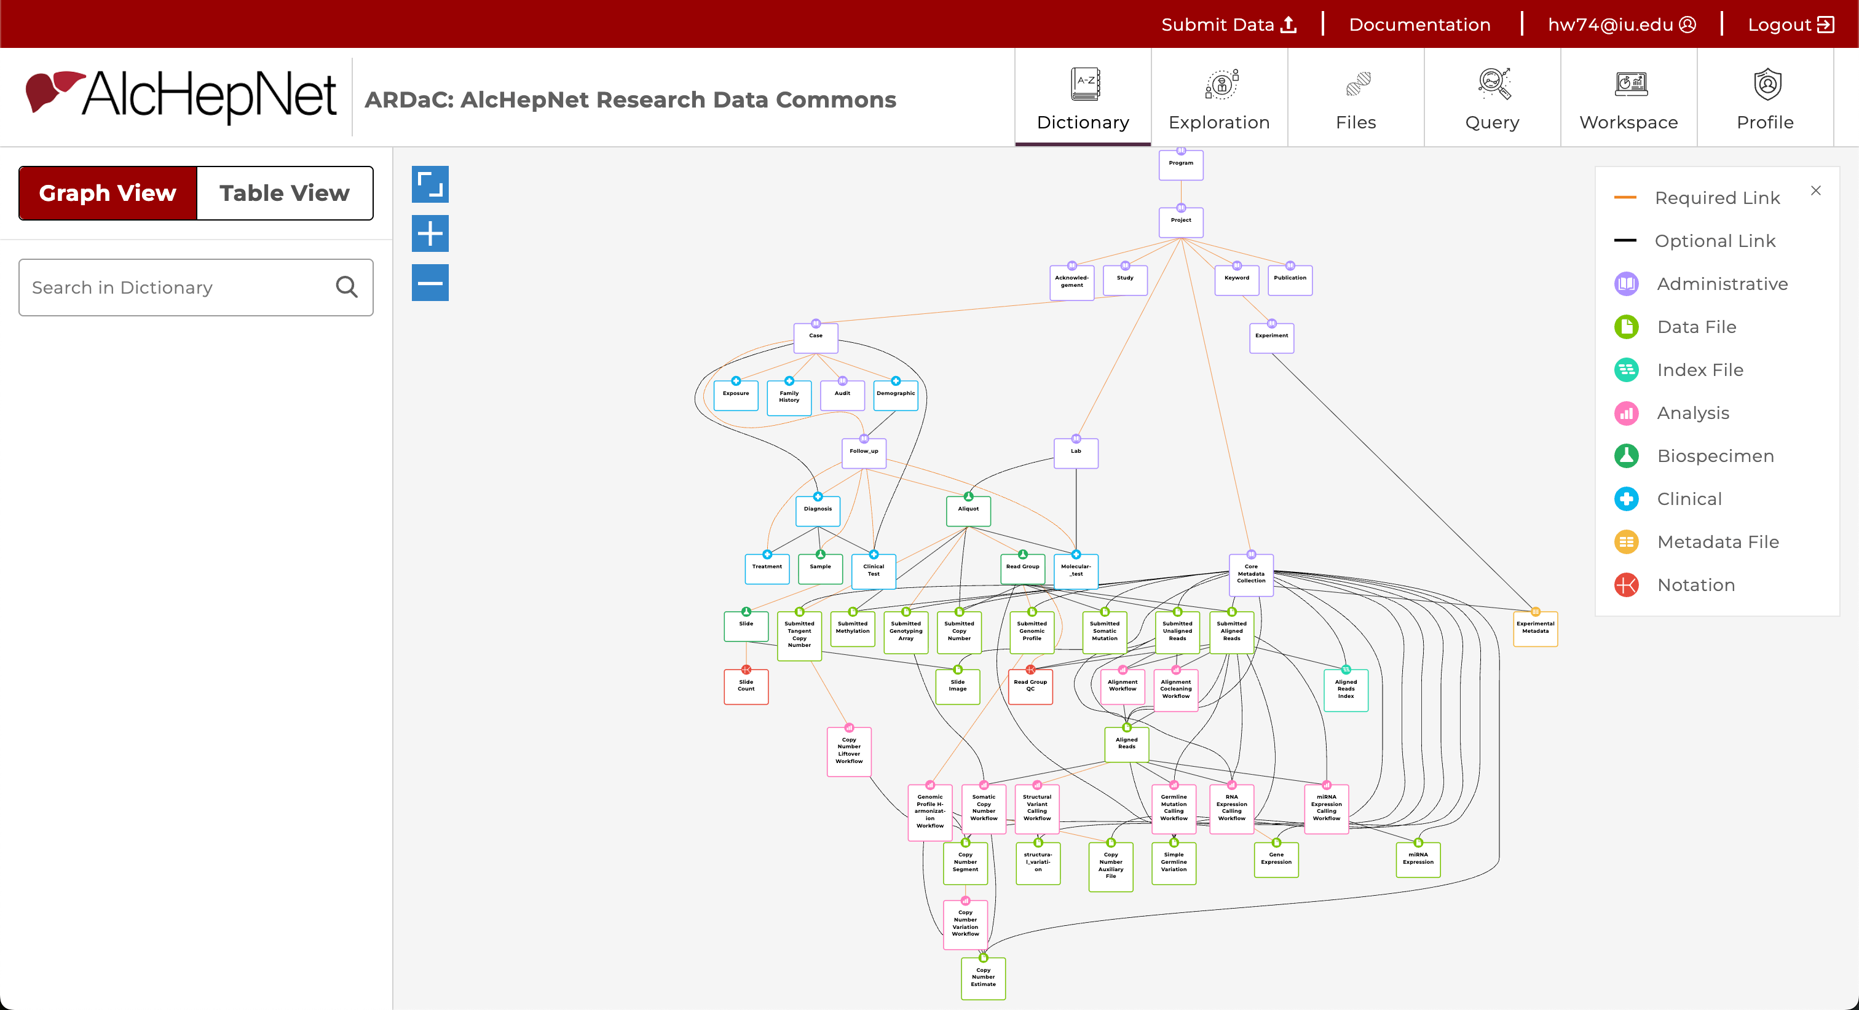
Step 3: Data Dictionary
Function: View the Data Model (nodes, attributes, relationships)
Switch Graph View / Table View
Right: - DD shown in graph structure: links, nodes, colors, relationships

Slide 36
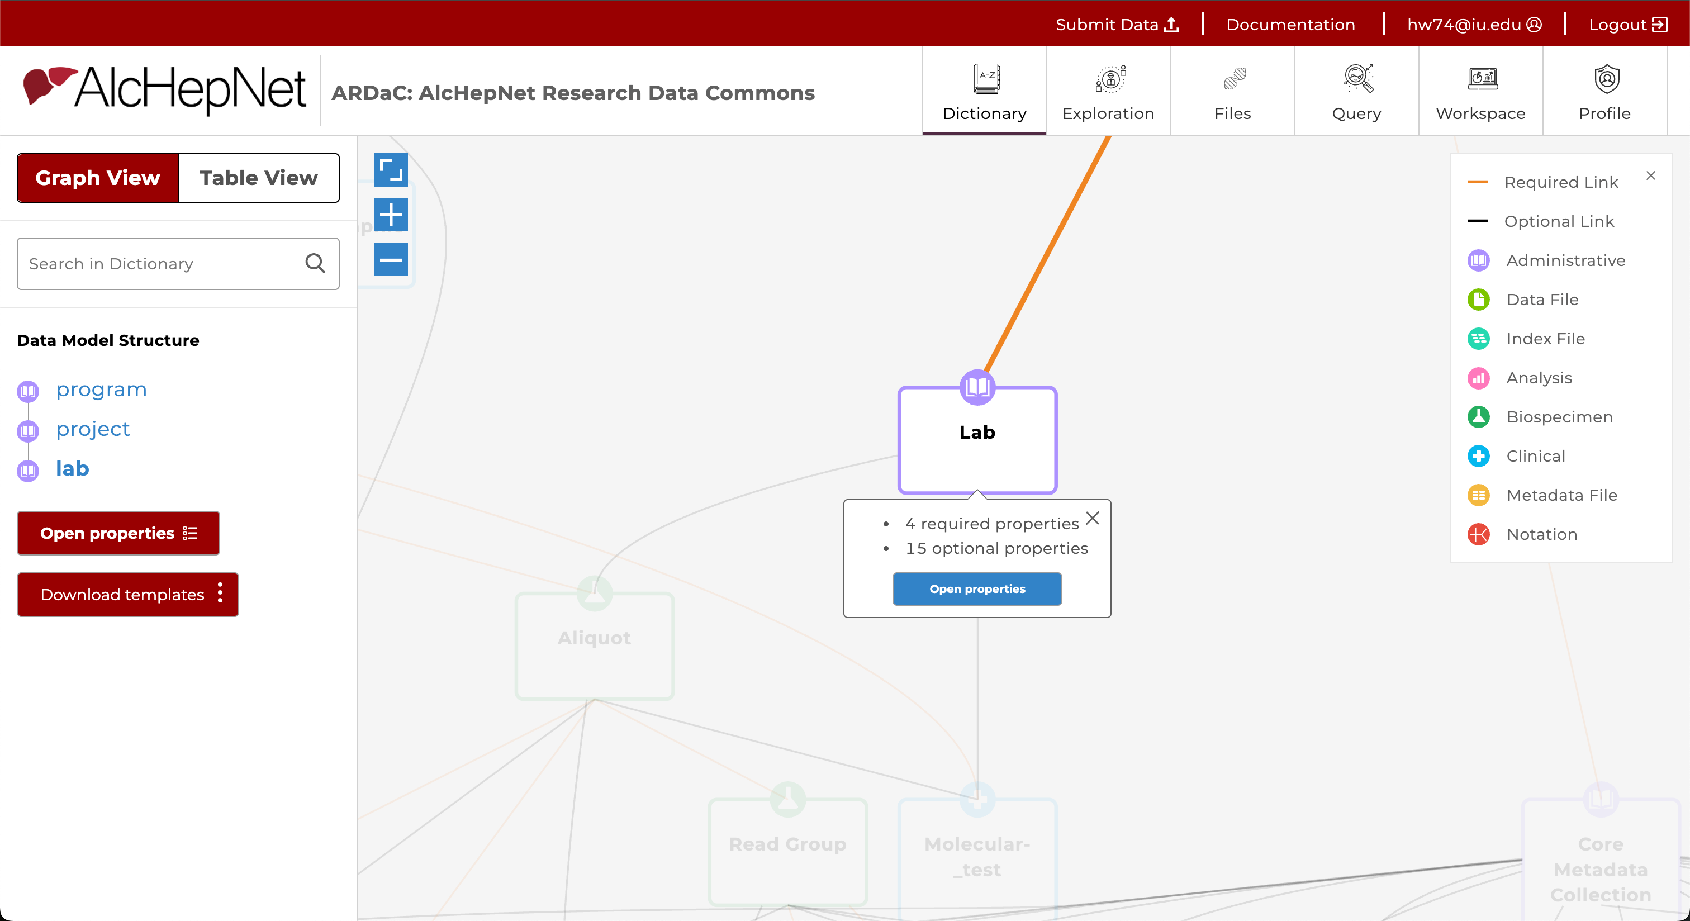
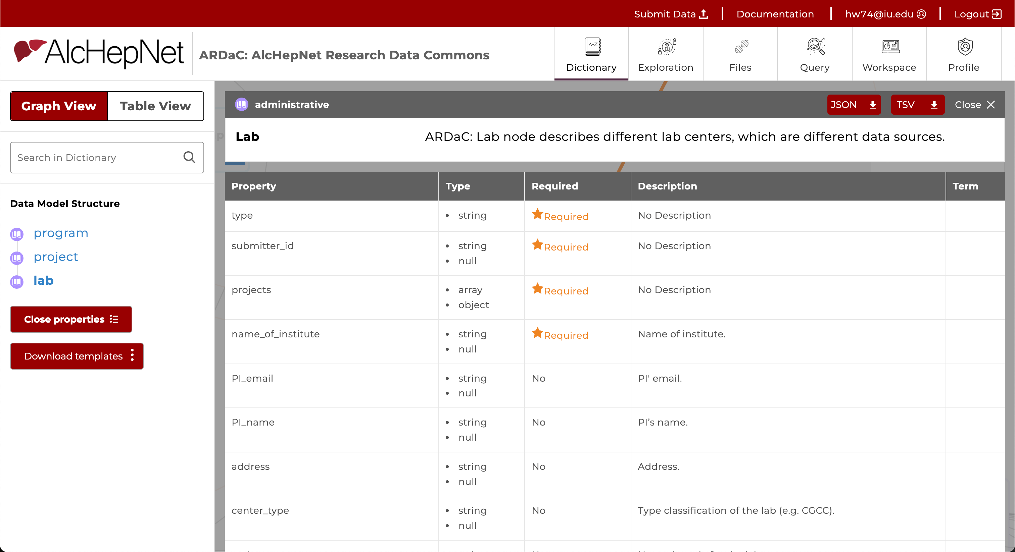
Step 3: Data Dictionary
Function: View the Data Model (nodes, attributes, relationships)
Switch Graph View / Table View
Right: - DD shown in graph structure: links, nodes, colors, relationships...
Can be zoom in/out
Click one node, can see more info, open properties
Left: see the node's parent nodes

Slide 37
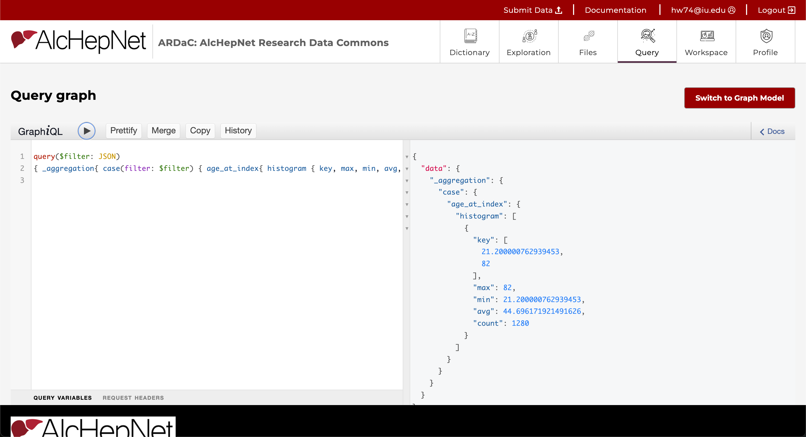
Step 4: Query Page
Function: Run GraphQL queries against the database
1. Input GraphQL e.g.
query($filter: JSON)
{ _aggregation{ case(filter: $filter) { age_at_index{ histogram { key, max, min, avg, count } } } } }
2. Run GraphQL
3. Show the reults
4. Switch to Graph Model
Intended For: Developers, data scientists
2
4
1
3

Slide 38
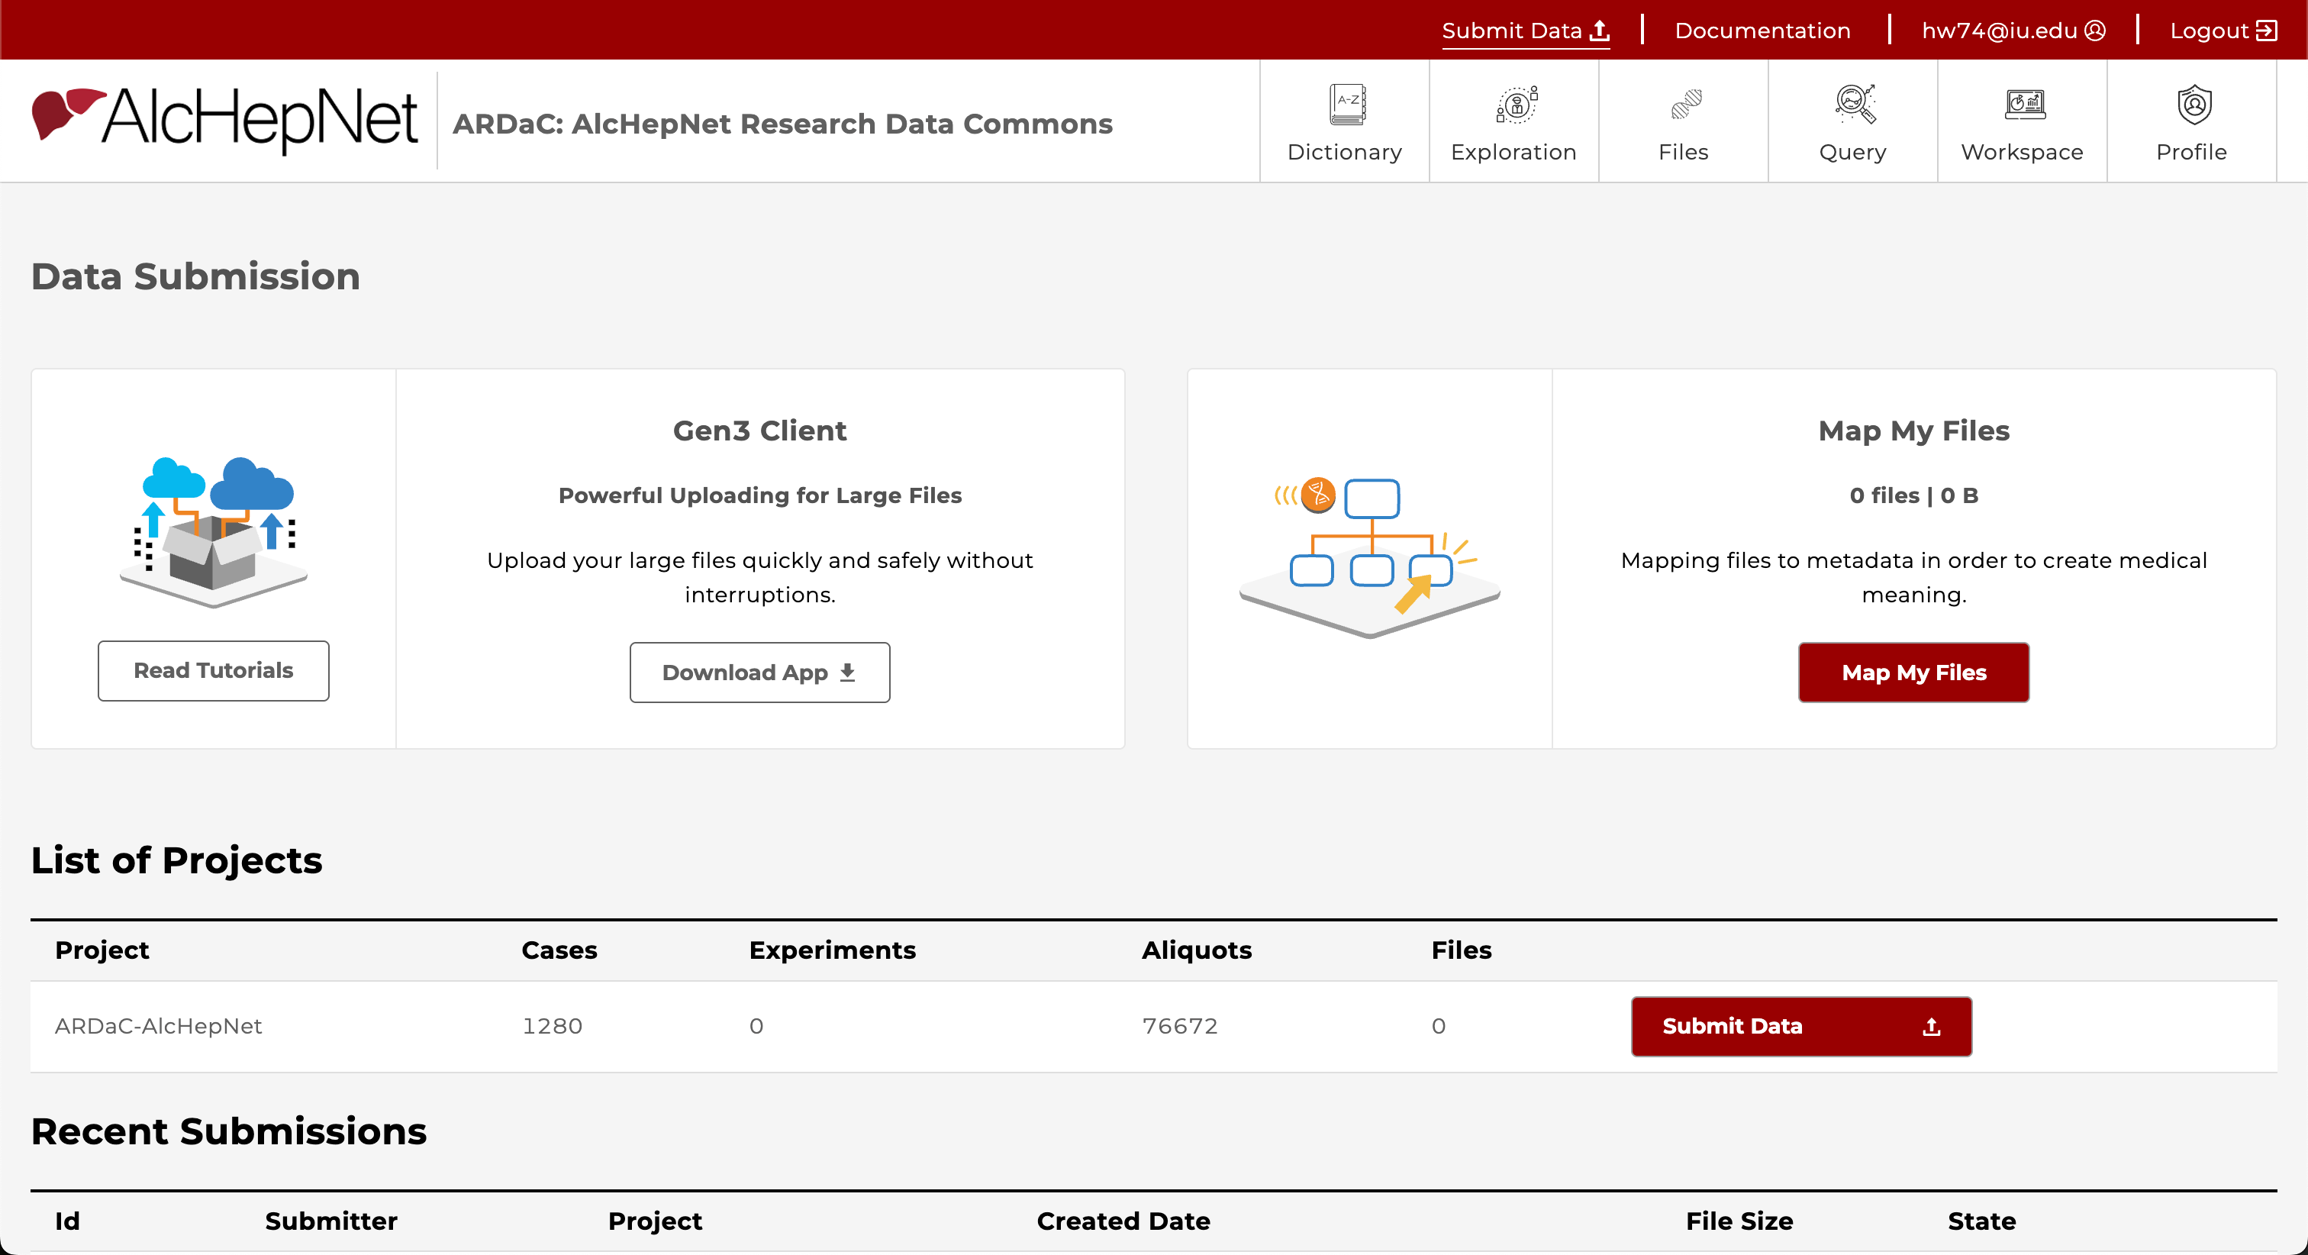
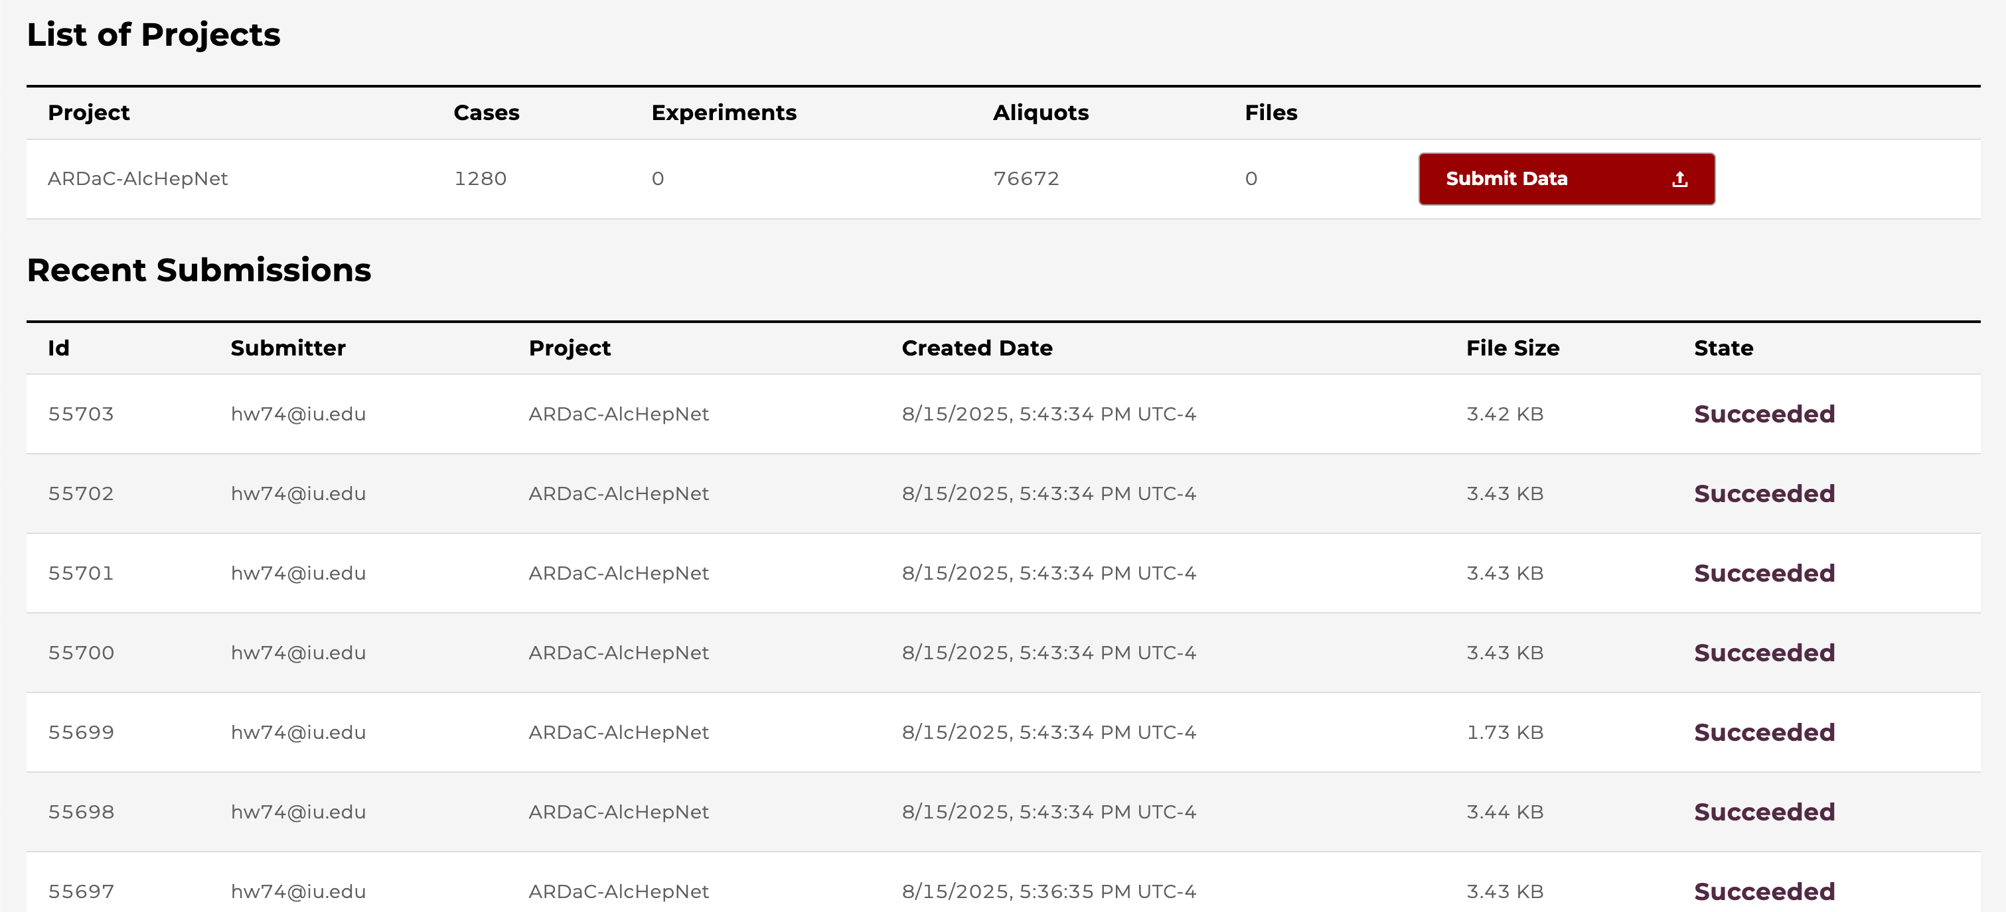
Step 5: Submit Data Page
List of Projects
Recent Submissions
Click Submit Data button go to submission page

Slide 39
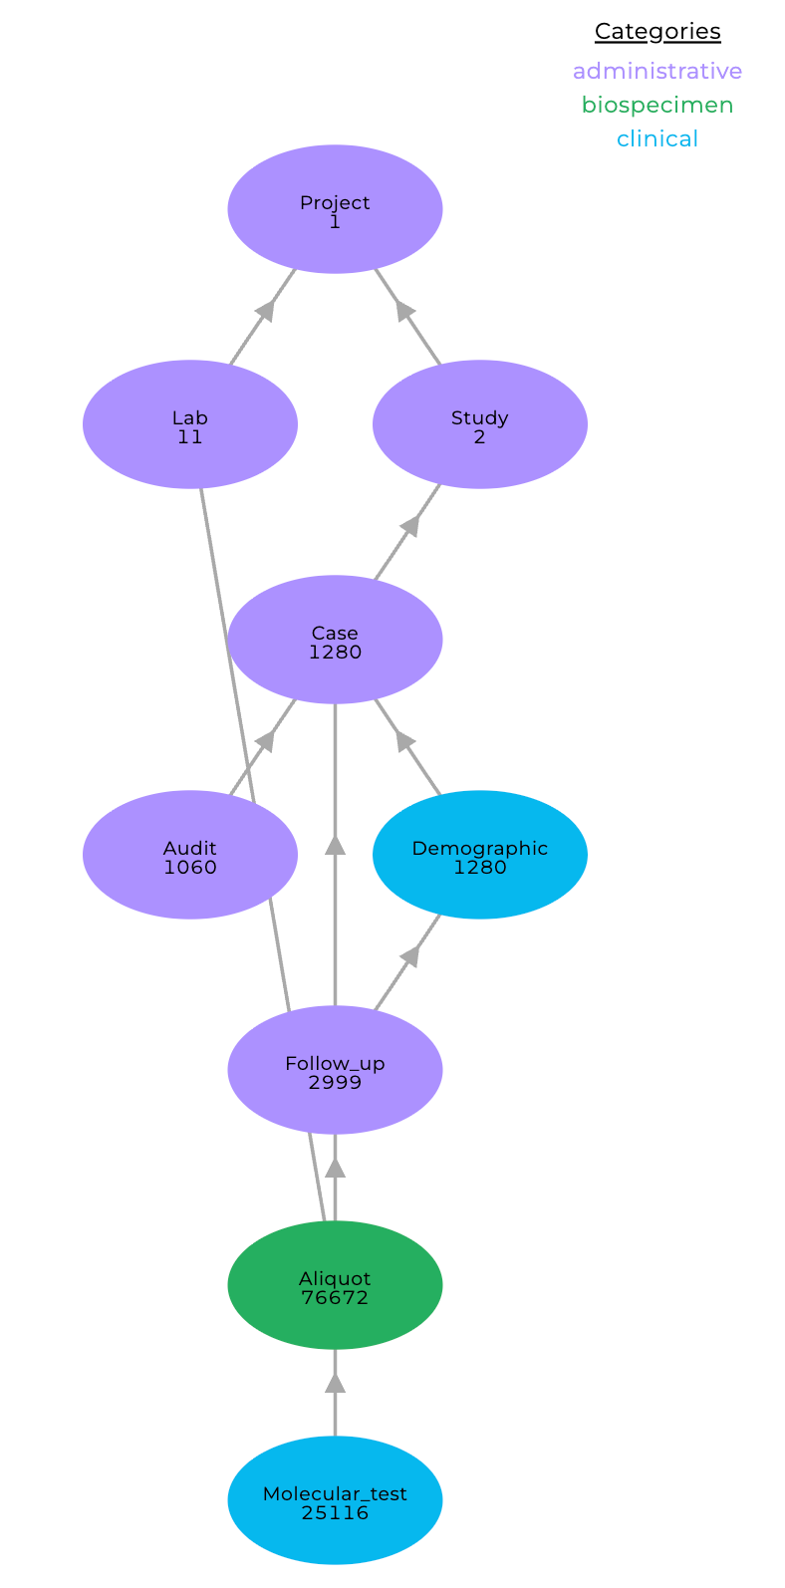
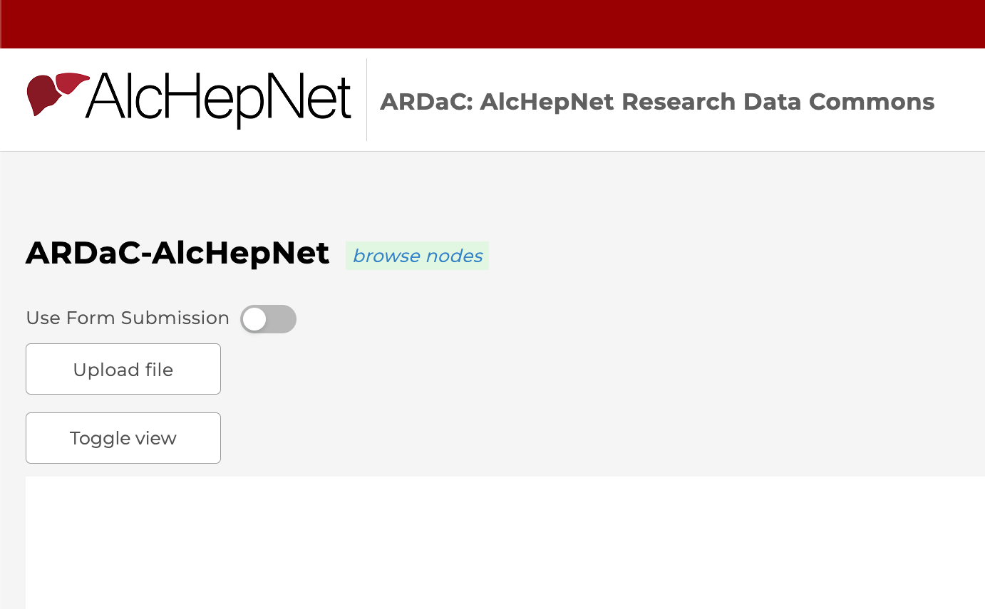

Step 5: Submit Data Page
Here you can see current data structure
Use Upload file button to upload new data file (.tsv) - Files must conform to dictionary structure
Use Toggle view button to switch to a more rich view

Slide 40

Step 6: Workspace Page
Click Launch to start a Jupyter Notebook environment
Users can upload files, access data, and run analyses in Python or R

Slide 41

Step 7: Profile Page
API Keys: - Users can create, view, and delete API keys. These keys allow programmatic access to the data commons
Project Access: - Shows which projects the user has permission to access and the available methods

Slide 42
Approval process for data request
ARDaC provides a platform for investigators to explore the AHN data
We have not enabled features for data downloading because the AHN Publication and Ancillary Study Subcommittee must approve the use of AHN data before IU DCC can dispense data.
For questions related to research proposal submission, please contact Savannah Yarnelle at samussel@iu.edu
For technical questions about ARDaC access, please contact Mengting Xiong at ardac@iu.edu

Slide 43

Cheat sheet
Functions | Tabs and
Survival analysis | Exploration → Participants [tab] → Chart panel → bottom
MELD Score analysis | Exploration → Follow-ups [tab] → Chart panel → bottom
Child-Pugh analysis | Exploration → Follow-ups [tab] → Chart panel → bottom
Maddrey's Discriminant Function Score analysis | Exploration → Follow-ups [tab] → Chart panel → bottom
Lille Score plots analysis | Exploration → Follow Ups [tab] → Chart panel → bottom
Other biomarkers | Exploration → Lab Results [tab] → *Select a lab* → Chart panel → bottom
Available biospecimens | Exploration → Biospecimens [tab] → Filter panel → Biospecimens [subtab] → Labs → *Select “Not assigned”*
Download a boxplot | Top right corner → Click then or or
Download a spaghetti plot | Top right corner → Click

Slide 44
Useful info, links, and contacts
Useful links: - Login Guide: ARDaC login guide.docx - AlcHepNet Website: https://www.alchepnet.org/ - ARDaC Website: https://ardac.org/ - ARDaC source codes: https://github.com/Su-informatics-lab/ardac
Social media: - YouTube: AlcHepNet Training Videos (@alchepnettrainingvideos6289)
https://www.youtube.com/@alchepnettrainingvideos6289
- X (Twitter): AlcHepNet @AlcHepNet (https://x.com/AlcHepNet)
ARDaC help and support: ardac@iu.edu
ARDaC mail list: ardac4in@iu.edu

Slide 45
Acknowledgement
ARDaC is developed and maintained with the support of NIAAA (U24AA026969)
It is hosted by the Indiana University Data Coordinating Center
Data are generated by AHN studies and translational investigators
Indiana University Genetic Biobank is the central biorepository for AHN
Preparation of training materials: Hao Wang, Mengting Xiong, Jing Su, Wanzhu Tu, Carla Kettler

Slide 46
Q & A
Please submit the survey before you leave the training.

