Slide 1
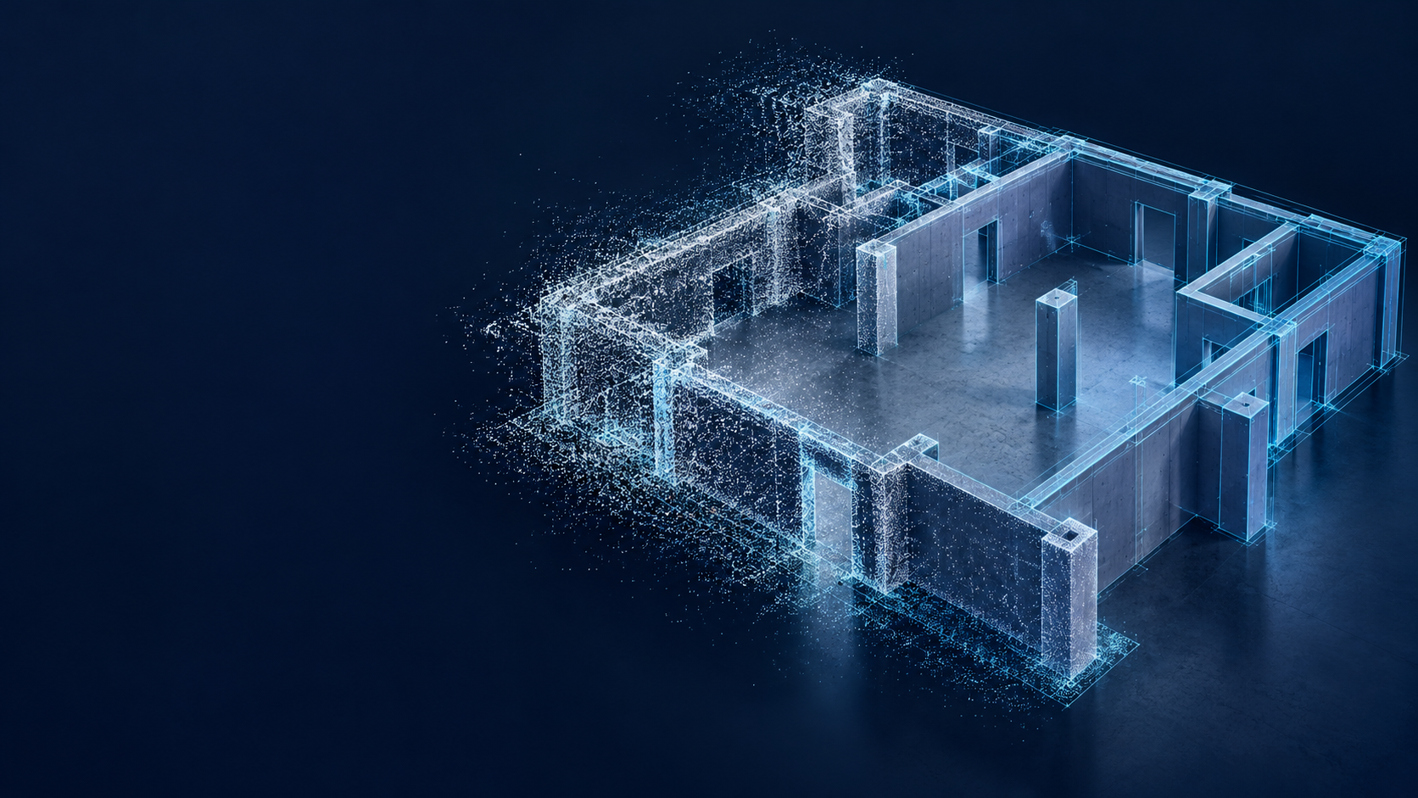
云铸
CloudForge
基于 Agnes Harness 的
点云分析与 CAD 重建工作台
Notes:
CloudForge 云铸：基于 Agnes Harness 的点云分析与 CAD 重建工作台。标题和说明为可编辑文本。
配图使用内置 image_gen 工具生成，仅为概念插画，不代表现场扫描数据或本次算法输出。
提示词：Use case: productivity-visual. Create a polished widescreen 16:9 raster illustration background for the opening project poster of CloudForge 云铸, an Agnes Harness based point-cloud geometry analysis and CAD reconstruction workbench. Output a high-resolution 3840x2160 landscape image if possible. This is a conceptual illustration, not a fake screenshot or claimed real project result. NO TEXT anywhere, no words, letters, numbers, logos, watermarks, UI, badges, dashboard panels, or charts. Composition: reserve the entire left 43 percent as very calm clean deep midnight navy negative space for large editable white Chinese project text that will be added separately. Keep a smooth restrained dark navy background across the scene. On the right 57 percent, create one visually striking and technically credible axonometric cutaway of an indoor building structural model: floor slab, several wall slabs, simple doorway openings, and a few columns. A scan-like cloud of delicate white and cyan points on the left portion of that building gradually becomes clear planar CAD surfaces and fine cyan technical edges on the right portion of the building, without arrows or labels. The structure should look like a clean simplified engineering reconstruction, not a futuristic megacity. Make the architectural volume large, readable and dimensional, fitting fully within the right region with ample edge padding. Dark blue solid geometry, pale cyan highlights, carefully controlled cyan glow, sophisticated soft lighting, gentle cast shadows, subtle sparse point particles close to the building only. Elegant premium engineering poster, crisp structural planes, realistic perspective and clean geometry, strong depth, quiet background, no dense grid. Do not put any bright elements in the left title space.

Slide 2
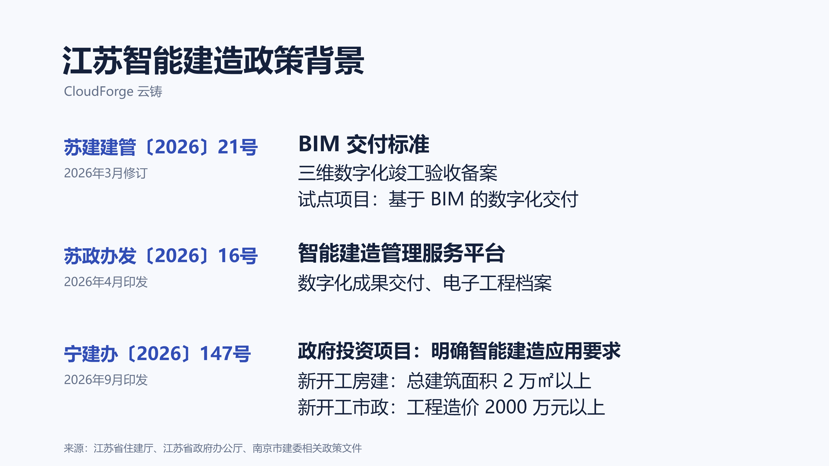
Notes:
此页完整嵌入已制作的政策图片，未重新排版或裁剪。政策摘要不表示项目已满足 BIM 交付标准或法定验收要求。
苏建建管〔2026〕21号《关于推进江苏省智能建造发展的实施方案》：正文第12页及附件2第18页。
https://file.smejs.cn/file/group1/M00/01/9A/rBIAAWmv3MeAcjauAAjsw3aSzho318.pdf
苏政办发〔2026〕16号《关于加快全省建筑业转型升级的若干措施》，第三项。
https://www.jiangsu.gov.cn/art/2026/4/23/art_64797_11761512.html
宁建办〔2026〕147号《关于进一步加强智能建造技术应用的通知》，第二部分第一项。
https://sjw.nanjing.gov.cn/njscxjswyh/202609/t20260921_5914764.html

