Slide 1


DeXOR: Enabling XOR in Decimal Space for Streaming Lossless Compression of Floating-point Data
Chuanyi Lv¹ | Huan Li¹* | Dingyu Yang¹ | Zhongle Xie¹ | Lu Chen¹ | Christian S. Jensen²
VLDB 2026 | Presented by Chuanyi Lv
* Corresponding author
¹
²
Notes:
Good afternoon. Today I will present DeXOR, a streaming lossless compression scheme for floating-point data. Its key idea is to expose similarities directly in decimal space, instead of relying only on binary XOR, and then encode the remaining suffix efficiently.

Slide 2

Outline
Background and Observation
Decimal XOR and DeXOR Design
Experimental Evaluation
DeXOR Family Extension
Notes:
I will begin with the motivation and existing schemes.

Slide 3
Why We Need Streaming Lossless Compression?
Need Compression: Streaming data arrives at massive scale.
Aviation systems can generate terabytes of sensor data per second [1].
Need Lossless: Small errors can have serious operational consequences.
Industrial control, finance, and scientific measurement may require exact reconstruction of floating-point values.
Need Streaming: New values should be compressed without decoding prior data.
Together, these requirements motivate Streaming Lossless Compression (SLC).
[1] S. K. Jensen, T. B. Pedersen, and C. Thomsen, "Time series management systems: A survey," IEEE TKDE, 2017.
Notes:
Streaming floating-point data creates three needs. First, data volume is large, so compression matters. Second, small numerical errors can be unacceptable in industrial control, finance, or scientific measurement, so recovery must be exact. Third, new values should be compressed without decoding old data. Together, these requirements define streaming lossless compression, or SLC.

Slide 4
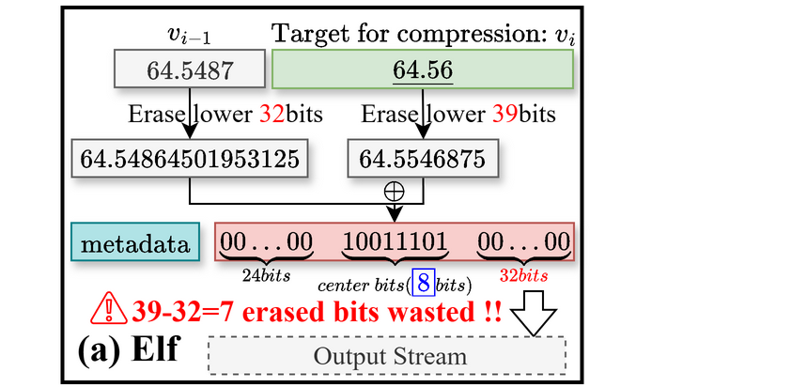
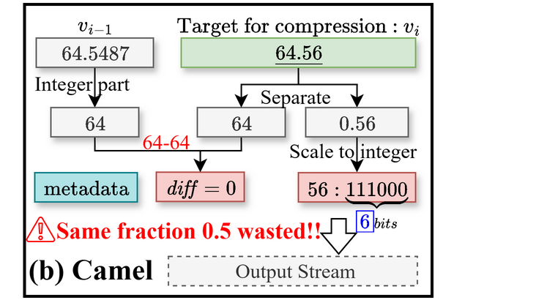
Existing Schemes Exploit Two Redundancy Sources
Redundancy Sources: Existing schemes reduce storage of floating-point streams in two ways.
Inter-value smoothness: encode differences between adjacent values, e.g., with XOR (Gorilla [2], Chimp [3]).
Intra-value redundancy: use a compact representation, e.g., by scaling decimals to integers (PDE [4], ALP [5]).
Joint Exploitation: Elf [6] and Camel [7] combine both sources, but representation conversion introduces interference.
[2] Pelkonen et al., PVLDB 2015. [3] Liakos et al., PVLDB 2022. [4] Kuschewski et al., SIGMOD 2023. [5] Afroozeh et al., SIGMOD 2023. [6] Li et al., PVLDB 2023. [7] Yao et al., SIGMOD 2024.
Notes:
Existing schemes exploit two sources of redundancy. Gorilla and Chimp use smoothness between adjacent values, often through XOR. PDE and ALP reduce redundancy within each value by scaling decimals to integers. Elf and Camel try to combine both ideas. However, their representation conversion can weaken the smoothness used by the next step. This interference motivates us to rethink the conversion itself.

Slide 5
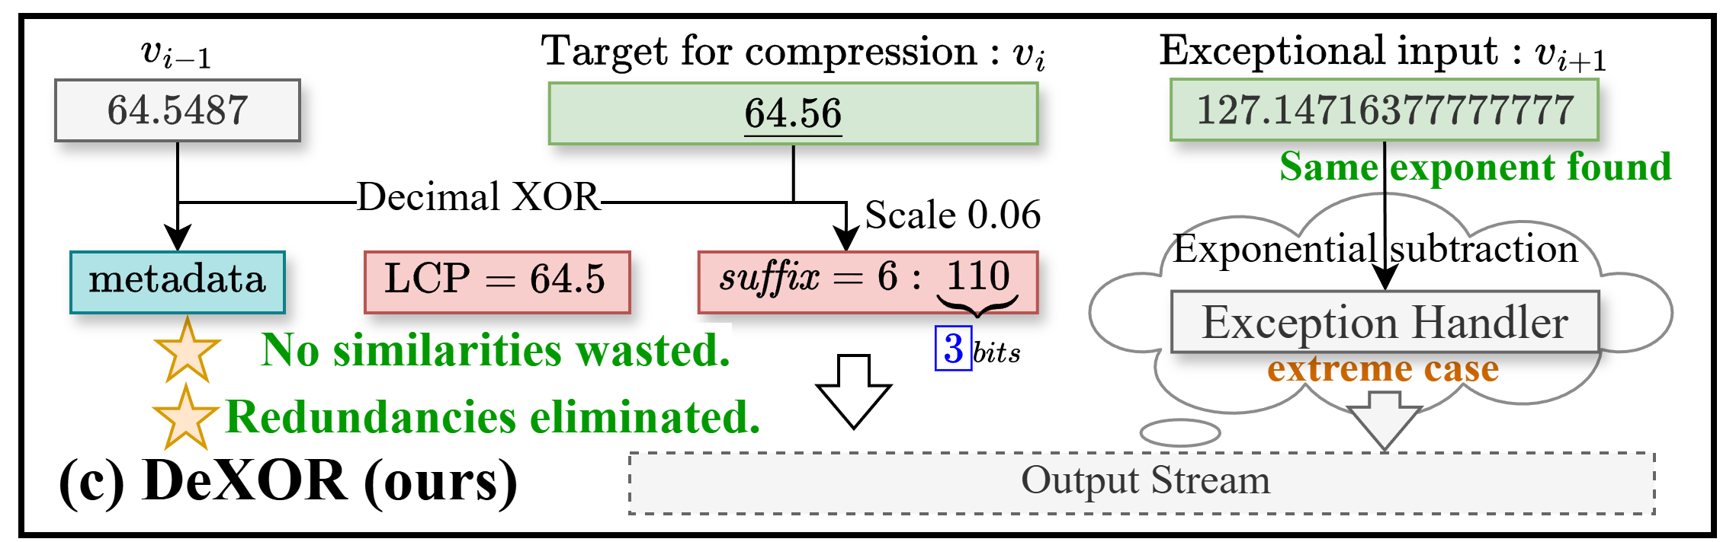
Three Challenges for Decimal-Space Compression
Decimal XOR: performs an XOR-like operation in decimal space, combining both sources without conversion interference.
Decimal XOR introduces three practical challenges.
C1: exact reconstruction under binary-decimal conversion
C2: computational and metadata overhead in prefix and suffix processing
C3: robustness when high-precision values provide little compressible redundancy
Notes:
Our answer is Decimal XOR, an XOR-like operation in decimal space. It removes the shared decimal prefix and leaves a compact suffix. A practical design must still solve three problems: exact recovery despite binary-decimal rounding, low computation and metadata overhead, and robust compression when high-precision values provide little redundancy.

Slide 6
Outline
Background and Observation
Decimal XOR and DeXOR Design
Experimental Evaluation
DeXOR Family Extension
Notes:
With the motivation established, I will now explain Decimal XOR and the complete DeXOR workflow.

Slide 7
DeXOR: Three Main Components
Converter: Decimal XOR exposes a shorter decimal suffix and manages its metadata.
◆ It removes the shared decimal prefix and records the coordinates required for reconstruction.
Notes:
DeXOR has three main components. First, the converter uses Decimal XOR to expose a shorter decimal suffix and records the coordinates needed for reconstruction.

Slide 8
DeXOR: Three Main Components
Compressor: The remaining suffix is encoded according to its decimal length.
◆ A tailored representation reduces the cost of both the residual and its metadata.
Notes:
Second, the compressor receives only the remaining suffix. It uses the decimal length to reduce the storage cost of both the suffix and its metadata.

Slide 9
DeXOR: Three Main Components
Exception Handler: Difficult values follow a purely binary fallback path.
◆ It prevents compressed-size expansion and preserves bitwise recovery when reconstruction fails.
Notes:
Third, the Exception Handler receives values that compress poorly or fail reconstruction verification. It follows a purely binary path, which prevents compressed-size expansion and guarantees bitwise recovery.

Slide 10
DeXOR Converter
Core Mechanism: Decimal XOR removes the longest common prefix.
◆ Only the decimal suffix remains for compression; the prefix is reconstructed from the preceding value.
Notes:
Here is the core converter operation. We compare the current value with its predecessor in decimal coordinates and find their longest common prefix. The prefix can be reconstructed from the previous value, so only the remaining decimal suffix is passed to the compressor.

Slide 11
DeXOR Converter
Metadata Management: The converter records prefix and tail coordinates.
◆ Repeated coordinates are reused whenever possible, while the remaining suffix is passed to the compressor.
Notes:
The converter also records the prefix and tail coordinates. When consecutive values use the same coordinates, DeXOR reuses them instead of writing them again. This reduces metadata while keeping the same reconstruction path.

Slide 12
DeXOR Compressor
Vanilla Encoding: Variable-length schemes store the sign, binary-suffix length, and suffix separately.
◆ The length metadata remains even when the binary suffix itself is short.
Notes:
A vanilla variable-length encoding stores three parts: one sign bit, the binary-suffix length, and the suffix itself. When the suffix is short, the length metadata becomes a large part of the output.

Slide 13
DeXOR Compressor
Compressor: Sign consistency removes one bit, while decimal length determines the binary width.
◆ The suffix is padded to this width without storing a separate binary length.
Notes:
DeXOR removes this overhead in two steps. The suffix sign is consistent with the prefix difference, so it is usually omitted. Then the decimal length gives a fixed upper bound for the binary width. We pad to that width without storing a separate binary length.

Slide 14
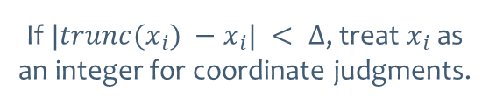
Error Tolerance for Rounding-Error Compensation
Rounding-Error Compensation: A precision-adaptive tolerance identifies scaled near-integers.
◆ This filters most binary-decimal conversion errors, and reconstruction is verified before encoding.
Scale toward an integer
Recognize near-integers
Verify before encoding
After scaling toward an integer, Δ follows the precision of the tested coordinate.
If $|trunc(x_{i}) −x_{i}| < Δ$, treat $x_{i}$as an integer for coordinate judgments.
The encoder sends any remaining failure to the binary Exception Handler for exact storage.
Notes:
Binary-decimal conversion can create tiny rounding errors. DeXOR scales the value toward an integer at the tested coordinate. If the scaled value is within Delta of an integer, it is treated as that integer for coordinate judgment. This compensates for most rounding errors. The encoder still verifies reconstruction, and any remaining failure goes to the Exception Handler.

Slide 15
Exception Handler
Exponential Subtraction: The exponent carries the reusable smoothness in high-precision values.
◆ Adjacent exponents are subtracted, while sign and fraction remain in their original binary form.
Notes:
For high-precision values, the fraction often has little smoothness, while the exponent is more stable. The Exception Handler therefore subtracts adjacent exponents and keeps the sign and fraction in their original binary form.

Slide 16
Exception Handler
Adaptive Storage, Contraction: Repeatedly small exponent differences reduce the adaptive bit width.
◆ After $ρ$ consecutive fits in the smaller range, EL contracts by one bit.
Notes:
The exponent difference is stored with an adaptive width, EL. If rho consecutive differences fit a smaller range, EL contracts by one bit. This avoids storing a separate length for every value.

Slide 17
Exception Handler
Adaptive Storage, Expansion: Overflow stores the original IEEE754 value and increases EL by one bit.
◆ An all-one code signals overflow, preserving correctness while EL expands by one bit.
Notes:
If the current difference does not fit, an all-one code signals overflow. The original IEEE754 value is stored for exact recovery, and EL expands by one bit for later values. The path is therefore adaptive and safe.

Slide 18
Outline
Background and Observation
Decimal XOR and DeXOR Design
Experimental Evaluation
DeXOR Family Extension
Notes:
Now I will summarize the evaluation settings and the main results.

Slide 19
Evaluation Settings
Evaluation Scope: We evaluate DeXOR across diverse precision and streaming settings.
◆ Compressed size and throughput are measured under each scheme's intended configuration.
Notes:
We evaluate DeXOR on 22 public datasets from prior work. They include time-series and non-time-series streams with different precision. The primary comparison uses five baselines plus DeXOR under the same one-predecessor setting. We also report schemes with larger buffers using the configuration recommended by their authors. The main metrics are compressed size, compression throughput, and decompression throughput.

Slide 20
DeXOR Improves Compression and Decompression
Main Results: DeXOR improves compression and decompression across the benchmark.
◆ We compare compressed size, compression throughput, and decompression throughput.
DeXOR improves compression ratio by 15% and decompression speed by 20%.
Notes:
Across the 22 datasets, DeXOR improves compression ratio by 15 percent and decompression speed by 20 percent over the best competitors, while compression speed remains competitive. The largest gains appear when Decimal XOR leaves a short suffix. The paper reports the full per-dataset results.

Slide 21
Robust Across Precision and Stream Order
Robustness: DeXOR remains effective under high precision and disrupted stream order.
◆ The experiments isolate expansion-prone values and weakened temporal smoothness.
◆ Please refer to our paper for the complete experimental results.
High precision can expand the main path
Random sampling does not remove the gain
The Exception Handler keeps every result below the 64-bit baseline.
DeXOR remains robust after random sampling.
Notes:
These experiments test two risks. On high-precision data, the main Decimal XOR path can exceed the 64-bit input size, but the Exception Handler keeps the final output below that baseline. Random sampling disrupts contextual continuity and weakens smoothness. DeXOR remains robust because it can still exploit representation redundancy within each value.

Slide 22
Outline
Background and Observation
Decimal XOR and DeXOR Design
Experimental Evaluation
DeXOR Family Extension
Notes:
Finally, I will briefly introduce the error-bounded member of the DeXOR family.

Slide 23
E-DeXOR Extends the Family to Error-Bounded Streams
Error-Bounded Extension: E-DeXOR extends Decimal XOR to error-bounded compression.
◆ It anchors metadata at the error bound, removes low-order digits, and allows optional prediction.
Notes:
In an updated version under preparation, we also study streaming error-bounded compression. E-DeXOR uses the global error bound as a decimal anchor, removes low-order digits, and simplifies metadata. The previous reconstructed value remains the default reference, while prediction is optional. DeXOR targets bitwise-exact SLC, and E-DeXOR extends the same Decimal XOR view to error-bounded streams.

Slide 24
Summary
Problem: Streaming Lossless Compression.
Existing converters exploit smoothness or representation redundancy, but conversion disrupts their joint use.
Key observation:
Decimal coordinates preserve the shared prefix and expose a shorter decimal suffix.
Challenges:
C1: exact reconstruction under binary-decimal conversion
C2: computational and metadata overhead in prefix and suffix processing
C3: robustness when high-precision values provide little compressible redundancy
DeXOR:
C1: scaled truncation with error-tolerant rounding enables exact reconstruction
C2: coordinate reuse and tailored suffix encoding reduce computation and metadata
C3: a binary Exception Handler handles high-precision and non-smooth values
Experimental Result:
DeXOR improves compression ratio by 15% and decompression speed by 20% over state-of-the-art schemes.
Notes:
To summarize, existing schemes exploit smoothness or representation redundancy, but conversion can interfere with using both. Decimal XOR preserves the shared decimal prefix and exposes a short suffix. DeXOR addresses the practical challenges through scaled truncation with error-tolerant rounding, coordinate reuse and tailored suffix encoding, and a binary Exception Handler. Across 22 datasets, it improves compression ratio by 15 percent and decompression speed by 20 percent.

Slide 25
Thanks & Q&A
DeXOR: Enabling XOR in Decimal Space for Streaming Lossless Compression
Of Floating-point Data
Contact Email: chaunyi.lv@zju.edu.cn
Repository: https://github.com/SuDIS-ZJU/DeXOR
Poster
Slides
25
Notes:
Thank you for your attention. The code and complete experimental materials are available in our repository. I am happy to take questions.

