Slide 1
SoftEther VPN
報告者：蘇己盛
日期：2014/07/01

Slide 2
Outline
Inroduction
SoftEther VPN
Features of SoftEther VPN
Architecture of SoftEther VPN
OpenVPN vs. SoftEther VPN
Installation
Benchmark

Slide 3
Introduction
SoftEther VPN Project
Develops and distributes SoftEther VPN
An Open-Source Free Cross-platform Multi-protocol VPN Program
An academic project form University of Tsukuba
SoftEther VPN
"SoftEther" means "Software Ethernet”
any personal or commercial use for free charge

Slide 4
SoftEther VPN
An alternative VPN server to existing VPN products
OpenVPN
IPsec
MS-SSTP
Original strong SSL-VPN protocol
Ultra-optimized SSL-VPN Protocol
very fast throughput
low latency
firewall resistance

Slide 5
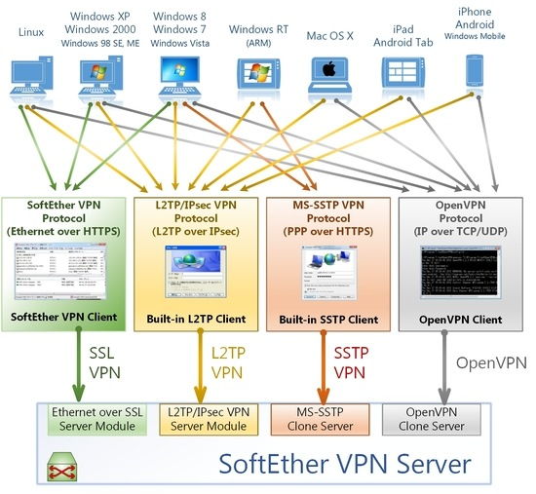

Slide 6
Features of SoftEther VPN
Free and open-source software.
Easy to establish both remote-access and site-to-site VPN.
SSL-VPN Tunneling on HTTPS to pass through NATs and firewalls.
Revolutionary VPN over ICMP and VPN over DNS features.
Resistance to highly-restricted firewall.
Ethernet-bridging (L2) and IP-routing (L3) over VPN.
Embedded dynamic-DNS and NAT-traversal so that no static nor fixed IP address is required.
AES 256-bit and RSA 4096-bit encryptions.
Sufficient security features such as logging and firewall inner VPN tunnel.
1Gbps-class high-speed throughput performance with low memory and CPU usage.
Windows, Linux, Mac, Android, iPhone, iPad and Windows Mobile are supported.
SSL-VPN (HTTPS) and 6 major VPN protocols (OpenVPN, IPsec, L2TP, MS-SSTP, L2TPv3 and EtherIP) are all supported as VPN tunneling underlay protocols.
The OpenVPN clone function supports legacy OpenVPN clients.
IPv4 / IPv6 dual-stack.
The VPN server runs on Windows, Linux, FreeBSD, Solaris and Mac OS X.
Configure All settings on GUI.
Multi-languages (English, Japanese and Simplified-Chinese).
No memory leaks. High quality stable codes, intended for long-term runs. We always verify that there are no memory or resource leaks before releasing the build.
RADIUS / NT Domain user authentication function
RSA certificate authentication function
Deep-inspect packet logging function
Source IP address control list function
syslog transfer function

Slide 7
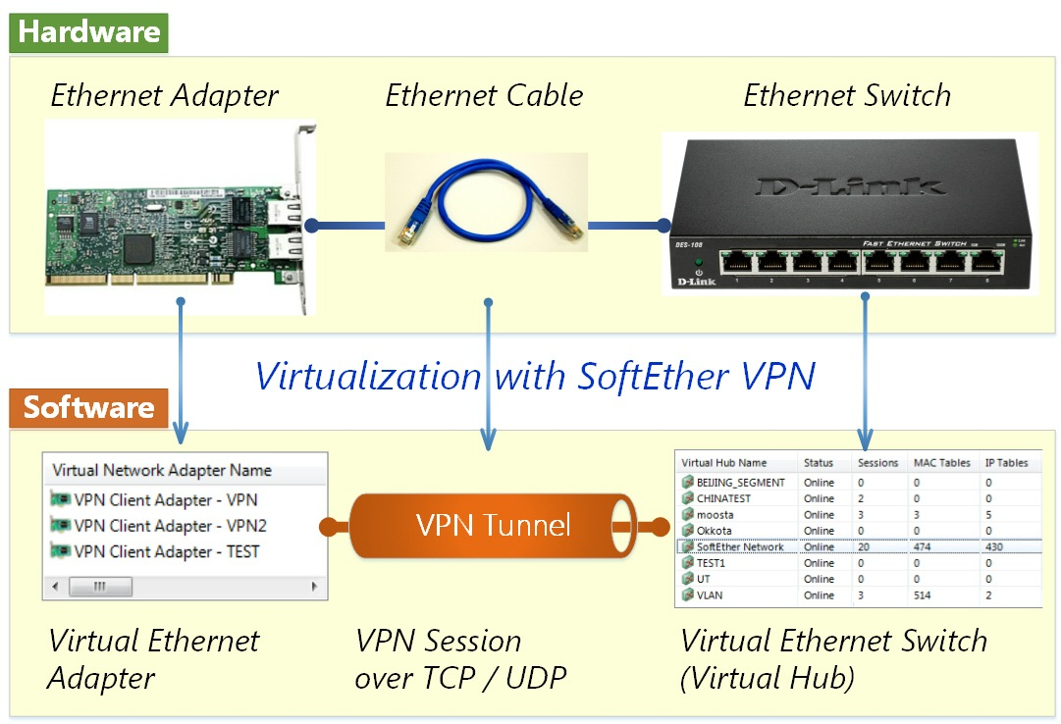
Architecture of SoftEther VPN

Slide 8
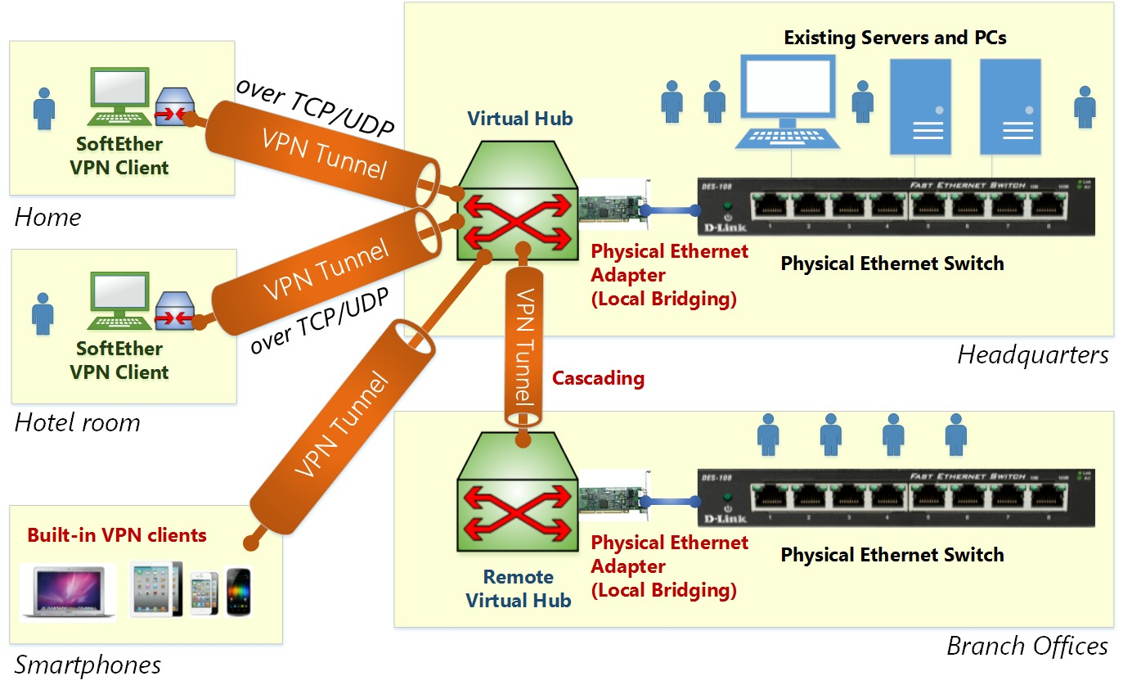
Architecture of SoftEther VPN

Slide 9
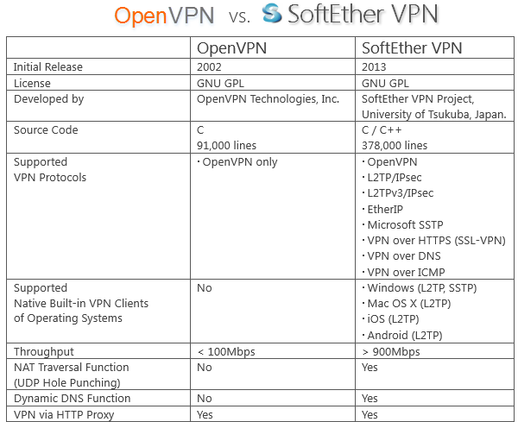
OpenVPN vs. SoftEther VPN

Slide 10
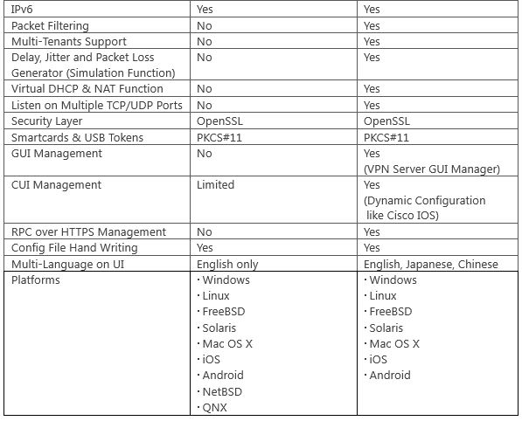
OpenVPN vs. SoftEther VPN

Slide 11
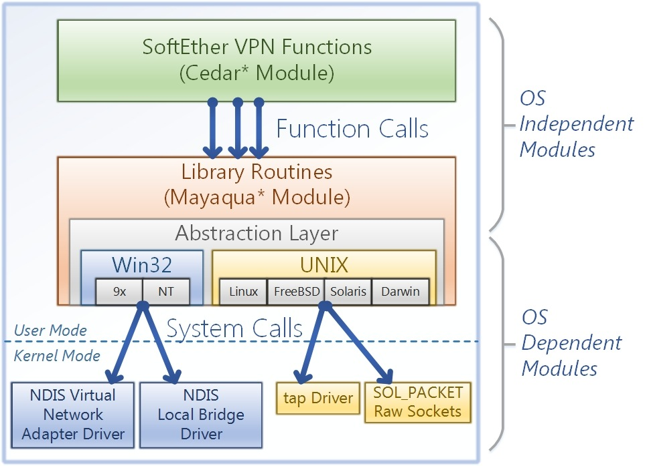
Implementation

Slide 12
Installation
https://www.digitalocean.com/community/tutorials/how-to-setup-a-multi-protocol-vpn-server-using-softether

Slide 13
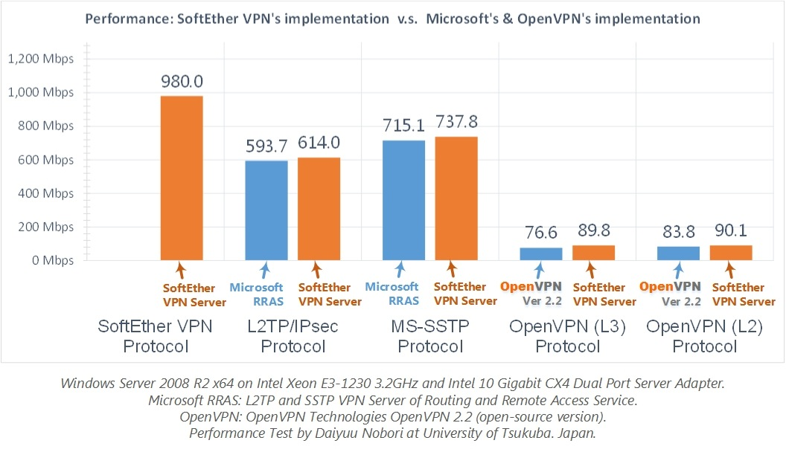
Performance

Slide 14
Benchmark

Slide 15
Future work
Compare SSL-VPN with OpenVPN
Compare SSL-VPN with VXLAN
Compare SSL-VPN with GRE
Pass through NATs and firewalls

