Slide 1



JavaScript
WEEK 1 – Introduction to JavaScript
Trainers : Long Chhun Hour & Chhorn Sothea ​
Group 9 Generation 10

Slide 2

Session objectives
Understand basic JavaScript syntax
Learn about Variables, Data Types, and Operators
Work with Arrays and Objects
Understand Control Statements and Loops
Convert simple code from C to JavaScript
SYNTAX
FUNDAMENTALS
DATA STRUCTURES
CONTROL FLOW
CONVERSION

Slide 3
What is JavaScript ?
Definition
A high-level, interpreted programming language
Domain
The language of the web
Purpose
Used for creating interactive and dynamic web pages
Environment
Runs on the client-side and server-side

Slide 4
SYNTAX
JS vs. C Syntax
Feature | JavaScript | C | Takeaway
Typing | Dynamic (let, const) | Static (int, char) | Declare variables, not types.
Semicolons | Optional (but recommended) | Mandatory | Always use them.
Comments | // and /* */ | // and /* */ | The syntax is the same!
Case Sensitive | Yes | Yes | Pay attention to caps.
Example: Variable Declaration
JavaScript | C
let score = 100; let name = "Sothea"; | int score = 100; char name[] = "Sothea"

Slide 5
SYNTAX
Variables
Variables are Containers for Storing Data.
Keyword | Explanation | Example
Let | The modern way. Use this when you expect the value might change later. | let age = 25;
Const | Use this for values that should never change (constants). | const birthYear = 2000;
Var | The old way. It has some tricky behaviors, so it's best to use let and const instead. | var score = 100;

Slide 6
SYNTAX
Data Types
Most Common data types in JavaScript:
Data Type | Explanation | Example
String | For storing text. Always wrap in quotes. | let greeting = "Hello";
Number | For storing numbers, both whole and decimal. | let score = 95; let pi = 3.14;
Boolean | For storing true or false values. | let isLoggedIn = true;
Undefined | A variable that has been declared but not given a value. | let name;
Null | Represents the intentional absence of a value. | let data = null;
Object | For storing collections of related data. | let car = {make: "Toyota"};

Slide 7
SYNTAX
Operator
Operators are symbols that perform actions on values and variables.
Operator Type | Explanation | Example
Arithmetic | Used to perform mathematical calculations. | let sum = 5 + 10;
Assignment | Used to assign values to variables. | let x = 15;
Comparison | Used to compare two values, resulting in true or false. | age > 18;
Logical | Used to combine or modify boolean expressions. | isLoggedIn && isAdmin;

Slide 8
DATA STRUCTURES
Array
An Array is an object type designed for storing data collections.
Key characteristics of JavaScript arrays are:
An array is a list of values, known as elements.
Array elements are ordered based on their index.
The first element is at index 0, the second at index 1, and so on.
Arrays can grow or shrink as elements are added or removed.
Arrays can store elements of different data types (numbers, strings, objects and other arrays).
Elements:
Ordered:
Zero indexed:
Dynamic size:
Heterogeneous:

Slide 9

DATA STRUCTURES
Array
Why Use Arrays?

Slide 10

DATA STRUCTURES
Array
If we have a list of students , storing the names in single variables could look like this:
let student1 = “Sok"; let student2 = “Bopha"; let student3 = “Hong";
what if you want to loop through the students and find a specific name? And what if you had not 3 students, but 300?
The solution is an array!
An array can hold many values under a single name, and you can access the values by referring to an index number.
const array_name = [student1, student2, ...];

Slide 11
DATA STRUCTURES
Array
Creating an Array: You create an array using square brackets [].
Accessing Items: You get items by their position (index), which starts at 0.
Array Length: You can find out how many items are in an array using .length.
// An array of fruits
let fruits = ["Apple", "Banana", "Cherry"];
// Access the first item (index 0)
console.log(fruits[0]); // Outputs: "Apple"
// Find the number of items
console.log(fruits.length); // Outputs: 3
// Add a new item to the end
fruits.push("Mango");
console.log(fruits); // Outputs: ["Apple", "Banana", "Cherry", "Mango"]

Slide 12
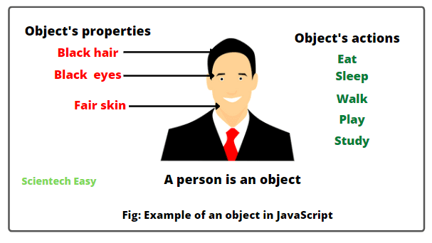
DATA STRUCTURES
Object
If an array is a list, an object is a description of a single thing. It stores details in key: value pairs.

Slide 13
DATA STRUCTURES
// An object describing a person
let person = {
// Properties
hair: "black",
eyes: "black",
skin: "fair",
// Methods (Actions)
eat: function() {
console.log("The person is eating.");
},
study: function() {
console.log("The person is studying.");
}
};
// Accessing a property
console.log(person.hair); // Outputs: "black"
// Calling a method
person.eat(); // Outputs: "The person is eating."

Slide 14
CONTROL FLOW
Control Statement
Control statements allow your code to make decisions and take different paths based on certain conditions.
Keyword | Explanation
if | It checks if a condition is true. If it is, the code inside runs.
else if | Lets you check for another condition if the first if was false.
else | If none of the if or else if conditions are true, the else code runs.
Example:
let time = 14; // This is 2 PM
if (time < 12) {
console.log("Good morning!");
} else if (time < 18) {
console.log("Good afternoon!"); // This code will run
} else {
console.log("Good evening!");
}

Slide 15
CONTROL FLOW
Loops
Loops save you from writing the same code over and over.
Loop Type | When to Use It | Example
for | When you know exactly how many times you want to repeat an action. | for (let i = 0; i < 5; i++) { console.log(i); }
while | When you want to repeat as long as a condition is true, but you don't know how many times. | let count = 0; while (count < 5) { console.log(count); count++; }
do...while | Same as while, but it guarantees the code runs at least once. | let num = 5; do { console.log(num); num++; } while (num < 5);

Slide 16
CONVERSION
C to JavaScript
Let's Practice: Converting C to JS
#include <stdio.h>
int main() {
int i;
for (i = 1; i <= 5; i++) {
printf("%d\n", i);
}
return 0;
}

Slide 17
CONVERSION
C to JavaScript
Let's Practice: Converting C to JS
for (let i = 1; i <= 5; i++) {
console.log(i);
}

Slide 18
Lab
Practice
Exercise 1: The Greeting Card
Goal: Practice using variables and strings.
Instructions:
Create a variable called name and store a friend's name in it (e.g., "Sokha").
Create a variable called greeting and store the message "Hello, ".
Combine the greeting and name variables to create a personalized message.
Print the final message to the console. It should look like: Hello, Sokha
let name = "Sokha";
let gretting = "Hello";
console.log(gretting + " " + name)

Slide 19
Lab
Practice
Exercise 2: Simple Age Calculator
Goal: Practice using number variables and arithmetic operators.
Instructions:
Create a const variable called currentYear and set it to 2025.
Create a let variable called birthYear and set it to the year you were born.
Calculate your current age by subtracting birthYear from currentYear. Store the result in a new variable called age.
Print a message to the console that says: You are [age] years old.
const currentYear = 2025;
let birthYear = 2007;
let age = currentYear - birthYear;
console.log("My age" + "" ,age);
console.log(`age ${age}`)

Slide 20
Lab
Practice
Exercise 3: My Favorite Foods
Goal: Practice creating an array and using a for loop.
Instructions:
Create an array called favoriteFoods and add three of your favorite foods to it as strings (e.g., "Amok", "Kuy Teav", "Bai Sach Chrouk").
Write a for loop that goes through each item in the favoriteFoods array.
Inside the loop, print a message for each food, like: I love to eat [food name]!
// Step 1: Create an array
let favoriteFoods = ["Amok", "Kuy Teav", "Bai Sach Chrouk"];
// Step 2: Loop through the array
for (let i = 0; i < favoriteFoods.length; i++) {
console.log("I love to eat " + favoriteFoods[i] + "!");
}

Slide 21
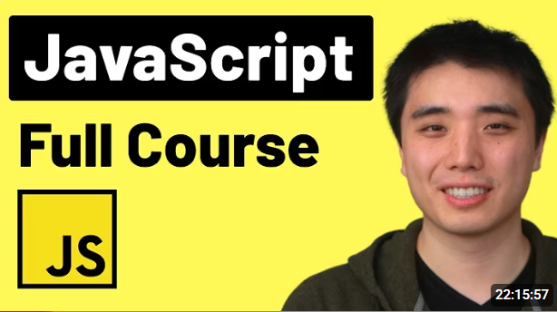

TO GO FURTHER
OFFICAL DOCUMENTATIONS
https://javascript.info/
TUTORIALS
https://www.w3schools.com/js/default.asp
VIDEOS
https://youtu.be/NBN7EkIDrf4?si=xOg7OBFwY6BGSZKl
https://youtu.be/EerdGm-ehJQ?si=Zy9D06xDqNAhrPm3

Slide 22
Question?
Contact:
Name: Long Chhun Hour & Chhorn Sothea
Email: Chhunhour.long@student.cadt.edu.kh
Sothea.chhorn@student.cadt.edu.kh
Telegram: @longchhunhour
@ch_sothea

Slide 23


QUIZ
Variable
JS

Slide 24
Thank You

