Slide 1
A4.ba
Plotting
Sabah Ul-Hasan Credit: Karthik Gangavarapu and Huitian Dao

Slide 2
Resources
More details on elements, vectors, and lists
Best RNA-Seq analysis practices (ie labeling) Conesa and Madrigal et al. 2016
Practices for labeling code
https://www.r-bloggers.com/2018/09/r-code-best-practices/
https://adv-r.hadley.nz/names-values.html
https://swcarpentry.github.io/r-novice-inflammation/06-best-practices-R/ (from HW3)
Various programming cheatsheets
Zoom study group (self-organized) for any time Meeting ID: 944 7012 5565 Passcode: AbcbStudy

Slide 3
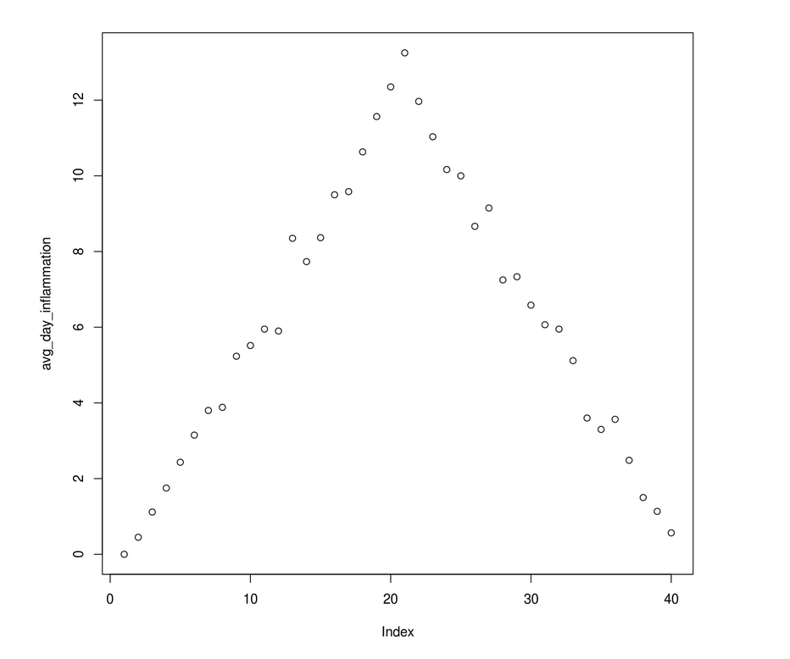
Plotting Informs Us About the Data

Slide 4
Good... and Bad Examples
https://sabahzero.github.io/dataviz/workshops

Slide 5
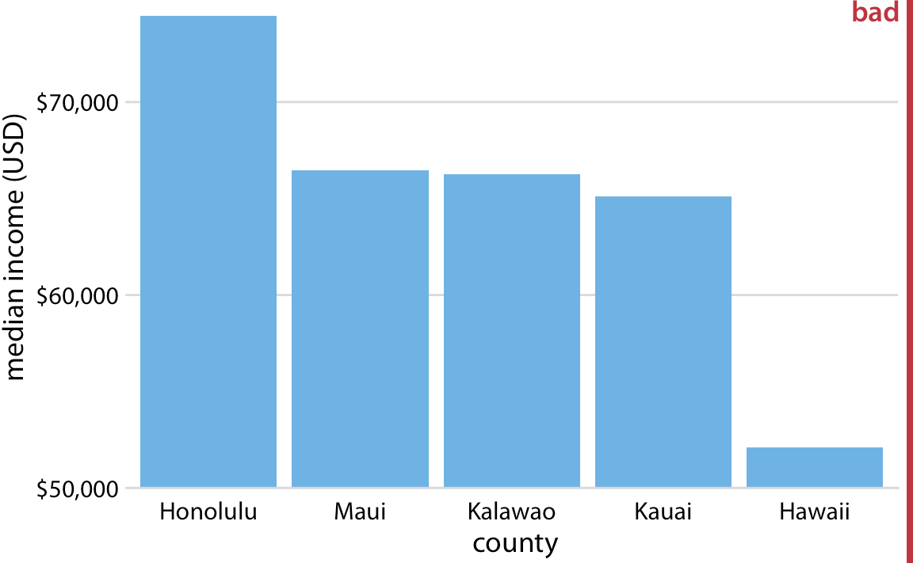
Why is this bad?
No error bars
Y-axis not from 0
Abbreviated numbers to be clearer what they are (what are the exact numbers for each county?
© Claus O. Wilke Fundamentals of Data Visualization
https://sabahzero.github.io/dataviz/workshops

Slide 6
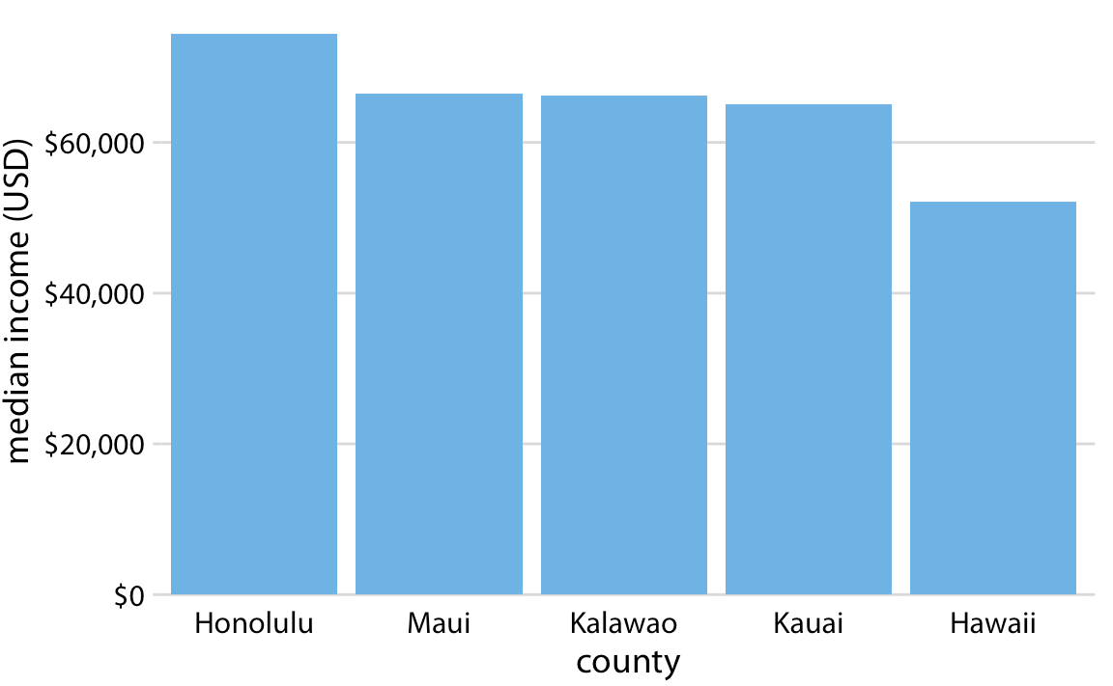
Why is this better?
© Claus O. Wilke Fundamentals of Data Visualization
https://sabahzero.github.io/dataviz/workshops

Slide 7
Data Visualization: What it is, and what it isn’t
https://sabahzero.github.io/dataviz/workshops

Slide 8
Data Visualization: What it is, and what it isn’t
Informs you on the data
https://sabahzero.github.io/dataviz/workshops

Slide 9
Data Visualization: What it is, and what it isn’t
Informs you on the data
Not a substitute for statistics, but can (and often should) include statistics
https://sabahzero.github.io/dataviz/workshops

Slide 10
Data Visualization: What it is, and what it isn’t
Informs you on the data
Not a substitute for statistics, but can (and often should) include statistics
Appropriately reflects the question you want explored
What figure(s) makes the most sense?
https://www.r-graph-gallery.com/
https://sabahzero.github.io/dataviz/workshops

Slide 11
Data Visualization: What it is, and what it isn’t
Informs you on the data
Not a substitute for statistics, but can (and often should) include statistics
Appropriately reflects the question you want explored
What figure(s) makes the most sense?
https://www.r-graph-gallery.com/
“A good paper tells a story through its figures”
Each figure should answer a fundamental sub-question of your overarching scientific question
https://sabahzero.github.io/dataviz/workshops

Slide 12
Data Visualization: What it is, and what it isn’t
Informs you on the data
Not a substitute for statistics, but can (and often should) include statistics
Appropriately reflects the question you want explored
What figure(s) makes the most sense?
https://www.r-graph-gallery.com/
“A good paper tells a story through its figures”
Each figure should answer a fundamental sub-question of your overarching scientific question
Always ask for feedback (peer review, friends, family)
Does the figure relay the results as you intended them to be perceived?
https://sabahzero.github.io/dataviz/workshops

Slide 13
Data Visualization in Base R

Slide 14
Zoom Poll
What is Base R?
What we installed as R kernel on Jupyter (notebook and hub) R programming as-is (no other installations) I’m not sure
Notes:
Want to know if you encounter unwelcoming behavior outside or inside classroom

Slide 15

Data Visualization in Base R
https://lichess.org/

Slide 16
games.csv (demo)
Type of file?
Type of data?
Labeling: What does the file refer to?
*why bash is useful (awk)
File contents (ie dataframe size)
https://www.r-graph-gallery.com/base-R.html

Slide 17
Why Base R first > directly ie tidyverse and ggplot2?
https://rstudio-pubs-static.s3.amazonaws.com/84527_6b8334fd3d9348579681b24d156e7e9d.html

Slide 18
Zoom Poll
What are tidyverse and ggplot2? (two are true, select all that apply)
Packages that enhance Base R data manipulation and plotting (respectively) Packages that enhance Base R plotting and data manipulation (respectively) They’re included as part of Base R
They’re included as part of our r-essentials R kernel
https://repo.anaconda.com/pkgs/r/
Notes:
Want to know if you encounter unwelcoming behavior outside or inside classroom

Slide 19
Package version (and R version) matters - demo

Slide 20

A4.ba: Think-Pair-Share

Slide 21
A4.bb
Scripting
Sabah Ul-Hasan

Slide 22
Write a script that creates two figures?

Slide 23
Write a script that creates two figures?
Reduces repetition (DRY > WET code)

Slide 24
Write a script that creates two figures?
Reduces repetition (DRY > WET code)
Reproducible (FAIR principles)

Slide 25
Write a script that creates two figures?
Reduces repetition (DRY > WET code)
Reproducible (FAIR principles)
A function or loop for multiple files and figures (again, saves time)

Slide 26
Write a script that creates two figures?
Reduces repetition (DRY > WET code)
Reproducible (FAIR principles)
A function or loop for multiple files and figures (again, saves time)
Pseudocoding (demo)

Slide 27
HW4 Q3, Q4

Slide 28
Open Q&A on R

Slide 29
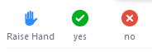
A4.bb: Individual

