Slide 1
A1.ba
Redirections and Pipes
Sabah Ul-Hasan Credit: Huitian Dao

Slide 2

But first!

Slide 3
Brief Recap of Day 1
Participation: 2.5 pts per class for Letter and Pass/Fail Post a Question or Answer prior 8 AM PST of the next class

Slide 4

Our Class

Slide 5
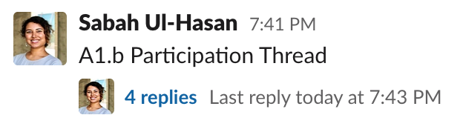
Brief Recap of Day 1
Participation: 2.5 pts per class for Letter and Pass/Fail Post a Question or Answer prior 8 AM PST of the next class

Slide 6
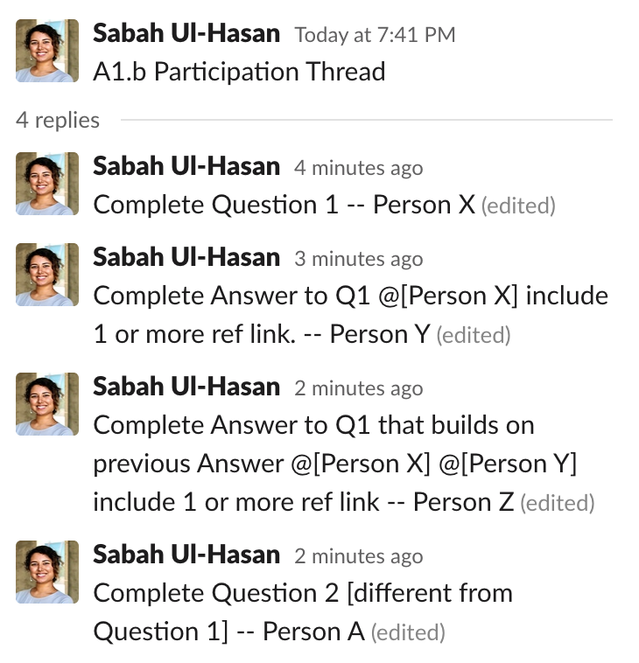
Brief Recap of Day 1

Slide 7
Brief Recap of Day 1
Participation: 2.5 pts per class for Letter and Pass/Fail Post a Question or Answer prior 8 AM PST of the next class
*today we will keep it simple with a reaction emoji
Homework: Submit HW1 on JupyterHub prior to 8 AM PST Sept 15th

Slide 8
Brief Recap of Day 1
Participation: 2.5 pts per class for Letter and Pass/Fail Post a Question or Answer prior 8 AM PST of the next class *today we will keep it simple with a reaction emoji
Homework: Submit HW1 on JupyterHub prior to 8 AM PST Sept 15th
Jupyter notebook (local) vs JupyterHub ? Think “personal notes” vs “final essay”

Slide 9
doing work
getting/submitting homeworks
jupyter (locally)
yes, access via local "terminal"
no
jupyterhub
yes, but need to be on campus or via VPN
yes

Slide 10
Brief Recap of Day 1
Participation: 2.5 pts per class for Letter and Pass/Fail Post a Question or Answer prior 8 AM PST of the next class
Homework: Submit HW1 on JupyterHub prior to 8 AM PST Sept 15th
Jupyter notebook (local) vs JupyterHub ? Think “personal notes” vs “final essay”
How do I access HW1 on JupyterHub? (demo) jupyterhub-abcb.scripps.edu

Slide 11

I CAN’T ACCESS JUPYTERHUB, I’M FREAKING OUT!

Slide 12
I CAN’T ACCESS JUPYTERHUB, I’M FREAKING OUT!
Step 1: Take a screenshot of your problem
Step 2: Describe your problem in email form with screenshot included, email it to JC Ducom with Sabah Cc’d
Step 3: Continue working on HW1 locally. If we’re not able to get you access by Friday, we’ll figure out an alternative.

Slide 13

I CAN’T ACCESS JUPYTERHUB, I’M FREAKING OUT!

Slide 14
Zoom Poll
How much time did you spend on HW1 aa-ab?
< 1 hour
1-2 hours
2-4 hours
4 or more hours
Notes:
Want to know if you encounter unwelcoming behavior outside or inside classroom

Slide 15
Feeling frustrated? You’re on the right track to learning things!

Slide 16

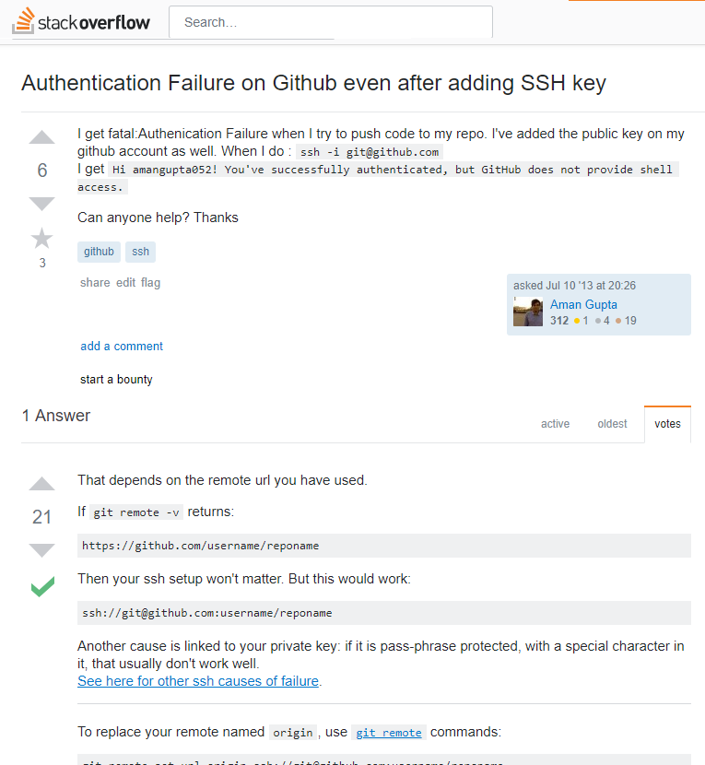
Where to get help?
Using the --help option in terminal
e.g., ls --help
Using the man pages (“manual”) in terminal
e.g., man ls
Google
e.g., ls sort by recently modified
Common useful sites: Stack Overflow, Stack Exchange
Slack and Github Issues

Slide 17
How to ask for help?
Reduce the complexity of the problem to the minimum required to reproduce the error
Post the code necessary to produce the error and all error messages
Describe the process you’ve carried out to solve the problem yourself
Describe your computing environment (e.g., operating system, software versions)

Slide 18
Common Questions (demo)
Question 1
data.zip
%%bash (executing a cell, and formatting)
save vs submit

Slide 19

Let’s try it! in chronological order
10 min [ ] Slack participation for A1.b today: Reaction emoji to JupyterHub post
[ ] Contact JC Ducom (slide 11) if you can’t access [ ] Enable Slack, access abcb-2020 *update name and picture, if needed [ ] Enable Canvas notifications 20 min
[ ] In your group of 3, review and discuss HW 1 A1.aa-A1.ab
[ ] Confirm you’ve turned on ‘watch releases’ for 2020 Github repo

Slide 20
A1.ba
Redirections and Pipes
Sabah Ul-Hasan Credit: Huitian Dao

Slide 21

Inspecting and Editing Files
head – show lines from beginning
grep – search file contents
wc – word count
less – examine file contents
tail – show lines from end
nano – text editor
sort – change order of lines
??? – mystery command
cp – copy file
mv – move file
rm – remove file
touch – create an empty file (or change modification date)
mkdir – make a directory
rmdir – remove a directory
Advanced: check out other common commands https://www.thegeekstuff.com/2010/11/50-linux-commands/

Slide 22
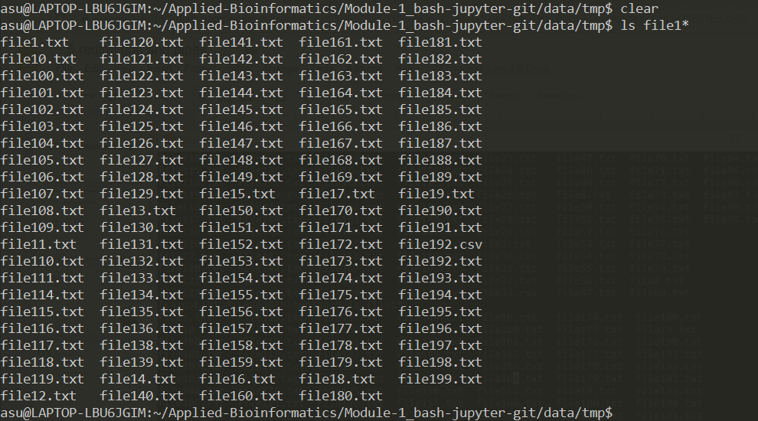
STDOUT – Standard Output
STDOUT
ls
grep
sort
head
tail
Notes:
Many commands you’ve learned – ls, grep, sort, head, tail – primarily send information to STDOUT. By default, STDOUT is simply printed to your terminal display.

Slide 23

Redirecting STDOUT
STDOUT
ls
grep
sort
head
tail
Redirection
“>”
New file
[command] > [filename]
Notes:
Many commands you’ve learned – ls, grep, sort, head, tail – primarily send information to STDOUT. By default, STDOUT is simply printed to your terminal display.

Slide 24
Redirection Example
data/tmp has a lot of text files, but how many?
$ ls *.txt
file1.txt file122.txt file145.txt file167.txt file189.txt file30.txt file54.txt file77.txt
file10.txt file123.txt file146.txt file168.txt file19.txt file31.txt file55.txt file78.txt
file100.txt file124.txt file147.txt file169.txt file190.txt file32.txt file56.txt file79.txt
file101.txt file125.txt file148.txt file17.txt file191.txt file33.txt file57.txt file8.txt
file102.txt file126.txt file149.txt file170.txt file192.txt file34.txt file58.txt file80.txt
file103.txt file127.txt file15.txt file171.txt file193.txt file35.txt file59.txt file81.txt
file104.txt file128.txt file150.txt file172.txt file194.txt file36.txt file6.txt file82.txt
file105.txt file129.txt file151.txt file173.txt file195.txt file38.txt file60.txt file84.txt
file106.txt file13.txt file152.txt file174.txt file196.txt file39.txt file61.txt file85.txt
file107.txt file130.txt file153.txt file175.txt file197.txt file4.txt file62.txt file86.txt
file108.txt file131.txt file154.txt file176.txt file198.txt file40.txt file64.txt file87.txt
file109.txt file132.txt file155.txt file177.txt file199.txt file41.txt file65.txt file88.txt
file11.txt file133.txt file156.txt file178.txt file2.txt file42.txt file66.txt file89.txt
file110.txt file134.txt file157.txt file179.txt file200.txt file44.txt file67.txt file9.txt
file111.txt file135.txt file158.txt file18.txt file21.txt file45.txt file68.txt file90.txt
file114.txt file136.txt file159.txt file180.txt file22.txt file46.txt file69.txt file91.txt
file115.txt file138.txt file16.txt file181.txt file23.txt file47.txt file7.txt file92.txt
file116.txt file139.txt file160.txt file182.txt file24.txt file48.txt file70.txt file93.txt
file117.txt file14.txt file161.txt file183.txt file25.txt file49.txt file71.txt file94.txt
file118.txt file140.txt file162.txt file184.txt file26.txt file5.txt file72.txt file96.txt
file119.txt file141.txt file163.txt file185.txt file27.txt file50.txt file73.txt file97.txt
file12.txt file142.txt file164.txt file186.txt file28.txt file51.txt file74.txt file98.txt
file120.txt file143.txt file165.txt file187.txt file29.txt file52.txt file75.txt file99.txt
file121.txt file144.txt file166.txt file188.txt file3.txt file53.txt file76.txt
ls *.txt > t1
wc -l t1

Slide 25
Append File (via glob)
$ ls data/tmp/*.txt > t1
$ wc t1
191 191 3909 t1
$ ls data/art/ >> t1
$ wc -l t1
192 197 4007 t1
$ ls data/art
artists.txt
$ head -5 t1
data/tmp/file100.txt
data/tmp/file101.txt
data/tmp/file102.txt
data/tmp/file103.txt
data/tmp/file104.txt
$ tail -5 t1
data/tmp/file97.txt
data/tmp/file98.txt
data/tmp/file99.txt
data/tmp/file9.txt
artists.txt

Slide 26

Pipelines
STDOUT
ls
grep
sort
head
tail
Redirection
“>”
New file
Pipe
“|”
Command
[command1] | [command2]
Notes:
Many commands you’ve learned – ls, grep, sort, head, tail – primarily send information to STDOUT. By default, STDOUT is simply printed to your terminal display.

Slide 27
Pipelining Example
data/tmp has a lot of text files, but how many?
$ ls *.txt
file1.txt file122.txt file145.txt file167.txt file189.txt file30.txt file54.txt file77.txt
file10.txt file123.txt file146.txt file168.txt file19.txt file31.txt file55.txt file78.txt
file100.txt file124.txt file147.txt file169.txt file190.txt file32.txt file56.txt file79.txt
file101.txt file125.txt file148.txt file17.txt file191.txt file33.txt file57.txt file8.txt
file102.txt file126.txt file149.txt file170.txt file192.txt file34.txt file58.txt file80.txt
file103.txt file127.txt file15.txt file171.txt file193.txt file35.txt file59.txt file81.txt
file104.txt file128.txt file150.txt file172.txt file194.txt file36.txt file6.txt file82.txt
file105.txt file129.txt file151.txt file173.txt file195.txt file38.txt file60.txt file84.txt
file106.txt file13.txt file152.txt file174.txt file196.txt file39.txt file61.txt file85.txt
file107.txt file130.txt file153.txt file175.txt file197.txt file4.txt file62.txt file86.txt
file108.txt file131.txt file154.txt file176.txt file198.txt file40.txt file64.txt file87.txt
file109.txt file132.txt file155.txt file177.txt file199.txt file41.txt file65.txt file88.txt
file11.txt file133.txt file156.txt file178.txt file2.txt file42.txt file66.txt file89.txt
file110.txt file134.txt file157.txt file179.txt file200.txt file44.txt file67.txt file9.txt
file111.txt file135.txt file158.txt file18.txt file21.txt file45.txt file68.txt file90.txt
file114.txt file136.txt file159.txt file180.txt file22.txt file46.txt file69.txt file91.txt
file115.txt file138.txt file16.txt file181.txt file23.txt file47.txt file7.txt file92.txt
file116.txt file139.txt file160.txt file182.txt file24.txt file48.txt file70.txt file93.txt
file117.txt file14.txt file161.txt file183.txt file25.txt file49.txt file71.txt file94.txt
file118.txt file140.txt file162.txt file184.txt file26.txt file5.txt file72.txt file96.txt
file119.txt file141.txt file163.txt file185.txt file27.txt file50.txt file73.txt file97.txt
file12.txt file142.txt file164.txt file186.txt file28.txt file51.txt file74.txt file98.txt
file120.txt file143.txt file165.txt file187.txt file29.txt file52.txt file75.txt file99.txt
file121.txt file144.txt file166.txt file188.txt file3.txt file53.txt file76.txt
ls *.txt > t1
wc -l t1
ls data/tmp/*.txt | wc -l

Slide 28

STDIN – Standard Input
STDIN
STDOUT
ls
grep
sort
head
tail

Slide 29
Pipelining
sort
grep
head
wc
tail
awk
uniq
cut
sed
gzip

Slide 30
Let’s try it! [9:00 - 9:20]
[ ] Complete A1.ba tasks in groups of 3
[ ] What’s something you discovered that wasn’t in the lecture?

Slide 31
Zoom Poll
How are you feeling about ABCB now?
Confident I can do this.
Better than on Tuesday. More worried!
One day at a time.
Notes:
Want to know if you encounter unwelcoming behavior outside or inside classroom

Slide 32
A1.bb
Open Q&A on Bash

Slide 33
HW 1: Due @ 8 AM Tue, then review Key as class
[ ] Complete A1.bb tasks on your own
[ ] Reflections (Q7) and Improvements (Q8)
[ ] Make sure to complete all of A1 tasks for HW 1 prior to Tue

