Slide 1
A4.aa
Refresh of Week 3
Sabah Ul-Hasan

Slide 2
Grading (Student Focused)
Fundamentals (Unit A): 50 pts
Participation (20 pts): Zoom and Slack
Homework (3 x 10 pts): Due each Tuesday @ 8 AM PST
Applied Bioinfo (Units B-C): 100 pts
Participation (20 pts): Zoom and Slack
Homework (5 x 10 pts): Due each Tuesday @ 8 AM PST
Capstone (30 pts): 15 pts for content, 10 for presentation, 5 for peer review

Slide 3
Grading
In Canvas now
Participation (10 pts): Week 1, Week 2
HW (20 pts): HW1, HW2
To be added in Canvas
Participation (10 pts): Week 3 (Thu), Week 4
HW (10 pts): HW3

Slide 4
Grading
In Canvas now
Participation (10 pts): Week 1, Week 2 **be sure to update Slack and Zoom with Canvas name** ie First Name (preferred name) Last Name [pronouns]
HW (20 pts): HW1, HW2
To be added in Canvas
Participation (10 pts): Week 3 (Thu), Week 4
HW (10 pts): HW3

Slide 5
Grading
In Canvas now
Participation (10 pts): Week 1, Week 2 **be sure to update Slack and Zoom with Canvas name** ie First Name (preferred name) Last Name [pronouns] Sabah (Sabz) Ul-Hasan [they/them/theirs]
HW (20 pts): HW1, HW2
To be added in Canvas
Participation (10 pts): Week 3 (Thu), Week 4
HW (10 pts): HW3

Slide 6
Reminder: It’s not about grades
In Canvas now
Participation (10 pts): Week 1, Week 2
HW (20 pts): HW1, HW2
To be added in Canvas
Participation (10 pts): Week 3 (Thu), Week 4
HW (10 pts): HW3

Slide 7
HW 2 -- Overview
Points: 11 points, so we gave you a bonus point (jupyterhub vs Canvas)
Question 8 and 10: More or less duplicates (something that can happen when trying to get homeworks ready for ~45 students)

Slide 8
HW 2 -- Overview
Points: 11 points, so we gave you a bonus point (jupyterhub vs Canvas)
Question 8 and 10: More or less duplicates (something that can happen when trying to get homeworks ready for ~45 students)
If you have a question about grading, first visit the key in the Github repo
If you still have a question about grading after that, let us know -- provide a thorough justification (if applicable)
This isn’t intended to create extra work for you, but it is to help with being mindful of TA and instructor time

Slide 9
HW 2 -- Overview
Points: 11 points, so we gave you a bonus point (jupyterhub vs Canvas)
Question 8 and 10: More or less duplicates (something that can happen when trying to get homeworks ready for ~45 students)
If you have a question about grading, first visit the key in the Github repo
If you still have a question about grading after that, let us know -- provide a thorough justification (if applicable)
This isn’t intended to create extra work for you, but it is to help with being mindful of TA and instructor time
Don’t forget to thank your TAs -- they’re grad students, too!

Slide 10
Reminder: It’s not about grades
In Canvas now
Participation (10 pts): Week 1, Week 2
HW (20 pts): HW1, HW2
To be added in Canvas
Participation (10 pts): Week 3 (Thu), Week 4
HW (10 pts): HW3

Slide 11
HW 2
Q&A

Slide 12
Zoom Poll
More of these grading recaps in the future?
No, I’m fine with the Code Review and key as we currently have it
Yes, I’d like the recaps of the previous homework before Code Review
Yes, I’d like the recap of recently submitted homework before Code Review
Yes, I’d like the recap of recently submitted homework after Code Review
Notes:
Want to know if you encounter unwelcoming behavior outside or inside classroom

Slide 13

For those that put “No”, we’ll give you another task during

Slide 14
What have we learned so far?

Slide 15

What have we learned so far?

Slide 16
What have we learned so far?
Bash
pipes
Loops
R basics (also has pipes, but haven’t reviewed)
Objects (ie data types)
Dataframes, matrices
Data types
Functions and operators
Plotting (not quite yet.. Kind of)
Jupyter notebook architecture, Jupyter Hub (navigation, usages)
Syntax (associated errors, ie debugging)

Slide 17
What have we learned so far?
Jupyter Notebook and JupyterHub
Bash basics
R basics

Slide 18
What have we learned so far?
Jupyter Notebook and JupyterHub
Bash basics: Commands, operations, pipes, awk, loops, scripting
R basics: Objects, operators, loops, conditionals
Software installation and troubleshooting navigation for all of these
Intro to experimental design from experimentation set-up → data output with RNA-Seq as example

Slide 19
What have we yet to learn?
Jupyter Notebook and JupyterHub
Bash basics: Commands, operations, pipes, awk, loops, scripting
R basics: Objects, operators, loops, conditionals
Software installation and troubleshooting navigation for all of these
Intro to experimental design from experimentation set-up → data output with RNA-Seq as example
R basics
Functions (more in-depth), scripting, plotting
Advanced R: Plotting, statistics

Slide 20
What have we yet to learn?
Jupyter Notebook and JupyterHub
Bash basics: Commands, operations, pipes, awk, loops, scripting
R basics: Objects, operators, loops, conditionals
Software installation and troubleshooting navigation for all of these
Intro to experimental design from experimentation set-up → data output with RNA-Seq as example
R basics
Functions (more in-depth), scripting, plotting
Advanced R: Plotting, statistics
Application of bash and R to RNA-Seq pipeline example
SAM, BAM, FASTQC, HISAT2, DESEQ2, publish-ready figures w/ stats

Slide 21
What have we yet to learn?
Jupyter Notebook and JupyterHub
Bash basics: Commands, operations, pipes, awk, loops, scripting
R basics: Objects, operators, loops, conditionals
Software installation and troubleshooting navigation for all of these
Intro to experimental design from experimentation set-up → data output with RNA-Seq as example
R basics
Functions (more in-depth), scripting, plotting
Advanced R: Plotting, statistics
Application of bash and R to RNA-Seq pipeline example
SAM, BAM, FASTQC, HISAT2, DESEQ2, publish-ready figures w/ stats
Non-RNASeq pipelines in bioinformatics, and career directions
RNASeq-oriented bioinformatics resources at TSRI

Slide 22
Question 1
What does it mean when you see [3] at the beginning of an R output in jupyter notebook?
3rd element in a list 3rd element of a character vector 3rd number
Question 2 (select all that apply)
What is the difference between class() and typeof() functions? They output the same thing
class() defines object as OOP, typeof() defines object as R They output different things, but essentially yield the same result None of the above
Question 3 (select all that apply)
Which functions will inform you more about an object and/or operator of interest? help() example() ?
Notes:
Want to know if you encounter unwelcoming behavior outside or inside classroom

Slide 23
Resources
R vs Python overview (1) and (2), intro (DataCamp)
Quick commands
Installing R packages in jupyter outside of R essentials
Parallel computing
Objects
Mode, Class, Type
Subsetting lists
Numeric and empty vectors
Printing and displaying strings
Object Oriented Programming (OOP)
Viewing stored objects in jupyter
Best R programming practices (1) and (2)
Zoom study group (self-organized) for any time Meeting ID: 944 7012 5565 Passcode: AbcbStudy

Slide 24

Code Review
[ ] Open HW 4, complete A4.aa tasks in groups of 3

Slide 25
A4.ab
Basic Data Analysis
Sabah Ul-Hasan
Credit: Huitian Dao and Karthik Gangavarapu

Slide 26
Working With Data

Slide 27
Working With Data
Vector | x <- c("a", "b", "c") | Create a vector
 | x <- c(1:10) | Create a numeric vector with number 1 to 10
 | x <- seq(0,10, by=2) | Create a numeric vector: 0 2 4 6 8 10
 | x <- vector(mode="character" , length=10) | Create an empty character vector with 10 elements
 | x <- character(10) | Create an empty character vector with 10 elements
 | x <- rep("Foo", 10) | Create an vector with “Foo” repeating 10 times
Matrix | matrix(, nrow=5, ncol=10) | Create a empty matrix with 5 rows and 10 columns
 | matrix(c(1:50), nrow=5, ncol=10) | Create a matrix with 5 rows and 10 columns with 1-50
Array | x <- array(c(1:27), dim=c(3,3,3)) | Create an array with 1-27 with 3 rows, 3 columns and 3 matrices

Slide 28
Working With Data
Data frame | x <- data.frame(vector.1, vector.2, vector.3) | Create a dataframe with vector
 | x <- data.frame(matrix(ncol=5, nrow=10)) | Create a dataframe from an empty matrix
 | x <- as.data.frame(matrix.1) | Create a dataframe by converting matrix
 | x <- read.csv(“123.csv”) | Create a dataframe from reading a csv file
List | x <- list(my.name="Foo", my.num=2, "Foo" ) | Create a list with different types of things

Slide 29
Working With Data -- HW3; What type of data?

Slide 30
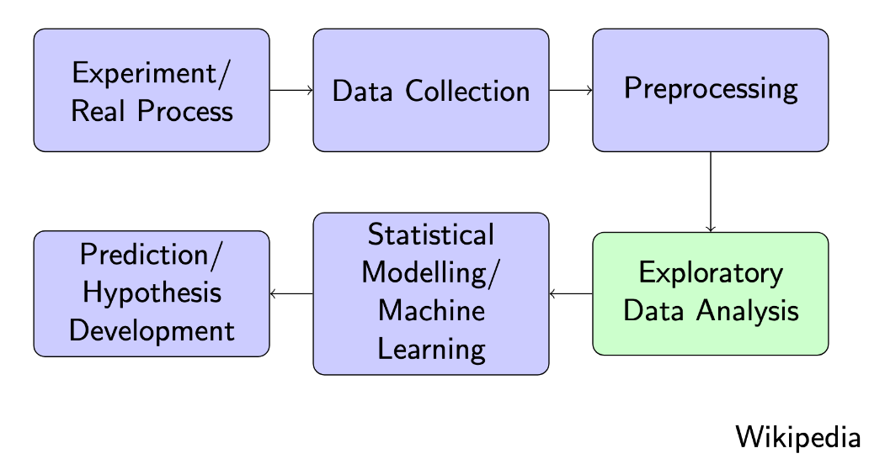
Working With Data -- HW3; What type of data?

Slide 31
Working With Data -- HW3; What type of data?
Biological examples of data frames?
RNA-Seq matrices (includes single-cell)
Microarray
16S, ITS, 18S amplicon sequence data (markers) -- microbes, population haplotypes
Colony counts
SNP (haplotypes, markers)
NCBI: nucleotide sequences, aa sequences
Bash (.txt) > R (.txt, .csv)
meta-analyses

Slide 32
NAV-D14_DEseq2.csv (demo): naive CD8 T cells, Day 14

Slide 33
NAV-D14_DEseq2.csv (demo)
Type of file?

Slide 34
NAV-D14_DEseq2.csv (demo)
Type of file?
Type of data (stage in RNA-Seq)?

Slide 35
NAV-D14_DEseq2.csv (demo)
Type of file?
Type of data (stage in RNA-Seq)?
Labeling: What does the file refer to?
*why bash is useful (awk)

Slide 36
NAV-D14_DEseq2.csv (demo)
Type of file?
Type of data (stage in RNA-Seq)?
Labeling: What does the file refer to?
*why bash is useful (awk)
File contents

Slide 37
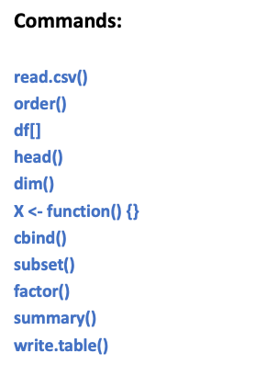
NAV-D14_DEseq2.csv (demo)
Type of file?
Type of data (stage in RNA-Seq)?
Labeling: What does the file refer to?
*why bash is useful (awk)
File contents *note parallels to bash

Slide 38
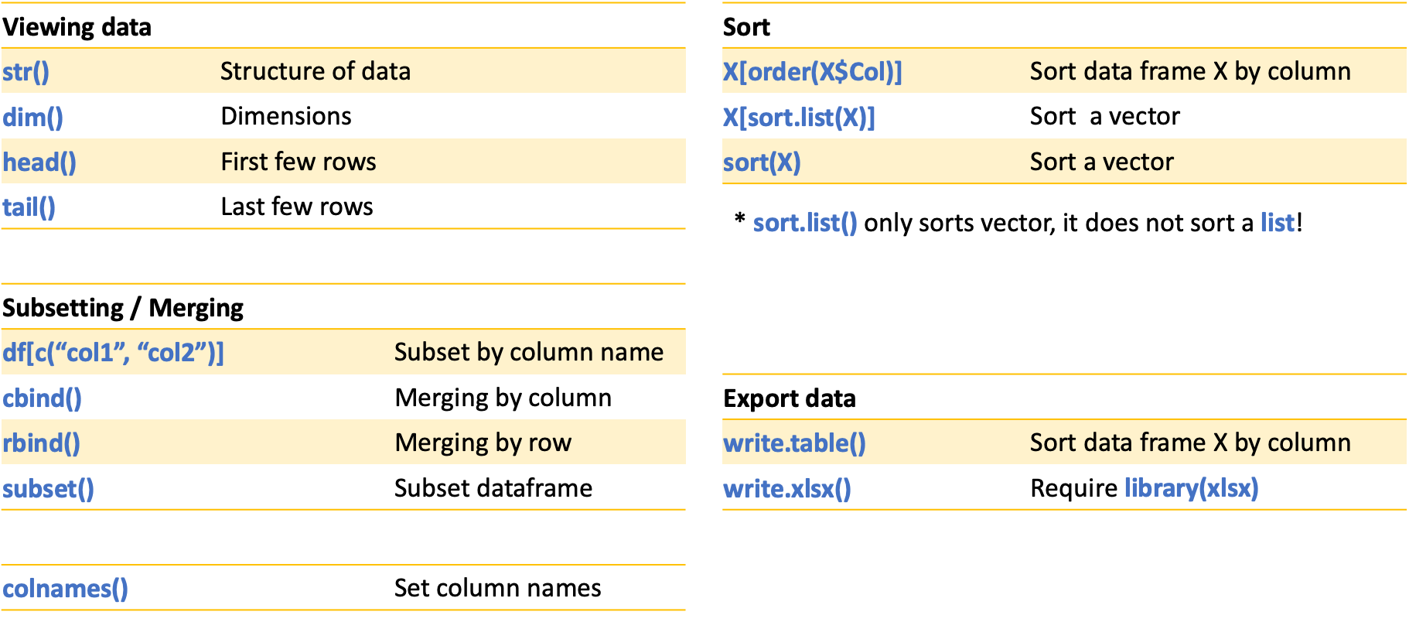
Dataframe operations

Slide 39
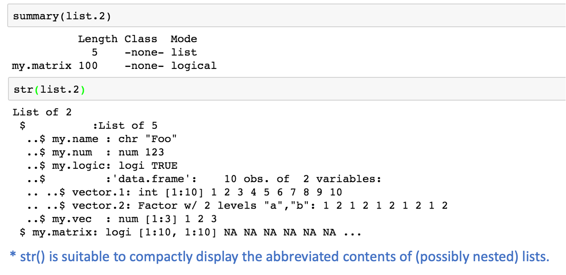
Viewing df with str()

Slide 40
Functions

Slide 41
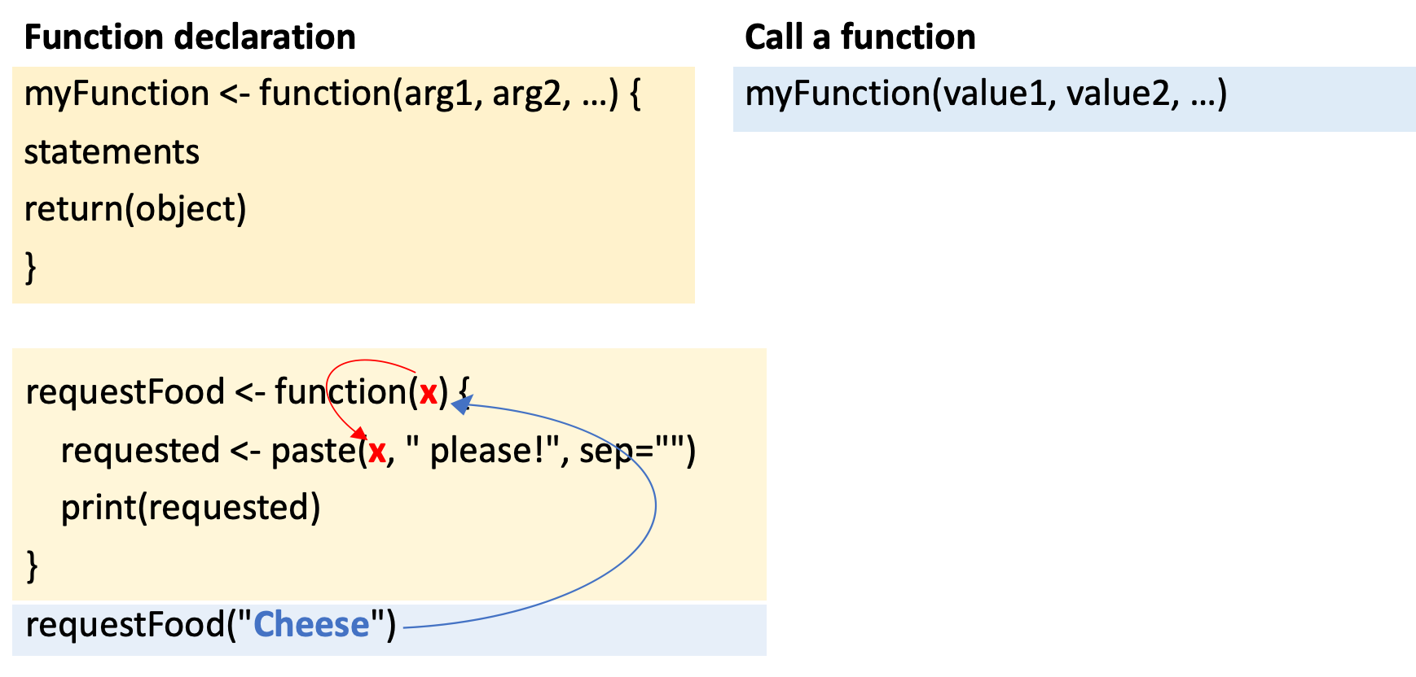
Functions
https://swcarpentry.github.io/r-novice-inflammation/02-func-R/

Slide 42
Functions: lapply()
https://www.guru99.com/r-apply-sapply-tapply.html

Slide 43
Functions: lapply()
https://www.guru99.com/r-apply-sapply-tapply.html
https://datacarpentry.org/r-socialsci/03-dplyr-tidyr/index.html

Slide 44
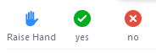
A4.ab: Individual

