Slide 1
B5.ba
Visualizing RNA-Seq Data
Sabah Ul-Hasan

Slide 2
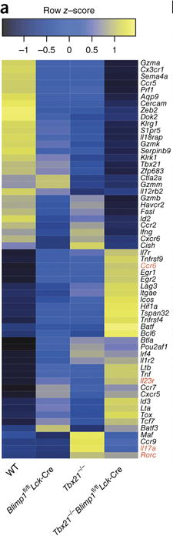
Capstone: 30 points
Xin et al. 2016

Slide 3
Capstone: 30 points
Groups of 3: Instructions to be sent out tomorrow
Recommendation: Read the papers now, start the work later (Week 9)
No homework given after Week 8 (homework is the Capstone)
Xin et al. 2016

Slide 4
Capstone: 30 points
Groups of 3: Instructions to be sent out tomorrow
Recommendation: Read the papers now, start the work later (Week 9)
No homework given after Week 8 (homework is the Capstone)
Week 10: Each group will have a paper they will work through alongside individual reports
Xin et al. 2016

Slide 5
Capstone: 30 points
Groups of 3: Instructions to be sent out tomorrow
Recommendation: Read the papers now, start the work later (Week 9)
No homework given after Week 8 (homework is the Capstone)
Week 10: Each group will have a paper they will work through alongside individual reports
Deadline: Presentations (10 pts) will start and end Week 12, in tandem with peer review (5 pts) of presentations
Xin et al. 2016

Slide 6
About the Papers
4 total
3 that range between easy-medium, a 4th that’s advanced

Slide 7
About the Papers
4 total
3 that range between easy-medium, a 4th that’s advanced
If you choose to do the 4th one, this is done on your own as practice
You can receive up to 2 extra points for completing the 4th paper

Slide 8
About the Papers
4 total
3 that range between easy-medium, a 4th that’s advanced
If you choose to do the 4th one, this is done on your own as practice
You can receive up to 2 extra points for completing the 4th paper
No older than 2016
Open-source, with access to raw data

Slide 9
About the Papers
4 total
3 that range between easy-medium, a 4th that’s advanced
If you choose to do the 4th one, this is done on your own as practice
You can receive up to 2 extra points for completing the 4th paper
No older than 2016
Open-source, with access to raw data
Mindful of gender balance and representation

Slide 10
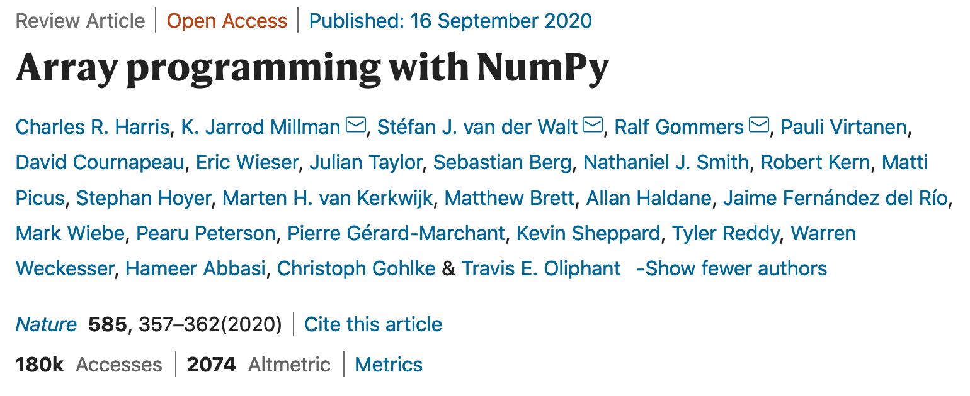
A tool is only as good as its creator(s)

Slide 11
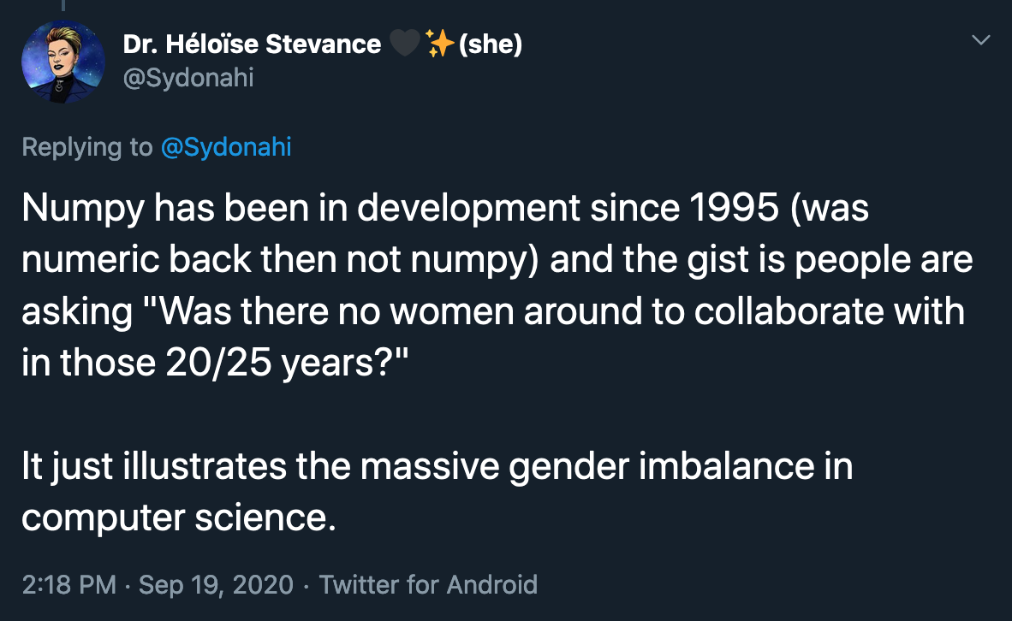
A tool is only as good as its creator(s)

Slide 12
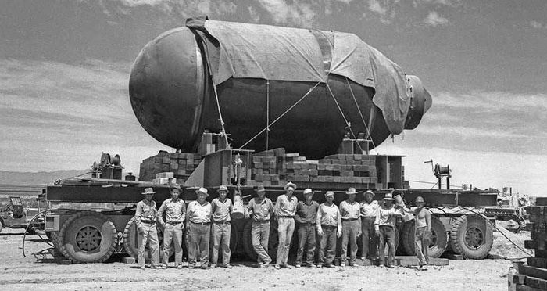
Dangers of exclusion

Slide 13
RNASeq, ggplot2, ggpubr, and tidyverse
Xin et al. 2016

Slide 14
Stage of the data? What should it look like?
Xin et al. 2016

Slide 15
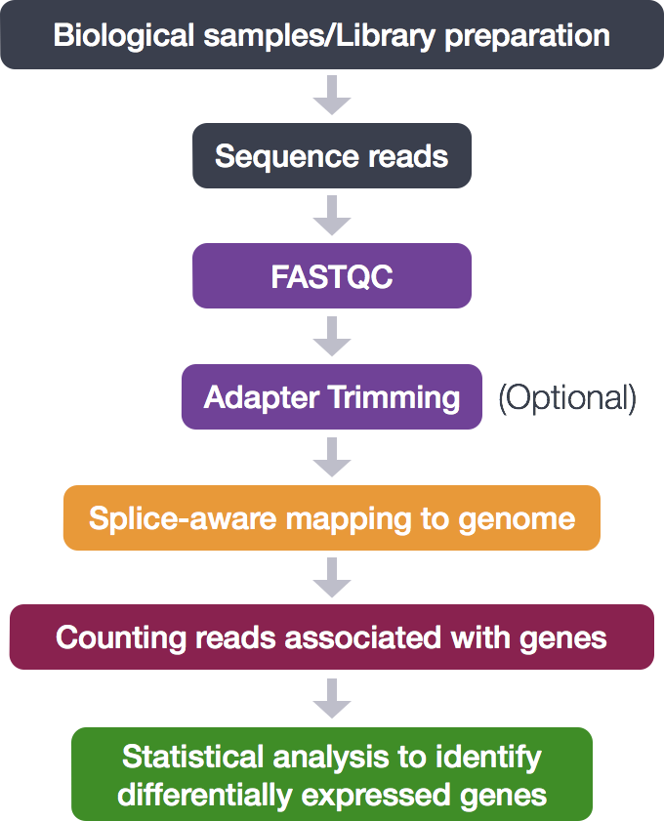
‘Counting reads associated with genes’
}
Bash
R
Xin et al. 2016

Slide 16
Week 6: Reads → Trimming (Karthik)
}
Bash
R
Xin et al. 2016

Slide 17
Pipes in R (demo)

Slide 18
Disadvantages of ggplot2 and/or tidyverse?
Big datasets → complex figures (which can take more time)
https://bioconductor.org/packages/release/workflows/html/rnaseqGene.html
https://combine-australia.github.io/RNAseq-R/
https://rna-seqblog.com/tag/r-package/

Slide 19

B5.ba: Think-Pair-Share

Slide 20
B5.bb
Tying it Together
Sabah Ul-Hasan

Slide 21
The Programming
Similarities
Pipes, loops, scripting, indentation (significance)
Bash (unique)
Jupyter notebook syntax (call %%bash -- Python kernel), awk,...
R (unique)
R kernel already included, packages,..

Slide 22
The Biology
Experimental Design
Replications, reproducibility, controls (batch effects), validation
Garbage in, garbage out
Hypothesis Testing
Applying the scientific method to dry lab / computational work
Hypothesis testing still applies when only working with data
Considering bias (in experiments and/or data, etc)
RNA-Seq
When to use what type of programming (what is appropriate where)
Labeling and naming of files, editing of files accordingly (to match biology)

Slide 23
Visualization and Statistics
What does each do, and how do they compliment?

Slide 24
Heatmap Demo
https://www.r-graph-gallery.com/heatmap

Slide 25

B5.bb: Individual

