Slide 1
Alignment
Karthik

Slide 2
Overview: Analysis
Raw sequencing signal
Base called raw files
Demultiplexing
FASTQ
Alignment to reference
Differential expression analysis
Counts per feature
SAM/BAM
Variants Calling

Slide 3
Comparing strings
T A T G
A T G
T A T G T
A T T
A T G
A T C
T A T G
| | |
A T G
T A T G T
| | |
A T T
A T G
| | |
A T C
T A T G
| | |
A T G
T A T G T
| | |
A T T
T A T G
| | | |
- A T G
T A T G T
| | | |
A T - T
Exact string comparison
Substrings
Alignment

Slide 4
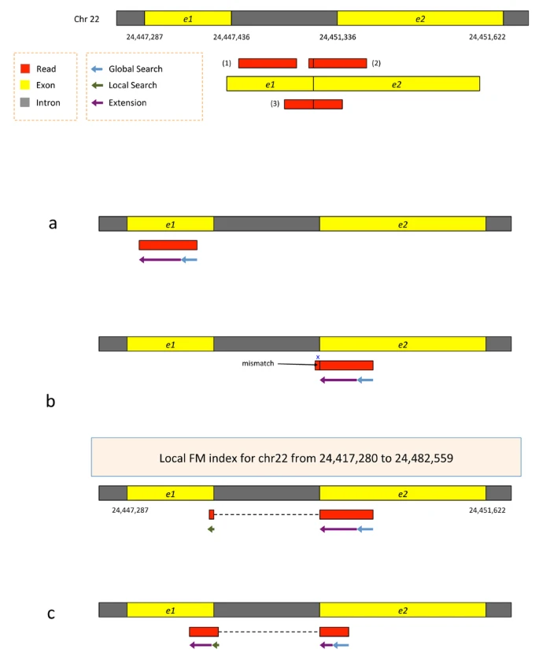
Alignment: HISAT2
Kim et al. 2015

Slide 5
Commands
Manual - https://daehwankimlab.github.io/hisat2/manual/
hisat2-build: Builds index
hisat2-inspect: View all references in the index
hisat2: Align reads to a reference index
Example workflow,
hisat2-build ref.fa ref
hisat2-inspect ref
hisat2 -f -x ref -U reads_example.fa -S example.sam

Slide 6
Demonstration: Mapping using HISAT2
(module is available on hpc directly)

Slide 7
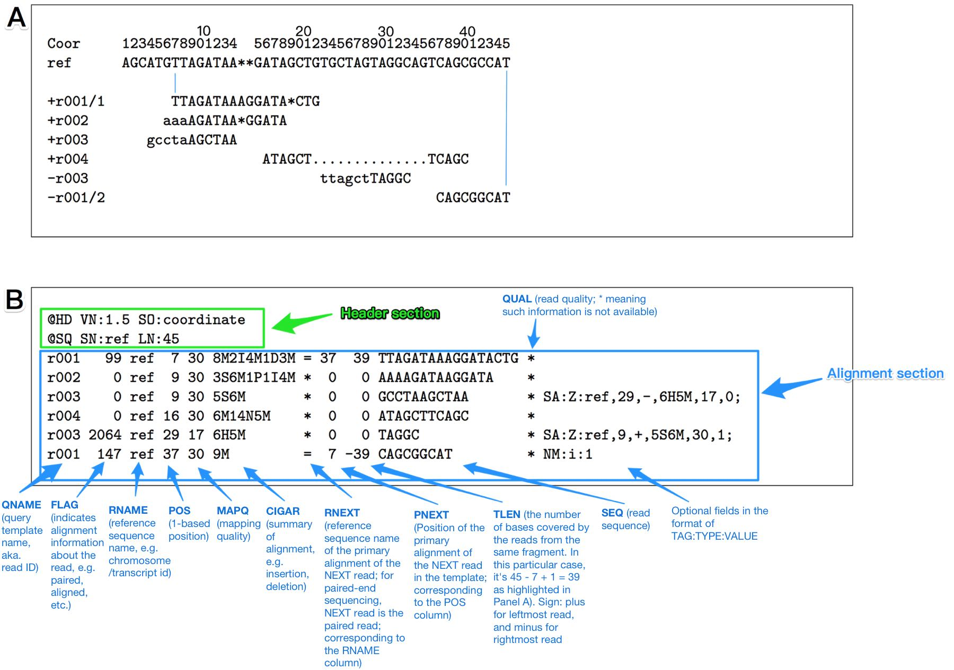
Sequence Alignment Map (SAM) Format
https://zyxue.github.io/2017/09/26/sam-format-example.html

Slide 8
Demonstration: Samtools
samtools view
Convert between SAM and Binary Alignment Map (BAM) format
Filter out unmapped reads
Samtools flags - https://broadinstitute.github.io/picard/explain-flags.html
samtools sort
Sort by coordinate
Sort by name
samtools index
Index BAM file for downstream
samtools depth
Get number of reads covering each case in the reference sequence
Samtools manual - https://www.htslib.org/doc/samtools.html

Slide 9
Tuesday more on bam?

