Slide 1
B7.ba
Bioinformatics Workflows
Sabah Ul-Hasan Credit: Andrew Su

Slide 2




If this is all of bioinformatics....
Provide a broad overview of all topics in bioinformatics?
Cover a selection of bioinformatics topics in great depth?
Provide guidance and confidence in your ability to manage and analyze your own data
YOU TODAY

Slide 3
What have we yet to learn?
Jupyter Notebook and JupyterHub
Bash basics: Commands, operations, pipes, awk, loops, scripting
R basics: Objects, operators, loops, conditionals
Software installation and troubleshooting navigation for all of these
Intro to experimental design from experimentation set-up → data output with RNA-Seq as example

Slide 4
What have we yet to learn?
Jupyter Notebook and JupyterHub
Bash basics: Commands, operations, pipes, awk, loops, scripting
R basics: Objects, operators, loops, conditionals
Software installation and troubleshooting navigation for all of these
Intro to experimental design from experimentation set-up → data output with RNA-Seq as example
R basics
Functions (more in-depth), scripting, plotting
Advanced R: Plotting, statistics
Application of bash and R to RNA-Seq pipeline example
SAM, BAM, FASTQC, HISAT2,...

Slide 5
What have we yet to learn?
Jupyter Notebook and JupyterHub
Bash basics: Commands, operations, pipes, awk, loops, scripting
R basics: Objects, operators, loops, conditionals
Software installation and troubleshooting navigation for all of these
Intro to experimental design from experimentation set-up → data output with RNA-Seq as example
R basics
Functions (more in-depth), scripting, plotting
Advanced R: Plotting, statistics
Application of bash and R to RNA-Seq pipeline example
SAM, BAM, FASTQC, HISAT2, DESEQ2, publish-ready figures w/ stats
Non-RNASeq pipelines in bioinformatics, and career directions
RNASeq-oriented bioinformatics resources at TSRI

Slide 6
Zoom Poll
Mid-quarter check-in (select all that apply)
I have learned more on bioinformatics in this class than I would on my own. I have learned new critical thinking approaches in this class than I would on my own. I am more comfortable with programming than I was before this course. I am more comfortable with RNA-Seq than I was before this course. None of the above apply to me.
Notes:
Want to know if you encounter unwelcoming behavior outside or inside classroom

Slide 7
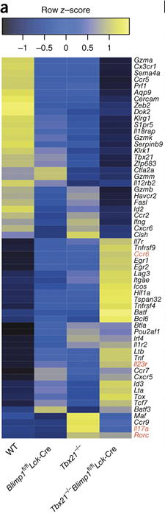
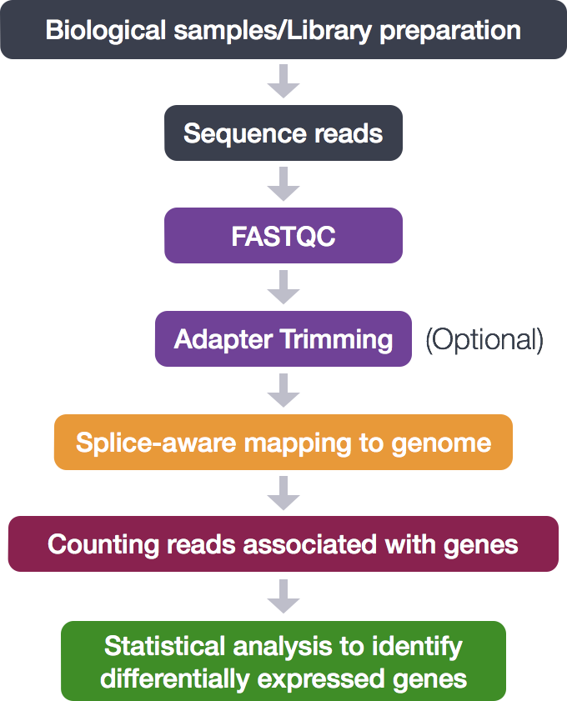
Week 7: Counting Reads
}
Bash
R
Xin et al. 2016

Slide 8
Pre- vs Post- Processing?
RNA-Seq example
Pre-processing
QC, alignment
Post-processing
Counting, gene identification
What do they mean?
Why do we separate these?
https://h3abionet.github.io/H3ABionet-SOPs/RNA-Seq

Slide 9
HW7.a -- The many ways to analyze RNA-Seq Data
As you walk through your capstone project, ask yourself about the fundamental steps being taken Basic of Bioinformatics (free ebook)

Slide 10
Open Q&A
HW questions
Capstone questions
Material questions
Know your neighbor Capstone group icebreaker

Slide 11
B7.bb
Read Counts and DESEQ2
Sabah Ul-Hasan Credit: Karthik Gangavarapu, Jerry Zak

Slide 12
Overview: Analysis
Raw sequencing signal
Base called raw files
Demultiplexing
FASTQ
Alignment to reference
Differential expression analysis
Counts per feature
SAM/BAM
Variants Calling

Slide 13
Why do we need to count reads, can we automate?
To get ratio value instead of interval value after getting the read and exclude the one pair end file instead of using two files.

Slide 14
How would you automate the RNA-Seq process?
Loops, pipes, etc: Bash vs R
… you could have a script that has both (just be mindful of syntax)
Yes, you can automate this process (most of the time you probably want to do this)
Mindful of times you dont want to do this
Working on a dataset of different sample types
Change your experimental protocol
Working with a collaborator

Slide 15
Demo -- hisat read output and count

Slide 16
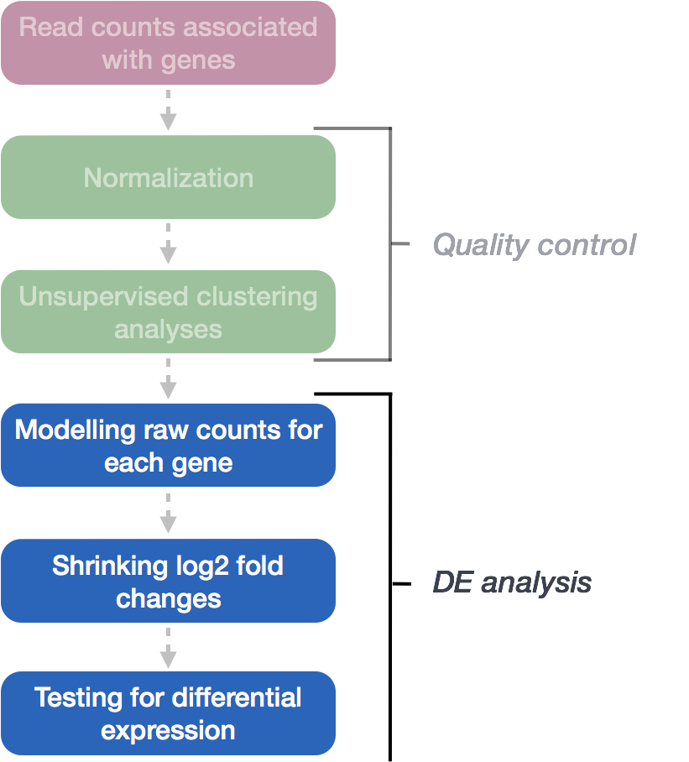
DESeq2
https://hbctraining.github.io/DGE_workshop/lessons/05_DGE_DESeq2_analysis2.html

Slide 17

B7.bb: Think-Pair-Share

