Slide 1
B8.ba
DESeq2 Prep
Sabah Ul-Hasan Credit: Karthik Gangavarapu, Jerry Zak

Slide 2
Today: Clarifying this process
Raw sequencing signal
Base called raw files
Demultiplexing
FASTQ
Alignment to reference
Differential expression analysis
Counts per feature
SAM/BAM
Variants Calling

Slide 3
Zoom Poll
Are featureCounts and htseq-count interchangeable?
Yes.
Mostly, but there are some differences.
No, both should be used.
Notes:
Want to know if you encounter unwelcoming behavior outside or inside classroom

Slide 4
Clarifying this process
Raw sequencing signal
Base called raw files
Demultiplexing
FASTQ
Alignment to reference
Differential expression analysis
Counts per feature
SAM/BAM
Variants Calling

Slide 5
When, or why, may we want to use both?
What can/do we do if we don’t use these tools?
Different efficiencies, depending on the tool
Output file should be identical
If you use multiple tools, these can be validation checks
Good way to check that you understand the tool
Scripting manually → loops, pipes, package, etc
Still should get the same output

Slide 6
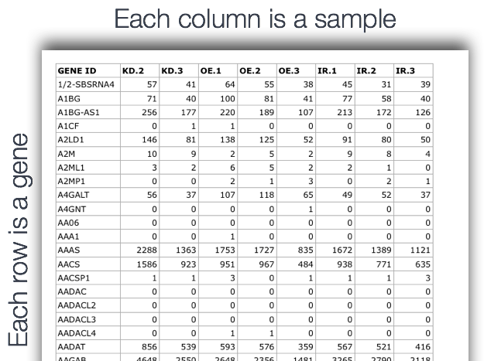
So you have a count matrix… now what?
You can work with it directly but… not ideal
Normalize and filter (transformations)
Analysis, go deeper in questions
Exploratory analysis
Go deeper with scientific Qs

Slide 7
Critical! Filtering and normalizing your data
https://www.geeksforgeeks.org/data-normalization-in-data-mining/
https://www.bioconductor.org/help/course-materials/2016/CSAMA/lab-3-rnaseq/rnaseq_gene_CSAMA2016.html#summarizing-an-rna-seq-experiment-as-a-count-matrix
http://www.sthda.com/english/wiki/rna-sequencing-data-analysis-counting-normalization-and-differential-expression

Slide 8
Demo: Exploring your matrix in prep for DESeq2
Just because a function works, don’t assume it did what you wanted
(DESeq fxn for normalization)

Slide 9

B8.ba: Think-Pair-Share
Try it out.
B8.ba of HW8 is for you to practice on your own, Adjust a count matrix from these files
*note your kernel
https://github.com/SuLab/Applied-Bioinformatics/blob/Fall-2018/Unit2-RNAseq/3.6_DESeq2_differential_expression_analysis.ipynb

Slide 10
Notes
Data loading (instructor source path vs yours)
Metadata (dataframe), gene counts, design → matrix
Normalization and filtering

Slide 11
B8.bb
DESeq2 Analysis
Sabah Ul-Hasan Credit: Karthik Gangavarapu, Jerry Zak

Slide 12
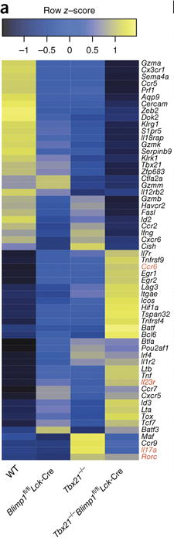
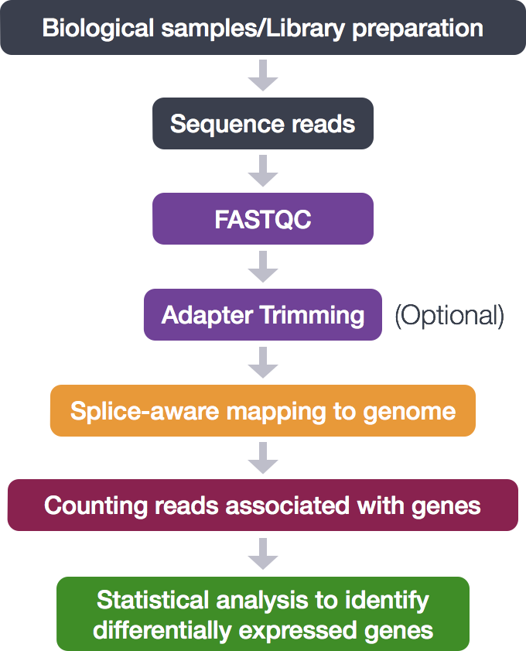
}
Bash
R
Xin et al. 2016

Slide 13
Clarifying this process
Raw sequencing signal
Base called raw files
Demultiplexing
FASTQ
Alignment to reference
Differential expression analysis
Counts per feature
SAM/BAM
Variants Calling

Slide 14
Demo cnt’d (HW8.bb)
https://lashlock.github.io/compbio/R_presentation.html

Slide 15
Zoom Poll
What would be the best way to ‘manually’ re-create DESeq2?
Create a loop that goes from start to finish in parallel with the package
Create your own personalized package
Line by line in a script
None of the above
Notes:
Want to know if you encounter unwelcoming behavior outside or inside classroom

Slide 16
Outstanding Questions
HW questions
Capstone questions
Material questions

Slide 17
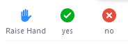
B8.bb: Individual Begin walking through B8.bb of HW8 Use the files outlined in this notebook
https://github.com/SuLab/Applied-Bioinformatics/blob/Fall-2018/Unit2-RNAseq/3.6_DESeq2_differential_expression_analysis.ipynb

Slide 18
Resources
Bash
Plotting
Data visulzation (1), (2), and (3)
R vs tidyverse, general tidyverse info
Histograms
Bar charts
Shapes
RNASeq
Relevant Databases: NCBI, UCSC, GENECODE
Experimental design
Relevant Packages
Bioconductor family (specifically stats)
Tutorials
Overview tutorials: (1) and (2)
QC
Nanopore
biostars
Alignment
Samtools (1) and (2)
hisat2
htslib (1) and (2)
Cutadapt
Read counting
Normalization
Enrichment analysis (1) and (2)

