Slide 1
SIO R User Group:
Data log viewer using Shiny and YAML
Jooil Kim
2019.10.30.

Slide 2
AGAGE Log Data Viewer
Q. Something better than the long list of items on a .doc file…
Requirements:
Easy to share among team members
Easy to maintain
Open, flexible format for creating/editing/storing raw log data

Slide 3
Shiny R web service
Website generation based on R
Easy to create, maintain with R
Web-based access for sharing the data
https://shiny.rstudio.com
Another success story of the SIO-RUG!

Slide 4
My approach (1): YAML
Store raw file on the YAML format
YAML = “YAML Ain’t Markup Language”
“YAML is a human friendly data serialization standard for all programming languages.”
Simple text files with formatting, easy to create and maintain.
R yaml package for importing files into R
https://yaml.org, https://learnxinyminutes.com/docs/yaml/

Slide 5
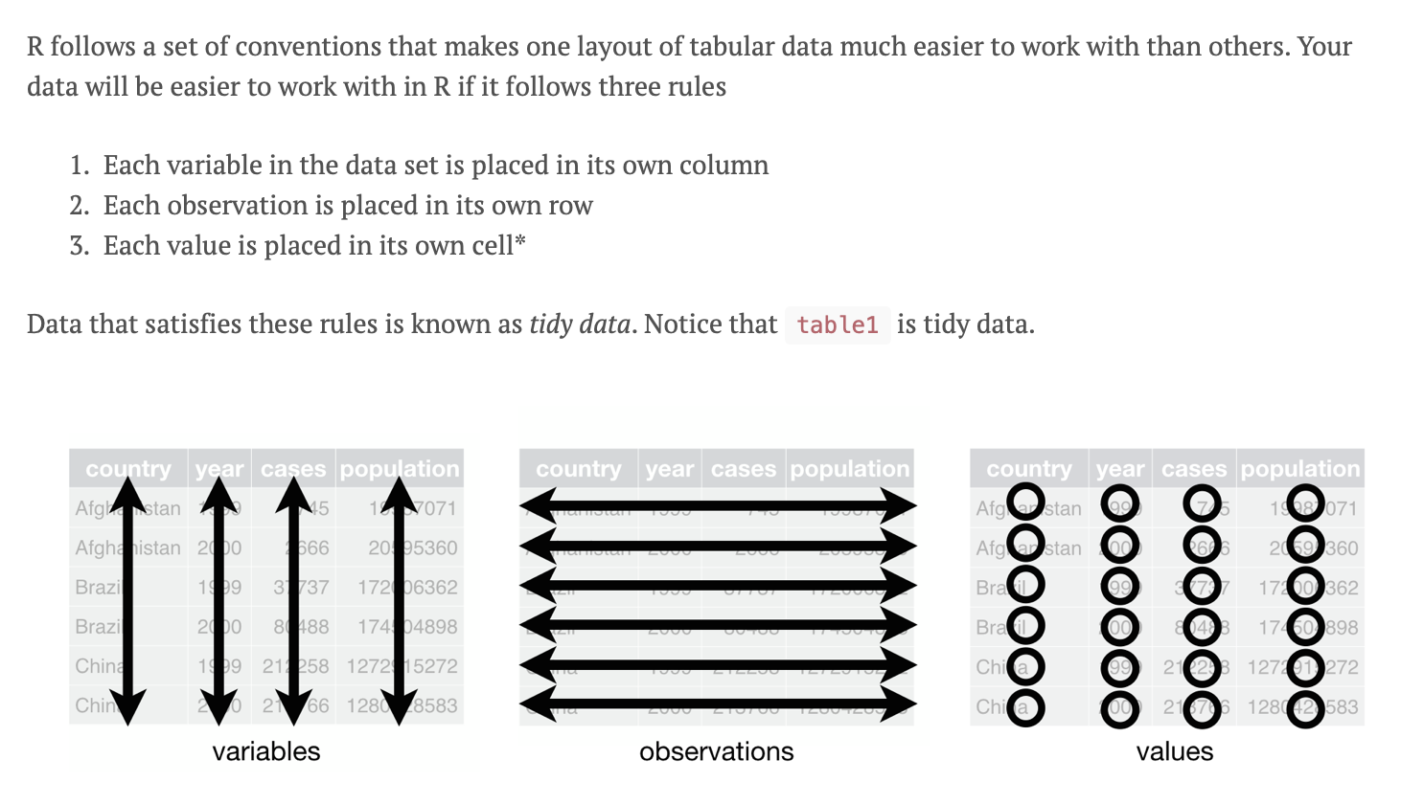
My approach (2): Tidy-R
Some intros on “tidy” data
https://garrettgman.github.io/tidying/
Tidy data builds on a premise of data science that data sets contain both values and relationships. Tidy data displays the relationships in a data set as consistently as it displays the values in a data set.

Slide 6
R Studio’s tidyverse
Uses pipes (%>%) to pass results from one step of processing to the next
purrr library: Advanced way to write loops that are more readable
tidyr library: Way to reformat input data to be “tidy”
I didn’t realize that most of my data ISN’T tidy…
dplyr: Great way to merge data.frames
bind_rows(): Binds by row two data.frames, lining up columns that match for both, and creating NA’s for those that don’t.

Slide 7
R code structure
Data import/processing function
Import raw log data in yaml format
Process imported data to create data frame for viewing
Shiny
Call function to import data and create data frame
Show data frame as table
Provide options to manipulate table in flexible ways

Slide 8
Challenges
Dealing with lists
ymal() imports into list format, need to get more familiar with it…
Getting more used to tidyverse in general
Learning to use functions in purrr(), dplyr(), etc.
Handling log items with multiple values
Would like to give station operators the freedom to write logs in the way that makes sense to them
“one value per cell” rule…
Changing current Word file into ymal format?
Hosting Shiny service on a server somewhere?

