Slide 1


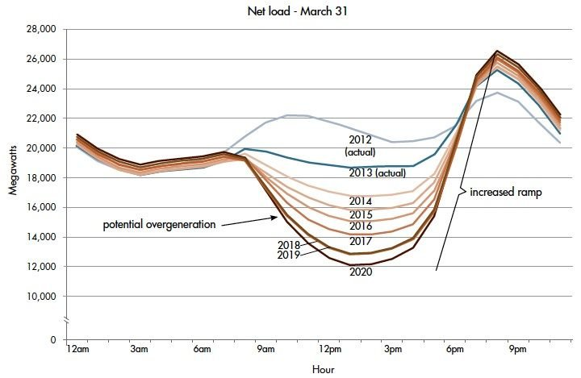
Study Committee D2
D2 INFORMATION SYSTEMS AND TELECOMUNICATION
Topics: PS2 - Cybersecurity Techniques, Technologies and Applications for Securing Critical Utility Assets
Paper ID: 10414
Securely implementing and managing neighborhood solar with storage and peer to peer transactive energy
Steven KNUDSEN[1], Subir MAJUMDER[2], Anurag K. SRIVASTAVA[2]
[1] KeyLogic Systems, Inc., [2] West Virginia University
Motivation
Reduce California ‘duck curve’ implications using neighborhood energy storage resources. See Fig. 1, to the right (Source: https://www.energy.gov/eere/articles/confronting-duck-curve-how-address-over-generation-solar-energy)
Control algorithm is needed for “peer to peer” on grid edge, with minimal control from the utility
Cost analysis also need to be performed for best possible strategies for storage integration
Need to consider different types of energy storage resources include battery electric storage systems (BESS) with lithium or vanadium redox chemistries
Customer interactions are secured based on a “zero-trust approach”
Case Study: Cost and payback data
We examine three strategies as case studies to facilitate the policymakers making the recommendation :
single home with solar power
single home with Solar power and BESS
two or more homes with solar power and community energy storage.
Table 1 shows case studies with cost-benefit analysis
Method/ Approach
Transactive energy concept where prosumers control generation and storage near the grid edge.
We utilize a peer-to-peer (P2P) transactive approach for the information sharing and optimization
The technical target of our research is a conceptual design of a DC-coupled solar + battery energy storage system (BESS) with P2P control
Discussion/Conclusion
Community storage would work particularly well in sunny locations such as California, Colorado, or Arizona
A more extensive storage system provides voltage/frequency regulation service for the neighborhood and may receive payments from the utility or market for this service
A P2P transactive energy architecture, where the neighboring customers exchange resources via a DC-coupled network while still being connected to the AC grid, has been proposed in this work
The need for DC coupling arises due to increased penetration of behind-the-meter solar PV, substantial presence of DC loads within the customer premises, and AC/DC conversion efficiency

Slide 2
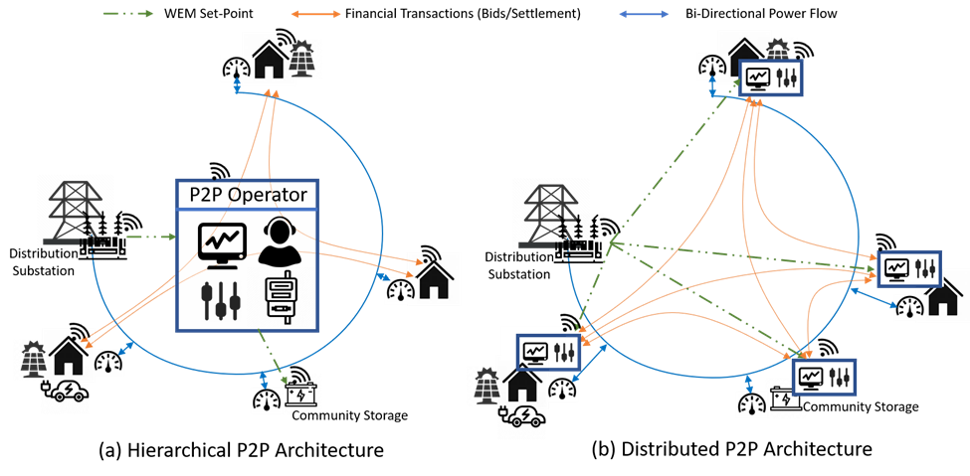
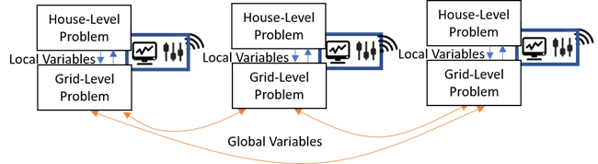
Study Committee D2
D2 INFORMATION SYSTEMS AND TELECOMUNICATION
Topics: PS2 - Cybersecurity Techniques, Technologies and Applications for Securing Critical Utility Assets
Paper ID: 10414
Securely implementing and managing neighborhood solar with storage and peer to peer transactive energy
Transactive Energy for promoting renewable energy integration
Transactive energy takes markets and negotiation to the grid edge
Consumers are now prosumers, managing their EVs, microgrids, virtual power plants (VPPs), or other assets
Residential customers, with excess resources and storage devices or share and manage storage devices at the community level among each other in an economical fashion
Multiple neighboring customers would like to interconnect their DC system due to the enormous efficiency advantages of DC-coupled systems
The grid edge can be reasonably secured due to its remoteness and relatively small scale
Optimization approaches
The grid-level problem interacts with the house-level problem through the local variables (primal and dual variables of the optimization problem)
Each of the houses comprises specific devices that require the provision of discrete set-points, while some of the devices would require continuous decision variables
House level loads could be completely isolated, if necessary. Therefore, house-level problems can be of mixed-integer problem formulation.
The homeowners (via their edge devices) should decide whether it’s acceptable for them to transfer energy over the P2P DC system or to/from the grid
Simulation (for CBA) written in C++ programming language showed how energy storage can divert energy from solar panels for later dispatch in the evening
Extended Applicability
Multiple scenarios, such as outages due to storms or cyber-attacks, with stochastic values for network connectivity, could be addressed
References
“Confronting the Duck Curve: How to Address Over-Generation of Solar Energy, https://www.energy.gov/eere/articles/confronting-duck-curve-how-address-over-generation-solar-energy, Oct. 12, 2017.
N. Atamturk, “Transactive Energy: A Surreal Vision or a Necessary and Feasible Solution to Grid Problems?” California Public Utilities Commission, Tech. Rep., 2014
Knudsen, Steven, Code repository for Solar-BESS P2P simulation, https://github.com/BarkFace/DuckCurve, initiated 1/9/2022

