Slide 1


Cyber-Power Testbed for Analyzing Distributed Control Performance during Cyber-Events
MSCPES 2022
Partha S. Sarker, Niloy Patari, Brian Ha, Subir Majumder and Anurag K. Srivastava

Slide 2
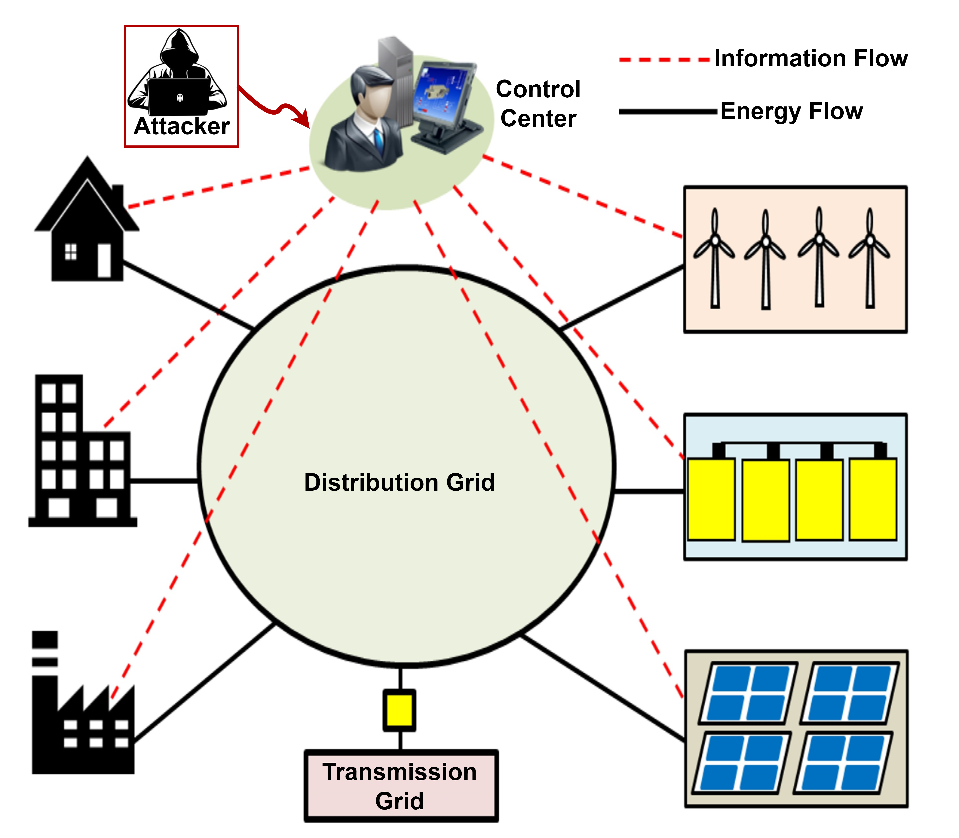
Motivations
Typical control center-based approaches pose significant coordination and scalability challenges
Centralized control center-based architecture with single-point of failure (with backup) --> Vulnerable information and communication technologies (ICTs)
Distributed controls --> Data need not be aggregated at centralized location
Distributed techniques need to be evaluated with actual ICTs based network under realistic cyber-attacks

Slide 3
Contributions
Testbed for emulating realistic cyber-power networks facilitating distributed optimization-based applications
Generic distributed coordination algorithm capable of identifying neighboring controllers -- facilitating inter-controller communication
Implemented realistic cyber-attacks (specifically, Man in the Middle and the Denial-of-Service attacks) within Mininet network emulator with the capability of attacking multiple hosts in the communication layer

Slide 4
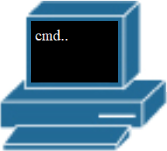
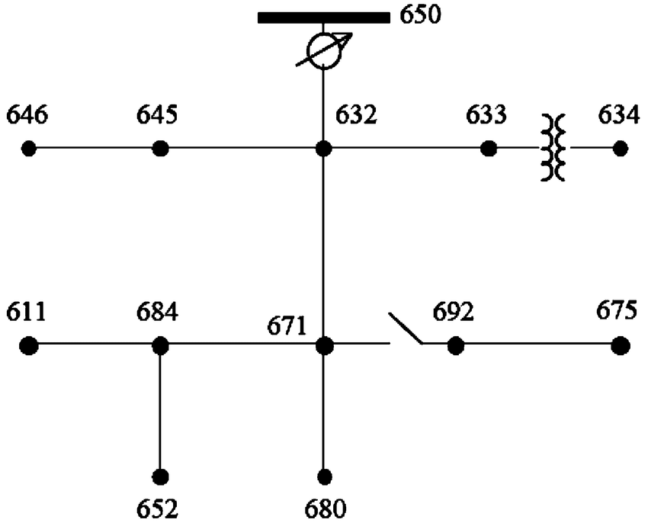
Cyber-Power Test-bed
Deployed in Mininet Hosts
Coordination Application
Distributed Optimization Application
Cyber
Attack
Application
Power System Layer : Developed with OpenDSS
h650
h646
h645
h632
h633
h634
Cyber Layer: Developed with Mininet
Python Wrapper
h611
h684
h671
h692
h675
Mininet
DERs Setpoint
Application Layer : Developed with Python
Power System Data
h652
h680
Python Wrappers binds all three layers
OpenDSS

Slide 5
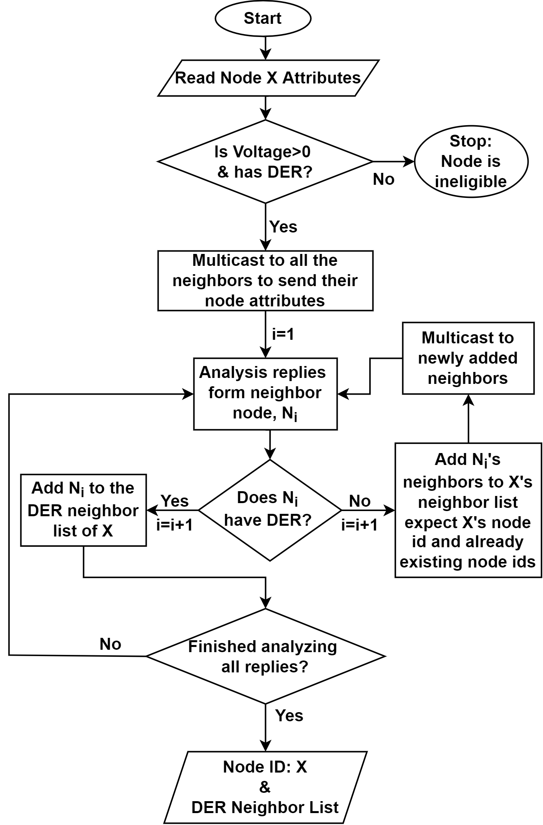

Cyber-Power Test-bed
Deployed in Mininet Hosts
Application Layer :
Coordination Application
Distributed Optimization Application
Cyber
Attack
Application
h650
Node Attributes
h646
h645
h632
h633
h634
Python Wrapper
h611
h684
h671
h692
h675
Cyber Attacks:
Man in the Middle
Denial-of-Service attack
Mininet
DERs Setpoint
Power System Data
h652
h680
OpenDSS

Slide 6
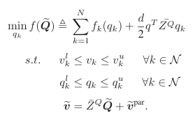
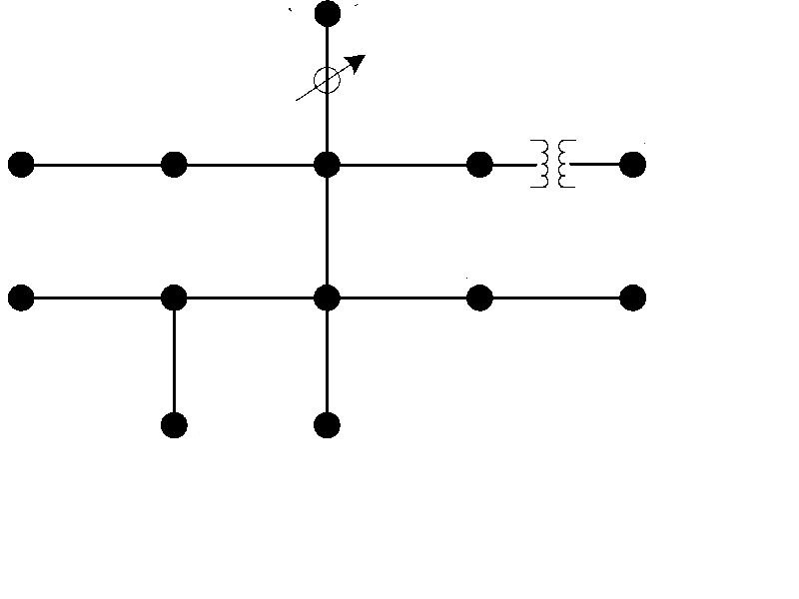



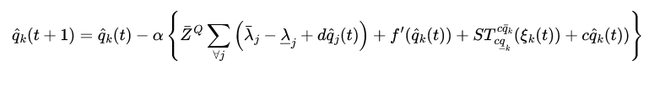
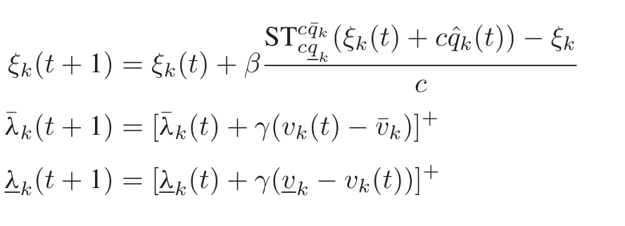
Distributed Volt-Var Optimization
Volt-VAR Optimization (VVO) Problem
Primal-Dual Method for solving the problem above
independently solves OPTDIST-VC algorithm based on modified primal-dual method for VVO

Slide 7
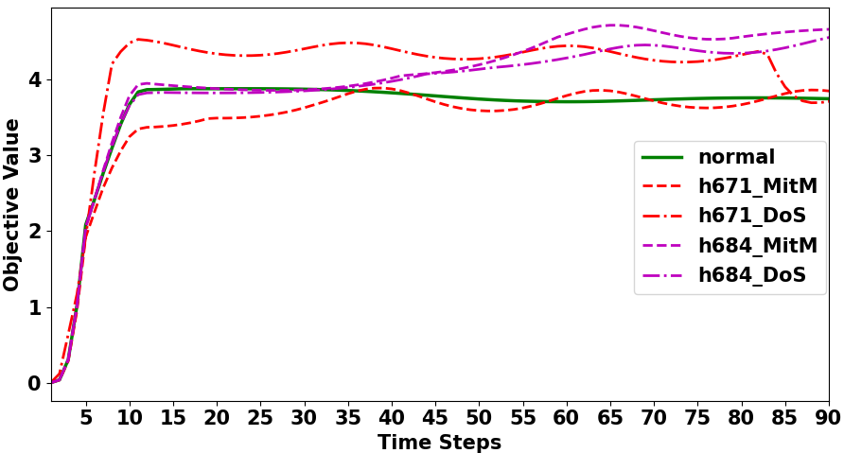
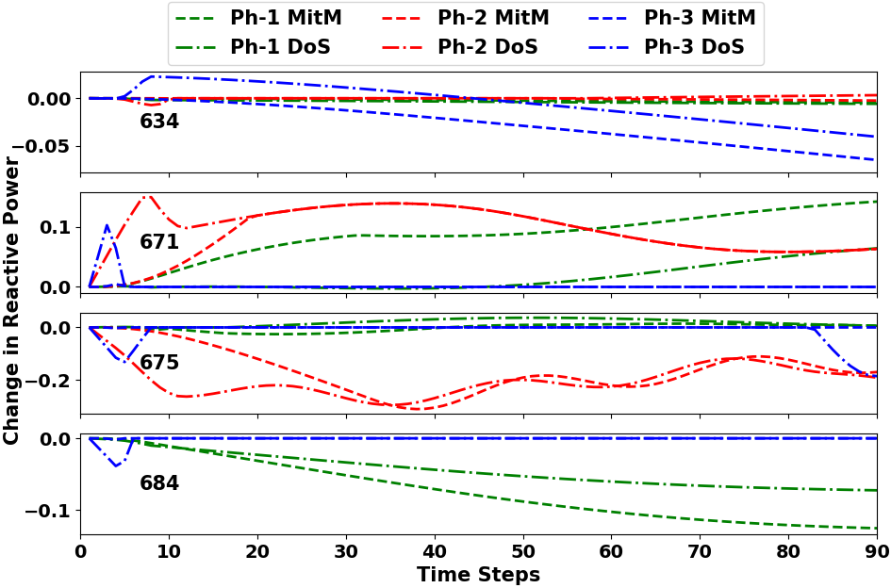
Test Cases & Results
Use case:
DERs are connected at nodes 671, 684, 675, and 634.
h634 and h671 are under attack with MitM and DoS individually.

Slide 8
Conclusions
Developed
Testbed for cyber-power system with network emulator for distributed control application.
Distributed coordination algorithm for distributed control application.
Analyzed
Performance of distributed control during different cyber-attacks.
Findings
Distributed control is not immune to cyber-attacks.
Effects of cyber-attacks on distributed volt-var control in different nodes of the distribution system.
Advantages
Developed cyber-power test-bed can be utilized to analyze the robustness of any distributed control/optimization algorithms in the event of cyber-attacks.
Comparison between centralized and distributed controllers can be done easily in this test-bed to select the most feasible controller for a given distribution system.
Distributed controllers need to be able to identify cyber-attacks and isolate rogue nodes and self-organize.
Modeled realistic cyberattacks to test performance of distributed control application

Slide 9
Acknowledgement to… Thank you & For Questions
Partha S. Sarker
Email: ps00030@mix.wvu.edu

