Slide 1



NAPS 2022
Distributed Optimization Approaches with Discrete Variables in the Power Distribution Systems
Jannatul Adan, Subir Majumder and Anurag K. Srivastava

Slide 2
Outline
Motivation
Key Challenges
Approaches for Distributed Optimization with Discrete Variables
Classification of the Distributed Discrete Approaches in Power Distribution System
Summary & Future Work
Centralized vs. Distributed
2/20

Slide 3
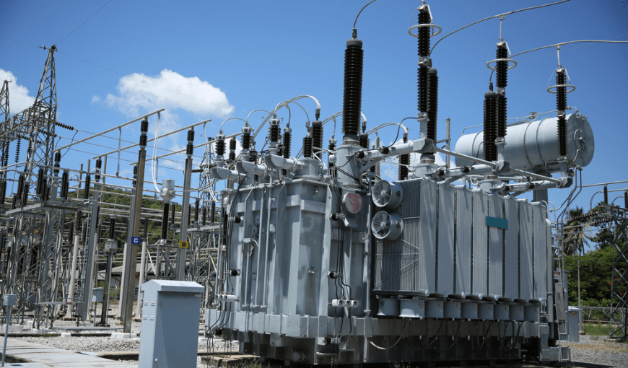
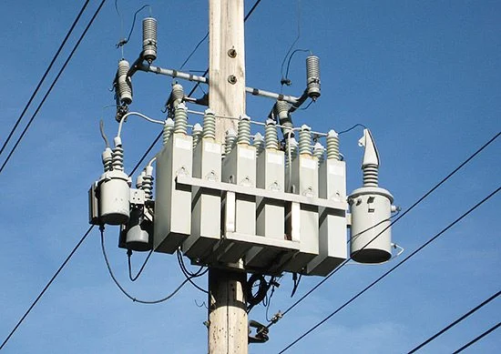
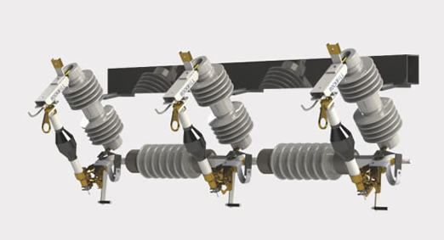
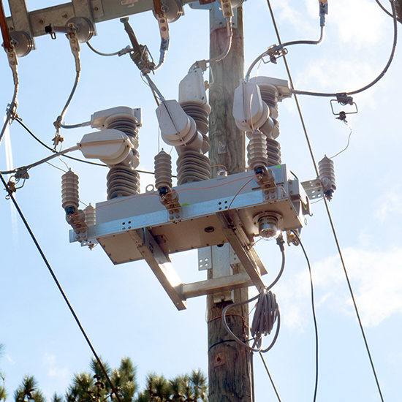
Motivations
Centralized Optimization Algorithms → single point of failure
→ scalability challenges
Distributed Approaches → resilient against single point of failure
→ improved security and scalability
Distributed Optimization Algorithm capable of handling discrete variables?
Thorough study of the existing literature on this scope?
→ Discrete Control Devices
3/20

Slide 4
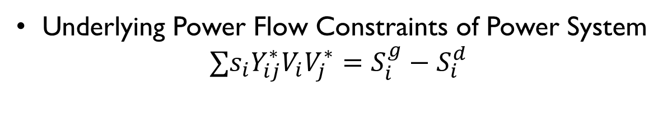
Key Challenges
Underlying Power Flow Constraints of Power System
$$∑{s_{i}Y}_{ij}^{∗}V_{i}V_{j}^{∗}=S_{i}^{g}−S_{i}^{d}$$
Non-Linear &
Non convex
Switch
status {0,1}
Network
Reconfiguration
Mixed Integer Non-Linear Problem
NP-Hard
Continuous relaxation and rounding off →guarantee convergence?
Feedback-based approaches →guarantee feasibility?
Combinatorial analysis without a central coordinator?
Lack of extensive research in this field
4/20

Slide 5


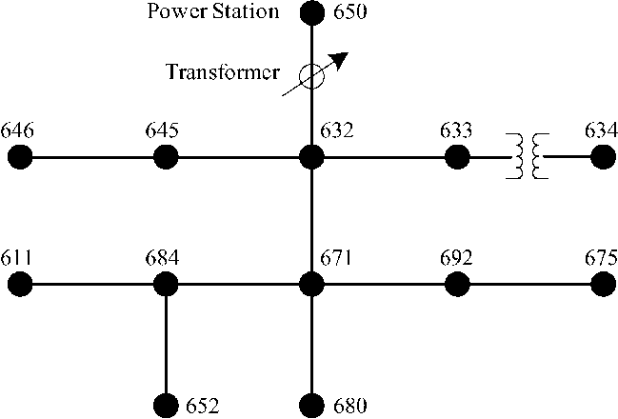
Centralized vs. distributed OPF
ADMS
5/20

Slide 6
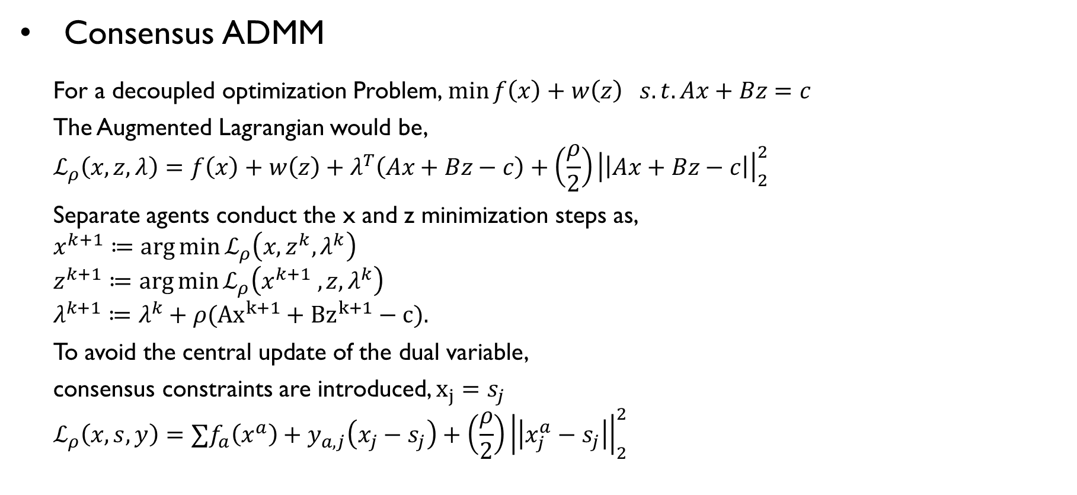
Distributed Optimization Algorithms
Consensus ADMM
For a decoupled optimization Problem,$\min{f\left(x\right)+w\left(z\right) s.t. Ax+Bz}=c$
The Augmented Lagrangian would be,
$$ℒ_{ρ}\left(x,z,λ\right)=f\left(x\right)+w\left(z\right)+λ^{T}\left(Ax+Bz−c\right)+\left(\frac{ρ}{2}\right){\left|\left|Ax+Bz−c\right|\right|}_{2}^{2}$$
Separate agents conduct the x and z minimization steps as,
$$x^{k+1}≔\arg{\min{ℒ_{ρ}\left(x,z^{k},λ^{k}\right)}}$$
$$z^{k+1}≔\arg{\min{ℒ_{ρ}\left(x^{k+1} ,z,λ^{k}\right)}}$$
$$λ^{k+1}≔λ^{k}+ρ({Ax}^{k+1}+{Bz}^{k+1}−c){.}$$
To avoid the central update of the dual variable,
consensus constraints are introduced, $x_{j}=s_{j}$
$$ℒ_{ρ}\left(x,s,y\right)=∑f_{a}\left(x^{a}\right)+y_{a,j}\left(x_{j}−s_{j}\right)+\left(\frac{ρ}{2}\right){\left|\left|x_{j}^{a}−s_{j}\right|\right|}_{2}^{2}$$
f1
S1
f2
Fig. Bipartite graph representing
Consensus Constraints
6/20

Slide 7
Approaches for Distributed Optimization
with
Discrete Variables
7/20

Slide 8
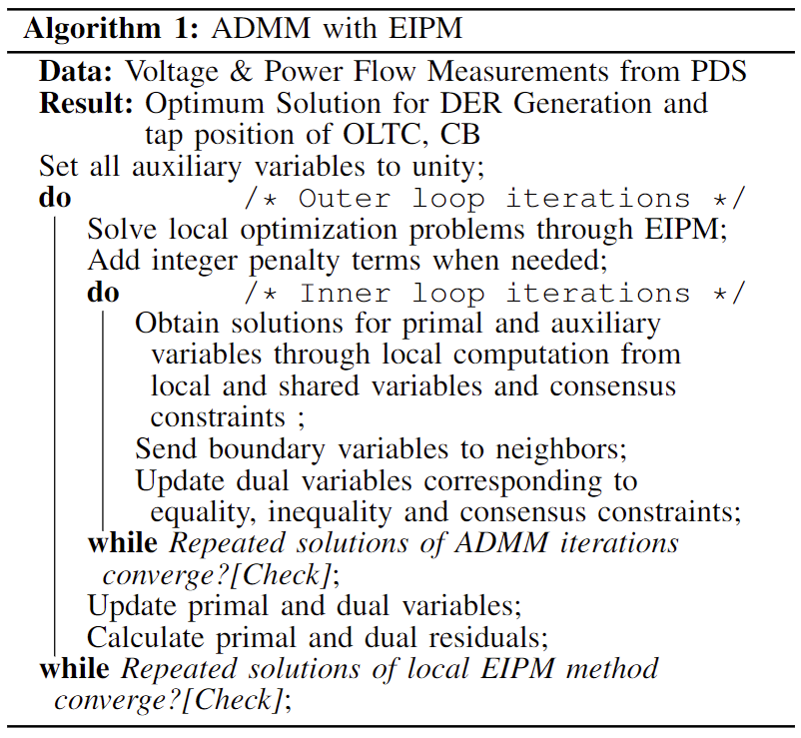
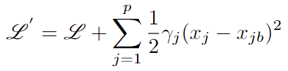



ADMM With Extended Interior Point Method
Quadratic Penalty function
Effect of Penalty term on Objective
Function Value:
Penalty
function
$$x_{b0}$$
$$x_{b1}$$
$$x_{b2}$$
8/20

Slide 9
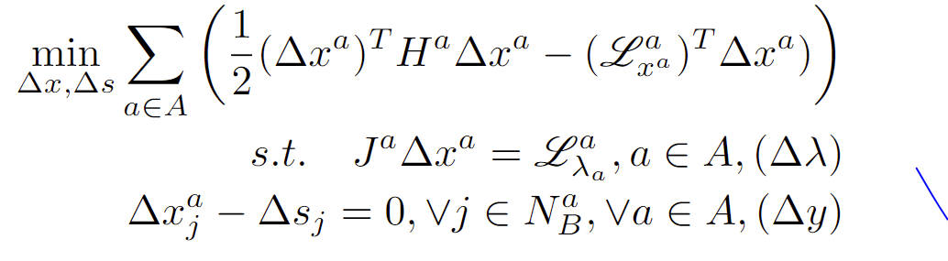
Incremental ADMM With Extended IPM
Quadratic Penalty function
Perturbing the KKT conditions & linearization result in calculating Increments in decision variables iteratively,
9/20

Slide 10
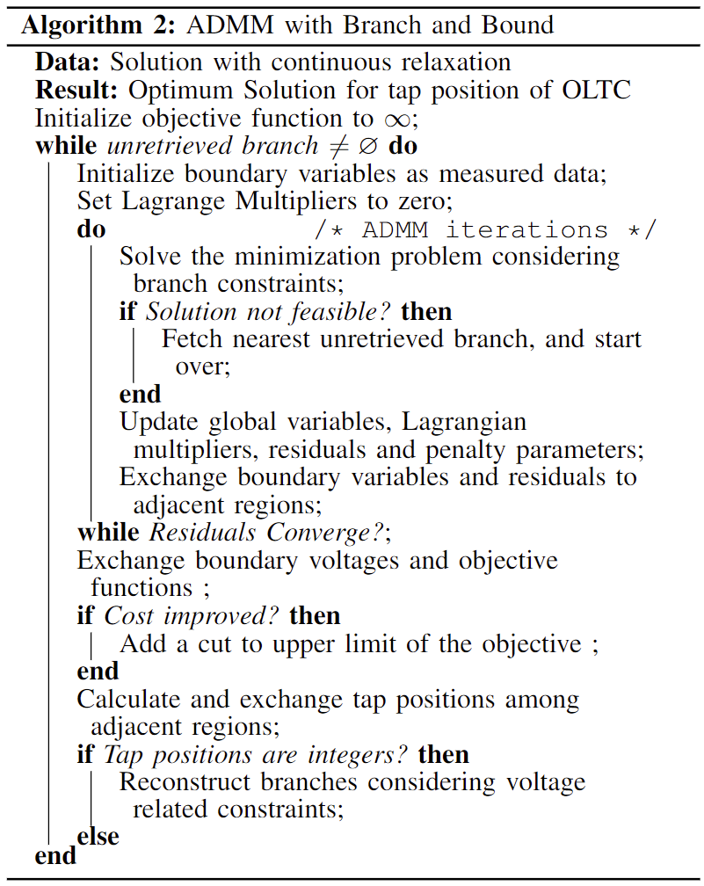
ADMM With Branch and Bound
After the Relaxed Problem Converges
Modified constraints
With Lower tap position
Modified Constraints with
Upper tap position
10/20

Slide 11
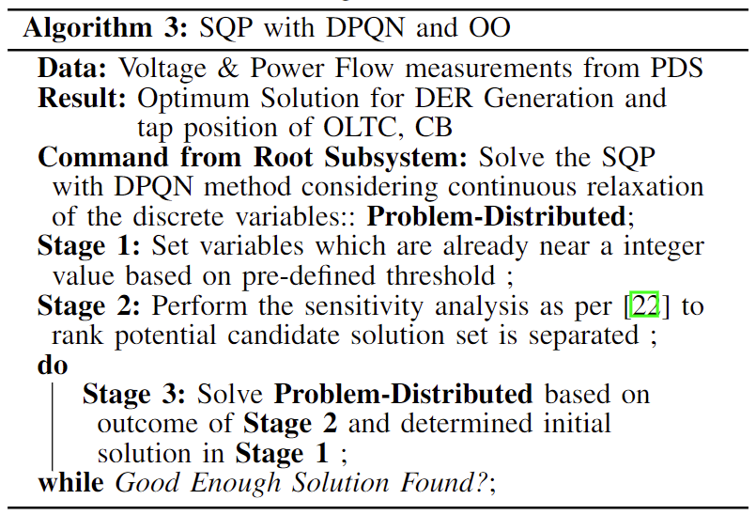
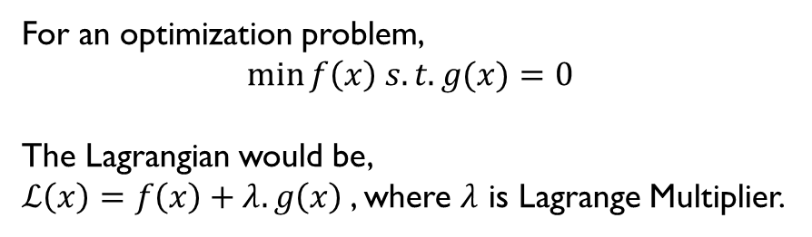
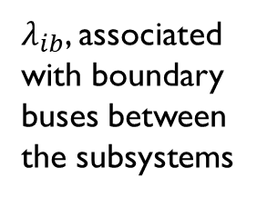
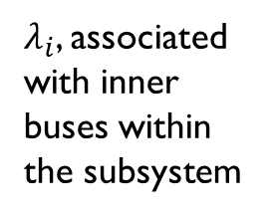
Dual Decomposition with Sqp & Ordinal optimization
For an optimization problem,
$$\min{f\left(x\right) s.t. g(x)}=0$$
The Lagrangian would be,
$ℒ\left(x\right)=f\left(x\right)+λ.g\left(x\right)$, where $λ$ is Lagrange Multiplier.
$λ_{i}$, associated with inner buses within the subsystem
$λ_{ib}$, associated with boundary buses between the subsystems
Iterative update of the relaxed problem
Shared between subsystems
11/20

Slide 12
How Network Reconfiguration works?
Closed Switch
Open swtch
DER
DER
DER
Fig. Under Normal Operating Conditions
12/20

Slide 13
How Network Reconfiguration works?
DER
DER
DER
Fig. Power System Fault Situation
13/20

Slide 14
How Network Reconfiguration works?
DER
Unfaulted but Without power Supply
DER
DER
Fig. After Clearing Fault
14/20

Slide 15
How Network Reconfiguration works?
DER
MG
DER
DER
Fig. Restored Network
15/20

Slide 16
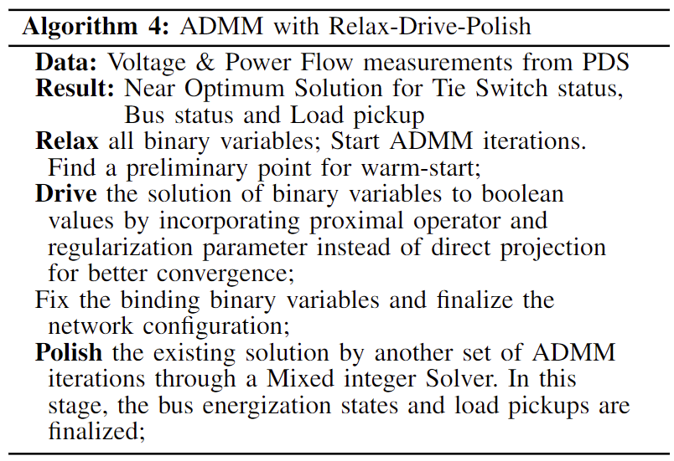




ADMM With Relax drive polish
Aim: Distribution Service Restoration part of FLISR
Radiality Constraints for maintaining Radiality during reconfiguration
Auxiliary variables : corresponding to the radiality constraints → shared variables among neighboring subsystems
$$x_{3}$$
i=o=
i=0, warm start
i>0
$$x_{2}$$
i$→∞, Boolean Solution$
$$x_{1}$$
Fig. Drive Phase
16/20

Slide 17
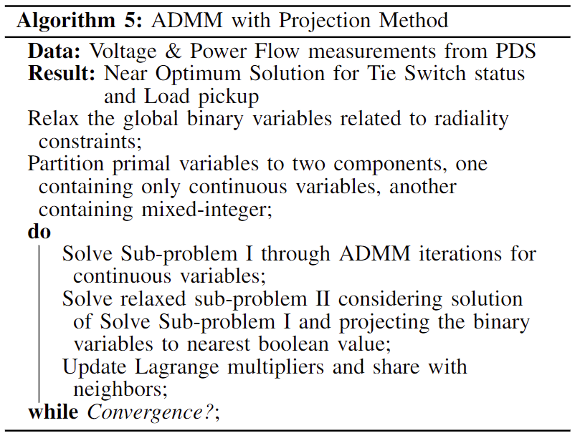
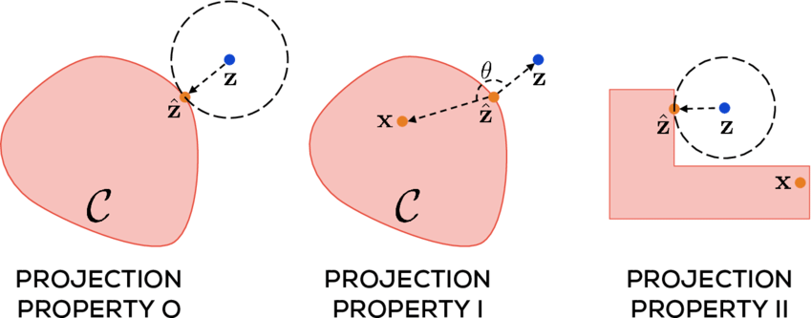
ADMM With projection method
Aim: Distribution Service Restoration part of FLISR
Radiality Constraints for maintaining Radiality during reconfiguration
Auxiliary variables : corresponding to the radiality constraints → shared variables among neighboring subsystems
Fig. Depiction of Projection Method
17/20

Slide 18
Classification OF THE distributed discrete APPROACHES in power distribution system
App- roach | Problem Specifi-cation | Objective Function (minimizing) | Discrete Algorithm | Distributed Algorithm | Boundary Variables | Comm. Require-ment | Decision Variables | Comments
A | MINLP | CoE, Loss | Quadratic penalty term for non Integer values | ADMM | Auxiliary variables representing the real and imaginary part of voltages at the boundary buses | Neighbor agents only | OLTC Tap, Cap bank Switching | – May diverge due to nonconvexity.
B | MIQP | CoE, Loss | Quadratic penalty for non integer values for Increments | ADMM | Auxiliary variables representing the increments in real & imaginary part of voltages at boundary buses | Neighbor agents only | OLTC Tap, Cap bank Switching | - Convergence guarantee with ADMM. Better privacy due to only sharing the incremental values.
C | MISOCP & Cutting Planes | Active power curtailment cost, System Loss | Branch and Bound | ADMM | Tie-line PQ, primal & dual residual, boundary node V, objective value of up & downstream region, SVR tap | Neighbor agents & Root system | OLTC Tap | - Optimality and convergence guaranteed. Capacitor bank position not considered.
D | MIQP | CoE, Loss | Ordinal Optimization | Dual Decom-position | Lagrange Multipliers associated with boundary buses | Neighbor agents & Root system | OLTC Tap, Cap bank switching | - Root Subsystem needed. Sub-optimal but good enough solution. No convergence guaranteed.
E | MICP with Linearized constraint | Unrestored Load After Outage, Change in network topology | Proximal Operator With Projection | ADMM | Tie Line P & Q, Boundary Node voltage, Lagrange Multipliers associated with boundary buses variables for radiality | Neighbor agents only | Tie-switch Status, Load pickup, Bus Status | -Inner Binary Variables are determined by MICP solver – Convergence relies on ADMM Parameter
F | MISOCP | CoE, De-energized Zone, Loss, load Shed, change in network topology | Relaxed and then Projected | ADMM | Tie Line PQ, Boundary Node V, Lagrange Multipliers associated with boundary bus variables for radiality | Neighbor agents only | Tie-switch status, Load pickup | – Direct projection may fluctuate convergence – convergence is not guaranteed
18/20

Slide 19
Summary & Need
Existing methodologies to solve OPF involving discrete variable in a distributed way
Some approaches need more boundary information to be shared → increases communication burden
Can we develop a Standardized way of incorporating different discrete variables?
Can we make the algorithms robust to cyber and communication uncertainties?
Can we utilize Distributed discrete Optimization techniques in other engineering applications for implementation in Power System Domain
19/20

Slide 20
Acknowledgement to
DOE UI-Assist, NSF CPS and Conference Organizers
Thank you & For Questions
Jannatul Adan
Email: ja00060@mix.wvu.edu

