Slide 1

DFT-based sizing of battery storage devices to determine day-ahead minimum variability injection dispatch with renewable energy resources
Paper No: 18PESGM0466
Subir Majumder
Indian Institute of Technology Bombay
subirmajumder@iitb.ac.in
Notes:
Good afternoon everyone.
I am Subir Majumder.
I will be presenting our transaction paper entitled ‘DFT-based sizing of battery storage devices to determine day-ahead minimum variability injection dispatch with renewable energy resources”
In case you have any specific question, you can reach me at the mentioned email address.

Slide 2
Background
With storage devices, renewable energy generators can behave as constant generation base-load plant
Sizing is based on historical dataset
Multiple types of storage devices for bulk energy storage in conjunction is well established
low-frequency component to be associated with finite cycle batteries
Large life-cycle battery to be used in conjunction with high-frequency component
Battery mix will be cost-effective
DFT-IDFT and the cut-off frequency segregates high and low frequency components within a dataset

Slide 3
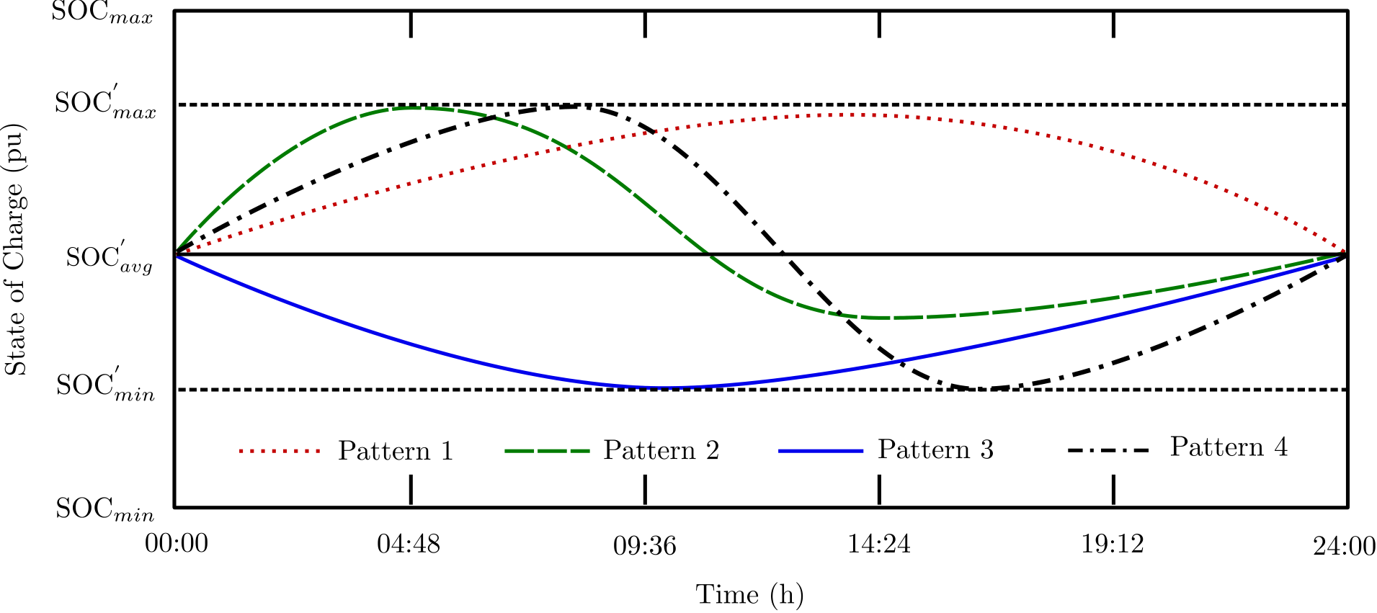
Calculation of sizing of Converters and Batteries
Days are randomly sampled
The objective is to minimize the squared sum of injection of variability, while total energy stored into a battery in a day is zero
Sizing conforms to ‘throughput’, ‘C-rate’, and ‘depth of discharge cycle’ limits
Rating of the converter will be absolute maximum of the battery output
A two battery model is applied for sizing
Throughput: Factor to account for asymmetric cycles
C-rate: Current drawn from each of the module
Depth of discharge cycle: Account for capacity degradation
**Impact of limited transmission corridor is not considered
Different SOC profiles to demonstrate the requirement
of two-battery model

Slide 4

Problem Formulation
Annualization factor
Statistically calculated based on historical data
Capacity cost
Cost of batteries
Cost of converters
Selection of storage type
Capacity cost
Cut-off frequency
Battery type
Capacity rating of components
Power rating
Annualization factor
High and low frequency component
Discount rate
Physical life of battery
Approximation is obtained considering
Constant for a given Z
Throughput factor of battery S
Cut-off frequency is varied iteratively according to mode-pursuing sampling method to calculate the total annualized cost
Two different batteries of different unit cost and throughput rating are considered, and can be associated to any of the high and low frequency component, the binary variable accounts for that

Slide 5
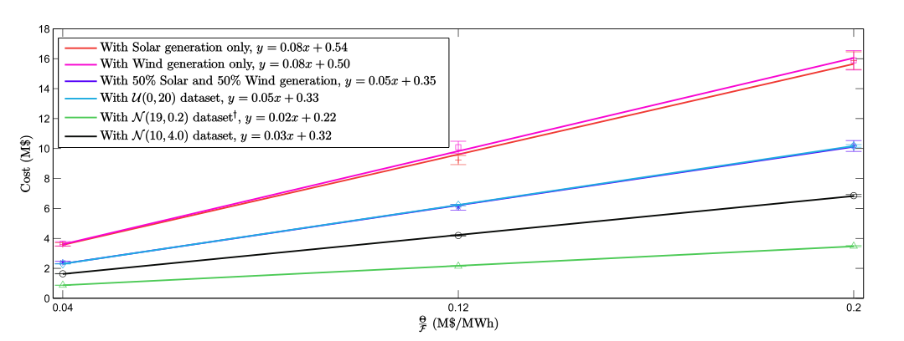
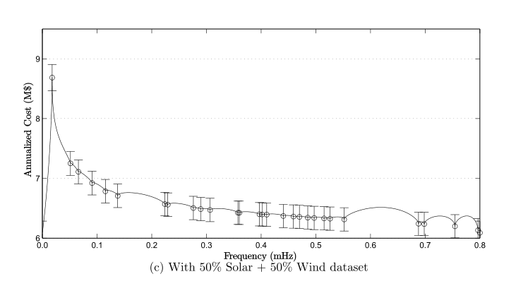
Optimal sizing of BSD
Impact of unit cost to throughput factor on annualized
planning cost
Variation in annualized cost at different cut-off frequency for minimum variability injection
For minimization of total investment cost with multiple available BSDs, a storage device with minimum ‘unit cost to throughput factor’ ratio will only participate into the optimal mix independent of high or low frequency segment.
Total cost linearly increases with increasing capacity rating
Multiple BSDs in conjunction need not result in most economic planning
Residual SOC level need not remain at 0.5
Sizing requirement increases with increasing variability within the dataset

Slide 6
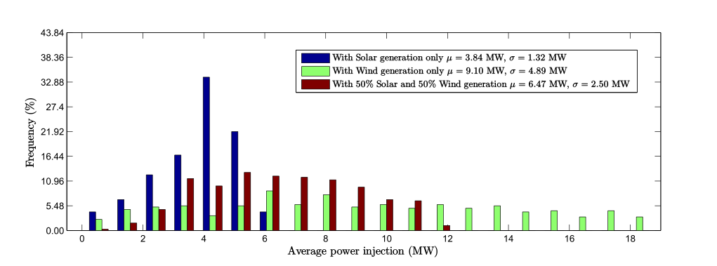
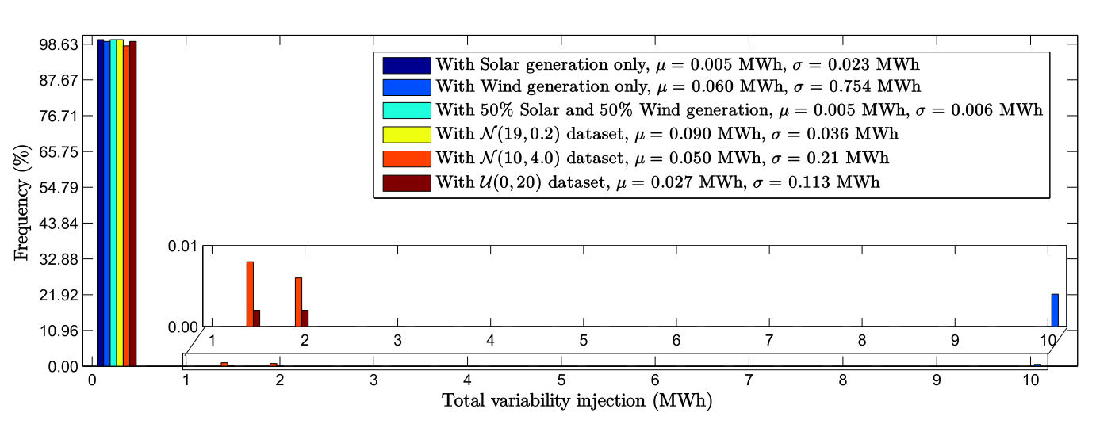
Impact of 3σ sizing on operation
Statistical Average daily power injection
Statistical Average daily variability injection
Average daily injection of variability is negligible; but,
Randomness within the historical data derives average daily injection for a day
Negligible smaller moment within the historical data implies negligible sizing requirement
Given historical solar generation data follows a given pattern, compared to wind generation data, daily solar injection from solar-battery combination is much smaller
Comparing solar and wind plant of given capacity, lower capacity factor of solar plant will result into lower average injection
RE-mix performs well compared to both solar only and wind only operation

Slide 7
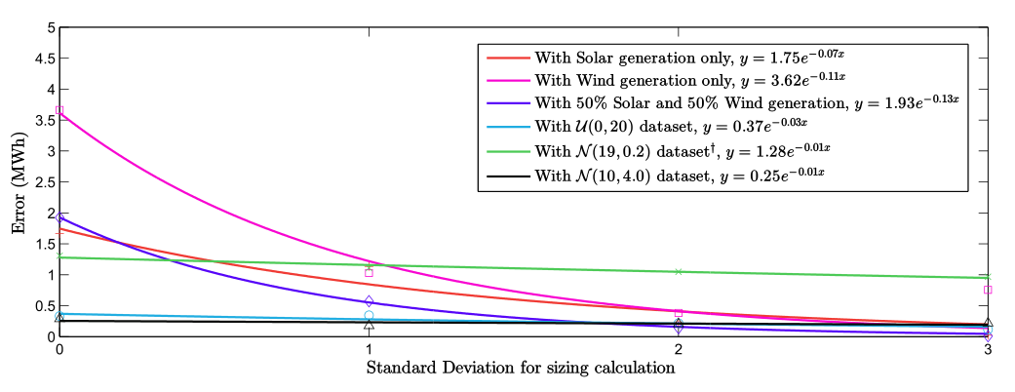
Impact of statistical significance
Injection of variability with increasing statistical significance
Total daily variability injection is exponentially decreasing with increasing statistical significance
A proportional increase in the planning cost will incur an exponential reduction in the daily injection of variability
The statistical significance itself can be a criterion to study the economic feasibility

Slide 8
Conclusions/Recommendations
In all the studied scenarios, MPS show that the cut-off frequency for the minimum cost is located at either of the extreme
Mathematical analysis (with necessary simplification), and simulation shows batteries based ‘cost to throughput factor’ minimizes cost
‘Cost to throughput factor’ has no-impact on optimal cut-off frequency; so, batteries can be replaced with the one with least ‘cost to throughput factor’ called “pay-as-you-go” plan
Asymmetry in charging and discharging cycle will result into residual state of charge not at 50%
Storage devices with different characteristics such as different self discharge rate may impact sizing

