Slide 1


Optimal Voltage Sag Mitigation Solution Provision using Customers Approximate Marginal Willingness-to-Pay Function
Subir Majumder
Indian Institute of Technology Bombay
subirmajumder@iitb.ac.in

Slide 2
Challenges
Existing Approach:
  Sag distribution (either through Monte-Carlo, or, multiyear PQ-analysis)
  Extensive insitu PQ-analysis to derive detailed plant model
  Obtain overall loss curve → combining sag-distribution and detailed plant model
Consequently, sag-related loss determination is simulation driven
Proposed approach:
  We replace sag distribution determining a generic PDF
  Plant model is replaced by an approximated linear model
  Overall loss curve is found to be quadratic → Marginal willingness to pay linearly decreasing
Proposed loss curve would supplement detailed model through primitive cost estimation

Slide 3
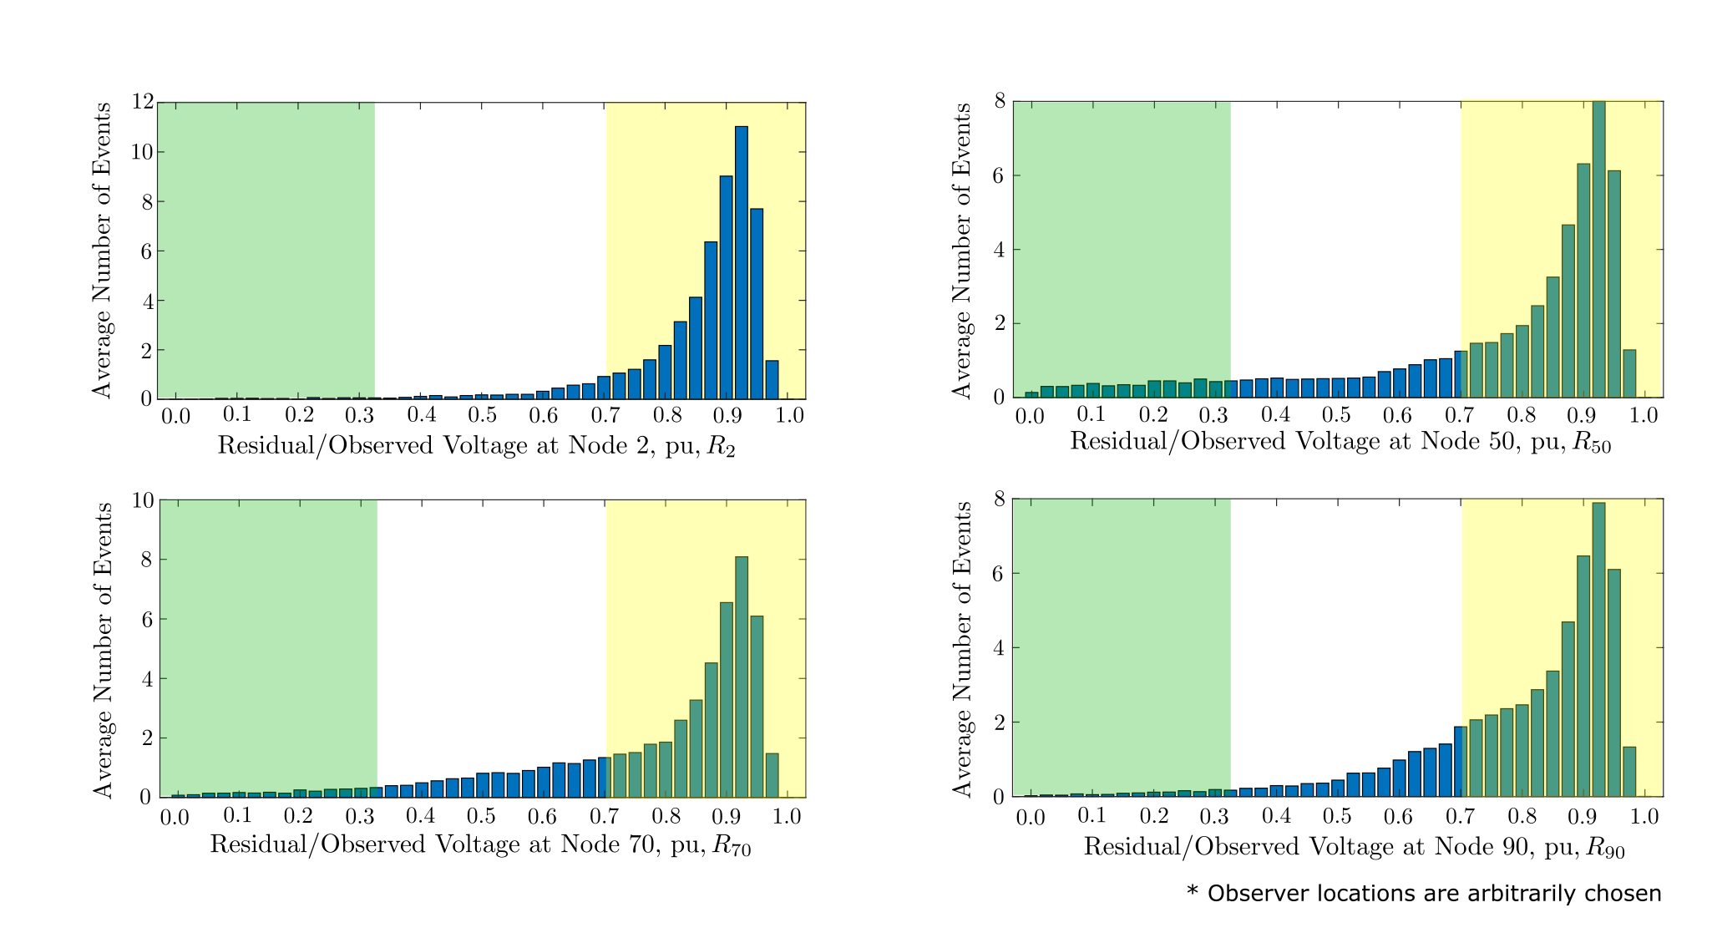
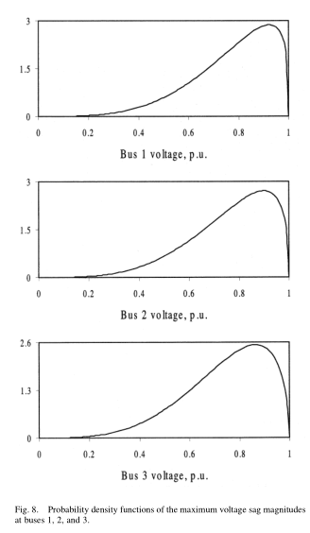
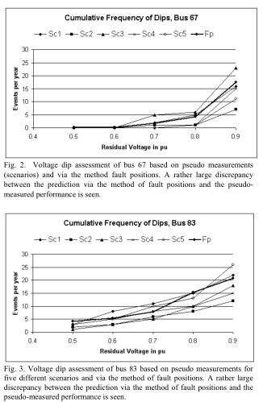
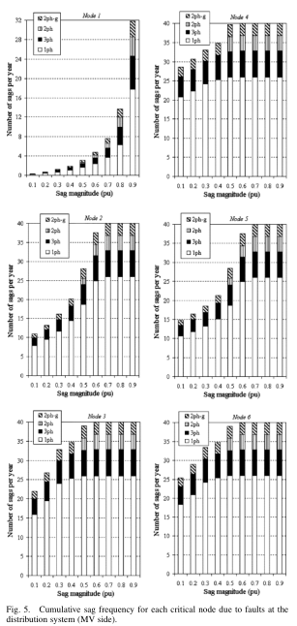
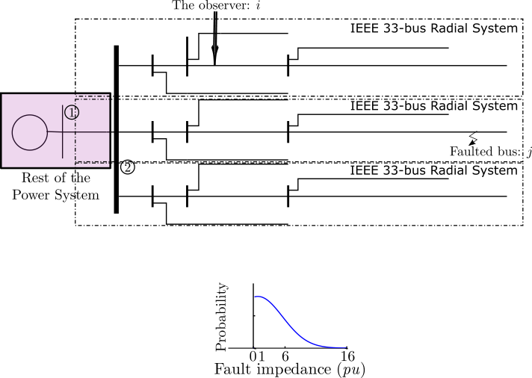
Dropped Voltage Statistics
We considered a 98-bus modified IEEE distribution network for sag statistics
We assumed a truncated normally distributed fault impedance
1. S. O. Faried and S. Aboreshaid, “Stochastic evaluation of voltage sags in series capacitor compensated radial distribution systems,” IEEE Trans. Power Del., vol. 18, no. 3, pp. 744–750, Jul. 2003.
2. G. Olguin, D. Karlsson and R. Leborgne, "Stochastic assessment of voltage dips (Sags): The method of fault positions versus a Monte Carlo simulation approach," 2005 IEEE Russia Power Tech, 2005, pp. 1-7
3. M. N. Moschakis and N. D. Hatziargyriou, "Analytical calculation and stochastic assessment of voltage sags," in IEEE Transactions on Power Delivery, vol. 21, no. 3, pp. 1727-1734, July 2006

Slide 4
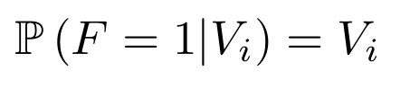
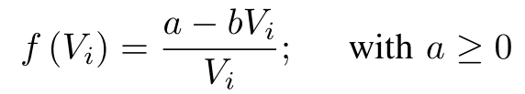
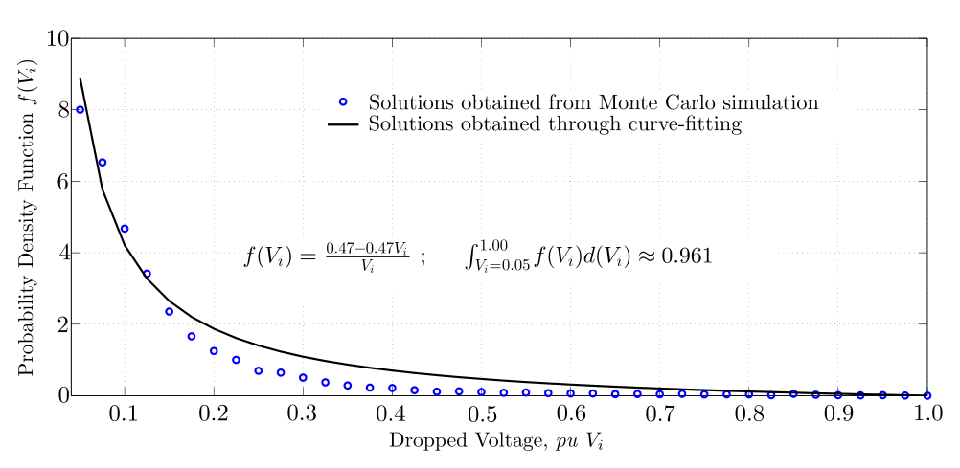
PDFs of Dropped Voltage and Process Failure
Rational approximant has been considered for deriving PDF of the dropped voltage
We use kernel density estimation to obtain the PDF of dropped voltage
Considered linearly increasing process failure probability curves
Ignored sag duration, the point-on-wave, etc., (all of these are known to impact process failure) for simplicity

Slide 5
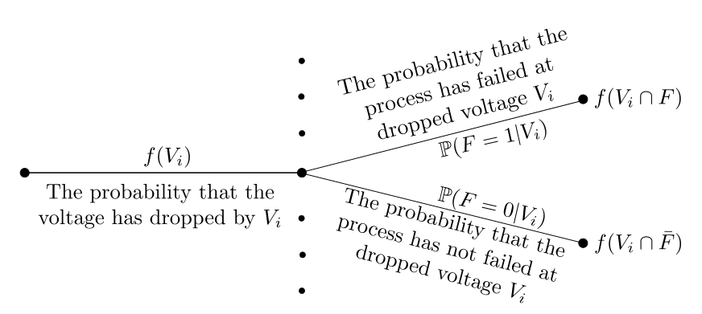
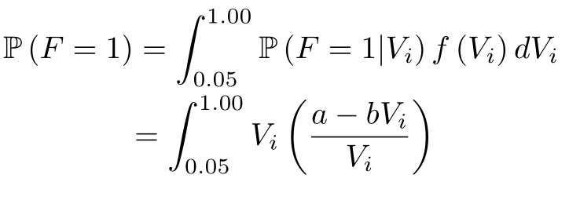
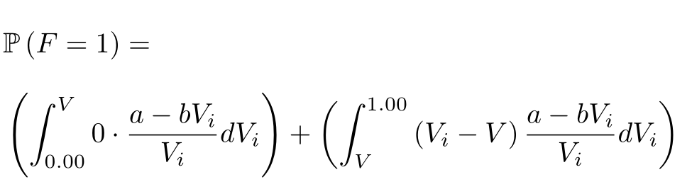
Willingness-to-Pay Calculation
Within mitigation devices capability, processes won’t experience any sags, beyond which failure rate will be proportional to observed voltage
Without Mitigation Solution:
With Mitigation Solution:
Average
Cost of
Failure
Discounted
Future Values
Number of
Events/year
Cost of
Interruption
Probability of
Interruption
=
×
×
×

Slide 6

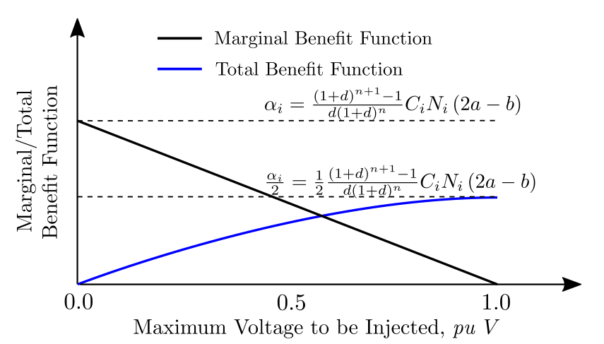
Derived Willingness-to-Pay
(average) Benefit function = Willingness to pay
Marginal WIP:
Benefit functions with multiple customers are additive → Marginal WIP is obtained by summing up constant part of the WIPs
Benefit function is undefined beyond [0,1]

Slide 7
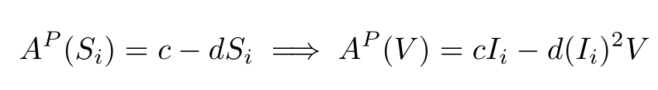
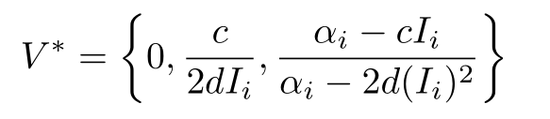
Example: With DVRs
Average cost:
Average cost is non-decreasing and non-negative within operating range*
Given the cost and benefit function, we have four conditions → Optimal mitigation resource provision will be:
Theorem: Optimal mitigation resource provision (V) is decreasing with increasing plant capacity.
* K. Habur and D. O’Leary, “FACTS — For cost effective and reliable transmission of electrical energy,” Tech. Rep., 2004.

Slide 8
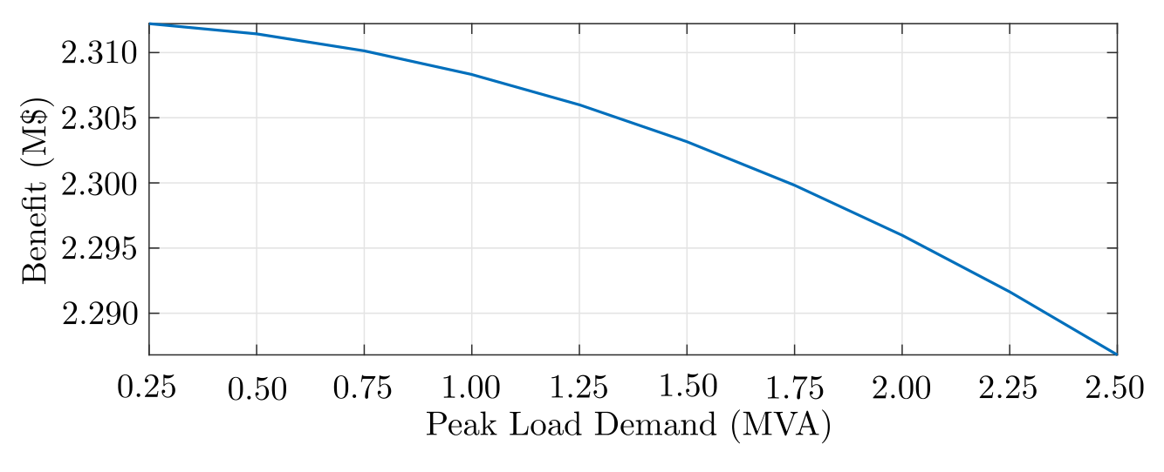
Example: With DVRs (Contd.)
Customer’s lifetime benefit with 0.75 MVAp demand is $2.31M
Two customers, each of 0.75 MVAp contributes with similar benefit function → lifetime benefit = $2.3102M
This couples with decreasing cost function
Benefits from such symbiotic behavior exists.
Benefit is common for multiple customer → Free-Riding Behavior exists!

Slide 9
Conclusion
Derived a rudimentary mathematical expression of the customer’s willingness-to-pay with respect to the maximum voltage injected from the mitigation devices
Described linearly decreasing characteristic of the willingness-to-pay function
The derived expression has been utilized to determine a mathematical expression of the optimal mitigation solution requirement
Increasing individual benefits and the decreasing cost in a collaborative setting is expected to incentivize the customers to behave symbiotically
Proposed mathematical expression has been utilized in our earlier research to distribute the utility in a collaborative setting where customers are unwilling to free-ride
Notes:
Fig. Cluster_DVR_B

Slide 10
References
Y. Zhang and J. V. Milanovic, “Global voltage sag mitigation with facts-based devices,” IEEE Trans. Power Del., vol. 25, no. 4, pp. 2842–2850, 2010.
S. O. Faried and S. Aboreshaid, “Stochastic evaluation of voltage sags in series capacitor compensated radial distribution systems,” IEEE Trans. Power Del., vol. 18, no. 3, pp. 744–750, Jul. 2003.
G. Olguin, D. Karlsson, and R. Leborgne, “Stochastic assessment of voltage dips (Sags): The method of fault positions versus a Monte Carlo simulation approach,” in 2005 IEEE Russia Power Tech, Jun. 2005, pp. 1–7.
M. N. Moschakis and N. D. Hatziargyriou, “Analytical calculation and stochastic assessment of voltage sags,” IEEE Trans. Power Deliver., vol. 21, no. 3, pp. 1727–1734, 2006.
K. Habur and D. O’Leary, “FACTS — For cost effective and reliable transmission of electrical energy,” Tech. Rep., 2004.
S. Majumder, S. A. Khaparde, V. Pradhan, S. V. Kulkarni, A. P. Agalgaonkar, S. Perera, and P. Ciufo, “A critical review on the methods for calculating the risk of process failure because of voltage sags,” in 2016 IEEE International Conference on Power System Technology (POWERCON), Sep. 2016, pp. 1–6.
S. Majumder, A. P. Agalgaonkar, S. A. Khaparde, P. P. Ciufo, S. Perera, and S. V. Kulkarni, “Allocation of common-pool resources in an unmonitored open system,” IEEE Trans. Power Syst., pp. 3912–3920, Sep. 2019.
S. Majumder, S. A. Khaparde, A. P. Agalgaonkar, S. V. Kulkarni, and S. Perera, “Graph theory based voltage sag mitigation cluster formation utilizing dynamic voltage restorers in radial distribution networks,” IEEE Trans. Power Deliv., Dec. 2020, [Early Access].
Notes:
Fig. Cluster_DVR_B

Slide 11
QUESTIONS ?
Thank You

