Slide 1
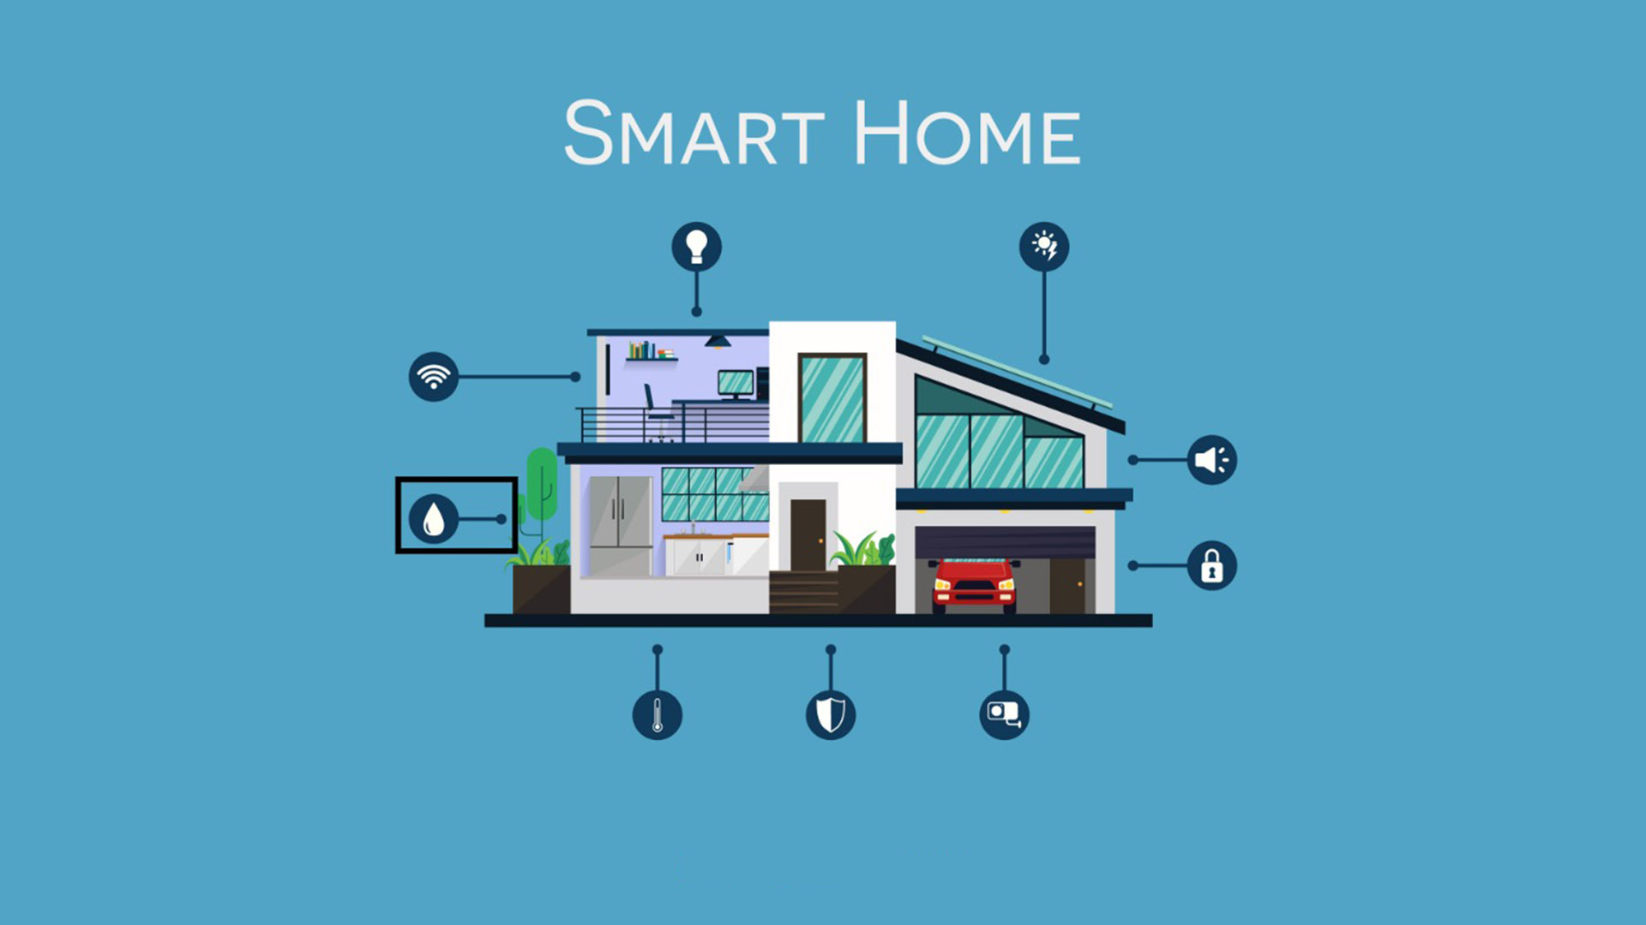
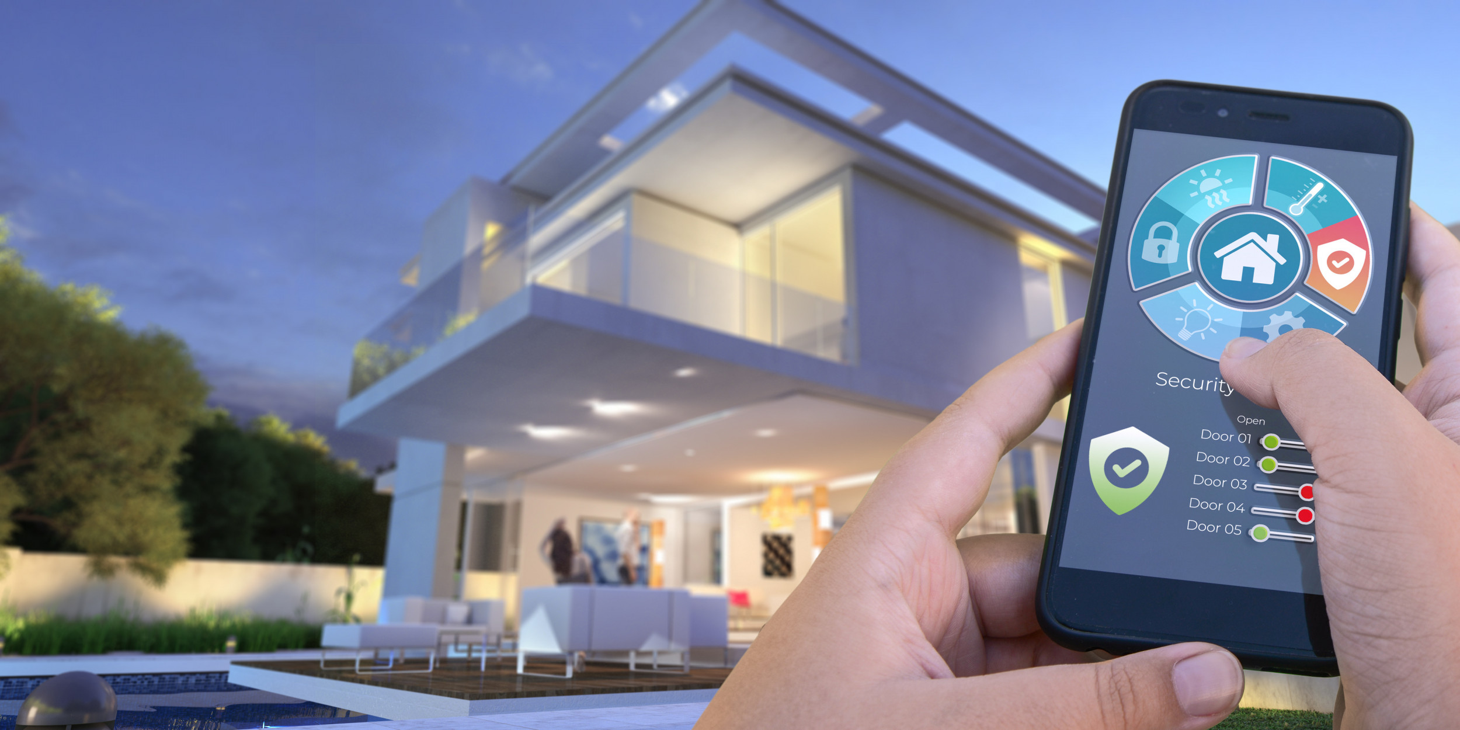
Smart Home
Group6
Su Myat Myat Htay (p2234951)
Ei Kyar Phyu (p2235105)

Slide 2
Agenda
1
2
3
4
5
Problem
Statement
+
Ideal Solution
Smart Lock
Air Conditioner Usage Tracker
Conclusion
Live Demo

Slide 3
Problem Statement
Energy Inefficiency
Home Security Vulnerabilities

Slide 4
Solutions
Smart Lock
Air Conditioner Usage Tracker

Slide 5
Smart Lock

Slide 6
Features
Face Detection
Keypad and LCD Display
Buzzer
Light symbolizing door opening

Slide 7
Face Detection
How Does It Work?

Slide 8
How does it work?
Take Photo and put it into the database
Train the model once you put photos inside database
Open camera and detect face once they enter the wrong password for 3 times in a row

Slide 9
Keypad and LCD Display
How Does It Work?

Slide 10
How does it work?
Enter the password to open the door lock.
Can change the Password
Check the password that you set up to open the door lock

Slide 11
Buzzer and Light Symbolizing
How Does It Work?

Slide 12
How does it work?
Buzzer On once they enter the wrong password
Light On Once they enter the correct password

Slide 13
Flow Of Security Lock

Slide 14
Flow Of Security Lock
Enter the password
If the password is correct, the light will on
If the password is incorrect, the buzzer is on
3 incorrect passwords in a row will open the camera
If, unknown detected, it will take photo

Slide 15
Before Using

Slide 16
Before Using
Take photo and put it inside the database
Can either take photo or import photo inside
Train the model once they put the new users in

Slide 17
Air Conditioner Usage Tracker

Slide 18
Features
Can control air conditioners through the website, even when the users are not physically present
Adjustable Desired Usage Limit
Show total usage time and remaining time
Notify via telegram when the total usage has reached the desired usage limit

Slide 19
How to implement?
Build website by importing flask
Use LED as air con and user can open or close LED through website
All the data is stored in csv files to track total usage time and calculate the remaining time
For notification, I made new bot in telegram and tried to get token and chat ID. And I send notification via telegram by importing requests.

Slide 20
Conclusion
The features are user-friendly and offer numerous benefits for homeowners
By using them, homeowners can create a more convenient, efficient, and secure living environment.

Slide 21
Thank You

