Slide 1

UNDERSTANDING OF CAUSAL INFERENCE
PROJECT TITLE:
The causal effect of Multi-Level Treatment of intervention using observational data

Slide 2
CAUSAL INFERENCE
Inferring the effects of any treatment/policy/intervention
Example:
Effect of treatment on a disease.
Effect of climate change policy on emission.
Effect of social media on mental health.
Aspirin's effect on headaches.

Slide 3
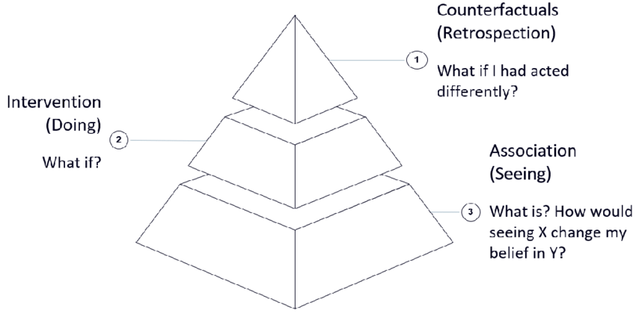

THREE LAYER CAUSAL HIERARCHY
The three Layer Causal Hierarchy
Association : P( y|x )
Intervention : P( y|do(x) , z)
Counterfactuals : P($y_{x}$| x’, y’)

Slide 4
THREE LAYER CAUSAL HIERARCHY
LEVEL | TYPICAL ACTIVITY | TYPICAL QUESTIONS | EXAMPLES
ASSOCIATION | Seeing | What is? How would seeing X change my belief in Y? | What does a symptom tell me about a disease? What does a survey tell us about the election results?
INTERVENTION | Doing | What if? What if I do X? | What if I take aspirin, will my headache be cured? What if we ban cigarettes?
COUNTERFACTUALS | Imagining, Retrospection | Why? Was it X that caused Y? What if I had acted differently | Was it the aspirin that stopped my headache? Would Kennedy have been alive had Oswald not shot him? What if I had not been smoking the past 2 years?

Slide 5
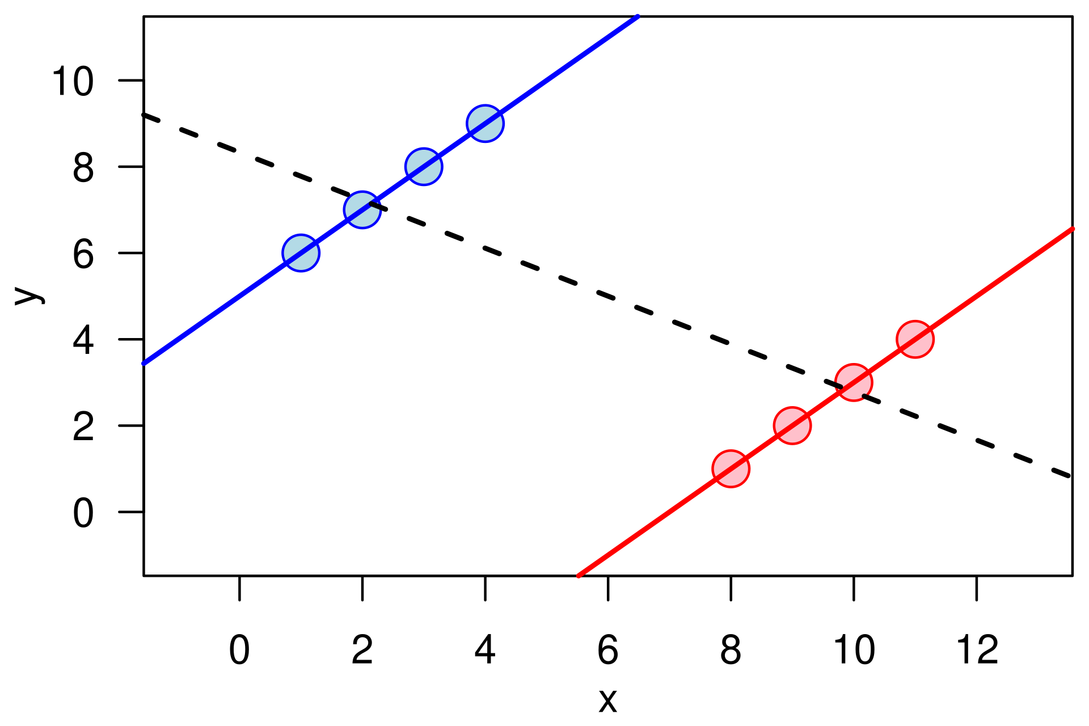
SIMPSON’S PARADOX
A trend that appears in combined data can disappear or even reverse when the data is broken down into smaller groups.
Visualization of Simpson's paradox on data resembling real-world variability indicates that the risk of misjudgment of true causal relationships can be hard to spot.
a positive trend appears for two separate groups, whereas a negative trend ( ) appears when the groups are combined.

Slide 6
METHODS OF CAUSAL INFERENCE
Conditioning-based methods
Conditioning effect on confounders
Matching and stratification
Regression
Doubly robust estimator
Synthetic control method
Natural experiments
Simple natural experiment
Instrument Variables
Regression discontinuity
Sensitivity Analysis

Slide 7
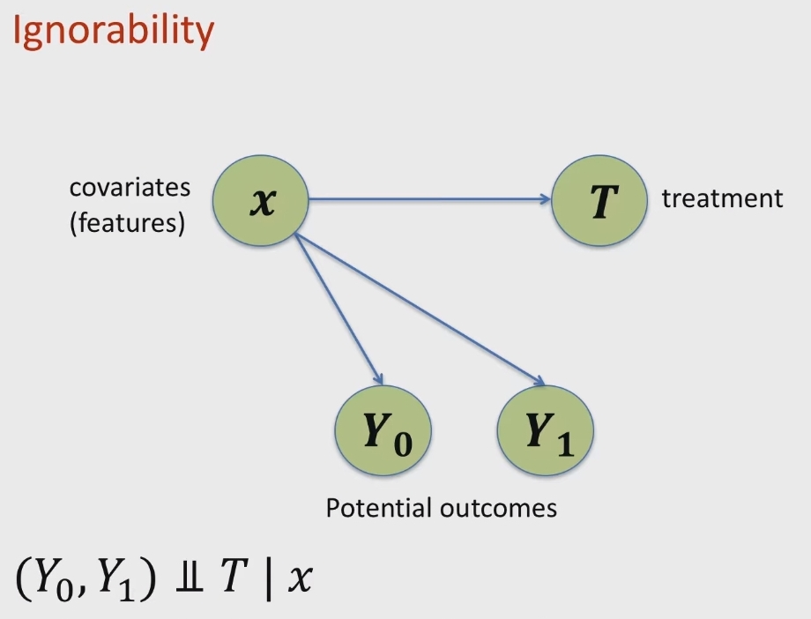
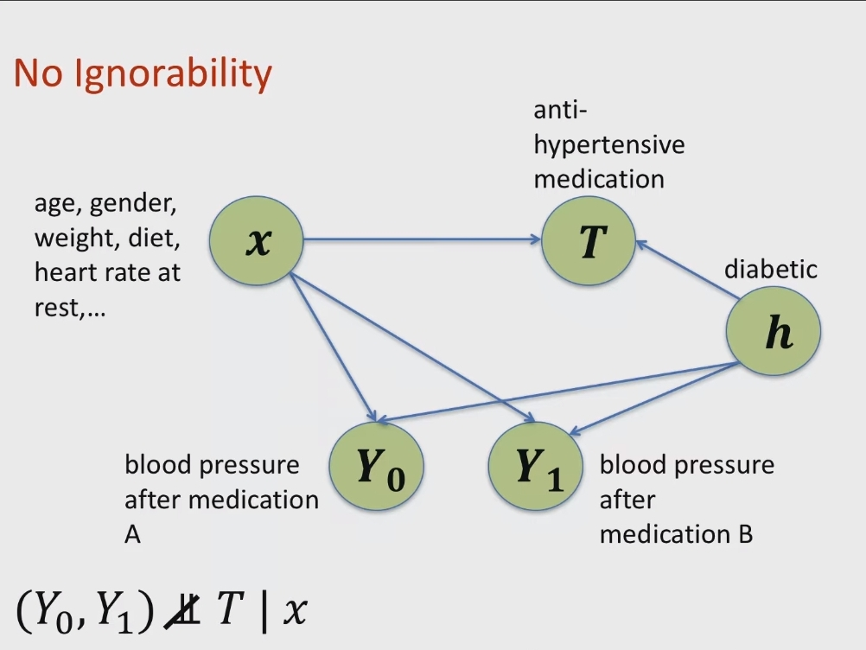

IGNORABILITY
P($Y_{0}$|X) = P($Y_{0}$|X, T)
P($Y_{1}$|X) = P($Y_{1}$|X, T)

Slide 8
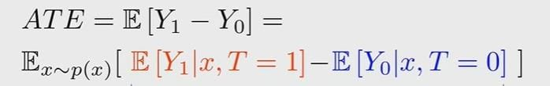


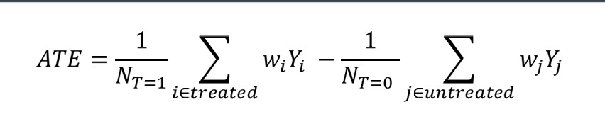
AVERAGE TREATMENT EFFECT (ATE) AND PROPENSITY SCORE
Propensity score : p( T = 1 | x )
Calculate ATE with propensity score for sample (x₁,t₁,y₁),…(x_{n},t_{n},y_{n})
Use any ML method to estimate p( T = t | x )
Imagine that we had data from a randomized control trial (RCT). Then we could simply estimate ATE using:
For weighted:

Slide 9
PROBLEMS TO SOLVE
Common confounders in social data analyses.
Interference due to network effects.
Challenges in high-dimensional data analyses.
Common issues when analyzing log data.
Bias arises from non-random sampling or differential attrition between groups.

Slide 10
Thank You !!

