Slide 1
MULTI INVESTMENT ATTRIBUTION
CAUSAL EFFECTS OF MULTI-LEVEL TREATMENT OF INTERVENTIONS USING OBSERVATIONAL DATA

Slide 2
TEAM MEMBERS
PROJECT ID: IN04
MENTOR’S NAME: Narayan Sarkar (IBM) (sarkar.narayan@gmail.com)
PROJECT TEAM MEMBERS:
Arkaprabha Pal
Ranjitha T M
Sandhiya S
Subhadeep Rakshit

Slide 3
PROBLEM STATEMENT
Companies allocate resources for customer interventions to boost engagement and revenue.
Intervention effectiveness varies with customer characteristics, like company size.
Implementing Multiple interventions simultaneously may lead to either compounding or diminishing effects on revenue.
The project quantifies each intervention's causal impact on revenue, considering confounders.

Slide 4
DATASET OVERVIEW
Dataset Used: https://msalicedatapublic.z5.web.core.windows.net/datasets/ROI/multi_attribution_sample.csv
Confounding Variable: Customer Size
Outcome: Revenue/ROI
Treatment Methods:
Tech Support
Discount
Tech Support and Discount

Slide 5

EconML library
EconML is a Python package for estimating multiple treatment effects from observational data via machine learning.
This package was designed and built as part of the ALICE project at Microsoft Research to combine state-of-the-art machine learning techniques with econometrics to bring automation to complex causal inference problems.

Slide 6
METHODOLOGY
DATA PREPARATION:
Defining a confounding variable, outcome, and treatment methods.
Confounding Variable (X) - Customer Size
Outcome (Y) - Revenue
Treatments (T_bin) = [“Tech Support”, “Discount”]
Controls (W) - Other features excluding treatments, outcome, and confounding variables.

Slide 7
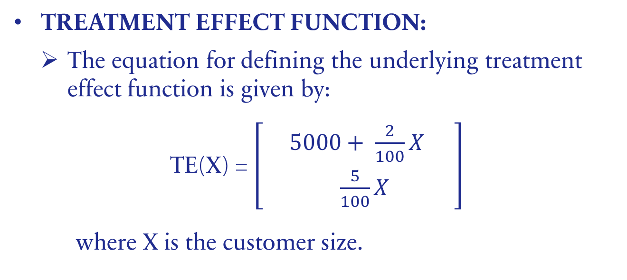
METHODOLOGY
TREATMENT EFFECT FUNCTION:
The equation for defining the underlying treatment effect function is given by:
TE(X) = $\left[\begin{matrix} 5000+ \frac{2}{100}X & \\ \frac{5}{100}X & \end{matrix}\right]$
where X is the customer size.

Slide 8
METHODOLOGY
DEFINING TRUE COEFFICIENTS AND INTERCEPTS:
Coefficient represents change in the outcome associated with a unit of change in the customer size.
true_coefs = [2 / 100, 5 / 100, 7 / 100]
The third coefficient is the sum of the first two since we assume an additive effect.
Intercept is the expected value of the outcome when the customer size is zero.
true_intercepts = [5000, 0, 5000]

Slide 9
METHODOLOGY
TRAIN ECONML MODEL FOR ESTIMATING EACH TREATMENT EFFECT:
LinearDRLearner:
It is a special type of estimator in EconML that improves the accuracy of treatment effect estimation by combining two methods: one that predicts the likelihood of treatment (propensity modeling) and another that predicts outcomes(outcome modeling).

Slide 10
METHODOLOGY
TRAIN ECONML MODEL FOR ESTIMATING EACH TREATMENT EFFECT:
Propensity Modeling:
Using XGBClassifier from xgboost library
Outcome Modeling:
Using XGBRegressor from xgboost library

Slide 11
METHODOLOGY
TREATMENT ESTIMATES:
Investment: Tech Support
True treatment effect = 5000 + 0.02*Size
Investment: Discount
True treatment effect = 0 + 0.05*Size
Investment: Tech Support & Discount
True treatment effect = 5000 + 0.07*Size

Slide 12
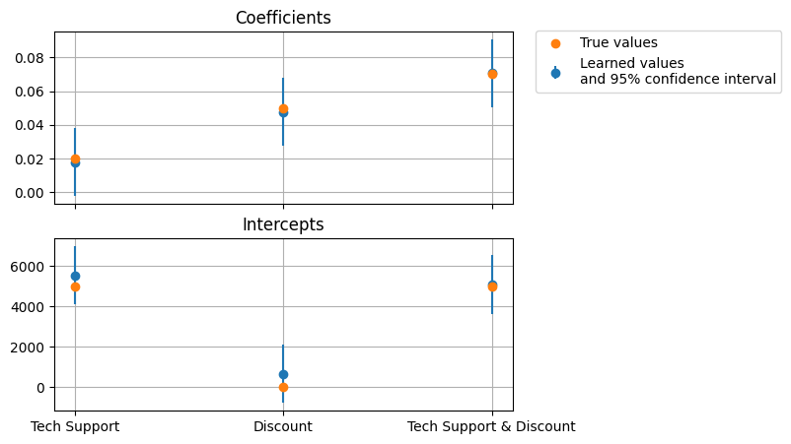
Estimated vs. True Coefficients and Intercepts

Slide 13
RESULTS
Investment | Coefficient Results |  | CATE intercept Results
 | Coefficient (Size) | p-value | CATE intercept | p-value
Tech Support | 0.018 | 0.083 | 5529.309 | 0.0
Discount | 0.048 | 0.0 | 647.327 | 0.38
Tech Support and Discount | 0.071 | 0.0 | 5081.263 | 0.0

Slide 14
CONCLUSION
Tech Support and Discount (combined):
With the highest Size coefficient (0.071) and significant intercept (5081.263) - the most effective investment.
GitHub: https://github.com/Sandhiya-2003/Multi-Investment-Attribution

Slide 15
THANK YOU
Arkaprabha Pal (arkaprabha.pal0@gmail.com)
Ranjitha T M (ranjithatm14@gmail.com)
Sandhiya S (Sandhiya.949@gmail.com)
Subhadeep Rakshit (subhadeeprakshit35@gmail.com)

