Slide 1

Picture Book Application
Sushant Bisht | 20BCS6148 |
Ankit Ahir | 20BCS4223
Anushka Rai | 20BCS4622
Vaani Ranjan |20CBS1061
Namandeep Singh | 20BCS4218

Slide 2
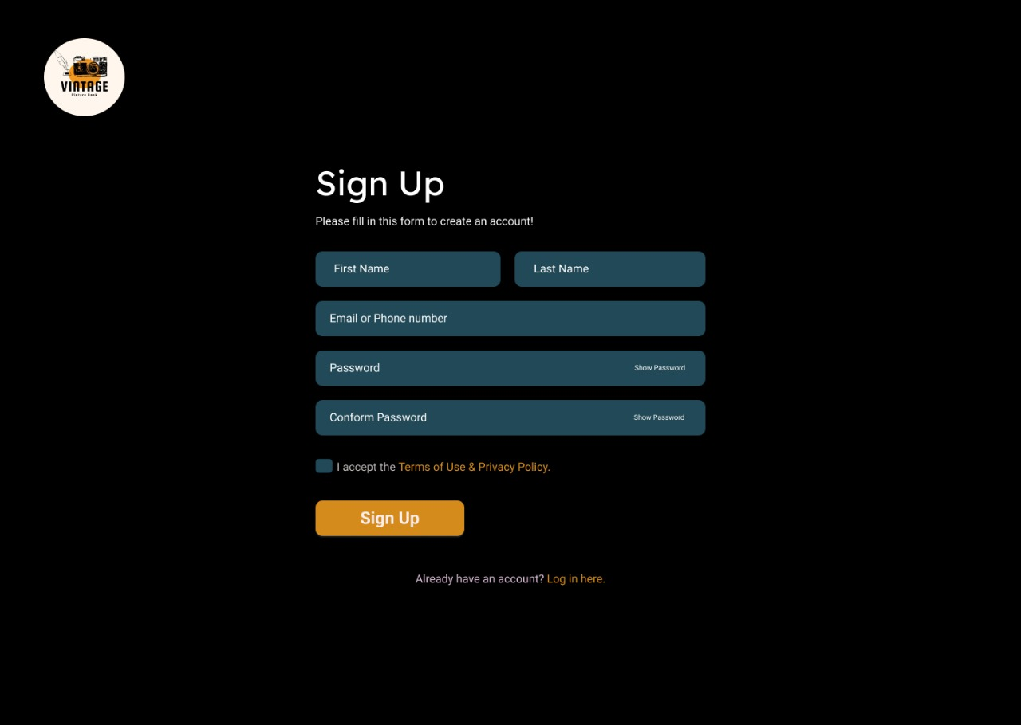

Slide 3
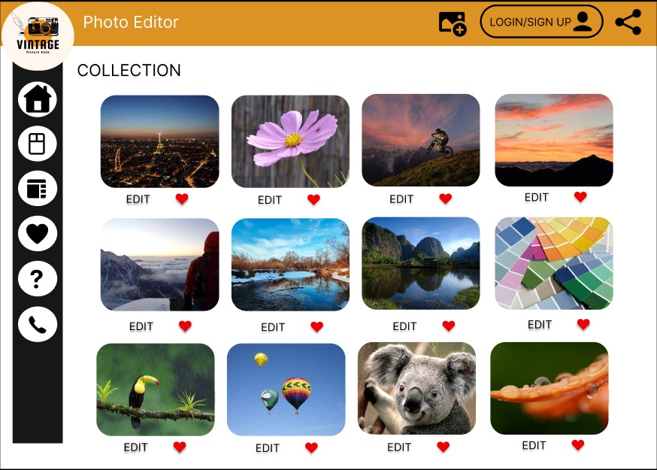


Slide 5
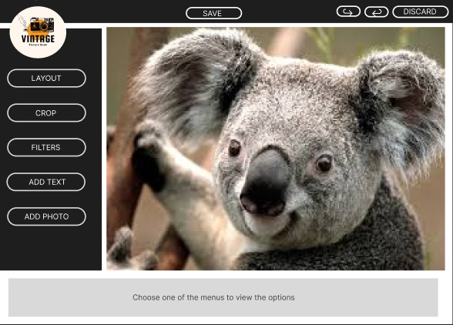


Slide 6
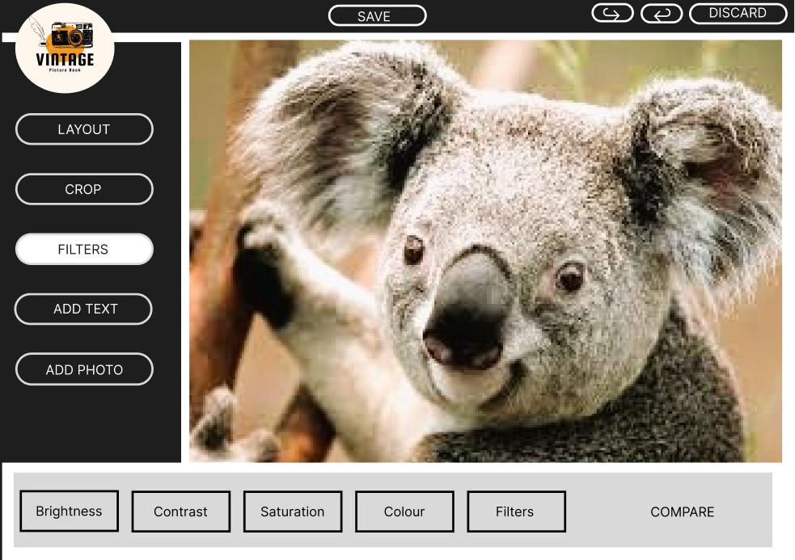

Slide 8
