Slide 1
INTERNET OF THINGS (IOT)AND ITS APPLICATIONS
Group Members
1.Sohaib Rehman Khan 2.Anna Trunina 3.Mark Nedzelskii 4.Igor Lipin 5.Petr Slavik 6.James O. Abuogo 7.SWATI ANINDITA SARKER 8.BELIBI TANA Armelle.E 9.OWASSA-DZA Rebecca A 10.GOUSSEBEO ROSELINE YOCELLE . S

Slide 2
Increasing Trend of IOT

Slide 3
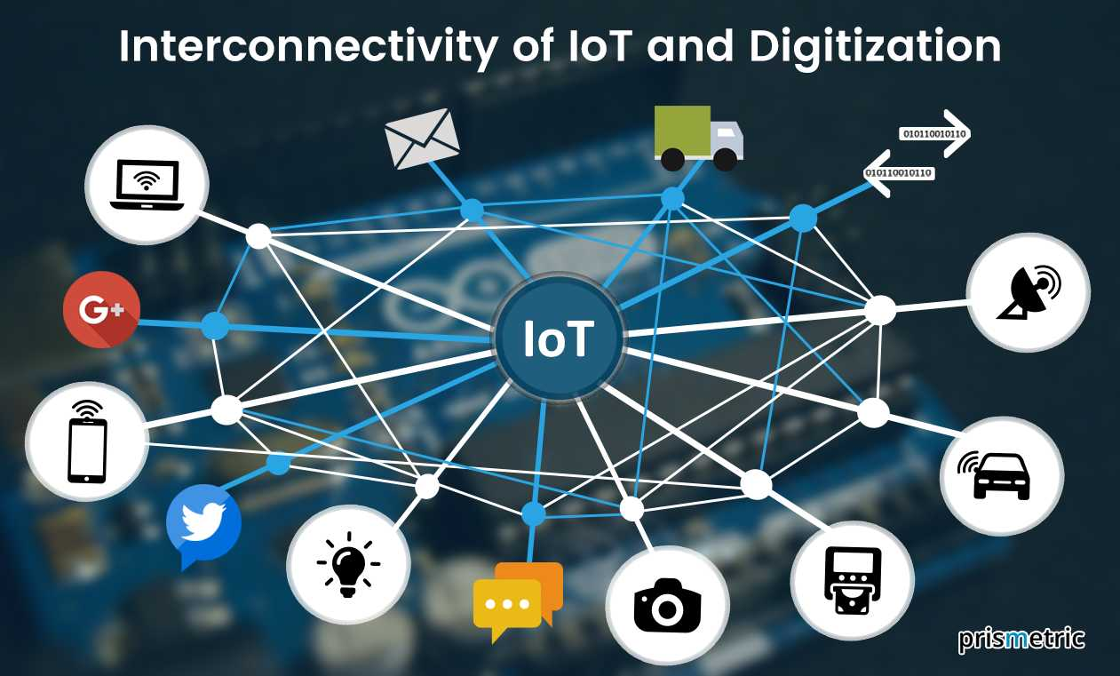
The internet of things (IoT) is a computing concept that describes the idea of everyday physical objects being connected to the internet and being able to identify themselves to other devices.

Slide 4
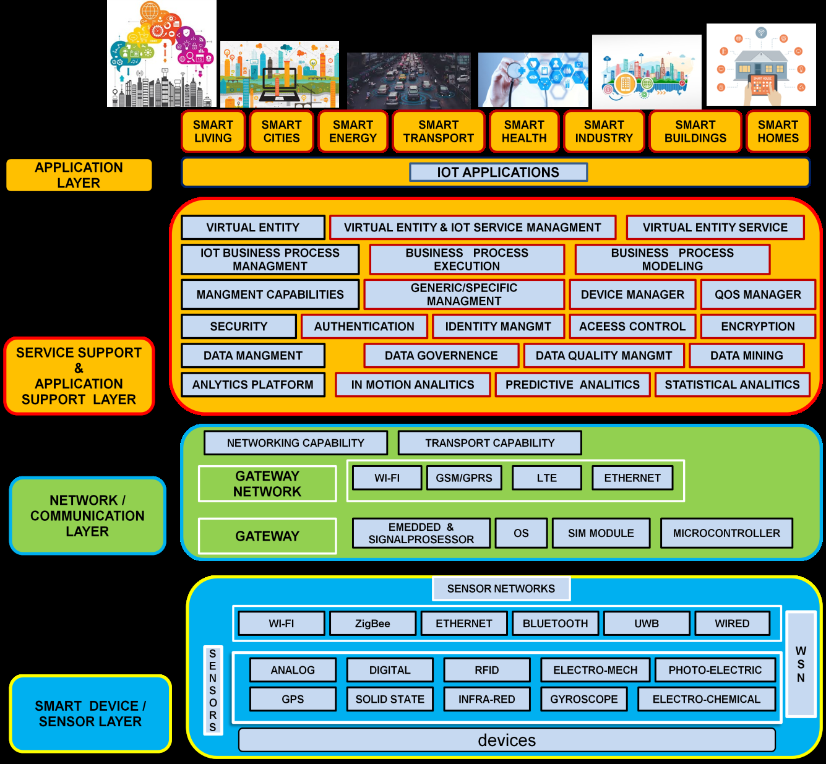

Slide 5
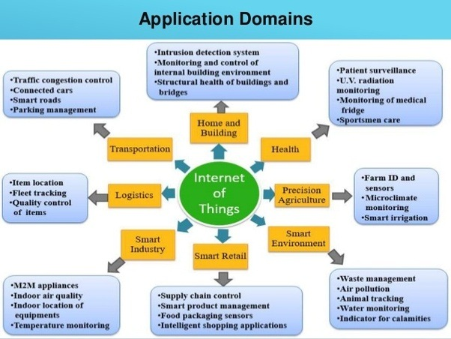

Slide 6
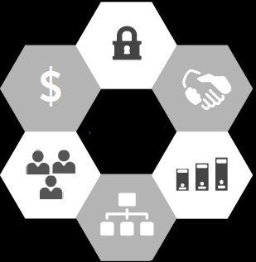
Challenges and Risks of IoT
Security & Data Governance
Confusion on where
to get value (ROI)
IT and business partnership
Where do
we Start?
Diversity of niche
providers & solutions
Data and analytics complexity
Lack of data protocol standards

Slide 7
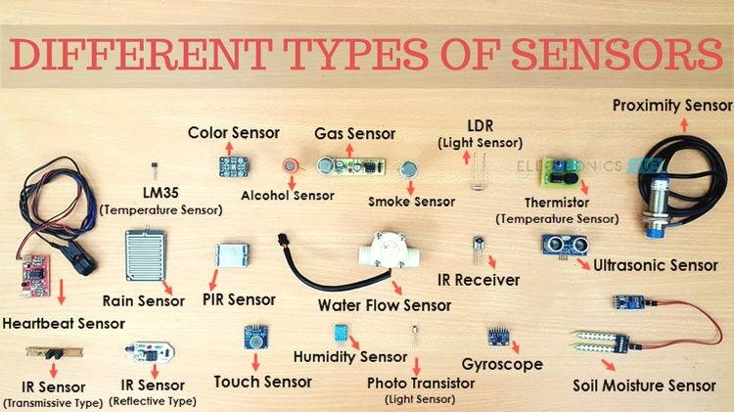

Slide 8
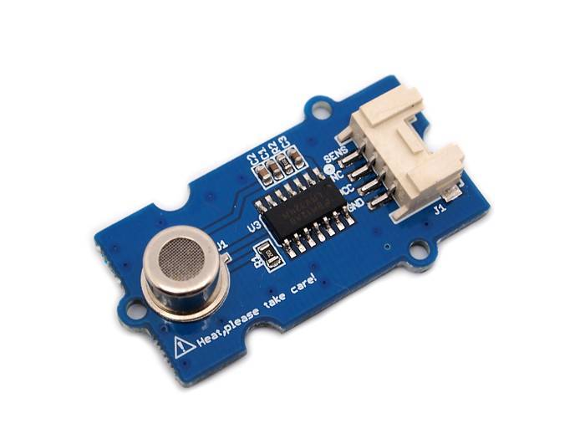
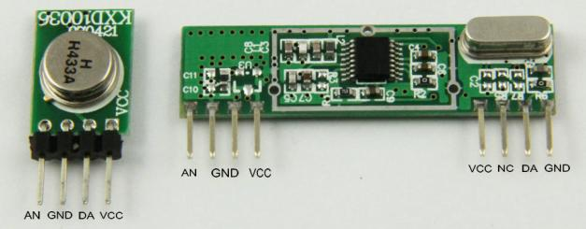
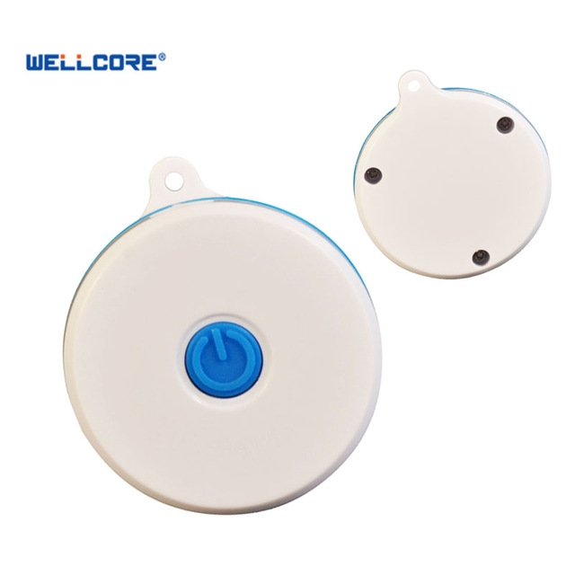
temperature and humidity sensor with RF modules Arduino
Air Quality Sensor
Bluetooth Beacon
4 USD
Air Quality Sensor
6 USD
Sensor + RF Transmittor
15 USD
bluetooth beacon IP67

Slide 9
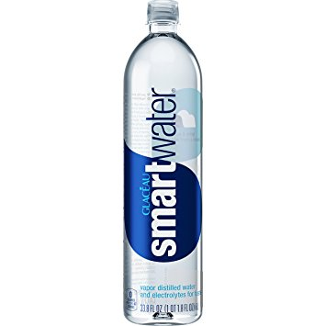
CASE STUDY- Sensor Based Smart Cap and Bottle to Rectify Plastic Pollution and Its Hazardous Effects
How to do waste management of plastic bottle efficiently?
How to know the safety limit of reuses for drinking water?
Who will ensure that water in bottle is pure and healthy?
Is there any way that waste management company reaches out to waste plastic bottle timely?
Is it possible to provide complete information about Bottle manufacturing water quality ?

Slide 10
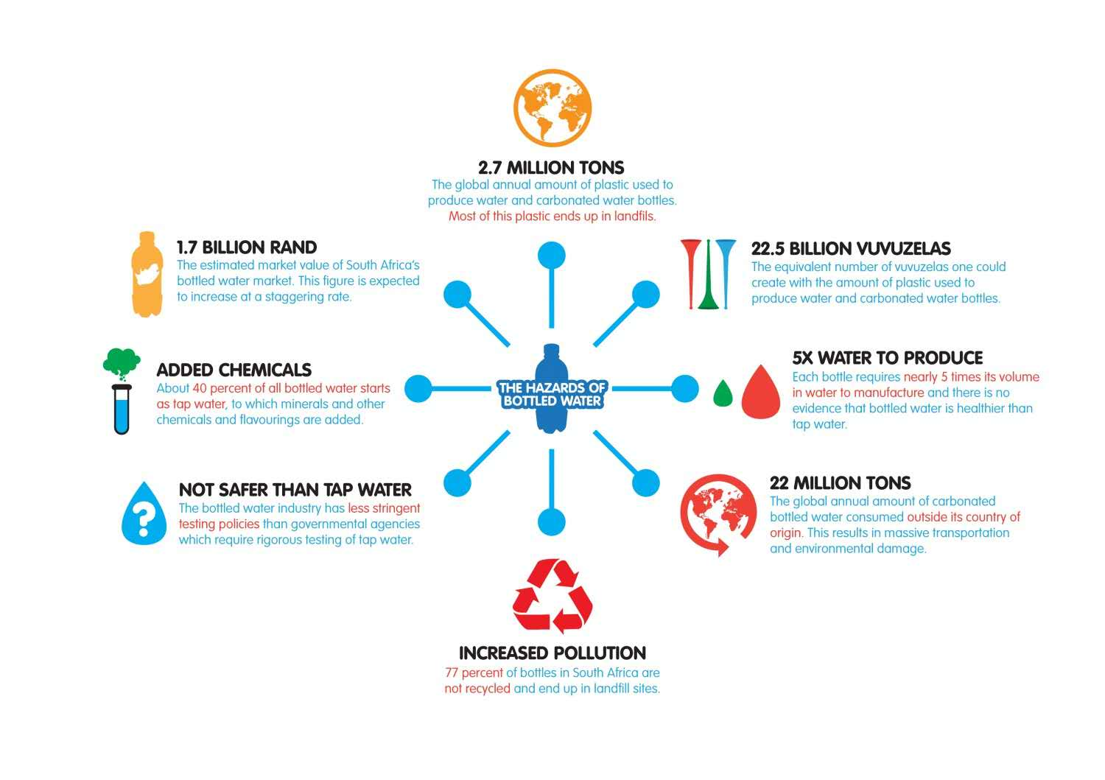

Slide 11
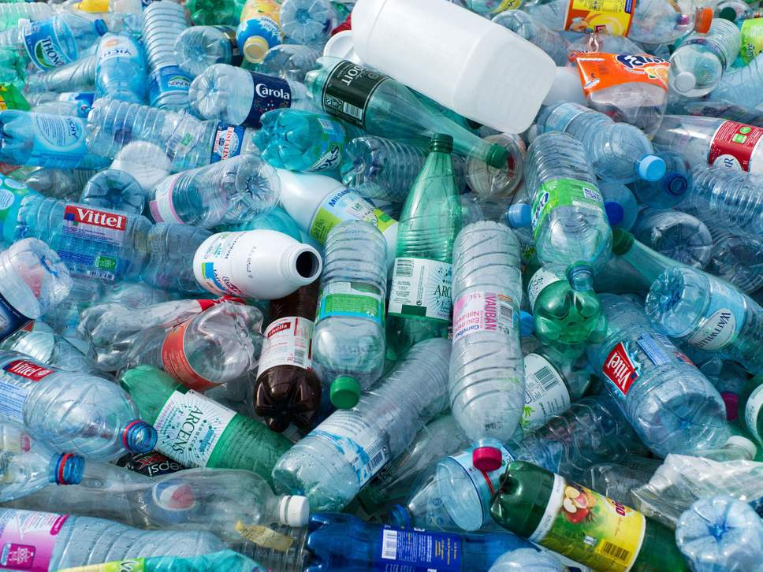
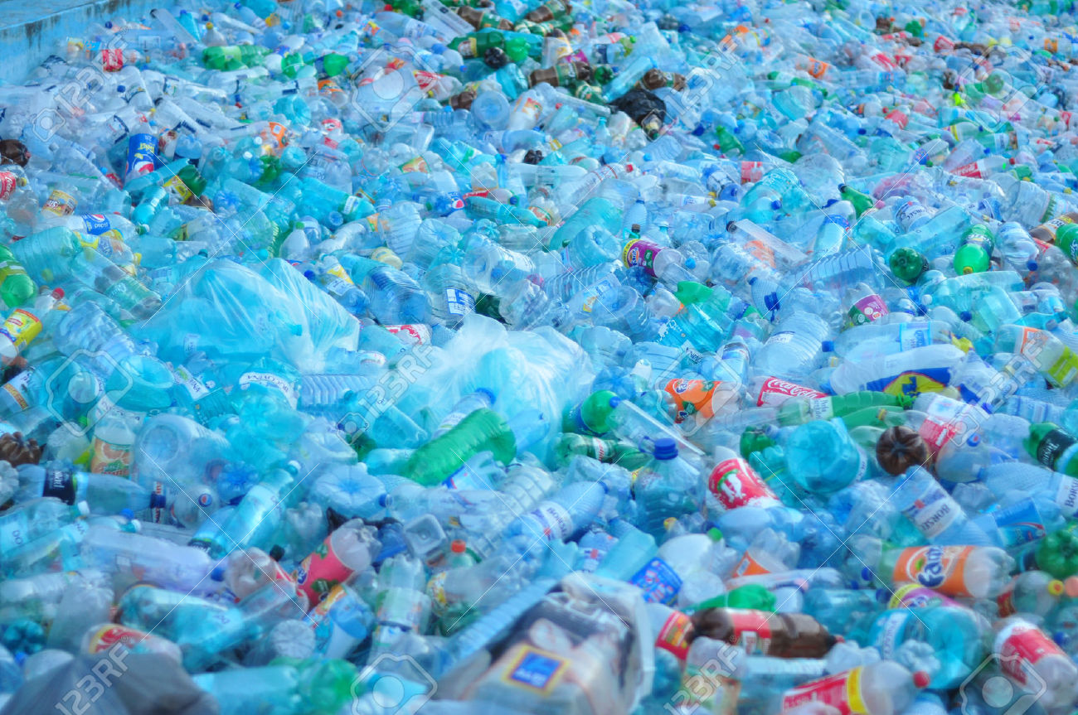
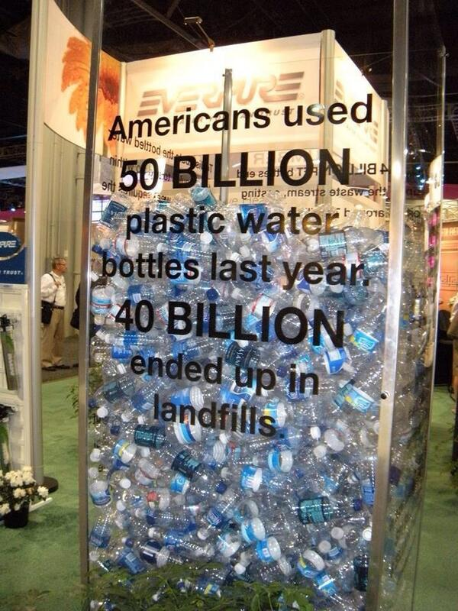
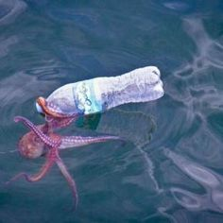
Water Bottle Garbage

Slide 12
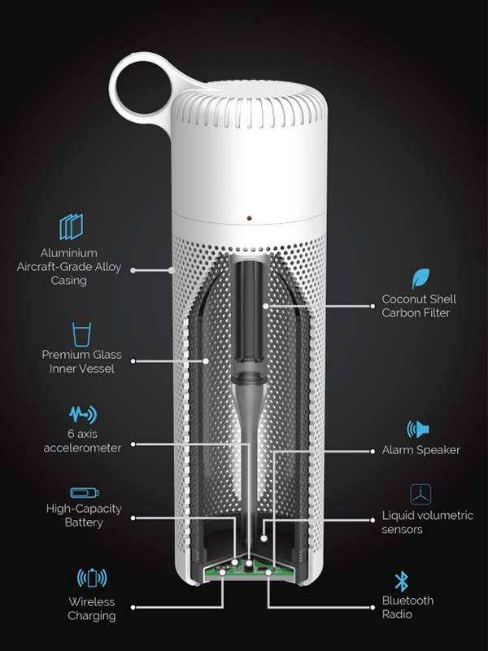
Quality of Water. Number of minerals and Ph level
Life cycle of Plastic, Whether it has been already used or not? If used how many times it has been opened, no of reuses allowed
Bar code containing information about Date, time position of bottle manufacturing , how it has been trransported
Position Tracking and in case of any contamination or deformation or completion of life cycle for reuses of bottle, data will be sent to Waste Management Company
To check about any contamination in water , any impurity

Slide 13
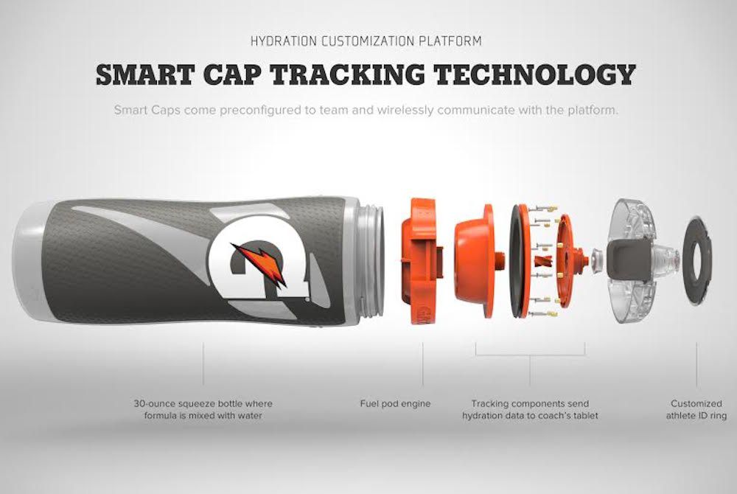
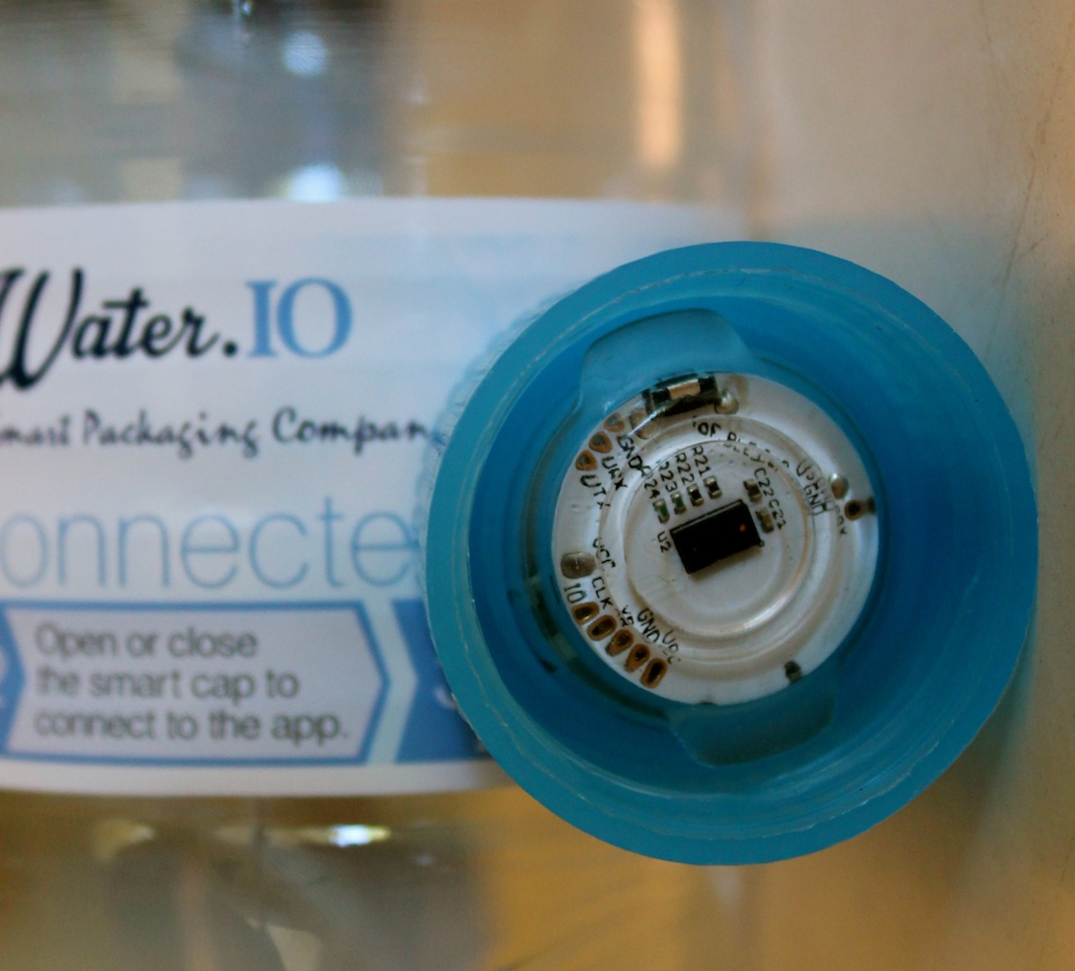
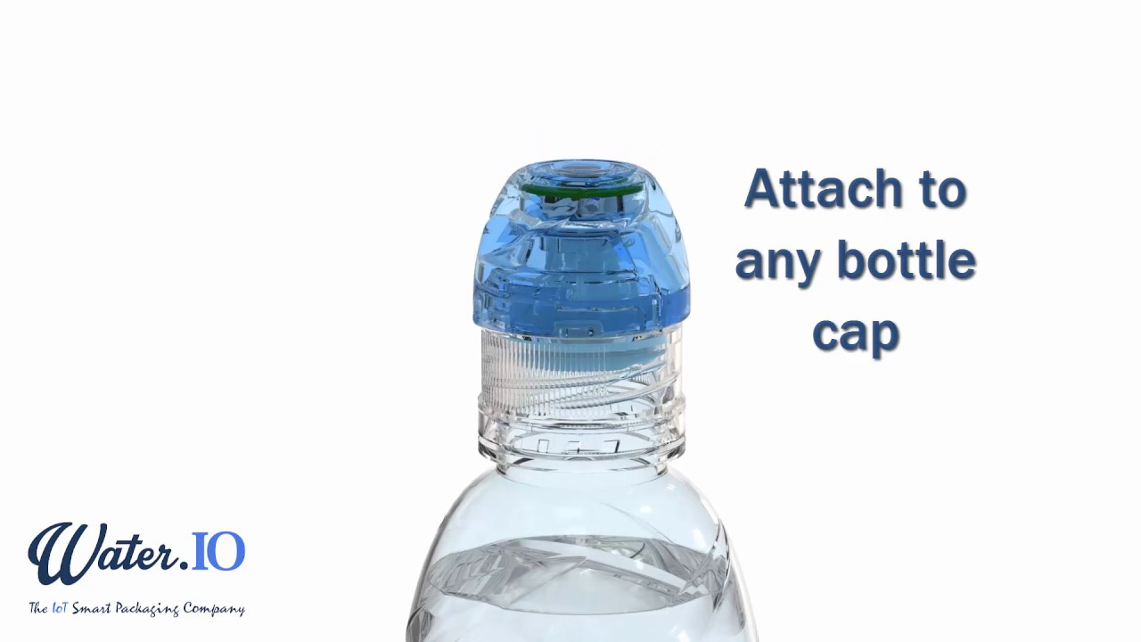
Idea of Smart Bottle and Smart Bottle Cap

Slide 14
Conclusion
IoT has been gradually bringing a sea of technological changes in our daily lives, which in turn helps to making our life simpler and more comfortable, though various technologies and applications.
The key observations in this presentation are that
There is no standard definition in worldwide
Universal standardizations are required in architectural level
Technologies are varying from vendor-vendor, so needs to be interoperable
For better global governance, we need to build standard protocols. Let us hope future better IoT

Slide 15
Once all our tasks are automated what do humans do everyday?

Slide 16
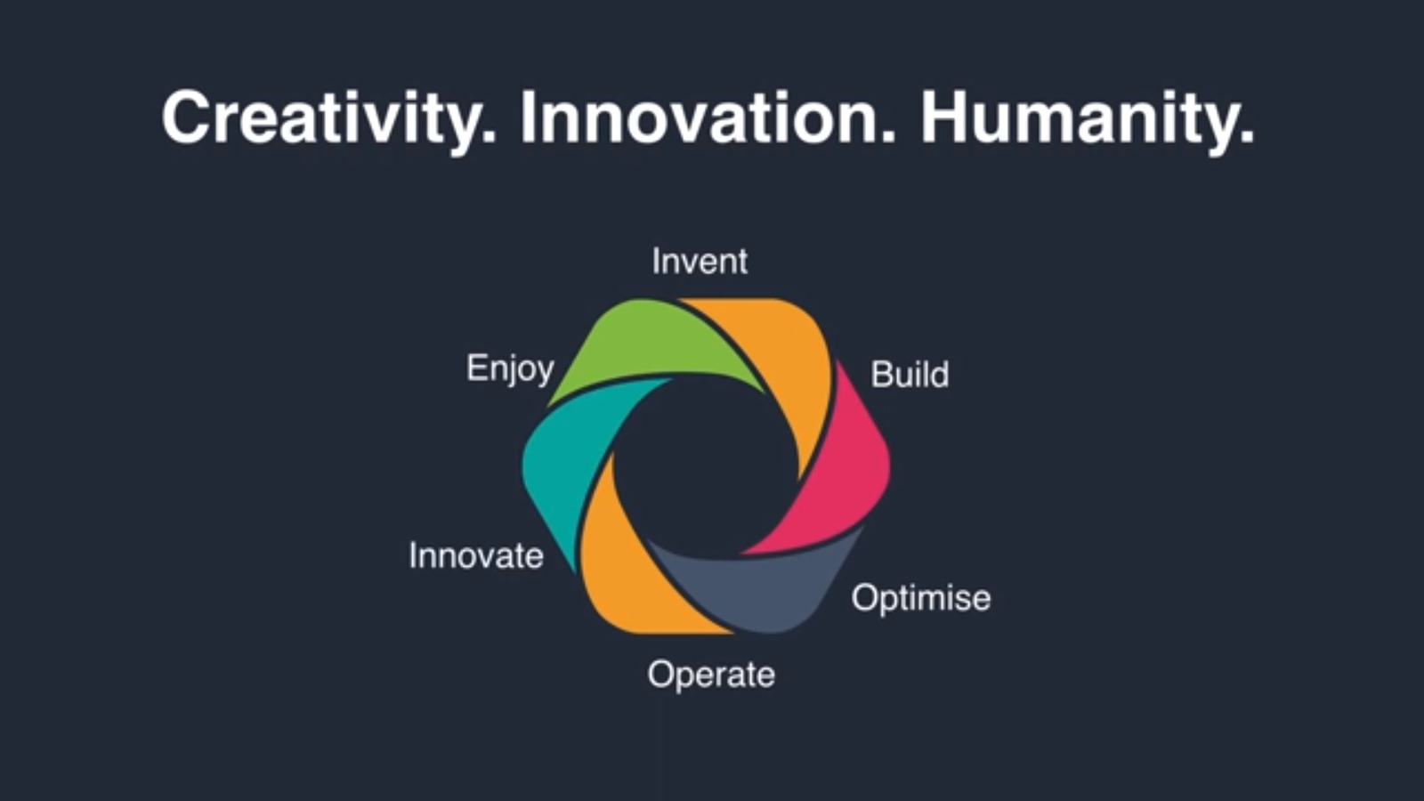

Slide 17
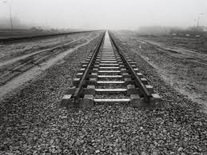
THANKS
AND QUESTIONS?

