Slide 1
School of Software
National Engineering Laboratory
for Big Data System
Program on “Innovation & Entrepreneurship ”
Internet Security:
State of the Art & Innovation
By
Abdelmonim Naway
AMISI FATAKI Clement
Jiwen Zhang
Sept. 28. 2018

Slide 2
Outline
Introduction to Internet
Review of Concepts
Terminologies
Common Threats and Attacks
Best Practices on Internet
AI & Machine Learning in the Cybersecurity Industry
The role of Blockchain in CyberSecurity
Conclusion

Slide 3
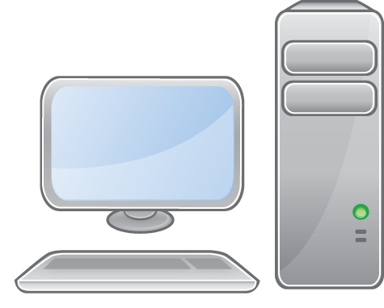
Introduction to Internet
A network of networks in which users at any one computer can, if they have permission, get information from any other computer.

Slide 4




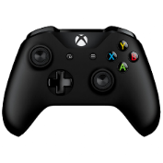
Today, people are not only use the Internet to talk to each other, but also for...

Slide 5
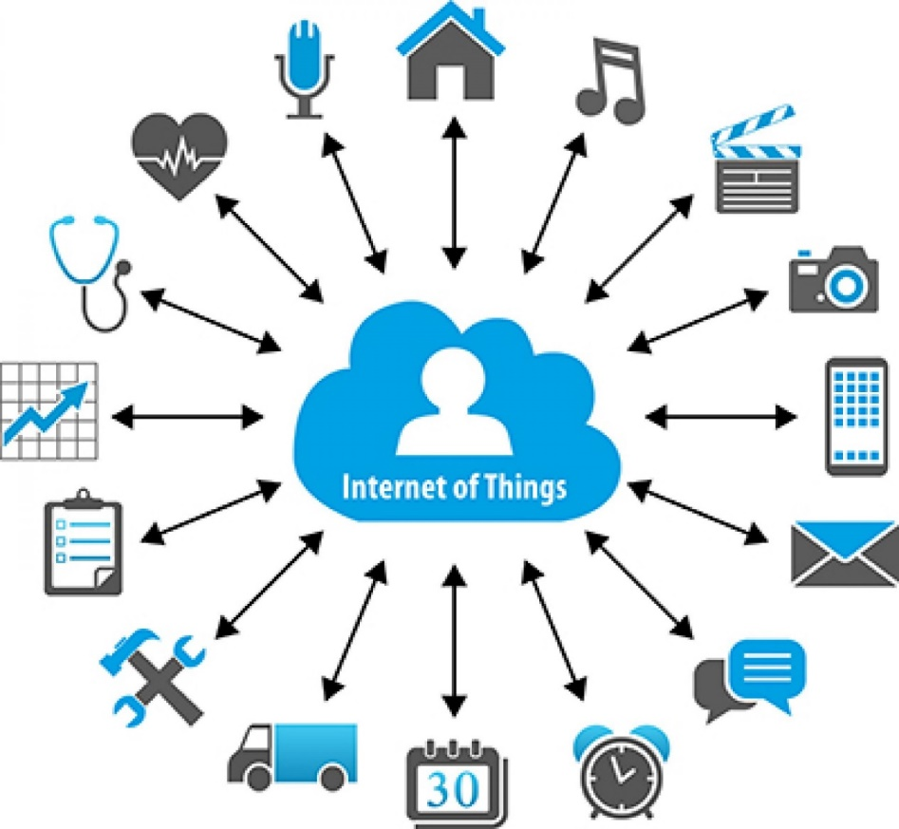
Recently, other devices has been Connected to the Internet.

Slide 6
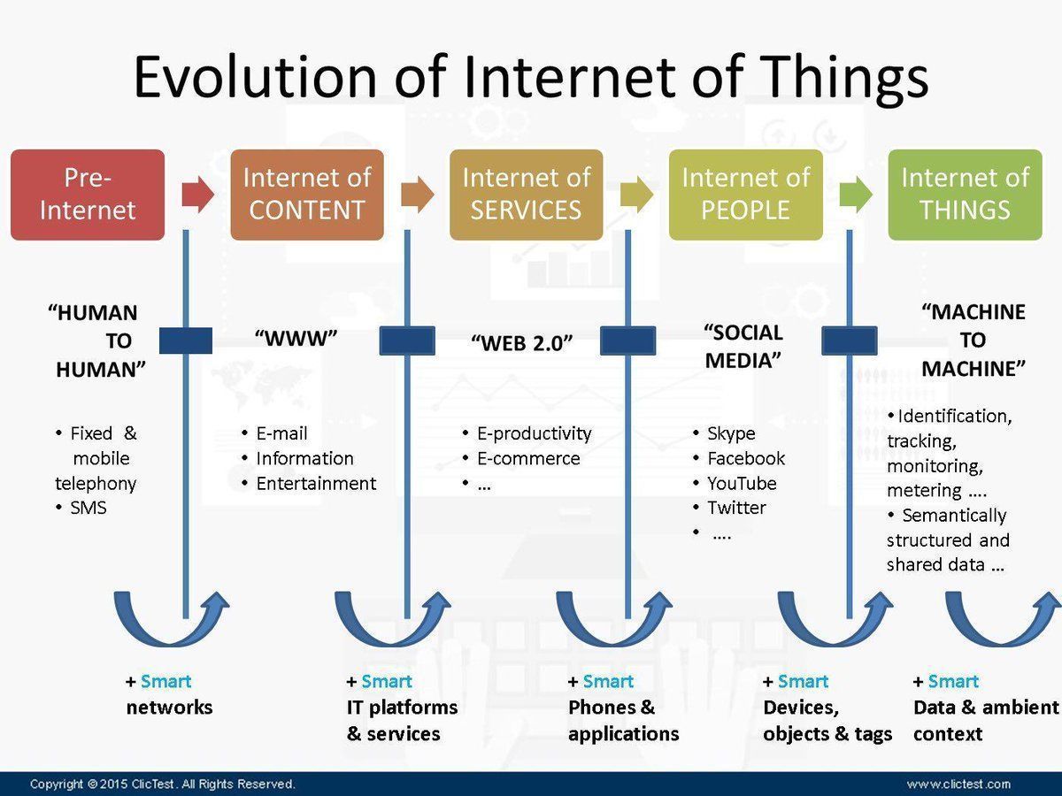

Slide 7
Security Threats
Unfortunately, the straightforward connectivity of these devices comes at a price
A computer virus is a malicious software program loaded onto a user's computer without the user's knowledge and performs malicious actions.
One person could steal another's identity by guessing, cracking or extracting a password.
Vulnerabilities such as these will never completely go away because they are built into the Internet's architecture.
Criminals use them to steal Billions of dollars, Governments use them for surveillance, Hacktivists use them to further their political goals.
In 2016 alone, over 3.1 billion records were stolen or leaked through data breaches of major organizations.

Slide 8
Review of Concepts
What is Information Assurance?
Emphasis on Information Sharing
Establishing and controlling trust
Authorization and Authentication (A&A)
What is Data Security?
is the prevention of unauthorized access, use, disruption, modification or destruction of data in storage.
What is Cybersecurity?
Protection of information and systems within networks that are connected to the Internet.
What is Internet Security?
internet security is a branch of computer security that deals specifically with Internet-based threats. These include hacking, where unauthorized users gain access to computer systems, email accounts or websites; viruses and other malicious software (malware).
What is Information security ?
The protection of information and information systems from unauthorized access, use, disclosure, disruption, modification, or destruction in order to provide confidentiality, integrity, and availability.
What is Computer Security?
Computer security deals with the prevention and detection of unauthorized actions by users of a computer system.
What is Network Security?
Network security is a subset of information/cyber security which deals with planning and implementing network security measures to protect the integrity of networks and programs against hacking and unauthorized access

Slide 9
Review of Concepts
Progression of Terminology
Computer Security
(COMPUSEC)
Legacy Term (no longer used).
Information Security
(INFOSEC)
Legacy Term (still used).
Information Assurance
(IA)
Term widely accepted today with focus on Information Sharing.
Cyber Security
Broad Term quickly being adopted.

Slide 10
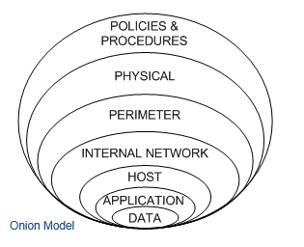
What is the Defense in Depth Strategy?
Using layers of defense as protection.
People, Technology, and Operations.

Slide 11

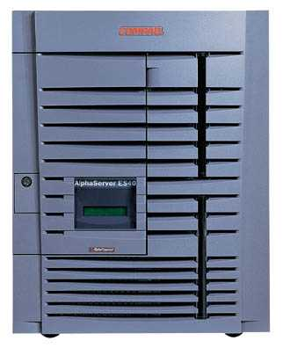

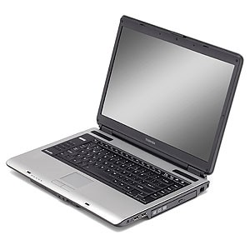
Security Breach
Internet
Attacker
Intercepts and controls network communication
Alice
Security is about
Honest user (e.g., Alice, Bob, …)
Dishonest Attacker
Disrupts honest user’s use of the system (Integrity, availability)
Learns information intended for Alice only (Confidentiality)
Source:Wei Wang, INFOSEC 2016, BJTU

Slide 12
Terminologies
CIA
Confidentiality
Integrity
Availability
Access Control
Authentication
Authorisation
Accountability
Risk
Threat
Vulnerability
Impact

Slide 13
Goals of Information Security
Confidentiality
Integrity
Availability
INFORMATION SECURITY
safeguards the
accuracy and
completeness
of information
authorized
users have
reliable and
timely access
to information
Prevents unauthorized
use or disclosure of information

Slide 14
Authentication
a means to verify or prove a user’s identity
The term “user” may refer to:
Person
Application or process
Machine or device
Identification comes before authentification
Provide username to establish user‘s identity
To prove identity, a user must present either of the following:
What you know (passwords, passphrase, PIN)
What you have (token, smart cards, passcodes, RFID)
Who you are (biometrics such as fingerprints and iris scan, signature or voice)
Access Control
The ability to permit or deny the use of an object by a subject.
It provides 3 essential services:
Authentication (identification of a user)
Authorisation (who is allowed to use a service)
Accountability (what did a user do)

Slide 15
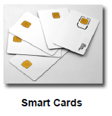
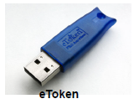

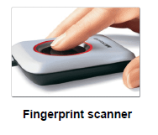
Authentication – Examples of Tokens

Slide 16
Authorisation
Defines the user’s rights and permissions on a system
Typically done after user has been authenticated
Grants a user access to a particular resource and what actions he is permitted to perform on that resource
Access criteria based on the level of trust:
Roles
Groups
Location
Time
Transaction type

Slide 17
Authentication vs. Authorisation
Service
“Authentication simply identifies a party, Authorisation defines whether they can perform certain action” – RFC 3552
Authentification Mechanism
Authorisation
Mechanism
Client

Slide 18
Accountability
The security goal is to generate the requirement for actions of an entity to be traced uniquely to that entity
Senders cannot deny sending information
Receivers cannot deny receiving it
Users cannot deny performing a certain action
Supports nonrepudiation, deterrence, fault isolation, intrusion detection and prevention and after-action recovery and legal action
Source: NIST Risk Management Guide for Information Technology Systems

Slide 19
Reliability
Relating to (accidental) failures, and safety, relating to impact of system failures on their environment, which also deal with situations where a system has to perform properly in adverse conditions.
Privacy
Is the ability of an individual or group to seclude themselves, or information about themselves, and thereby express themselves selectively.

Slide 20
Risk, Threats, and Vulnerability
Threat
Any circumstance or event with the potential to cause harm to a networked system
Vulnerability
A weakness in security procedures, network design, or implementation that can be exploited to violate a corporate security policy
Risk
The possibility that a particular vulnerability will be exploited

Slide 21
Common Security Threats
Network Attacks
Denial-of-Service (DOS)
Web Attacks
Cross-site Scripting(XSS)
SQL Injection
Phishing emails
Advertising
OS, applications and software attacks
Virus
Social Engineering
The art of manipulating people so they give up confidential information
Trojan
Worms
Rootkits

Slide 22
Security Mechanisms
Cryptographic Techniques | Use mathematical algorithms to transform data into a form that is not readily intelligible
Firewalls | Software and hardware for access limitations
Network Monitoring Intrusion Detection and Prevention Systems | Intrusion Detection and Prevention Systems
Hardware for authentication | Smartcards, security tokens
Security Policies | Define who has access to which resources
Physical Security | Keep data in a safe place which limited and authorized physical access

Slide 23
Best practices on Internet(Users)
Keep your OS and programs updated
Crate strong passwords
Physical Protection
Use Anti-virus software
Scan External data (USB-drives, E-mail attachments)
Only use trusted and Open Source Software
Notes:
Keep your OS Update:
Keep your operating system up-to-date: the developers of operating systems provide updates
that you should install from time to time. These may be automatic or you may have to request
them by entering a command or adjusting your system settings. Some of these updates make
your computer more efficient and easier to use, and others fix security holes. Attackers learn
about these security holes rapidly. Installing new updates on a new computer is very important.
User account and password
Every computer needs an account to login. This account is needed to access your data and use the functions of your computer. Please be sure to setup a password for every account.
Physical Protection
A lot of people do not realize the information on your computer can be very valuable for others. If you are working in an unknown/uncontrolled environment or area, always keep a good look on your belongings and never leave them unattended. Take some time to think over what the risks
are if the data on your computers fall in the wrong hands. Ask yourself, "which information is actually stored on my computer and what can other people do with this information?". Please realize, a password on your computer will maybe protect against quick access, but it doesn't protect your data once the whole system is lost.
Use Anti-virus software
If you're still using Microsoft Windows, use anti-virus software and keep it
updated. Malware is software written in order to steal information or to use
your computer for other purposes. Viruses and malware can gain access to
your system, make changes and hide themselves.
EXTERNAL DATA (USB-STICKS, E-MAIL ATTACHMENTS)
Transferring viruses with USB-sticks or with E-mail attachments is very
easy and often done by the virus itself rather then the owner/sender,
especially under Microsoft Windows. Be careful when inserting USB-sticks or lent out your stick to others.
ONLY USE TRUSTED AND OPEN SOURCE SOFTWARE
Be sure you can trust the vendor of the applications you use. A lot of companies are offering applications on the internet. Between these companies there are several with other intentions then they will tell you.
Be updated
Keep yourself updated on the latest security threats: the effort put into
harming you may change. Methods to protect yourself that works today may stop working or even become a threat themselves tomorrow. Even if you don't need it now, know where to find information and use different sources of information.

Slide 24
AI & Machine Learning in the Cyber Security Industry
The complexity of cyber threats is increasing, making it harder to detect attacks, and harder still to protect against them
Machine learning can learn how to automatically detect unusual patterns in encrypted web traffic and Internet of things (IoT) environments.
Ultimately, this would help improve network security defenses.
Another big cyber security issue has been the skills gaps:
organisations have not been able to find staff with the necessary skills.
AI and machine learning tools would help overcome these gaps.

Slide 25
The Role of Blockchain in Cybersecurity
Blockchain can offer the following for security:
Blockchain resolves the ‘lack of trust’ problem between counterparties at a very basic level.
This could potentially help enhance cyber-defense as the platform can prevent fraudulent activities via consensus mechanisms
Eliminating Human Factor from Authentication
Businesses are able to authenticate devices and users without the need for a password with the help of blockchain technology.
This eliminates human intervention from the process of authentication, thereby avoiding it from becoming a potential attack vector.
Decentralized Storage
Blockchain users can maintain their data on their computer in their network. Because of this, they can make sure that the chain won’t collapse
Traceability
Every transaction added to a private or public blockchain is timestamped and signed digitally.

Slide 26
Thanks !
monim88@msn.com
clement.fataki@gmail.com
blairzhang2015@gmail.com

