Slide 1

DigiHealth The Healthcare Service Platform
“Innovation & Entrepreneurship Program”
Tsinghua University
September, 2018
Developed by:
Innovation Digital Healthcare Services team

Slide 2
Contents
1. Overview
a. In the World
b. In China
2. Challenges
3. Solutions

Slide 3
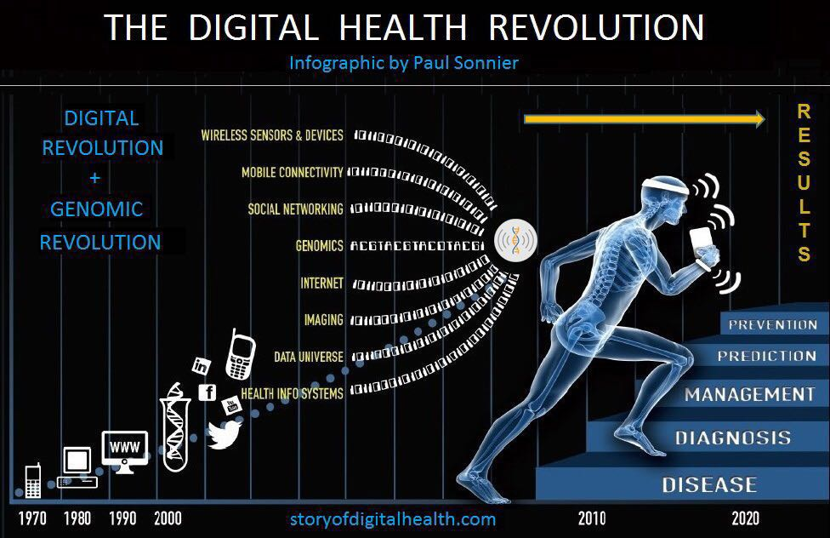
The Digital Health in the World
1
The beginning of 19th -
the first medical technologies to diagnose and treat diseases
1950 -
explosion of the use of medical technologies

Slide 4
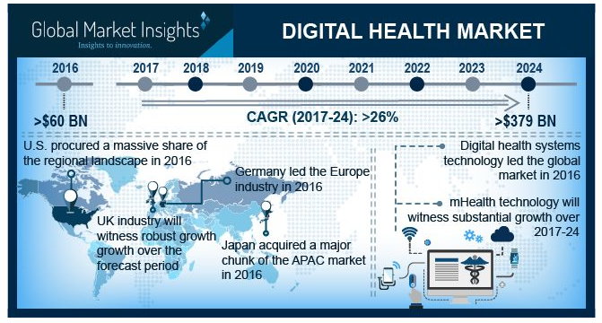

The Digital Health (World & China)
Mobile Healthcare Applications
Electronic Medical Record (EMR)
Key World Trends:
Wearable technology
Telemedicine
Addictive manufacturing
Electronic health records
Serious health games
Hospital Information Systems
China
Picture Archiving and Communication System
Telemedicine
The radiology information systems

Slide 5
Healthcare Platform Classifications (World & China)
W1
W2
- Inpatient clinical care
- Ambulatory & post-acute care
- Financial/ Revenue cycle/HIM
- Value-based Care
- Services & Consulting
- Imaging systems & equipment
- Payer solutions
• Cloud
• IoT
• AI/Machine learning/ Blockchain
• Other
• Patient
• Physician
• Enterprise
• Administrators
-
CN
- Integrated technology platform: 平安科技
- Pharmaceutical companies / device providers: 乐普医疗，鱼跃，糖医
- Online hospitals / Medical examination centers: 春雨医生，平安好医生，爱康国宾，慈铭体检
- IT companies: 东软熙康
- CROs: 百奥知，泰格医疗
- Pharmacies: 老百姓大药房，一心堂

Slide 6
Challenges
2
Data Collection/
Sharing/
Analysis/
Ownership
“Prevention →Treatment → Post-treatment care” platforms
less targeted platforms
Suitable Business Model
The manpower
Rising costs (healthcare)
Data security
continuity of users
The access
Lack of infrastructures
The services of the platform
Standards/
regulations,
classification
Lack of reliability, efficiency and transparency

Slide 7
Challenges & Solutions
3
regulations, standards/guidelines; sharing new inventions in the field, trainings; insurance policies; prevention medicine
No clear standards, regulations
Weak connection between regulators, physicians, inventors and patients
Data sharing, Security, and privacy
Different formats in different hospitals
The EHR data ownership;
Shared knowledge base and training
EHR management
1. keep a copy of their data locally; 2. store all the EHRs in our platform in the Cloud
Healthcare rising cost
Repeated examinations
User involvement
Not all platforms are focusing firstly on a patient or healthcare consumer
IT infrastructure and maintenance
Hospital Information System/ portal
billing, healthcare process management and reporting
Normal user (patient) portal
Check his/ her medical records, reports, doctors feedback; devices; tracking of lifestyle; emergency
Manpower gap; Data Analysis
Insufficiency of medical staff
Continuity of users
Attracting more users and keeping those interest
Suitable Business Model
Need in offline and online oper. modes
Most Medical data is not utilized for research purposes
AI
diagnosing and recommendations; better insurance policy; cutting costs; access for medical data for researches
Medical Facilities Rating
Rankings and reviews for hospitals, doctors, med.devices; startups

Slide 8

“DigiHealth” Visions
Developing a unified shared healthcare service platform with the patient as the main focus

Slide 9
“DigiHealth” System Diagram (Modules)
- Data security - Infrastructure - Sharing / Permissions
EMR (Electronic Medical Record)
Knowledge base & Training
Medical facilities rating
Hospital Information Systems (HIS)
AI
User Portal
- Researches - Best practice - AR games for trainings
- Data analysis - Help diagnose
Rating & review (doctors/hospitals/pharmacies)
- Billing - Process management - Reporting
- Records; - Medications;
- Keep track of the lifestyle - View the readings (from devises) - Predictions & Recommendations

Slide 10



“DigiHealth” Scheme for Users
Researches
Physicians
Regulators
Shared knowledge base and training
Entrepreneur
Insurance companies
User Portal
HIS
AI
User / Patient
SYSTEM
Hospital staff

Slide 11
“DigiHealth” Business Ideas
Electronic Medical Record
Healthcare Information Systems
Research & Training (for private sector)
EMR
HIS
R&T
Partnership with companies, R&D centers and hospitals/clinics

Slide 12

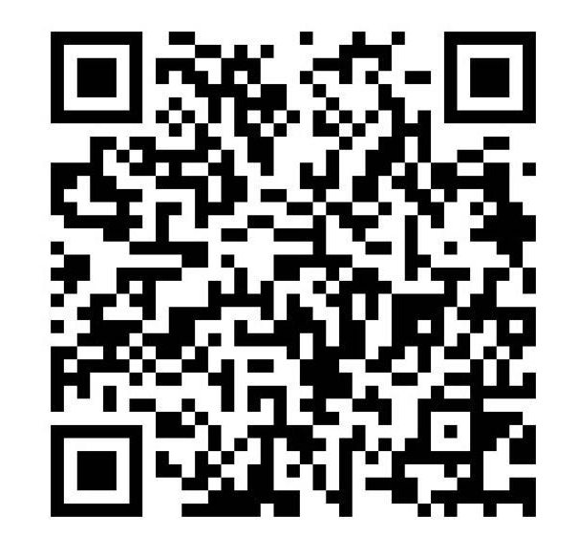
Thank You !
DigiHealth
Contact us for any questions or suggestions

