Slide 1

”
AI APLICATION
FOR
SMALL-MEDIUM
BUSINESSES
IEDE

Slide 2
Market overview
Fraud detection
Credit scoring
AI in Finance
Quantative trading
Insurance
IEDE
Better information about the repayment prospects of a small-business applicant makes it more likely that a lender will price the loan according to its expected risk. This prospect should increase the availability of credit to small businesses.

Slide 3




Lending platform Small-Medium businesses
Credit scoring
Fraud detection
IEDE
Better information about the repayment prospects of a small-business applicant makes it more likely that a lender will price the loan according to its expected risk. This prospect should increase the availability of credit to small businesses.
Notes:
https://www.stlouisfed.org/publications/bridges/winter-1998/credit-scoring-a-tool-for-smallbusiness-lending

Slide 4



How AI-Credit Scoring alter lending to Small-Medium Businesses
Borrower-Lender Interaction
Loan Pricing
Availability of Credit for Small Business
IEDE
Better information about the repayment prospects of a small-business applicant makes it more likely that a lender will price the loan according to its expected risk. This prospect should increase the availability of credit to small businesses.
Notes:
https://www.stlouisfed.org/publications/bridges/winter-1998/credit-scoring-a-tool-for-smallbusiness-lending
Interaction: By using a credit-scoring system, a lender with no physical presence in a community can lend money to small businesses without ever seeing a business plan or financial statements.
Pricing: The price of small-business loans will decline for higher-credit quality borrowers under credit scoring because these borrowers no longer have to bear the cost of a full human underwriting. Moreover, these high-quality borrowers will have access to a greater number of lenders. Lenders from across the country will be able to reach out to the small business via direct marketing. Furthermore, credit scoring makes pricing according to risk much more feasible.
Credit availability: Better information about the repayment prospects of a small-business applicant makes it more likely that a lender will price the loan according to its expected risk. This prospect should increase the availability of credit to small businesses.

Slide 5
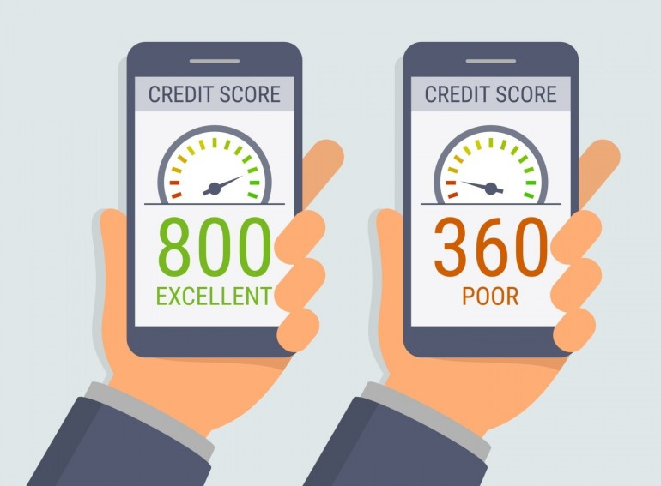

Traditional Credit Scoring (FICO)
Some of the factors that determine scores are
1
Payment History
2
Credit History
3
Outstanding Debt
4
Credit Inquiries
5
Types of Credit
IEDE
Notes:
Some of the factors that determine scores are:
Payment History—How borrowers paid their bills in the past can give lenders an indication of how they will pay in the future.
Credit History—How long borrowers have had and successfully managed credit.
Outstanding Debt—How much credit borrowers have and how much they have used.
Credit Inquiries—How many times borrowers have authorized lenders to check their credit report. Sometimes, having many inquiries within a time period indicates that credit usage may be increasing and creates an additional level of risk.
Types of Credit—Do borrowers have a mixture of types of credit, such as credit cards, personal loans, etc.?

Slide 6
Why Today Lenders Ignore Traditional Scoring
1
No credit history
2
Can not cope with Big Data
3
Missing out on a huge number of deserving borrowers
4
Lack sufficient information to generate a credit bureau score
IEDE
Notes:
https://lending-times.com/2017/07/19/ai-credit-scoring-fad-or-the-future/
Why Today Lenders Ignore Traditional Scoring
For years, traditional scorecards, linear models, decision trees, and so widely-used FICO scores have played a significant part in a decision-making process. Although they don’t tell an applicant’s full history and can’t cope with big data, they are still used by the 90% of the top industry players.
However, more and more lending startups come to the conclusion that ‘your grandpa’s approach to data analysis’ is not enough. Because many traditional underwriting systems are missing out on a huge number of deserving borrowers.
To get traditional credit, you often need a credit history. However, according to ID Analytics, nearly 20% – or 45 million U.S. consumers – have no credit history or lack sufficient information to generate a credit bureau score. Sounds like a catch-22.

Slide 7
How AI Benefit to Credit Scoring System
”
Lower acquisition costs
Consistent decision
Increasing speed of decision
Less paperwork
Remove human subjectivity (bias, prejudice, overt crimination)
Today, lenders have been using machine learning algorithms to solve problems both big and small, by making manual processes more simple, accurate, faster and less expensive.
”
However, algorithms won’t replace humans in complicated fields. Maybe someday, but not now. Today, AI is aimed to help experts. Scoring solution providers strive to ensure that machine learning techniques can be easily used by any lender without a need to hire a team of data scientists and developers.
IEDE
Notes:
Today, lenders have been using machine learning algorithms to solve problems both big and small, by making manual processes more simple, accurate, faster and less expensive.
Benefits
Technology can be a tremendous help when the number of variables that affect a decision increases. Automated scoring serves as an initial and primary screen for applications. In theory, automated scoring is used to screen large quantities of credit information for applications that may be approved with the least amount of credit analysis and decision-making resources. Such a screen could remove human subjectivity, especially bias, prejudice or overt discrimination. Applications scoring lower require further credit analysis, probably using manual or traditional underwriting.
The benefits of an automated screen of applicants can include lower acquisition costs, more objective and consistent decisions, and increased speed of decisions for the customer with less paperwork. Scoring also may contribute to the ability of a financial institution to make more loans that are profitable by decreasing the likelihood of default and collection costs. This could increase the amount and flow of funds to more borrowers. Fewer defaults could mean more money available for borrowers and mortgages.

Slide 8




/ Solution
Opportunities
Advanced Pattern Recognition
Automated financial advisory tools (chatbot)
Regulatory Compliance Systems
Investment decision-making
IEDE
Notes:
Pattern recognition: Identify rarity and warning signs, Fraud detection, Claims management, Anti-Money-Laundering Detection
Financial advisory: Cost reduction, Natural Language Processing, Financial Advice for Clients, Automated Customer Service, Collection of customer service
Regulations: Cognitive engines now available can understand and analyze high volumes of regulatory changes and verify that a business is alerted to the most up-to-date policies.
Investment decision making: Analyze large, unstructured, and semi-structured data sets, taking into account changes in market behavior, regulatory rules, and other trends, conducting reverse testing, model validation, Stress testing to avoid underestimating risks, improve model fault tolerance, and improve transparency

Slide 9

Challenges
Implementation challenges
Fear of risks and technological malfunction
Privacy and data protection concerns
Fake news affecting algorithmic trading
Impact of financial advice tools on market fraud
compliant and noncompliant not fully defined
Startups are challenged by incumbents
IEDE

Slide 10



/ Solution
Limiting technological factors
Data
Computing power
Model
IEDE
Notes:
Data: Artificial intelligence is hard to use financially without big data analytics. Data, is the foundation. If both formatted and unformatted data becomes computer-readable and understandable data, it has a good foundation for artificial intelligence applications.
Computing power: Due to the current explosion of network information, it is the key to calculate the fast and optimal match and use the cloud computing server to solve the problem of computing power.
Model: The essence of modeling is the application of artificial intelligence to wealth management and investment consultancy.

Slide 11










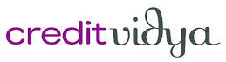



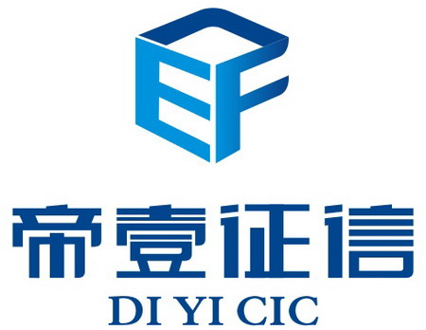





Credit Scoring Company
Traditional
Company
International Company
Chinese company
IEDE

Slide 12
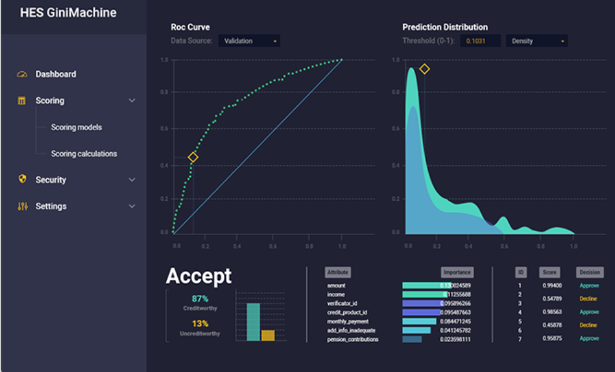
GINIMACHINE
GiniMachine has been implemented in December 2016. It is an AI-based credit scoring platform which lenders to build, validate and deploy high-performing risk models in a very short times. It can help to speed up decision making process, significantly improve loan operations, lower fraud risks and ultimately increase profits. The system also apply alternative data that traditional scoring willfully ignores or misses out which gives “thin-file” borrowers more chances.
”
Fighting bad loans with AI. Utilize Machine Learning & Artificial Intelligence. Build credit scoring models both for consumer and business lending.
IEDE
Notes:
https://ginimachine.com/product.html
https://lending-times.com/2017/07/19/ai-credit-scoring-fad-or-the-future/

Slide 13

Wecash (闪银奇异)
Wecash闪银 is a China's first Internet credit rating company developed by Beijing Spark Silver Biz Technology Co., Ltd., founded in April 2014. It provides solutions for technology companies by mining public mobile data from roughly 600 million mobile internet users. It is able to quickly provide extensive credit assessments and build predictive models for customers’ credit risk. After the assessment is completed, the user can withdraw cash within the limit.
IEDE

Slide 14
Regulations and Challenges
Challenges
Current Regulations
For lenders:
Collection of information
Control of Risks
Control of Cost
For Borrowers:
Lack of fixed asset as collaterals
Lack of awareness to use receivables or inventory as collaterals
1990: Inter company financing contracts without involvement of operation and sharing of risks of business operation are deemed void by law.
1996: The regulation “Lending General Provision” specified only licensed financial agencies can provide financing services.
Sources of financing for SME in China is very limited. Traditionally, businesses relied on large financial agencies (banks).
Excessive bad debt brought policy change, banks are reluctant to provide financing to SME.
IEDE
Notes:
http://finance.qq.com/zt2013/cjgc/rzn.htm
http://i3.sinaimg.cn/cj/pc/2013-04-05/32/U7171P31T32D103191F651DT20130405222112.pdf

Slide 15
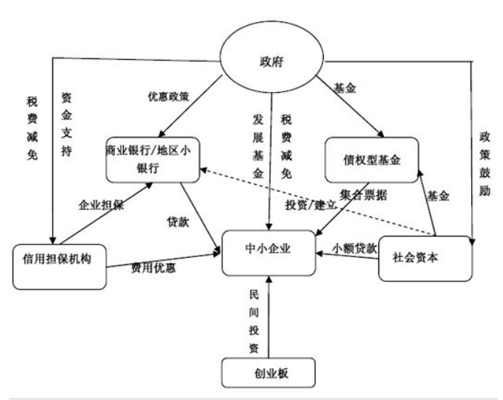
Current State
Current State
Over 90% small scale SME in China do not engage in business with lending agencies.
70% small and micro business prefer lending from banks. However, lending rates differ depending on the size and nature of the company.
SoE: bank rate
Privately owned: bank rate + 10 – 30%
Micro: 30%+
Sources of financing:
Large businesses: bank loans, debt issuing (10b vs. 3b)
Small and micro businesses: credit bureau, relatives
IEDE
Notes:
http://finance.qq.com/zt2013/cjgc/rzn.htm
http://www.chddh.com/xindetihui/20180305/1878907.html

Slide 16
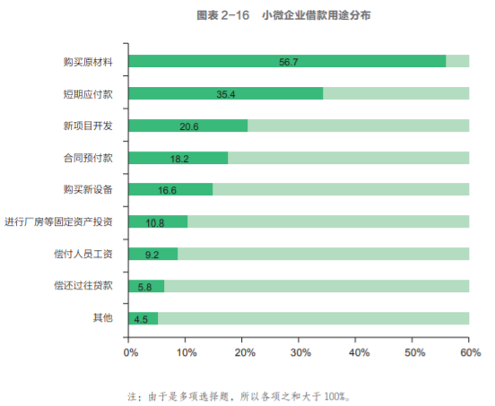
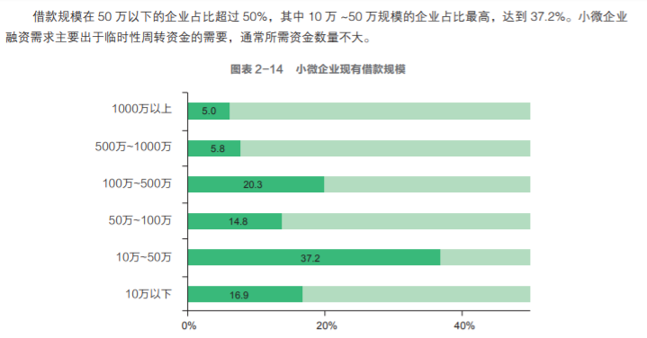
Future Prospects
Future Prospects
Lender’s perspective:
Tremendous market opportunity
78.6% companies can repay on time
10.3% have difficulties in repayment
Borrower’s Perspecive
Long approval process
High cost
Unable to meet collateral requirements
Alibaba combined e-commerce data and lending evaluation
Industry differences, Industry value chain integration (information), Lending to a transaction instead of a company,
IEDE
Notes:
http://finance.qq.com/zt2013/cjgc/rzn.htm
http://www.chddh.com/xindetihui/20180305/1878907.html

