Slide 1
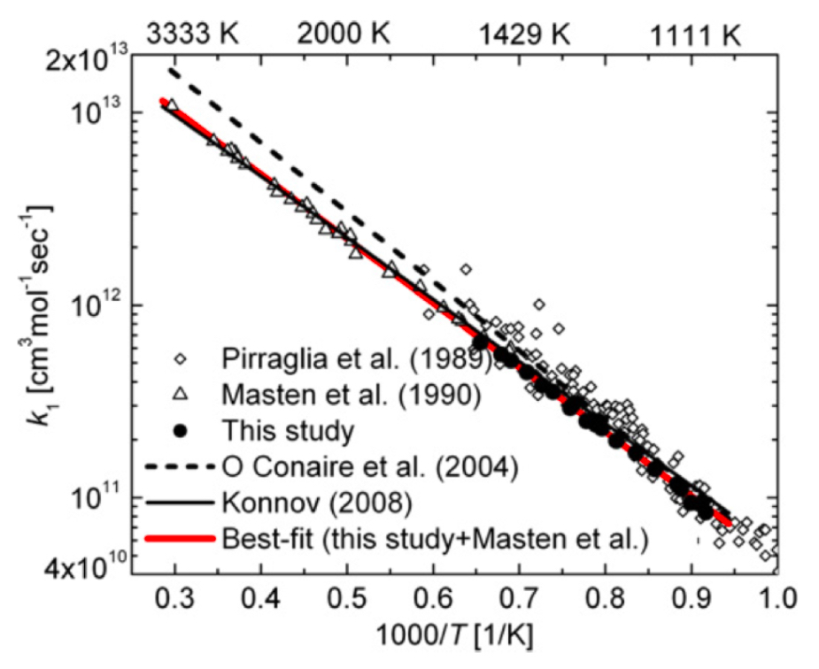


$$H+O_{2}⟶O+OH (R1)$$
$$f=1.15$$

