Slide 1






Input parameters
UQ
Uncertainty
Detailed model
$$k_{1} k_{2}⋯ k_{d}$$
Active subspace
$$σ_{r,d}$$
+
Transition state
$$k_{1} k_{2}⋯ k_{d}$$
Response surface
$$σ_{r,t}$$
fixed
+
Skeletal model
$$k_{1}⋯ k_{s}$$
MC or PCE
$$σ_{r,s}$$

Slide 2
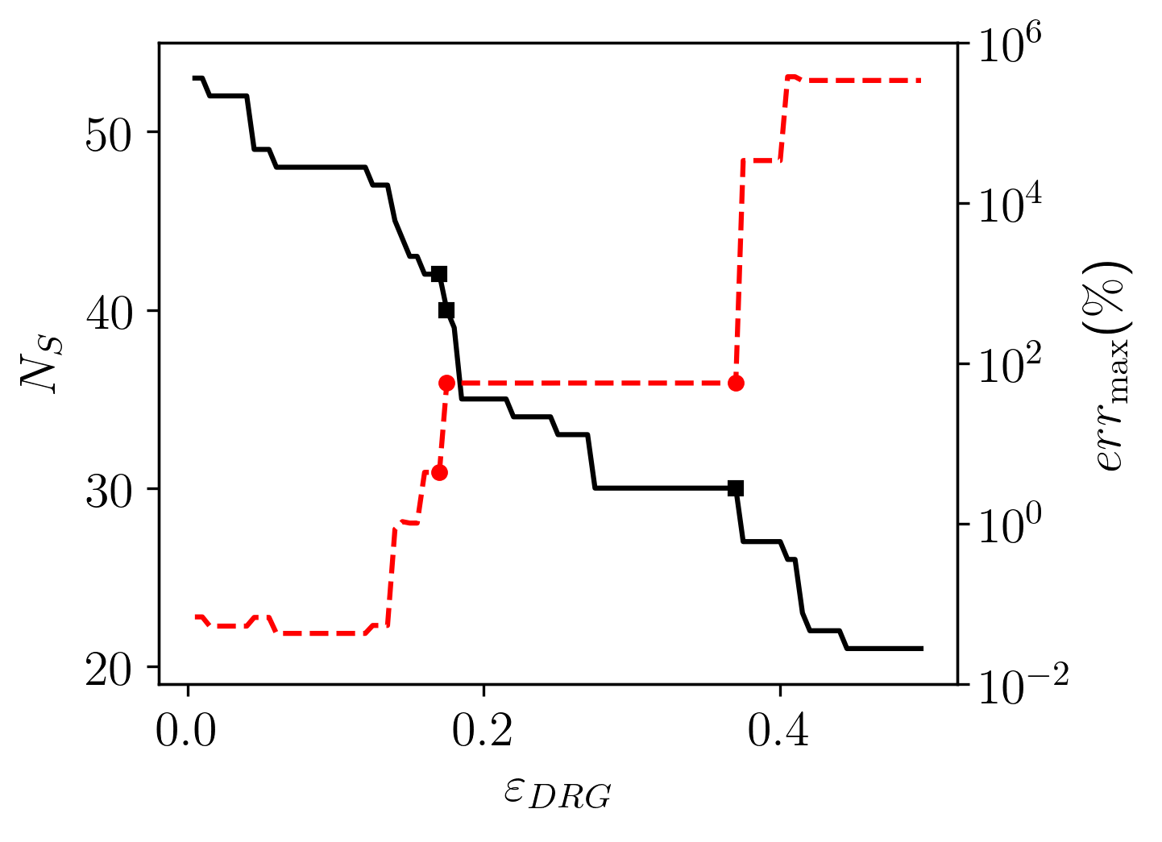
DME42
DME40
DME30

Slide 3
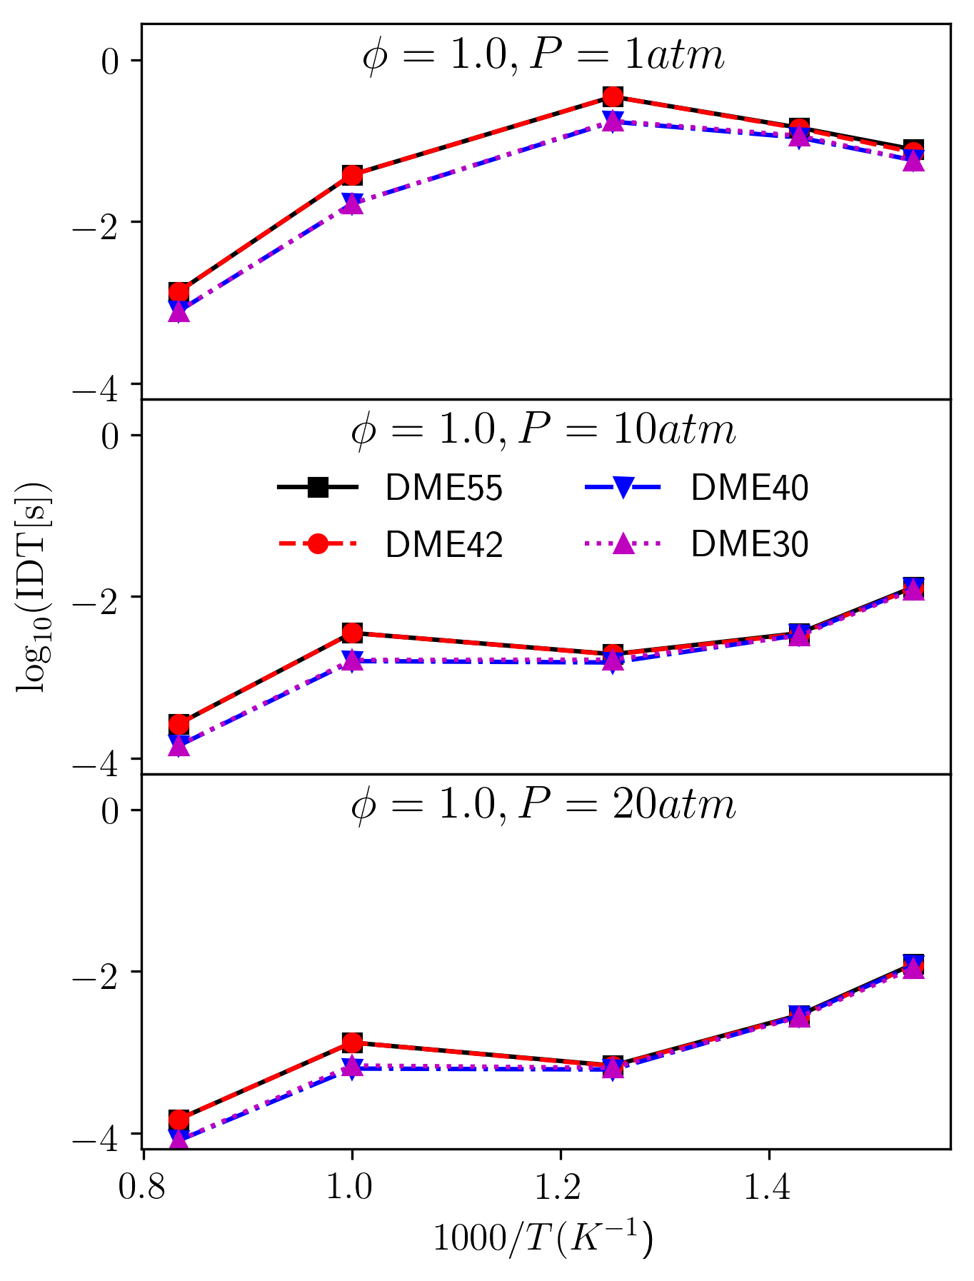

Slide 4
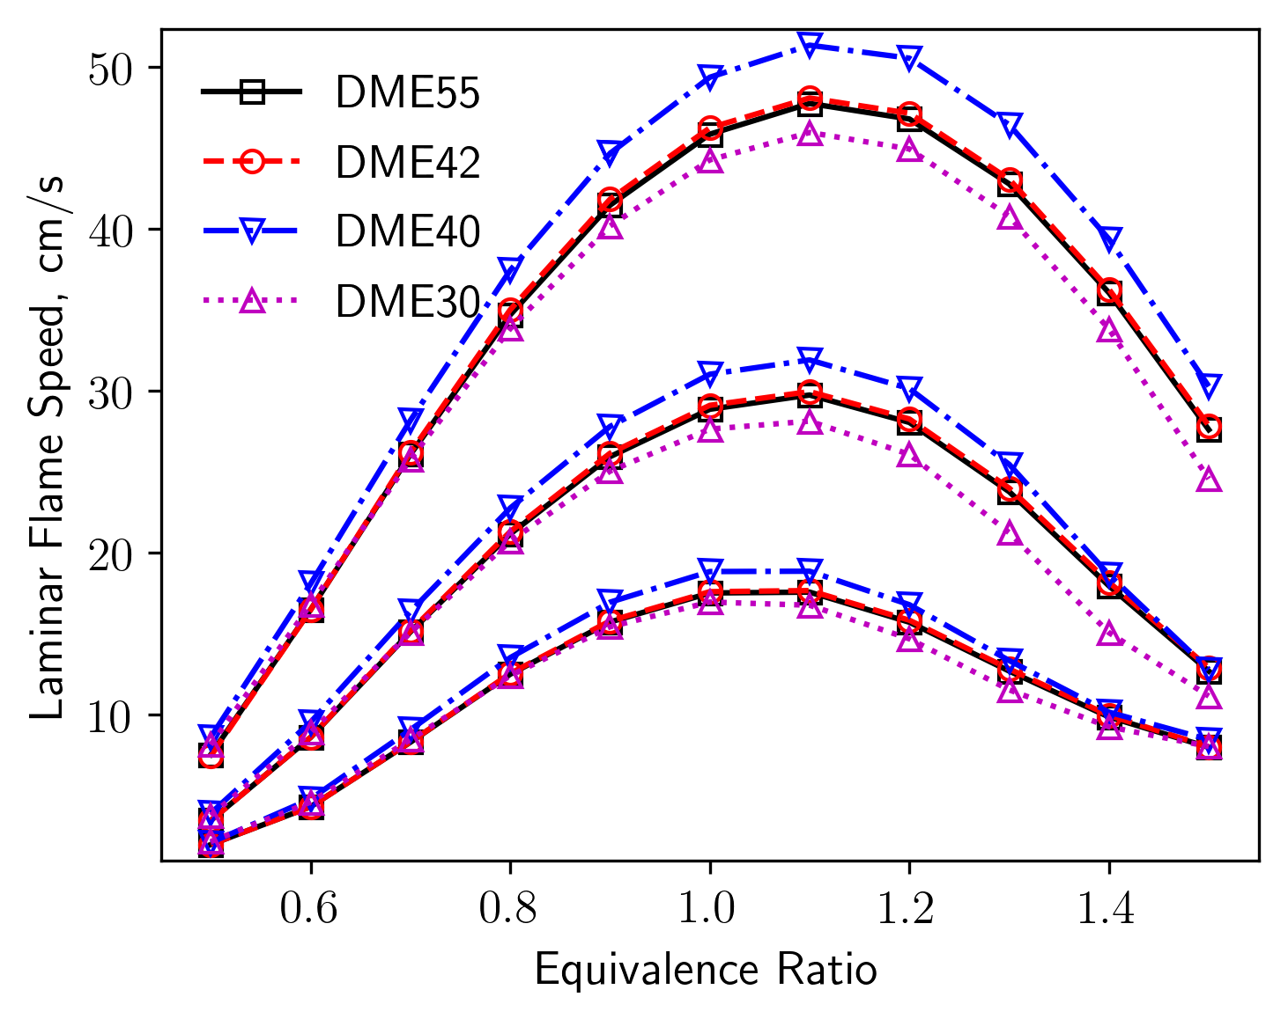
1 atm
5 atm
20 atm

Slide 5
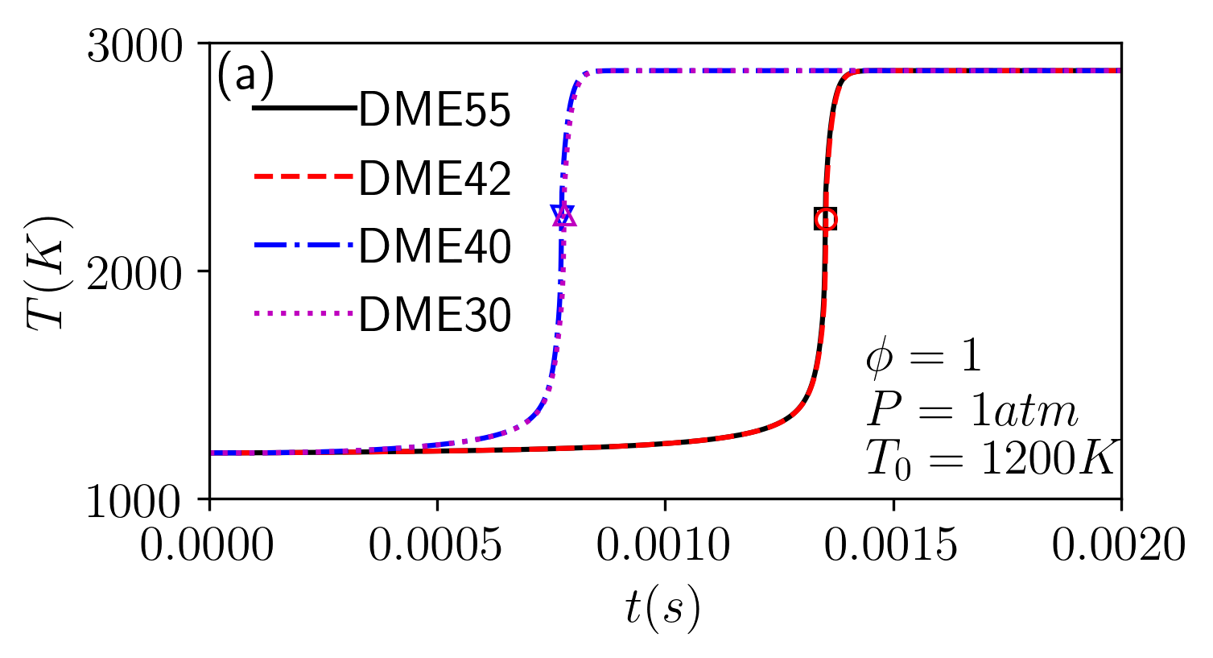
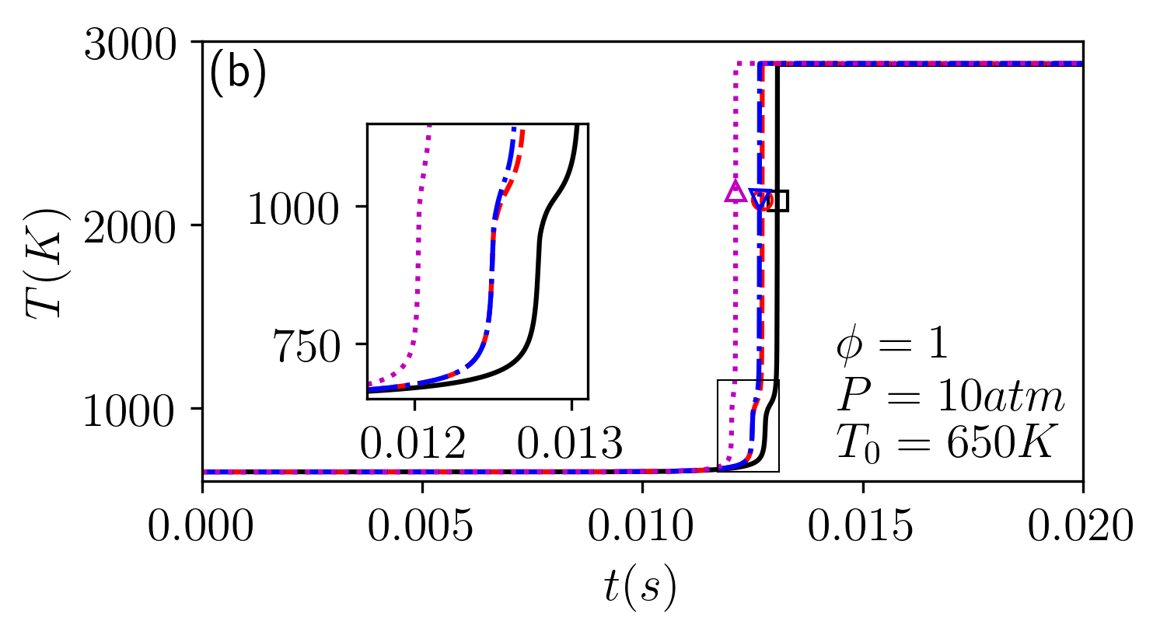

Slide 6
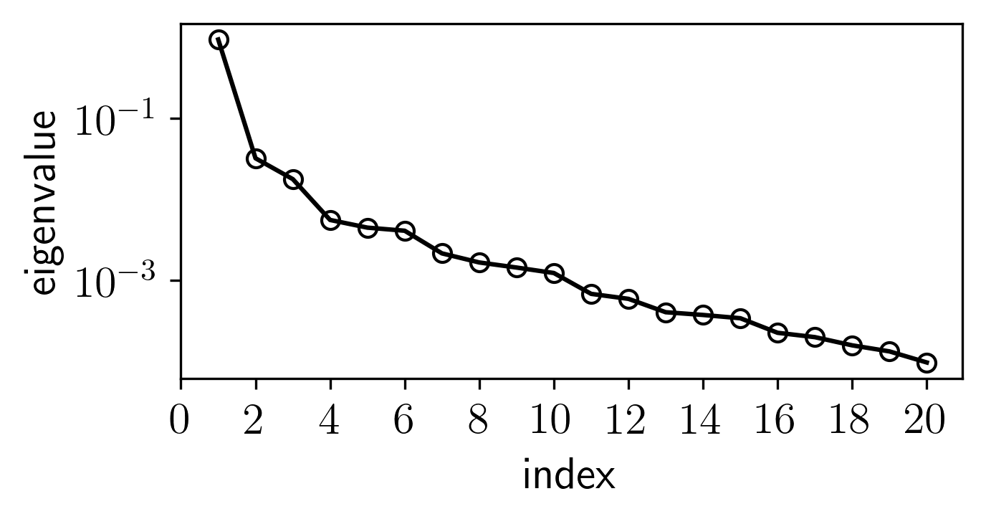
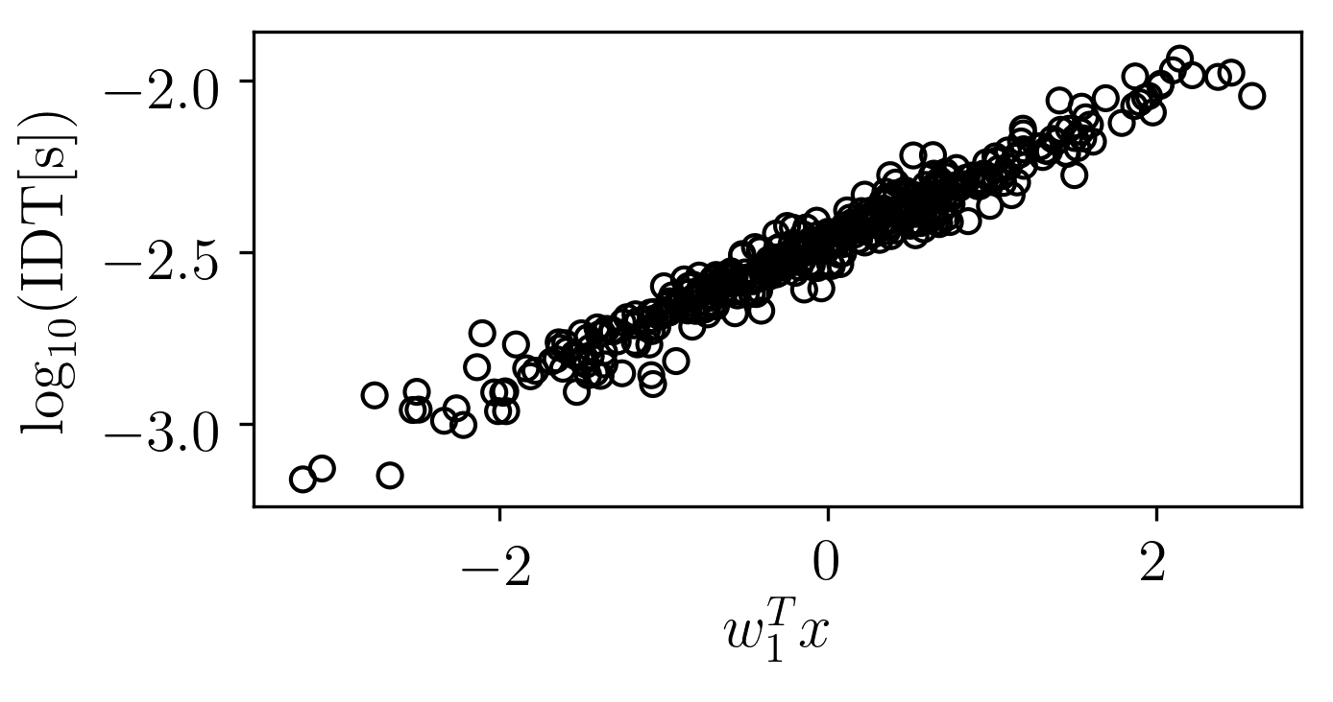
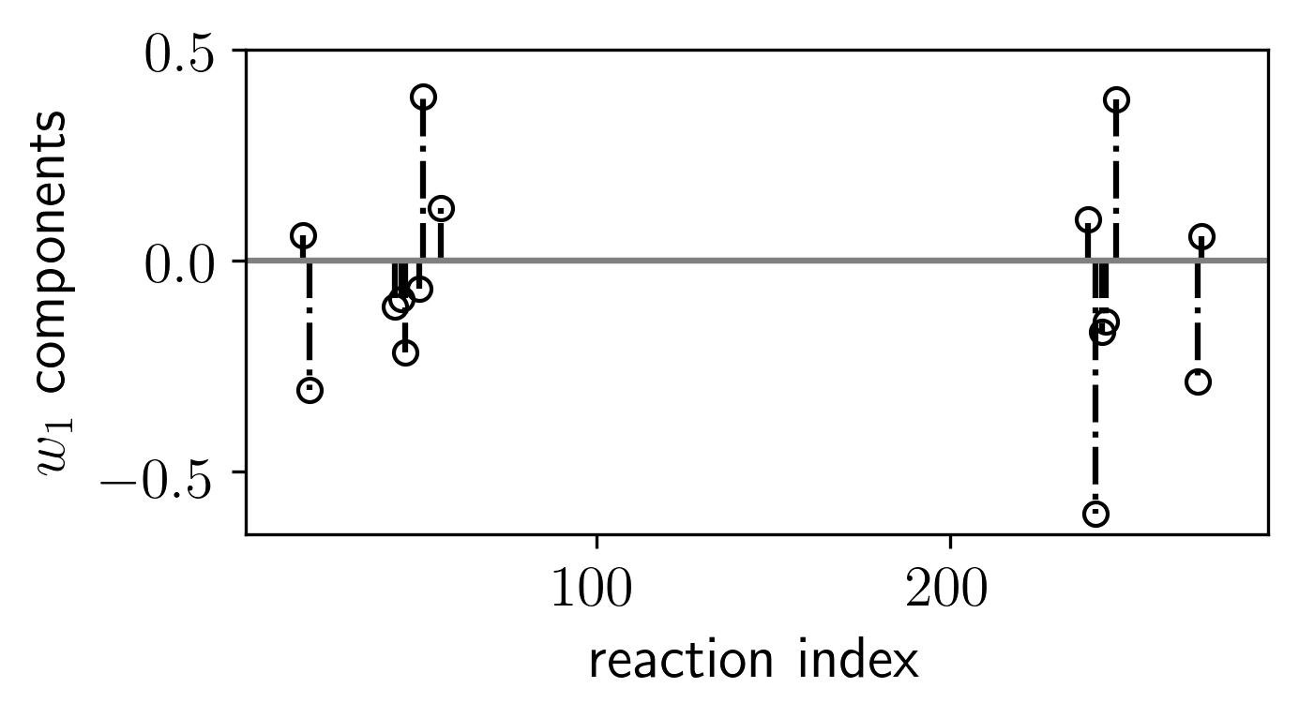
(a)
(b)
(c)
2CH₃ (+M) = C₂H₆ (+M)
CH₃OCH₂ = CH₂O + CH₃
CH₃ + CH₃OCH₃ = CH₃OCH₂ + CH₄

Slide 7
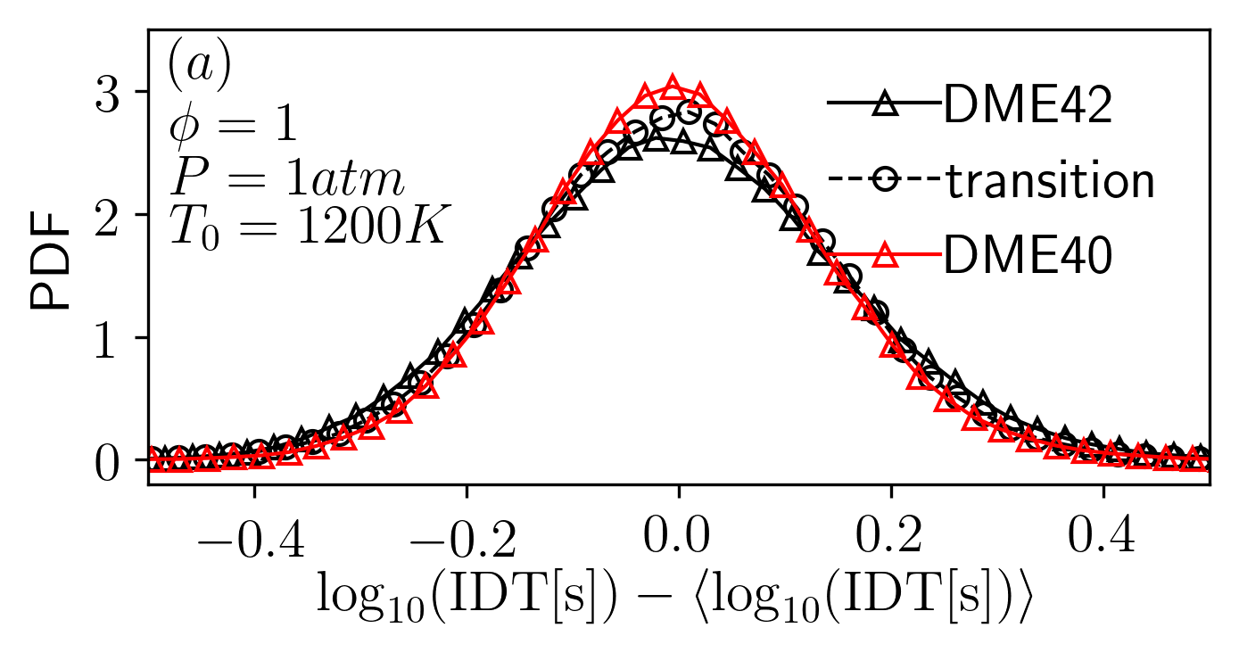
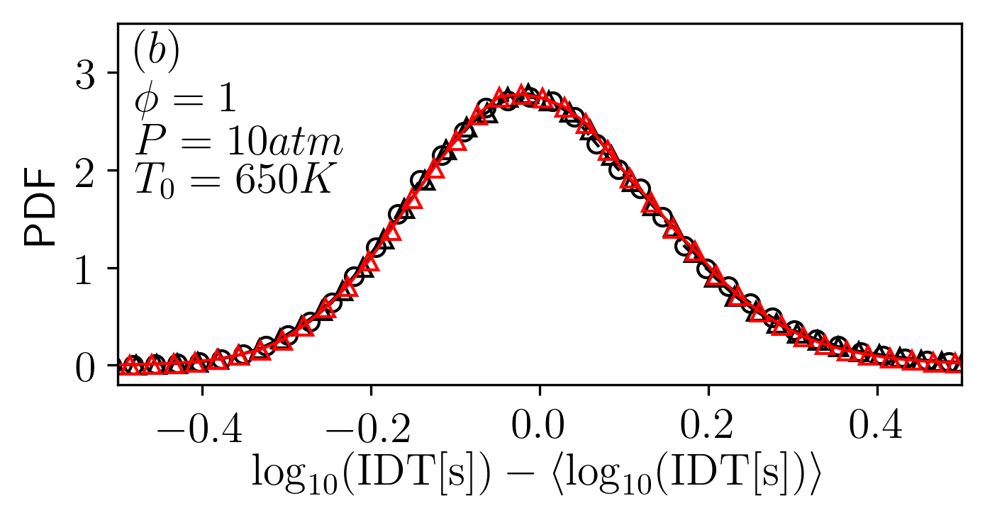

Slide 8
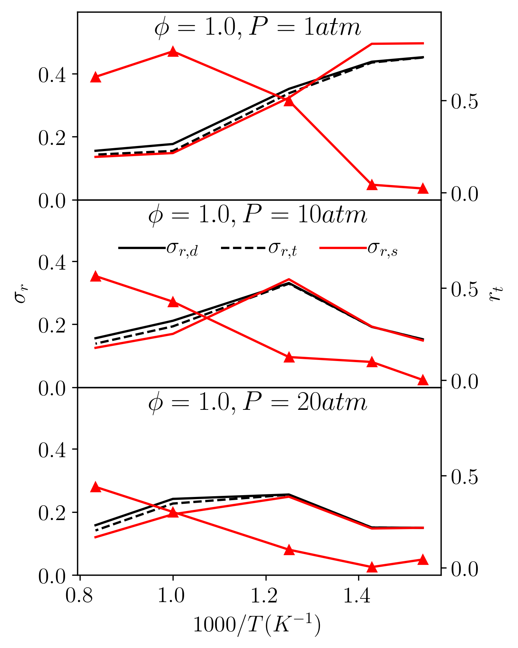

Slide 9
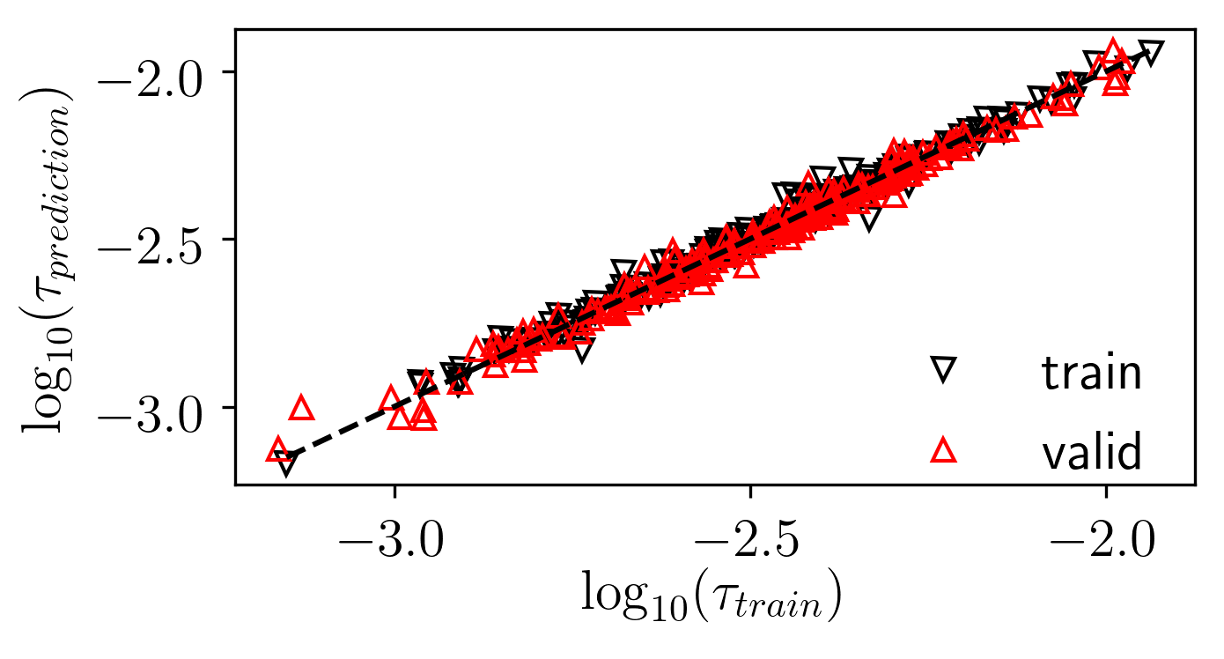
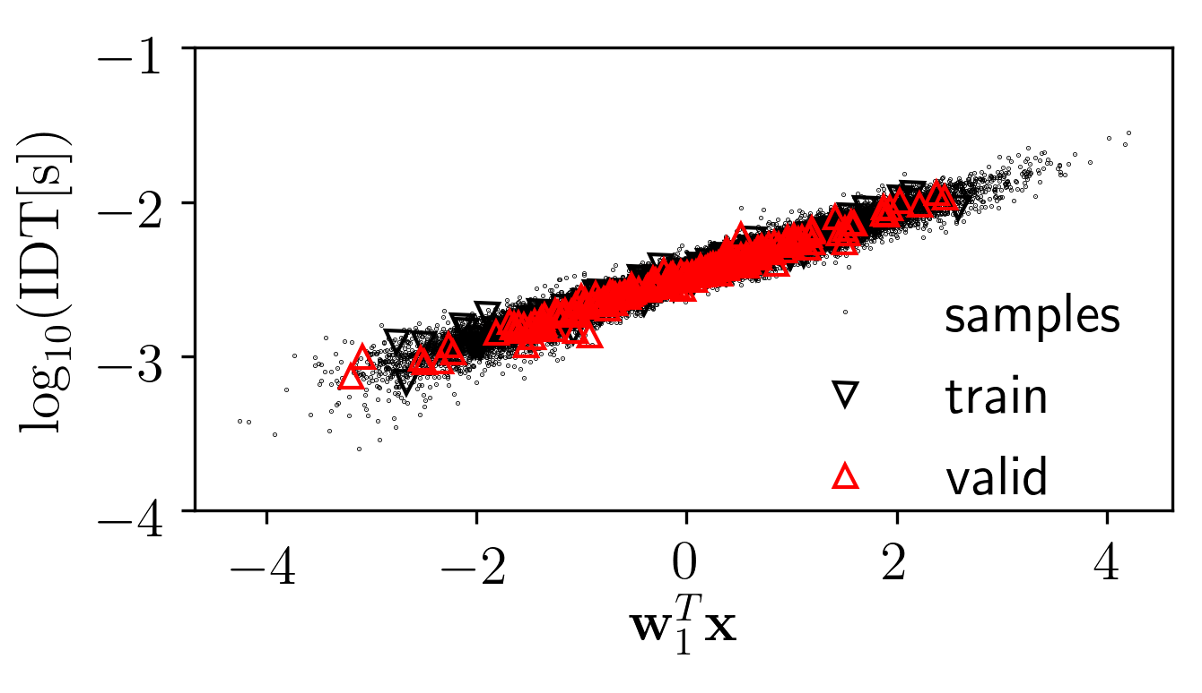
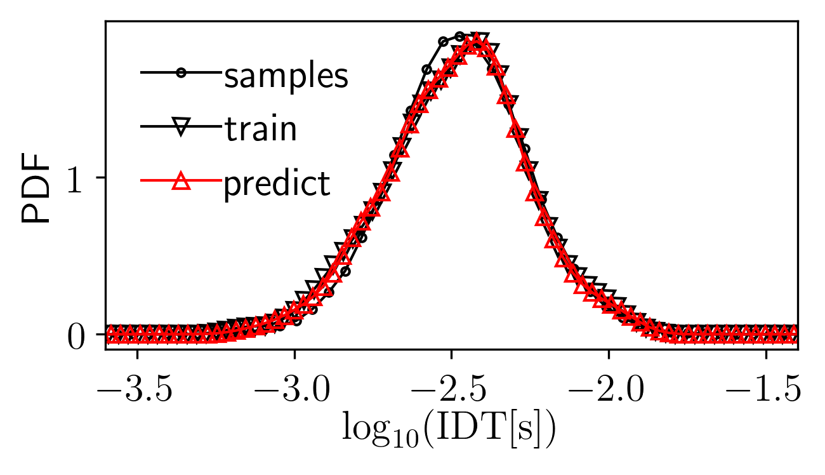
(a)
(b)
(c)

