Slide 1

The Spherical Inward Propagating Carbon-Oxygen
Two Step Flame of Type Ia Supernova
Tao Shu, Xingyu Su, Yang Gao
Department of Energy and Power Engineering
suxy15tsinghua@gmail.com
2019.01.17

Slide 2
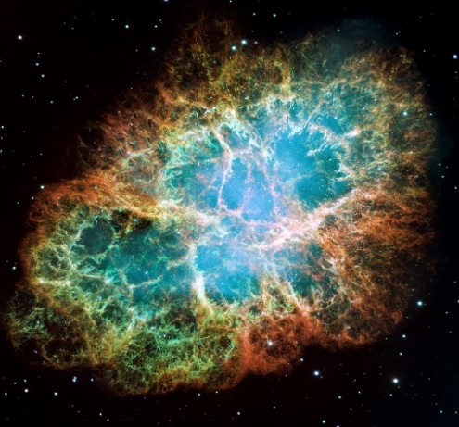
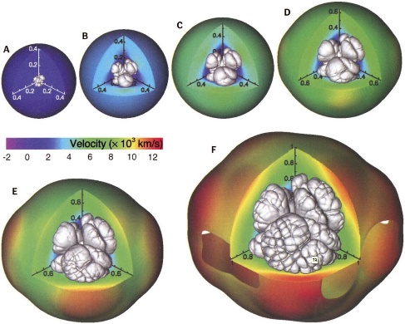
Introduction
Type Ia supernovae
Late stage of Carbon-Oxygen white dwarf evolution
“Standard candle”, measure large distance
The mechanism of detonation is unclear
Remains of supernova SN1054
Try to explain the explosion mechanism of the C/O white dwarf using flame structure
Gamezo V. N. et al. (2003)
Development of the thermonuclear deflagration in carbon-oxygen white dwarf
[1] http://antwrp.gsfc.nasa.gov/apod/ap100630.html
[2] Gamezo V. N., et al., Science, 2003.
Notes:
最大亮度的绝对星等与光度曲线有很明确的函数关系，可用于确认数亿秒差距外的星系距离。
Ia型超新星在爆发后会被热核反应彻底毁灭，所有的观测都显示在相同距离上的Ia超新星有相同的亮度（在经过光度曲线的校正之后）。

Slide 3
Introduction
The mechanism of flame speed up
Landau-Darrieus (L-D) instability：dominated by convection, wrinkles the flame surface, speed up 1-2%
Bell J. B. et al. (2004A)
Rayleigh-Taylor (R-T) instability：hot product goes up because of gravity, wrinkles the main flame surface, speed up 4-5%; generate unburned bubbles
Bell J. B. et al. (2004B)
Thermal diffusion instability：the flame speed oscillates periodically; speed peak 5-10 times
Bychkov V. V. et al. (1995)
Xing G. Z. et al. (2017)
Zel’dovich mechanism：flame speed up by reaction gradient
Zel’dovich Y. B. (1980)
[1] Bell, J. B., et al., Astrophys. J., 2004A.
[2] Bell, J. B., et al., Astrophys. J., 2004B.
[3] Xing, G. Z., et. al., Astrophys. J., 2017.
[4] Zel’dovich Ya. B, Combust. Flame, 1980.

Slide 4
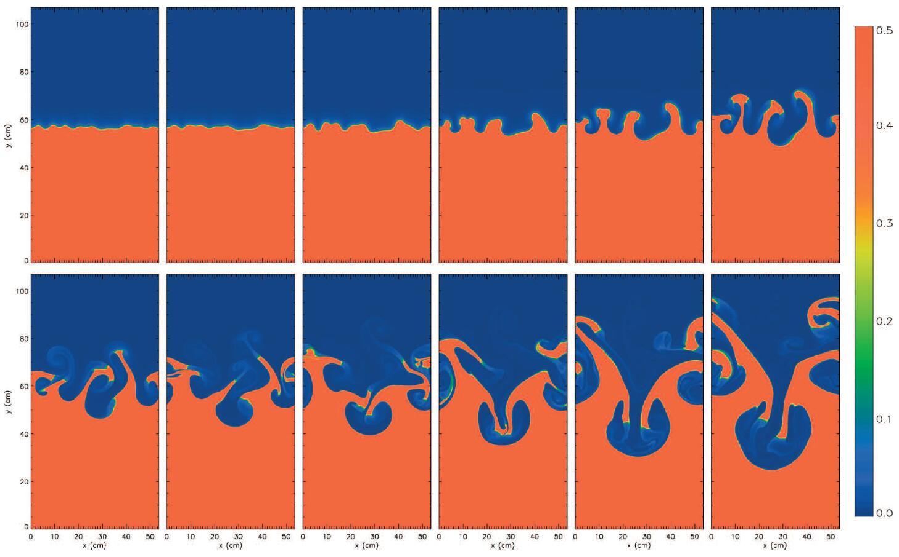
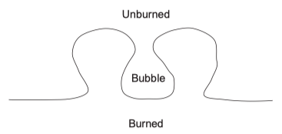
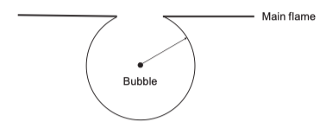
R-T Instability
Unburned bubbles
There exists some unburned bubbles because of the turbulent vortex.
Assume the bubble as a sphere
[1] Bell, J. B., et al., Astrophys. J., 2004.

Slide 5
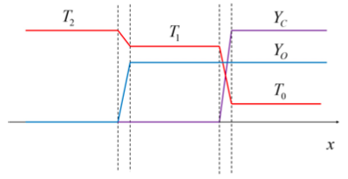
Zel’dovich Mechanism
In spherical inward propagating C-O two step flame
Set
1D spherical inward propagating flame

Slide 6
Spherical Flame of Carbon Reaction
Solutions
Flame temperature of the Carbon
Flame speed of the Carbon

Slide 7
Spherical Flame of Oxygen Reaction
Ignition delay time of the Oxygen
Williams F. A. (1985)
Ignition delay time of the Oxygen
Spontaneous-propagating speed of the Oxygen
Woosley S. E. et al. (2009)
[1] Williams F. A., Combustion Theory, 1985.
[2] Woosley S. E., et al., Astrophys. J., 2009.

Slide 8
Turbulence Flame Speed
Thin reaction zone turbulent model
Assumption: The Kolmogorov vortex and reaction zone have the same scale
Zimont V. L. (1979)
→
Shock wave
Woosley S. E. et al. (2009)
Ma number of
[1] Zimont V. L., Combustion Explosion and Shock Waves, 1979.
[2] Woosley S. E., et al., Astrophys. J., 2009, 704: 255-273

Slide 9
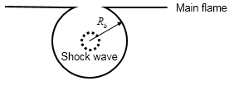
Shock wave speed up the main flame
A single shock wave heats up the main flame
A single shock wave speeds up the main flame
Multiple shock waves speed up the main flame
Where, is the interaction times, is the shock wave frequency, is the propagating time of the main flame.
Fowler W. A. et al.(1975)
[1] Fowler W. A., et. al. Annu. Rev. Astron. Astrophys., 1975, 13: 69-112

Slide 10
Shock wave speed up the main flame
Results
Generation frequency (Hz)
Single shock wave heat effect
Single shock wave speed up effect
Interaction times to supersonic
Propagating time of the main flame (s)

Slide 11
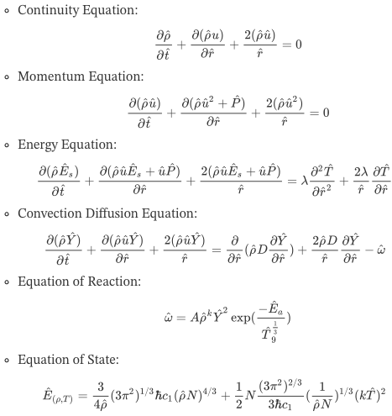
Control Equations
1D
Spherical
No viscosity
Compressible
Temperature profile
Domain

Slide 12















Dimensionless

Slide 13
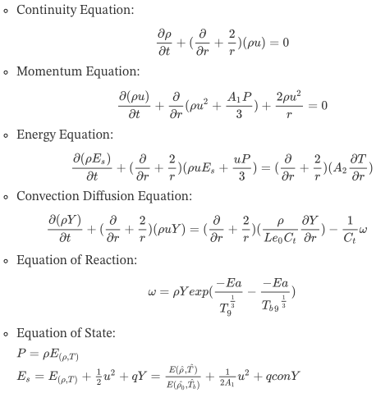
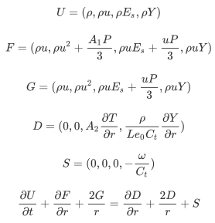
Dimensionless Equations

Slide 14
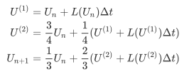
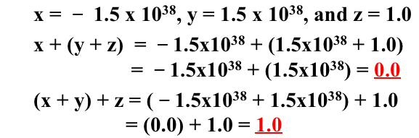
Numerical Methods
Time evolution: 3rd order TVD Runge-Kutta
Convection term: finite volume
Roe method: solve convection flux by eigen vector
Diffusion term: 7th order central difference
Source term: direct solve
Numerical precision
Boundary conditions?
$$\begin{matrix}\frac{∂m_{i}}{∂x}=\frac{1}{60}m_{i+3}−\frac{9}{60}m_{i+2}+\frac{45}{60}m_{i+1}−\frac{45}{60}m_{i−1}+\frac{9}{60}m_{i−2}−\frac{1}{60}m_{i−3}\end{matrix}$$

Slide 15
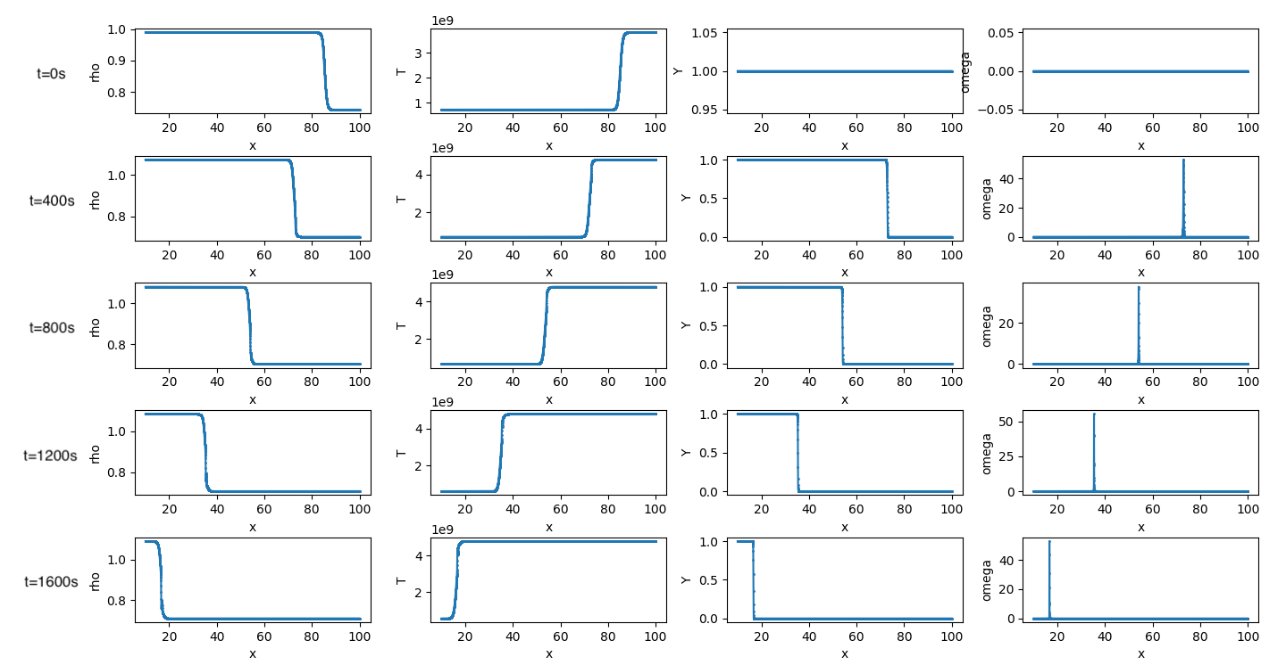
Case Study: Plane Flame

Slide 16
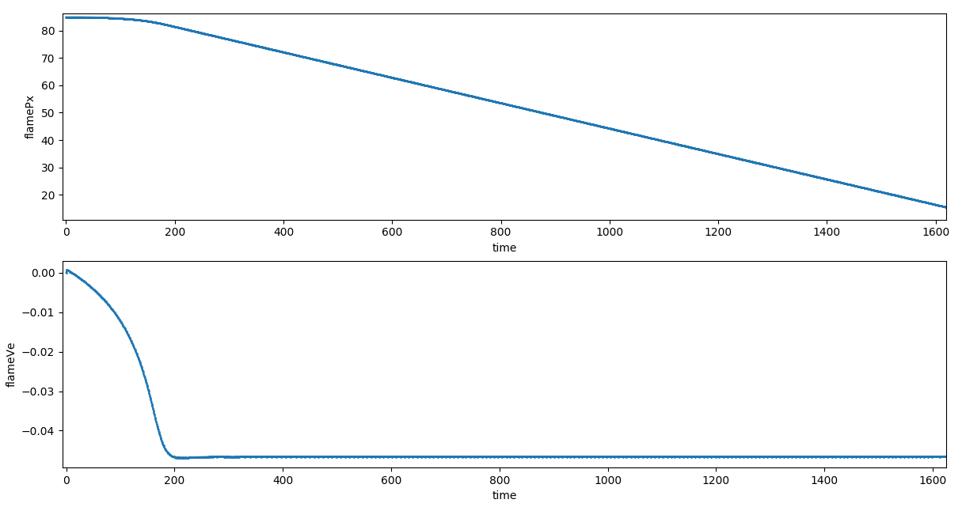
Case Study: Plane Flame

Slide 17
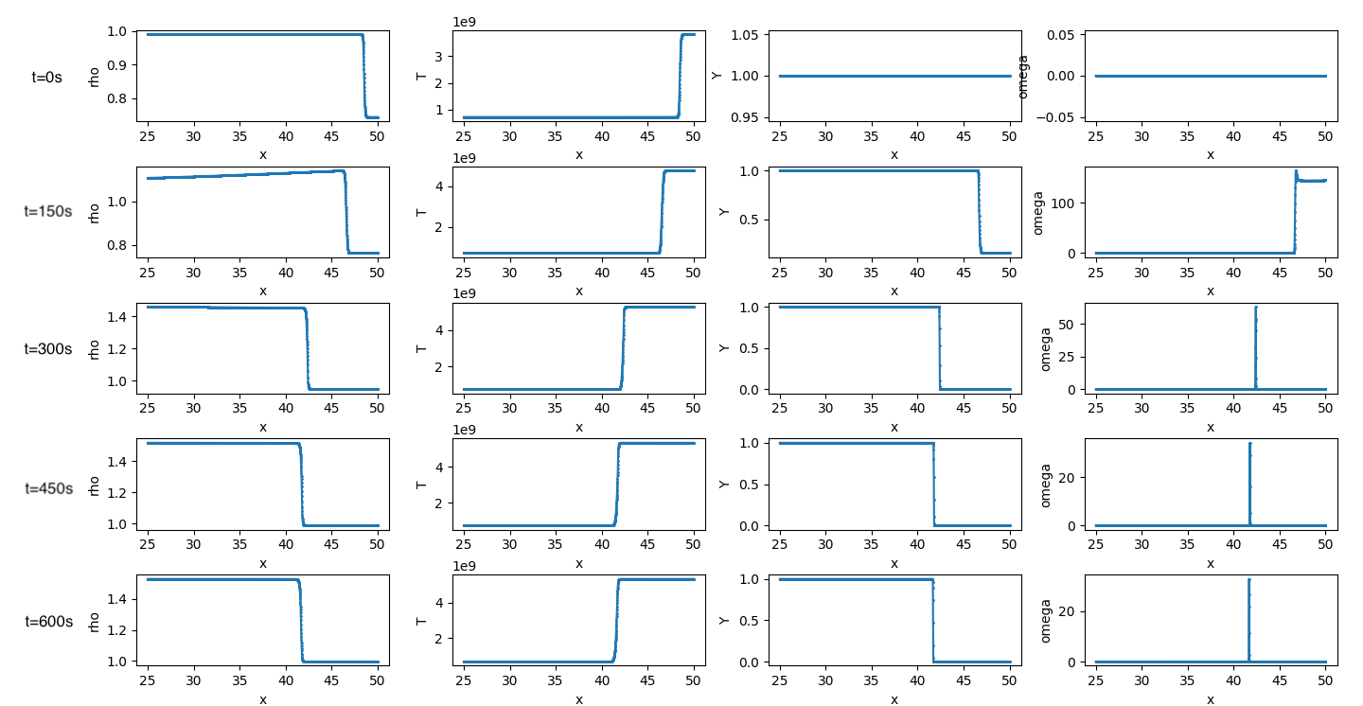
Case Study: Spherical Inward Flame

Slide 18
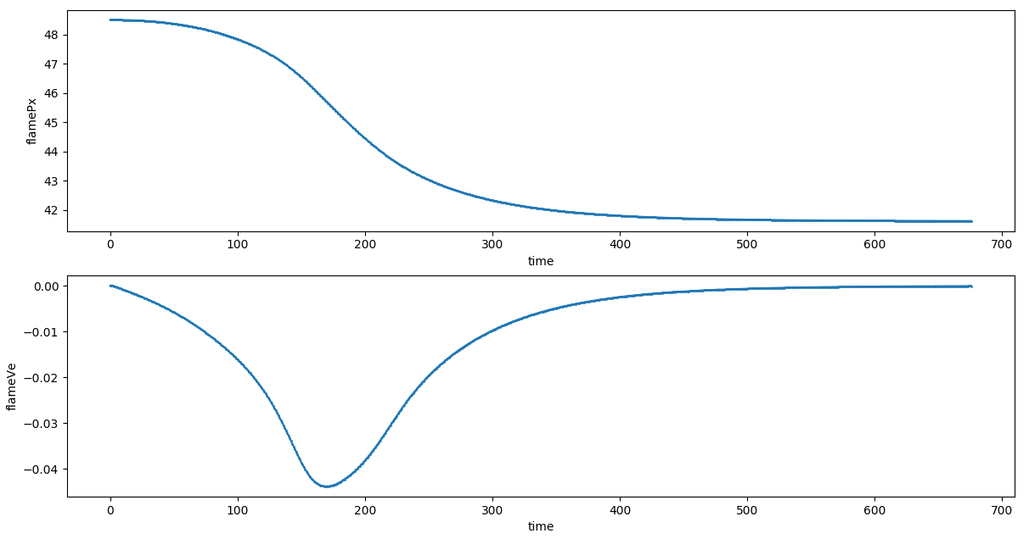
Case Study: Spherical Inward Flame

Slide 19
Thanks

Slide 20
Appendix: Curvature Effect
Volume for the thermal energy
Volume for the reactant
If , That is , then the flame temperature is expected to be reduced from for outward propagating, while the opposites holds for inner propagating.
Curvature effect of
the spherical flame

Slide 21
Appendix: Equation of State
Specific internal energy for a relativistic degenerate electron gas
Specific heat for the degenerate Fermi gas
Specific internal energy at temperature
Enthalpy at temperature
, where
[1] Xing, G. Z., et. al., Astrophys. J., 2017.

Slide 22
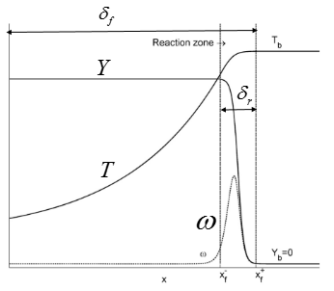
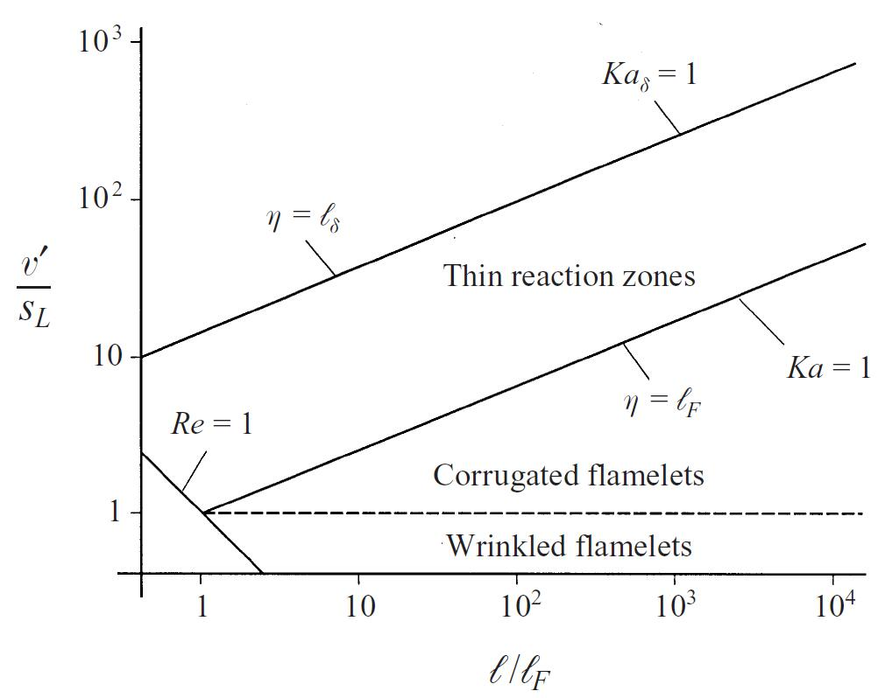
Appendix: Reaction Zone
Turbulent models
Karlovitz number:
Corrugated flame
Wrinkled flame
Thin reaction zone
Well-stirred reactor
Peter N. (1997)
Regime diagram for premixed turbulent combustion
[1] N. Peter, Fluid Mech Vol., 1997, 384, 107-132

